Slide 1
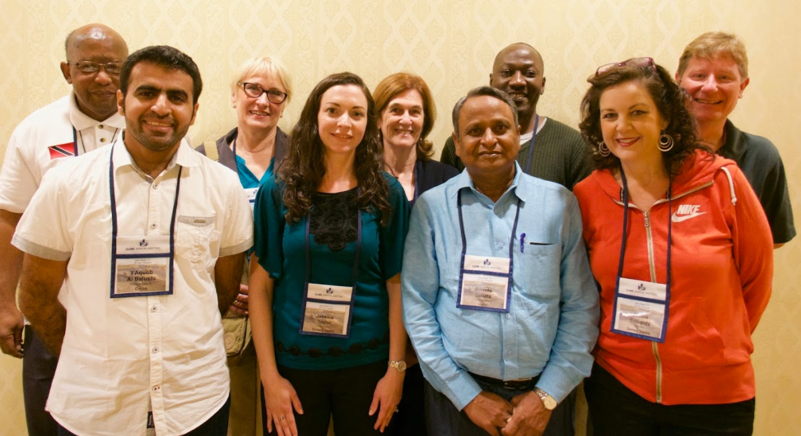
Education Working Group
Report Out

Slide 2
GLOBE Working Group Members
Jessica Taylor, Chair, United States
Henry Saunders, Vice Chair, Trinidad and Tobago
Audra Edwards, Secretary, United States
Yaqoub Yousuf Ali AL-Balushi, Oman
Marta Kingsland, Argentina
Francis Wasswa N. Nsubuga, Uganda
Binoda Sabata, India
John Ristvey, GIO Liason
Notes:
This team has been meeting about once per month

Slide 3
Areas of Focus
Student “Field Guide” videos
Translated Resources
GLOBE in Higher Education
School Collaborations
Examples
Best Practices

Slide 4
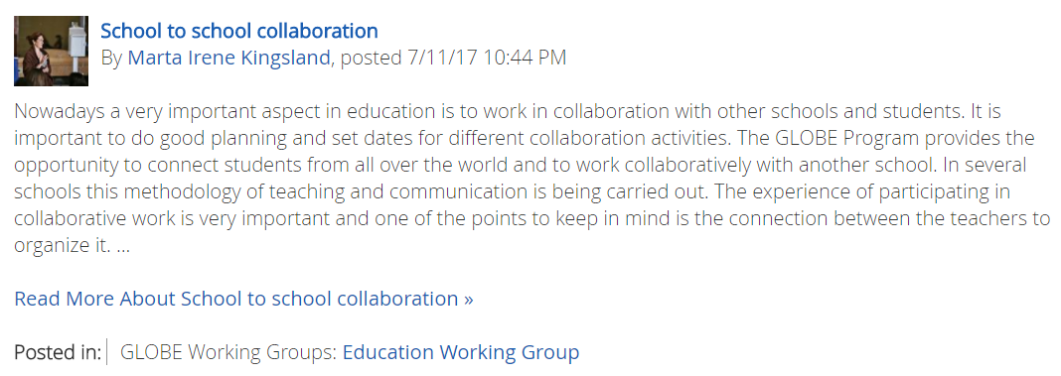
School Collaborations
Notes:
Greetings All- I look forward to visiting with you all tomorrow. Please find below my submission to Fostering International Collaborations BLOG Post that was written by students involved in a recent International GLOBE Collaboration.
Written by Madison Jaco, GLOBE Alumni Hawkins Texas
I have just finished up my first year at the greatest university in the world, Texas A&M (Gig ‘Em!), with the goal of earning my Bachelor of Arts in International Studies with a focus on Politics and Diplomacy and a French minor. Any time I tell people that, they are shocked. “How did you ever get into that coming from such a small town in East Texas?” I usually answer this with a follow up question. “Ever heard of the GLOBE Program?”
Then I go into my spiel. I tell people all about the fun I had working with not only my school, but schools all across the world studying the environment and finding innovative ways to create a dialogue to save it. I tell them about my trips to India and Washington D.C. and the all nighters at the middle school doing dissolved oxygen testing.
Most importantly to me, I am sure to mention the relationships I have built all thanks to GLOBE. Last summer, I had the opportunity to travel to Croatia to stay with some girls I had met briefly two years before at a GLOBE conference. Since then, I had kept up with the students via Facebook, Snapchat, and the occasional late night Skype. For nearly a month, I lived with the Pavletic family, running around Rijeka, Croatia, and even parts of Italy. Never in a million years would I have imagined myself flying 40 hours alone to go stay with people I had hardly met 2 years prior. I may not always remember how to perform a D.O. test, but I will never forget a friendship like that which GLOBE has provided me.
When I interviewed for a scholarship just prior to graduating high school, they asked me, “What would you consider your greatest success?” Instantly, I thought of GLOBE and how it shaped and pushed me to discover what I am truly passionate about: equality of education across the world. I consider finding what I love to be a success because that is quite uncommon to at 18. The Terry Foundation saw something in the way I talked about this passion, and I have since been selected as a Terry Scholar and am receiving my education at Texas A&M fully funded by the Terry Foundation.
GLOBE truly expanded my definition of the global community, and sparked my interest in education. Because of this, I am now the Co-Chair of a brilliant organization, The Women’s Bakery (TWB). Our campus chapter works to create a community dialogue on women’s rights and socioeconomic status in all corners of the world and raise funds to send to TWB, currently working in Rwanda and Tanzania. TWB is an education-centric social enterprise which works to empower women and men through education. The program sends them through business classes, and upon graduation they are given the opportunity to join one of TWB’s bakeries and create a source of stable income for themselves and their families. I consider GLOBE directly responsible for this passion, and I am thankful each day that I get to work on a project as impactful as The Women’s Bakery.
Ultimately, this is how I will remember the program. It is not just about the science, it is about creating a global community, a sense of knowing your neighbor even when they live an ocean away. GLOBE created a foundation of friends and colleagues who truly understand the importance of science, education, and changing the world for the better. Merci, GLOBE.
Written by Pegi Pavletić, Croatian GLOBE Alumni
Four years ago, as a Croatian GLOBE team of Medical high school in Rijeka, Megi Pavletić, Dina Bolkovac, our professor Tatjana Holjević and I, Pegi Pavletić visited 2nd Student research exhibition in Maryland, USA. That was an exciting opportunity for us as students in medical branch of studies, to experience ecological experimental work and gain further knowledge. That is where we stepped into contact with Hawkins school in Texas and their GLOBE team: Madison Jaco, Hope Hughes, Allyson Edwards and their mentor Audra Kay Edwards. They offered a fresh insight into their ecological projects and we connected quickly. That is why we continued to collaborate on several projects that followed. We couldn`t re-connect in person with most of the team, but we still communicate online. I would say that the GLOBE never left me, nor my friends, after I finished high school, and Megi and I went on to universities and have continued to be actively involved in ecology preservation.
We have since been involved in founding a GLOBE Alumni association on state level and have held may presentations on our work, ecology and climate. Now, I am a leader of EcoLab project at the level of University of Rijeka, which is the largest ecology project at the University; I am fighting to create an open concept ecological laboratory for all of the students at the University, as a leader of the Office for Science and in high schools and I have gotten a place in Journey 2017, a KIC Climate School which is the largest ecology summer school in Europe. Also, I am to recieve a bachelor degree in October, based on my bachelor work: “Research of the sea in port Delta and possible infrastructure improvement“, based on GLOBE practices. Megi is also actively involved in projects regarding ecology and ecology congress on her faculty, while Dina strongly supports ecological goals and tries to implement them in her everyday life as much as she can. I would say that what most inpired us are the people who think alike and who carry the passion for ecology improvement. They created a safe and durable community of supporters and they inspire us to continue with our work. I would say lots of it came by collaborating with Hawkins school and their mentor Audra who always asks us to step in and grow with their students, she gives us opportunity to matter on a larger scale and the girls we are now close friends with are here every step of the way to help us be better and to strive for exellence in this particular field, just as we support them. Our collaborations, wether through webinars, videos or experiments is successful because we are all friends and we want to stay in touch doing something that makes us all happy. Then we are disciplined but relaxed, responsible but we have fun and it why our relationship and our passion never fades.
Written By Vaibhav Chakraborty New Delhi, India
It’s been almost 5 years since I first met these lovely people from Hawkins, Texas at GLOBE conference in New Delhi. At that point if someone would’ve asked me whether it’s a long run friendship or just a temporary meeting, but soon it turned out to be one of the best thing to have happened to me. While working on water and soil protocol as a part of GLOBE project, our respective schools scheduled Skype sessions so that we could exchange our data and be able to measure the differences between our data and draw a conclusion. Soon I used to have similar Skype sessions from my home and I was surprised and moved when in 2014 during GLOBE GLE Conference in Delhi, Mrs. Audra of Hawkins High School invited me to attend the conference and hang out with Allyson and Madison after two years, even though I had graduated from high school. Although now we all have been busy in our respective lives but every now and then we get in touch with each other to know whereabouts of each other. I feel none of this would have been possible without the platform provided by GLOBE and with the bottom of my heart I would like to thank GLOBE for doing such an amazing work in the field of environment as well providing young and enthusiastic children from across the world to come together and solve out the problem of environment by using scientific data research and through deliberation and discussion.
My thank you note would be incomplete without mentioning an achievement that I achieved last year when I was selected to represent my country India for the Study of the United States Institutes fellowship on environmental issues and I feel it wouldn’t have been possible without the learning and development that I have gained through being a part of GLOBE Family.
Written By Allyson Edwards Hawkins High School, Hawkins Texas
When signing up for the GLOBE science club at my school, little did I realize the impact that it would have on my life. Our original team, comprised of just three eighth grade girls would one day develop into an international collaboration among students in three different countries. It wasn’t always easy but it my entire worldview was changed by being apart of GLOBE. For our story, it began with us meeting face to face at a science conference while each school was working on separate projects. We formed friendships first and then decided to attempt to work together on a single research project that would span the globe. There were lots of bumps along the way, but the biggest issue we came across were the time zones. If we wanted to video chat (which was always our favorite form of communication because it allowed us to have the closest thing to real in person interaction with each other) one of the schools would have to call late at night while the others would early in the morning their time. Emails, texts and phone calls also helped our project to succeed. Every second was worth it. I learned more from being apart of that project than I did from volleyball, cheerleading, or theatre which were three of the things I loved most in high school. Because of our collaboration, I realize that science is something that can connect anyone. Even students from our school that joined the project after we went to the original science conference that had connected our schools and had never met any of the kids from India or Croatia, were just as excited about being apart of the project and forming relationships. Science was the start of a friendship for them and I cannot thank the GLOBE Program enough for fostering that.

Slide 5
School Collaboration
Notes:
Greetings All- I look forward to visiting with you all tomorrow. Please find below my submission to Fostering International Collaborations BLOG Post that was written by students involved in a recent International GLOBE Collaboration.
Written by Madison Jaco, GLOBE Alumni Hawkins Texas
I have just finished up my first year at the greatest university in the world, Texas A&M (Gig ‘Em!), with the goal of earning my Bachelor of Arts in International Studies with a focus on Politics and Diplomacy and a French minor. Any time I tell people that, they are shocked. “How did you ever get into that coming from such a small town in East Texas?” I usually answer this with a follow up question. “Ever heard of the GLOBE Program?”
Then I go into my spiel. I tell people all about the fun I had working with not only my school, but schools all across the world studying the environment and finding innovative ways to create a dialogue to save it. I tell them about my trips to India and Washington D.C. and the all nighters at the middle school doing dissolved oxygen testing.
Most importantly to me, I am sure to mention the relationships I have built all thanks to GLOBE. Last summer, I had the opportunity to travel to Croatia to stay with some girls I had met briefly two years before at a GLOBE conference. Since then, I had kept up with the students via Facebook, Snapchat, and the occasional late night Skype. For nearly a month, I lived with the Pavletic family, running around Rijeka, Croatia, and even parts of Italy. Never in a million years would I have imagined myself flying 40 hours alone to go stay with people I had hardly met 2 years prior. I may not always remember how to perform a D.O. test, but I will never forget a friendship like that which GLOBE has provided me.
When I interviewed for a scholarship just prior to graduating high school, they asked me, “What would you consider your greatest success?” Instantly, I thought of GLOBE and how it shaped and pushed me to discover what I am truly passionate about: equality of education across the world. I consider finding what I love to be a success because that is quite uncommon to at 18. The Terry Foundation saw something in the way I talked about this passion, and I have since been selected as a Terry Scholar and am receiving my education at Texas A&M fully funded by the Terry Foundation.
GLOBE truly expanded my definition of the global community, and sparked my interest in education. Because of this, I am now the Co-Chair of a brilliant organization, The Women’s Bakery (TWB). Our campus chapter works to create a community dialogue on women’s rights and socioeconomic status in all corners of the world and raise funds to send to TWB, currently working in Rwanda and Tanzania. TWB is an education-centric social enterprise which works to empower women and men through education. The program sends them through business classes, and upon graduation they are given the opportunity to join one of TWB’s bakeries and create a source of stable income for themselves and their families. I consider GLOBE directly responsible for this passion, and I am thankful each day that I get to work on a project as impactful as The Women’s Bakery.
Ultimately, this is how I will remember the program. It is not just about the science, it is about creating a global community, a sense of knowing your neighbor even when they live an ocean away. GLOBE created a foundation of friends and colleagues who truly understand the importance of science, education, and changing the world for the better. Merci, GLOBE.
Written by Pegi Pavletić, Croatian GLOBE Alumni
Four years ago, as a Croatian GLOBE team of Medical high school in Rijeka, Megi Pavletić, Dina Bolkovac, our professor Tatjana Holjević and I, Pegi Pavletić visited 2nd Student research exhibition in Maryland, USA. That was an exciting opportunity for us as students in medical branch of studies, to experience ecological experimental work and gain further knowledge. That is where we stepped into contact with Hawkins school in Texas and their GLOBE team: Madison Jaco, Hope Hughes, Allyson Edwards and their mentor Audra Kay Edwards. They offered a fresh insight into their ecological projects and we connected quickly. That is why we continued to collaborate on several projects that followed. We couldn`t re-connect in person with most of the team, but we still communicate online. I would say that the GLOBE never left me, nor my friends, after I finished high school, and Megi and I went on to universities and have continued to be actively involved in ecology preservation.
We have since been involved in founding a GLOBE Alumni association on state level and have held may presentations on our work, ecology and climate. Now, I am a leader of EcoLab project at the level of University of Rijeka, which is the largest ecology project at the University; I am fighting to create an open concept ecological laboratory for all of the students at the University, as a leader of the Office for Science and in high schools and I have gotten a place in Journey 2017, a KIC Climate School which is the largest ecology summer school in Europe. Also, I am to recieve a bachelor degree in October, based on my bachelor work: “Research of the sea in port Delta and possible infrastructure improvement“, based on GLOBE practices. Megi is also actively involved in projects regarding ecology and ecology congress on her faculty, while Dina strongly supports ecological goals and tries to implement them in her everyday life as much as she can. I would say that what most inpired us are the people who think alike and who carry the passion for ecology improvement. They created a safe and durable community of supporters and they inspire us to continue with our work. I would say lots of it came by collaborating with Hawkins school and their mentor Audra who always asks us to step in and grow with their students, she gives us opportunity to matter on a larger scale and the girls we are now close friends with are here every step of the way to help us be better and to strive for exellence in this particular field, just as we support them. Our collaborations, wether through webinars, videos or experiments is successful because we are all friends and we want to stay in touch doing something that makes us all happy. Then we are disciplined but relaxed, responsible but we have fun and it why our relationship and our passion never fades.
Written By Vaibhav Chakraborty New Delhi, India
It’s been almost 5 years since I first met these lovely people from Hawkins, Texas at GLOBE conference in New Delhi. At that point if someone would’ve asked me whether it’s a long run friendship or just a temporary meeting, but soon it turned out to be one of the best thing to have happened to me. While working on water and soil protocol as a part of GLOBE project, our respective schools scheduled Skype sessions so that we could exchange our data and be able to measure the differences between our data and draw a conclusion. Soon I used to have similar Skype sessions from my home and I was surprised and moved when in 2014 during GLOBE GLE Conference in Delhi, Mrs. Audra of Hawkins High School invited me to attend the conference and hang out with Allyson and Madison after two years, even though I had graduated from high school. Although now we all have been busy in our respective lives but every now and then we get in touch with each other to know whereabouts of each other. I feel none of this would have been possible without the platform provided by GLOBE and with the bottom of my heart I would like to thank GLOBE for doing such an amazing work in the field of environment as well providing young and enthusiastic children from across the world to come together and solve out the problem of environment by using scientific data research and through deliberation and discussion.
My thank you note would be incomplete without mentioning an achievement that I achieved last year when I was selected to represent my country India for the Study of the United States Institutes fellowship on environmental issues and I feel it wouldn’t have been possible without the learning and development that I have gained through being a part of GLOBE Family.
Written By Allyson Edwards Hawkins High School, Hawkins Texas
When signing up for the GLOBE science club at my school, little did I realize the impact that it would have on my life. Our original team, comprised of just three eighth grade girls would one day develop into an international collaboration among students in three different countries. It wasn’t always easy but it my entire worldview was changed by being apart of GLOBE. For our story, it began with us meeting face to face at a science conference while each school was working on separate projects. We formed friendships first and then decided to attempt to work together on a single research project that would span the globe. There were lots of bumps along the way, but the biggest issue we came across were the time zones. If we wanted to video chat (which was always our favorite form of communication because it allowed us to have the closest thing to real in person interaction with each other) one of the schools would have to call late at night while the others would early in the morning their time. Emails, texts and phone calls also helped our project to succeed. Every second was worth it. I learned more from being apart of that project than I did from volleyball, cheerleading, or theatre which were three of the things I loved most in high school. Because of our collaboration, I realize that science is something that can connect anyone. Even students from our school that joined the project after we went to the original science conference that had connected our schools and had never met any of the kids from India or Croatia, were just as excited about being apart of the project and forming relationships. Science was the start of a friendship for them and I cannot thank the GLOBE Program enough for fostering that.

Slide 6
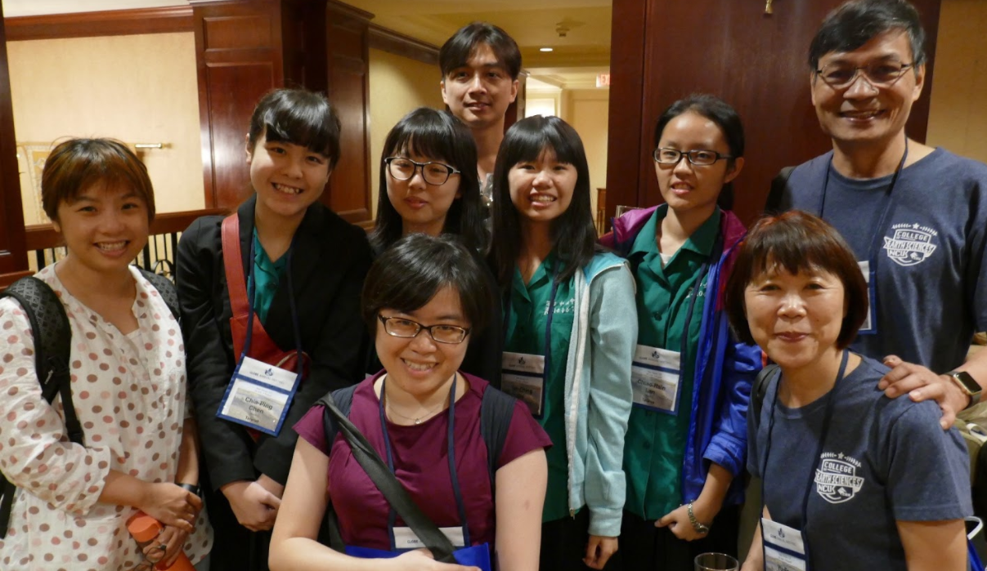
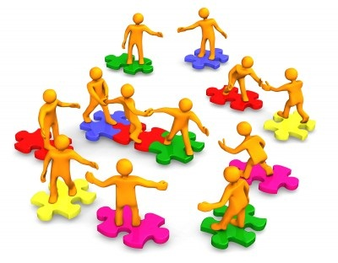
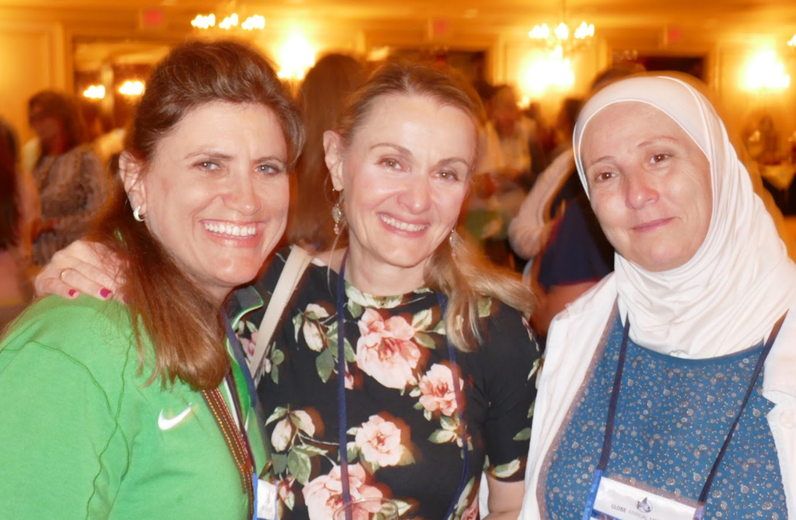
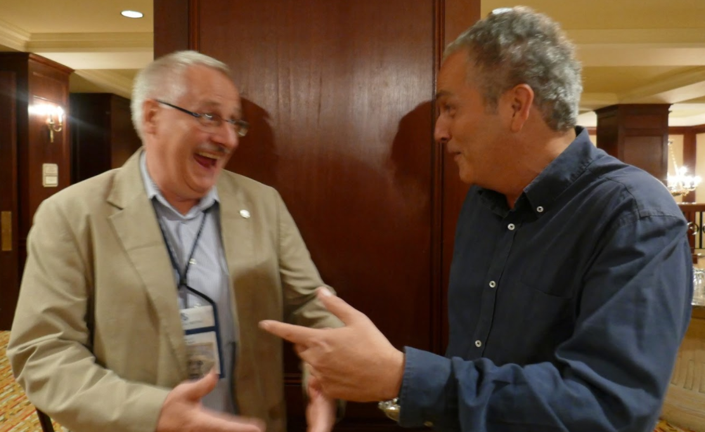
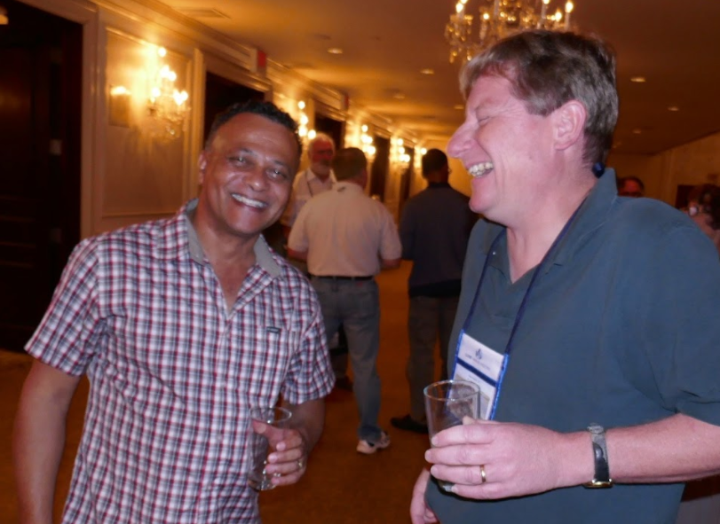
1. Meet Others
Notes:
Meet others and share contact information: We don’t want you to miss this opportunity to be together, in person, and start a new relationship with someone here.
Think about your GLOBE connection: All of us in GLOBE have a common interest in understanding our environment, so what’s something you can focus on to get the conversation started.
Use tools you already know: You can connect with each other using tools you are already familiar with – facebook, skype, google docs, email.
Start small: When getting the collaborations started, make sure the connection is manageable.

Slide 7
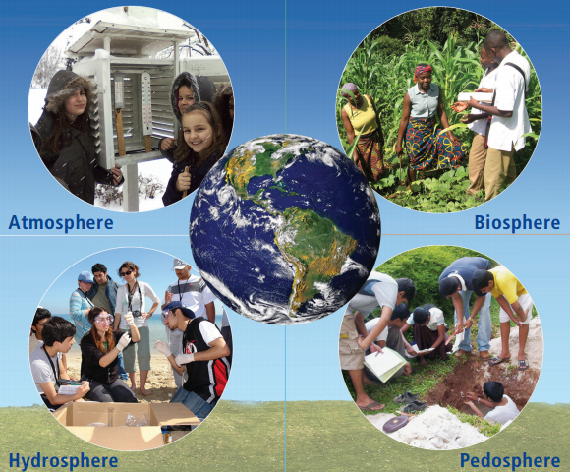
2. What’s Your GLOBE Connection
Notes:
Meet others and share contact information: We don’t want you to miss this opportunity to be together, in person, and start a new relationship with someone here.
Think about your GLOBE connection: All of us in GLOBE have a common interest in understanding our environment, so what’s something you can focus on to get the conversation started.
Use tools you already know: You can connect with each other using tools you are already familiar with – facebook, skype, google docs, email.
Start small: When getting the collaborations started, make sure the connection is manageable.

Slide 8



3. Use Tools You Know
Notes:
Meet others and share contact information: We don’t want you to miss this opportunity to be together, in person, and start a new relationship with someone here.
Think about your GLOBE connection: All of us in GLOBE have a common interest in understanding our environment, so what’s something you can focus on to get the conversation started.
Use tools you already know: You can connect with each other using tools you are already familiar with – facebook, skype, google docs, email.
Start small: When getting the collaborations started, make sure the connection is manageable.

Slide 9
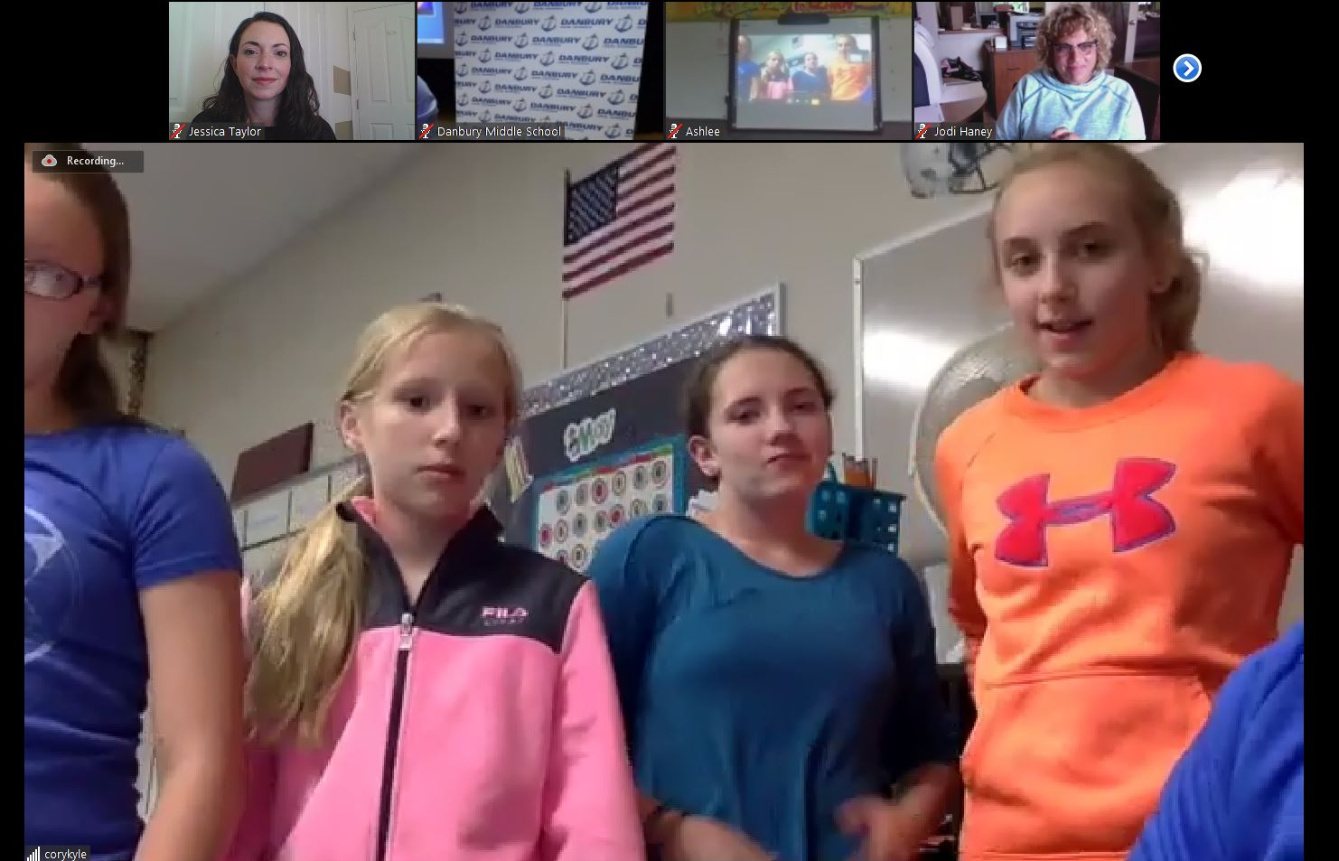
4. Start Small
Notes:
Meet others and share contact information: We don’t want you to miss this opportunity to be together, in person, and start a new relationship with someone here.
Think about your GLOBE connection: All of us in GLOBE have a common interest in understanding our environment, so what’s something you can focus on to get the conversation started.
Use tools you already know: You can connect with each other using tools you are already familiar with – facebook, skype, google docs, email.
Start small: When getting the collaborations started, make sure the connection is manageable.

Slide 10
You’re Action
At the Poster Session, Think about…
Is there a school you want to connect with?
Is there a protocol you wanted to learn more about?
What part of the world is similar to your environment?
Which is different?
Notes:
So as you meet people this week, or while you talk to people at the poster session tonight, think about who you might want to connect with later.

