Slide 1
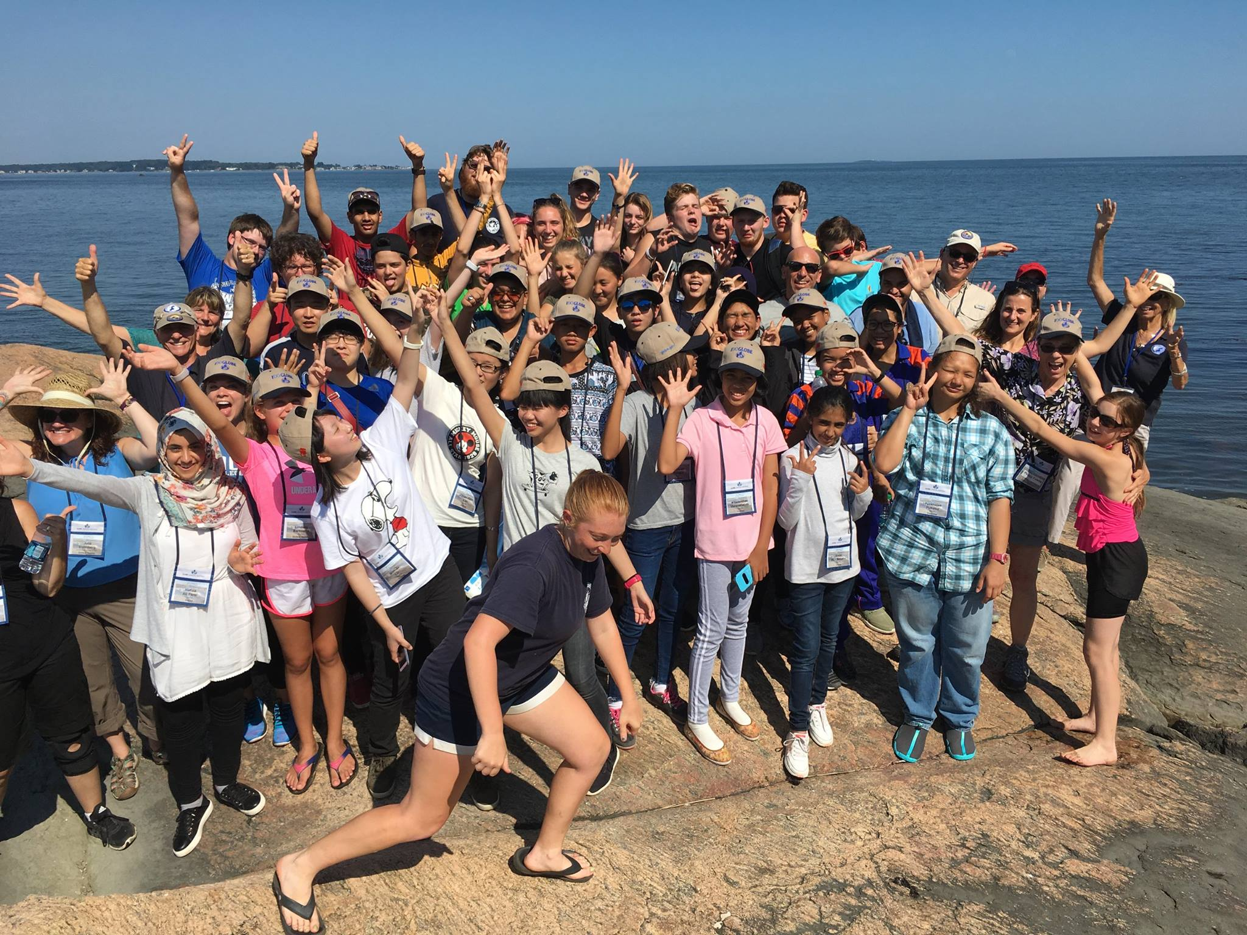
Student Learning Experience Round Robin

Slide 2

Schedule
Introduction
Adults rotate to different tables
Students present 3 – 5 minutes, 3 – 4 minutes of questions from adults
Adults visit all 9 student groups (8 minutes per group)
Group discussion

Slide 3
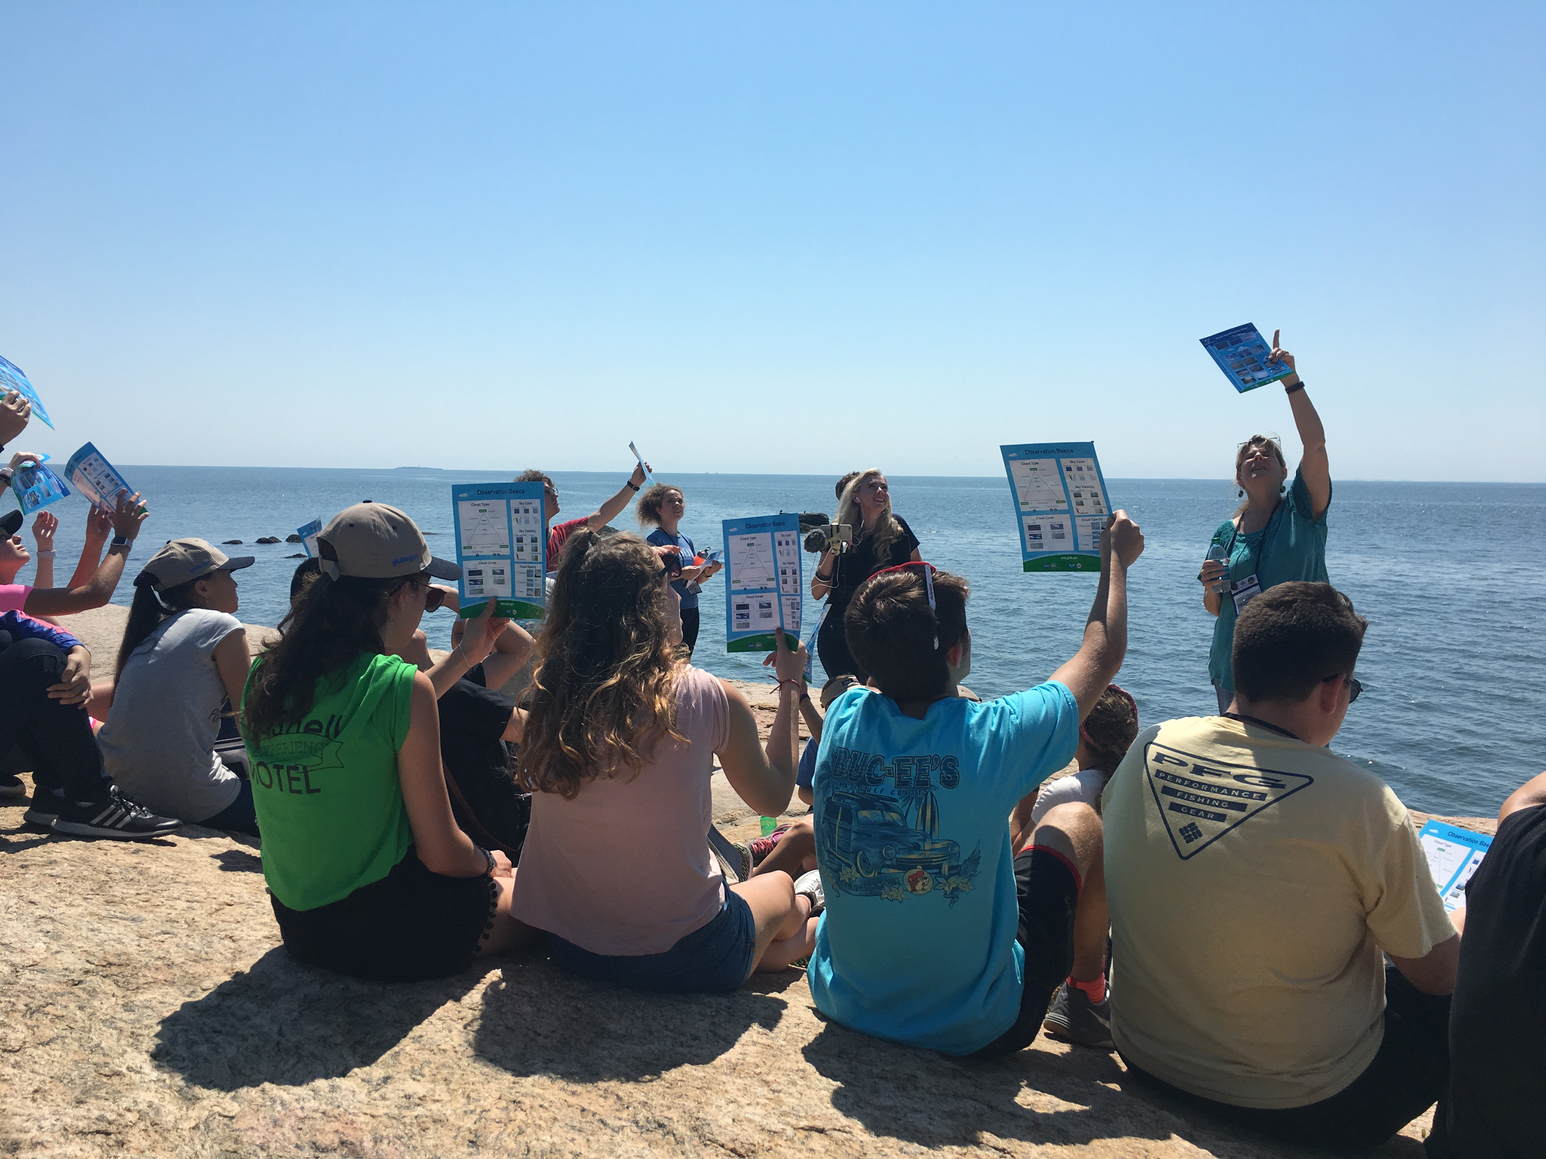
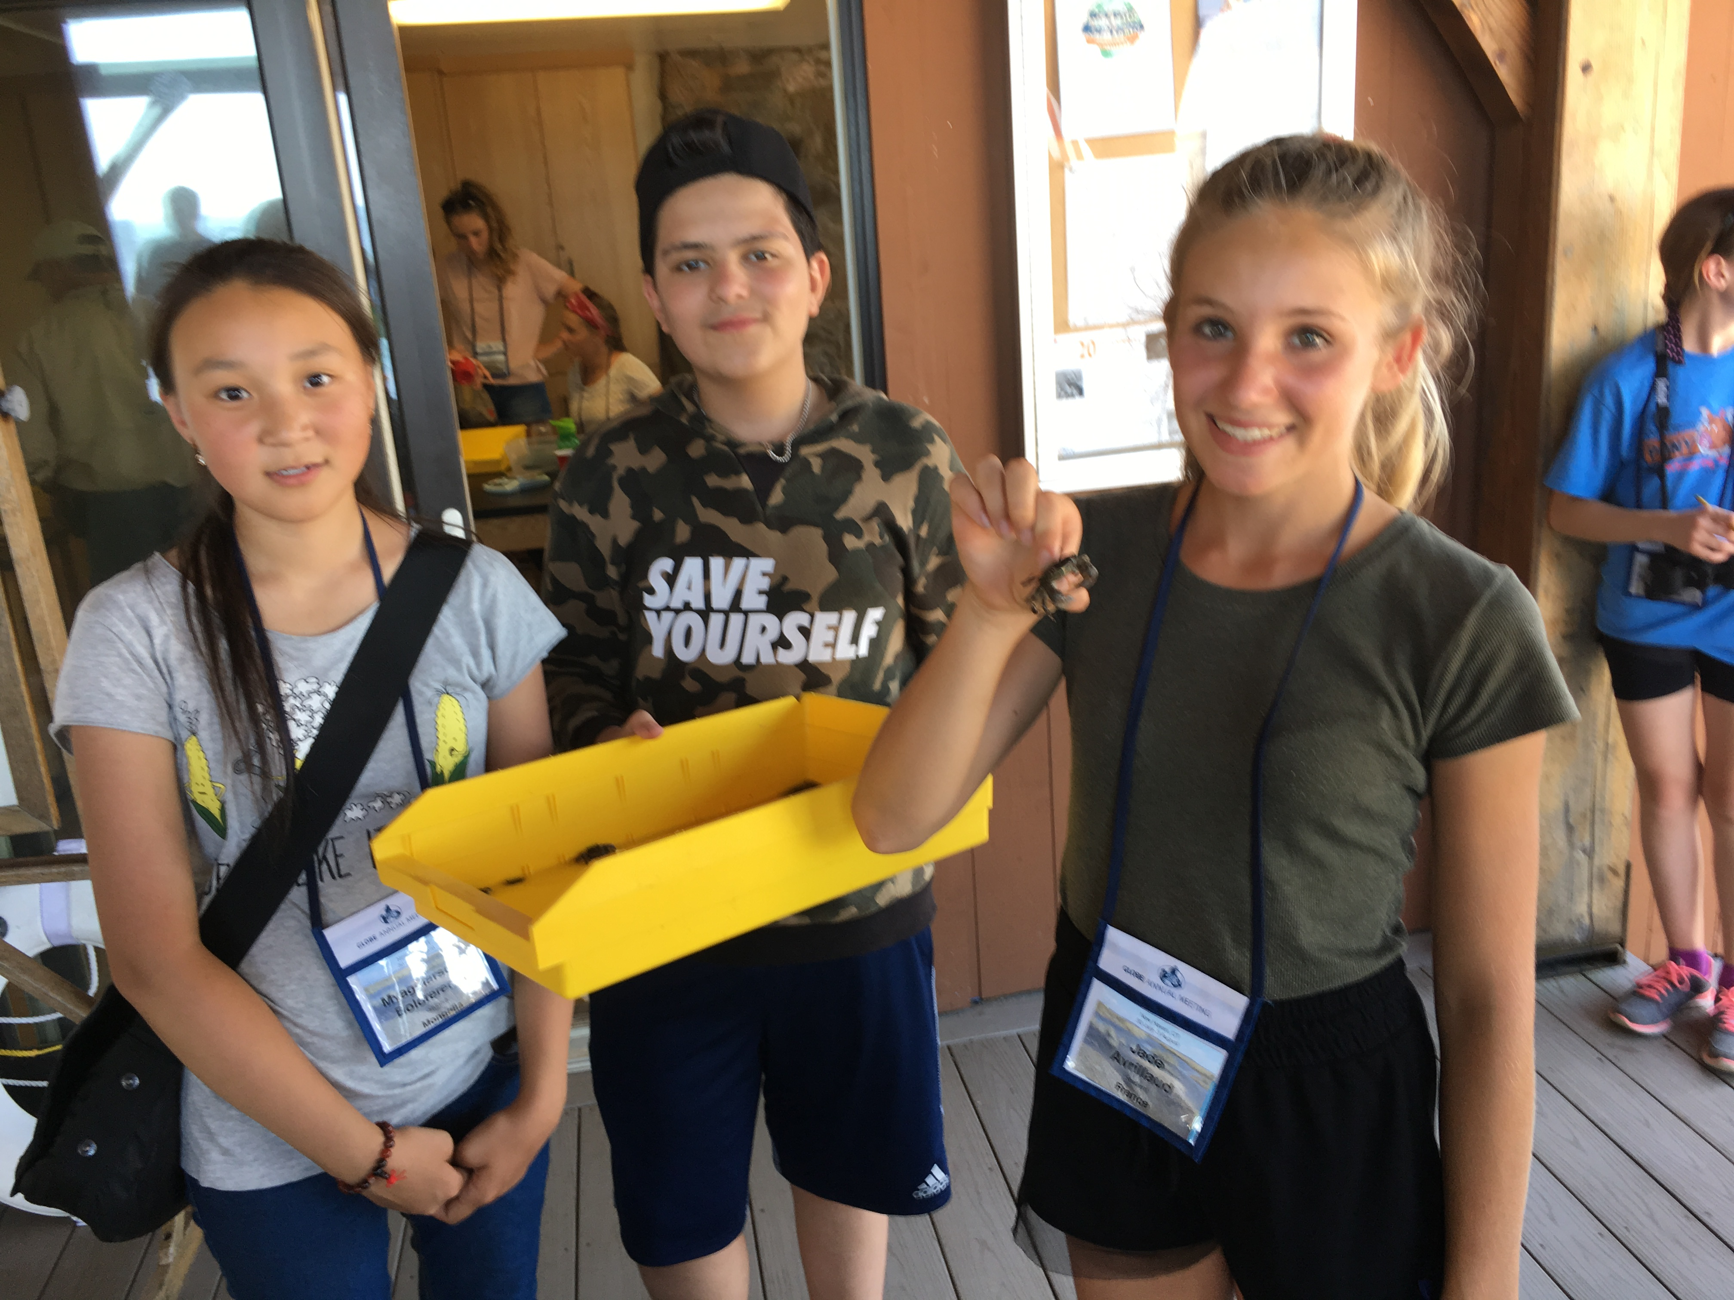
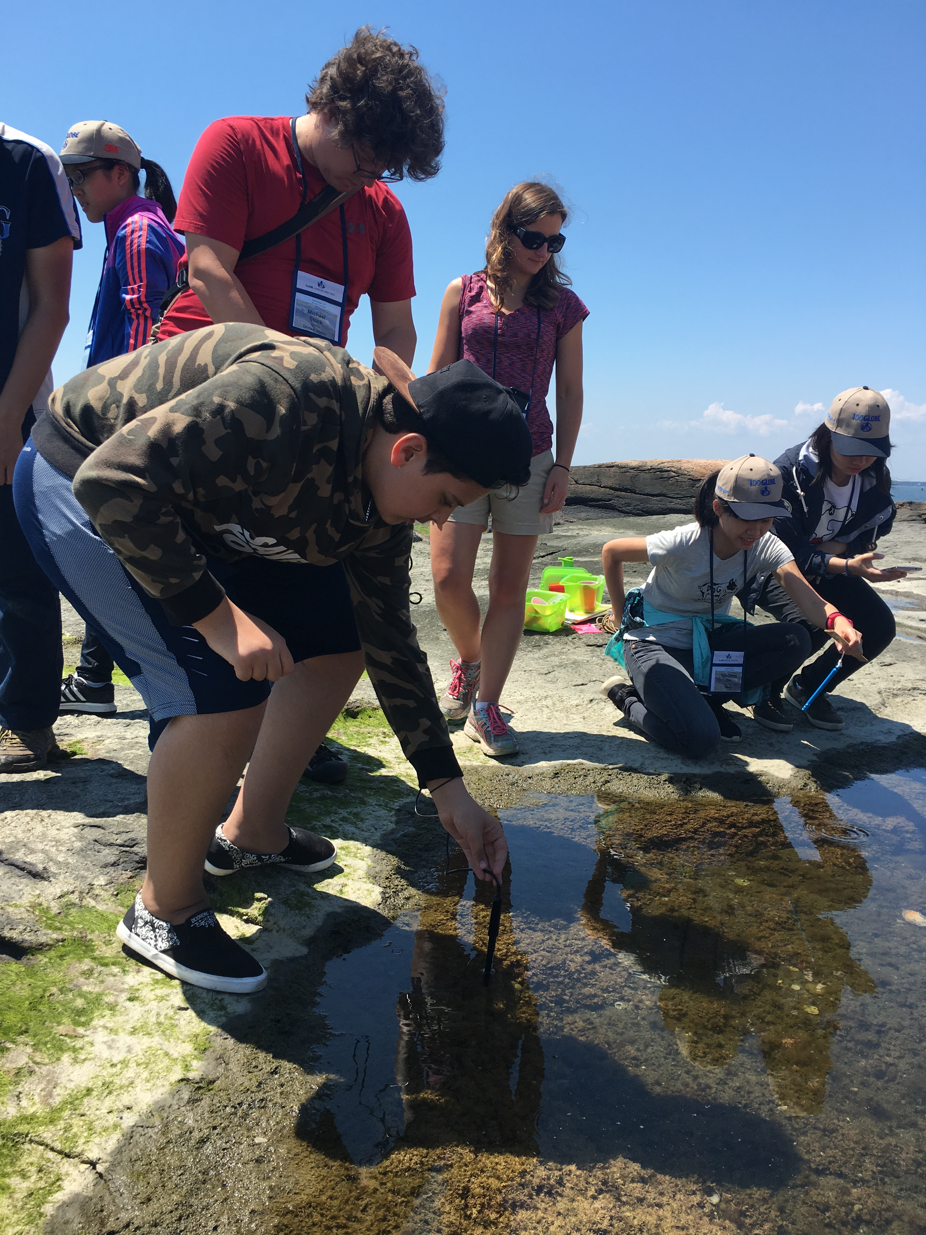
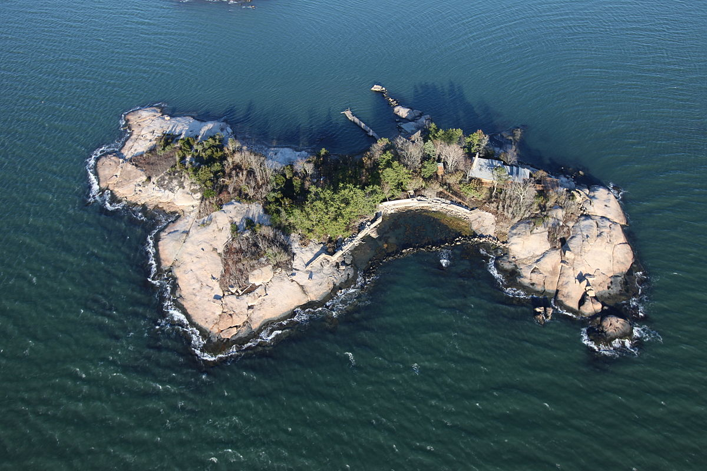
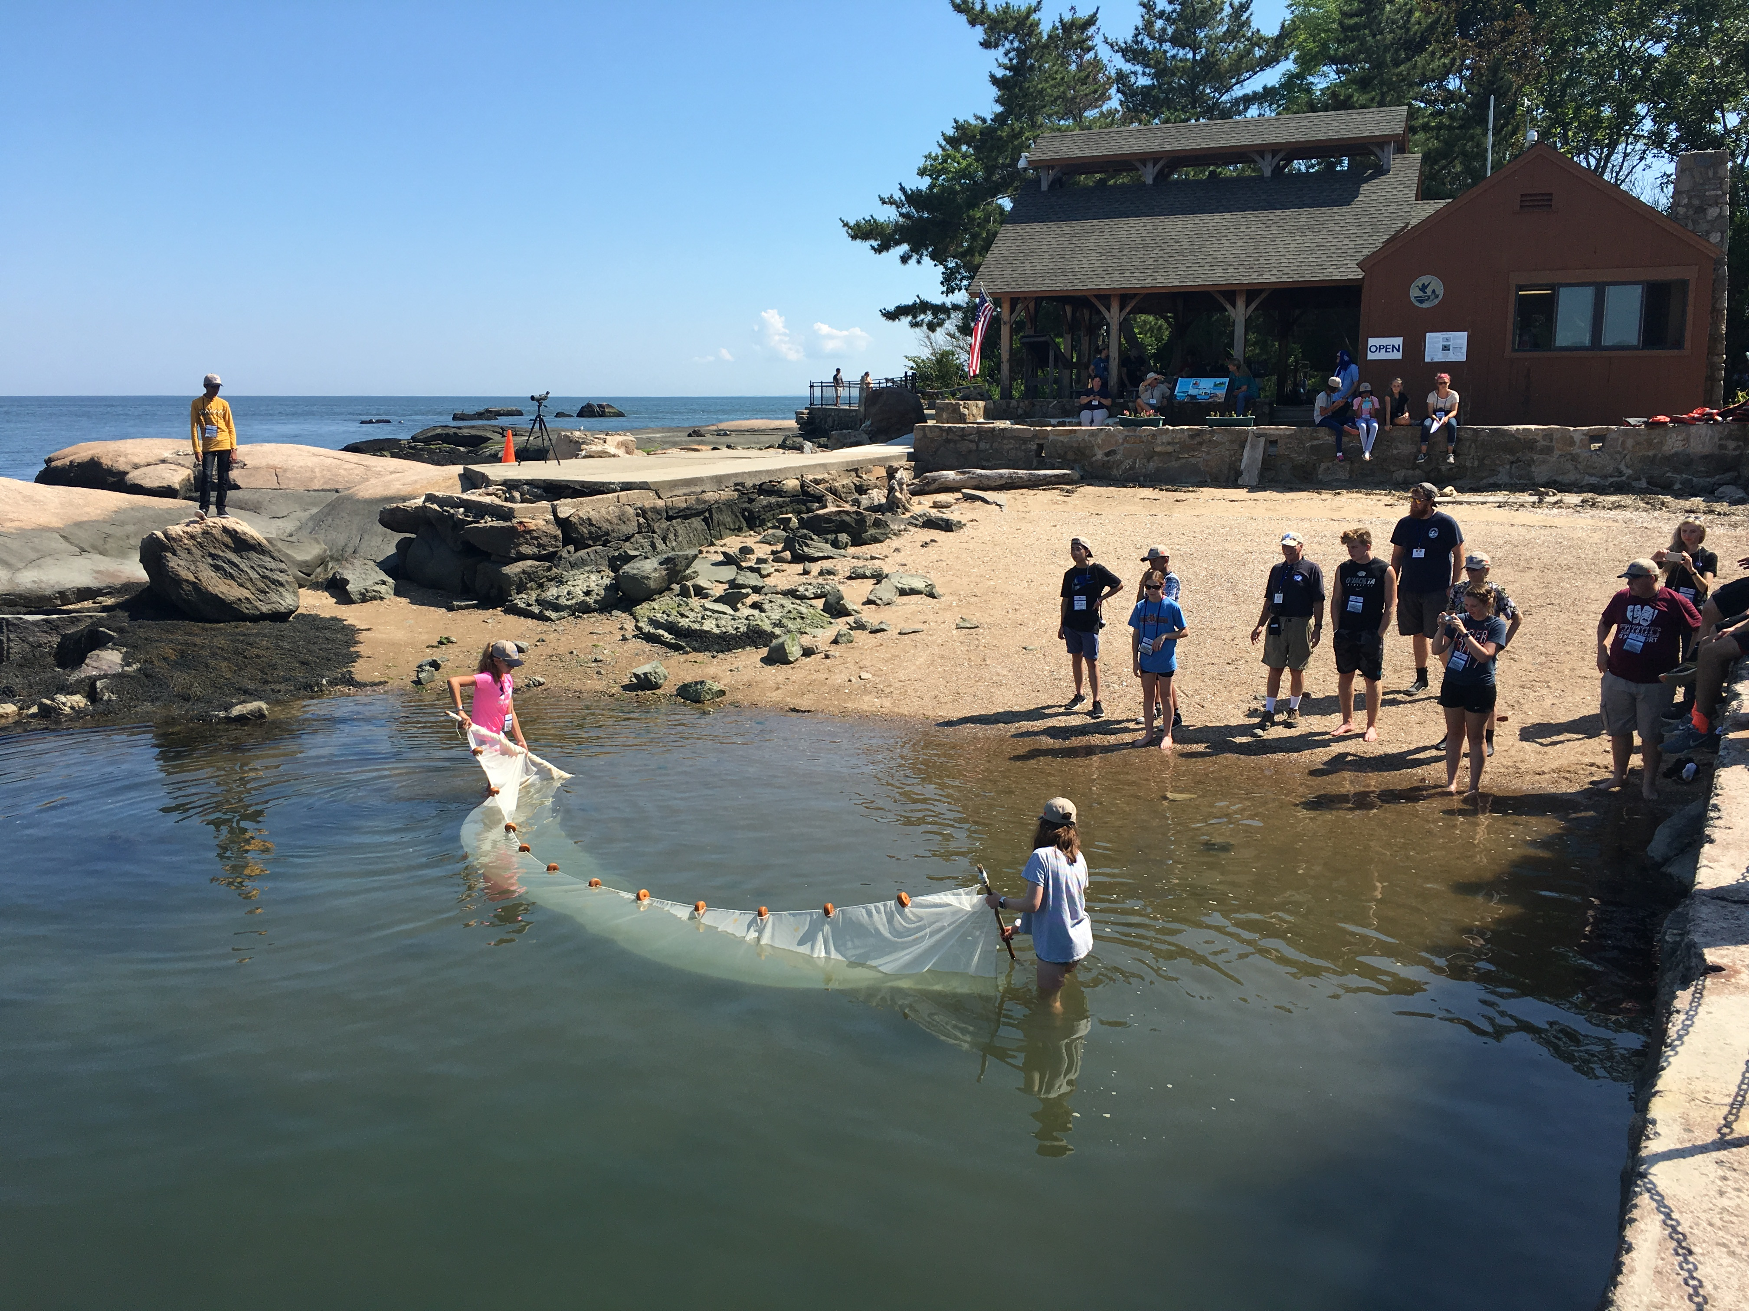
Outer Island

Slide 4
Adult Discussion
What was something you learned from the students about Outer Island?
Compare the students’ hydrology findings with your hydrology data collection at Hammonasset, Cove River, or on campus. What stands out to you?
What advice would you give the students? Consider GLOBE in the classroom, higher education, and STEM careers.

