Slide 1
Inclusion in the GLOBE Community – STEM Equity
Moderator: Jen Bourgeault
U.S. CC, UNH Leitzel Center

Slide 2
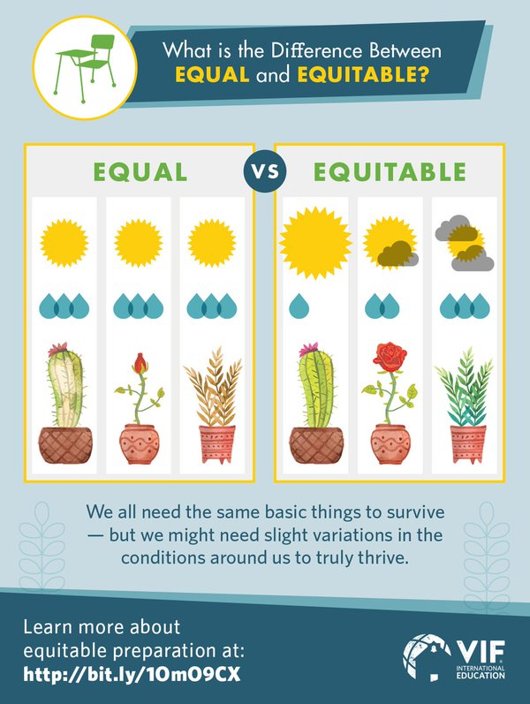
Notes:
- VIF International Education: Connect All Schools
- You do not and should not do this work yourself. Recruit the right partners.

Slide 3
STEM Equity
2017 Boulder Bootcamp Nuggets (Carolyn Brinkworth):
Social exclusion activates the same part of the brain as physical pain.
If you are not being explicitly inclusive, you are being silently exclusive!
If you say nothing, you are complicit.

Slide 4
My Trip Through Universal Design
John Ristvey
UCAR Center for Science Education
https://www.mcrel.org/my-trip-through-universal-design/

Slide 5
https://www.ncsu.edu/ncsu/design/cud/
Notes:
“the design of products and environments to be usable by all people, to the greatest extent possible, without the need for adaptation or specialized design”
https://www.ncsu.edu/ncsu/design/cud/

Slide 6
My Trip
Notes:
For example, after maneuvering through airport security, I stood at my gate and watched, with others, the latest news on TV. The volume was muted, and we were all reading the closed-captioning—an example of technology designed for the deaf and hard of hearing but which benefits everyone without adaption.
After arriving in Hartford, I used the maps/GPS feature on my phone. Even though I didn’t know the zip code for my destination, the system was still able to find the location. Before I got on my way, though, the GPS asked whether I wanted the shortest route, the fastest route, or to avoid highways. It also told me which gas stations and restaurants were along the way. With all of these options, I thought, this GPS could meet everyone’s needs, from the business traveler to the hungry sightseer.

Slide 7
Universal Design for Instruction
Class Climate
Interactions
Physical Environments
Delivery Methods
Information Resources and Technology
Feedback
Assessment
Accommodation
http://www.washington.edu/doit/sites/default/files/atoms/files/Equal-Access-Universal-Design-of-Instruction.pdf
Notes:
Class Climate: Adopt practices that reflect high values with respect to both diversity and inclusiveness.
Interaction: Encourage regular and effective interactions between students and the instructor and ensure that communication methods are accessible to all participants.
Physical Environments: Ensure that facilities, activities, materials, and equipment are physically accessible to and usable by all students, and that all potential student characteristics are addressed in safety considerations.
Delivery Methods: Use multiple, accessible instructional methods that are accessible to all learners.
Information Resources and Technology: Ensure that course materials, notes, and other information resources are engaging, flexible, and accessible for all students.
Feedback: Provide specific feedback on a regular basis.
Assessment: Regularly assess student progress using multiple accessible methods and tools, and adjust instruction accordingly.
Accommodation: Plan for accommodations for students whose needs are not met by the instructional design.

Slide 8
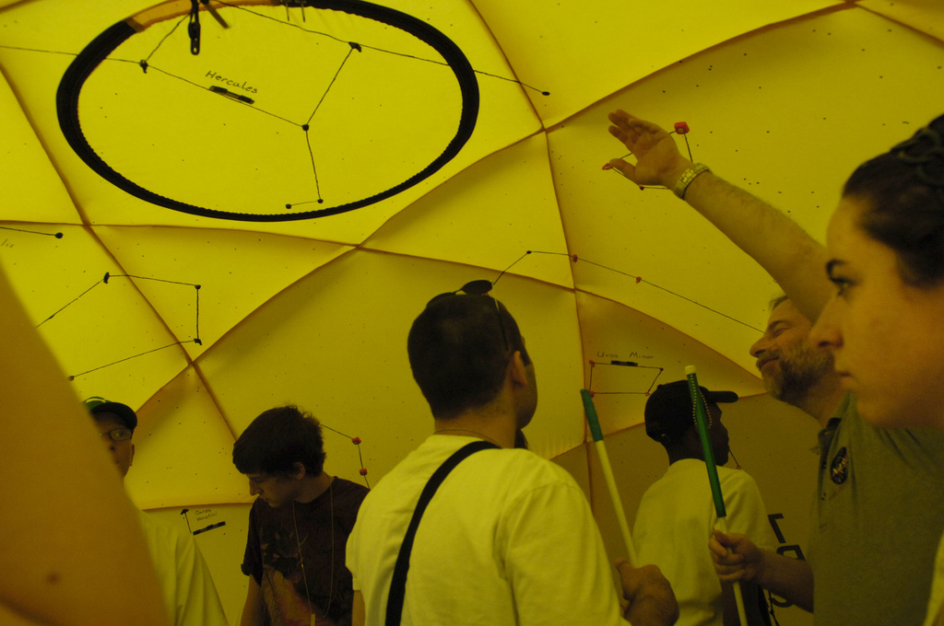
My Experience
Adapted Curriculum Enhancements for Students with Visual Impairments:
http://www.ace-education.org/
UDI Blog:
https://www.mcrel.org/my-trip-through-universal-design/
Students in a Tactile Planetarium at NASA Goddard Space Flight Center
Notes:
Use principles of UDL to help teachers assist students in visualizing complex science concepts through tactile graphics with written descriptions and 3-D models. The overarching principle is to develop course material, curriculum, and instruction with UDL in mind from the beginning, so that educators don’t have to “retro-fit” their teaching when they have diverse learners in their classrooms.

Slide 9
STEM for EL’s
Resources available
Creating a win/win mindset
What Can Teachers Do?
Henry Ortiz
Los Angeles Unified School District (CA)
GLOBE Partnership

Slide 10
Resources
ELL teacher specialists
Rubrics for each grade Level (WIDA) (Consortium of 35 States). What to expect at different stages of language development.

Slide 11
Use Rubrics when planning Lessons

Slide 12
What has been particularly successful?
Distinguishing between Two Types of English:
Social Language (1-2 Years)
Academic Language (4-7 years, 10)
Recognize that more support needed for EL’s in content classes.
And…
That interaction between ELL’s and Native English Speakers benefits both populations socially and academically.

Slide 13
What STEM Teachers Can Do
Provide context for Vocabulary (Phenomenon, events, tangible experience) that builds background and goes from concrete to abstract.
Support the student’s vocabulary building skills (Journals or models that must be revisited with greater understanding) Tier 1) vocabulary, Tier 2) STEM vocabulary and Tier 3) application of vocabulary to explain concepts. Use words often.
Model the Use of STEM Vocabulary with sentence starters or examples.

Slide 14
What STEM Teachers can Do
Increase opportunities to use language skills in class
Receptive: listening and reading,
Productive: speaking and writing
Use Different Grouping Strategies
Can be native language (for conceptual understanding) with other primary language speakers
English language with other native speakers. Teachers lesson objectives should include intentional strategies to teach specific language objectives (from WIDA rubric previously mentioned)

Slide 15
Inclusion in the GLOBE Community – STEM Equity
Latina
&
Julie Malmberg, Ph.D.
malmberg@ucar.edu
03 August 2017

Slide 16
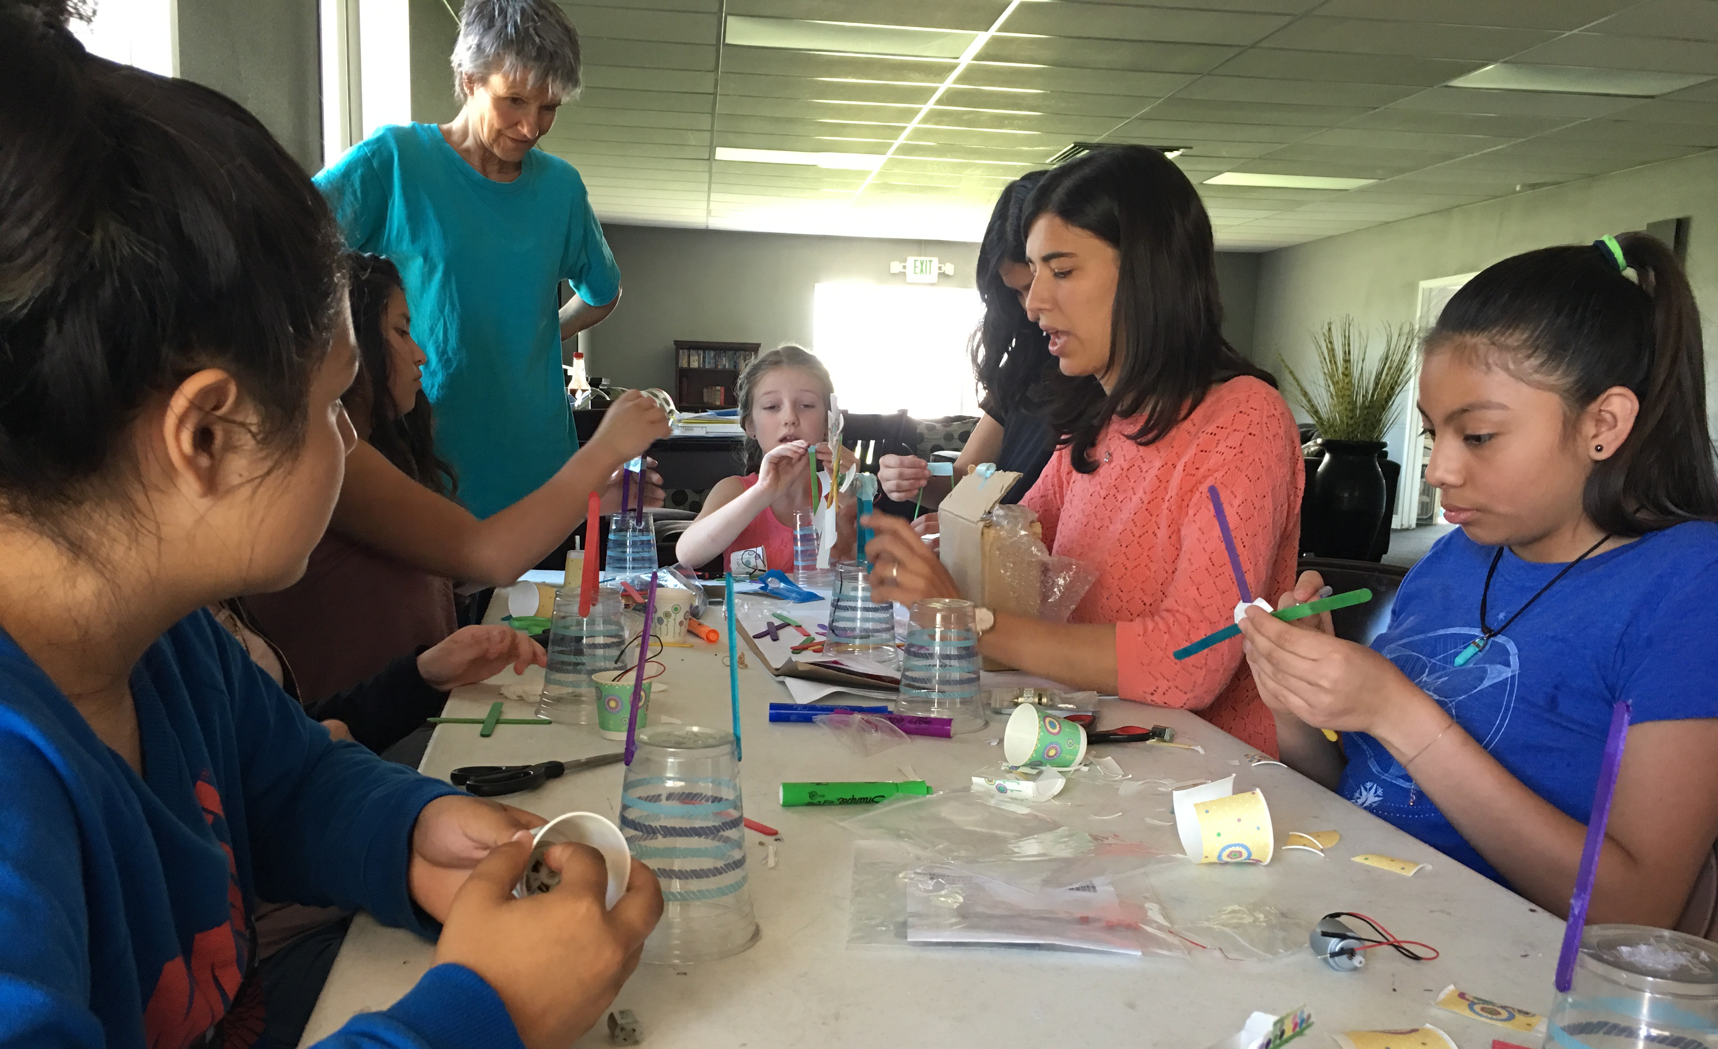
GLOBE – SciGirls Club
NSF-funded
Two years
Minimum of 16 hours per year
12+ girls ages 8-14
SciGirls activities + GLOBE activities
Mentors

Slide 19
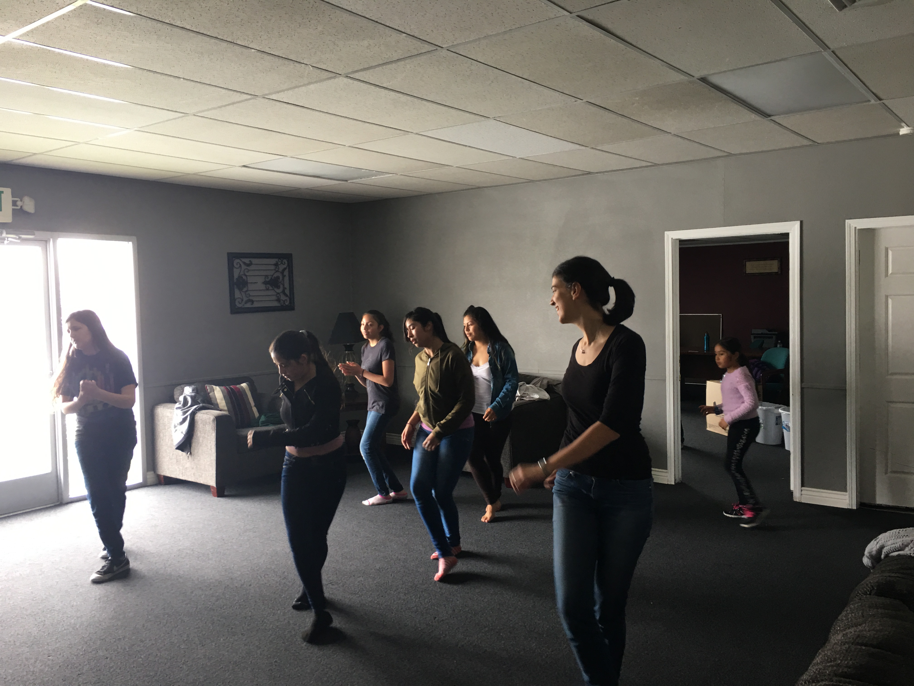
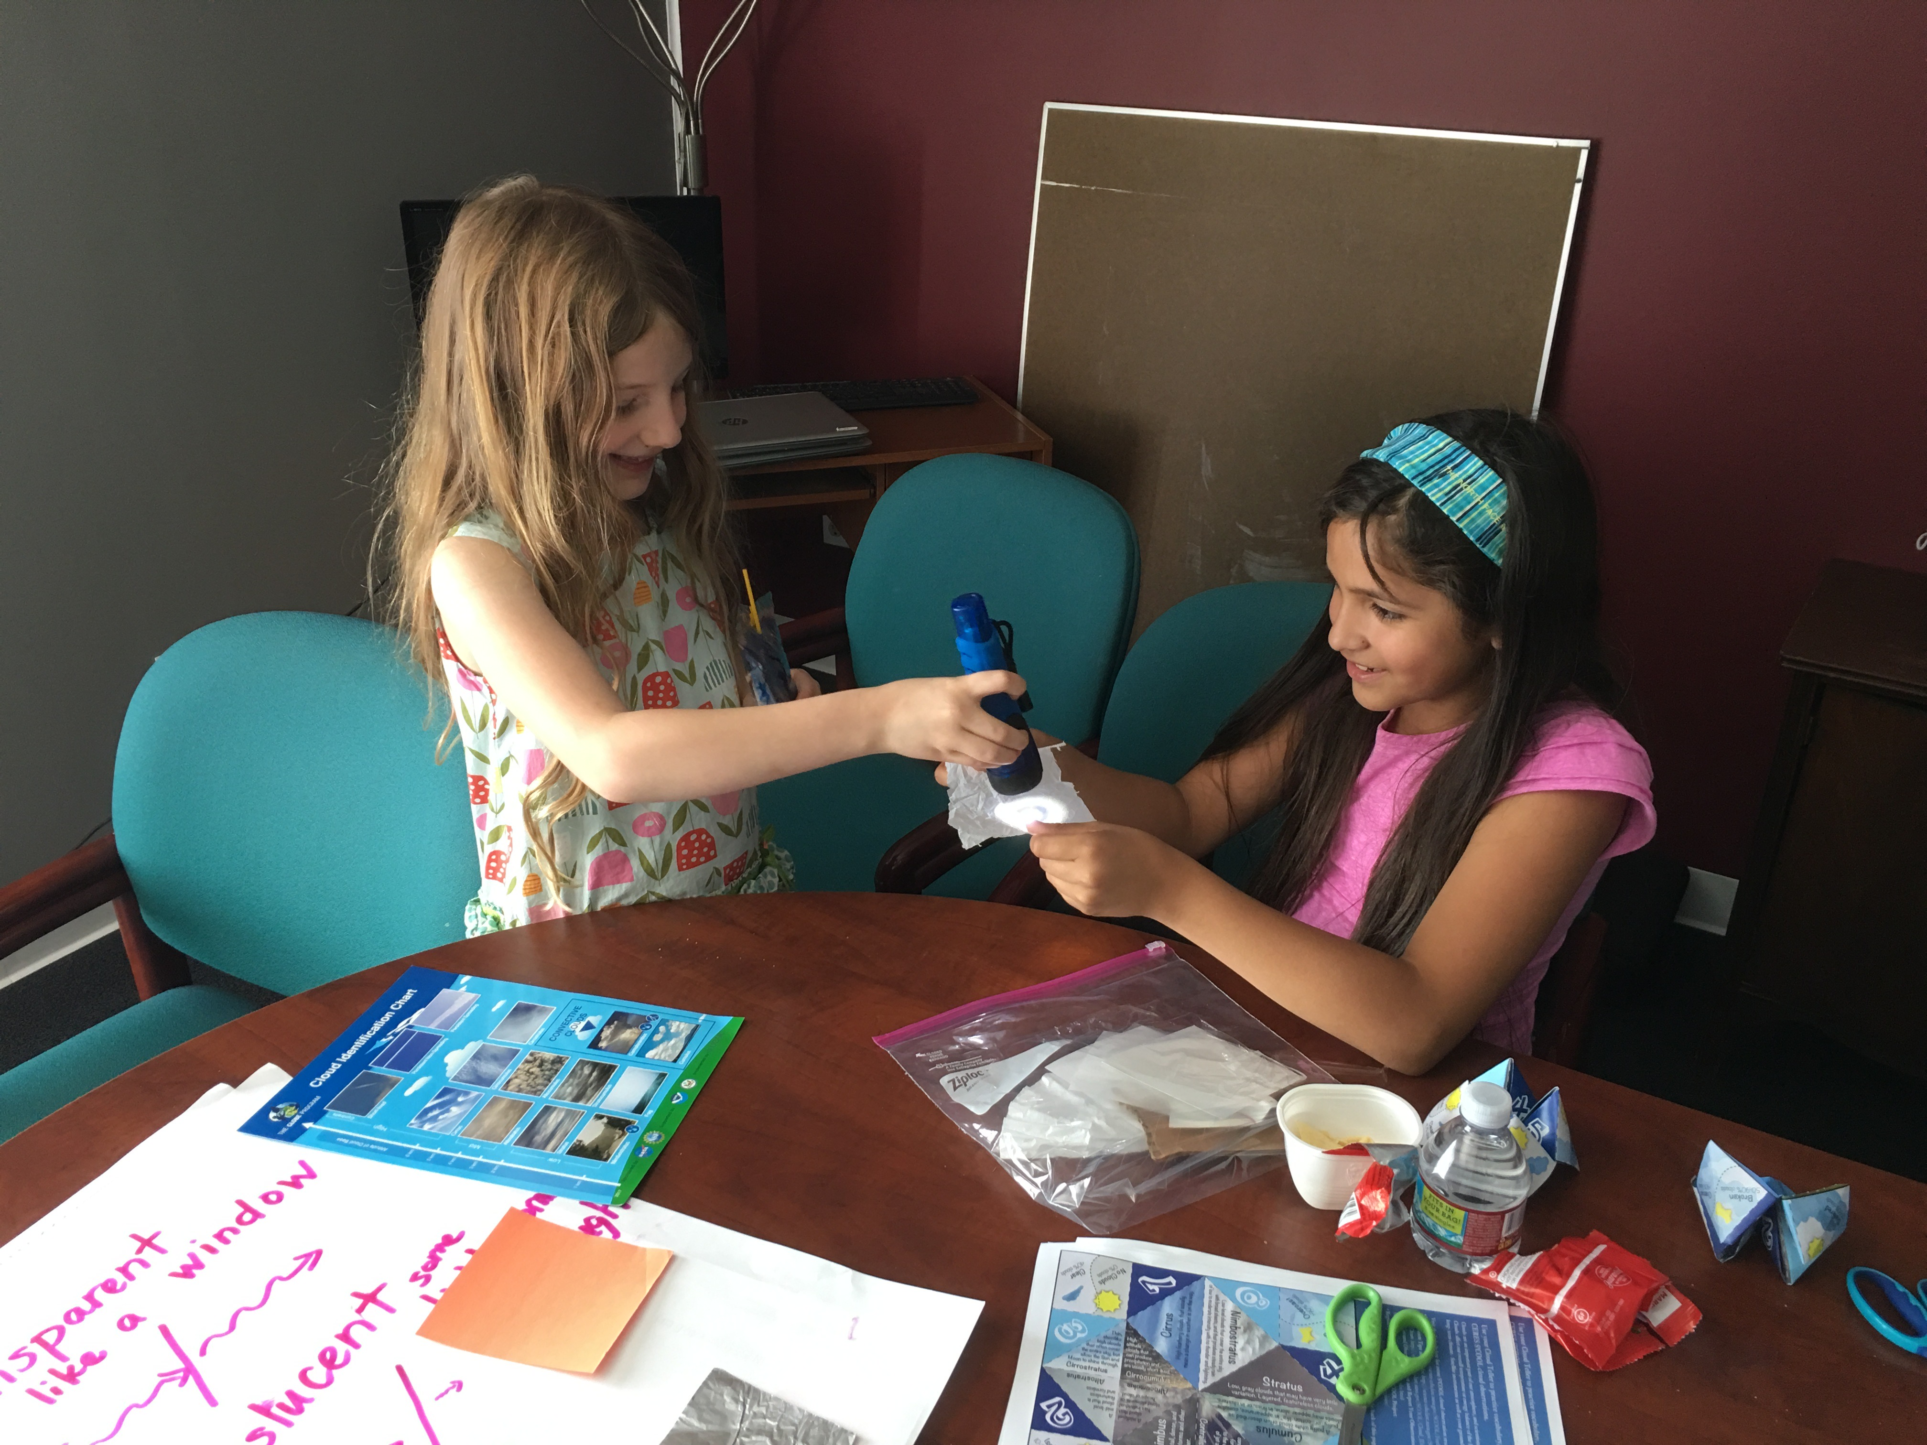
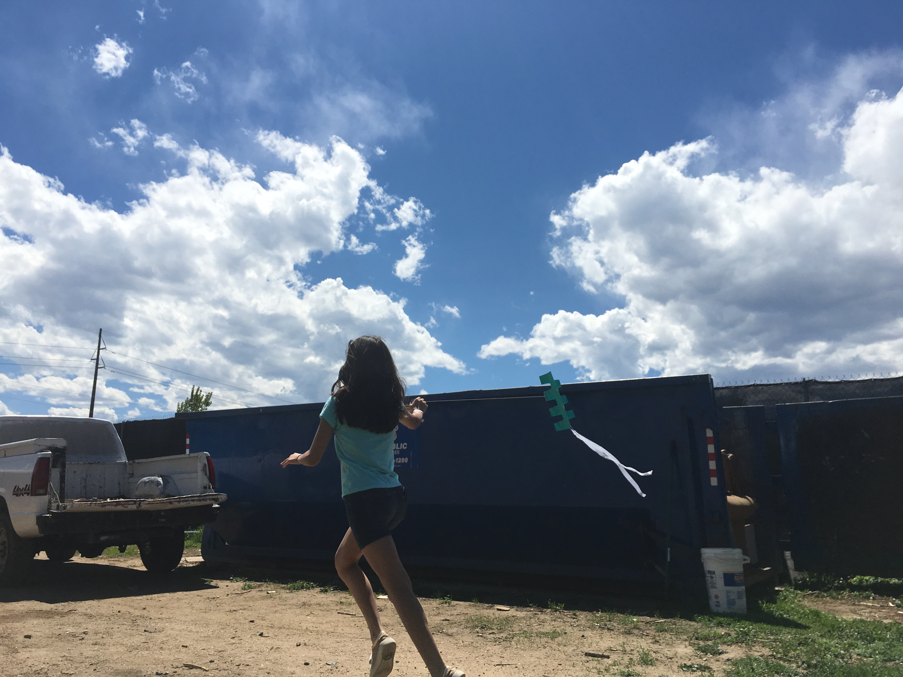
Challenges
Successes
Recruiting girls
Engaging families
Evaluation
Scheduling
Excited about science
New career ideas
New role models
Incredibly fun

Slide 20
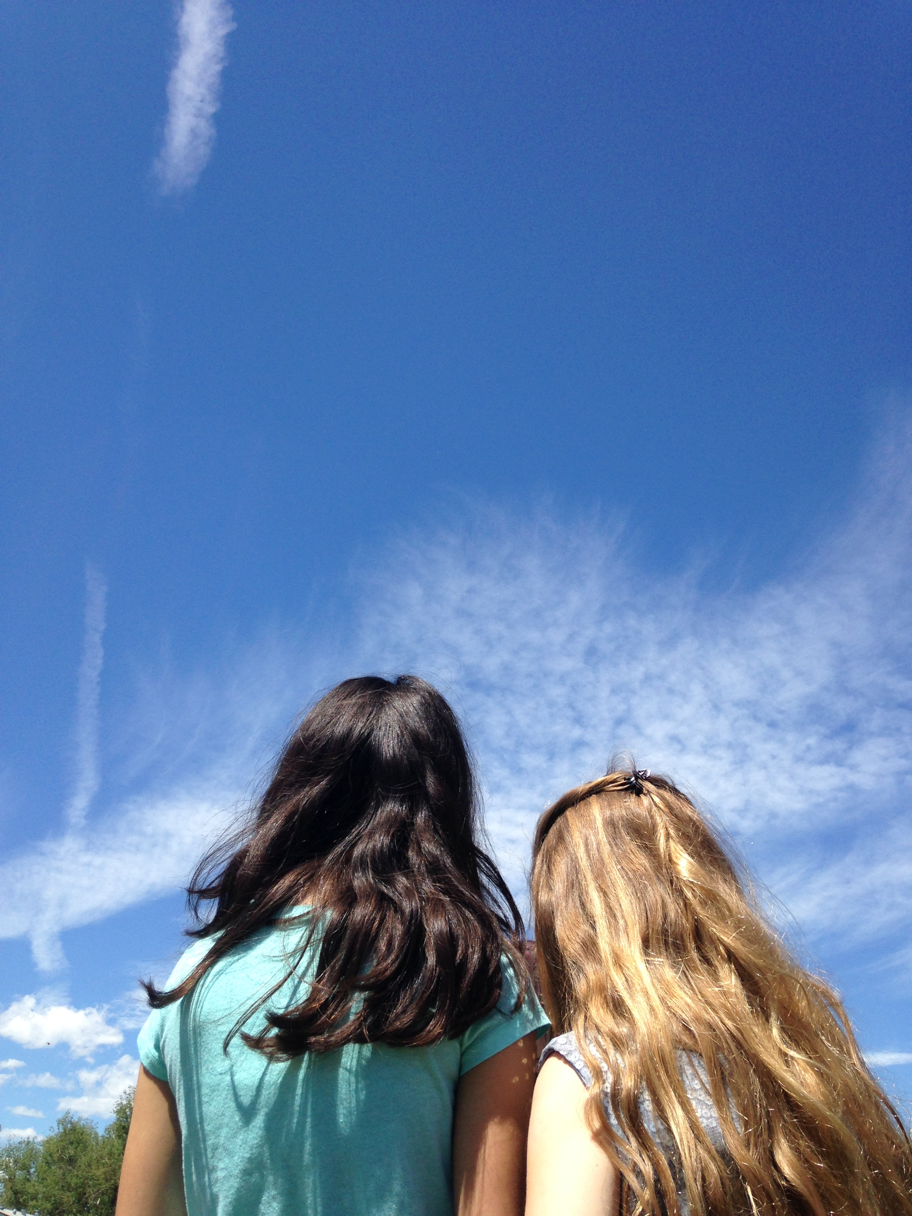
Questions? Comments?
malmberg@ucar.edu

Slide 21
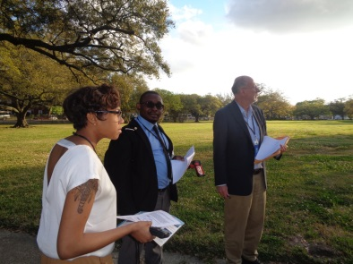
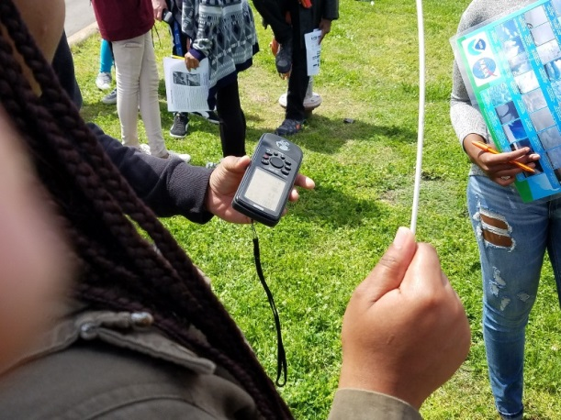
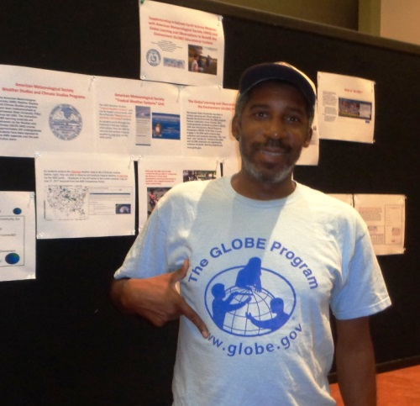
The Global Learning and Observations to Benefit the Environment (GLOBE) Mission Earth Program at Tennessee State University Dr. David A. Padgett
Tennessee State University has been a Global Learning and Observations to Benefit the Environment (GLOBE) program Partner Institution since October 2001. Undergraduate students enrolled in GEOG 3500 and introductory World Regional Geography (GEOG 1010/1020) courses engage in GLOBE earth science data collection and analysis exercises. The "real time" and "hands-on" format of the AMS and GLOBE materials can significantly enhance students' learning experiences. Over the past year approximately a dozen pre-service teachers have been certified in the GLOBE Atmosphere Protocols. Professional Development activities for in-service teachers are planned for fall 2017.
Nashville is the largest US city in the “region of totality” for the August 21 solar eclipse. Tennessee State University students and local high school students will jointly participate in a GLOBE Surface Temperature exercise in and around the eclipse date.

Slide 22
Tennessee State University has been a Global Learning and Observations to Benefit the Environment (GLOBE) program Partner Institution since October 2001. Undergraduate students enrolled in GEOG 3500 and introductory World Regional Geography (GEOG 1010/1020) courses engage in GLOBE earth science data collection and analysis exercises. The "real time" and "hands-on" format of the GLOBE materials can significantly enhance students' learning experiences
www.globe.gov.

Slide 23
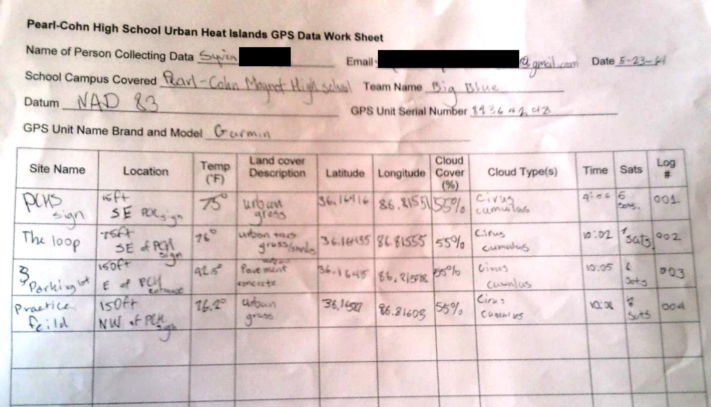
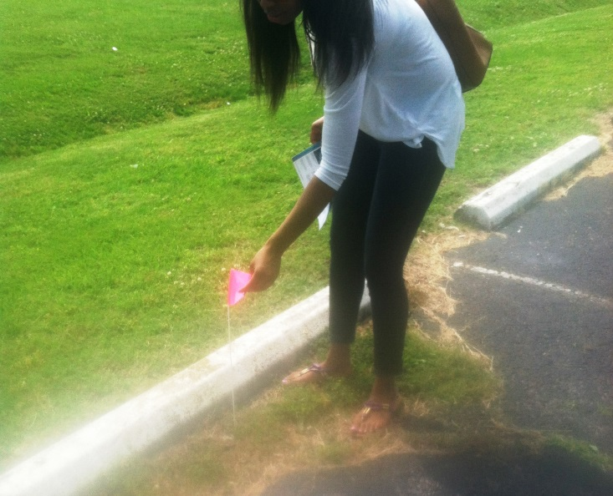
GLOBE Surface Temperature Protocol Service Learning Exercise – Summer 2014 – Students enrolled in TSU’s Weather & Climate (GEOG 3500) course led Pearl-Cohn High School students in an outdoor exercise using infrared thermometers and GPS receivers to map the temperatures of various land covers surfaces in order to understand the concept of “Urban Heat Islands.” This exercise could be used to supplement the Assessment portion of the InTeGrate “Earth’s Thermostat” Module

Slide 24
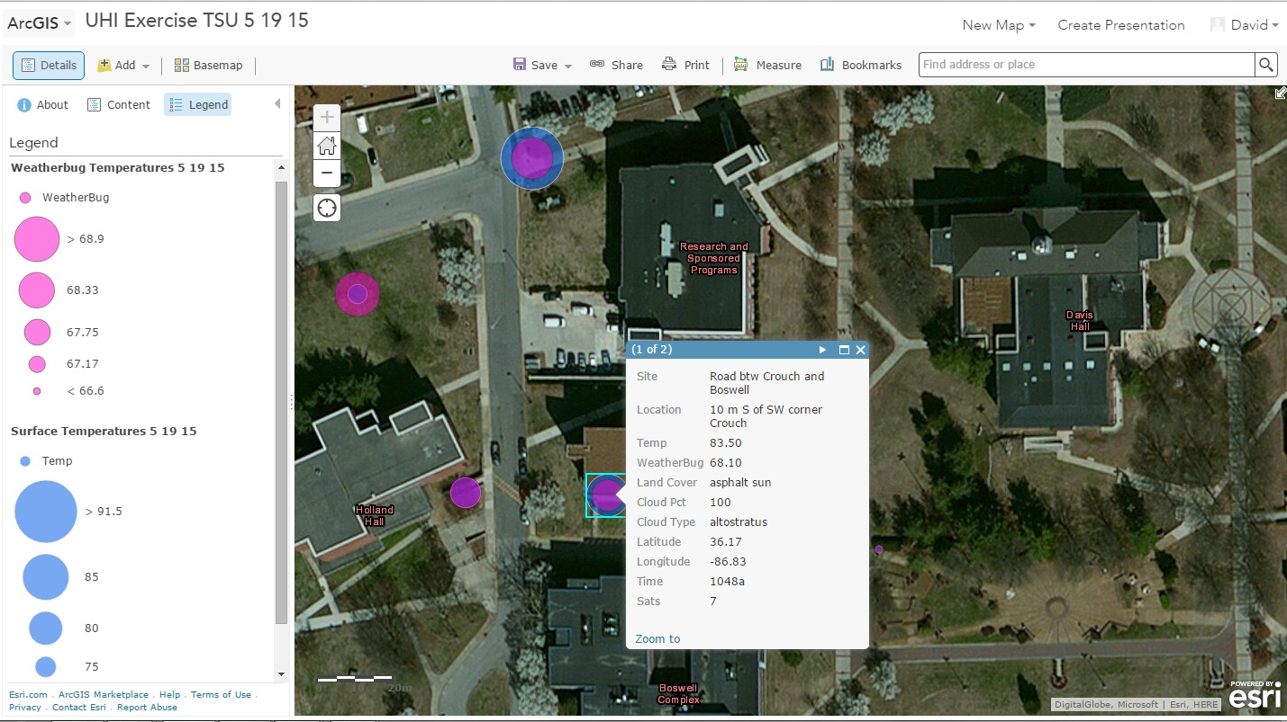
GLOBE Surface Temperature Protocol Atmospheric Data Mapping Exercise – Summer 2015 – Students enrolled in the Weather & Climate (GEOG 3500) course collected GLOBE surface temperature data using the Nexus 7 tablets and then convert the data into comma delimited text (CSV) format. The CSV file was then imported into ArcGIS Online. The map symbology created allowed for students’ surface temperature data to be compared with ambient air temperature data collected from TSU’s Weatherbug Station (http://weather.weatherbug.com/).

Slide 25
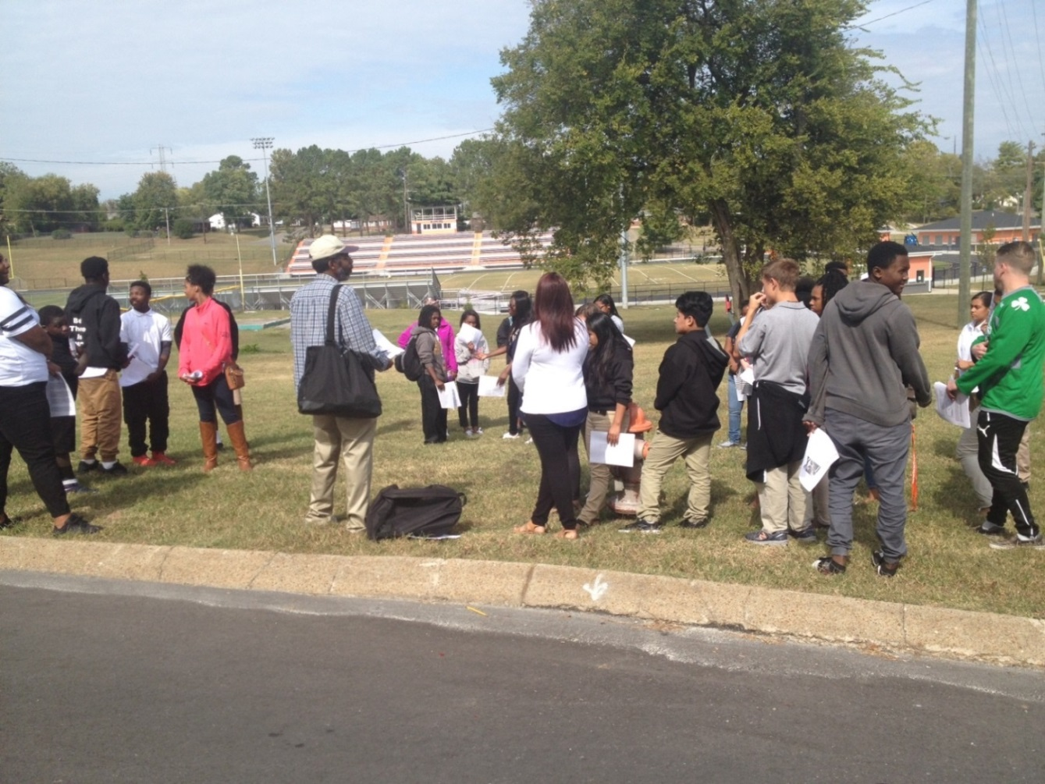
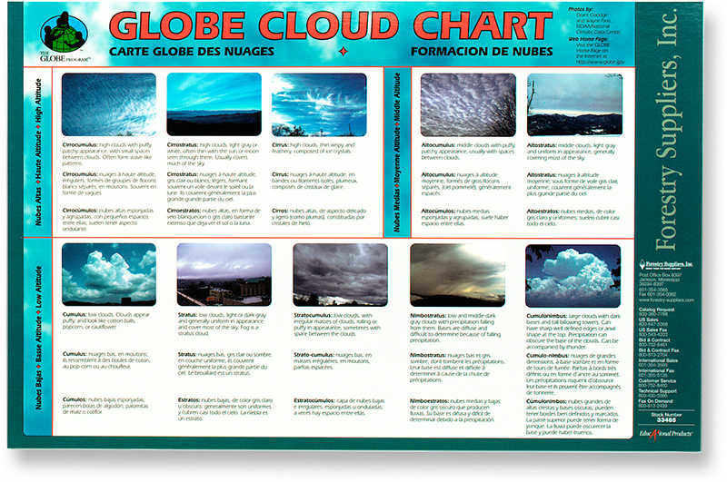
In completing the GLOBE Surface Temperature Protocols, students spend time outdoors engaged in "citizen science" collection of cloud, ambient temperature, and other atmospheric data, providing a “real world” experience.

Slide 26
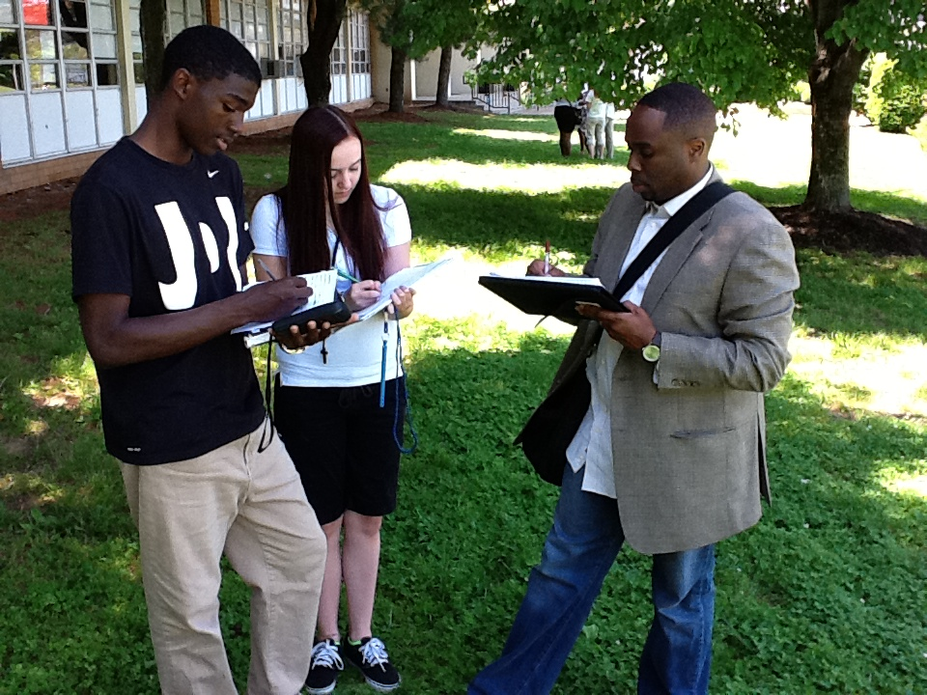
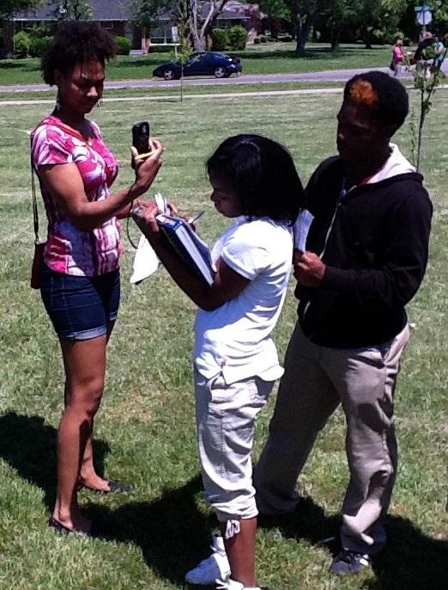
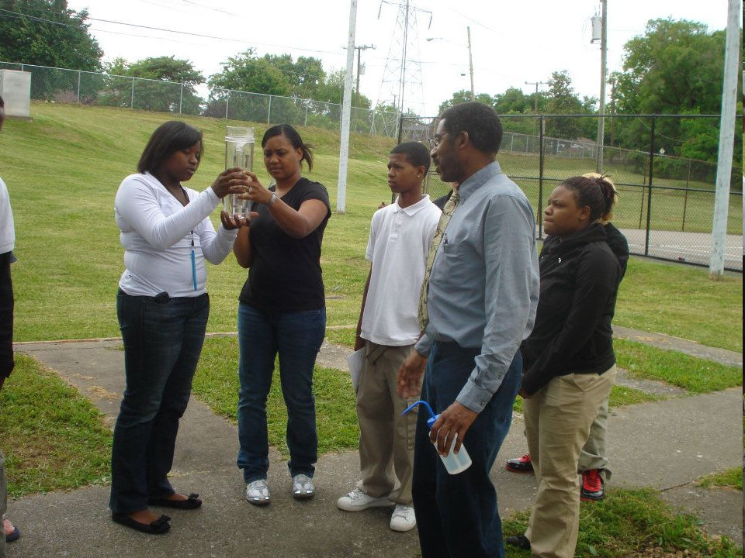
With GLOBE content faculty are able to "customize" the lessons to focus upon atmospheric sciences phenomena in students’ own neighborhoods and local communities.

Slide 27
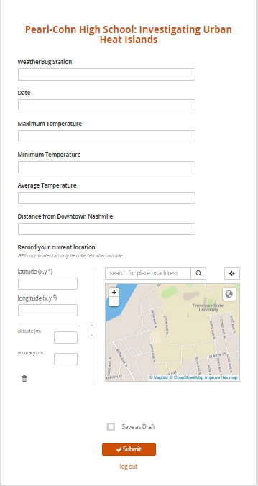
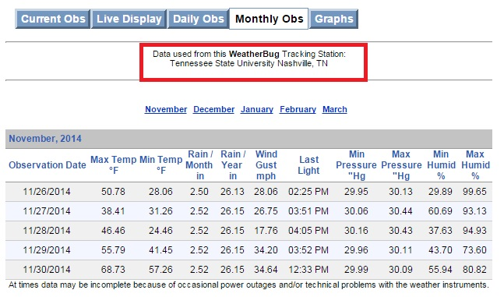
GLOBE Surface Temperature Protocol “Urban Heat Islands” Service Learning Data Mapping Exercise – Fall 2014 – TSU World Regional Geography II (GEOG 1020) and Cartography (GEOG 3100) students assisted ninth grade physical sciences students in entering climate data into the Map Your World data collection form hosted on Google Nexus 7 tablets. Data included maximum and minimum average temperature observations at selected local WeatherBug stations.

Slide 28
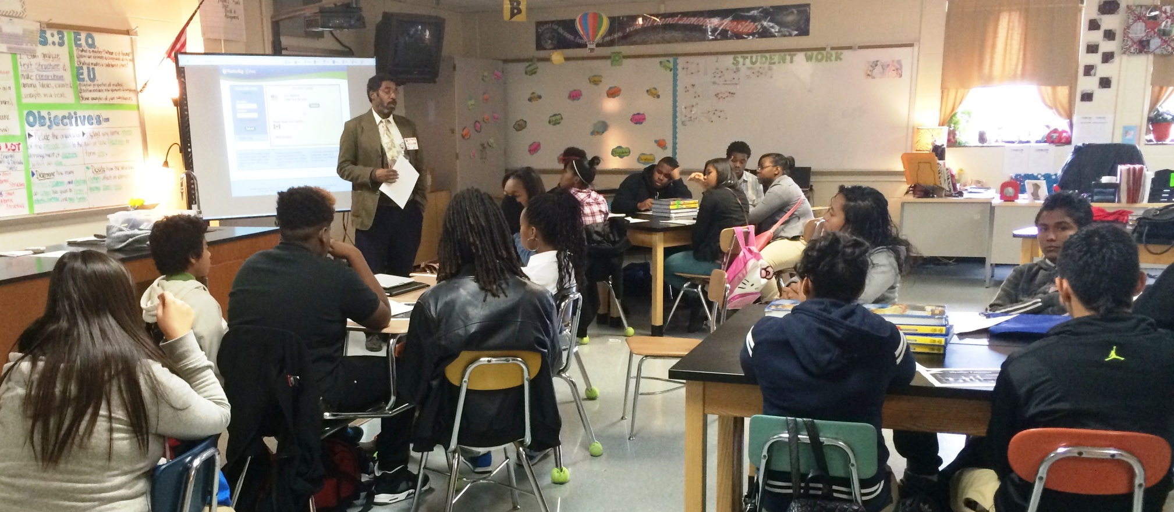
THANK YOU!
For your time and attention.
Dr. David A. Padgett, Associate Professor of Geography
Director, Geographic Information Sciences Laboratory
Tennessee State University, Nashville, Tennessee
615.963.5508 dpadgett@tnstate.edu @TSUGIScLab
https://www.facebook.com/geomental

Slide 29
STEM Equity Bootcamps
Thank you to NSF for the funding to offer these to US Partners.
Purpose: Build US Partnership capacity in reaching a broad and diverse audience and increase knowledge to create workshops and provide PD on the concept of “inclusive.”
4 workshops: Charlotte, North Carolina (March 2016), Santa Fe, New Mexico (May 2016), Boulder, Colorado (March 2017) and upcoming, New Orleans, Louisiana (November 2017)

Slide 30
STEM Equity Bootcamps
Three topic areas:
Protocol area training
STEM equity – the research and background, privilege, promising practices
Introduction to the GLOBE website
Approximately 15-20 participants.
Dr. Janelle Johnson (STEM equity specialist), Kristin Wegner (GIO), Jen Bourgeault, 2-4 protocol area trainers, Cornell or Dave

Slide 31
GLOBE US Student Research Symposia Participant Conduct Expectations
The GLOBE US Student Research Symposium includes people from many different backgrounds. GLOBE is committed to providing a friendly, safe and welcoming environment for all, regardless of age, disability, gender, nationality, race, religion, sexuality, or identity.

Slide 32
STEM Equity Bootcamps
Be respectful.
Not all of us will agree all the time, but we expect respectful behavior at all times.
It’s important to remember that a community where people feel comfortable and safe is a productive one.

Slide 33
STEM Equity Bootcamps
People are complicated. If misunderstandings happen, remember that we’re different. Not understanding why someone holds a viewpoint doesn’t mean that they’re wrong.

Slide 34
STEM Equity Bootcamps
STEM Equity Facebook page administered by Dr. Janelle Johnson.
Welcome to the Anti-Racism Movement, Here’s What You’ve Missed
The Establishment – Ijeoma Oluo
Bootcamp Online Diversity and Inclusiveness Resources (who to follow on Twitter, Facebook, websites and other resources)

