Slide 1
United States Partner Meeting
Jen Bourgealt
USCC, UNH Leitzel Center

Slide 2
Notecard Topics
One GLOBE achievement that you are proud of this year.
One GLOBE achievement that you saw as a U.S. community.
One challenge that you would like to crowd-source.
One thing that we should work on as a U.S. community.

Slide 3
“What do you know? We don't all have the luxury of deciding when and where we want to care about something. Suddenly the Rebellion is real for you? Now that you've got a stake in it, and - and - now that you don't have another life to go back to? Some of us live this Rebellion. I've been in this fight since I was six years old. You're not the only one who lost everything. Some of us just decided to do something about it.”
― Alexander Freed, Rogue One: A Star Wars Story

Slide 4
STEM Equity Bootcamps
Welcome to the Anti-Racism Movement, Here’s What You’ve Missed
  The Establishment – Ijeoma Oluo
STEM Equity Facebook page
Bootcamp Resource Page (who to follow on Twitter, Facebook, websites and other resources)

Slide 5
STEM Equity Bootcamps
2017 Boulder Bootcamp Nuggets
(Carolyn Brinkworth):
  Social exclusion activates the same part of the brain as physical pain.
  If you are not being explicitly inclusive, you are being silently exclusive!
  If you say nothing, you are complicit.

Slide 6
GLOBE US Student Research Symposia
Participant Conduct Expectations
The GLOBE US Student Research Symposium includes people from many different backgrounds. GLOBE is committed to providing a friendly, safe and welcoming environment for all, regardless of age, disability, gender, nationality, race, religion, sexuality, or identity.

Slide 7
GLOBE US Student Research Symposia
Participant Conduct Expectations
Be friendly and welcoming.
Be patient.
  Remember that people have different communication styles, and that not everyone may be using their native language.
Be thoughtful.
  Communication requires effort. Think about how your words will be interpreted by others.

Slide 8
GLOBE US Student Research Symposia
Participant Conduct Expectations
Be respectful.
  Not all of us will agree all the time, but we expect respectful behavior at all times.
  It’s important to remember that a community where people feel comfortable and safe is a productive one.

Slide 9
GLOBE US Student Research Symposia
Participant Conduct Expectations
People are complicated. If misunderstandings happen, remember that we’re different. Not understanding why someone holds a viewpoint doesn’t mean that they’re wrong.

Slide 10
GLOBE US Student Research Symposia
Participant Conduct Expectations
Harassment and other exclusionary behavior are not acceptable. This includes, but is not limited to:
  Insulting, demeaning, hateful, or threatening remarks.
  Discrimination based on age, disability, gender, nationality, race, religion, sexuality, or similar personal characteristic.
  Bullying or harassment.

Slide 11
GLOBE US Student Research Symposia
Participant Conduct Expectations
You are expected to attend all scheduled activities. Please be prompt and show respect to those speaking and participating.
If you are determined to be responsible for stealing, vandalism, or fighting you and/or your parents will be expected to pay any and all damages.
You are expected to observe the designated curfew.
Report any accident, injury or illnesses to an adult.

Slide 12
GLOBE US Student Research Symposia
Participant Conduct Expectations
You may not be in possession of or use:
  Tobacco and vapor products (including smokeless)
  Alcoholic beverages
  Illegal/illicit drugs
  Weapons, including firearms and knives.
Your conduct is the responsibility of yourself and your advisor/chaperone.

Slide 13
GLOBE US Student Research Symposia
Participant Conduct Expectations
Be friendly and welcoming.
Be patient.
Be thoughtful.
Be respectful.

Slide 14
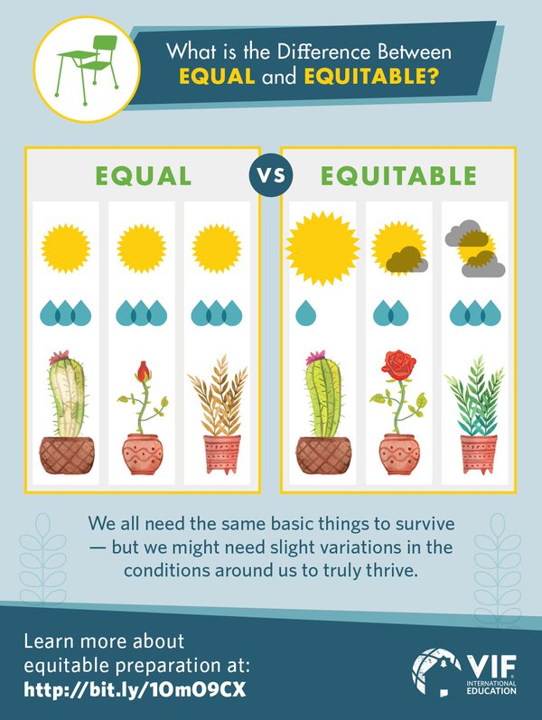
Notes:
- VIF International Education: Connect All Schools
- You do not and should not do this work yourself. Recruit the right partners.

Slide 15
Professional Learning/Development
Need for high-quality trainings
Stress adherence to protocols
Remember to enter GLOBE teachers into the database
Starting and completing a GLOBE workshop online is imperative!

Slide 16
GLOBE Trainings and Trainers
We need to offer a training/TTT schedule that is robust in order to build capacity and sustainability of the program.
This is resource-intensive.
Is this worth pursuing?

Slide 17
GLOBE Trainings and Trainers
  All activities must cover how to integrate GLOBE into what you already do!
  New partners: Introduction to GLOBE at the NARM
  Possible session at the annual meeting?

Slide 18
The GLOBE Trainer Pipeline
Action: Attend a teacher training by an experienced GLOBE Partner.
  Outcome: Become a GLOBE teacher.
Action: Attend a TTT with pedagogy explicit.
  Outcome: Become a candidate trainer.

Slide 19
The GLOBE Trainer Pipeline
Action: Assist in a teacher PD workshop as a candidate trainer.
  Outcome: Could become a trainer in certain protocols or areas (and Master Trainer candidate).
Action: Create and lead a teacher training with Master Trainer(s) observing.
  Outcome: Could become a Master Trainer in certain protocols or areas.

Slide 20
The GLOBE Trainer Pipeline
After Master Trainer status is attained in some protocols/areas, endorsement process for other protocols.
We need a robust calendar!
Bootcamps are additional PD for Partners - focused on diversity and equity promising practices. Those attending should already be a GLOBE teacher!

Slide 21
TTT/NARM 2018
PD offered will be Pedosphere.
Dates: 26-29 March 2018
Location: Purdue University
Recruit committee

Slide 22
Student Research Symposia (SRS)
Year | Projects | Students | Teachers | Partnerships
2016 | 67 | 164 | 38 | 24
2017 | 92 | 201 | 62 | 29
Total |  |  | 82 (unique) | 36 (unique)

Slide 23
Student Research Symposia
Geographic Area | Partnerships | Goal | Actual 2016 | Actual 2017 | Cumul-ative | % Goal Met (over 2 years)
Northwest | 14 | 7 | 4 | 5 | 5 | 71%
Pacific | 10 | 5 | 5 | 5 | 6 | 120%
Southwest | 36 | 18 | 2 | 3 | 3 | 16%
Midwest | 19 | 10 | 4 | 3 | 4 | 40%
Southeast | 25 | 13 | 4 | 7 | 8 | 62%
Northeast & Mid-Atlantic | 24 | 12 | 8 | 5 | 11 | 85%
Total | 128 | 65 | 27 | 28 | 37 | 57%

Slide 24
Student Research Symposia
Geographic Area | Goal -Participants (not including mentors & leadership team) | Actual 2016 | Actual 2017 | % Goal Met (2017)
Northwest | 7 teachers, 21 students | 4 Tchrs, 20 Sts | 3 Tchrs, 14 Sts | 43%, 67%
Pacific | 5 teachers, 15 students | 5 Tchrs, 17 Sts | 10 Tchrs, 18 Sts | 200%, 120%
Southwest | 18 teachers, 54 students | 7 Tchrs, 33 Sts | 9 Tchrs, 31 Sts | 50%, 57%
Midwest | 10 teachers, 30 students | 8 Tchrs, 40 Sts | 7 Tchrs, 33 Sts | 70%, 110%
Southeast | 13 teachers, 39 students | 4 Tchrs, 22 Sts | 9 Tchrs, 31 Sts | 69%, 79%
Northeast & Mid-Atlantic | 12 teachers, 36 students | 9 Tchrs, 32 Sts | 24 Tchrs, 74 Sts | 200%, 205%
Total | 65 teachers, 195 students | 37 Tchrs, 164 Sts | 62 Tchrs, 201 Sts | 95%, 103%

Slide 25
Science Class vs. Science Practices
“Psychometrically, students seem to conceptualize “science practices” differently from “science class.” Students were given a series of items that asked them to report their self-efficacy for science. Items varied, but included such things as “I am able to earn a good grade in science class” and “I am able to learn new things in science class” and “I am able to conduct peer review of my peers’ scientific work” and “I am able to analyze data.” When these items were subjected to an exploratory factor analysis, the items related to science class formed one factor and the items related to science practices formed a separate factor. These factors appear to be unrelated statistically, implying that students don’t view science practices as necessarily related to science class, and vice versa.”
Hadley Solomon
UNH Evaluator

Slide 26
Preliminary Data from SRS
Notes:
Value for Science in Blue. See no real change from pre- to post.
Self-Efficacy for Science increased (significantly) from 5.07 to 5.2.

Slide 27
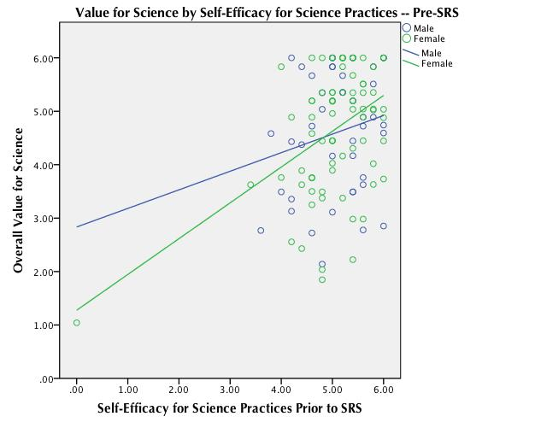
Preliminary Data from SRS
Notes:
This graph is the results of the regression model at Time 1 (pre-SRS). The blue line and dots represent male students; green for female. We can see on average, before the SRS, students with lower levels of self-efficacy for science practices also have lower levels of value for science more generally. This relationship is attenuated for female students, who report lower levels of both than their male counterparts. Interestingly, we see that as self-efficacy increases, value for science increases for both males and females, but at higher levels of self-efficacy, female students surpass their male counterparts in value for science—this suggests an interesting (possibly) interaction effect or that self-efficacy may be a more salient factor contributing to value for science for females than for males.
The relationship between these two variables (self-efficacy for science practices prior to SRS and overall value for science) is MODERATE: we see that for every unit increase in self-efficacy (1 point on the scale, for instance) we can expect a .37 unit increase in value for science (this is the effect size). So, for a student with average levels of self-efficacy for science practices (5.06 mean on scale) we expect average levels of value for science (4.62 on scale). For a student with a 6.06 on the self-efficacy for science scale, we would expect to see 4.99 on the value scale. Similarly, for a student with a 4.06 average level of self-efficacy for science, we would expect a 4.25 on the value scale. The OVERALL model accounts for about 13% of the variance in value for science.
These results differ a bit for males (effect size is .20; this means for males with a 4.06 for self-eff, we expect average value of 4.42) and females (effect size is .45; this means for females with a 4.06 self-efficacy, we expect to see 4.17 on value).
Translation: Self-efficacy for science practices before SRS is related to overall value for science. The relationship is moderately strong, but stronger for female students than male students. We can see that, on average, students with higher self-efficacy for science practices also have higher levels of value for science, and vice versa.

Slide 28
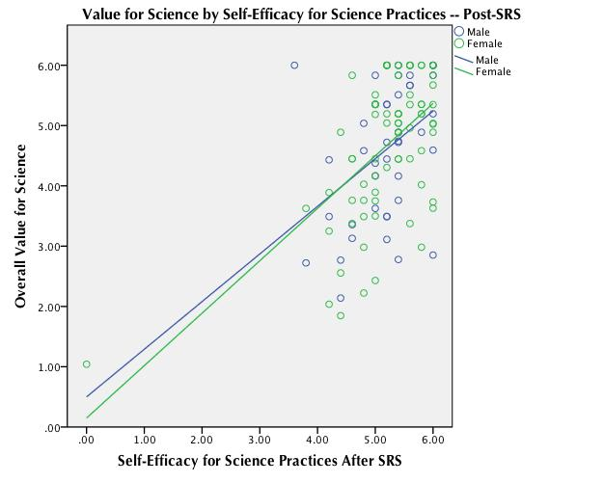
Preliminary Data from SRS
Notes:
Looking at the same relationships AFTER the SRS, we see that the relations between value for science and self-efficacy for science practices have become much more close, with self-efficacy for science practices predicting value for science more strongly than prior to the SRS. As with the first graph, blue lines and dots represent male students; green is female. As with the first graph, students reporting low levels of self-efficacy for science practices AFTER The SRS also report low levels of value for science, and vice versa. However, this time we see that overall value for science increases quickly as self-efficacy for science AFTER the SRS increases. Additionally, the differences in this relationship between males and females virtually disappears post-SRS. This suggests the SRS provided a particularly salient mastery experience for ALL students, but particularly for female students. The lines cross on the graph, suggesting the interaction effect is still present, but the difference between males and females is very, very marginal.
The relationship between these two variables (self-efficacy for science practices AFTER SRS and overall value for science) is STRONG: we see that for every unit increase in self-efficacy (1 point on the scale, for instance) we can expect an average .53 unit increase in value for science (this is the effect size). So, for a student with average levels of self-efficacy for science practices (5.21 mean on scale) we expect average levels of value for science (4.63 on scale). For a student with a 6.21 on the self-efficacy for science scale, we would expect to see a 5.16 on the value scale. Similarly, for a student with a 4.21 average level of self-efficacy for science, we would expect a 4.1 on the value scale. OVERALL (for both males and females together), this model accounts for 28% of the variance in overall value for science.
These results differ a bit for males (effect size is .60; this means for males with a 5.19 average for self-efficacy for science practices AFTER SRS, we expect average value of 4.60) and females (effect size is .81; this means for females with a 5.21 self-efficacy for science practices AFTER SRS, we expect to see 4.68 on value).
The OVERALL model accounts for about 28% of the variance in value for science.

Slide 29
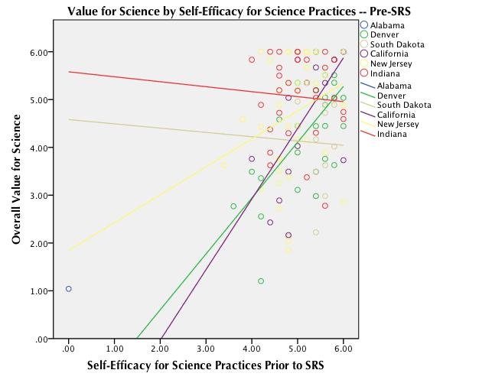
Preliminary Data from SRS
Notes:
This chart visualizes the regression modeling at the site level. As we can see from this visual, prior to the SRS, there was wide variance in the relations between self-efficacy for science practices and overall value for science. Some sites even showed a negative relationship between these variables for students.
***NOTE to JEN: This graph is a visual for illustrative purposes only. Parsing out the results from the regressions at the site level is statistically not very meaningful because the sample sizes are small at those levels, so interpretation needs to be cautious and that’s why I don’t provide specific stats. I think these graphs do show us, visually, that the relationships are changing as a result of the SRS and in the right direction, so I included it.****

Slide 30
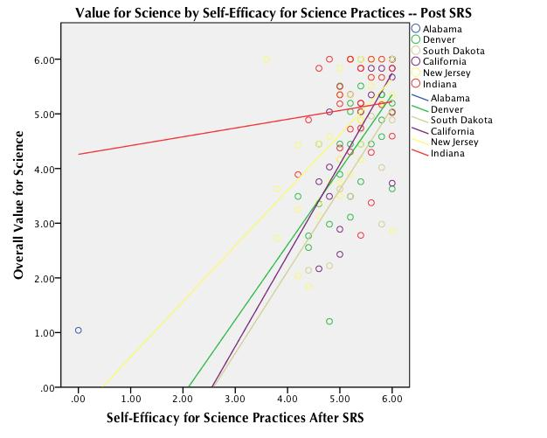
Preliminary Data from SRS
Notes:
Post-SRS, we see that all of the sites have students reporting a positive relationship between self-efficacy for science practices and value for science.
***NOTE to JEN: This graph is a visual for illustrative purposes only. Parsing out the results from the regressions at the site level is statistically not very meaningful because the sample sizes are small at those levels, so interpretation needs to be cautious and that’s why I don’t provide specific stats. I think these graphs do show us, visually, that the relationships are changing as a result of the SRS and in the right direction, so I included it.****

Slide 31
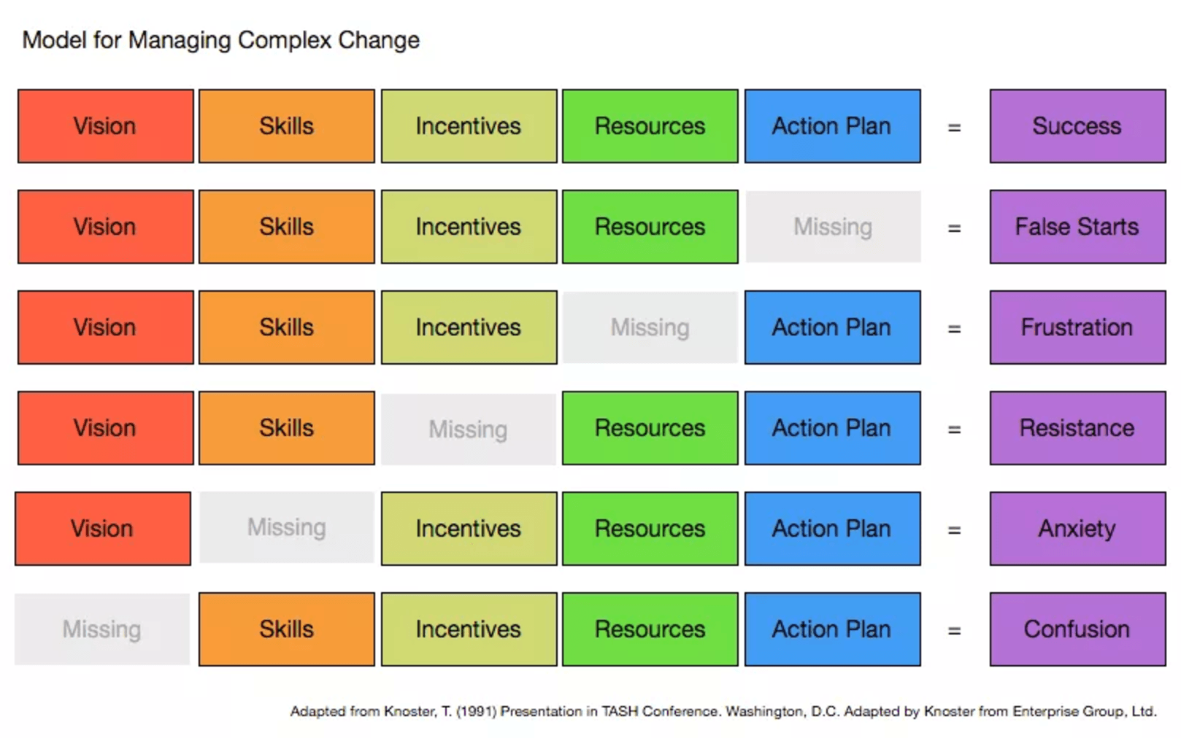
http://www.kathyperret.org/2015/03/04/managing-complex-change/

Slide 32
Discussion Topics
How do we improve the quality of workshops that Partners provide?
How/where do we provide a library of resources for partners to use?

