Slide 1
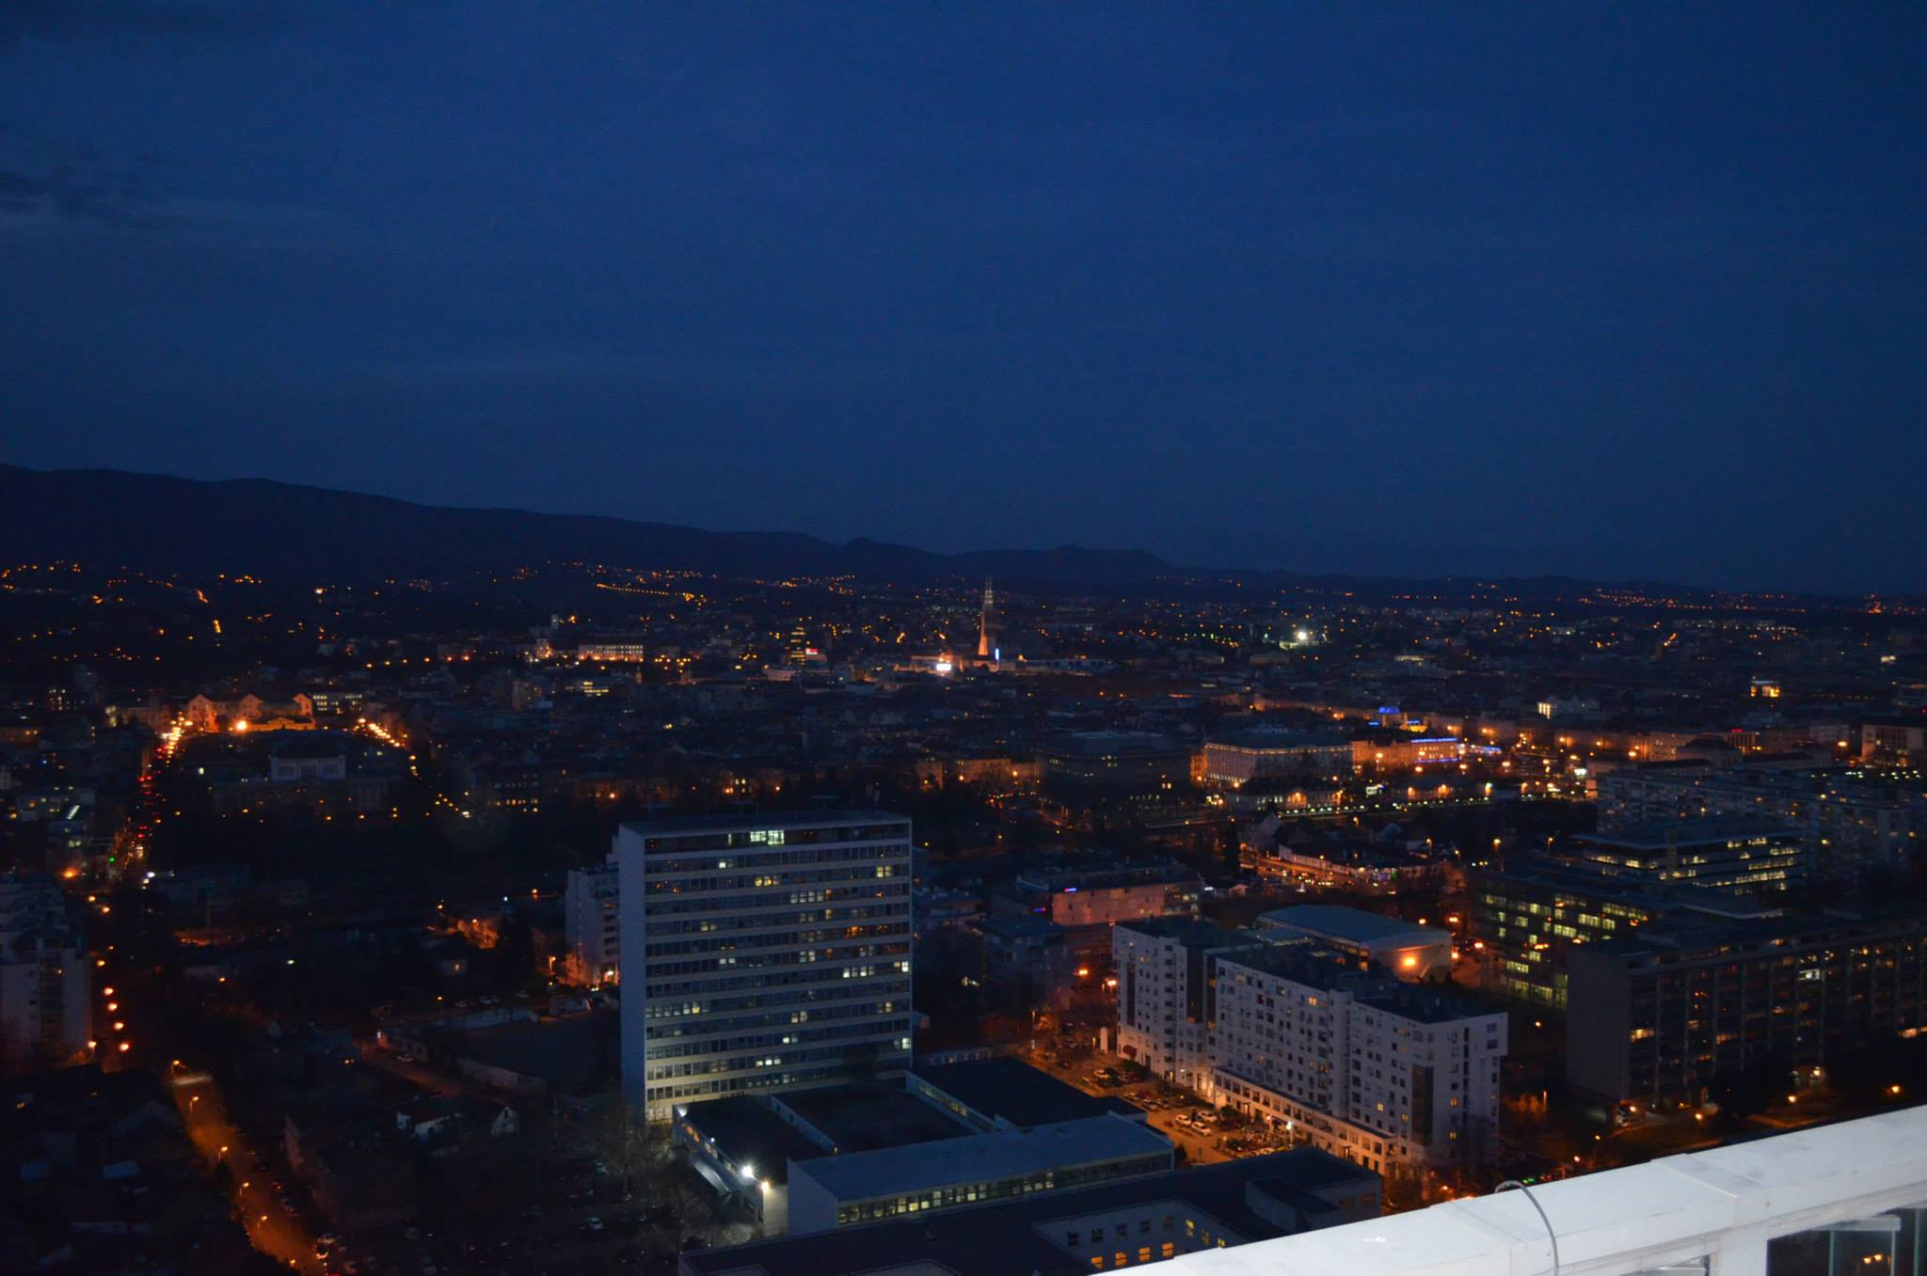


Light pollution and our sleep
Notes:
International Dark Sky Association (IDA) defines light pollution as the inappropriate or excessive use of artificial light which has harmful impact on environment, humans, wildlife and climate. It’s components are
Glare – excessive brightness that causes visual discomfort
Skyglow – brightening of the night sky over inhabited areas
Light trespass – light falling where it is not intended or needed
Clutter – bright, confusing and excessive groupings of light sources

Slide 2
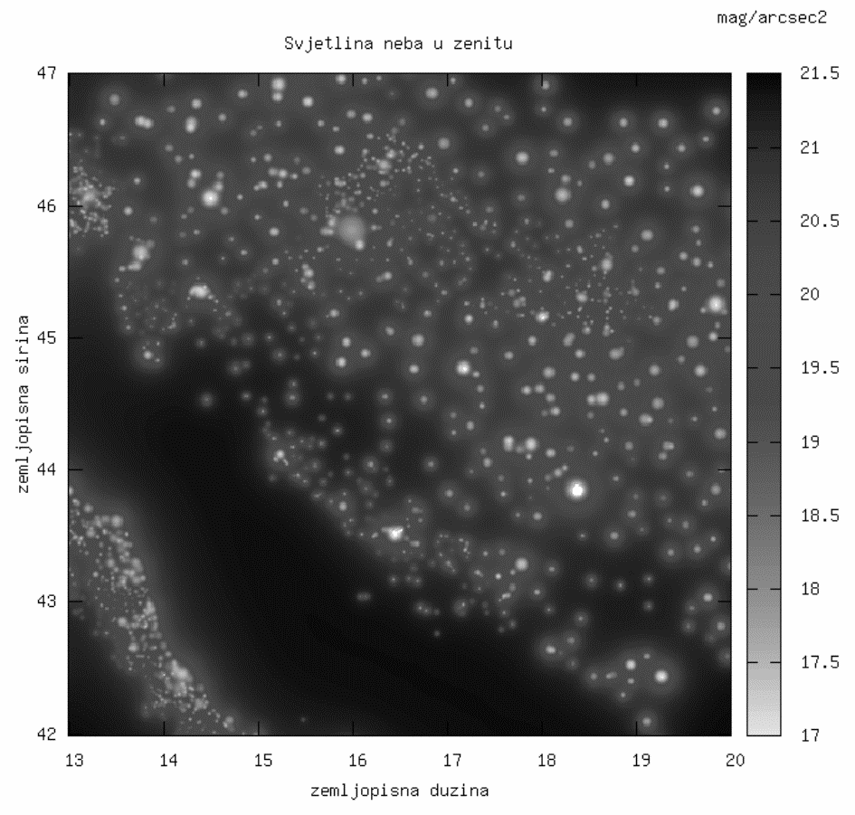
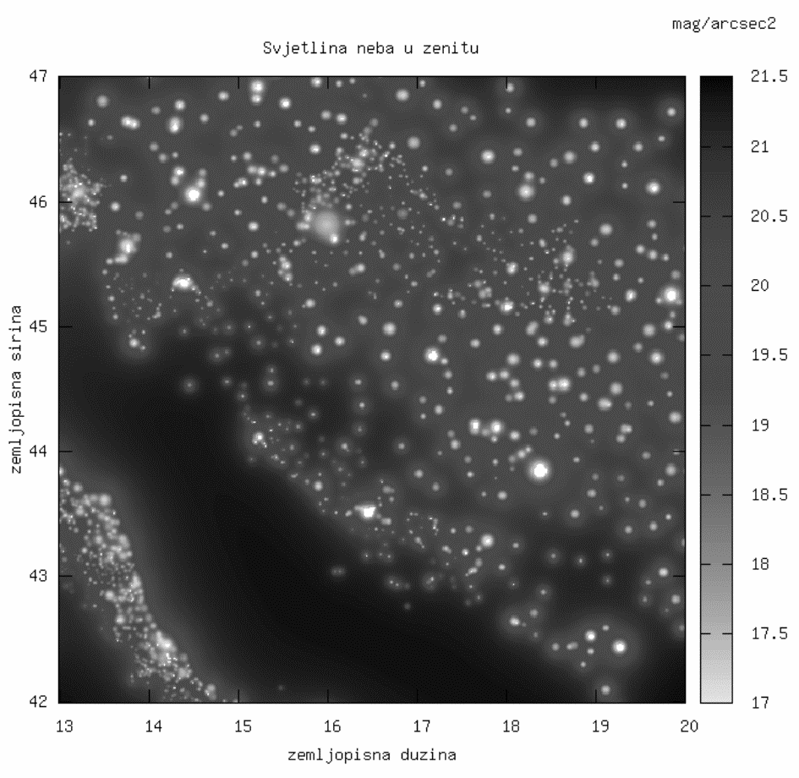
Notes:
The brightness of the night sky is defined as shine of the stars whose light, divided by the surface of the celestial sphere of one square arc-second (3600-you part 1 degree), gives the correct brightness of the sky..
At this scale, the natural brightness of the night sky is in the most favorable case (dark, clear night during solar minimum) about 21.9 mag / arcsec2 (magnitude of the arc per second squared)
Image 1.Natural brightness of the night sky over Croatia. The map is coded in shades of gray: black suits for natural sky, a white for lighting, while image 2 shows predicting the brightness of the night sky above the Croatia for the year 2020, assuming a 50-percent increase in power artificial lighting in a decade
Areas that still possess natural brightness of the night sky are small and isolated, mainly situated on the open Adriatic Sea, including several areas in Lika and Gorski Kotar (central mountain area). These places still have the night sky darker than 21 mag / arcsec2.

Slide 3
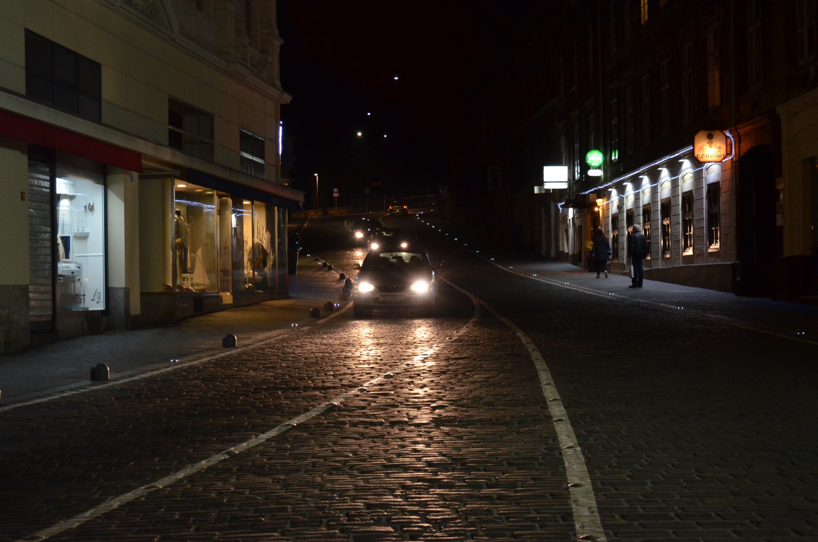
Katadiopters, Mesnička street, center of Zagreb
Notes:
In our research area we meet with stronger and stronger light pollution, and because it's negative influence on physiology of plants and animals, as well as on life course we wanted to find out could we prove it's influence on sleeping disorder, too. We were researching that problem in our environment using GLOBE protocols for those type of measurements.

Slide 4
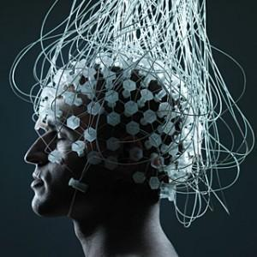
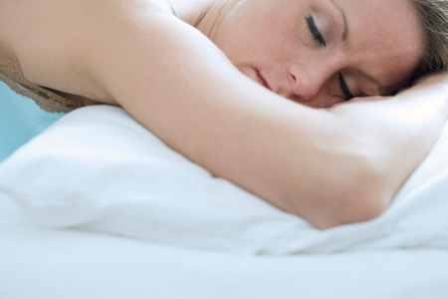
Negative impact on human health
Notes:
Our body naturally produces many hormones, including melatonin, which is produced when the body is in total darkness. Melatonin is found in almost all species and acts as an anti-oxidant.
If artificial light comes into the room where we sleep it can disrupt production of melatonin, which regulates our day-night rhythm. Disorder in secretion of melatonin may cause sleep disorders, headaches, fatigue, anxiety, stress ... and there is a connection with some types of cancer, and sometimes even occurs a blindness of an eye exposed to this type of pollution ...

Slide 5
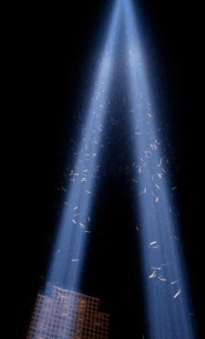
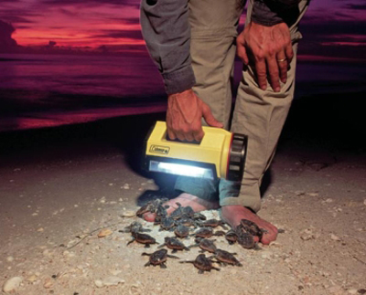
Negative impact on the ecosystem
Notes:
Due to light pollution there is a disturbance in the natural cycle of day and night. Disturbed is one of the basic factors of life in nature (Cycle of work / eating and rest / sleep). Similar things happen to animals and plants. Nights are gone, the day became unbearably too long.
The result is a dying of animal and plant populations ...

Slide 6
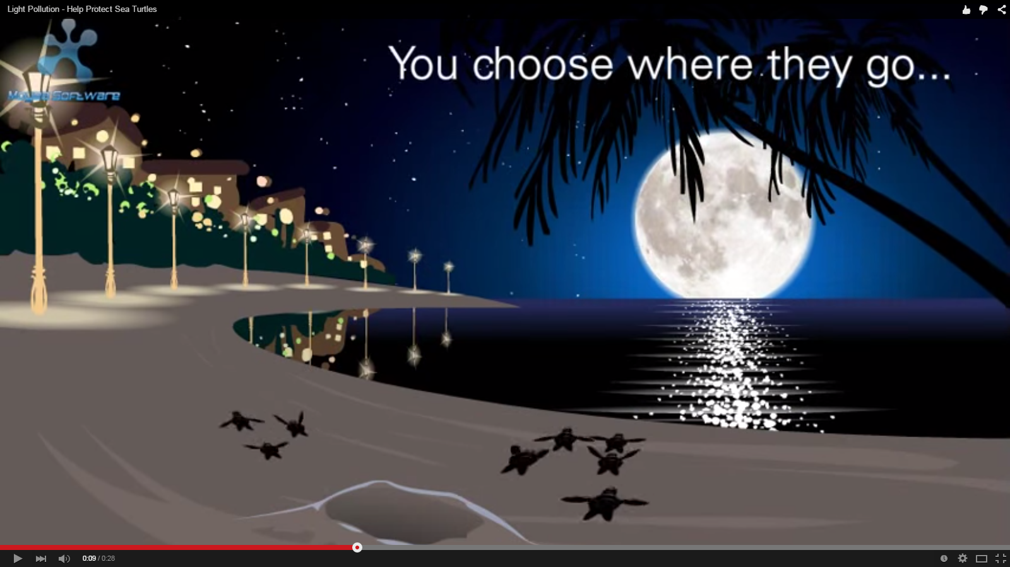
Notes:
Animals lose their orientation without starry sky. Bright lights will blind them, and many
colliding with a variety of buildings and obstacles (towers, trees, power lines, ...)

Slide 7
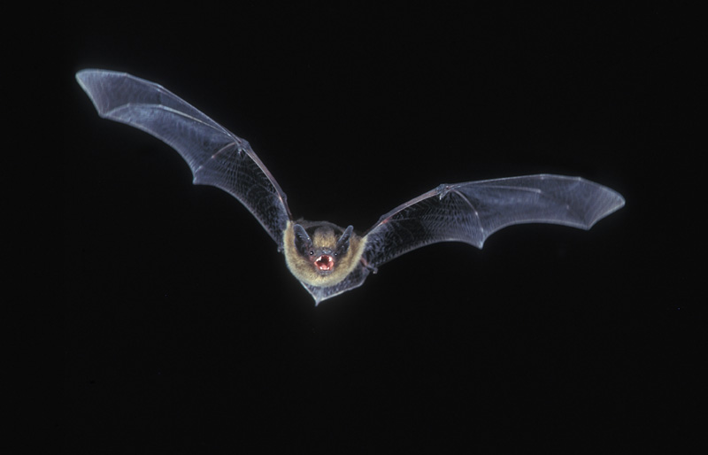
Notes:
Annually more birds suffer because of light pollution then because of other environmental disasters.

Slide 8
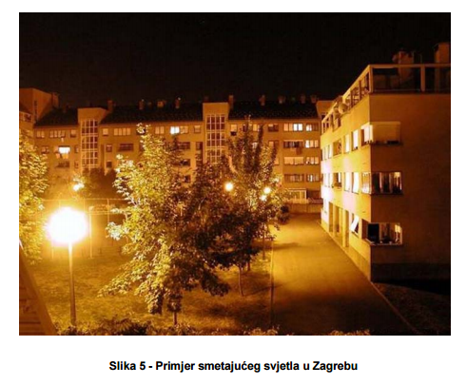
What makes outdoor lighting?
street lighting
lighting highway
lighting in parks
lighting in stadiums
lighting in parking lots
lighting landscape
lighting residential areas
lighting office buildings
lighting hiking and biking trails
Notes:
There is an image of few outdoor lightings combined in a small area, which causes a large impact on wider environment

Slide 9
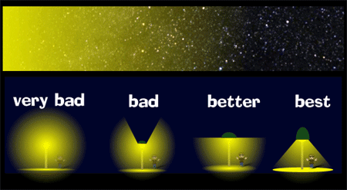
Notes:
Types of street lighting sorted according the types of a light pollution that they produce

Slide 10
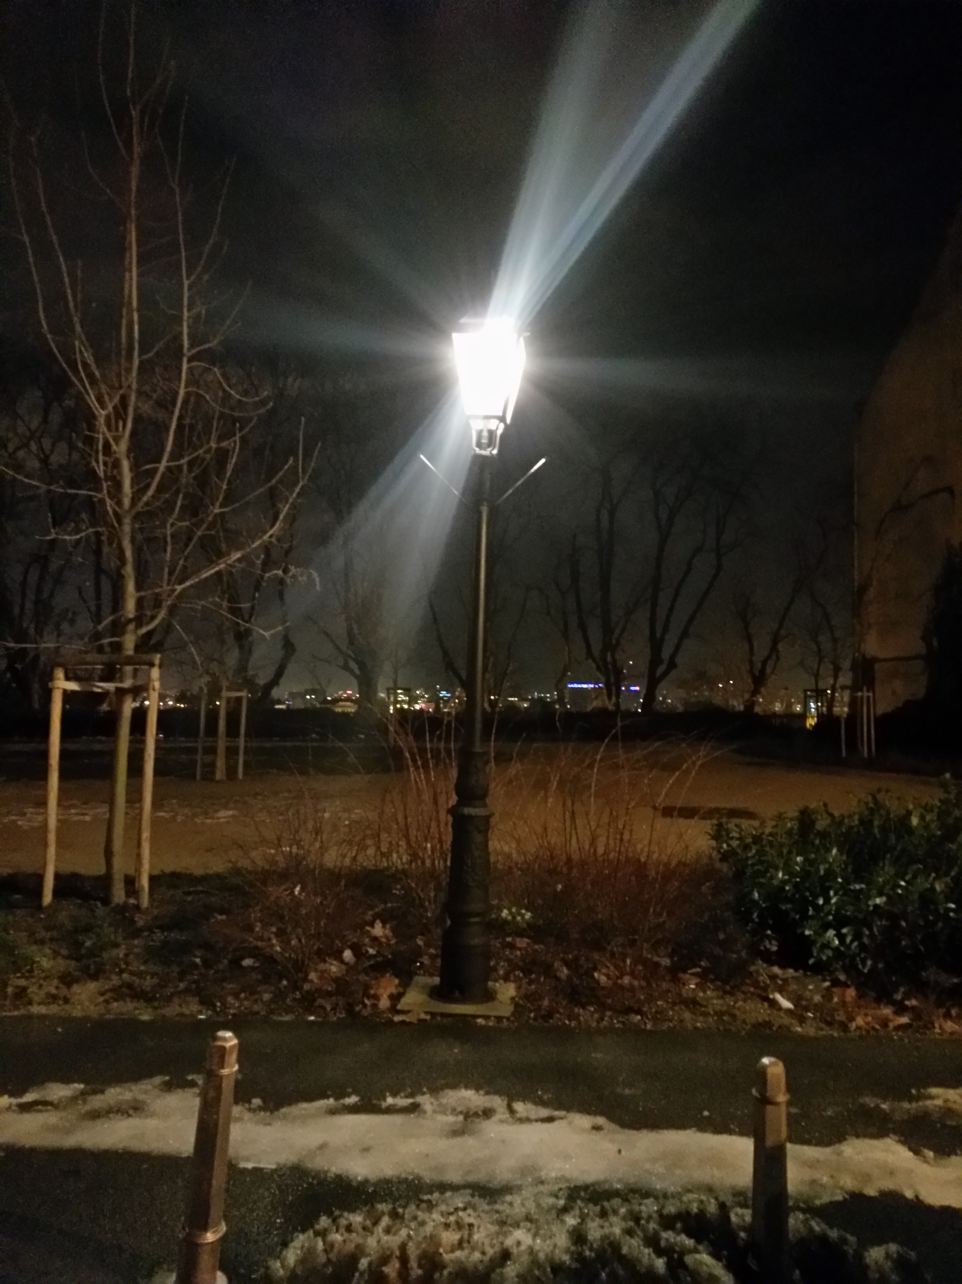
Law on Road Traffic Safety
"(1) On the road may not be installed boards, signs, lights,
poles or other similar objects that are obscured or
reduces the set of road signs, or that its shape, color, appearance or place setting mimic a road sign, or look like one
traffic sign, or blind road users, or
divert their attention to the extent that can be dangerous
for traffic safety."
Notes:
The problem of light pollution is a new one and Croatia's legislation in this area is very limited. Currently, only the blinding artificial light is mentioned in Art. 15 of the Law on Road Traffic Safety [26], whose first paragraph we quoted. Light pollution is also stated in the Law on Environmental Protection
Unfortunately, in practice, those articles are certainly not carried out.

Slide 11
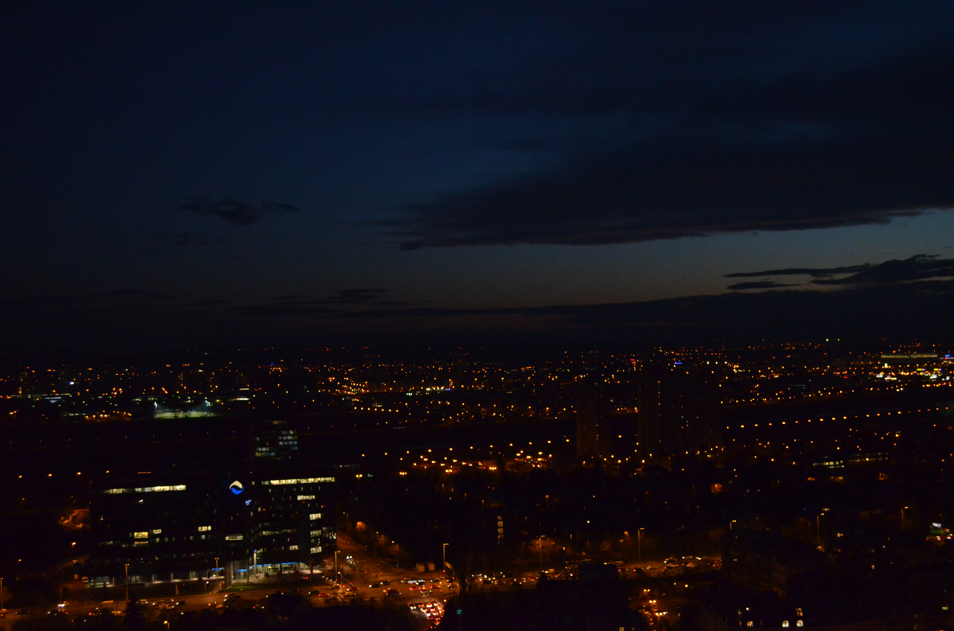
Hypothesis
There is a causal connection between light pollution and disrupted sleep.
The intense of that pollution is stronger in center of the city than in wider area.
Air humidity affects the visibility of the night sky.
Notes:
We pointed out several research questions. First we wanted to find out if there is any causal connection between light pollution and dispruppted sleep, common signs of fatigue or sleeping disorder. We also wanted to see if the intense of that pollution is stronger in center of the city than in wider area, and if perhaps air humidity affects the visibility of the night sky.
Then we made 3 hypothesis.
We assumed that the light pollution is stronger in center than in wider area, that is inversely proportional to the amount of air humidity and that it affects sleeping quality.

Slide 12
Observed constellation | Dates
Orion | 20.01.2014. - 29.01.2014.
Orion | 19.02.2014. - 28.02.2014.
Orion | 21.03.2014. - 30.03.2014.
Leo | 20.04.2014. - 29.04.2014.
Cygnus | 15.09.2014. - 24.09.2014.
Pegasus | 14.10.2014. - 23.10.2014.
Perseus | 12.11.2014. - 21.11.2014.
Orion | 11.01.2015. - 20.01.2015.
Orion | 09.02.2015. - 18.02.2015.
Orion | 11.03.2015. – 20.03.2015
Notes:
Our research methods were to collecte the data using GLOBE at night protocole and observation calendar; visibility of the stars (aestimated in magnitude from 0-7) was observed by students from classes 1.A, 2.A, 2.B i 3.A in following cycles
At geography, history and Latin classes students learned a lot of a mithology, astrology, sky observing and religion etc. in European and Croatian culture from early human ages till now days.

Slide 13
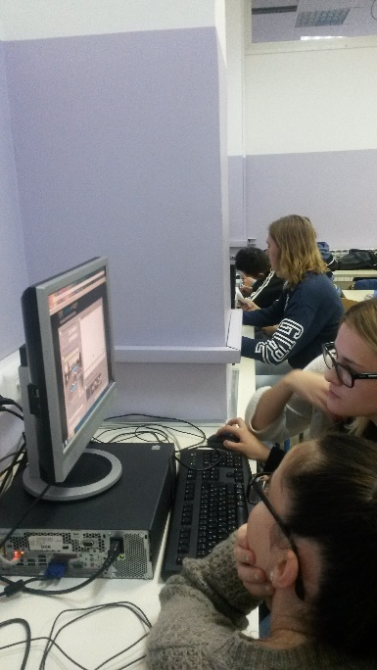
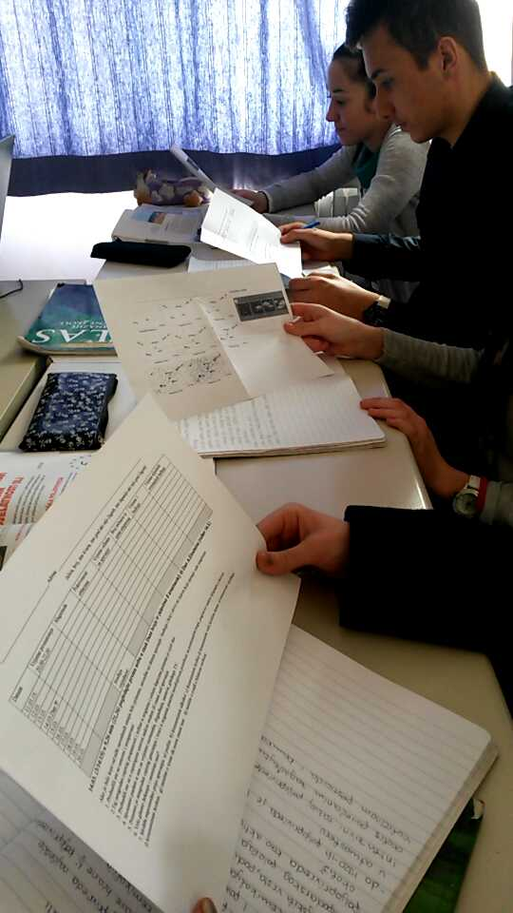
109 students
2 school years
10 cycles
6270 data
Notes:
There were 109 student involved in observing during 2 school years. In last 4 cycles of visibility measuring 77 students also answered sleeping quality criteria questionnaire

Slide 14
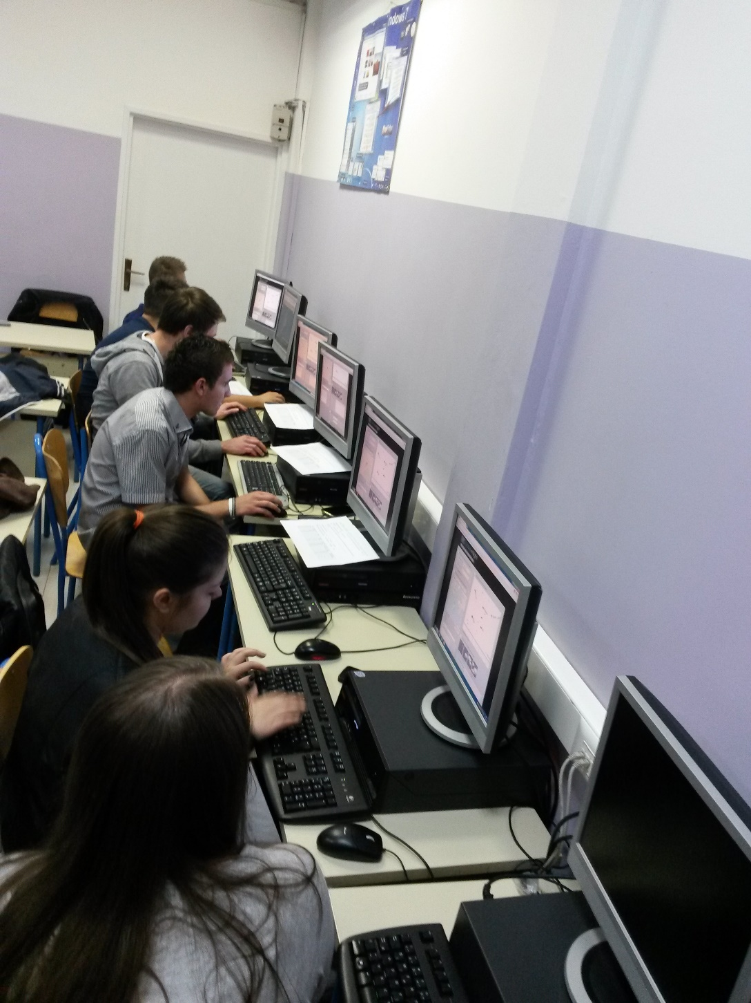
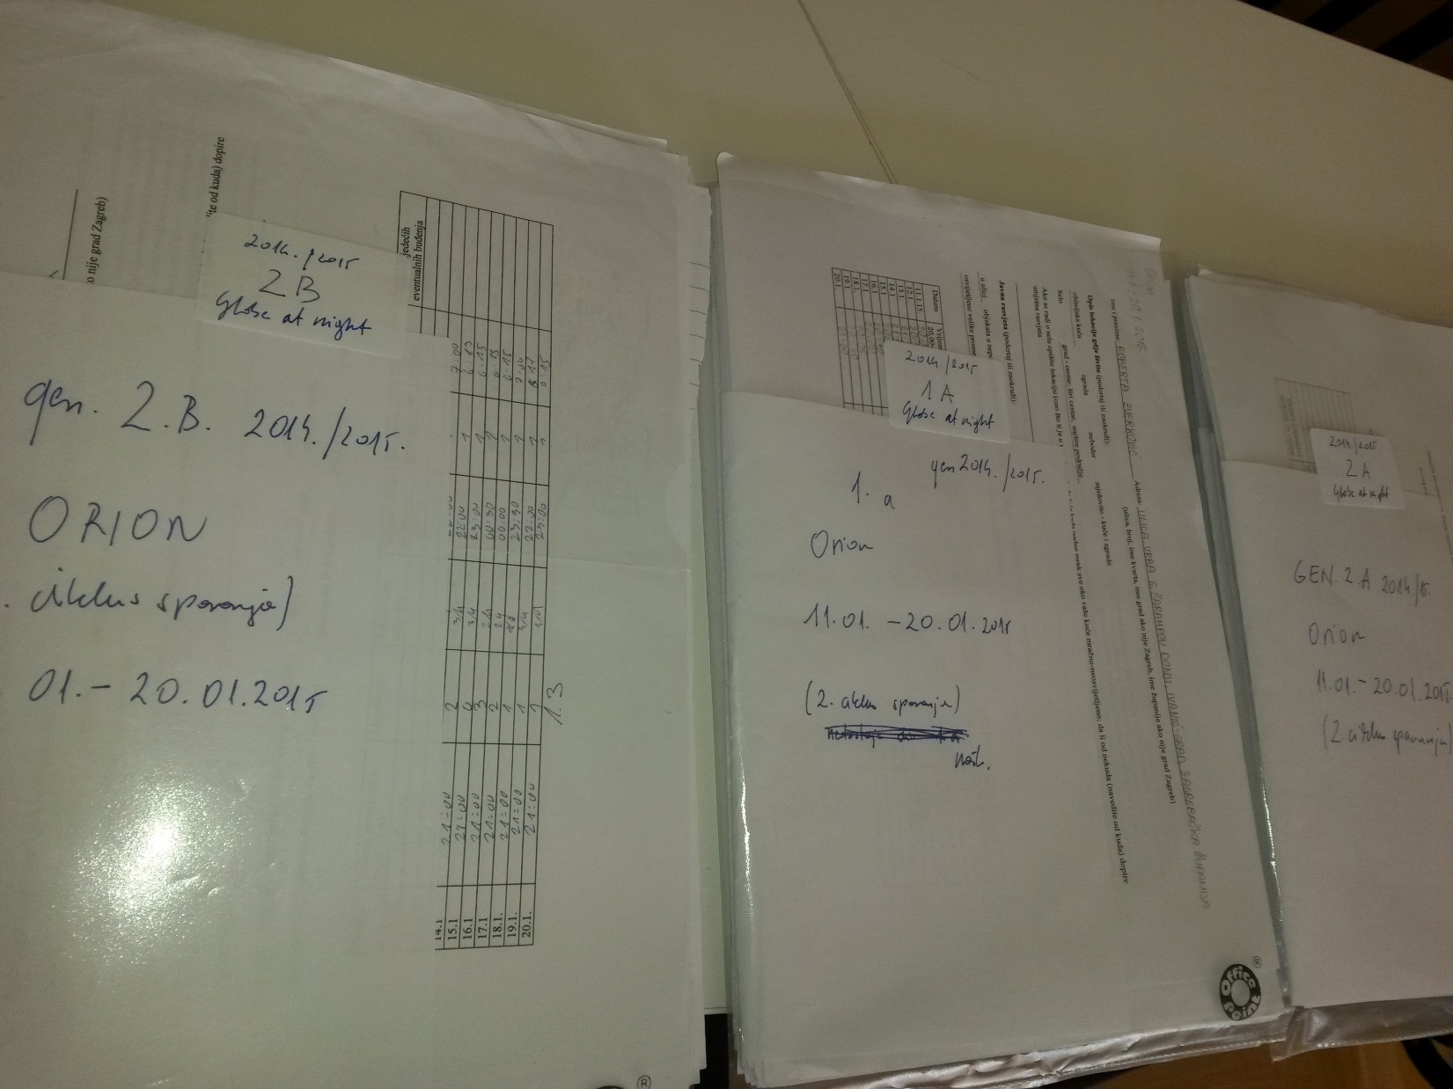
Notes:
At informatic classes number of students put the data in a GLOBE data base, processed them and made charts

Slide 15
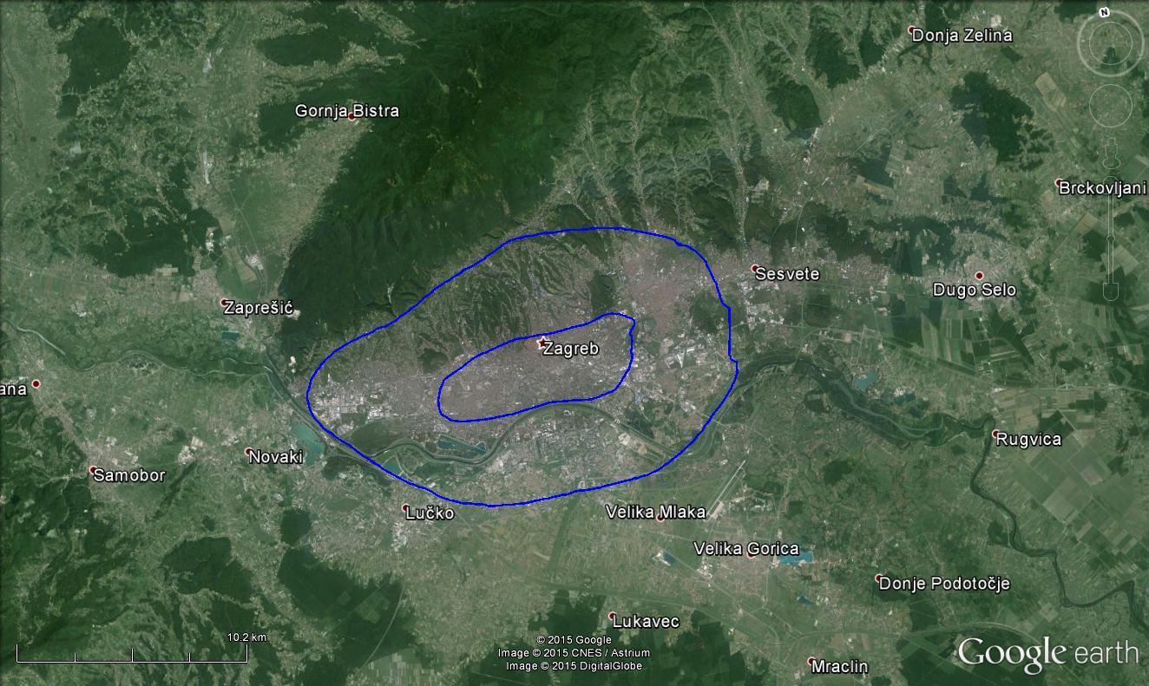
wide center
wider area
inner center
Notes:
We divided the city in 3 zones: inner center (18 students as observers), wide center (31 student) and wider area (60 students), according to city map.
They performed 6270 measurements.

Slide 16
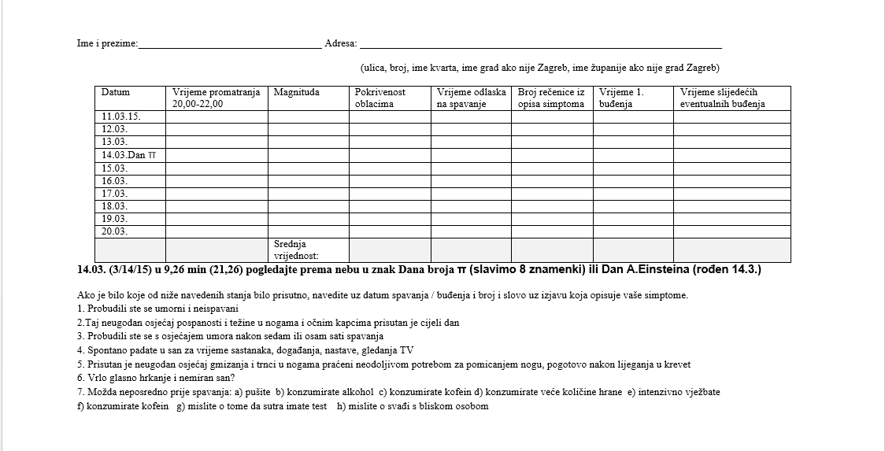
Notes:
In a questionnaire we made described were: type of settlement, position of a bed related to public lighting and other sources of artificial lightning.
We also recorded sleeping quality and possible causes for lack of sleeping.

Slide 17
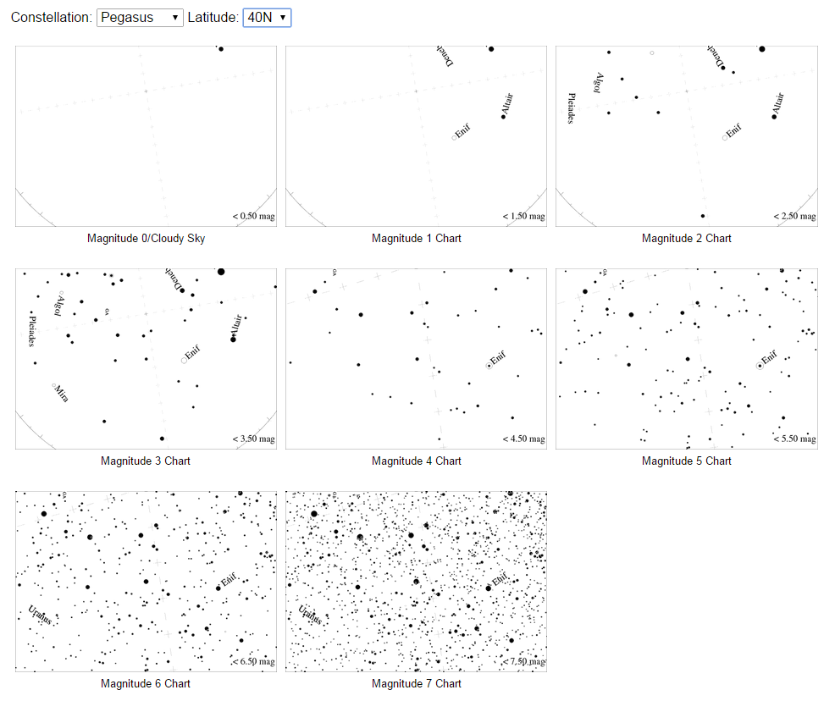
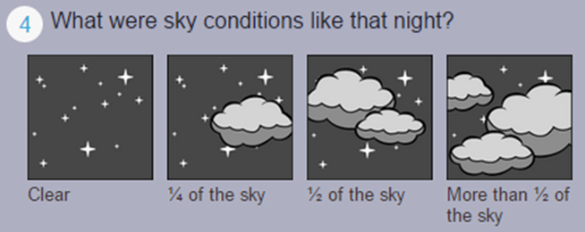

IME I PREZIME_________________________________________________Razred_________________
ADRESA (VELIKA SLOVA)_________________________________________________________________
ZVIJEŽĐE PEGASUS – POGLEDAJTE PREMA NEBU U PRAVCU SJVEROISTOKA I PRONAĐITE 4 JEDNAKO
SJAJNE ZVIJEZDE KOJE TVORE KVADRAT
Notes:
Those where the working sheets for students, so they could easily compare the visibility magnitude and cloude cover values

Slide 18
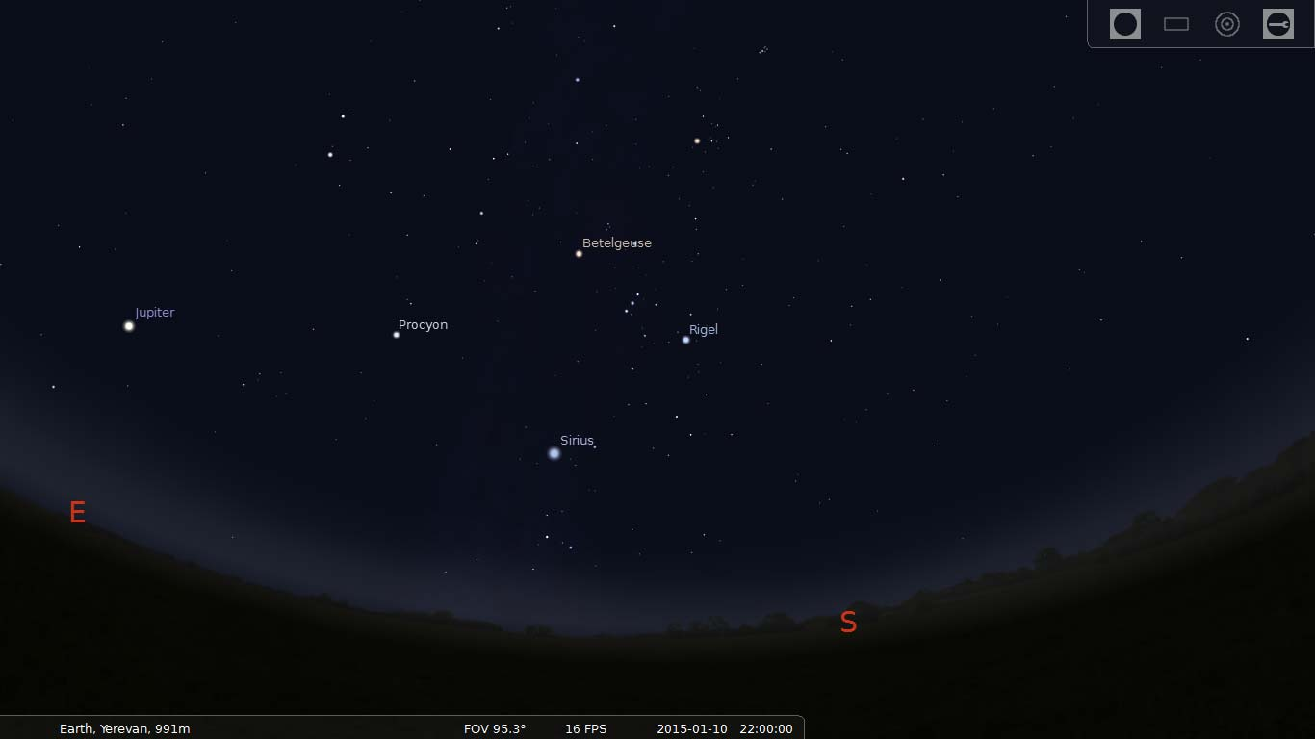
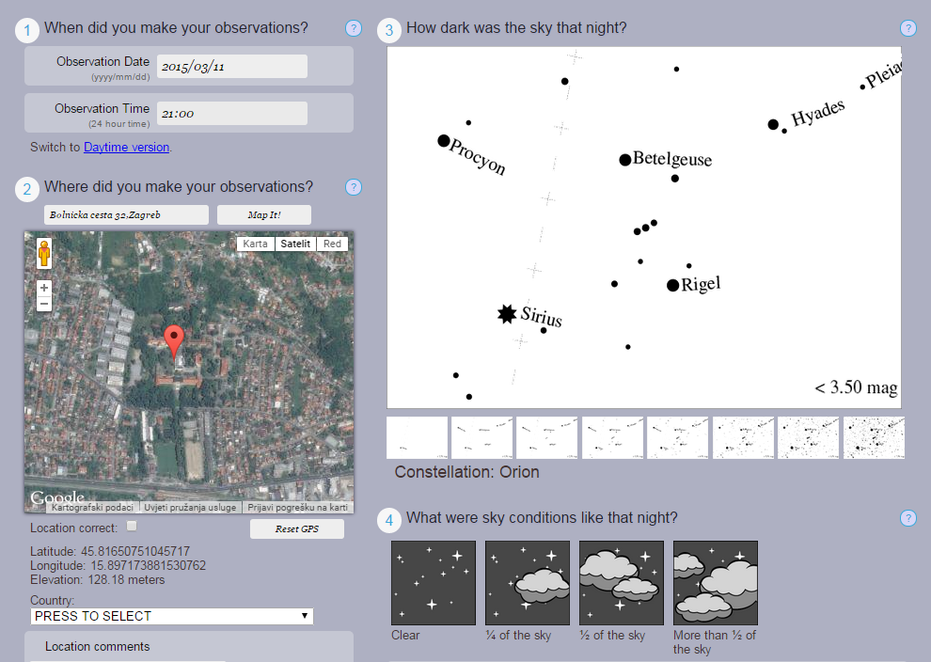

Slide 19
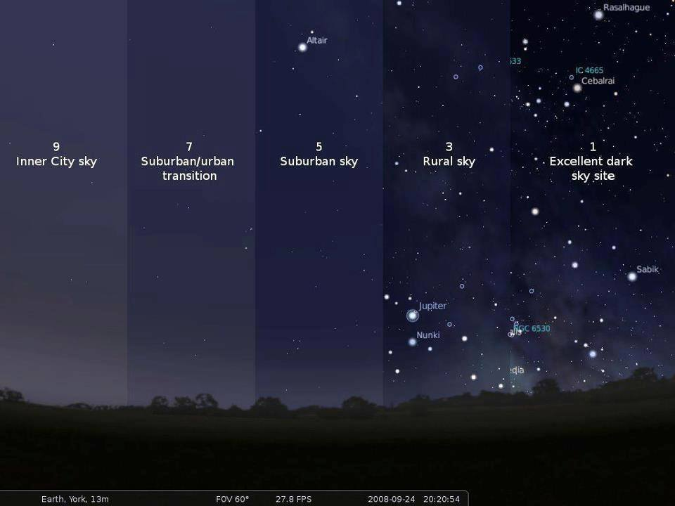

Slide 20
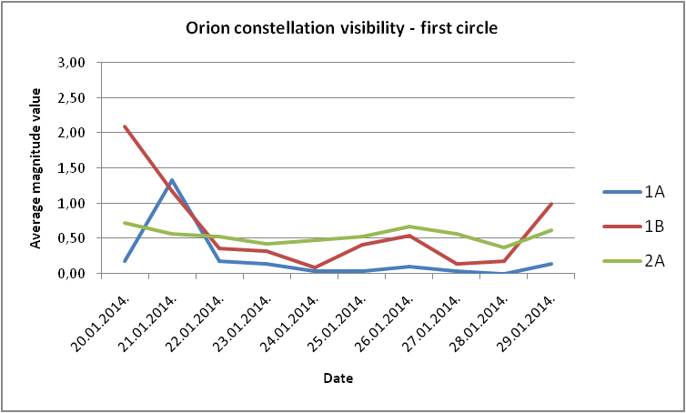
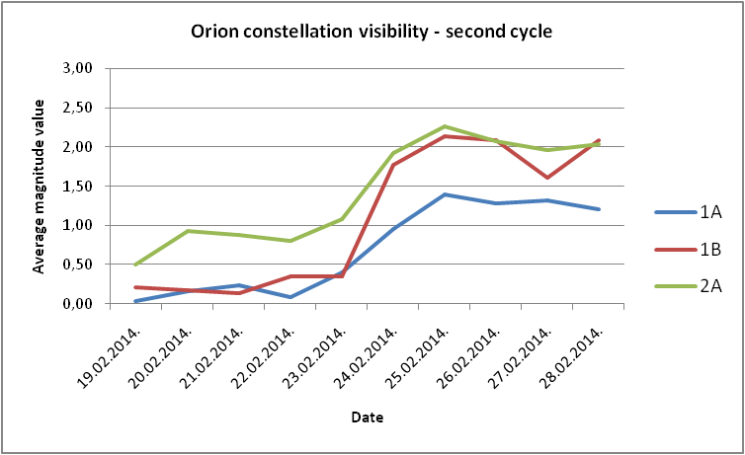
Notes:
Collected data were statistically analyzed, shown in charts and tables. All stages and most interesting events are documented with photos, too.
Collected data about magnitudes values were statistically analyzed and graphicaly presented for each group so that we could see if every group noticed the same visibility trend.

Slide 21
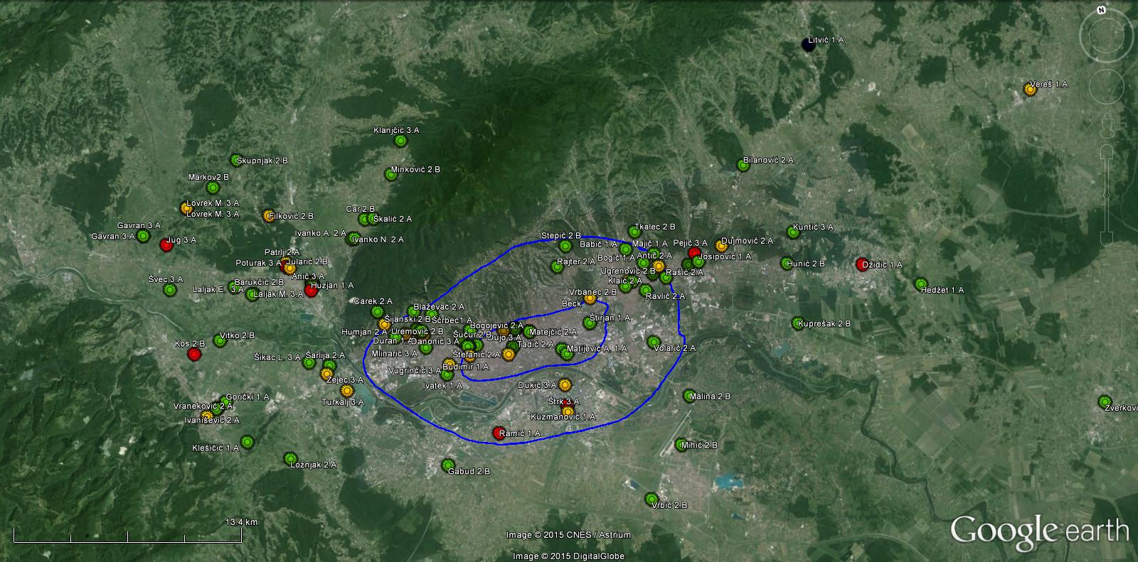
Average magnitude 0 – 1
Average magnitude 2 – 3
Average magnitude 1 – 2
Average magnitude > 3
Notes:
Each student located his position on a map using Google Earth program and GLOBE protocol, and he is marked with appropriate colour according to his average magnitude.
We calculated the average magnitude for all cycles and divided those values in 4 groups signed by colours – yellow, green, red and purple

Slide 22
Inner center
Wide center
Wider area
 | Students in inner center | Ʃ average magnitude value | Average magnitude
1 | Beck Ira | 0,78 | 1,17
2 | Belajec Matea | 0,71
3 | Budimir Luka | 0,90
4 | Danonić Marijana | 1,60
5 | Dujo Kristijan | 1,23
6 | Jurković Antonia | 1,05
7 | Košić Antonija | 1,04
8 | Kuprešak Antonio | 1,43
9 | Matejčić Karlo | 0,76
10 | Matijević Ana | 1,77
11 | Matijević Ena | 1,26
12 | Obrovac Andro | 0,78
13 | Posavec Matija | 1,30
14 | Rajniš Ivana | 1,01
15 | Štefanić Aleksandra | 0,53
16 | Štirjan Iva | 1,42
17 | Šućur Irena | 1,60
18 | Tadić Ivana | 1,83
 | Students in wide center | Ʃ average magnitude value | Average magnitude
1 | Andrić Filip | 0,45 | 1,26
2 | Antić Collina Mary | 0,77
3 | Babić Ana | 1,20
4 | Blaževac Katarina | 1,15
5 | Bogić Fran | 1,84
6 | Bogojević Dominik | 1,00
7 | Čolo Lucija | 0,67
8 | Dukić Novoselić Alan | 0,90
9 | Duran Anita | 0,94
10 | Humjan Iva | 1,10
11 | Ivatek Sara | 1,60
12 | Jovanović Milica | 1,31
13 | Klaić Bruno | 0,98
14 | Kuzmanović Tin | 2,48
15 | Majić Stipo | 1,92
16 | Mlinarić Dino | 1,95
17 | Rajter Paula | 1,52
18 | Ramić Ivan | 2,02
19 | Rašić Mara | 1,19
20 | Ravlić Maik | 1,20
21 | Stepić Doris | 1,25
22 | Sužnjević Dorian | 1,50
23 | Šćrbec Lucija | 1,17
24 | Šijanski Luka | 0,88
25 | Štrk Petra | 0,10
26 | Telinec Paula | 1,63
27 | Ugrenović Petra | 1,62
28 | Uremović Ivana | 1,31
29 | Volarić Ana | 1,36
30 | Vrbanec Anamarija | 1,34
31 | Vugrinčić Sandro | 0,80
 | Students in wider area | Ʃ average magnitude value | Average magnitude
1 | Anić Martina | 1,90 | 1,42
2 | Barišić Marijana | 1,88
3 | Barukčić Matej | 1,55
4 | Bilanović Jelena | 1,43
5 | Bošnjak Martina | 1,20
6 | Car Petra | 1,10
7 | Carek Philip | 1,57
8 | Dujmović Tin | 0,97
9 | Džidić Sandra | 2,02
10 | Filković Patricia | 0,90
11 | Gabud Ana Marija | 1,64
12 | Gavran Marina | 1,87
13 | Gorički Sara | 1,58
14 | Hedžet Petra | 1,95
15 | Hunić Mirela | 1,32
16 | Huzjan Nikolina | 2,02
17 | Ivanišević Mihael | 1,03
18 | Ivanko Antonela | 1,24
19 | Ivanko Nikola | 1,50
20 | Josipović Amarela | 1,83
21 | Jug Barbara | 2,40
22 | Jularić Filip | 2,07
23 | Juratovac Matej | 0,90
24 | Klanjčić Patricia | 1,44
25 | Kleščić Josip | 1,75
26 | Kos Sebastijan | 2,01
27 | Košić Karla | 1,68
28 | Kuntić Ana | 1,10
29 | Kuten Lucija | 1,09
30 | Laljak Eugen | 1,65
31 | Laljak Mario | 1,65
32 | Litvić Karlo | 3,26
33 | Lovrek Martina | 0,80
34 | Lovrek Matea | 1,58
35 | Ložnjak Karlo | 1,21
36 | Maleković Marta | 1,65
37 | Malina Petra | 1,53
38 | Marić Antonija | 0,20
39 | Markov Luka | 1,46
40 | Mihić Maja | 1,25
41 | Minković Michaela | 1,03
42 | Patrlj Neda | 0,83
43 | Pejić Ana | 2,10
44 | Poturak Laura | 0,60
45 | Relić Diana | 2,08
46 | Skupnjak Bruno | 1,21
47 | Smiljanec Tea | 1,08
48 | Šarlija Ana | 1,39
49 | Šikac Lana | 1,08
50 | Šikac Satti Katja | 1,27
51 | Škalić Nikola | 1,37
52 | Švec Karla | 1,20
53 | Tkalec Barbara | 1,24
54 | Turkalj Dora | 0,75
55 | Vereš Vanna | 0,90
56 | Vitko Ivona | 1,36
57 | Vraneković Mia | 0,94
58 | Vrbić Dajana | 1,04
59 | Zajec Ana | 0,93
60 | Zverković Roberta | 1,73
1,17
1,26
1,42
Notes:
We compared mean magnitudes between students in inner an wide center and with those from wider area. We put together results for the same area and calculated mean magnitude for each area to verify the hypothesis. We could see that minimum visibility was in inner center - mean magnitude from 1,17, and maximum visibility was in wider area - mean magnitude from 1,42

Slide 23
Daily average magnitude value for Orion constelation
Average magnitude
Date
Inner center
Wide center
Wider area
Notes:
IWe also calculated daily mean magnitudes for Orion constellation (11.1.2015. – 20.1.2015.) according to students locations and presented them in a chart. From that chart we could see that the maximum values are in wider area and that there are no big differences between inner and wider center

Slide 24
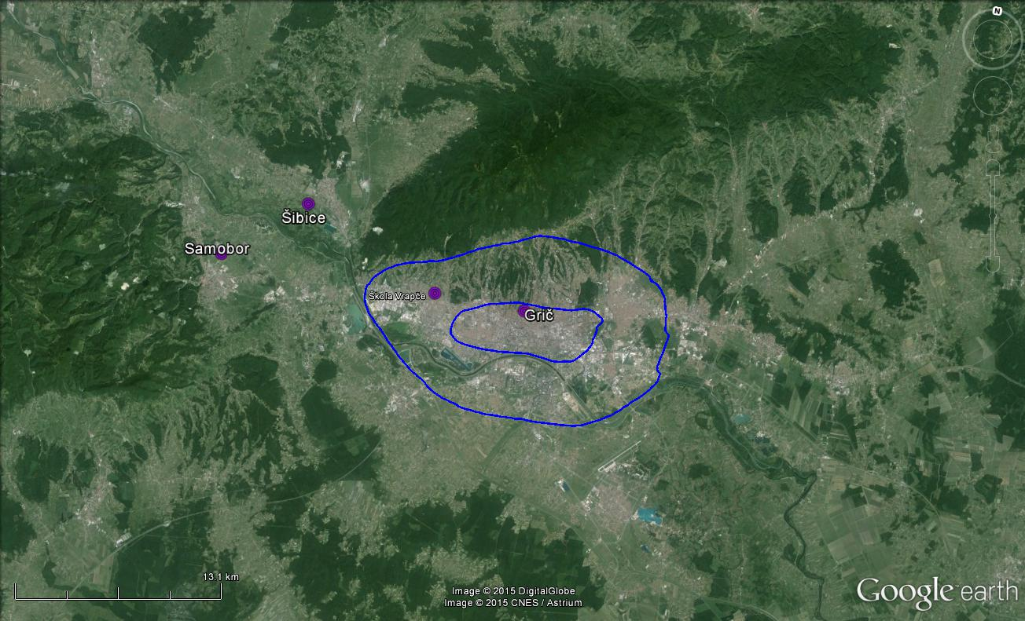
Notes:
According the locations of measuring stations we choose students whose visibility data for Orion, in period from 11.1.2015.-20.1.2015., we than compared with air humidity data recorded at 21,00. because we red in literature that the air humidity can enlarge the light pollution. Those data were downloaded from our GLOBE base (DAVIS-meteorological station - 138 m elev.) and from National hydro-meterological institute data base (main meteorological station Zagreb – Grič – 157 m elev., climatological station Samobor – 141 m elev. and climatological station Šibice – 133 m elev.)

Slide 25
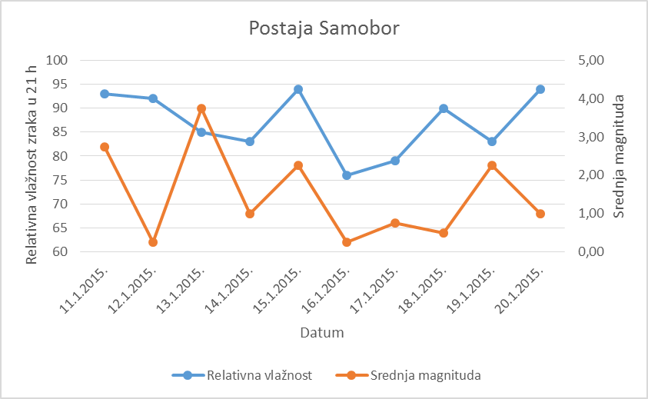
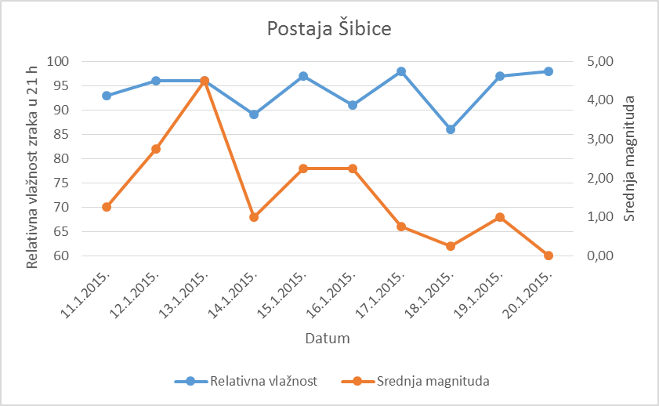
Graphical representation for relative air humidity at 21,00 at Samobor and Šibice stations and mean magnitude of Orion's visibility comparison
Samobor weather station
Šibice weather station
Relative air humidity at 21 h
Relative air humidity at 21 h
Average magnitude
Average magnitude
Date
Date
Relative humidity
Average humidity
Relative humidity
Average humidity
Notes:
From charts in pictures we could see that relative air humidity and mean magnitude are not connected.

Slide 26
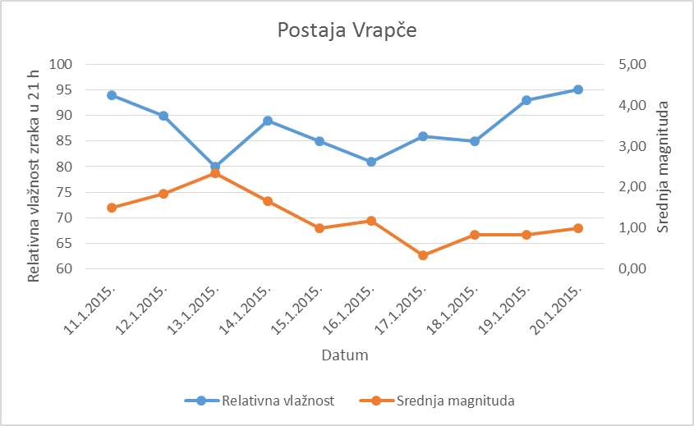
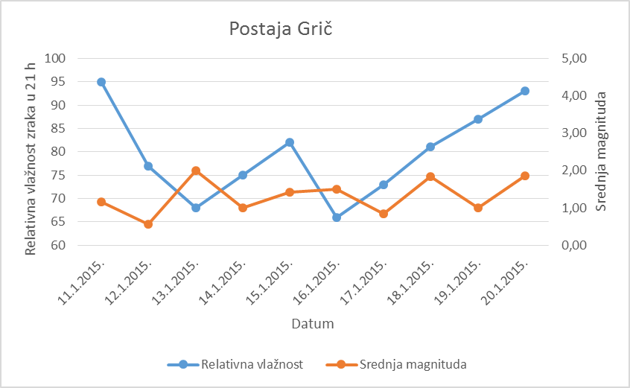
Graphical representation for relative air humidity at 21,00 at Vrapče and Grič stations and mean magnitude of Orion's visibility comparison
Vrapče weather station
Grič weather station
Average magnitude
Average magnitude
Relative air humidity at 21 h
Relative air humidity at 21 h
Date
Date
Relative humidity
Average humidity
Relative humidity
Average humidity
Notes:
Relative air humidity and mean magnitude for visibility at Vrapče station are inversely proportional with minor variations while they show no connection at Grič station.

Slide 27
Number of reported
problems with sleep
Number of reported
problems with sleep
STUDENTS TO WHOME LIGHT DOES NOT REACH THE ROOM
STUDENTS TO WHOME LIGHT REACHES THE ROOM
Total number
Average per student
Total number
Average per student
Notes:
After students questionnaires of sleeping quality analysis we randomly choose 15 students to whom artificial lightning does not come to a sleeping room and another 15 students to whom it comes.
In tables we presented how many times some sleeping difficulties were reported while observing Orion in one period (11.1.2015.-20.1.2015.). From that display we can conclude that students to whom artificial lightning comes to room had more sleeping difficulties than those to whom artificial lightning does not come to a sleeping room. sa spavanjem od onih kojima svjetlost ne dopire.

Slide 28
Average magnitude
Average magnitude
STUDENTS TO WHOME LIGHT DOES NOT REACH THE ROOM
STUDENTS TO WHOME LIGHT REACHES THE ROOM
Average value
Average value
Average value
Notes:
We compared mean magnitudes measured for Orion (11.1.2015.-20.1.2015.). In this review we can see that the students to whom artificial lightning comes to a sleeping room have
recorded a slightly higher visibility of observed constellation.

Slide 29
City area
City area –
category
City area –
category
City area
STUDENTS TO WHOME LIGHT DOES NOT REACH THE ROOM
STUDENTS TO WHOME LIGHT REACHES THE ROOM
Average value
Average value
Notes:
we also compared locations of students to whom artificial lightning does not come to a sleeping room with those to whom it comes.
We divided city area in 3 zones (inner center = 1, wider center = 2 wider area = 3). From table review we can conclude that the students to whom artificial lightning does not come to a sleeping room are mostly located in wider area, and those to whom artificial lightning comes to a sleeping room are mostly in inner and wider center.

Slide 30
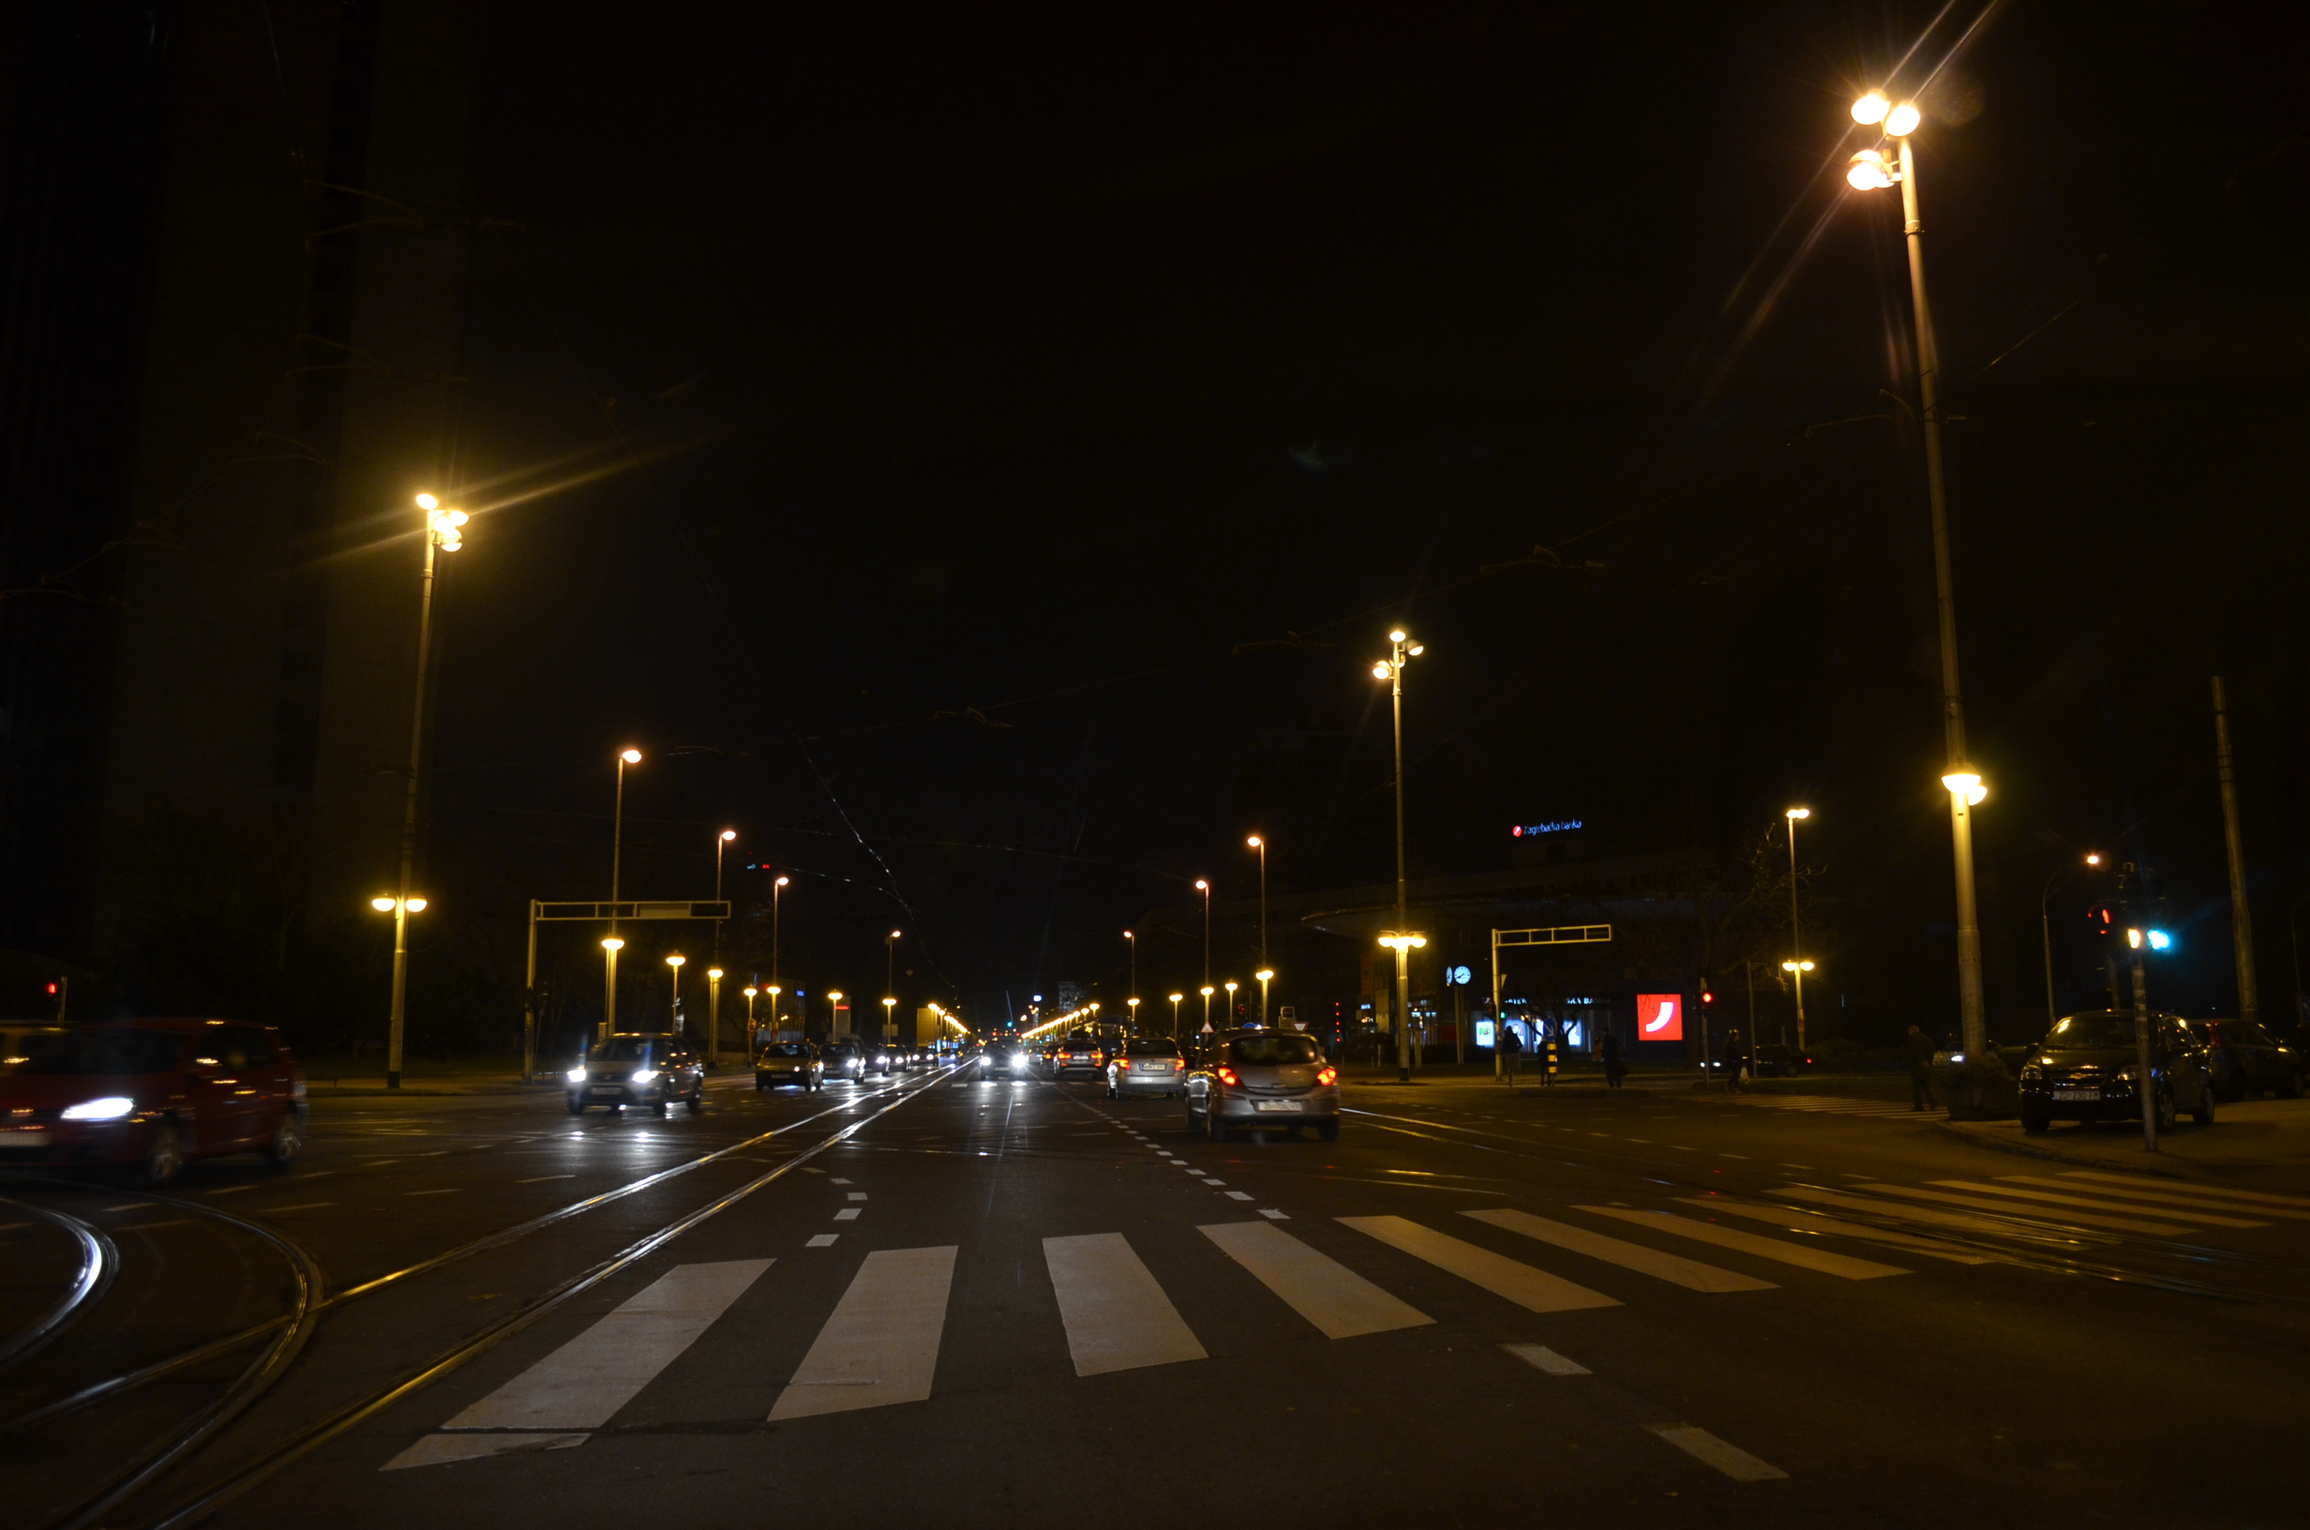
Conclusions
Inner center has minimum, wider area maximum visibility magnitude.
Relative air humidity does not affect constellation's visibility significantly.
Notes:
Using graphical review for constellation's visibility comparison in single gropus we concluded that visibility trend is similar.
-students in inner center have minimum visibility with mean magnitude from 1,17
-students in inner center have mean magnitude from 1,26
-students in wider area have maximum visibility with mean magnitude from 1,42.
relative air humidity does not affect constellation's visibility significantly

Slide 31
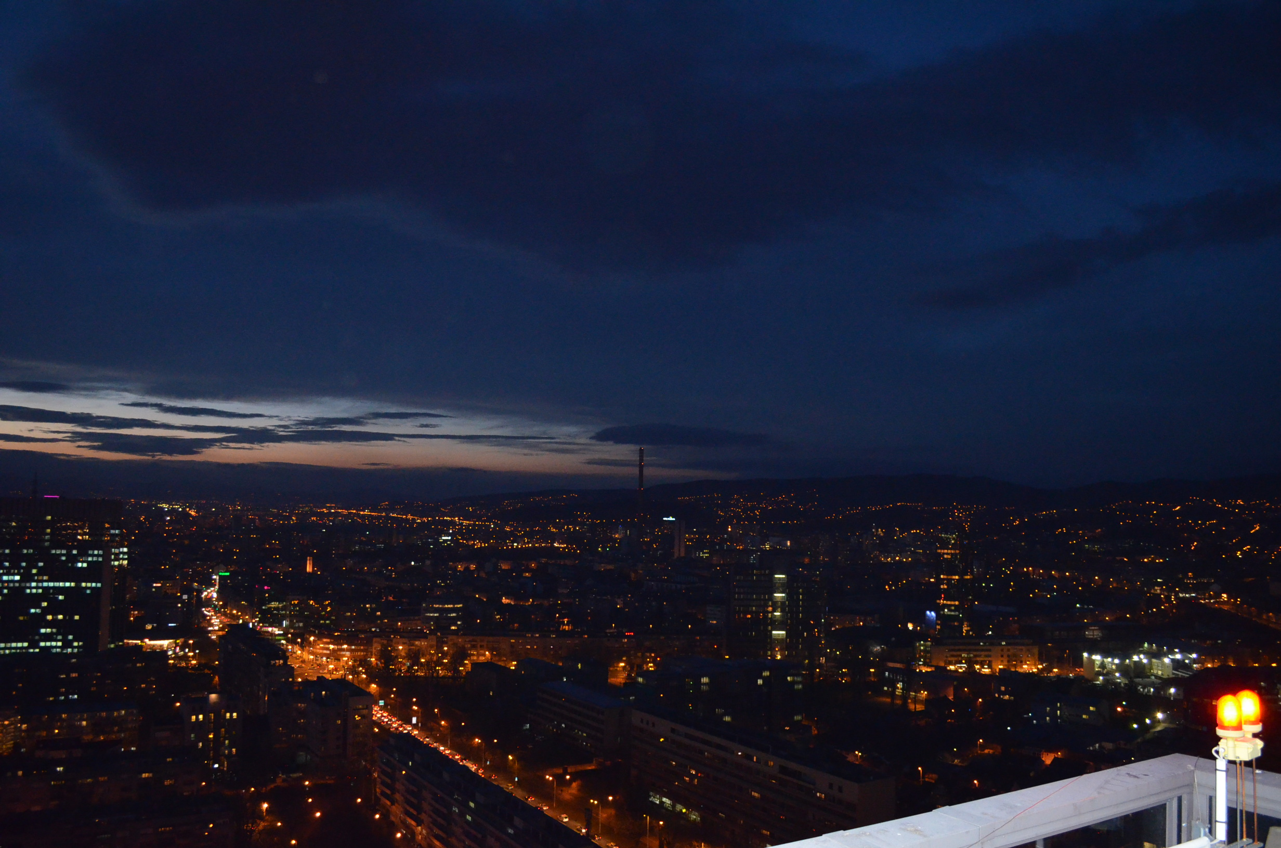
Lightning affects our sleep, especially artificial light that enters room.
Much more artificial lightning that disrupts sleeping is present in inner and wider center than in wider area.
Notes:
We also confirmed our hypothesis regarding sleeping quality and lightning

Slide 32
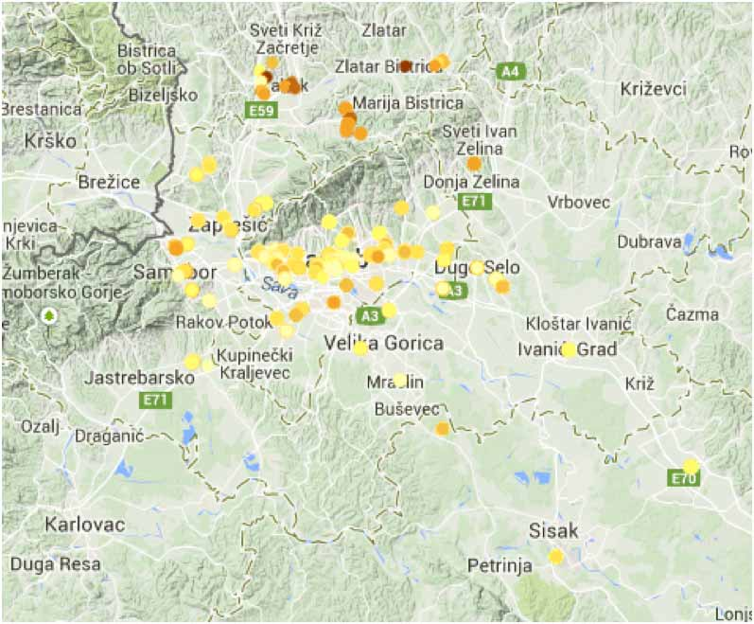
„Check out Zagreb, Croatia! The city of Zagreb and the surrounding area have contributed 1966 data points! These data points have helped to skyrocket Croatia from 443 data points in the month of April, to 2164 in May! Great job Zagreb. Keep up the good work!”
Notes:
This is an article from Globe Newsletter commenting our data in GLOBE at night project which gave us sense of importance for our work

Slide 33
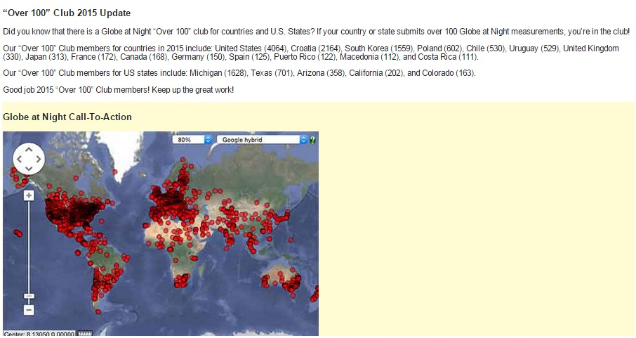
Notes:
Croatia’s entering an „Over 100” Club made us even more proud of our results

Slide 34
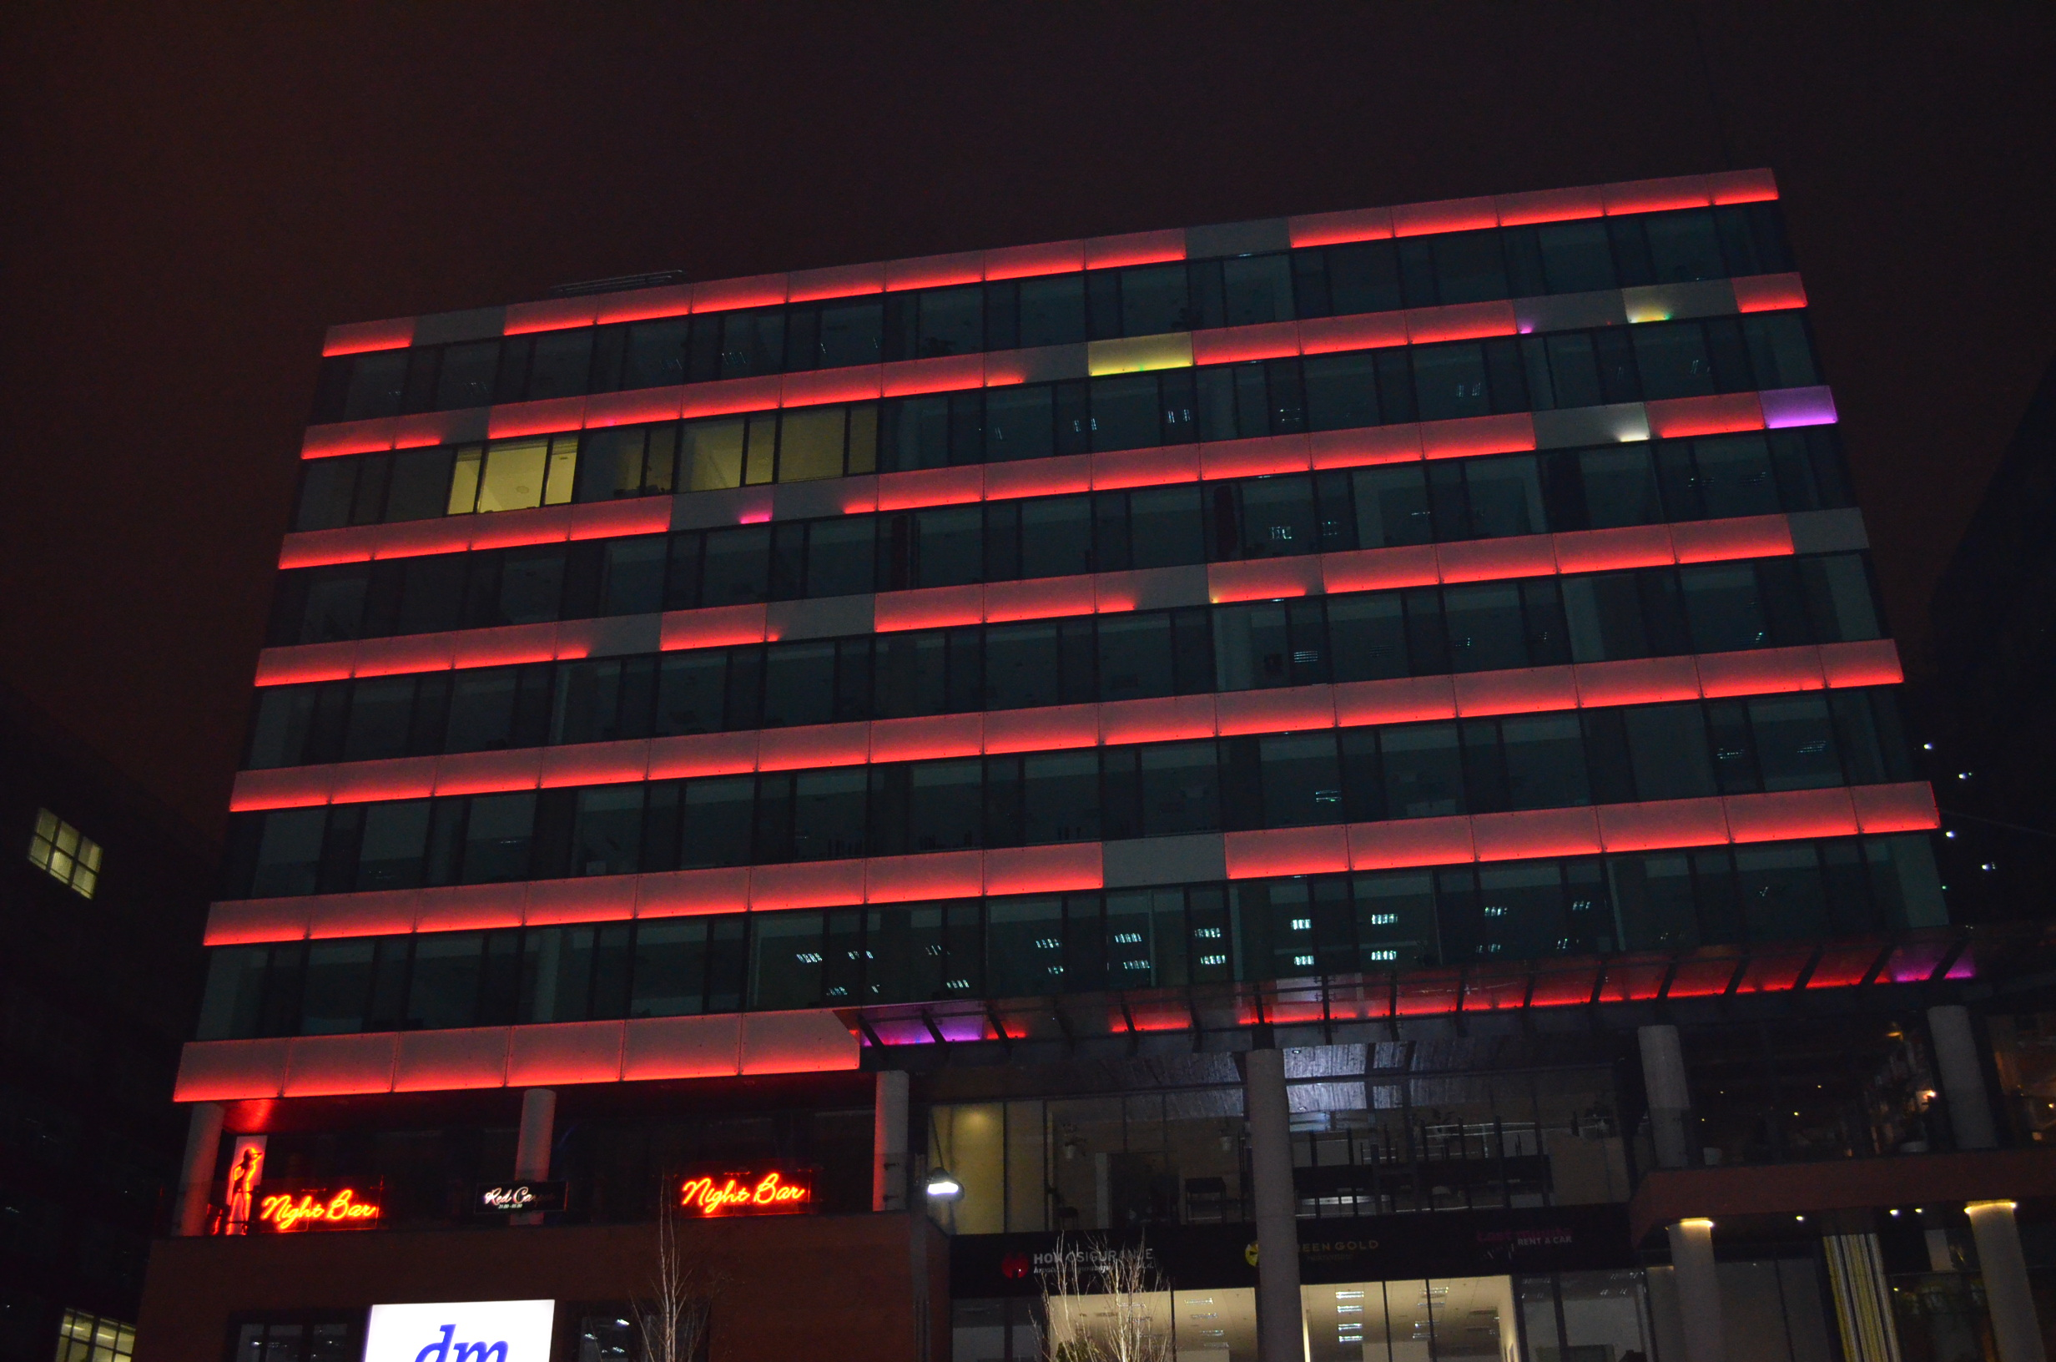
It was all about lightning
For your enlightning!
Notes:
Thank you for letting us enlight you!

Slide 35
Literature:
http://rgn.hr/~zandreic/studenti/lp/lp_p1.pdf - Problematika svjetlosnog onečišćenja, prof. Željko Andreić Rudarsko-geološko-naftni fakultet Sveučilište u Zagrebu
http://www.darksky.org/
http://visibleearth.nasa.gov/view.php?id=55167
http://www.astro.hr/lp_cdsa/
http://www.zvjezdarnica.hr/
http://www.zagreb.hr/default.aspx?id=12917
http://prognoza.hr/karte_postaja.php?id=glavne
http://prognoza.hr/karte_postaja.php?id=klimatoloske
Notes:
We thank all the sources enlisted

Slide 36
