Slide 1



Leaf surface characteristics and the amount of dust covering the leaf surface of perennial trees growing along the perimeters of Kasetsart University Laboratory School, Bangkok, Thailand
Student :
Mr.Sirapop Attapun
Mr. Poovis Boonyamongkonrat
Teacher :
Ms. Krissana Pokpun
Mr. Santichai Anuworrachai
School : Kasetsart University Laboratory School Center for Educational Research and development
Level : Grade 8

Slide 2
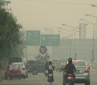
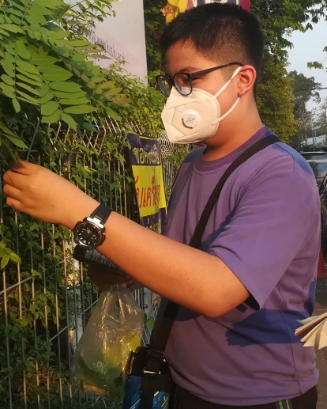
Introduction
Exposure to atmospheric particles and dust lead to negative consequences on quality of life in urban areas. Dust residues cause damages and leave dirt inside buildings. Hazardous dust particles can lead to annoyance, reduce visibility, and affect human health. Small dust particles can penetrate into the respiratory system, causing irritation, bronchitis, and asthma
There are a lot of dust particles in areas surrounding our school. We observed a lot of dust on leaf surface of trees growing along the streets. The same type of trees inside our school were found to have less dust particles, compared to those growing on the roadside. The researchers think that the leaves should to be able to retain dust

Slide 3
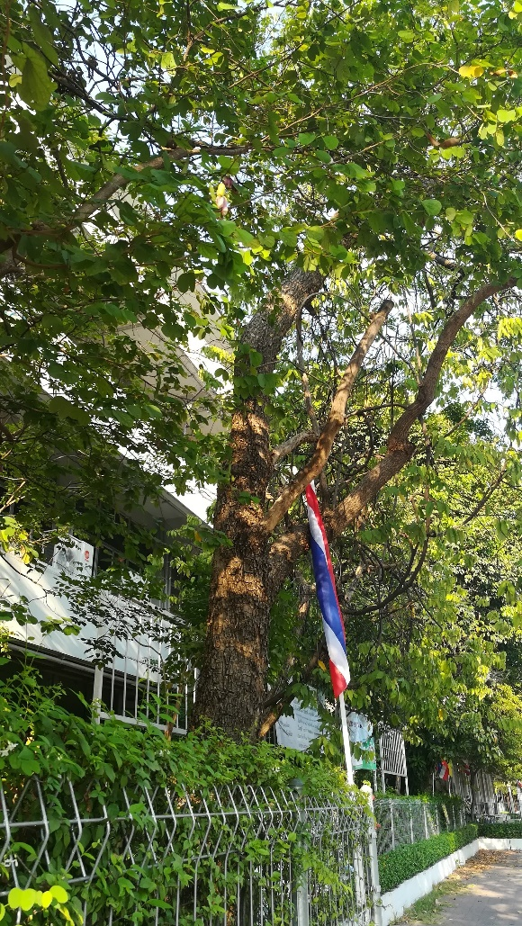
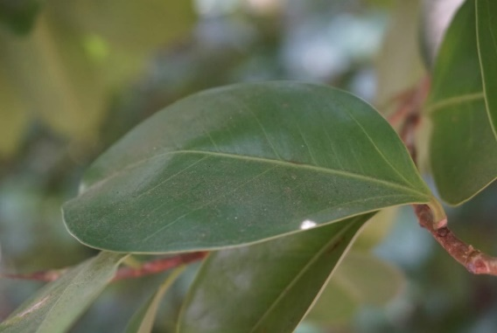
Introduction
Based on the researchers’ observations and literature reviews, previous studies have shown that leaves can help to trap the dust. However, there are many groups of plants grown around the school perimeters, for example, perennials, shrubs, ornamental plants. We found that the perennial plants have the largest number of trees, and were commonly planted next to the road, in contrast to other groups of plants. The researchers think that a majority of dust particles around the school were released from personal and public vehicles.

Slide 4
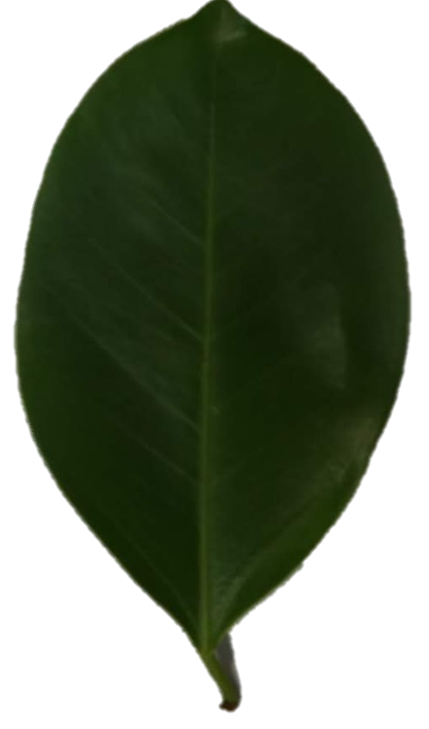
Question
1. What kind of perennial trees are grown in the perimeters of Kasetsart University Laboratory School?
?
2. What are surface characteristics of leaves of these perennials?
3. What is the amount of dust covered area on the leaf surface of these perennials?

Slide 5
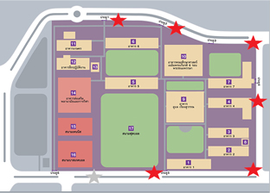
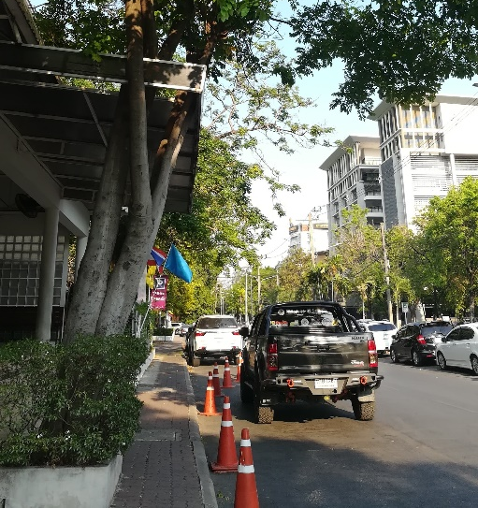
Method
1. Determination of sample collection sites and a survey of tree varieties for leaf sample collections
1.1 We determined 3 sample collection sites on the side of the street around the school: north, south and east sides of the road, adjacent to the school fence, 3 sub-points, collected samples in a radius of 1 m
1.2 We collected leaf samples in the morning 07.30-08.30 hrs, and in the evening 16.30 - 17.30 hrs. These two specific time slots were chosen as parents would drop off and pick up students during these periods of time, resulting in higher number of personal and public vehicles on the road surrounding the school

Slide 6
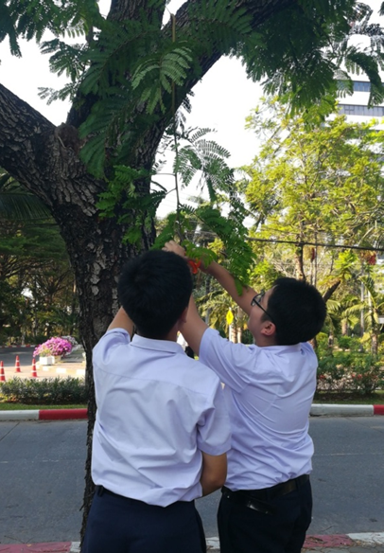
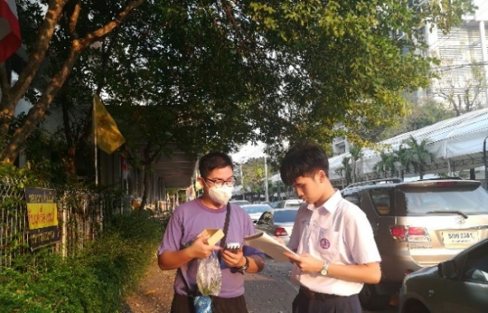
Method
1. Determination of sample collection sites and a survey of tree varieties for leaf sample collections
1.3 At each sample collection, we recorded species name, took pictures, and also determined the air quality in the study area using Air Quality Detector tool to measure the dust volume of 3 sizes, i.e. PM 10, PM 2.5 and PM 1. Three fresh leaf samples were collected from the ground below each tree of interest, and immediately stored in a bag

Slide 7
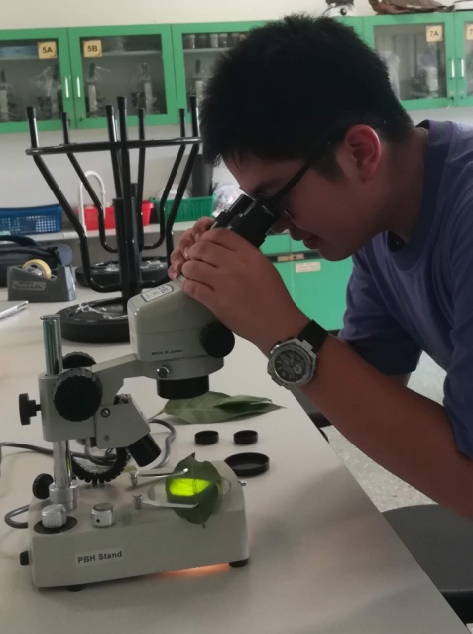
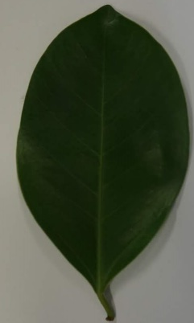
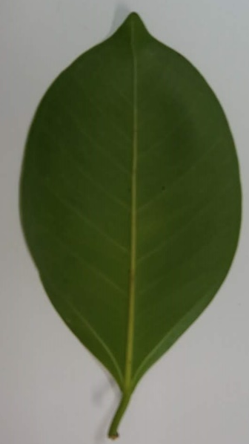
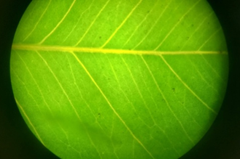
Method
2. Determination of leaf surface characteristics, leaf area and dust covered area
Upper surface (adaxial)
lower surface (abaxial)
stereo Microscope

Slide 8
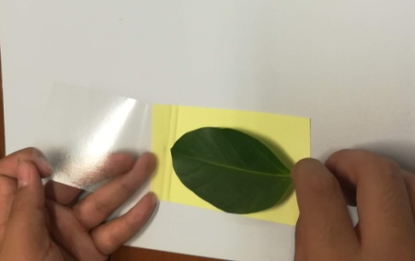
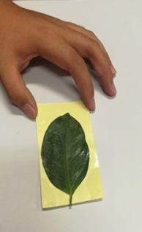
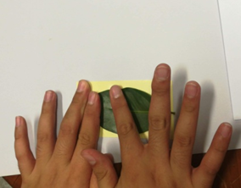
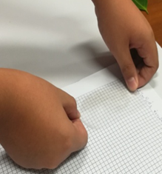
Method
2.1 We quantified the amount of dust covered area on the leaf surface on both sides of the leaf using a clear adhesive tape. Once peeled off from the leaf, the dust from the leaf surface were transferred onto the tape surface.
The dust covered tape were then placed on a paper with tables of a known size (a grid of 0.5 x 0.5 cm; 0.25 cm2).

Slide 9
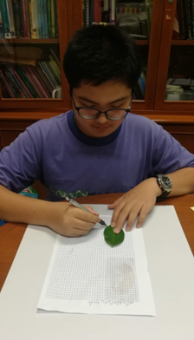
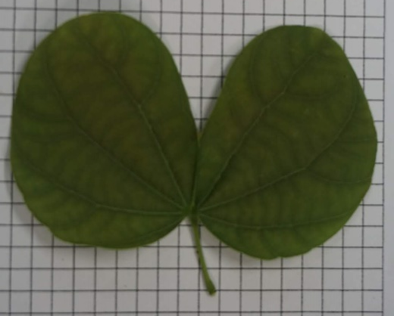
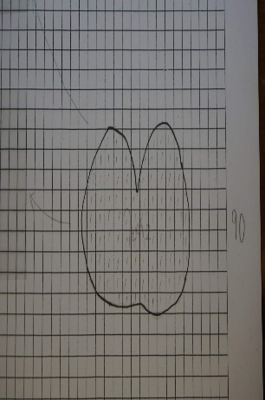
Method
2.2 We used a pencil to draw leaf edge on the same paper and later use this area to as a total leaf area when calculating a proportion of dust covered surface

Slide 10
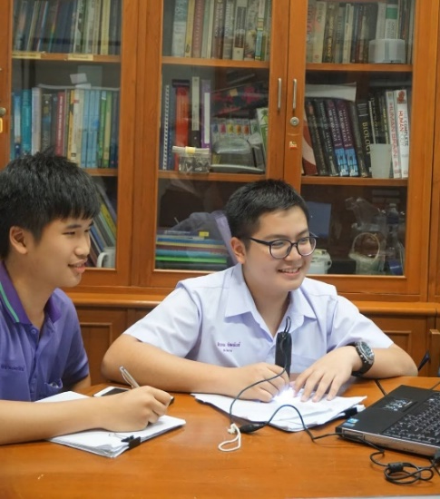
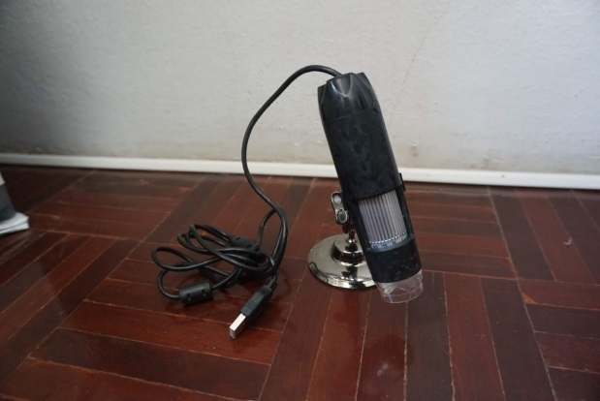
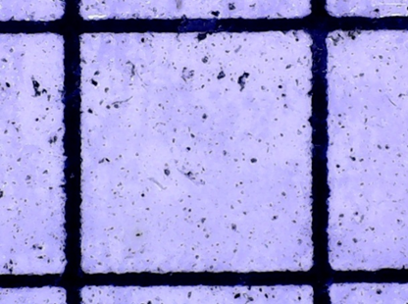
Method
3. Quantification of dust covered area
3.1 We determined the total leaf surface area by counting the number of grids on the table paper.
3.2 We then determined the amount of dust covered area on the leaf surface using a USB Digital Microscope camera. If each grid of 0.5 x 0.5 cm was covered by more than 50% of the total are, we considered it as a dust covered area.

Slide 11
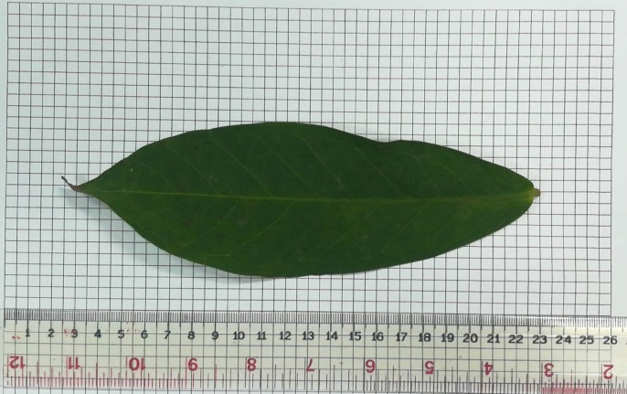

Method
3.3 We calculated the ratio of dust covered area versus the total leaf area and compared it to the leaf surface characteristics observed in the previous steps.
Leaf surface area
The leaf area that cover with the dust
e.g. Leaf surface area = 7.5 sq.cm
The leaf area that cover with the dust = 2.5 sq.cm.
Then the percentage of dust covering the leaf surface = 2.5 x 7.5 x 100
= 33.33%

Slide 12
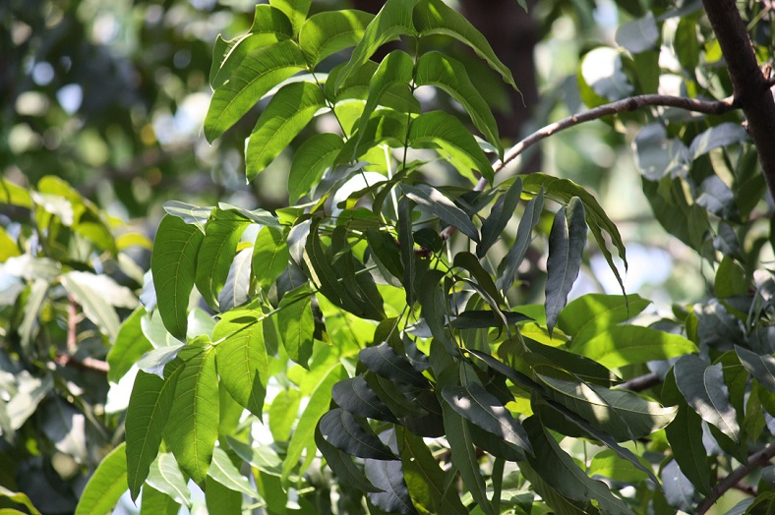
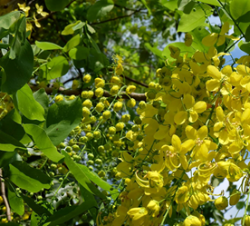
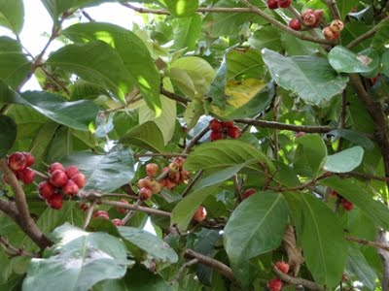
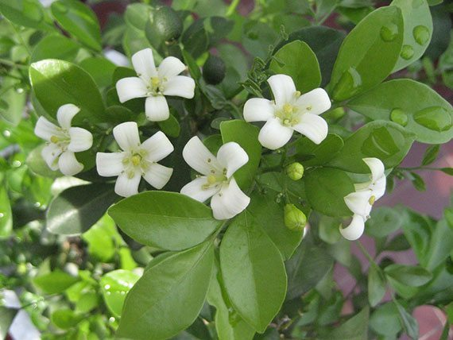
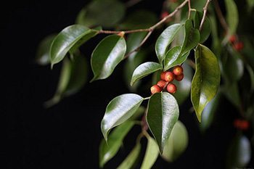
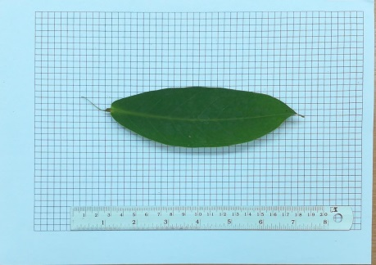
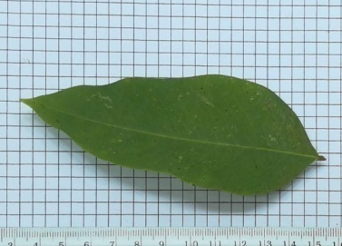
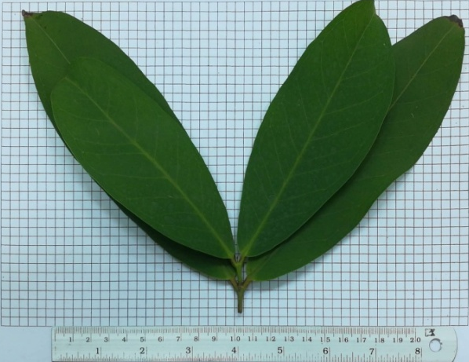
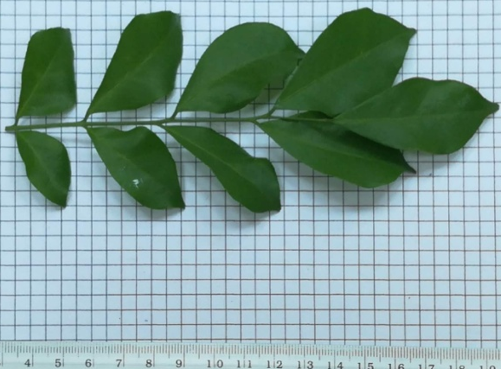
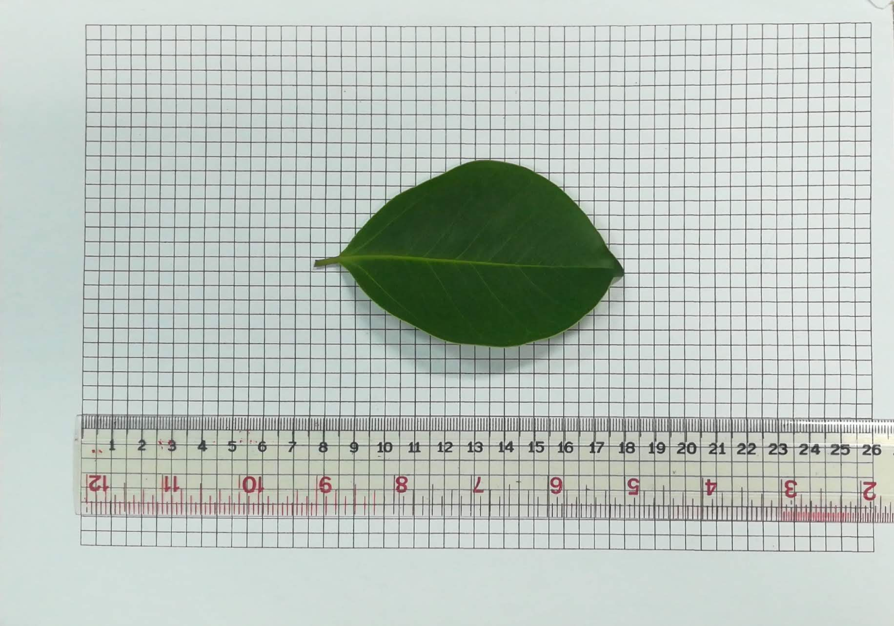
Result
1. The perennial plants, which are found composed of 10 species, consisting of 12 trees.
False Mahogany | Golden Shower | Malay rose apple | Orange Jasmine | Golden Fig

Slide 13
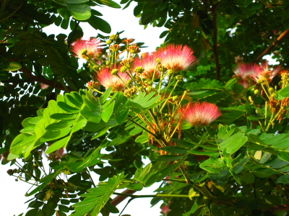
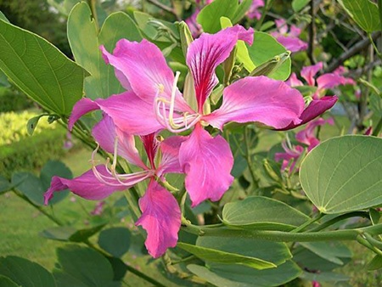
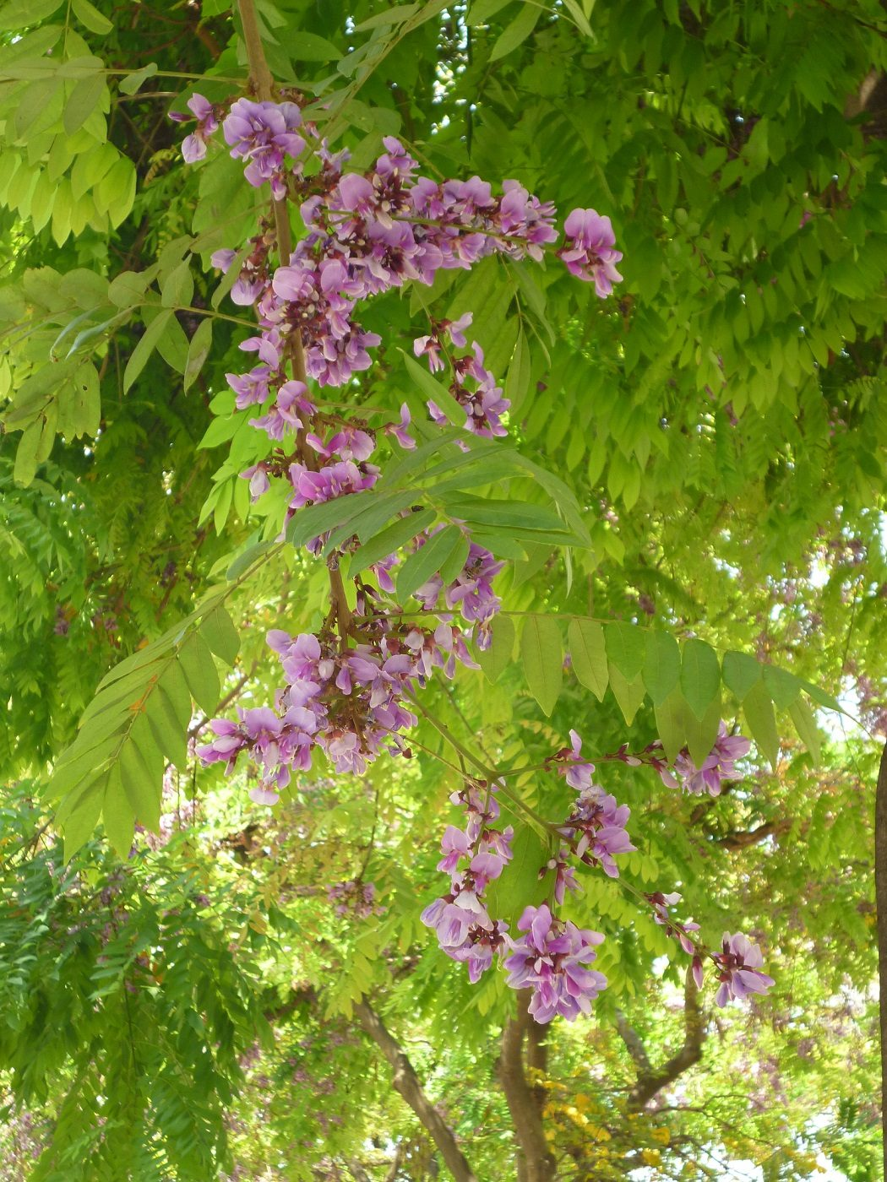
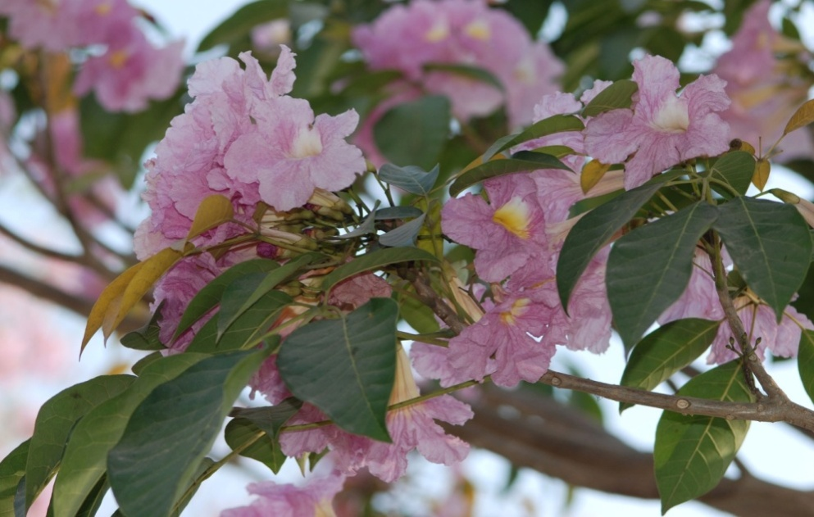
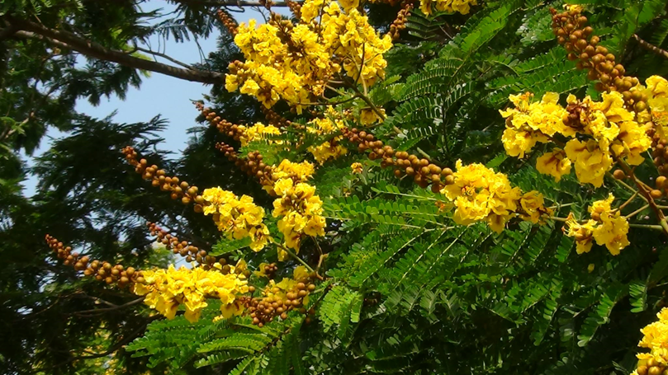
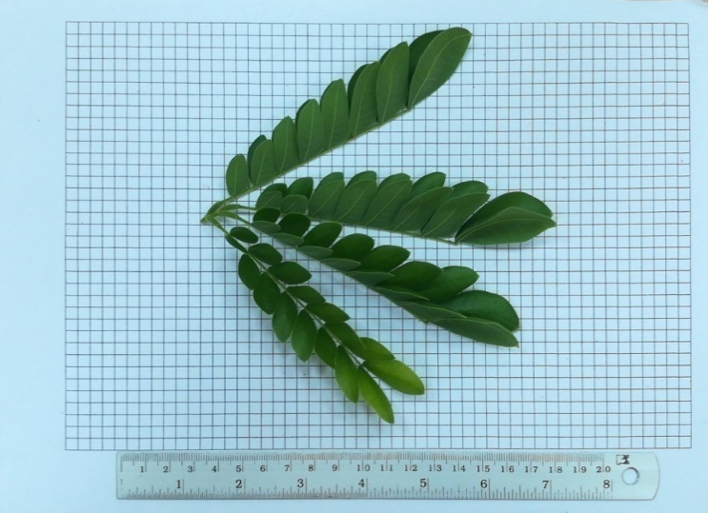
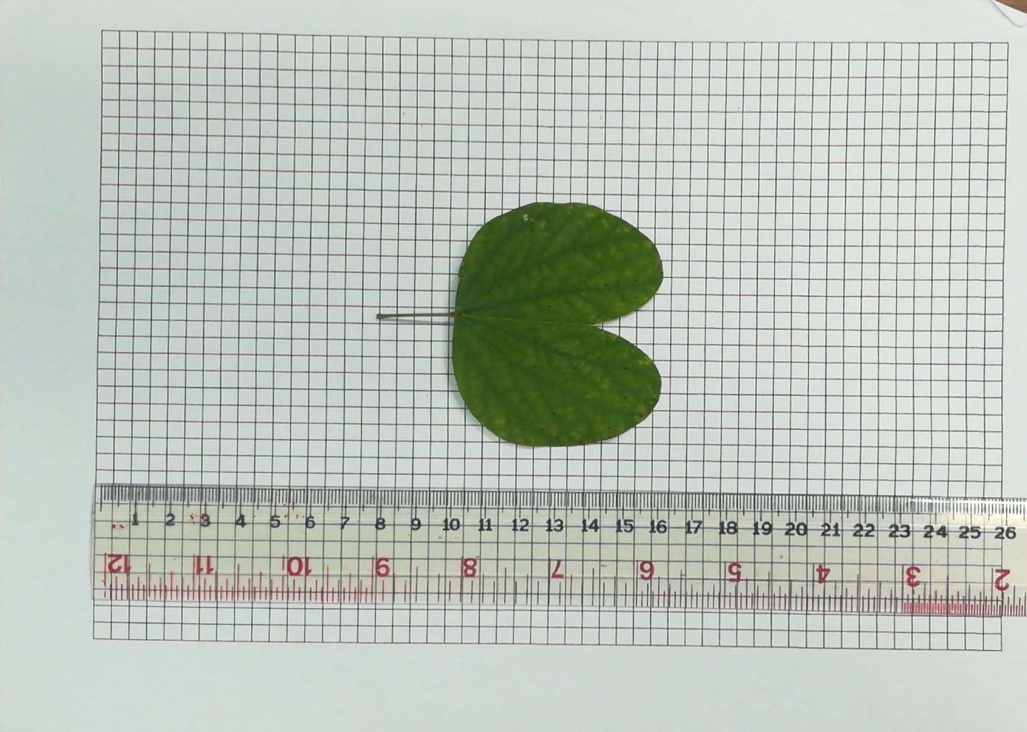
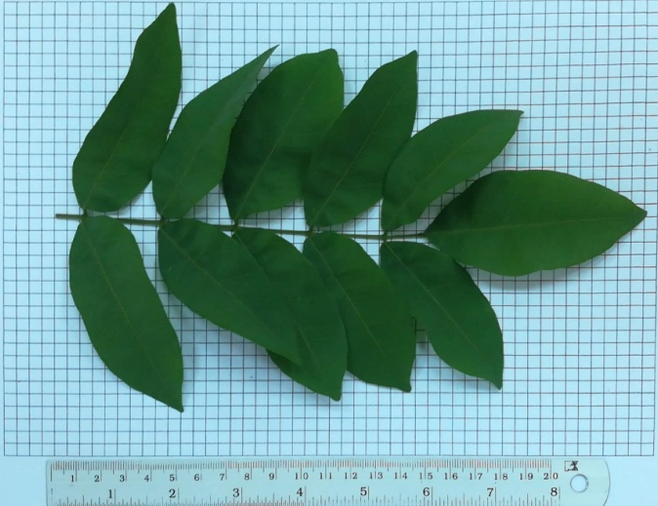
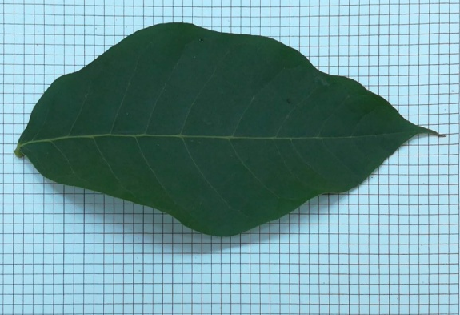
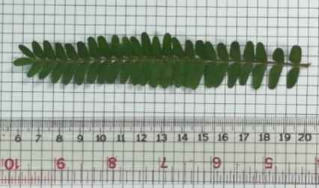
Result
From the observations found that every tree that grows fully Observed from the size of the trunk, height and some species bloom and are effective
Rain Tree | Purple Orchid Tree | Krapeechan | Rosy trumpet tree | Yellow Poinciana 1,2,3

Slide 14
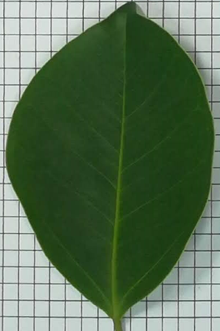
Result
2. The surface of the leaves of 10 kinds of perennials can be divided into 3 groups.
Group 1 - Smooth, glossy, covered leaves such as False Mahogany, Golden Shower, Malay rose apple, Orange Jasmine, Golden Fig, Rosy trumpet tree, and Purple Orchid Tree
Golden Fig

Slide 15
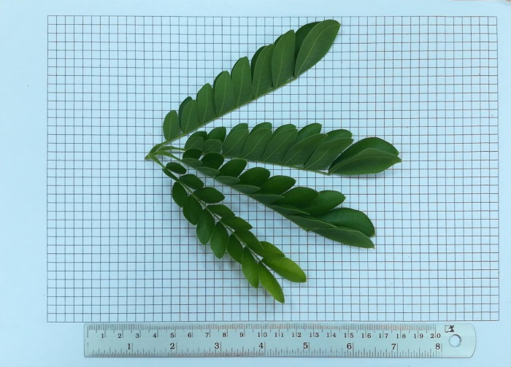
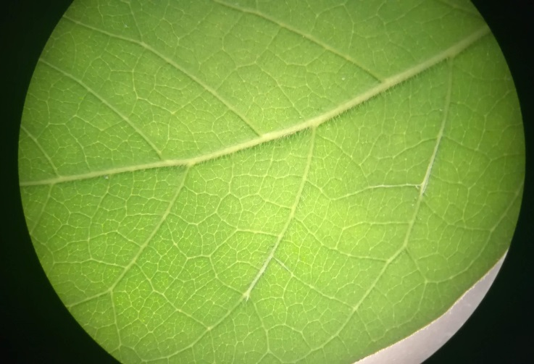
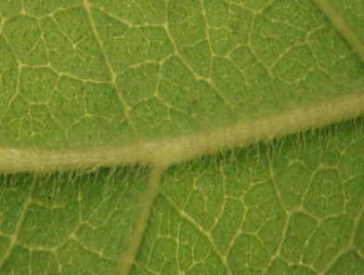
Result
Group 2 - The leaves have slightly smooth. With a little hair, including Krapeechan, Rain Tree
Rain Tree
*This is the picture that zoom from the large picture*

Slide 16
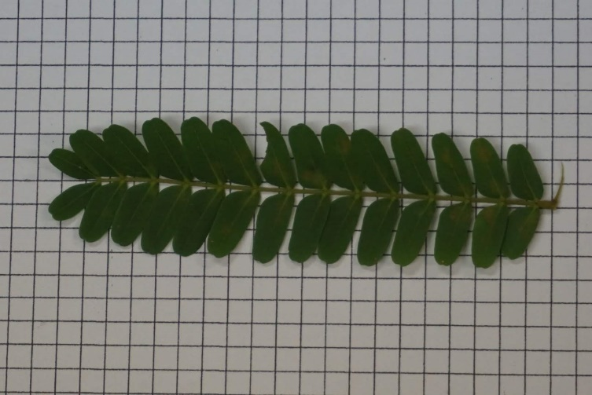
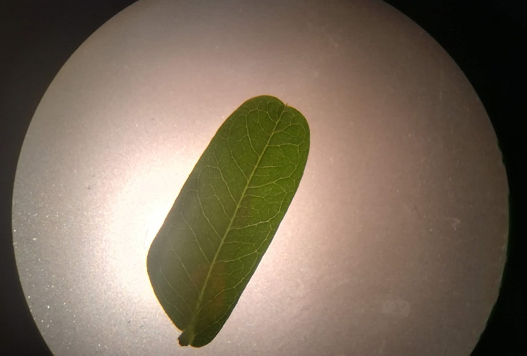
Result
Group 3 - The leaves have stingy leaves, clear middle lines leaves characteristic as following Yellow Poinciana.
Yellow Poinciana

Slide 17
Result
3. The amount of dust covering the leaf surface of the perennial plant growing along the road around the school.
In the morning
Highest dust - upper surface
Yellow Poinciana1 - 99.29%
Highest dust - lower surface
Yellow Poinciana1 - 79.90%
Least dust – upper surface
Golden Fig - 65.88%
Least dust - lower surface
Malay rose apple - 5.44%

Slide 18
Result
3. The amount of dust covering the leaf surface of the perennial plant growing along the road around the school.
In the evening
Highest dust - upper surface
Yellow Poinciana2 - 98.14%
Highest dust - lower surface
Yellow Poinciana2 - 91.41%
Least dust – upper surface
Sapwood Chan - 81.69%
Least dust - lower surface
Malay rose apple and Orange Jasmine – 0.00%

Slide 19

Conclusion
1. The perennial plants found were composed of 10 species, consisting of 12 trees including False Mahogany, Golden Shower, Malay rose apple, Orange Jasmine, Golden Fig, Rain Tree, Purple Orchid Tree, Krapeechan, Rosy trumpet tree and Yellow Poinciana.
2. The study of leaf surface characteristics and the amount of dust cover showed that if the leaves surface of each perennial plant had different leaf surface characteristics, so they can trap the different amount of dust volume. So the group that has a smooth, and glossy leaf characteristic and the group that has an insignificantly smooth leaf with a slightly hairy characteristic are less entrap the dust than the group of leaves that has a rough leaf surface, clear middle lines leaf characteristic

Slide 20

Conclusion
However, some species of the perennial plant for example Raintree, False Mahogany have a lot of dust cover on the leaves surface cause the volume of dust in this area may be different from another area, so they may be an effective ability to store the dust and another cause is when we collect the example of the leaves, it may be miss out. Also, the sticker that uses to trap the dust from the leaves may not be able to trap all of the particles of the dust that covers on the leaves surface.so this all factor will be controlled in the future.
From the result of this research may be the information for people who want to grow the perennial plant to trap the dust, you should select the perennial plant that has a rough leaf surface, clear middle lines leaf characteristic such as Yellow Poinciana, etc.

Slide 21
Conclusion
However, some species of the perennial plant for example Raintree, False Mahogany have a lot of dust cover on the leaves surface cause the volume of dust in this area may be different from another area, so they may be an effective ability to store the dust and another cause is when we collect the example of the leaves, it may be miss out. Also, the sticker that uses to trap the dust from the leaves may not be able to trap all of the particles of the dust that covers on the leaves surface.so this all factor will be controlled in the future.
From the result of this research may be the information for people who want to grow the perennial plant to trap the dust, you should select the perennial plant that has a rough leaf surface, clear middle lines leaf characteristic such as Yellow Poinciana, etc.

