Slide 1




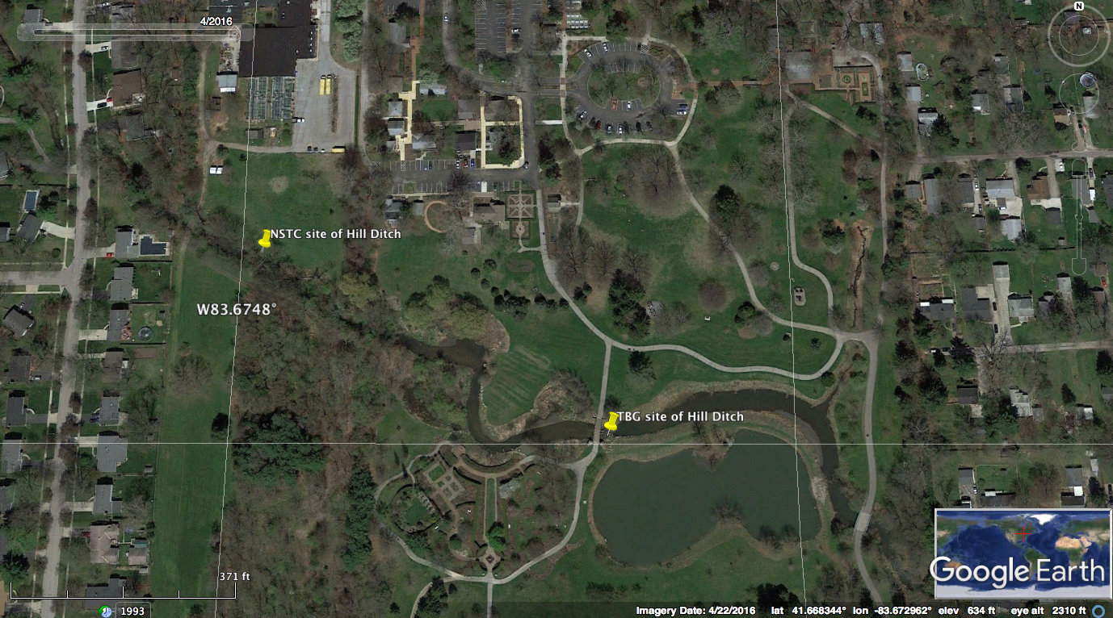
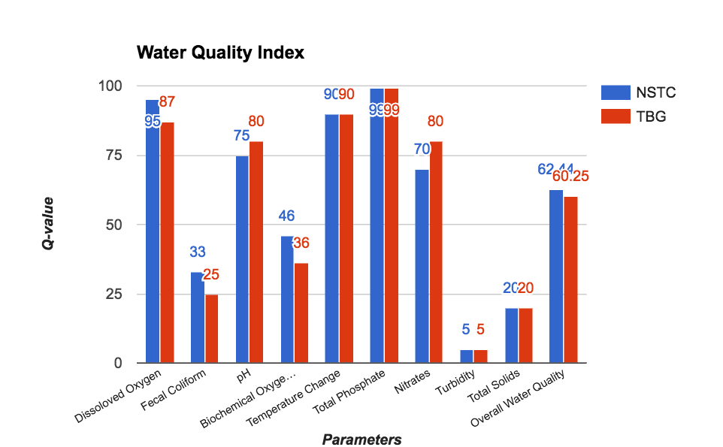
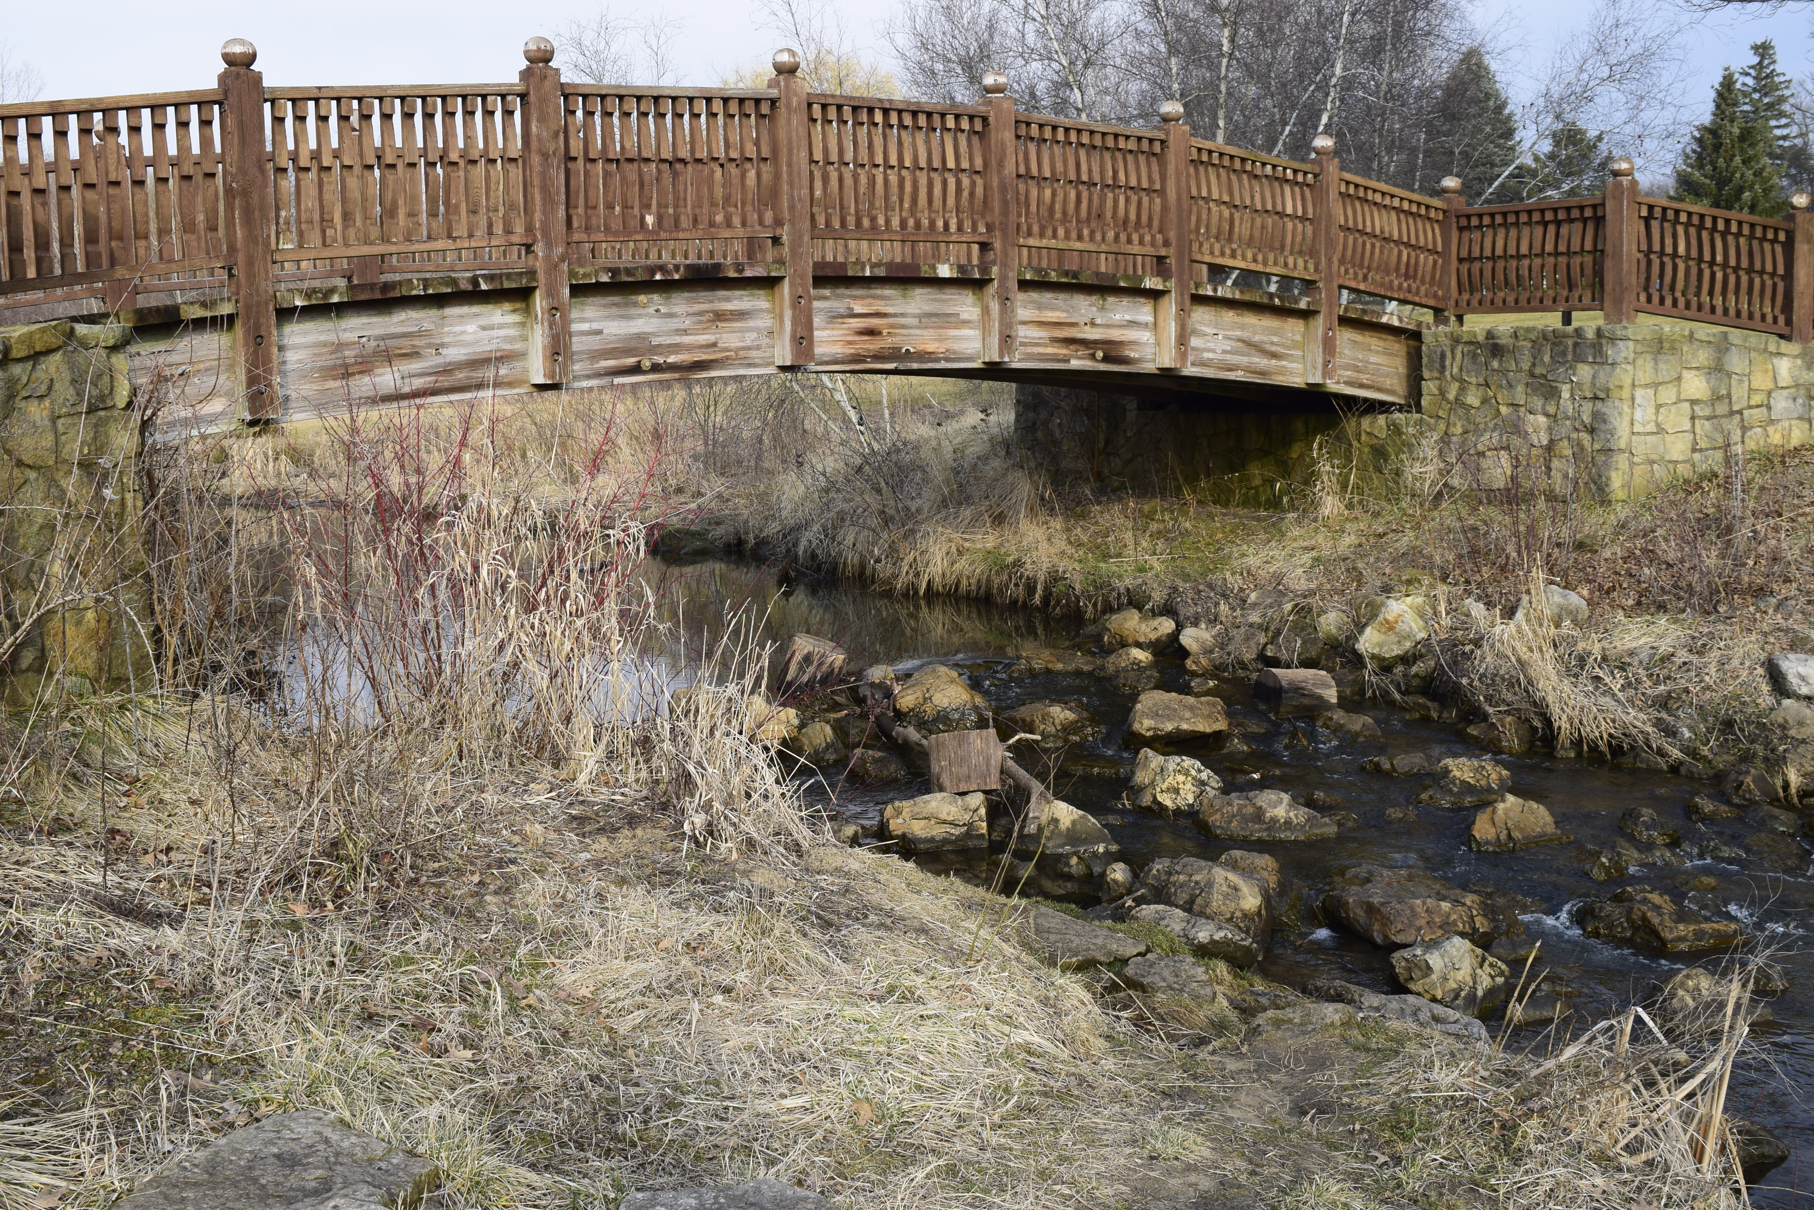
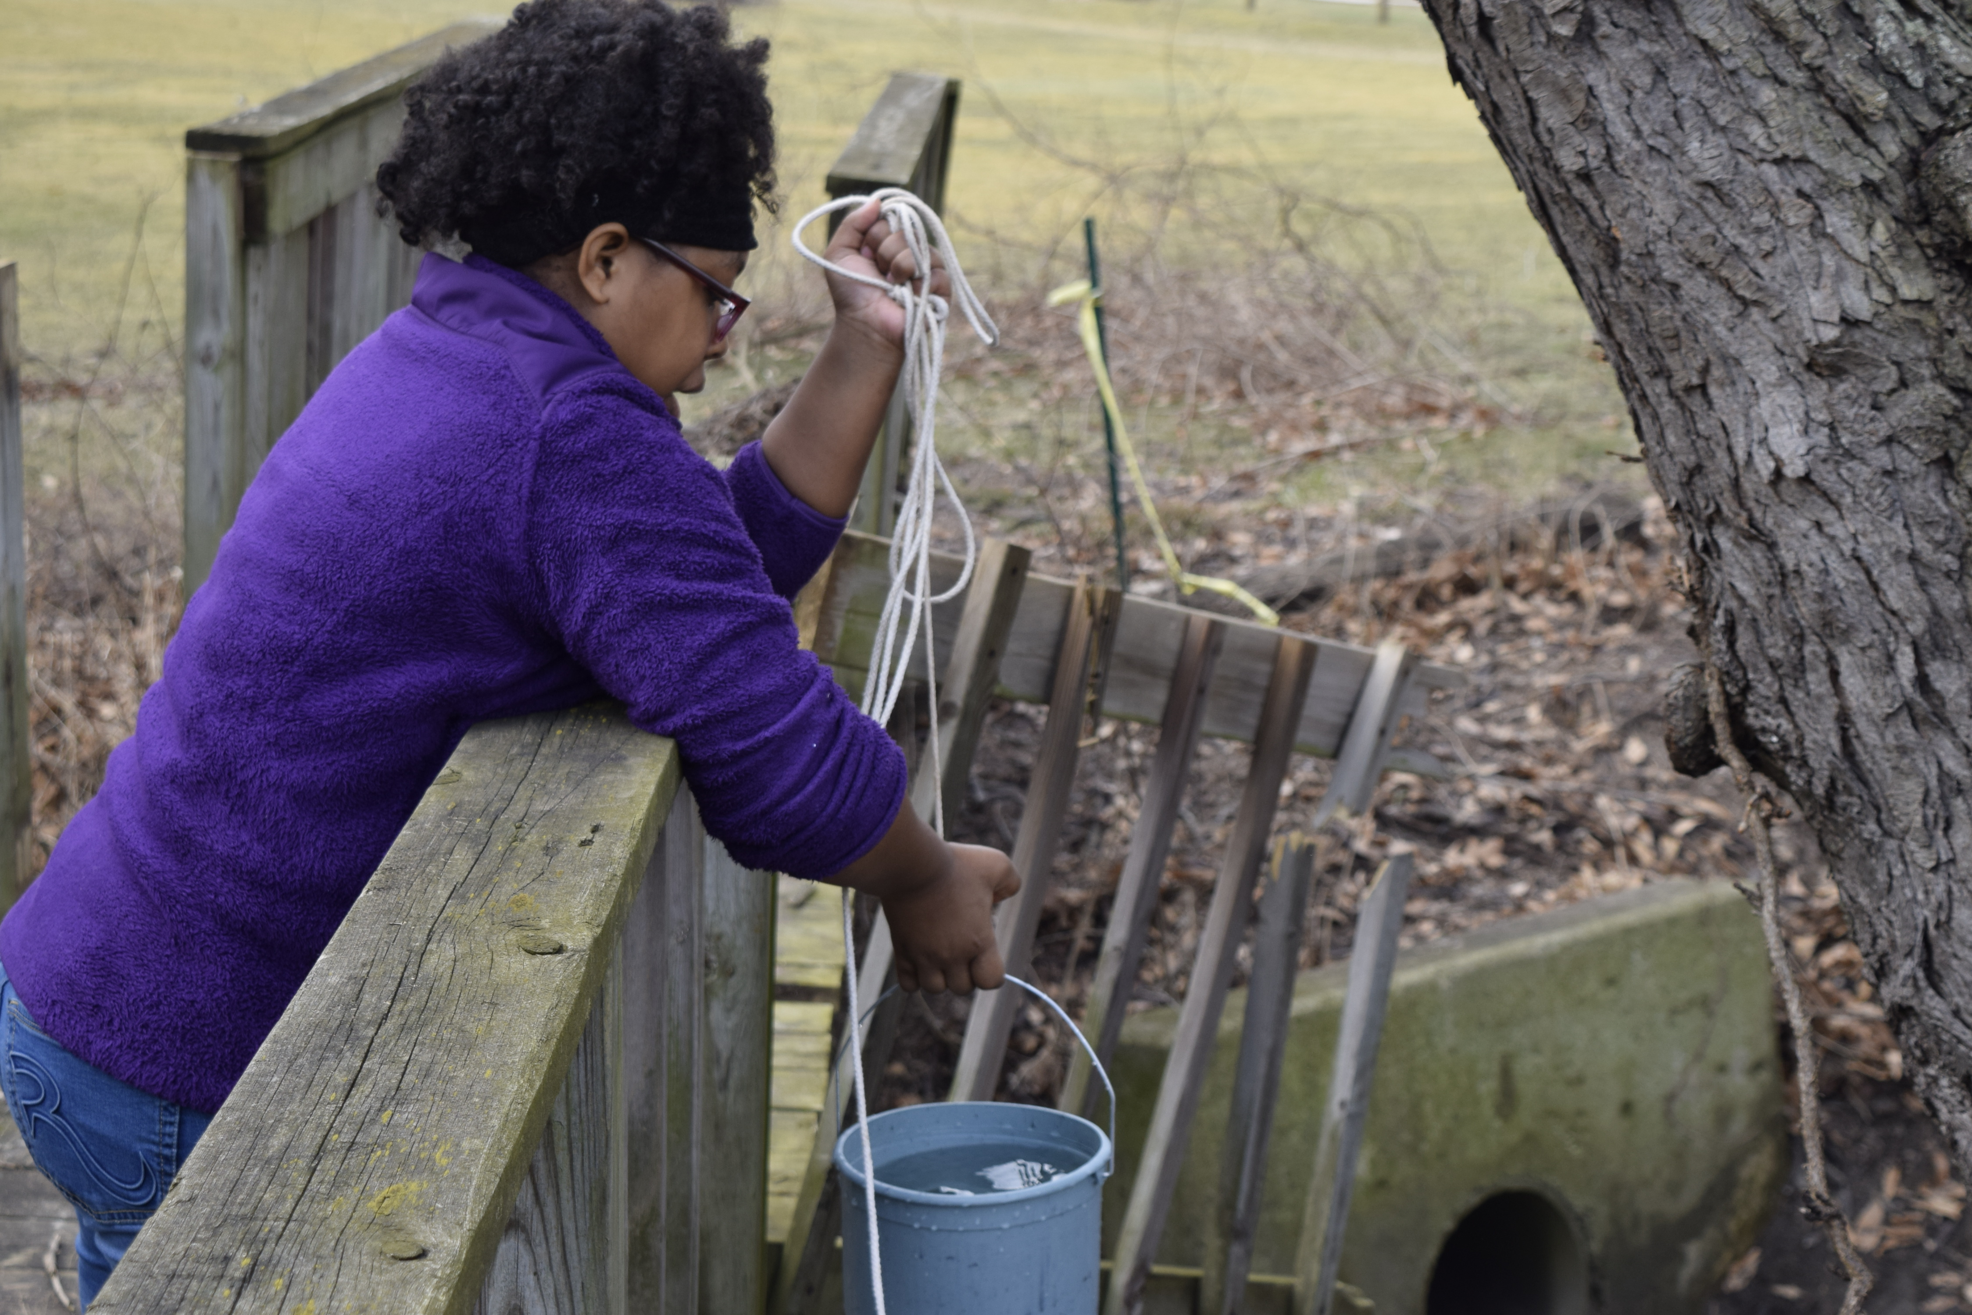
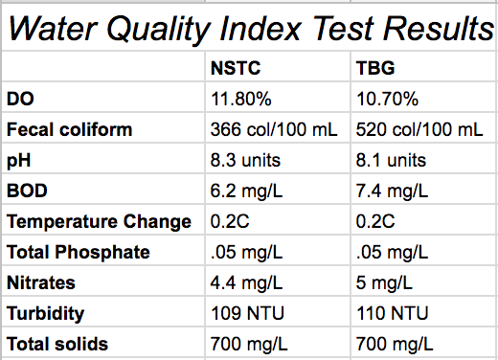
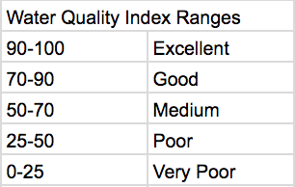
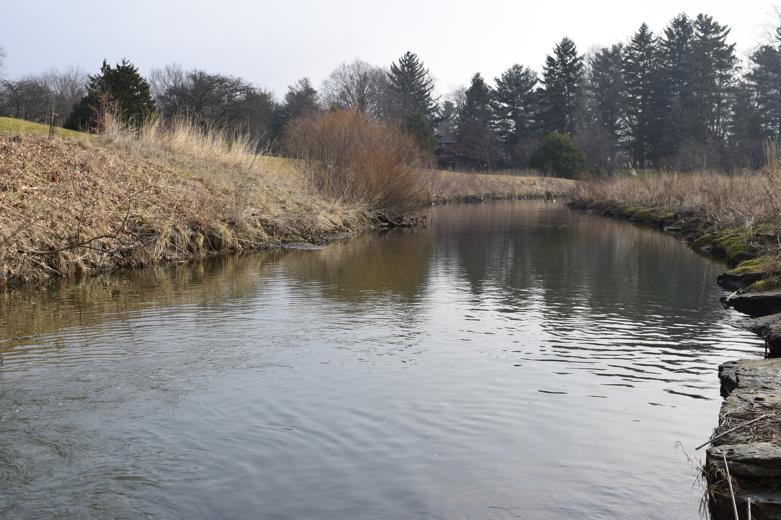
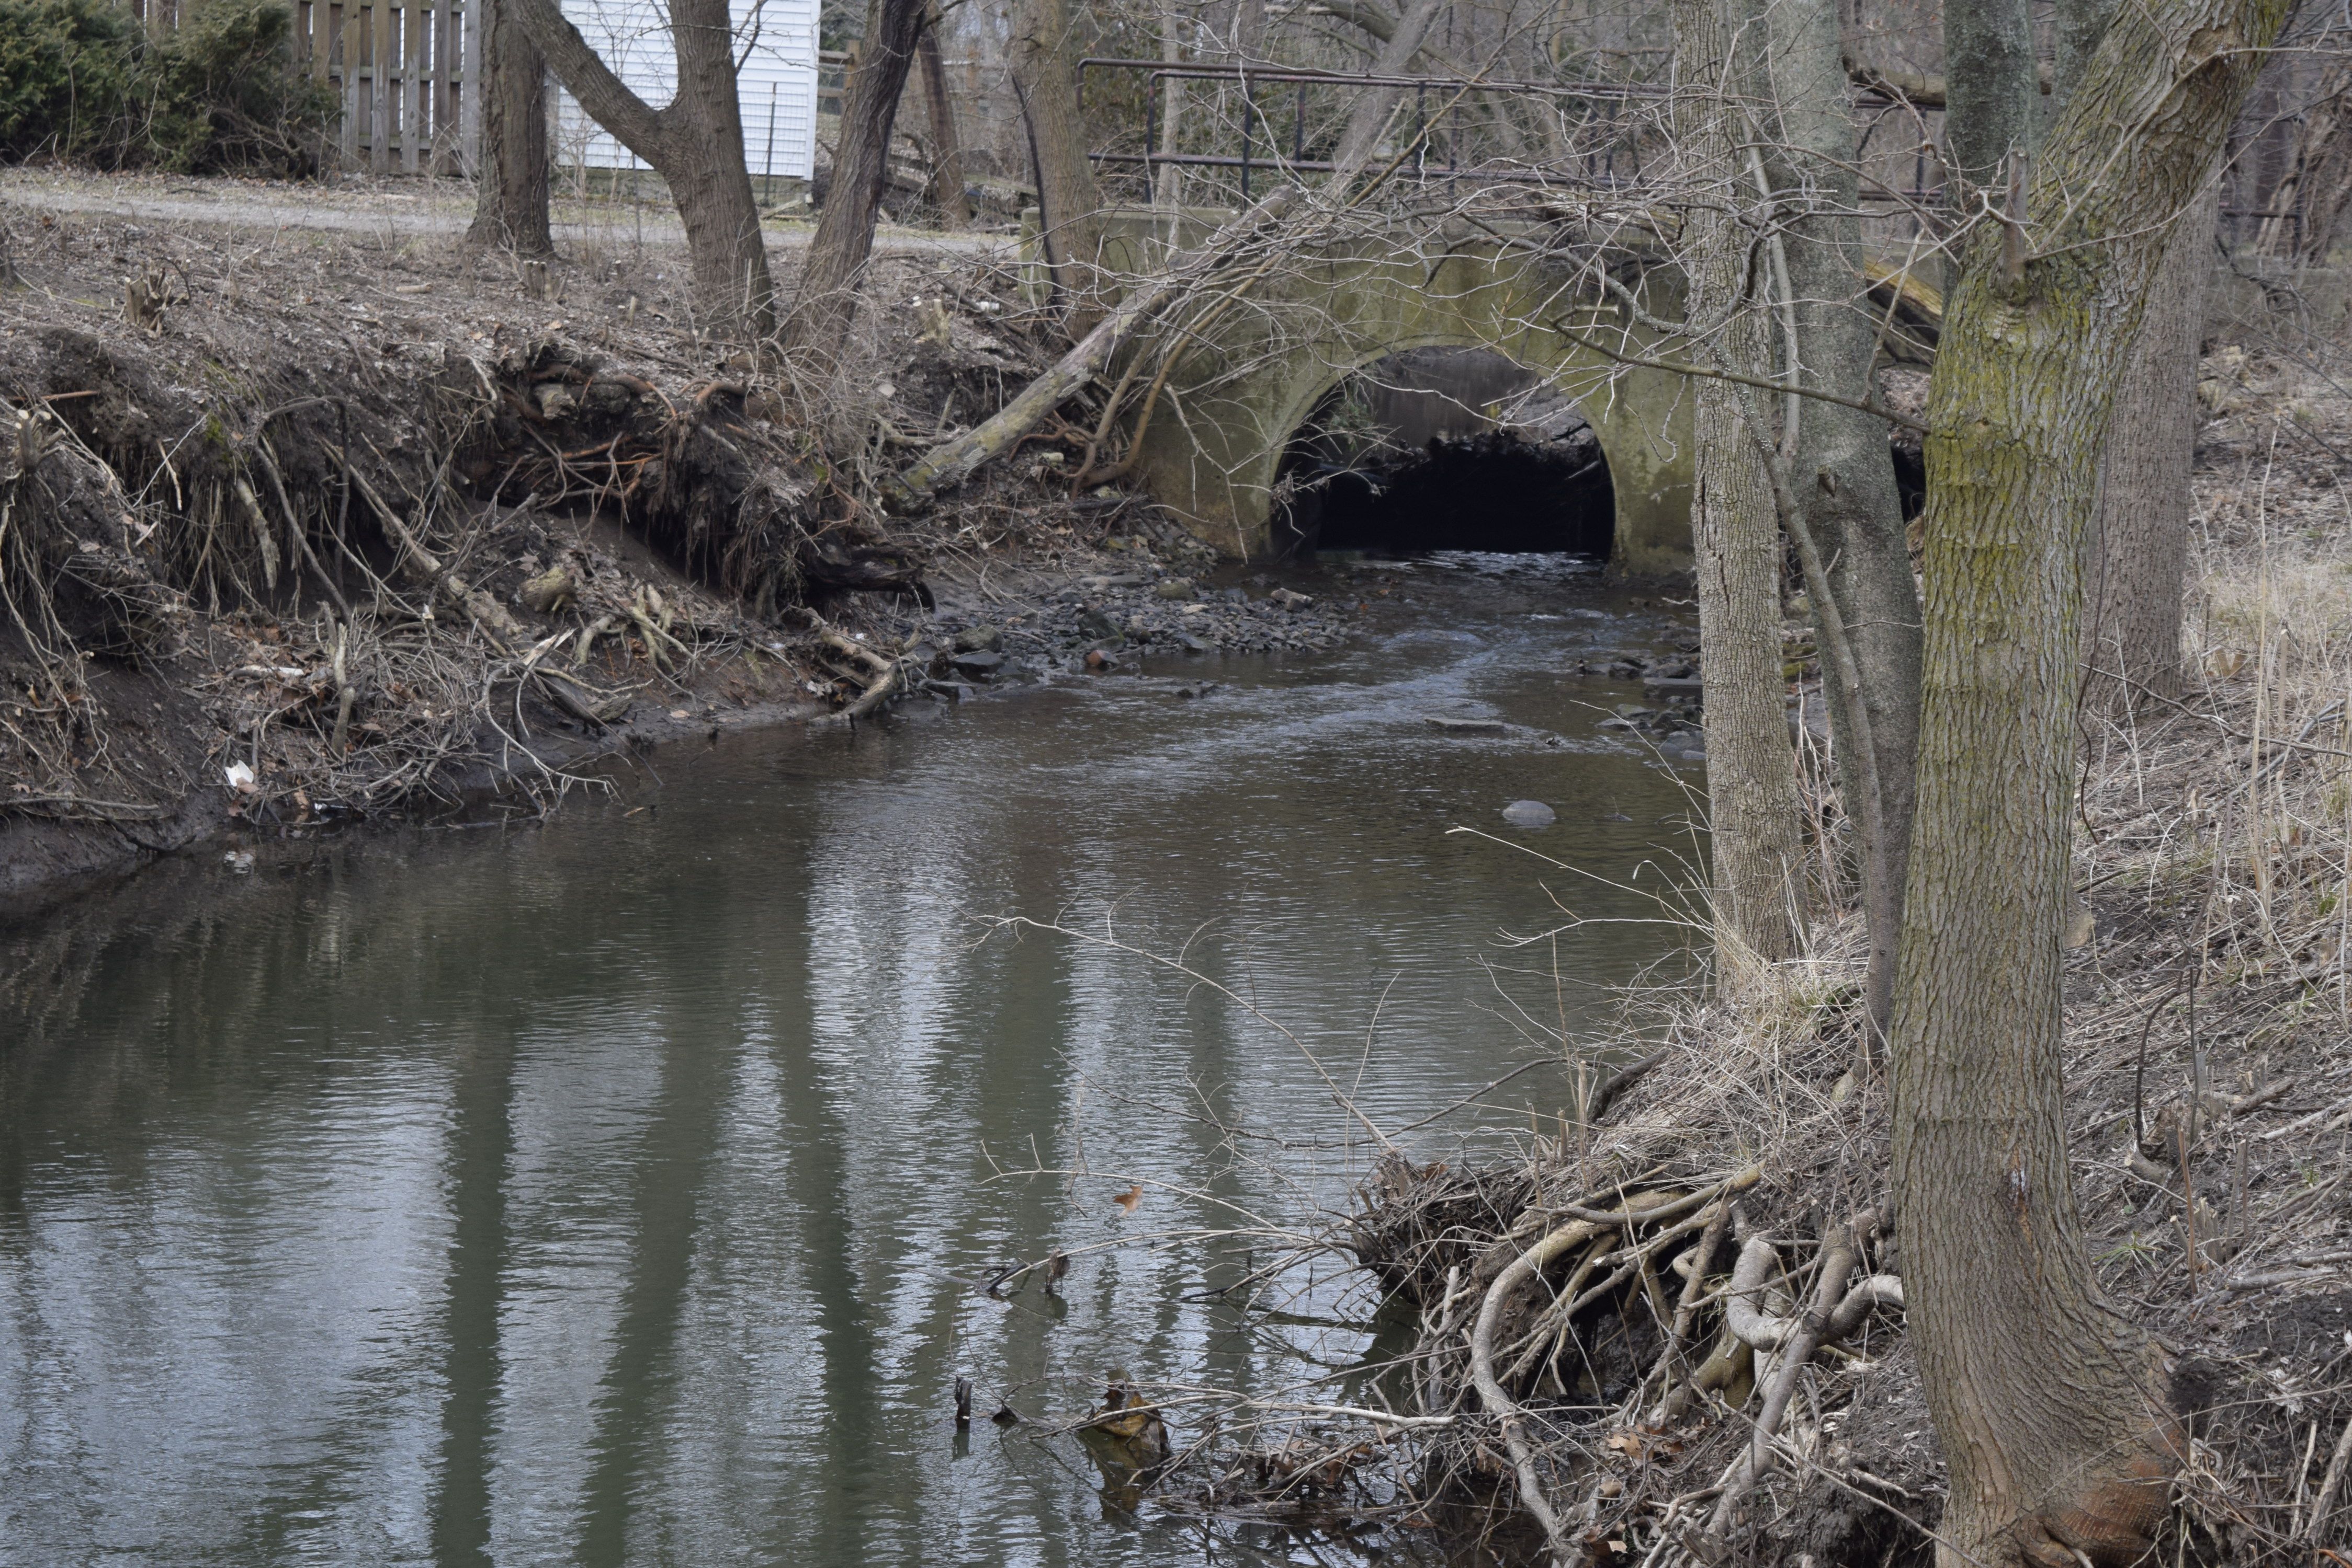
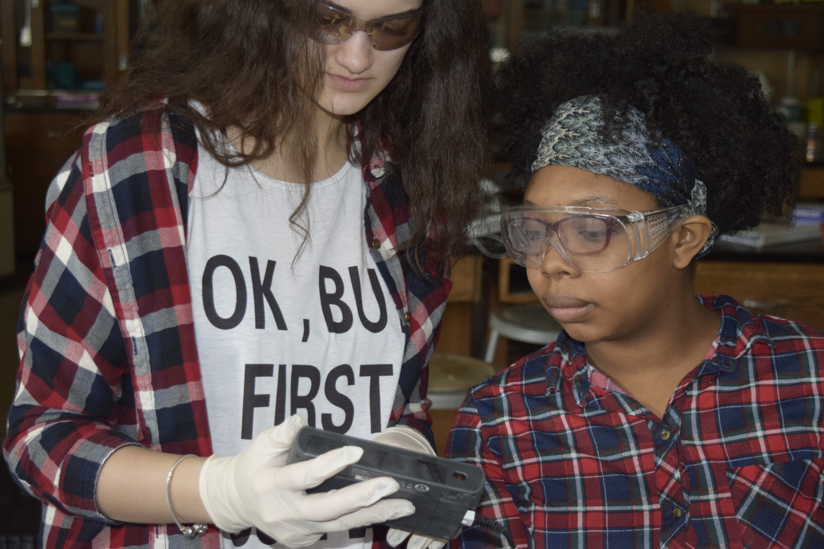
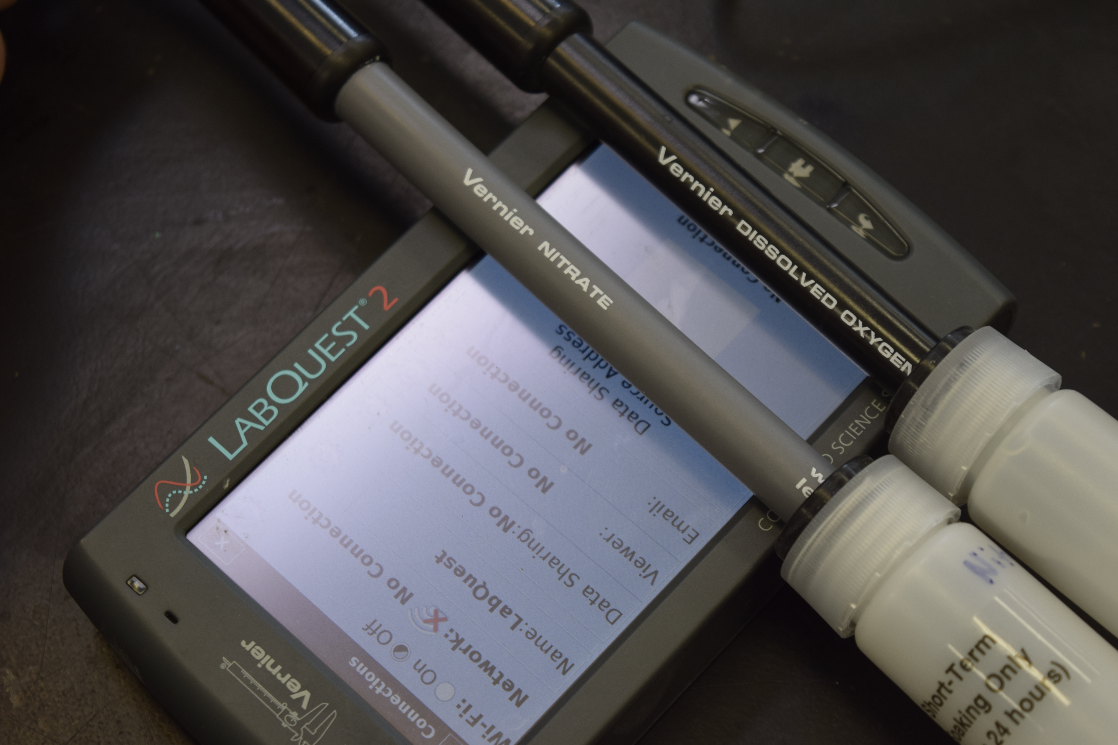
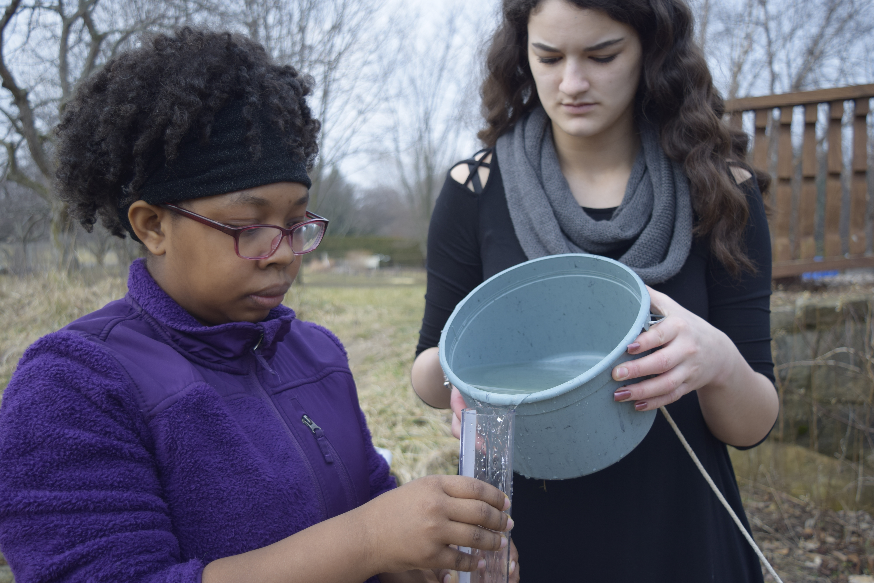
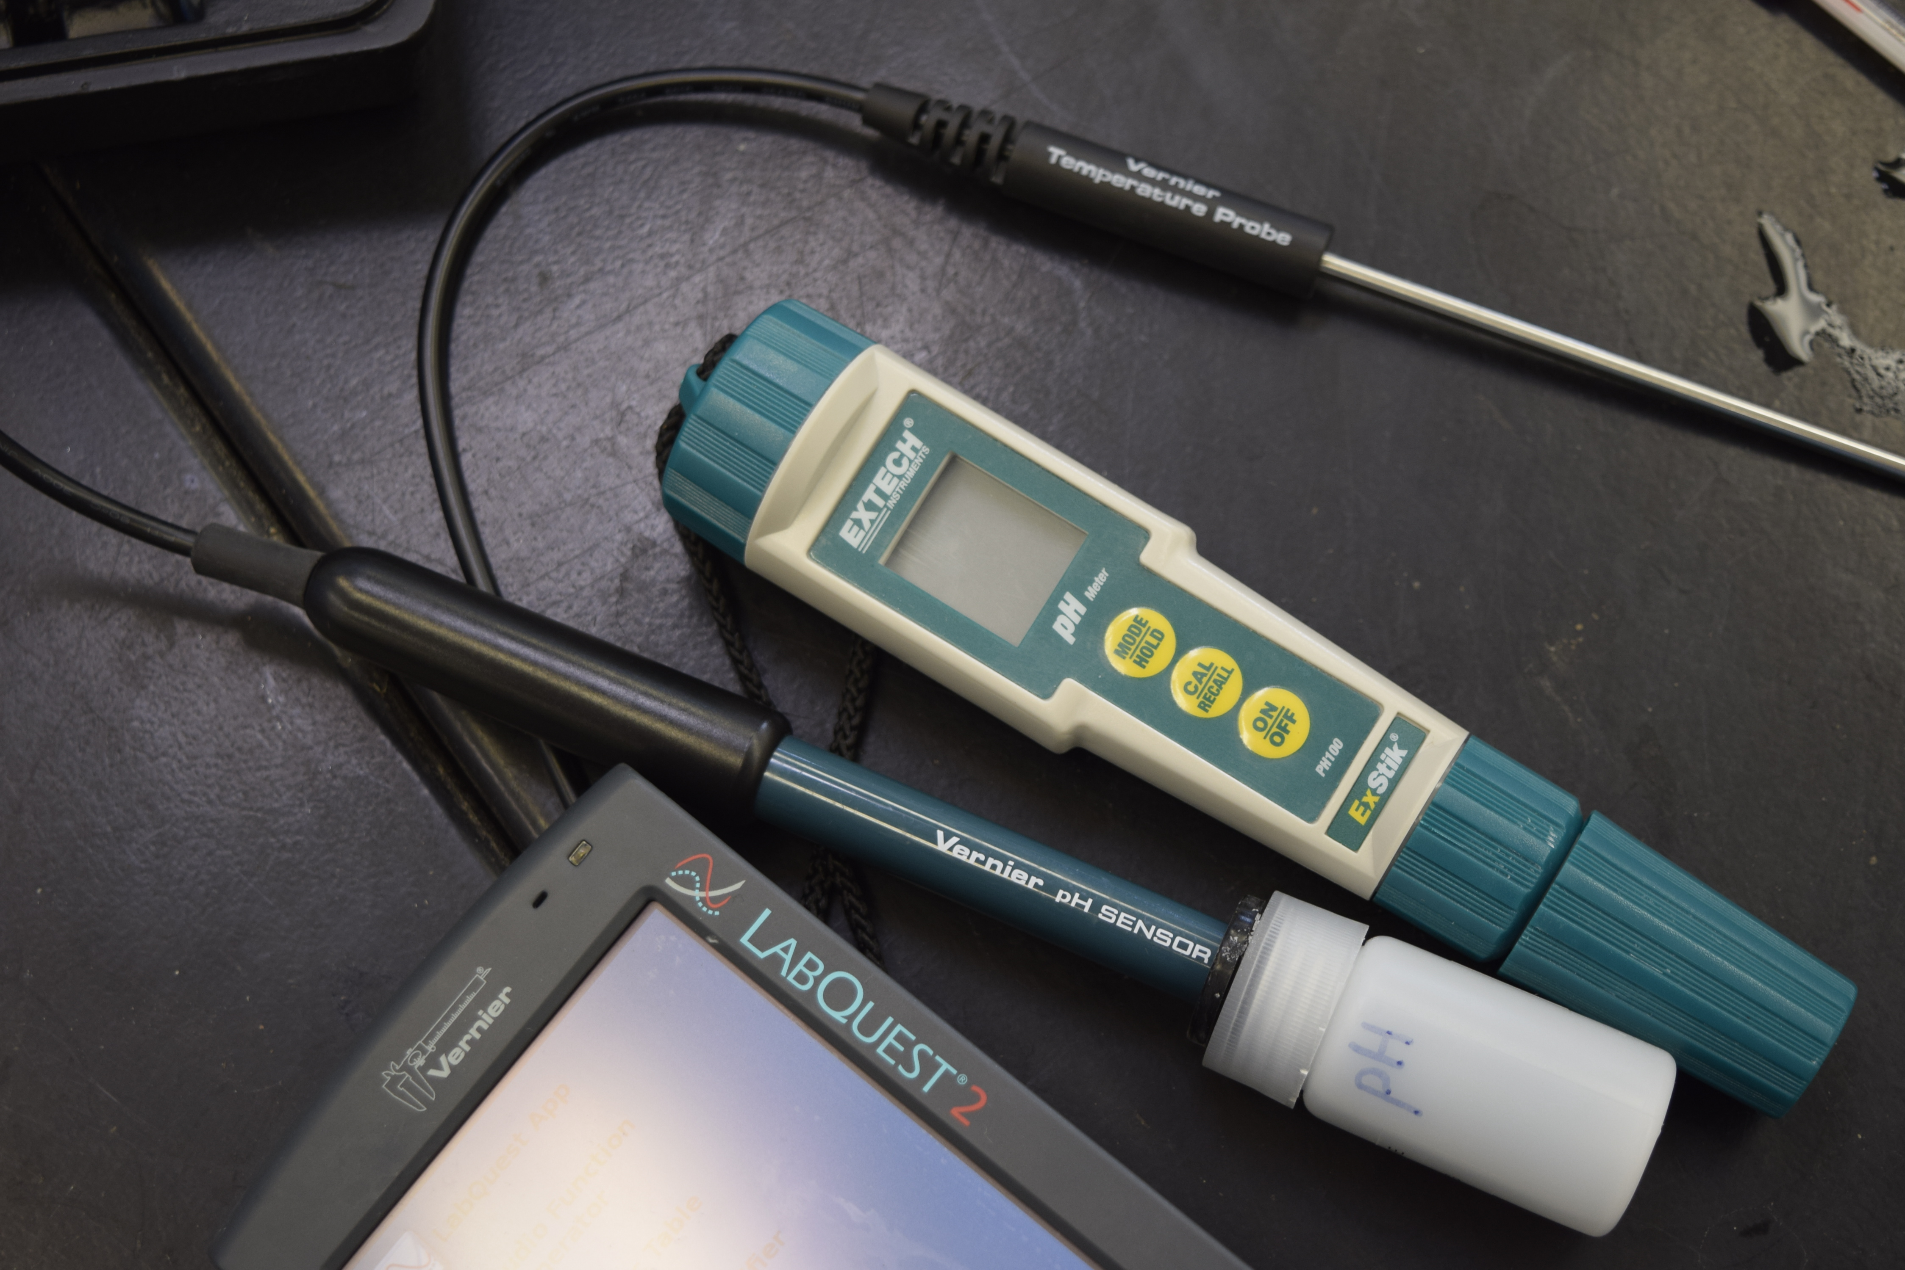
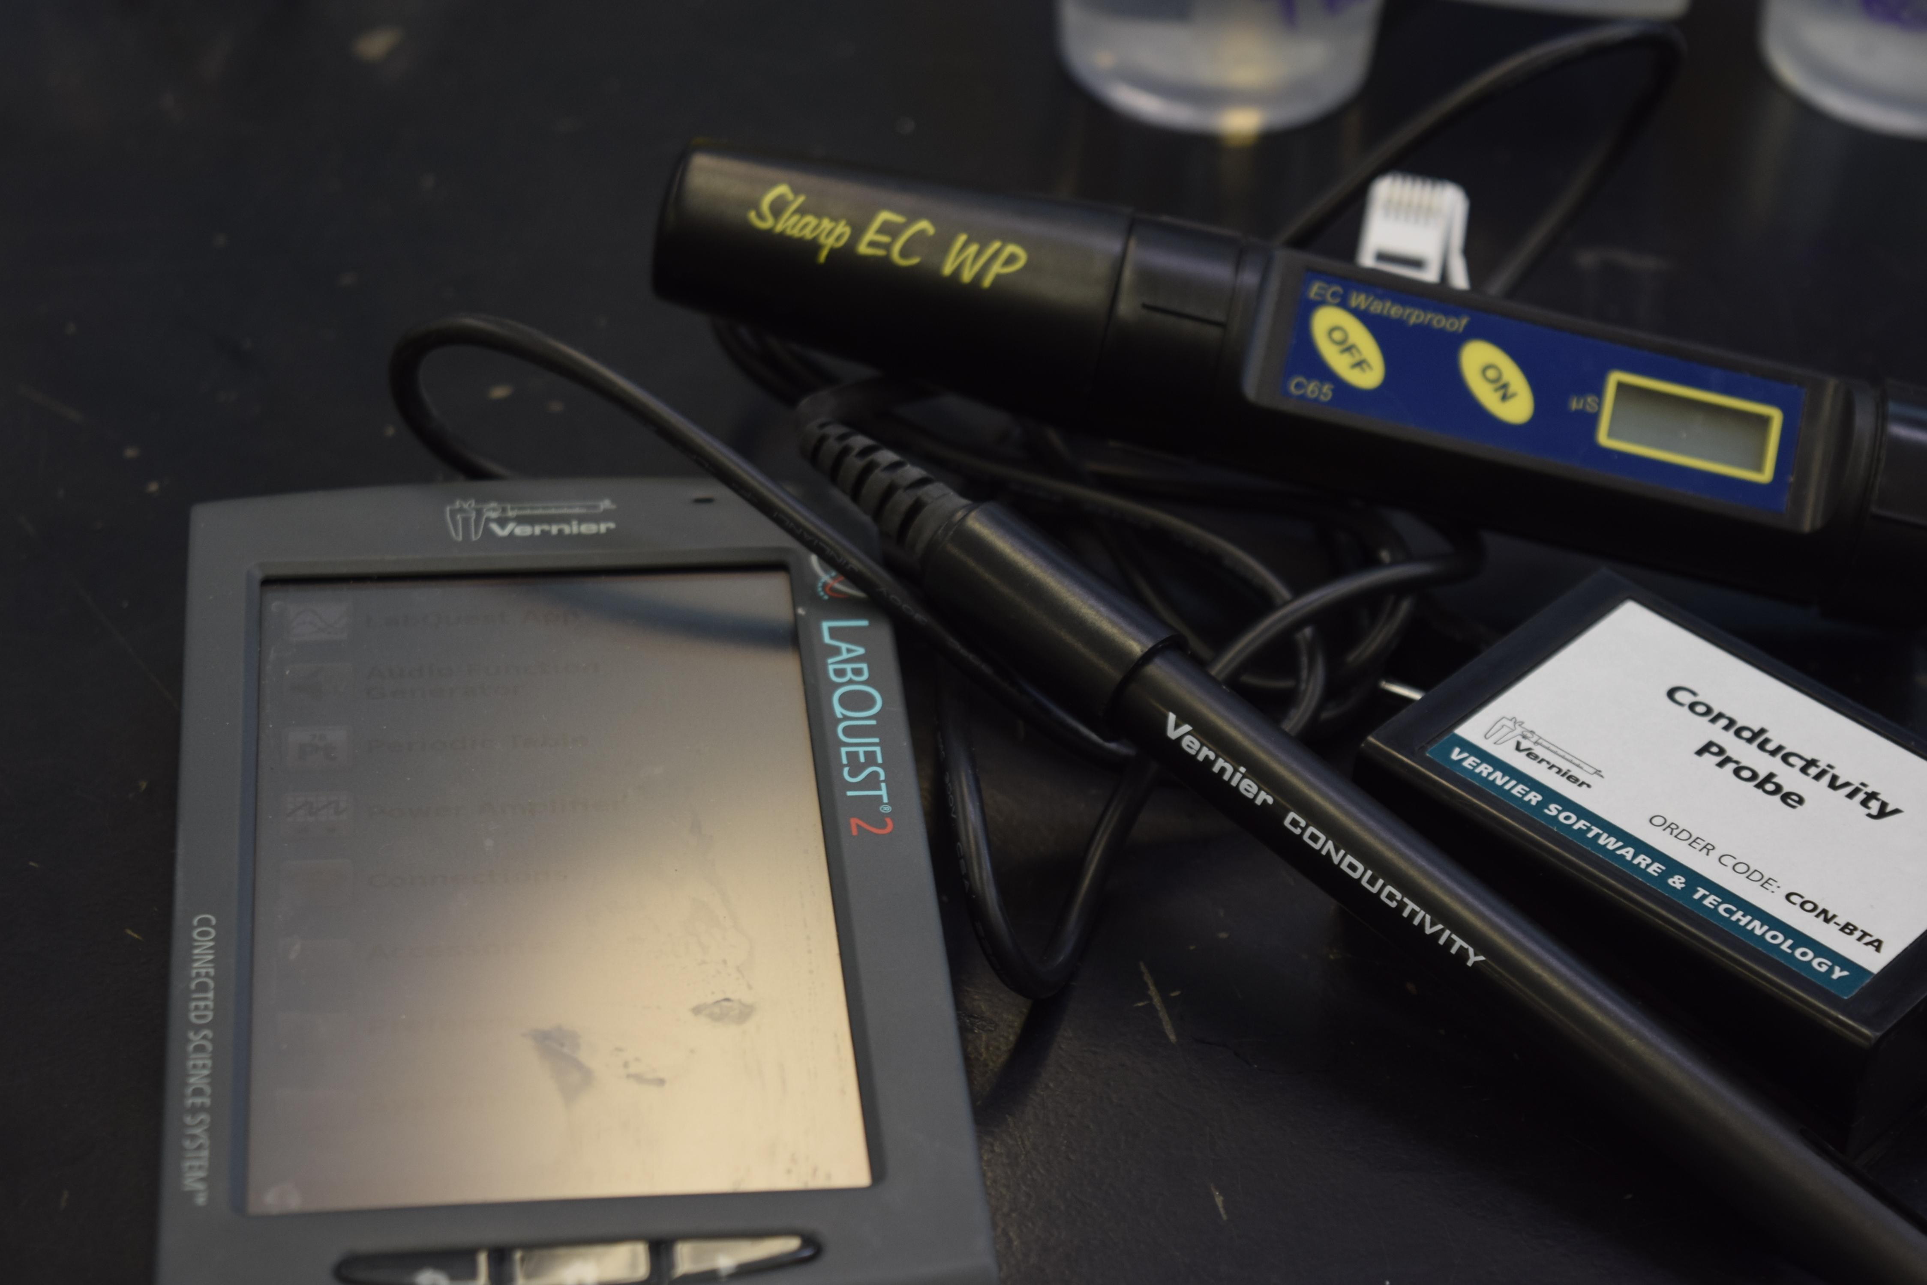
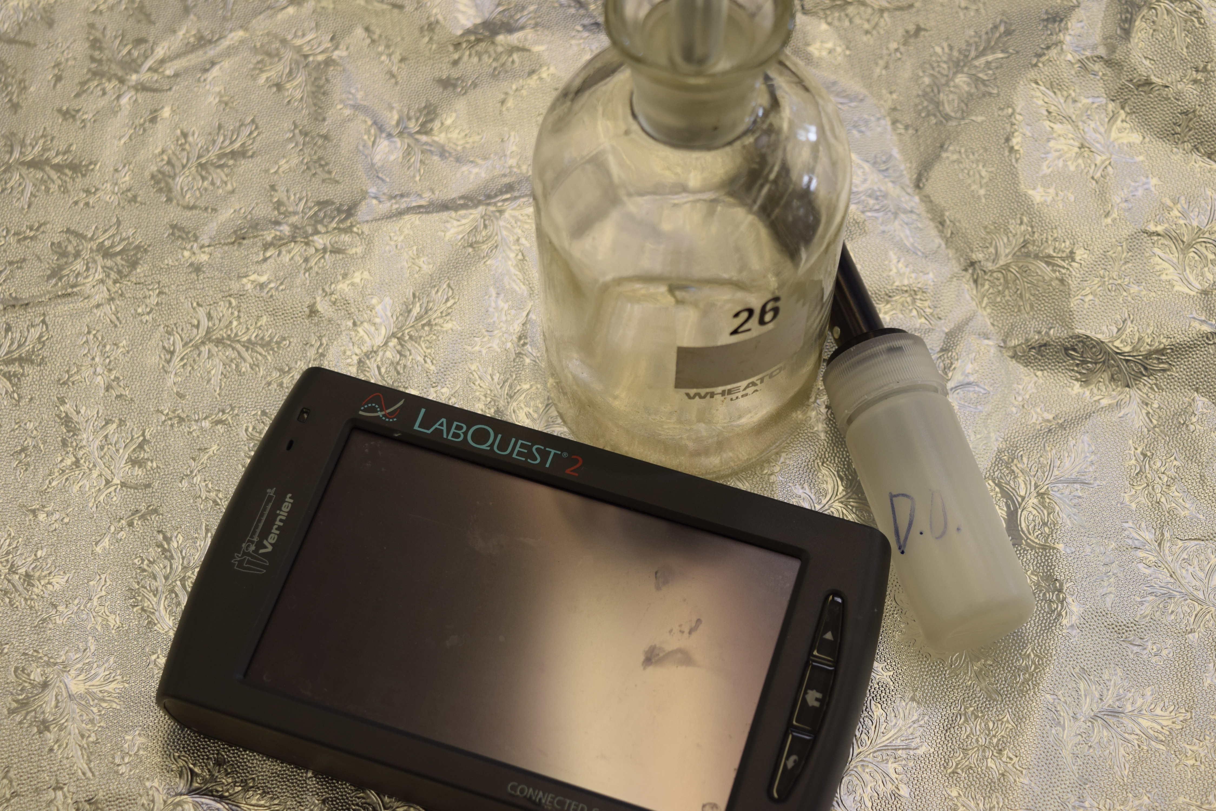
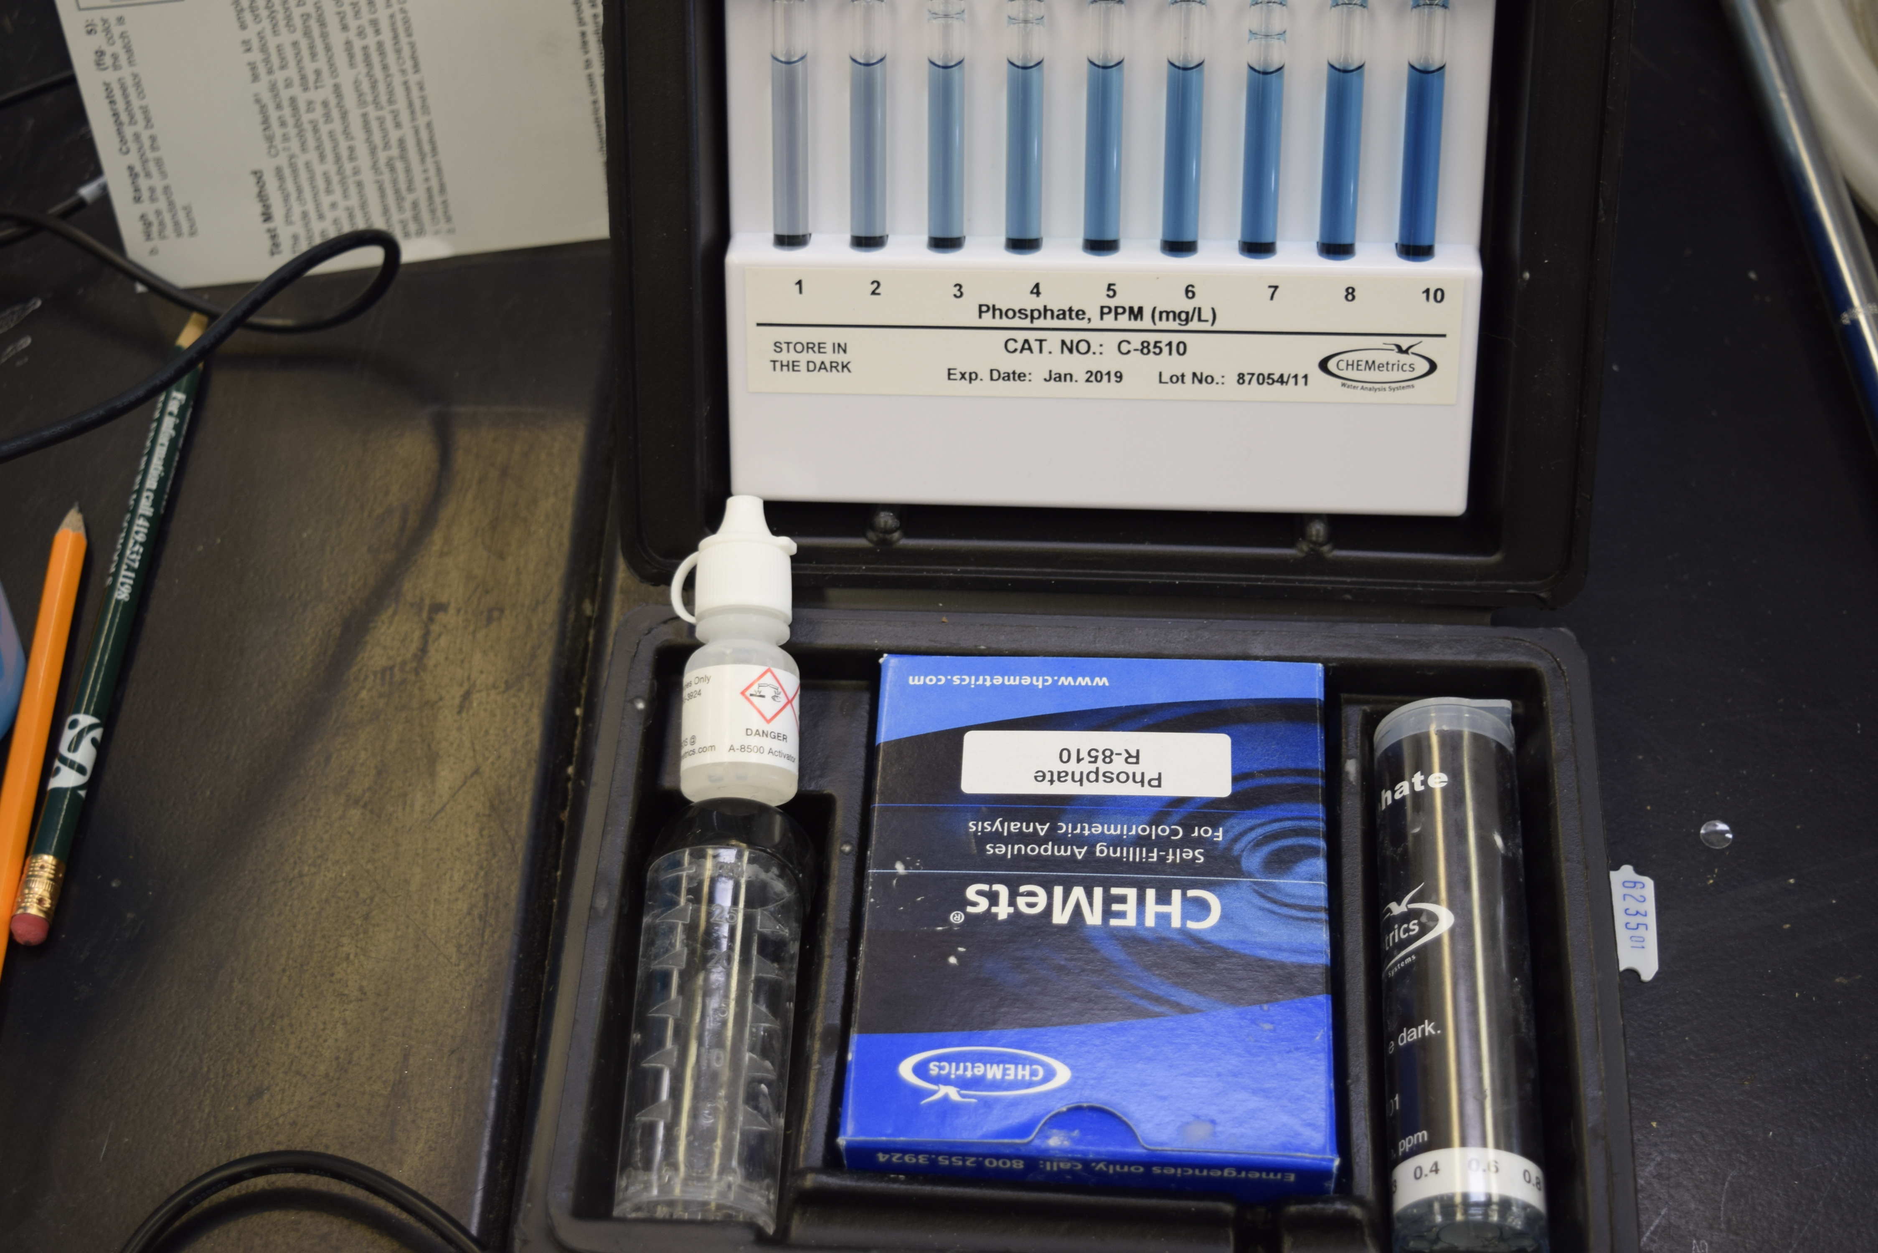
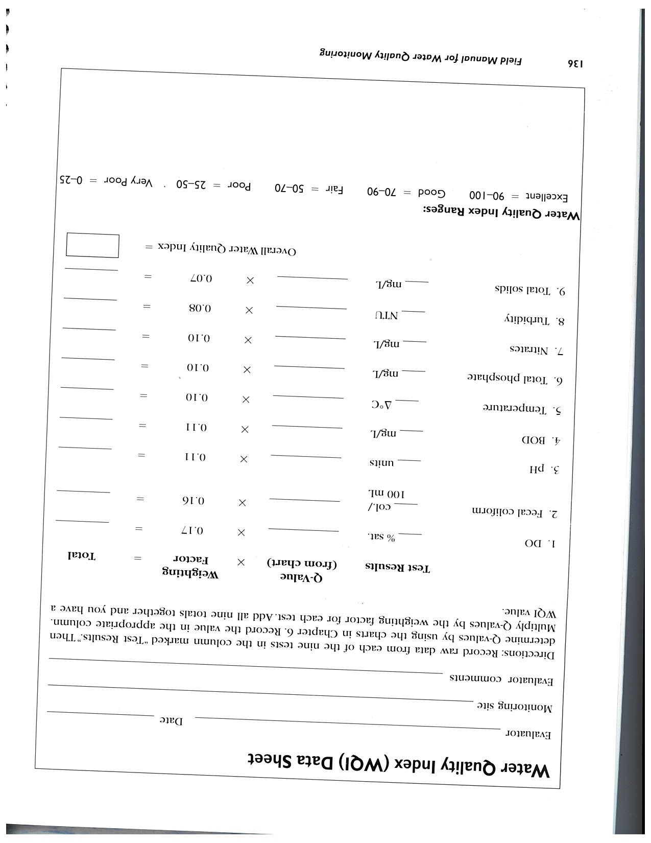
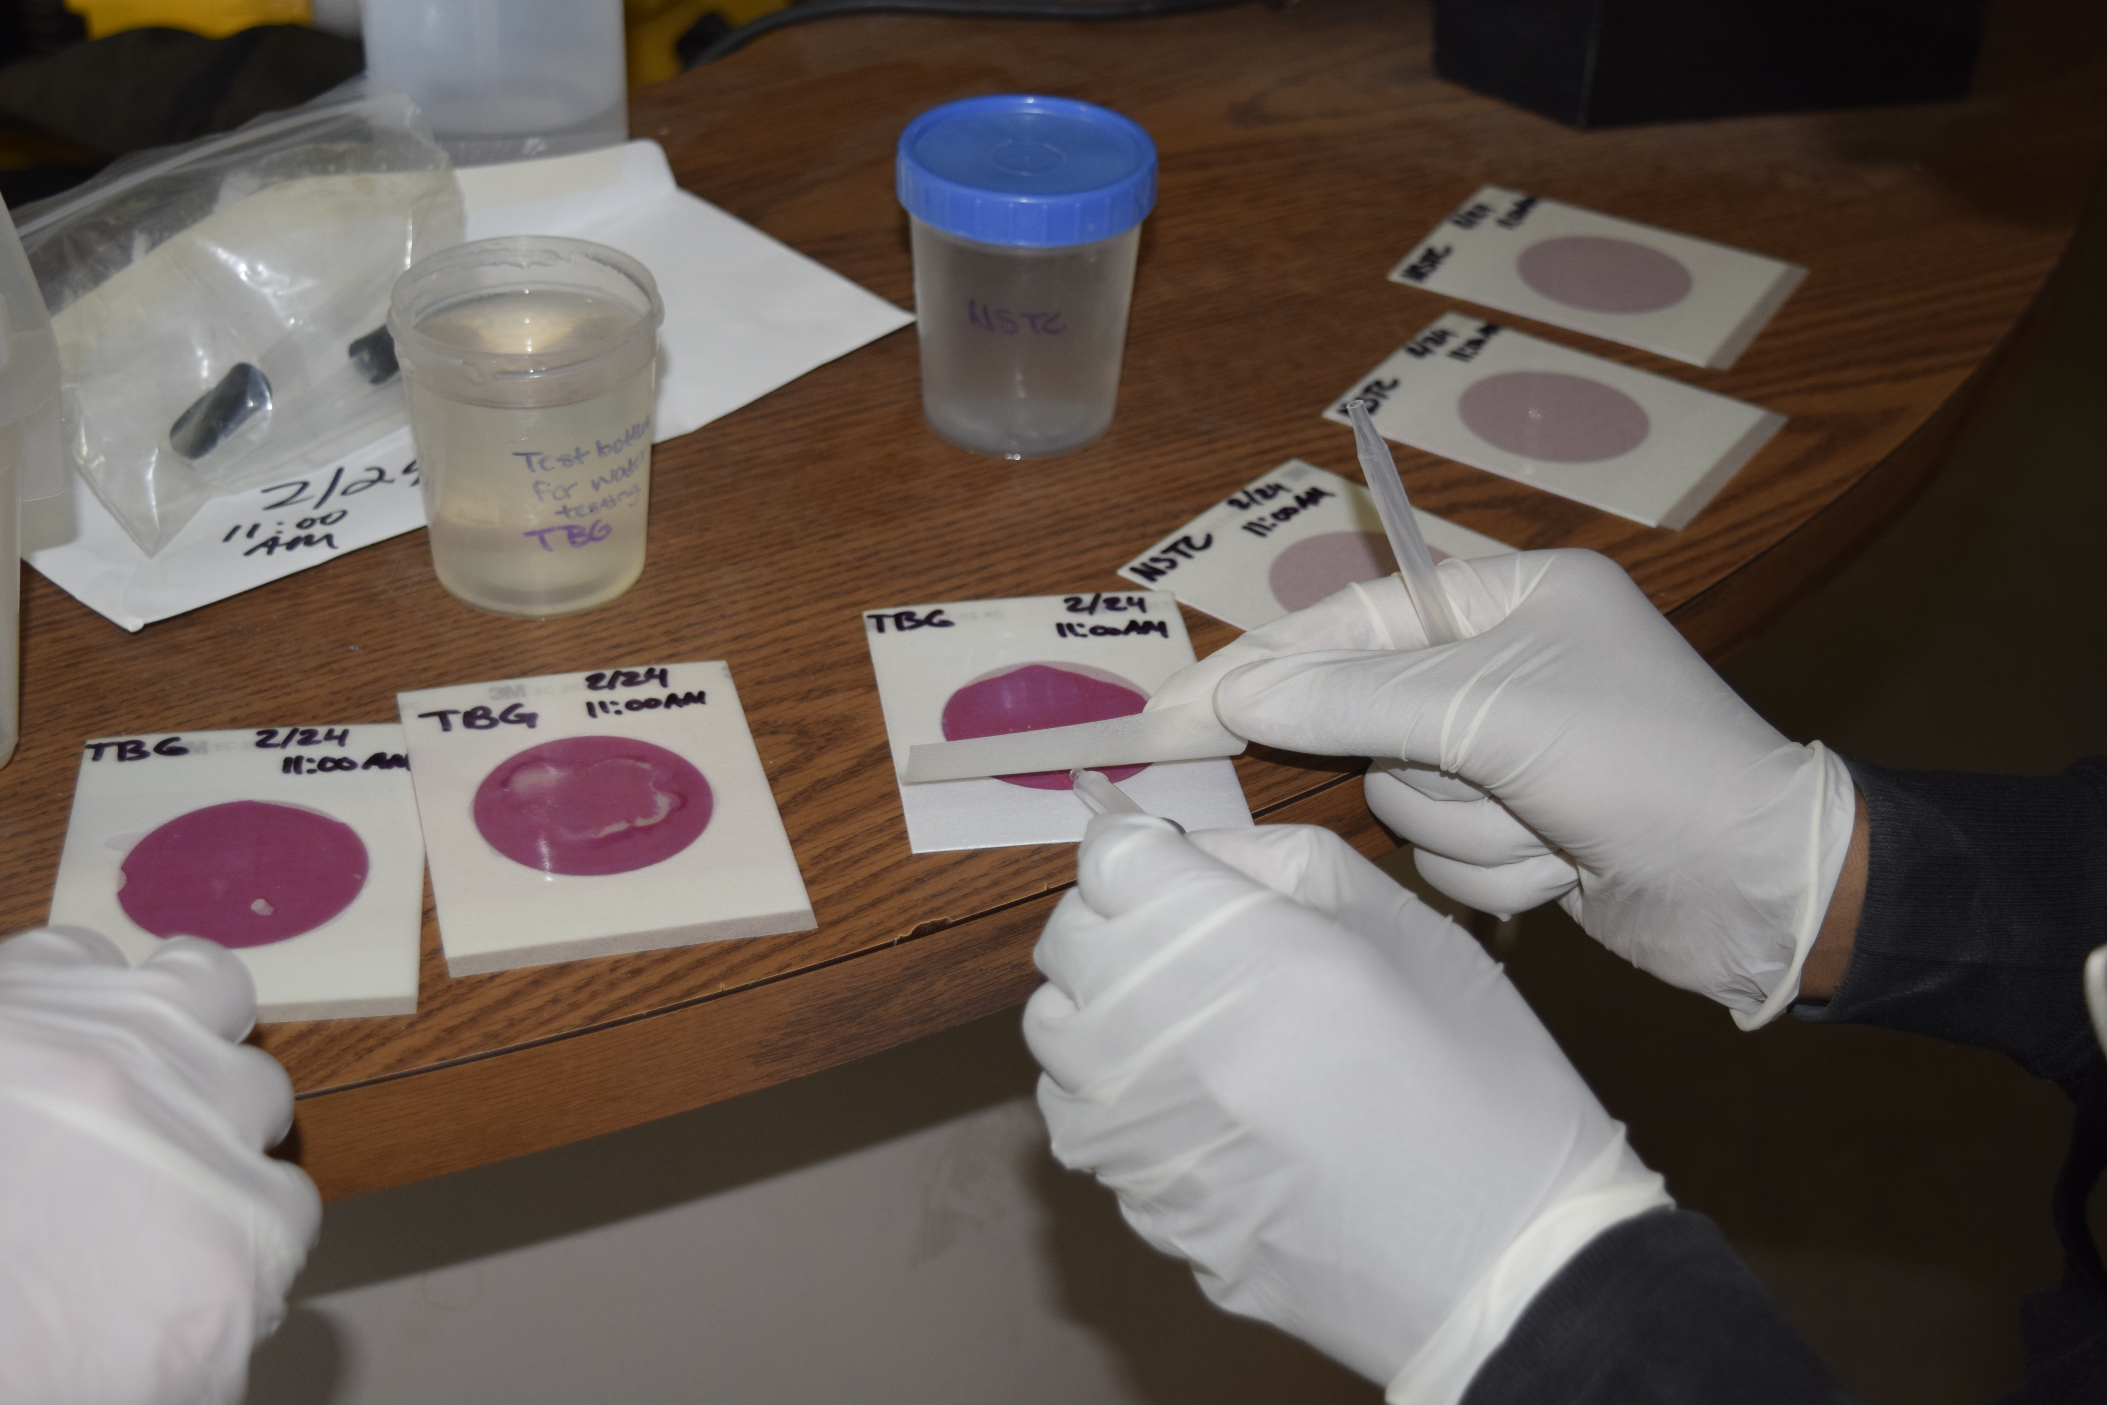
Comparative Water Quality Index in Restored Waterways
Audrie Hunt and Toyseana Stewart
Toledo Natural Science Technology Center
Introduction
Humans have lowered the quality of water. With strong data and dedicated scientists and citizens, waterways can be improved and restored, creating water quality that better supports the environment. Our project tests the water quality of the same stream, Hill Ditch, but two separate parts of it: one behind the school – Natural Science Technology Center (NSTC), and the other flows through Toledo Botanical Gardens (TBG). The TBG site has been previously restored, while NSTC has never been restored.
An overall score is given to a hydrology site, called a water quality index based on the following parameters: temperature, total phosphorus, biochemical oxygen demand (BOD), dissolved oxygen (DO), pH, nitrates, turbidity, total solids, and fecal coliform. Each test result is given a q-value from a chart, which is multiplied by a weighting factor. The sum of these totals determine an overall score which paints a picture of the site’s water quality. Temperature matters because certain types of organisms survive in certain temperature ranges; temperature changes also can change other parameters’ values. Phosphorus is both a nutrient found in all living things as well as a mineral in nature. It feeds plants to the point of overgrowth, then plants will die off and those in or near a stream will decay and oxygen levels drop from the decomposition. Next is BOD, which measures the amount of oxygen consumed by microorganisms in the process of decomposing matter in stream water. Dissolved oxygen (DO) is the oxygen that has dissolved into the water for aquatic creatures to breathe. Fecal coliform is from human and warm-blooded animals. High levels of fecal coliform can make a person or animal drinking the water ill. Turbidity is the cloudiness of water which measures suspended solids, and total solids measure dissolved and undissolved material. A pH test measures hydrogen ion concentration on a scale of 0-14, where 7 is neutral, less than 7 is acidic and more than 7 is basic.
It was predicted that the TBG portion of Hill Ditch would have a better or higher water quality index score.
Google Earth image of two water testing sites
Abstract
This project attempts to solve the issues of the non-restored and eroded section of a stream, Hill Ditch, by testing its water quality compared to a restored section of the stream at TBG, ultimately to win a grant to restore the NSTC portion of the stream. Also, results will be shared with others so they know about water quality impacts. The importance of this research is that other people can help in a way that helps not only local water, but also global water. Results showed that TBG and NSTC had very similar overall water quality scores, with NSTC having a slightly higher score because the TBG site had higher counts of fecal coliform. Regardless of stream restoration, all waterways connect and are affected by sites upstream. These results will be shared with TBG and potential grant funders to show how NSTC’s water site might be affecting downstream sites. The next step of this research would be a long-term study to compare how all four seasons affect water quality.
Figure 1. NASA SMAP SATELLITE IMAGE OF GLOBAL SOIL MOISTURE DISTRIBUTION
Results/Graph(s)
Figure 1
Figure 3
Figure 2
Objective
The goal of this project is to determine which stream has better water quality. Since the Toledo Botanical Gardens site has been restored, maybe sharing these results could aid in getting a grant for the Natural Science Technology Center’s stream section to be restored.
This project will determine which stream has better living conditions
for the betterment of the wildlife.
Methods
Collect water samples four times from two sites using bucket and rope
Restored site – Toledo Botanical Gardens, Hill Ditch Non-restored site – Natural Science Technology Center, Hill Ditch
Use GLOBE hydrology protocols to analyze water to find conductivity, DO, pH, temperature, nitrates, and turbidity. Share data on GLOBE website
Vernier labquest, DO and Nitrate probes Measuring with Turbidity tube pH and temperature instruments Conductivity instruments BOD instruments
Analyze total phosphate using hach kit
Analyze total solids using truncheon blue lab nutrient meter phosphate test kit
Collect fecal coliform data using 3M Petrifilms
Average nine parameters from each site
Found the Q-Value for each parameter petrifilm fecal coliform test
Multiplied Q-Value to weighting factor to receive Overall Water Quality Index Water Quality Index Calculation Data Sheet
Conclusions
According to the Water Quality Index scoring, TBG had an overall water quality score of 60 and NSTC had an overall water quality score of 62 (see Figure 1), which are both in the medium range
Between the two sites, most individual parameters were in the same range (see figure 3) with turbidity and total solids in the very poor range; BOD in the poor range; pH and nitrates in the good range; and total phosphates and temperature change in the excellent range. DO was excellent at NSTC and good at TBG. Fecal coliform was in the poor range at NSTC and in the very poor range at TBG.
According to classmate, Jazzary Drake’s analysis the higher levels of fecal coliform at TBG are likely from the ducks and geese who were not present at NSTC. There are also residences with septic tanks along Hill Ditch.
The very poor turbidity level could be caused by soil erosion, which was clearly observed at NSTC’s undercut stream bank.
Total solids’ score of very poor could be caused by runoff from salted roads, flowing through water regardless of restoration.
NSTC’s unrestored site with potential soil erosion could be flowing downstream to TBG’s restored site, affecting their turbidity and overall water quality.
Despite TBG’s stream restoration, their water quality is at-risk because of sites upstream with pollution. Restoring their upstream neighbor, NSTC’s site could improve the overall water quality of both NSTC and TBG.
This project’s hypothesis of a restored stream having higher water quality was not supported. The water quality at the two sites were overall very close, with a slightly higher score at NSTC.
Acknowledgements
BGSU and AEOP
GLOBE Program and Mission Earth
Ms. Laura Schetter, Mr. Bryan Ellis, Mr. Steve Oswanski
Classmates: Jazzary Drake and Kile Kennedy
Toledo Botanical Gardens
References
Background information and protocols from Globe.gov
http://earthforce.org/GreenSchoolsConnect/water/
Weather underground website
Field Guide for Water Quality Monitoring by Mark Mitchell
Flinn Scientific Water Quality Index Student Booklet
Google Earth

