Slide 1


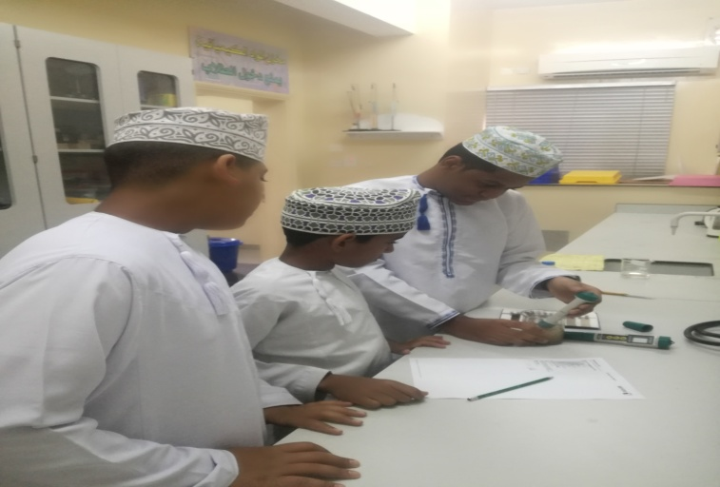
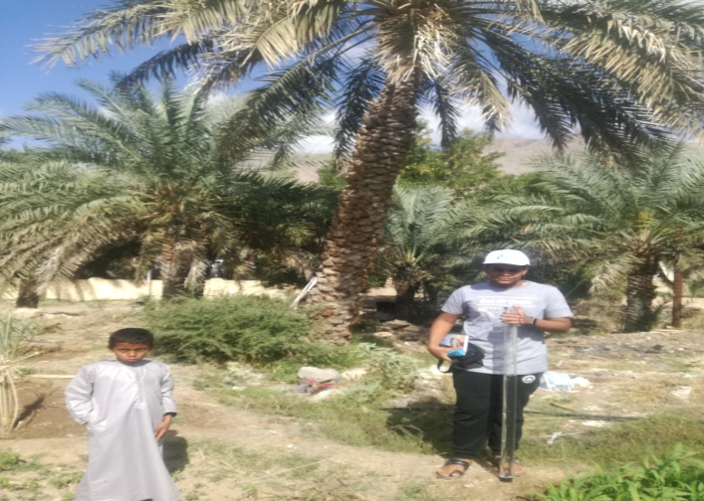
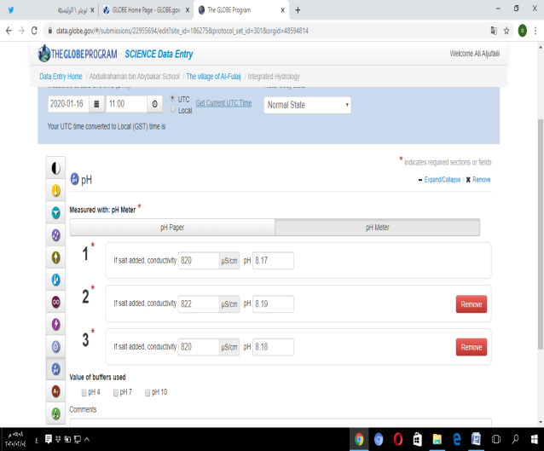
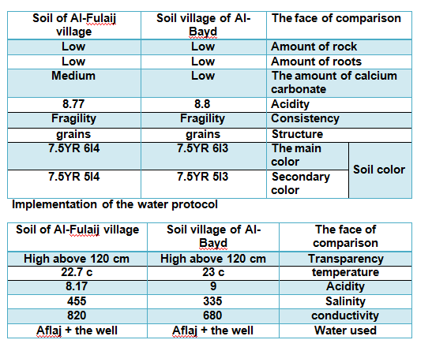
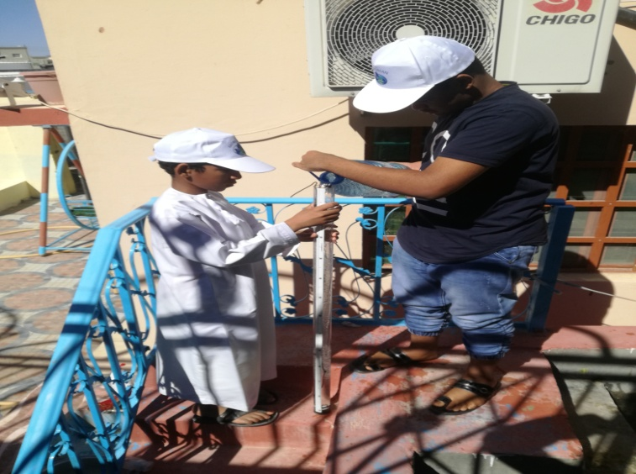
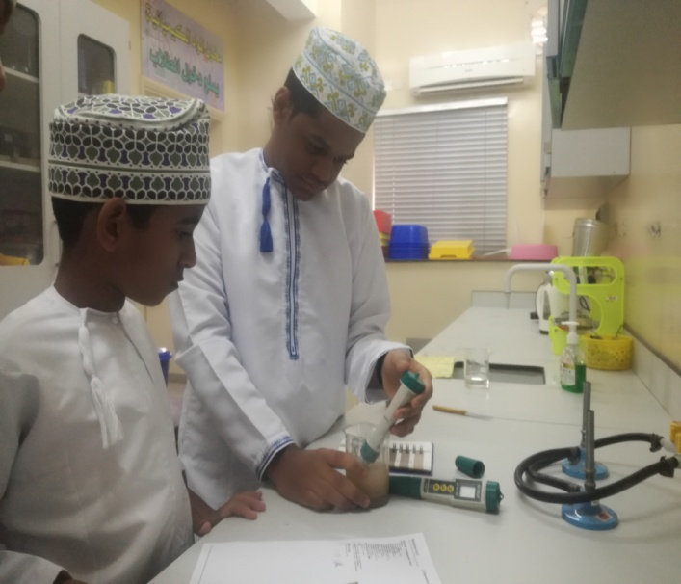
A compIn the village of Al-Bayd and village Al-Fulaij
arative study of Al naghal palm tree
Sultanate of Oman
Abdul Rahman bin Abi Bakr preliminary boys school (5- 9)
Ali Rashid Salem Al-Jufaili
Abdul Rahman Abdullah Hamid Al-Dhawi
Salem Hamad Salem Al-Mamari
Mohammed Salem Mohammed Al-Harthi
The two villages of Al-Fulaij in Ibra and Wilayat Al-Bayd in the state of Dima and Al-Ta'ayin in the North Eastern Province in the Sultanate of Oman were searched to compare the maturity of Al- naghal palm trees with their moisture.
The results showed the effect of both the rise in temperature and the geographical location on the velocity of wet formation of the palm tree in the village of El Baid, compared to the village of Al Fulaij, as the village of Al Baid is surrounded by mountains.
1- Does high temperature contribute to the rapid formation of wet palm trees?
2- How does high humidity affect the speed of wetness in palm trees?
3- Did the geographical location contribute to the rapid formation of wet palm trees?
4- Are there practices by farmers that have contributed to the rapid formation of wet for palm trees?.
1- Ibrahim, Abdel Baset Odeh. (2008). Date palm tree of life. Dar Degla Publishers and Distributors.
2- Diwan of Royal Court. (2019). Climatic factors specific to palm cultivation. General Directorate of the project to plant a million palm trees.
3- Zayed, Abdel Wahab, Al-Jabouri, Hamid Jasim. (2006). Date palm cultivation and production technology. Cairo, FAO Regional Office for the Near East.
4- Matar, Abdul Amir. (1991). Palm cultivation and production. Basra. Albasrah university.
Search Plan
Research timeline setting.
Distribution of tasks to the research team, in preparing tools and field work.
Searching for previous studies and information related to the research topic
Choose the search sites, collect information about them, and select them, in order to start collecting important information for the search
Determine the appropriate devices and tools to carry out the research
Apply protocols (atmosphere + water + soil)
Data collection and processing graphically.
Entering data related to the application of the soil and water protocols to the site (www.GLOBE.gov)
Conducting targeted interviews.
Finding and discussing the results and recommendations.
Research site: farm from Al-Fulaij village and one from Al-Baid village in North-Sharkia governorate
Data collection and analysis.
Interviews (farmers)
After we applied the study in both locations and collected the data that had to answer the research questions that determined the research plan, one of our most important results was:
The effect of high temperature in Al-Bayadh village, especially in the months of March and April, with a decrease in the relative humidity of this village compared to Al-Fulaij Village. It contributed significantly to the speed of wet ripening of palm trees, compared to the decrease in temperature and high relative humidity in Al-Fulaij village, which contributed negatively to the delay of ripening of the wetlands.

