Slide 1
Resilence act to reduce the impact of temperature change on larval mosquitos outbreak
Lycee Jacques Rabemananjara High School,
Salazamay Sud District Toamasina I
Toamasina , Madagascar

Slide 2
Research Team
GLOBE Students
1. RATOVOSON David
2. ZAFINANTENAINA Roméo Ejannick
3. MAHAVY Johny Geraldo
GLOBE Teachers
1. RABENANDRASANA Doris
2. TORA Adonis Ricardo

Slide 3
Research problem
In Toamasina , the east coast of Madagascar, malaria is still the cause of infant and adults mortality every year.
This disease is the result of the mosquito larval outbreak
This virulence has caused disabilities such as the inability of adults to work, paralyzing family life and even the economy of the region, as well as chronic weakness and stunting for children and adolescents
Most of organization such as globe program community has used malaria protocols and participated in the zika project. So, many breeding huts of mosquito larvae need second life

Slide 4
Research Objective
The research objective of the project was to:
Determine the principal factor that is caused the mosquito larvae outbreak and making action to reduce this larval proliferation

Slide 5
Research Question
The research question for the project was:
What is the relationship between the temperature and this larval proliferation and What can be done to make the fight against larval mosquito proliferation a resilience action for the sustainable development ?

Slide 6
Hypothesis
The hypothesis of the Project is that;
“During the hot period and at high temperature there is an intense proliferation of mosquito larvae if the place was predatory or less. And when the temperature decreases the proliferation of the larvae also decreases "But also, all actions against malaria will reduce larval proliferation and will be a commitment for social development”.

Slide 7
Research Methods
During the research, the students were initially trained on GLOBE Hydrology Protocol .
The students conducted their research in the area of school in the first , in them family house after and finally in villages around the School
The temperature data was collected daily using a thermomete for 2 or 3 months and the average of each well calculated.
The 2 where the data was collected were:

Slide 8
Research Results
Table 1 and II Number of mosquito larvae and temperature variation during 4 months in 2012

Slide 10
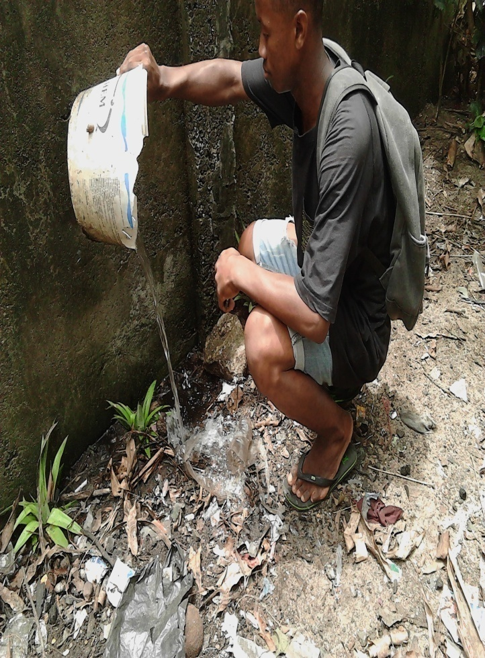
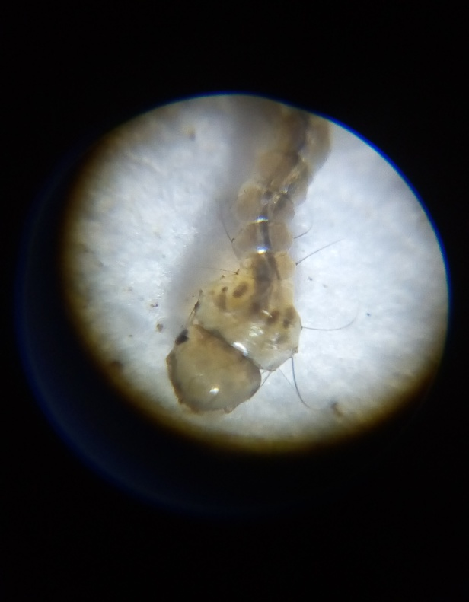
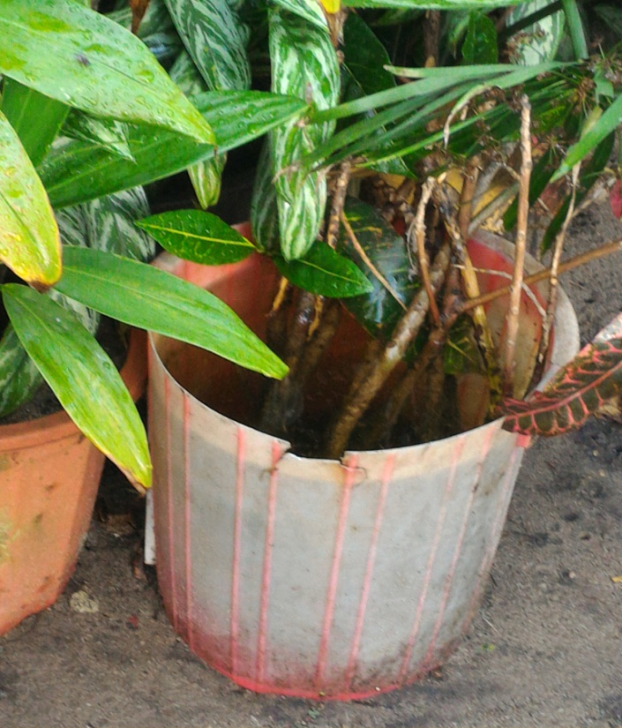
Making action to fight against malaria disease
Pictures showing some of action to reduce larval outbreak in the community and winner student by recycling breedings huts

Slide 11
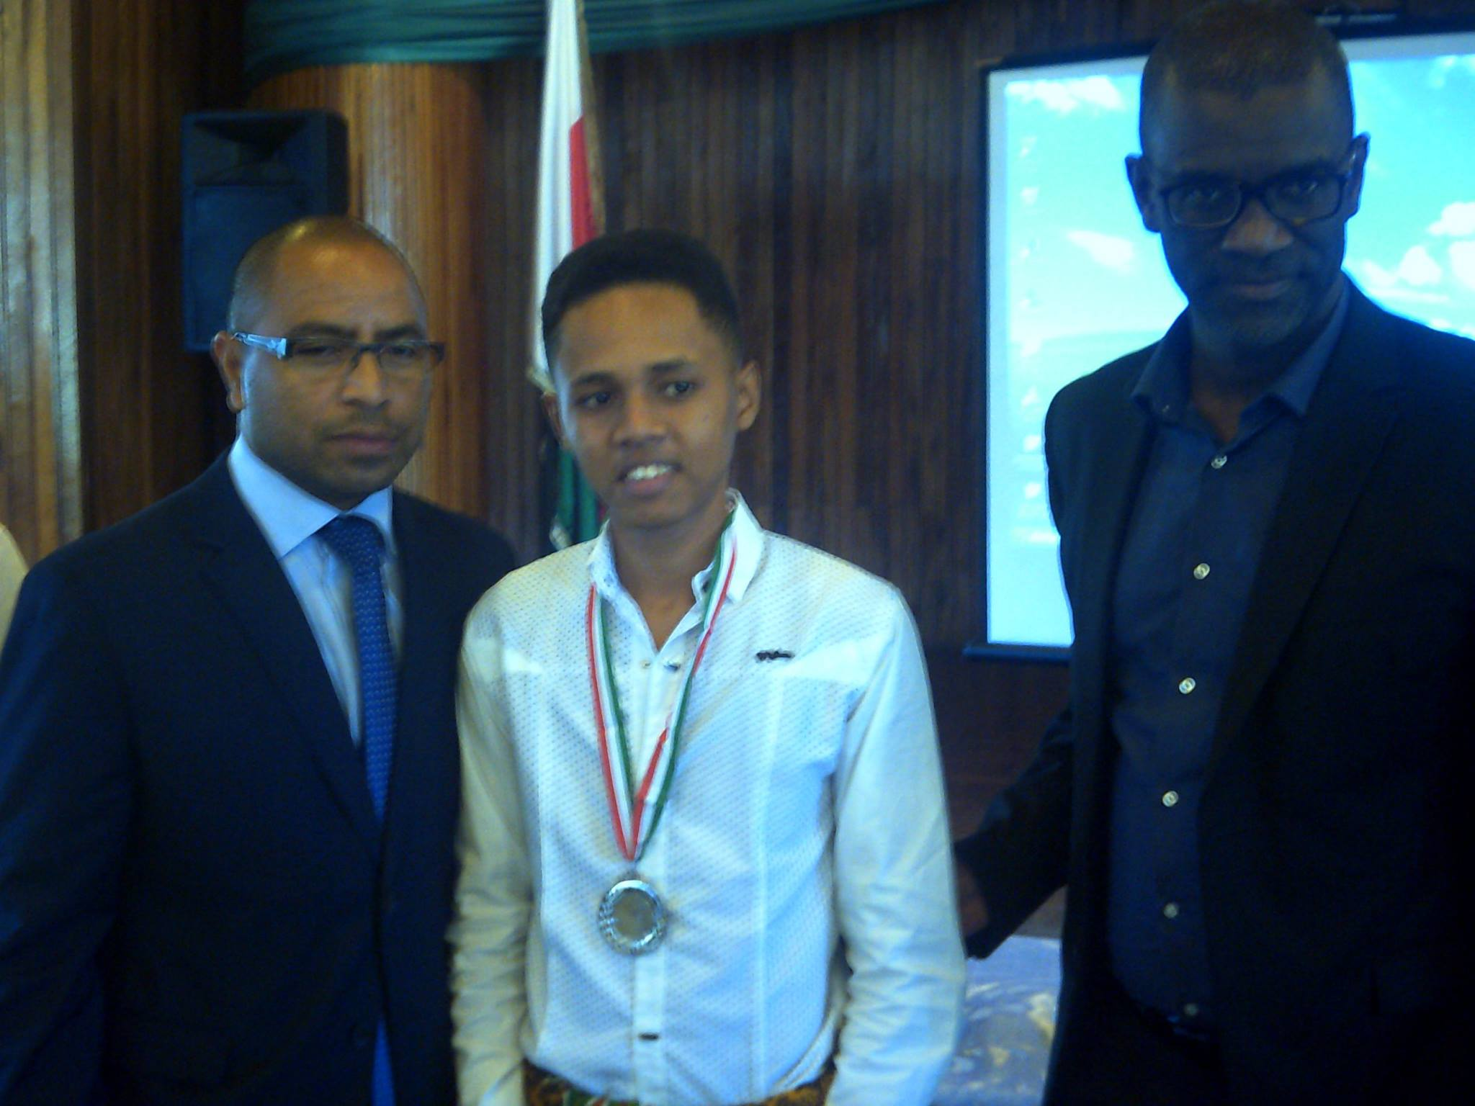

Slide 12
Conclusion
This indicated that the proliferation of mosquito larvae depends on the temperature and the absence of predators.
But it was necessary to making another research with an another factor to verify .
Then we recycled these breeding places ,so that they have a second useful life for us and the community

Slide 13
Recommendation
It was recommended to exploit the malaria protocol as a mosquito control and to stimulate the creativity of the guys to the benefit of the environment and them self
It was recommended that further research be undertaken to establish whether there is a link between the air temperature variation and the mosquito larvae outbreak
The students and the community members were advised to spill any objects that may store rainwater and raise awareness among over

Slide 14
References
The following were the reference resources used in this research;
GLOBE website (www.globe.gov)
Scientist publication
Thank You

