Slide 1
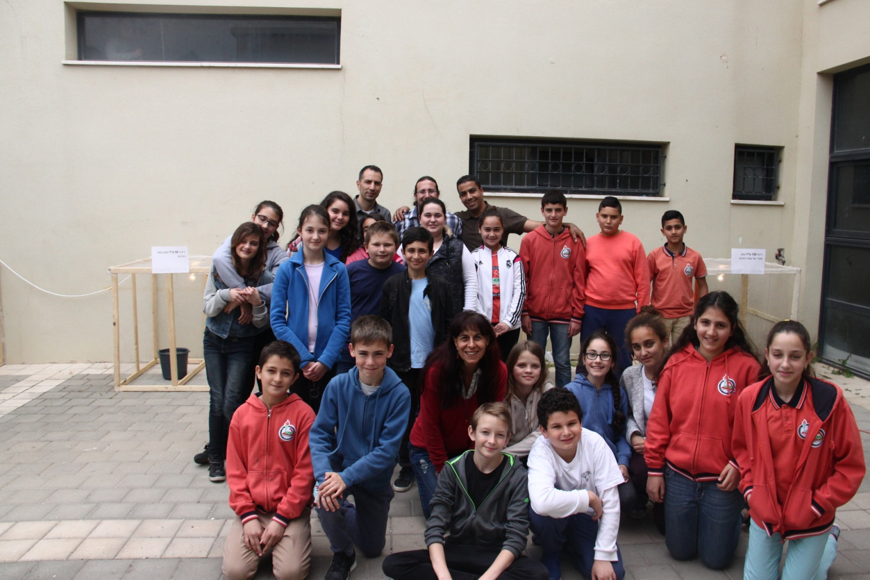
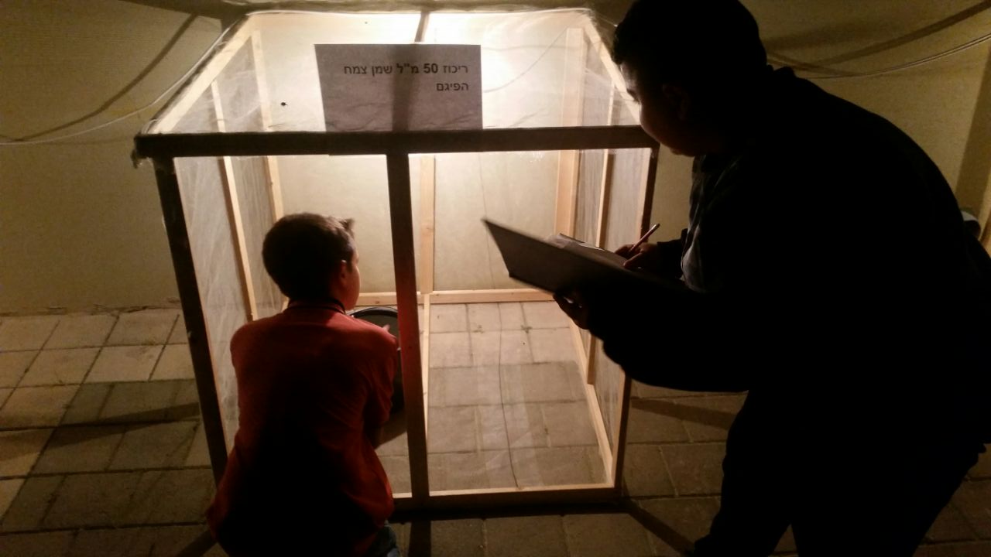
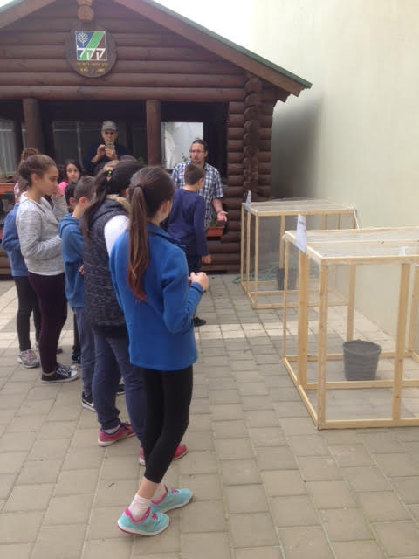
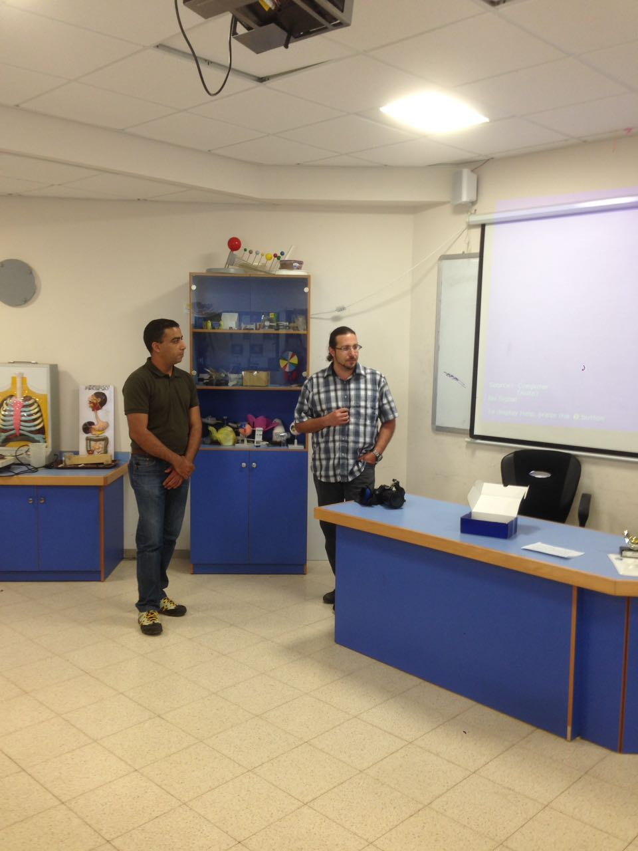
משרד החינוך
המזכירות הפדגוגית
אגף מדעים
הפיקוח על הוראת מדע וטכנולוגיה
The dedicated collaboration between the 2 schools contributed to create a reliable and quality research. The mutual goal of measuring the efficiency of the ethereal oil from the Ruta plant on number of mosquitoes around, served the purpose of the research in both schools. We hope this research will help people to defeat the mosquitoes annoyance through organic-biological pesticide and will keep the environment safe and clean from harmful chemicals.
The Effect of Different Amount of Concentrated Ethereal Oil from The Ruta on The Number of Mosquitoes Around.
Hypothesis –
The Ruta plant’s oil defeats insects and its leaves have very strong odor there for we assume the following:
1.The higher the amount of oil is the cage the smaller the number of mosquitoes.
2.The results in both schools will be pretty similar despite the different location and climate.
Procedure / Methods
The experiments bigan on 11th march in both schools. The lest test was on 16th march (6 days long).
There were 5 counting of the mosquitos in the cages in similar dates on both schools
we covered the 4 cages with mosquitos net and set the cages in the same location in equal distance between the cages.
In every cage we connected 60w light ball
In every cage we left 10 litters water gallon
We thin the oil with same cc of alcohol as we can see in the next table:
-Analysis and Conclusions
The goals of the research are the developing effective organic way to removal of environmental nuisance of mosquitos which adopt different environments. We do so by trying to preserve te environment and reduce damages to other organism.
From the results, we can conclude that we can use the ethereal oil of the rue for mosquitos removal. The results are match to our assumptions that a small amount of oil can reduce mosquitos. Never the less we assume, if we will change the way of spraing it (not necessary with alcohol) the results will by better.
We can defiantly say that the rue oil or plants, by taking advance its biological ingrediency can be effective biologic exterminator.
Recommendations
By the results, the conclusions ant long dissections on the results we surprised of the effectivity of rue oil on number of mosquitos and we are recommending about more researches.
The effectiveness ethereal rue oil on mosquitos larva in sweet water.
1. The influence of rubbing rue oil on the skin to reduce mosquitos bites.
2. The influence of the rue ethereal oil on some spices of bugs to reduce bugs from fields without damage the lend or harm other good bugs or organism.
3. The matching tests could be exsist only because the cooperation between two schools in different claimants and geographic locations. All above confirm the hypothesis.
Environmental Impacts-
The mutual collaboration between the 2 schools created a reliable and quality research. The pupils believe they work hard to help people to defeat the mosquitoes annoyance. They also hope that this research will contribute to keep nature and the environment from harmful chemicals by using the Ruta plant’s ethereal oil as an organic-biological pesticide which is easy to produce and friendly use.
Background -
The mosquitoes annoyance exists in many places around the world and in Israel as well. The bites are the most bothering. The mosquitoes known as disease transmitters and mainly the malaria. This disease is still one of the main death causes in the world .In 2009 225 million people got sick and in 2010 , 655,000 people died. Most death happened in Africa and southern the Sahara. The pioneers in Israel hoped by planting eucalyptus to defeat the Anopheles mosquitoes the carriers of malaria. Using DDT and other means helped reducing the number of sick people and for the last 40 years there is no malaria in Israel. There are no Anopheles and no sick people. The more common mosquito these days is the Culex pipiens. It is the kind which bites and bathers the most all over Israel. In the past we could find mosquitoes only in an environment which provided heat , humidity and water for the reproduction. These conditions are common to most people living areas. Lately , the mosquitoes are everywhere and during all seasons. This fact shows that mosquitoes have a significant ability of adapting changes of environment and as a result can be active all along the year .It also increases the disease transmit, and many people died in the past two years from the Zika illness transmitted by mosquitoes.
This research paper facing the need for finding an organic friendly use solution such as biological pesticide.
Research Question
What Is the effect of different amount of concentrated ethereal oil from the Ruta plant, on the number of mosquitoes around?
Goals
Investigating the options of defeating mosquitoes in 2 different climate eras – 2 schools located apart from each other on the map of Israel. The cages are placed near people’s living eras which support the existence of mosquitoes around. Increasing the ability to defeat mosquitoes by using organic-biological pesticide which is friendly use to environment and reduces the need of using chemicals which harm the natural balance of the environment.
Data / Results -
As we can see in the fooling chart, we can recognize that the number of mosquitoes was high in the first cage- the external control ( only alcohol).
In the second cage with the 50 cc of oil, we can see that the number of mosquitoes get low in the finals tests.
The effect of different amount of concentrated ethereal oil from the Ruta on the number of mosquitoes around march 2017
Cage nomber | The amount of concentrated ethereal oil from the Ruta Diluted in alcohol.
 | Alcohol in cc | Ethereal oil frome ruta in cc
1 external control | 150cc | 0cc
2 | 150cc | 50cc
3 | 150cc | 100cc
4 | 150cc | 150cc
mishel, shira, maaian, sofia k. lior, noam, shon, ron, eden, ariel, liel, ori, yehontan, ambar
Roa Nasser hamed dachla
ruth abu rahal mosha abu diba
Idan karo
shlomit mazliah
islam shibelלי
מורים מובילים:

