Slide 1

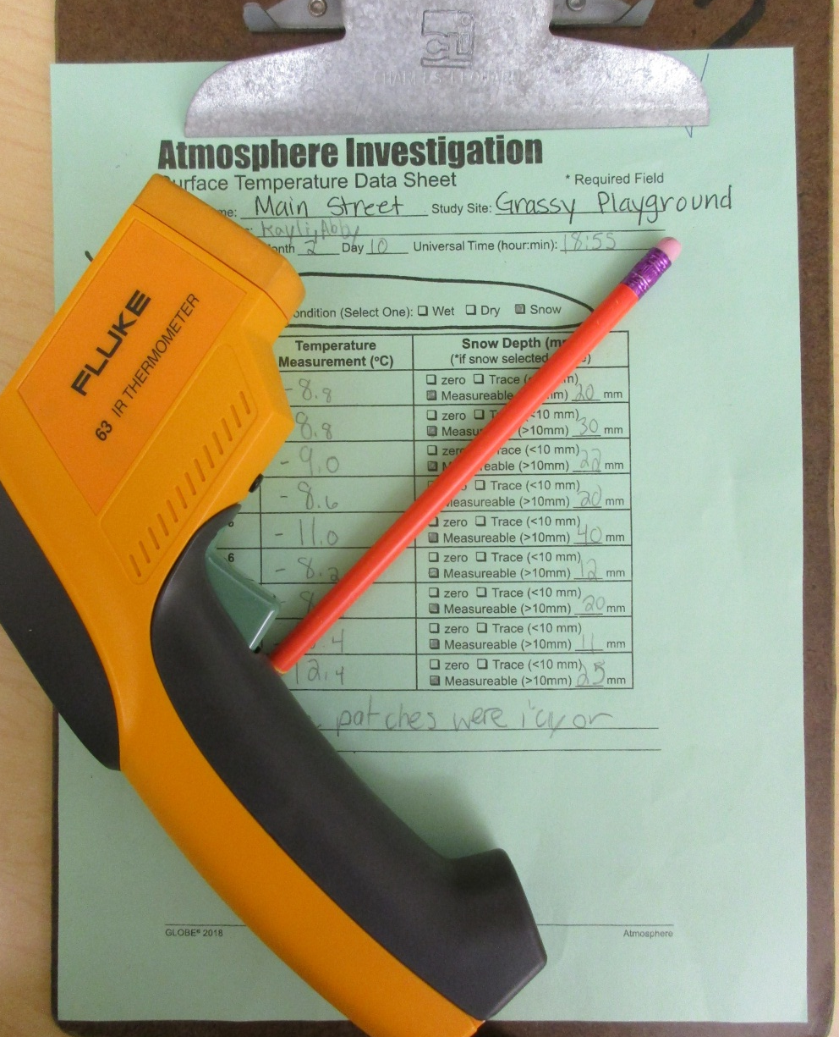
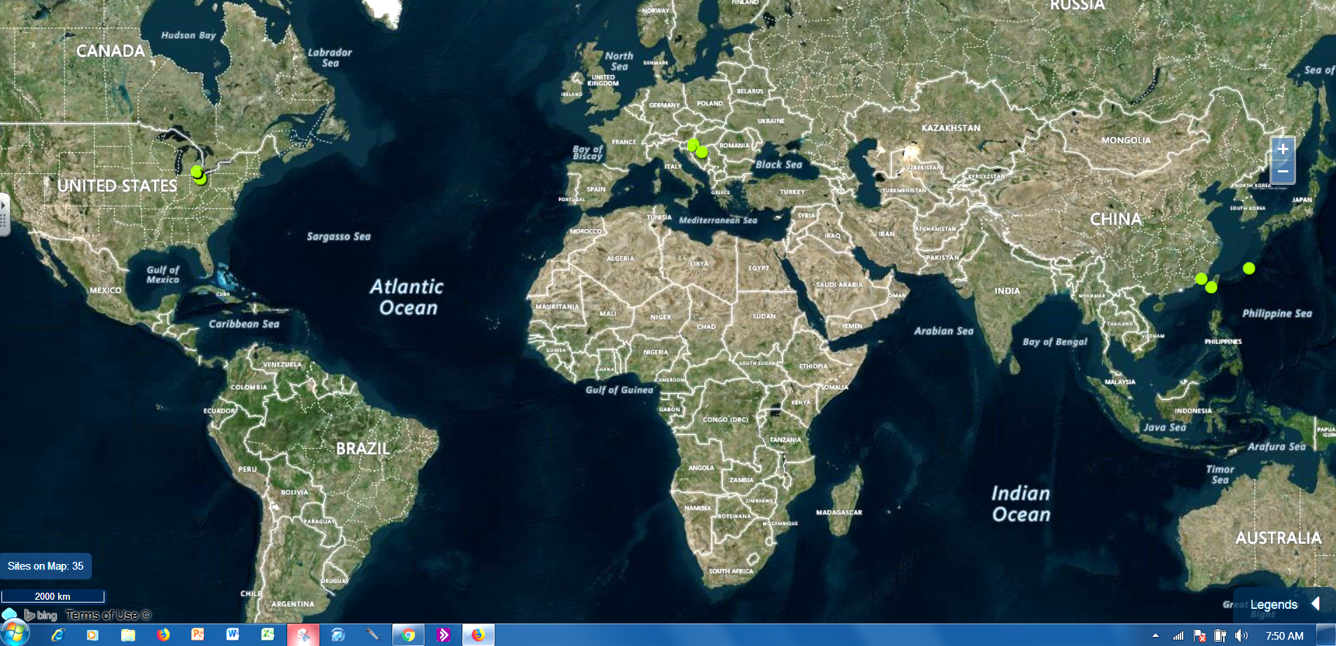
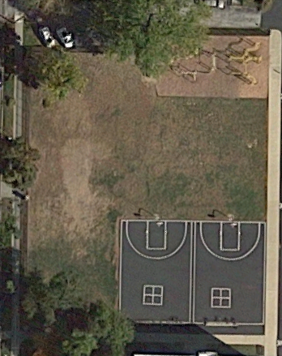
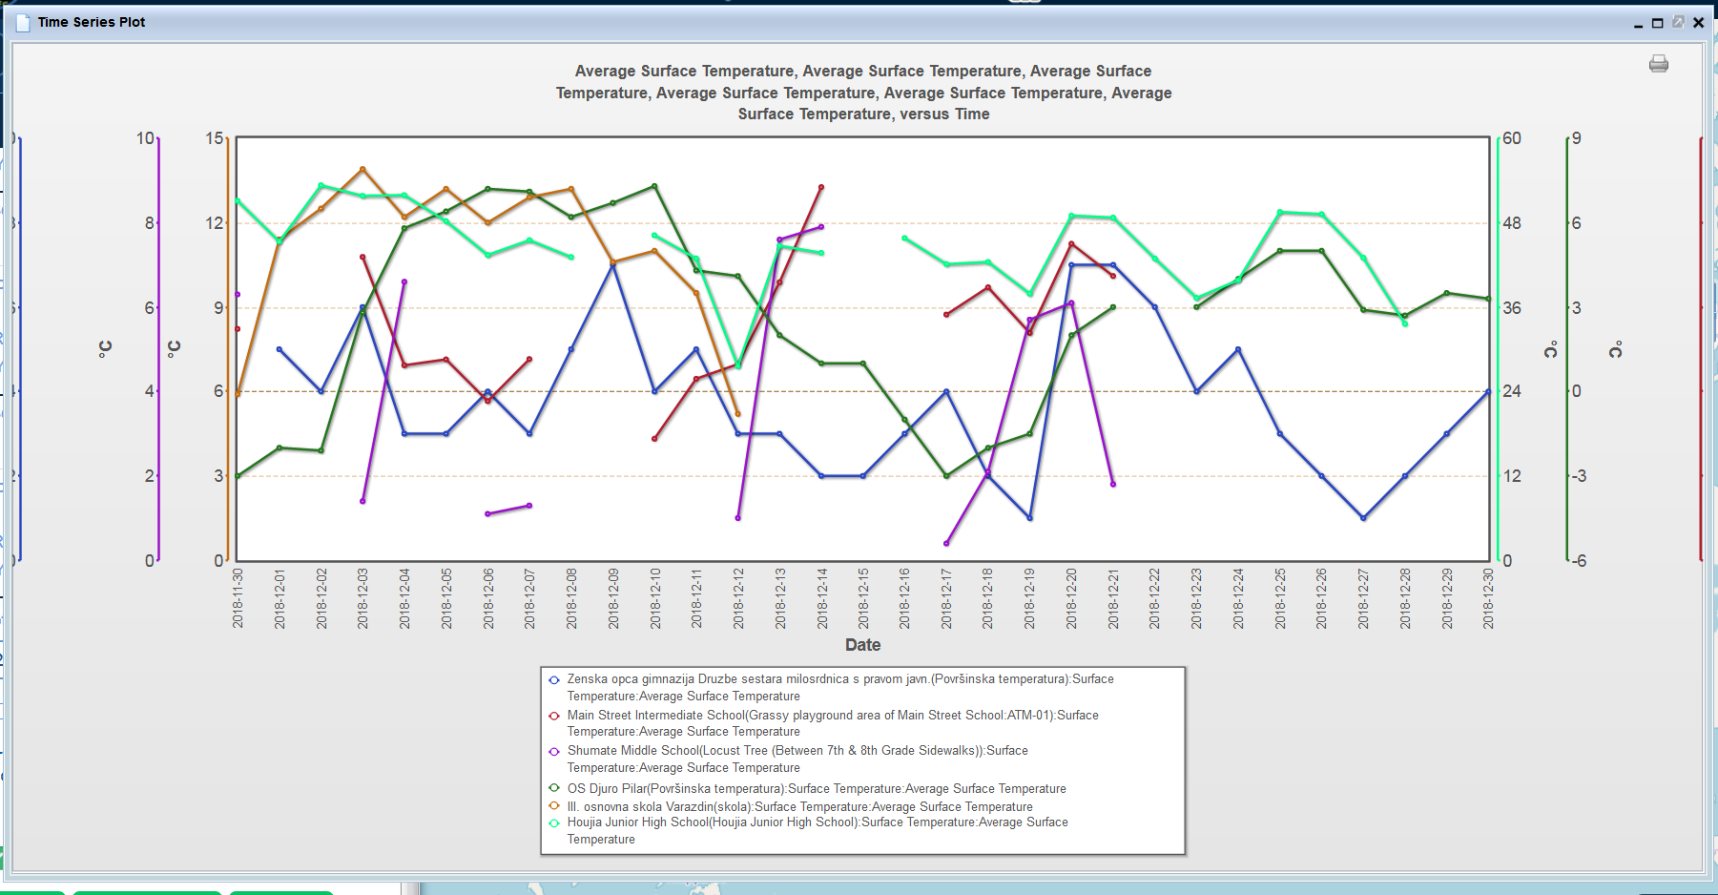
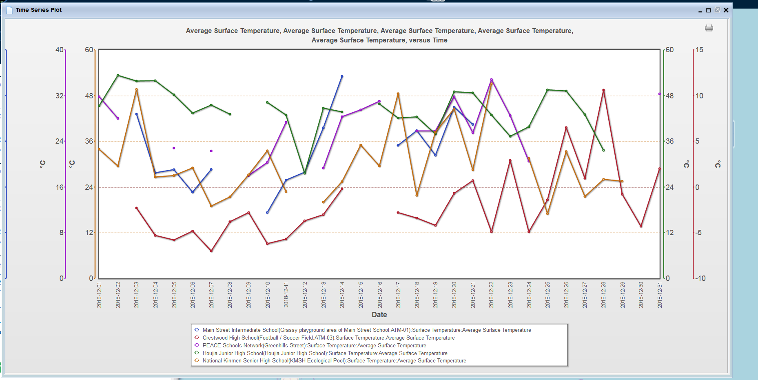

How does elevation affect surface temperature?
Summary
Our school has been measuring surface temperature during the month of December each year since 2006. We thought it would be interesting to compare surface temperature data taken at schools at different elevations. We found 8 schools in addition to our school that collected data at the same time on grassy surfaces. We thought the schools at the higher elevations would have colder surface temperature and the lower elevations would show warmer surface temperatures. We learned from the data that, for the most part, that our hypothesis was correct. However, the data also suggests that other things may also affect the data. More research needs to be done to find out how air temperature, distance from the equator, and landforms might also affect surface temperature data.
Project GLOBE School Sites
Map produced using the GLOBE website visualization tool
Conclusion
The purpose of our project was to find out more about surface temperature and elevation. Elevation affects the surface temperature data by increasing the surface temperature when the elevation is lower. So when we looked at our hypothesis it was right. Our hypothesis stated that when there is a lower elevation the surface temperature is warmer and when the temperature is lower the elevation is higher.
One of the schools that we borrowed data from is Houjia (Taiwan) has a warmer surface temperature and the elevation is 24.4 m. Another school, Crestwood (Michigan USA), has an elevation of 181 and the surface temperature is lower. Zenska’s (Croatia) elevation is 89 m and their temperature data is moderate. III osnovna (Croatia) has an elevation of 202 m, but it’s temperature is on the higher end. National Kinmen (Taiwan) has a lower elevation and a higher surface temperature. Our school, Main Street Intermediate (Ohio USA) elevation is 296.4 m and our temperature is in the middle, but higher than Zenska’s. With higher elevation the surface temperature seems to be lower because the air at higher elevations is usually colder.
Some of the data did not fit what we concluded, though. Some areas that had a higher elevation had a higher surface temperature and some areas with a lower elevation had a lower surface temperature. Some things that may affect the data are nearby landforms, the weather on the day the data was taken and the distance from the equator. To improve this research we would look more closely at what is around each school location and the daily weather conditions at each school when the data was taken.
Surface temperature tools
(Photo taken with Canon Powershot 170IS)
Purpose and Hypothesis
We want to find out more about how surface temperature data is affected by elevation. We thought it would be interesting to compare data from different schools that collected surface temperature data during December of 2018 on grassy surfaces. We think that when there is a lower elevation the surface temperature is warmer and when the elevation is higher the surface temperature is lower. Air temperature is usually warmer at lower elevations and colder at higher elevations, so we think that surface temperature data might follow that same pattern.
Surface Temperature Data
Data Source: www.globe.gov
Tools and Materials
Computer/Chromebook
GLOBE Surface Temperature Data Sheet
www.GLOBE.gov to enter our school’s data and to find data from other schools.
IRT- Infrared Thermometer FLUKE 63
Clipboard
Glitter (for poster)
Notebook for our project notes and data
Construction Paper (for poster)
Our School Surface Temperature Grassy Study Site
(Satellite image taken from Google Earth)
Questions for further study
Does the amount of snowfall affect the surface temperature during all of the year?
How much does the air temperature affect the surface temperature on grassy areas and pavement areas?
GLOBE schools and elevations used in this project:
Zenska opca gimnazija Druzbe sestara milosrdnica s pravom javn- Croatia 89 m.
Main Street Intermediate School-Ohio, USA 296.4 m
Shumate Middle School-Michigan, USA 176.7 m
OS Djuro Pilar-Croatia 98 m
III. osnovna skola Varazdin-Croatia 202 m
Houjia Junior High School-Taiwan 24.4 m
Crestwood High School-Michigan, USA 181 m
PEACE Schools Network-Japan 26.41 m
National Kinmen Senior High School-Taiwan 22 m
Procedures
Learn about surface temperature and how to collect data using the scientific GLOBE protocol. We took surface temperature measurements during the month of December 2018 as a part of the Globe Mission Earth Surface Temperature Field Campaign.
Enter data into www.globe.gov for our school.
Use www.globe.gov to find data from schools around the world that was taken on the same dates that we collected our data during December 2018 on grassy sites. The schools were located at a variety of elevations.
Use the visualization tool on www.globe.gov to create line graphs for each school and also made stacked line graphs so that we could compare all of the data.
Display data on a poster to share with others
Resources
www.globe.gov for protocol data sheet, and for finding surface temperature data taken by other schools during December 2018
Ms. Burns, our science teacher taught us how to do the surface temperature protocols and how to find and think about data from other GLOBE schools. She gave us guidance in how to do a research project.
Project Group
Brynn Prack, Brooke Elizabeth Heyman, and Kayli Bergman
5th grade students -- Main Street Intermediate School
Norwalk, OH USA
GLOBE School since 2006

