Slide 1



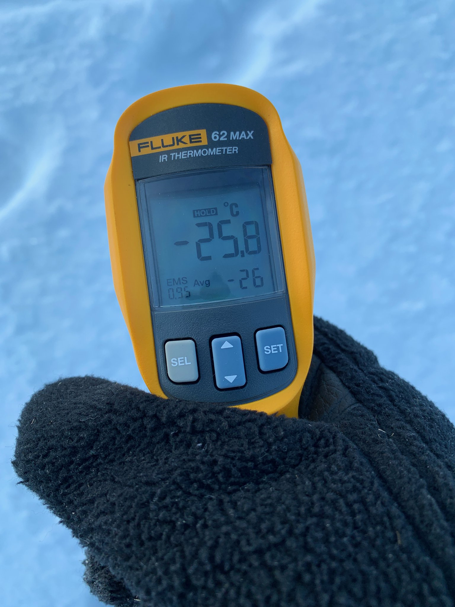
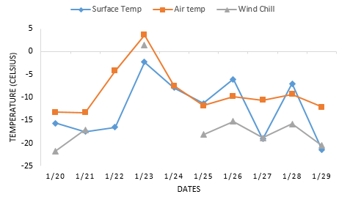
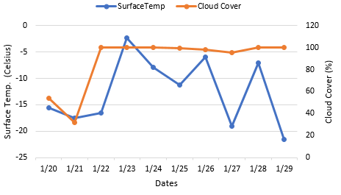
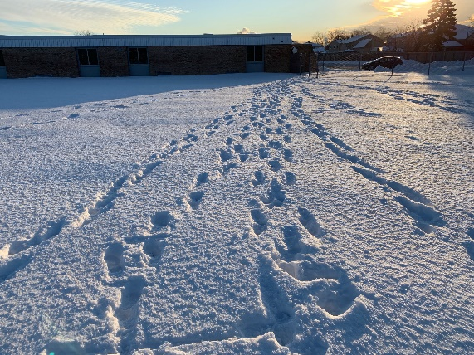
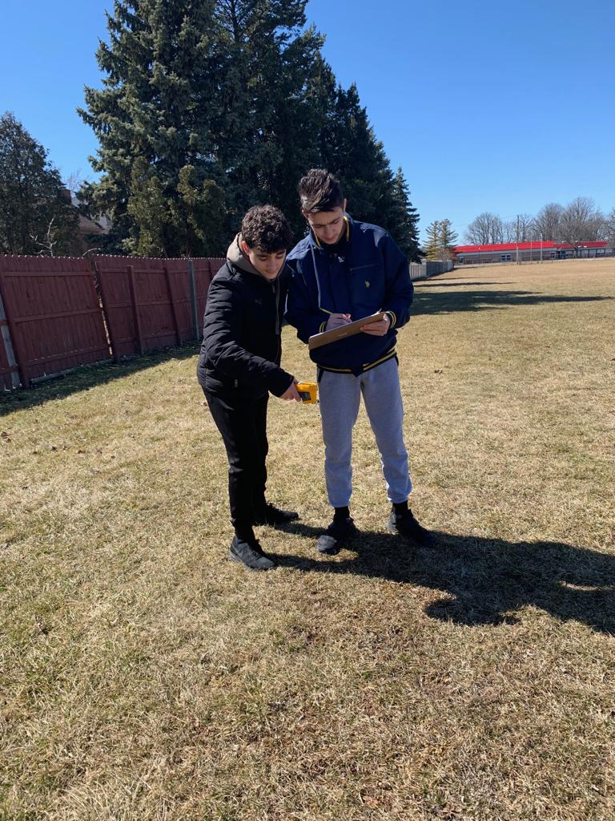
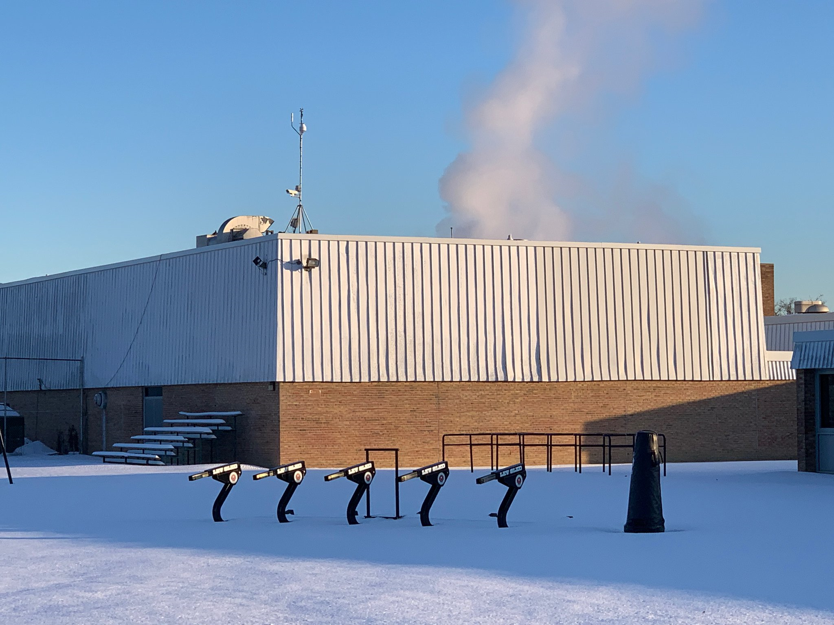

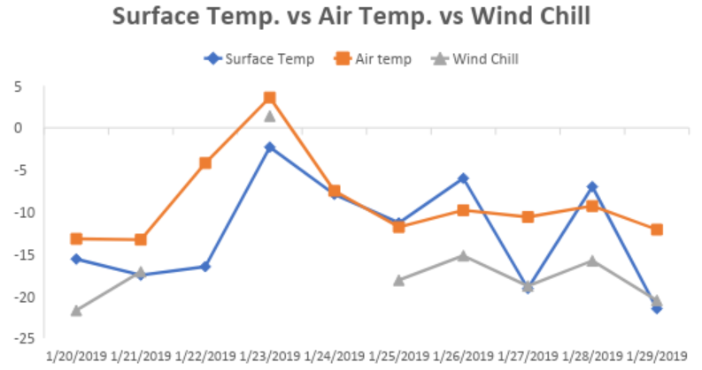
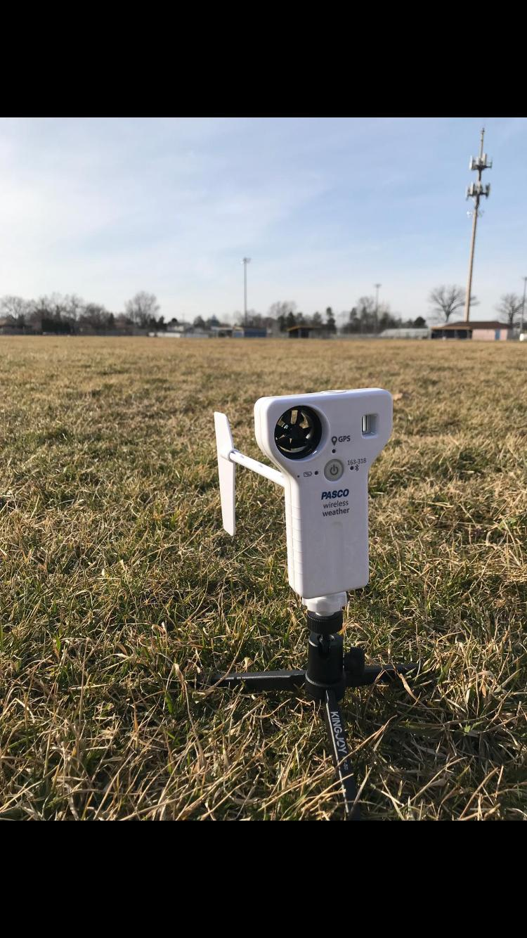
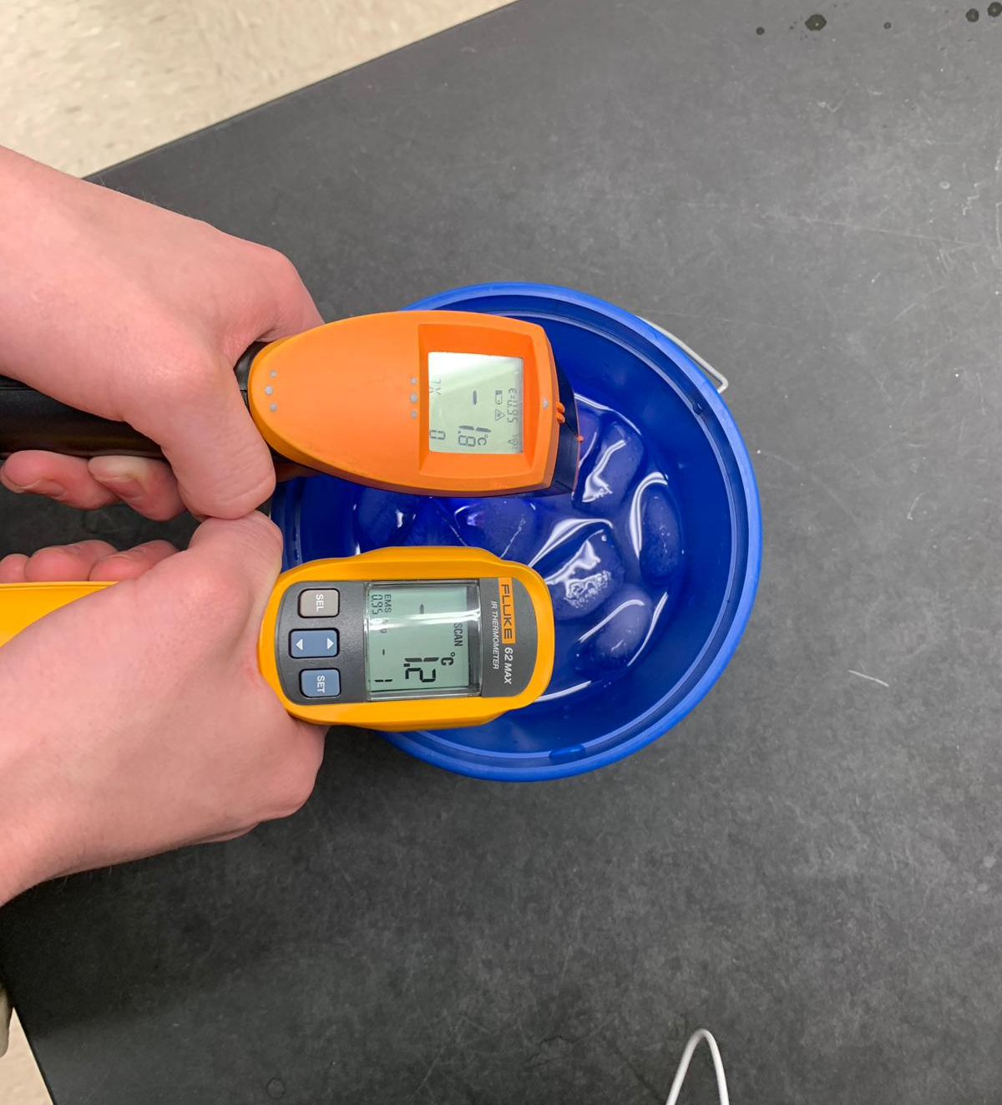
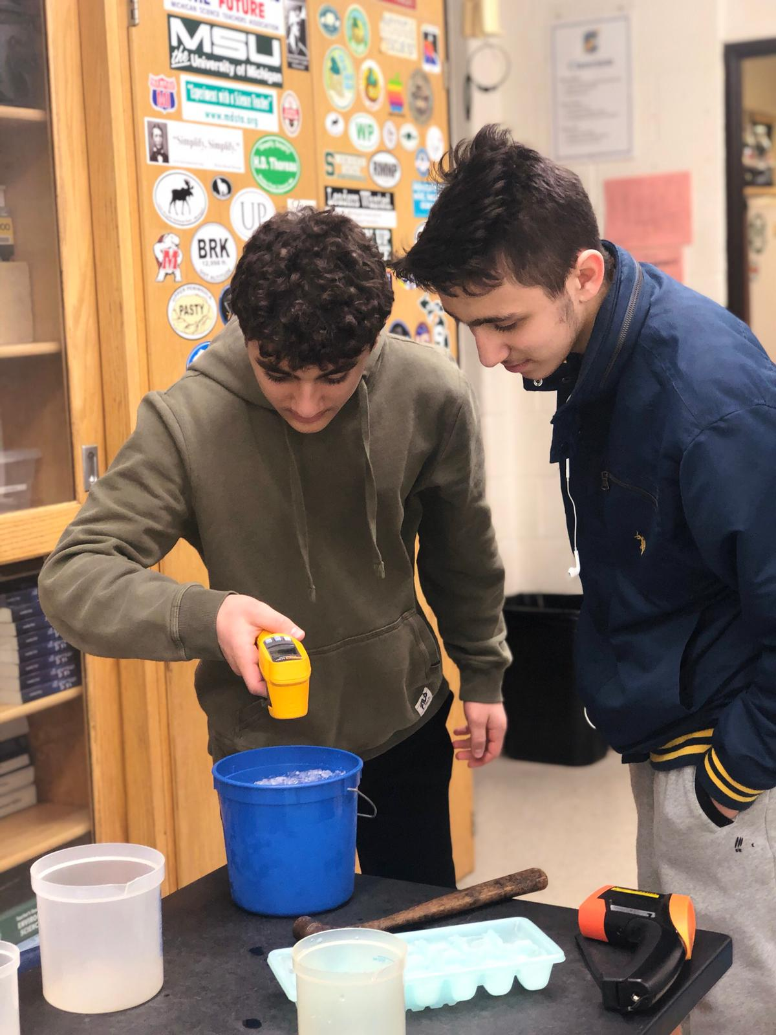
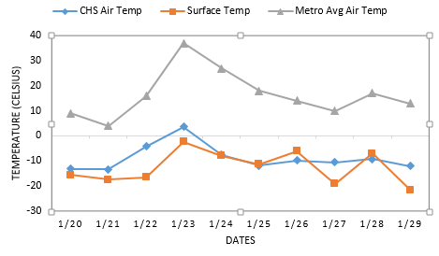
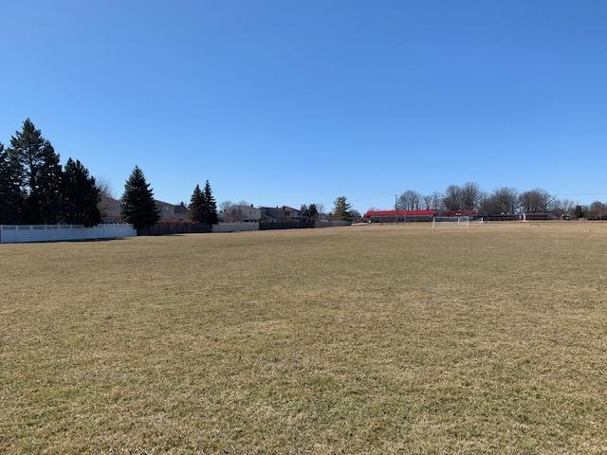
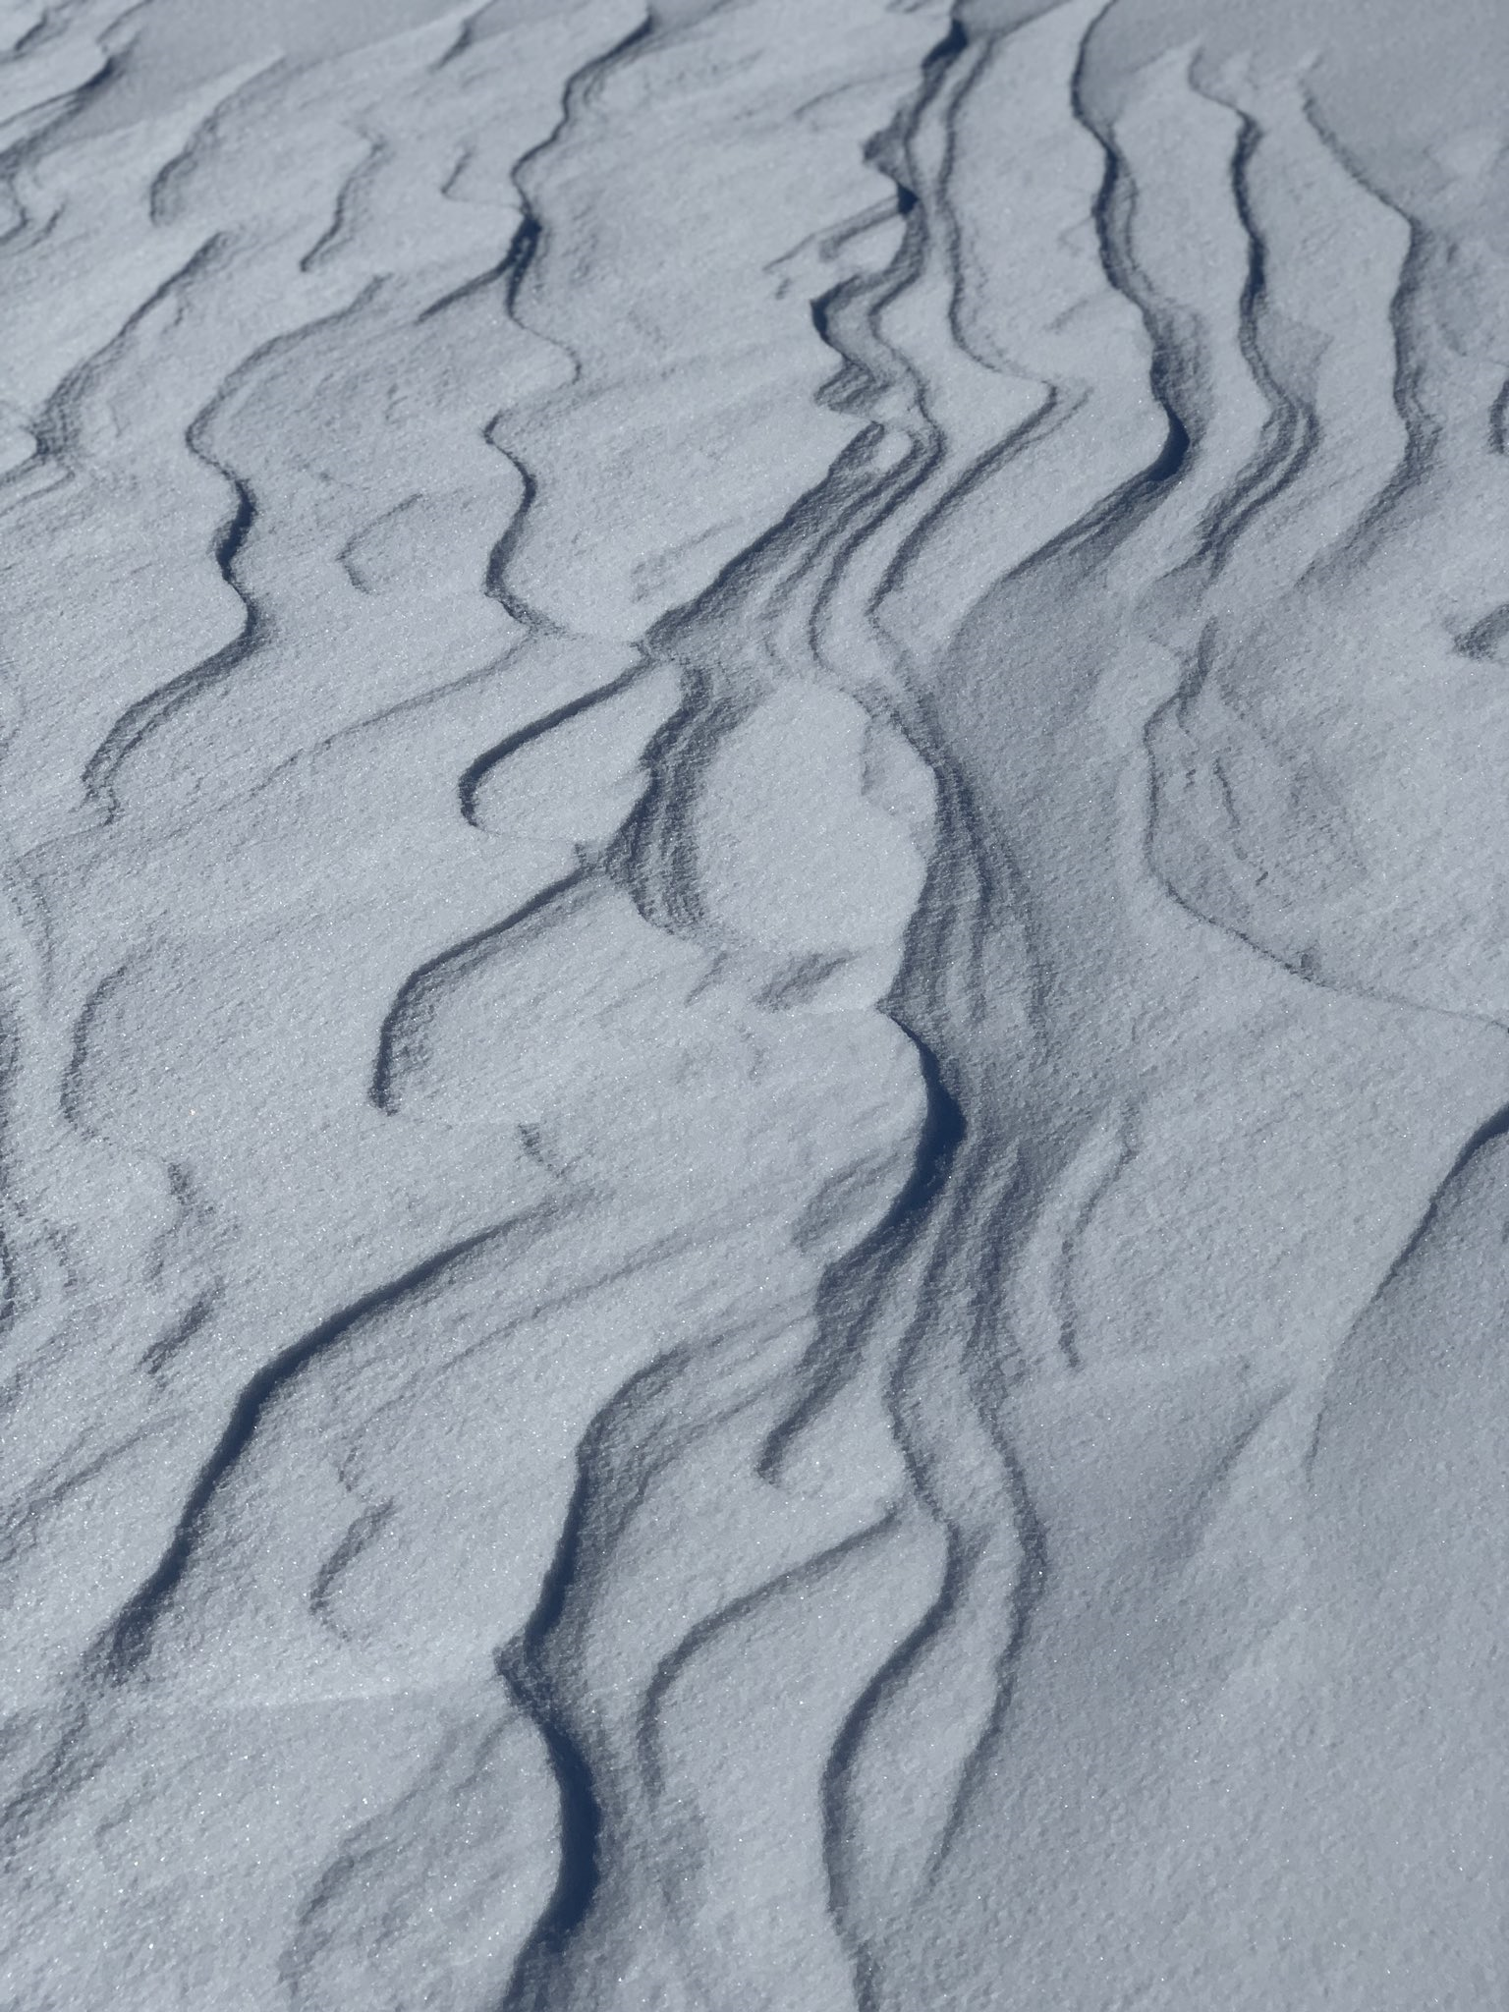
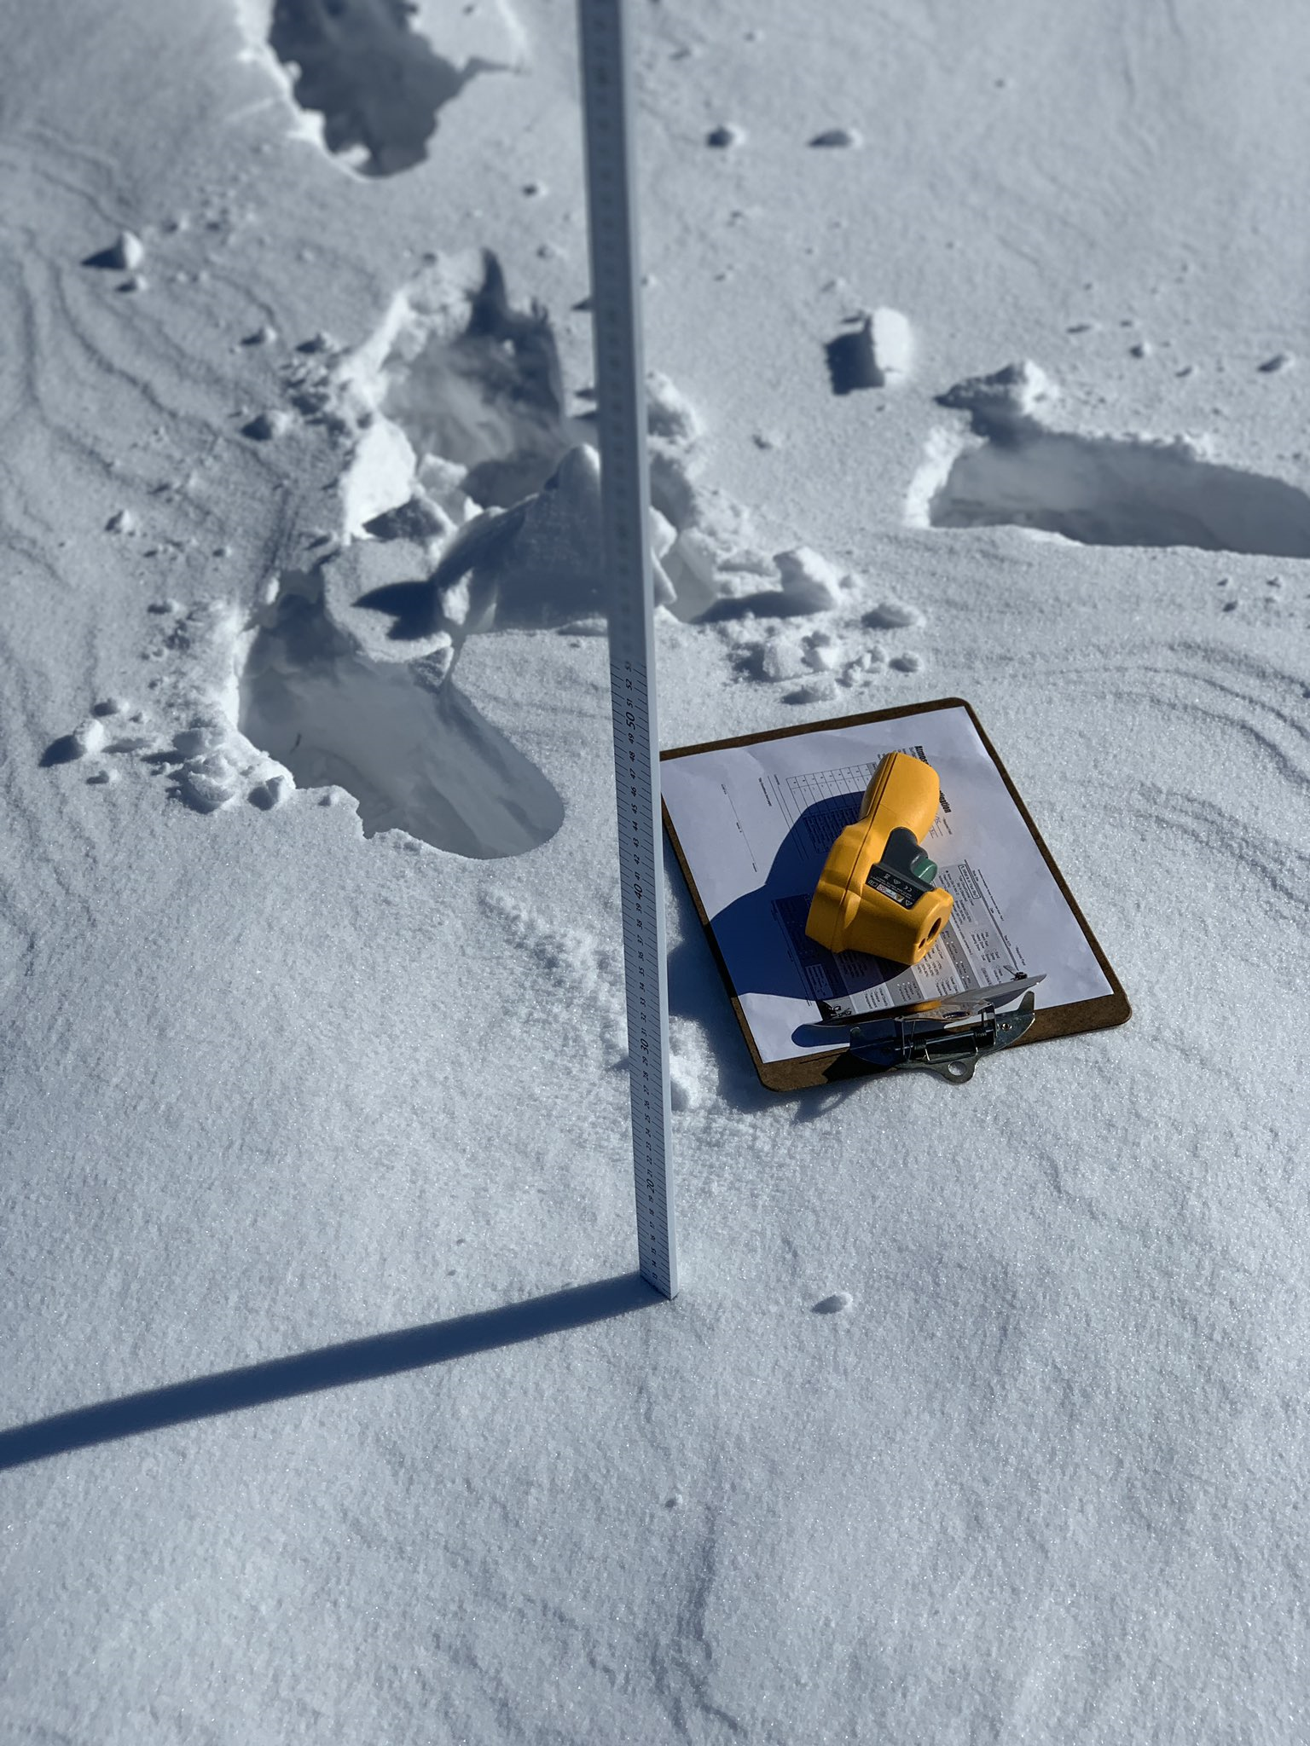
Effects of Select Weather Factors on
Surface Temperature During a Polar Vortex
Adam Ali and Ali Akil
Crestwood High School – Dearborn Heights, MI
Abstract
Results
Methods
Surface temperature is a critical factor that influences local and regional heating because the troposphere we live in warms from the bottom up. Scientists closely monitor surface temperature in their efforts to document and explain our rising worldwide temperatures. This year’s polar vortex in January was a significant recent weather phenomenon. With our research, we sought to determine if there is a correlation between the air temperatures and surface temperatures during this frosty period and if the polar vortex had an effect on the data we collected at all. For the majority of this school year, we have been collecting surface and air temperature data as well as cloud types and other select atmospheric parameters. We found that wind chill was consistently lower than air and surface temperature and the surface temperature was lower than air temperature on all but 2 days. It was also observed that the cloud cover doesn’t correlate with the surface temperature during this period but further research must be done over a longer period of time to confirm this.
Figure 1. Temperature versus windchill. This graph compares surface temperature, air temperature, and windchill during the 2019 Polar Vortex. The correlation between surface temperature and air temperature is fairly proportional with the surface temperature consistently colder than the air temperature. Air temperature and wind chill have a direct relationship with each other except where missing windchill data (due to our automated weather station malfunction in the extreme cold weather) makes it difficult to analyze the entire period.
9 marked locations on site.
Measurements taken everyday at each marked location
Air temperature taken hourly by school’s WeatherBug station
Upload data to Globe database
Contact NASA data specialist, Tina Rogerson
Precision And Accuracy
Analyze data
Figure 2. Surface Temperatures versus Cloud Cover. This graph compares surface temperature with cloud cover. There is no correlation between the two because the cloud cover stayed relatively the same while the temperature varied. If data was collected over a longer period of time, a relationship may have been present.
Conclusions
The two infrared thermometers used to collect the surface temperature data, Fluke 62 MAX IR THERMOMETER and the AUTO PRO Raytek, were calibrated in an ice water solution. In order to be properly calibrated the thermometers must be in a range of -2°C to 2°C, which they both were, ensuring accurate measurements.
There appears to be a one-day time delay between the change in near surface temperature and direct surface temperature. However, this is only true for when temperatures are increasing the first few days, as soon as temperatures began to fall and later stabilize the relative lag between the data is no longer present. Differences in results are caused by the approximate 10-meter height difference between the ground surface and our school’s WeatherBug weather station sensors positioned on above the school roof. Windchill directly correlated with both temperatures that were given. However, cloud cover did not appear to correlate with the surface temperatures, although more data may have been needed to confirm this due to consistent overcast conditions.
According to Judah Cohen, a climatologist at Atmospheric and Environmental Research “Colder temperatures have been arriving later in winter over the past few years.” The collection of the daily measurements could have been more accurate by leaving the handheld infrared thermometers outside for its full suggested 60 minutes which we were unable to do as a result of tests, assignments, or lessons.
A polar vortex is a low-pressure area—a wide expanse of swirling cold air—that is parked in polar regions. Global warming resulting in increased snowfall and frigid temperatures may sound paradoxical, however there is evidence to back it. For example, warmer temperatures in the winter of 2006 caused Lake Erie to not freeze for the first time in its history. This actually led to increased snowfalls because more evaporating water from the lake was available for precipitation. In the past 5 years, Michigan has been plagued with a polar vortex every year in the past 5 years, 2019 being the worst of all.
Potential follow up research could include comparing our surface temperature data with other schools across the country and even globally.
Research Questions
Research Implications
Is there a time delay between change in near surface temperature and actual surface temperature?
Does cloud cover correlate with surface temperature?
Does the CHS air and surface temperature correlate with the temperature of the Detroit Metropolitan area?
Scientists currently use surface temperature data from satellites to monitor weather and climate change around the world. Satellite temperatures of Earth’s surface are very accurate but typically give averaged readings over the large areas they are sampled from. Some climate skeptics currently question if NASA surface temperature data is accurate or not. Because our school is collecting surface temperature measurements at the same place over a period of many years, our data will allow scientists to verify that what data they sense from up on high, is comparable to what we see on Earth’s surface. To better understand the role that surface temperatures play in localized areas, it is important to get data from smaller parcels of land to see specifically how that particular surface responds to incoming solar insolation. Many small-scale and localized factors still need considerable research before a complete understanding of the role surface temperature plays in microclimate settings and at the community level (soil moisture levels, frozen ground, frost levels, etc.). This research found that very few schools consistently collect surface temperature data during the coldest months of the year. Our research found that accurate measurements can be taken throughout the most intensely cold portions of the year if students are properly protected from the elements and the instruments properly acclimated. To identify winter (December-February) heat island effects, it is suggested that GLOBE schools partner together and make a commitment to collect data not just during field campaigns but throughout the coldest months of winter. Only by combining a multitude of data from a whole host of local sites and over a long period of time will we be able to make any true contribution to a deep understanding of how localized surface temperature changes are being affected by climate change. Localized surface temperature data also allows scientists to accurately assess Climate change is currently linked into greater changes in temperatures than seen . By keeping track of the temperature and its increase, we can determine how much time we have left to find a solution to this critical issue. Due to the greenhouse gases released from the burning of fossil fuels the global average surface temperature rose from 1.1 to 1.6 degrees Fahrenheit between the years 1906 and 2005. This, alongside the fact that the rate of temperature increase has doubled in the last fifty years and will continue to rise, demonstrates the importance of recording and analyzing surface temperature data to ensure a healthier and safer future for this planet.
Figure 3. CHS Air and Surface Temperature versus Air Temperature of Detroit Metropolitan area
This graph compares air and surface temperature of Crestwood High School and air temperature of the Detroit Metropolitan area. There is a clear correlation between the two with the CHS temperatures being consistently lower because the recordings were taken much closer to the surface.
Acknowledgements and Citations
  Special thanks to:
  Mrs. Johns for instructing us on how to complete the measurements and providing us with the necessary equipment and always being there to provide support.
  The other globe students for helping collect the necessary data for the research.
  Sara Komaiha and Ali Eter for showing us how to access and use the Globe data.
  Tina Rogerson for providing necessary cloud cover data needed on short notice.
Hypothesis/ Null Hypothesis
There is no correlation between air temperature and surface temperature.
There is a direct correlation between cloud cover and surface temperatures.
There is a correlation between wind chill and surface temperature.
There is no correlation between the CHS air and surface temperature correlate with the temperature of the Detroit Metropolitan area.
Measurement Limitations
US Department of Commerce & Noaa. Learn About the Polar Vortex. National Weather Service(2017). Available at: https://www.weather.gov/dlh/polarvortex. (Accessed: 1st April 2019)
Resnick, B. The Midwest is facing record-breaking cold. Blame the polar vortex. Vox (2019). Available at: https://www.vox.com/science-and-health/2019/1/29/18201196/polar-vortex-2019-des-moines-midwest-record-cold-windchill. (Accessed: 1st April 2019)
Arctic Weather Plunges into North America. NASA Available at: https://earthobservatory.nasa.gov/images/144489/arctic-weather-plunges-into-north-america. (Accessed: 1st April 2019)
Research on Urban Heat-Island Effect. Procedia Engineering (2016). Available at: https://www.sciencedirect.com/science/article/pii/S1877705816332039. (Accessed: 1st April 2019)
Global Warming. NASA Available at: https://earthobservatory.nasa.gov/features/GlobalWarming/page2.php. (Accessed: 1st April 2019)
Rowlatt, J. Polar vortex: What role does climate change play? BBC News (2019). Available at: https://www.bbc.com/news/world-us-canada-47078054. (Accessed: 2nd April 2019)
Unable to take measurements at the same time every day due to tests or lessons.
Harsh Weather conditions prevented us from taking measurements on certain days.
Other students wrote false data that we couldn’t include. For example, putting down the clouds as nimbostratus when it there was no precipitation.
Our school’s WeatherBug station began to malfunction when temperatures reached very low points during the polar vortex, so data was missing for those days.
Other students who collected data may have held the thermometer at an angle instead of straight down.

