Slide 1
GLOBE Sponsors
Welcome
23rd GLOBE Annual Meeting
Detroit, USA
14– 18 July 2019

Slide 2
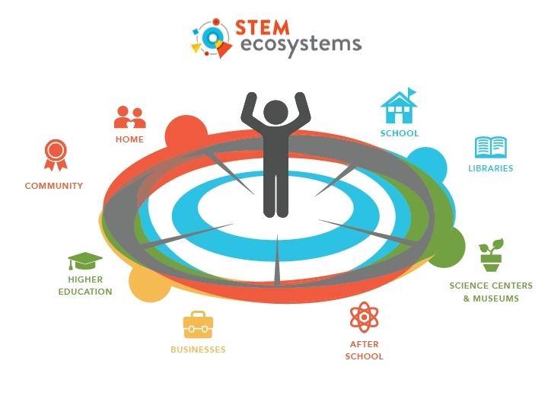
NSF
CONVERGENCE
Knowledge
Methodology
Expertise
GLOBE
Education
Technology
Public Participation
Community partners work together in STEM Ecosystems (Graphic: Business Wire)

Slide 3
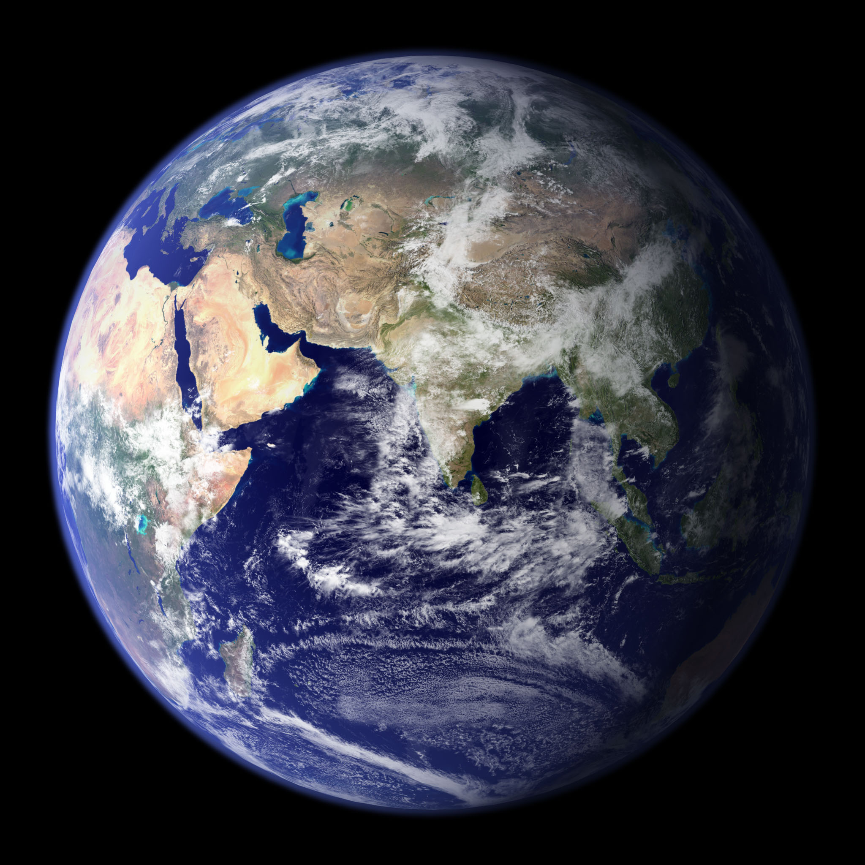
NASA
Notes:
Quick into of my background/current role

Slide 4
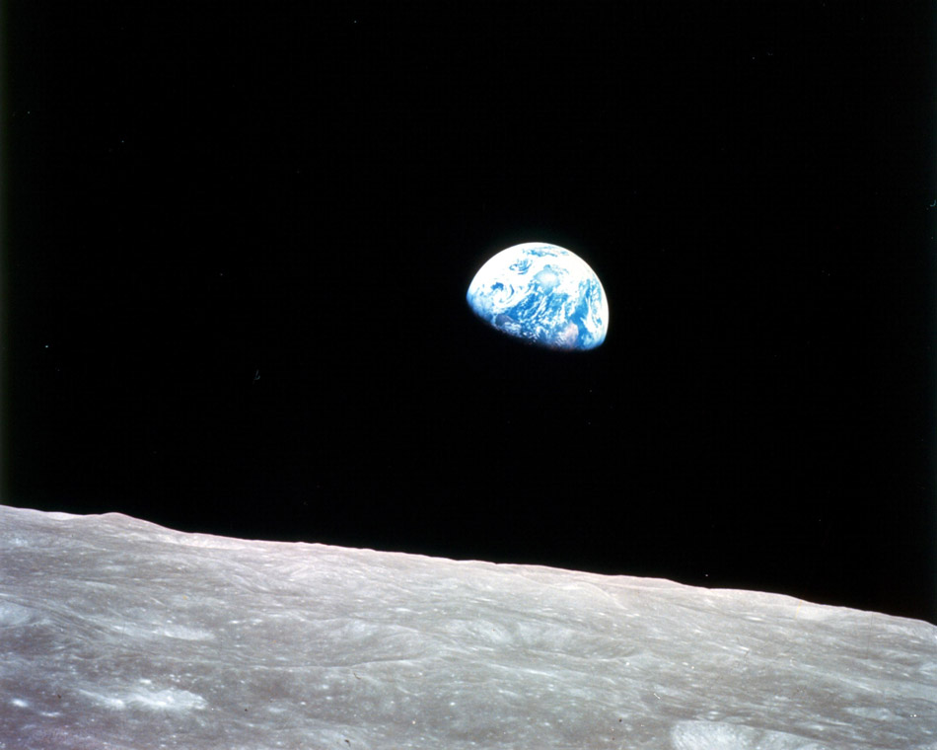
"We came all this way to explore the Moon, and the most important thing is that we discovered the Earth."
- Bill Anders, Apollo 8 astronaut, Earthrise photographer
Photograph: December 24, 1968
Notes:
This week: need to mention the moon. But before we even had firm plans to go, we were studying earth
https://airandspace.si.edu/stories/editorial/apollo-8-astronaut-remembers-looking-down-earth
PICTURES
"Earthrise" Taken aboard Apollo 8 by Bill Anders, this iconic picture shows Earth peeking out from beyond the lunar surface as the first crewed spacecraft circumnavigated the Moon.
Image Credit: NASA
One of the first steps taken on the Moon, this is an image of Buzz Aldrin's bootprint from the Apollo 11 mission.
Image Credit: NASA
Apollo 11 astronaut Buzz Aldrin on the Moon.
Image Credit: NASA
STORY
On July 20, 1969, humans walked on another world for the first time in history, achieving the goal that President John F. Kennedy had set in 1961, before Americans had even orbited the Earth. After a landing that included dodging a lunar crater and boulder field just before touchdown, Neil Armstrong and Buzz Aldrin explored the area around their lunar landing site for more than two hours. They collected soil and rock samples, set up experiments, planted an American flag, and left behind medallions honoring the Apollo 1 crew and a plaque saying, “We came in peace for all mankind.”
Crew: Neil Armstrong, commander; Edwin E. Aldrin Jr., lunar module pilot; Michael Collins, command module pilot
Launch: July 16, 1969; lunar landing: July 20; splashdown: July 24.

Slide 5
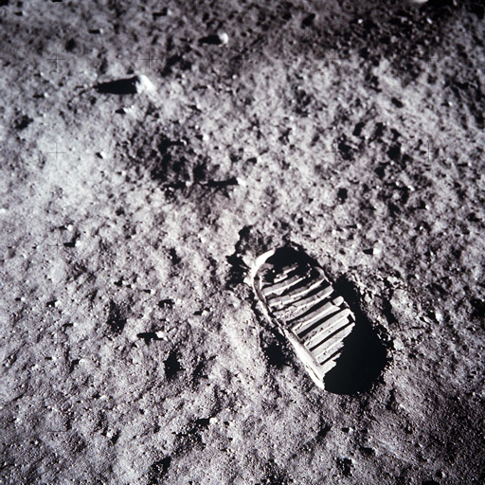
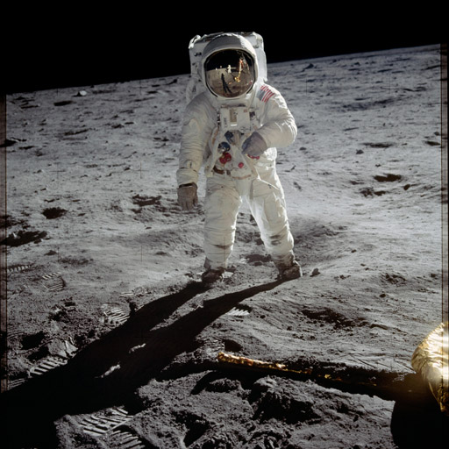
"We came all this way to explore the Moon, and the most important thing is that we discovered the Earth."
- Bill Anders, Apollo 8 astronaut, Earthrise photographer
Photograph: December 24, 1968
Apollo 11, 1969
Launch: July 16
Lunar Landing: July 20
Splashdown: July 24
Notes:
https://airandspace.si.edu/stories/editorial/apollo-8-astronaut-remembers-looking-down-earth
PICTURES
"Earthrise" Taken aboard Apollo 8 by Bill Anders, this iconic picture shows Earth peeking out from beyond the lunar surface as the first crewed spacecraft circumnavigated the Moon.
Image Credit: NASA
One of the first steps taken on the Moon, this is an image of Buzz Aldrin's bootprint from the Apollo 11 mission.
Image Credit: NASA
Apollo 11 astronaut Buzz Aldrin on the Moon.
Image Credit: NASA
STORY
On July 20, 1969, humans walked on another world for the first time in history, achieving the goal that President John F. Kennedy had set in 1961, before Americans had even orbited the Earth. After a landing that included dodging a lunar crater and boulder field just before touchdown, Neil Armstrong and Buzz Aldrin explored the area around their lunar landing site for more than two hours. They collected soil and rock samples, set up experiments, planted an American flag, and left behind medallions honoring the Apollo 1 crew and a plaque saying, “We came in peace for all mankind.”
Crew: Neil Armstrong, commander; Edwin E. Aldrin Jr., lunar module pilot; Michael Collins, command module pilot
Launch: July 16, 1969; lunar landing: July 20; splashdown: July 24.

Slide 6
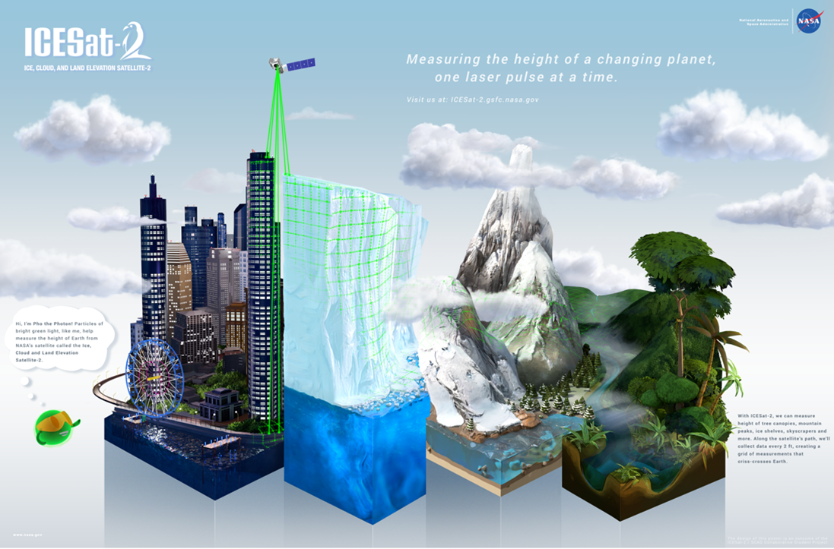
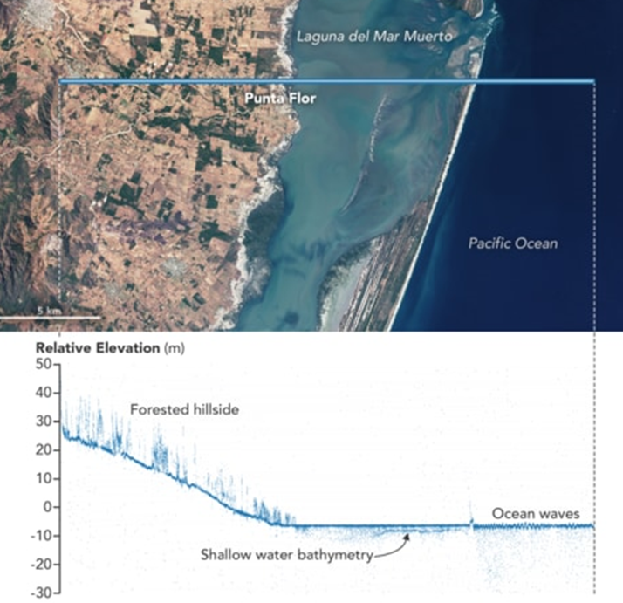
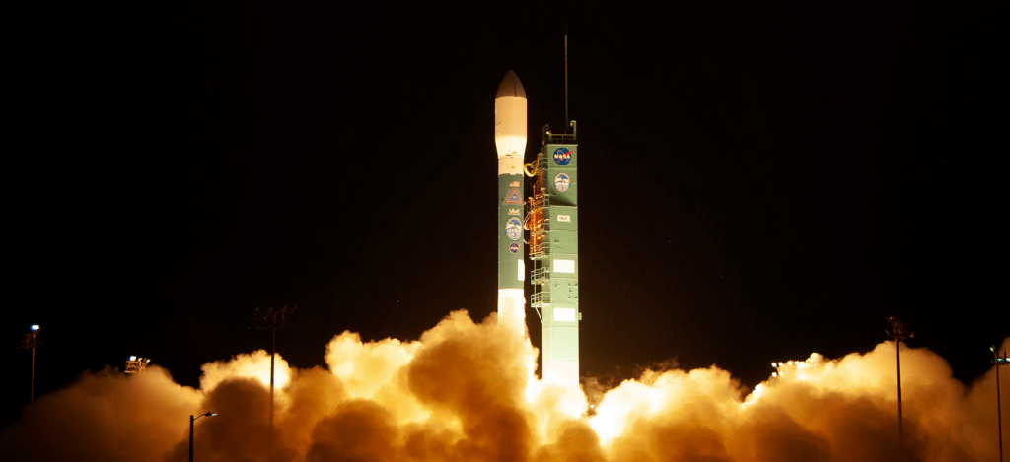
Notes:
GLOBE community - students, teachers, citizen scientists - today is making important contributions to studying Earth
The final United Launch Alliance Delta II rocket lifts off from Space Launch Complex 2 at Vandenberg Air Force Base in California, on Sept. 15, 2018, carrying NASA’s Ice, Cloud and land Elevation Satellite-2 (ICESat-2). Liftoff was at 9:02 a.m. EDT (6:02 a.m. PDT). Photo credit: NASA/Kim Shiflett

Slide 7
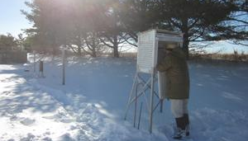
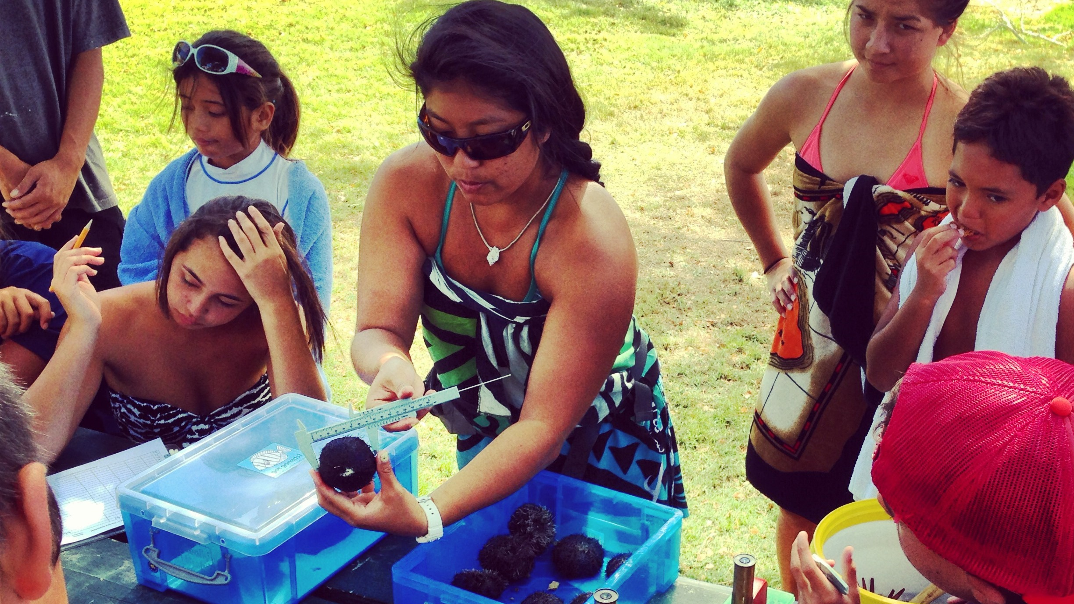
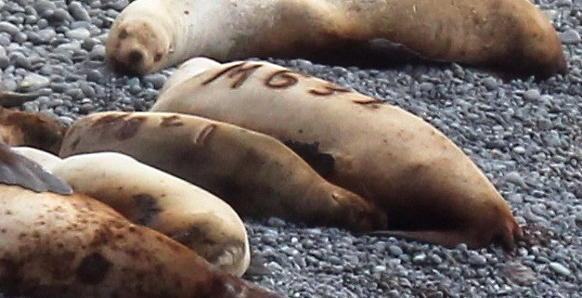
NOAA
Much of our work explores Intersections of Diverse Environments and Exploring Changing Environments
Partnerships are essential
Citizen science allows us to partner with individuals
Thankful for these collaborations
Notes:
Focus on citizen science growth, federal efforts, impacts from National Academies Report

Slide 8
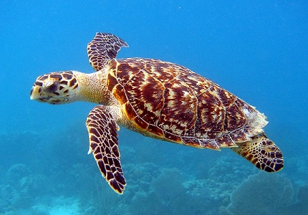
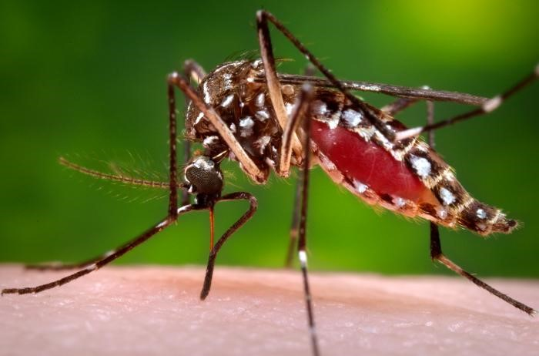
Department of State
U.S. Embassies and Science
International Health
Water Conservation
Space and Technology
Science Diplomacy
GLOBE and the Department of State
Notes:
The U.S. Department of State has been a proud supporter of GLOBE since its launch in 1995. Our embassies help GLOBE expand each year to new countries, new schools, new areas of investigation, and new audiences.
You might be wondering what U.S. Embassies overseas have to do with science. Well, at our embassies overseas, diplomats promote all sorts of U.S. Foreign Policy including science issues. We bring governments and citizens together to discuss and agree on science issues like:
International health – For example we decide how the U.S. government will respond to disease outbreaks such as Zika, Malaria and Ebola and we provide education and resources to prevent these outbreaks from starting and spreading.
Marine conservation – We negotiate treaties to protect marine wildlife like sea turtles, seals and dolphins, or to prevent overfishing.
Space, science and technology – We work on treaties that guide the use of international technology such as access to GPS satellites. And we encourage and promote cooperation between countries to explore space through things like the international space station.
To accomplish our mission, our diplomats that serve overseas receive training on science programs like GLOBE at the Foreign Service Institute in Washington DC, so they can use science as a tool in conducting diplomacy.
We call this “Science Diplomacy”. Science Diplomacy helps Embassies promote important policies like showcasing science and technology innovations, improving understanding of the environment, promoting English language learning, and empowering diverse populations.
GLOBE programs like GLOBE Zika are examples of the connection between diplomacy and science. GLOBE Zika, by enlisting thousands of students, teachers, and community leaders to crowdsource data on mosquitoes in a global mapping project, creates data that scientists can use to better understand the worlds mosquito population and hopefully help control the spread of the Zika virus and other illness that are spread through mosquitoes.
We at the Department of State are currently working with GLOBE to develop virtual exchanges and personal exchanges between GLOBE schools, as well as with scientists here in the United States.
There are people from over 30 countries here at the Annual meeting, which is a testament to the power of GLOBE to build worldwide connections. If government offices like the State Department do activities called science diplomacy, then each of you who are here today are doing what we should call citizen science diplomacy.
So when you are working on GLOBE projects or collecting data in class to contribute to the GLOBE program, I encourage you to think about how GLOBE has brought students, teachers and scientists from around the world together to create this great network. And remember that science is useful in diplomacy and can bring people around the world together to reach a common goal.
Through GLOBE, we have made a meaningful impact to the health and lives of the communities that we have engaged over the past 25 years. You represent the best of your countries and your shared commitment to science brings you together to help make a better world. Thank you for participating in GLOBE and congratulations on making GLOBE such a success.

