Slide 1
Meeting Information
Julie Malmberg
15 July 2019

Slide 2
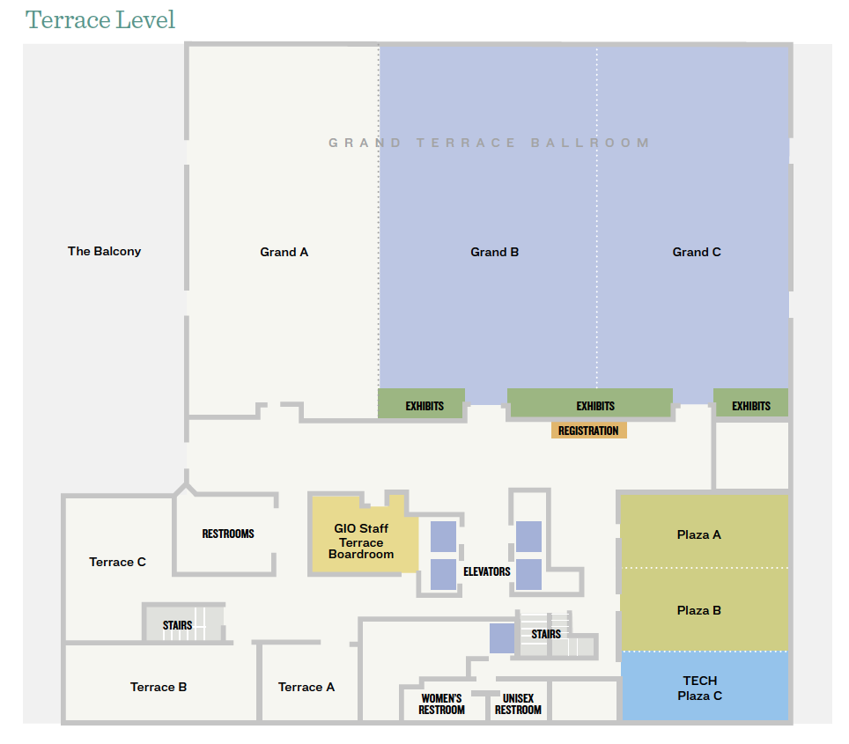

Slide 3
General
Wear your name badge at all meeting times
Bee sticker (adults)
“First Time Attendee” ribbon
Note the Registration Desk hours in your program (if closed, email address and cell phone number provided)
Announcements every morning at 8:15 am in Grand BC
Breakfasts are from 7:00 am - 8:15 am in Grand A
Breaks are in Grand A or Registration Desk Hallway
Lunches – pick up food in Grand A, sit in Grand BC
Tables in Registration Desk Hallway → free items!

Slide 4
Questions!
Do you have a question for the GLOBE Implementation Office (GIO) or the Sponsors?
Ask! Fill out a form on the laptop at the Registration Desk
Put in your questions by Wednesday afternoon
Put your name or keep it anonymous
GIO and the Sponsors will answer questions on Thursday at lunch

Slide 5
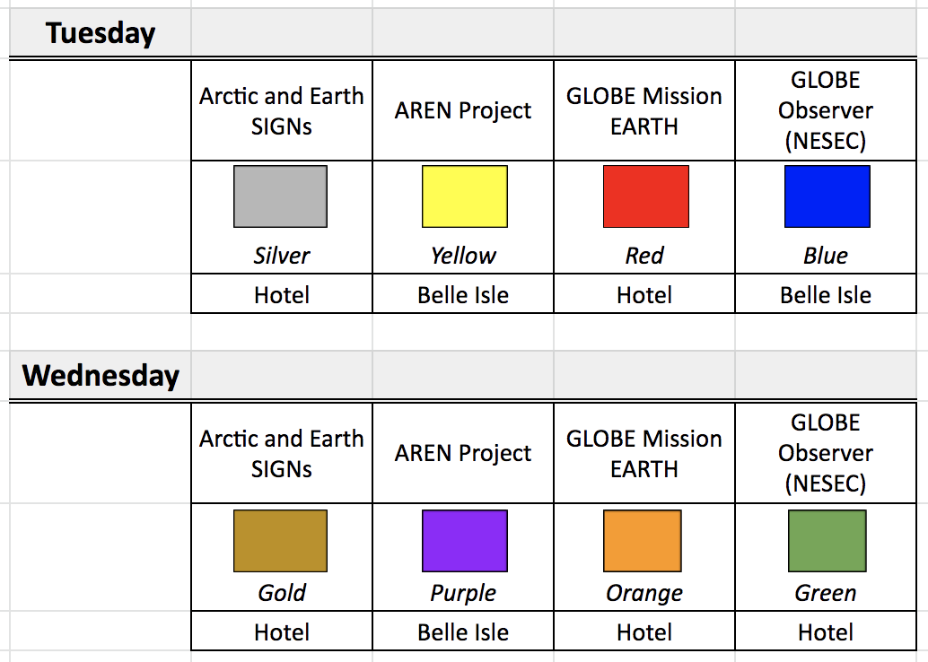
Trainings on Tue and Wed morning – Wristbands

Slide 6
Monday Afternoon Schedule
1:45 pm – 4:00 pm: Students and Howell Guides in Windsor AB (Lobby level; Stairs are by the Elevators)
1:45 pm – 4:30 pm: Teachers and Community Members in Grand BC
1:45 pm – 5:00 pm: Country Coordinators and US Partners in Terrace C
4:00 pm: Students set up posters in Grand A
4:30 pm – 6:00 pm: Adults set up posters
5:00 pm – 5:30 pm: Volunteer Check In in Terrace B
6:30 pm – 8:30 pm: Student and Community Poster Session in Grand A
8:30 pm: Take down posters

Slide 7
Tuesday Morning Schedule
7:00 am – 8:15 am: Breakfast in Grand A
8:00 am: Students and Howell Guides meet in Lobby
8:15 am: Adults - morning announcements in Grand A
8:30 am: Adults go to training sessions (Hotel or Belle Isle – meet in lobby for buses to Belle Isle)

