Slide 1
GLOBE Website + Social Media Report
David Overoye & Autumn Burdick
Science Systems and Applications, Inc.
July 15, 2019

Slide 2
Data Information System – It Takes a Team
Allison Leidner – NASA GLOBE Program Manager
Lisa Dallas – NASA Technical Manager
Technology Working Group Members
Elzbieta Woloszynska-Wisniewska – Poland
Ana Prieto – Argentina
Krisanadej Jaroensutasinee – Thailand
Allyson Edwards – USA/GLOBE Alum
Laura Altin - Estonia
Charles Maina Mwangi – Kenya
Ahmad Mbaidin – NENA Region
GIO representative – Eslam Khair
Weekly Meetings – Travis Andersen, Dixon Butler, Holli Kohl, Kristen Weaver, Jessica Taylor, Autumn Burdick
The GIO Helpdesk
The GLOBE DIS team in Pasadena, CA
New GO Protocols – Peder Nelson (Land Cover), Brian Campbell (Trees)

Slide 3
And you – keep giving us your feedback!

Slide 4
What’s New – Mobile/Data Entry

Slide 5

GLOBE Observer – New Land Cover App
The Land Cover app enables citizen scientists (GLOBE Observers) to photograph with their smartphones the landscape, identify the kinds of land cover they see (trees, grass, etc.), and then match their observations to satellite data. Users can also share their knowledge of the land and how it has changed.
Land cover maps are helpful for assessing risks from disaster like floods or fires, for defining wildlife habitat, for understanding change, and addressing many other scientific questions.
The app includes fun tutorials on how to photograph and analyze land cover.
Go to https://observer.globe.gov for more info

Slide 6
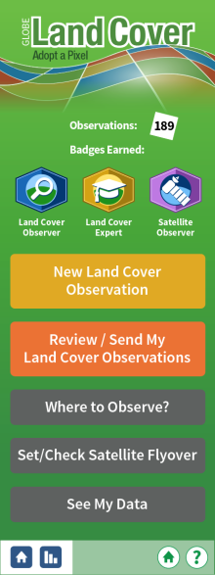
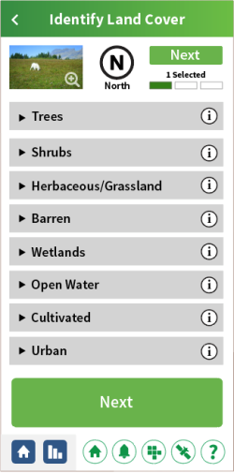
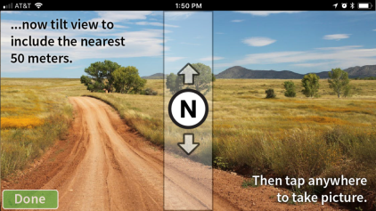

Slide 7
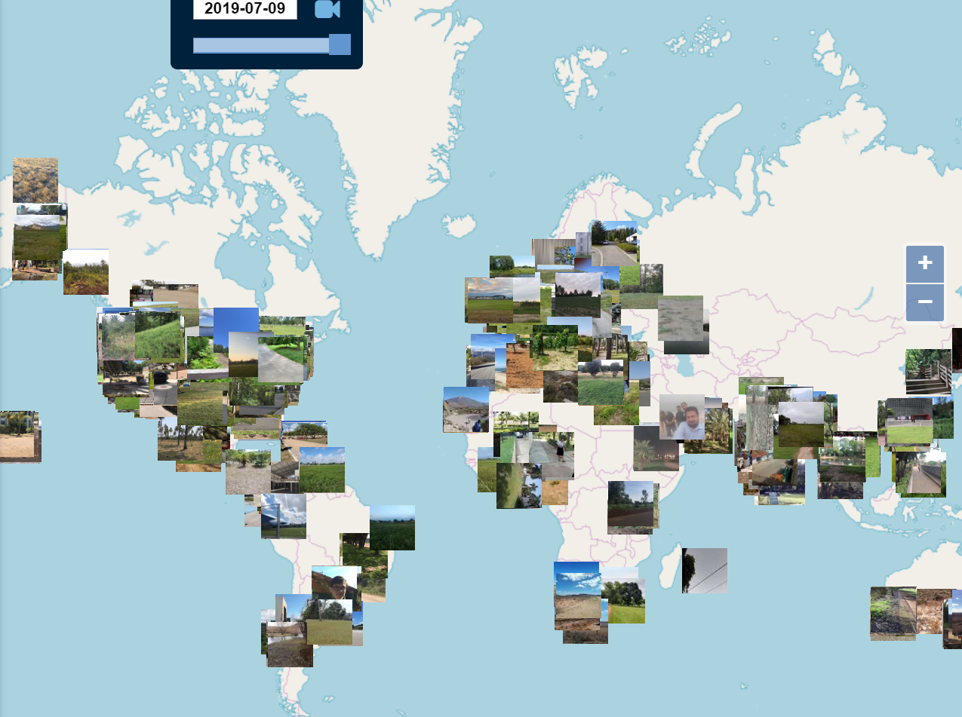
https://vis.globe.gov/land_cover

Slide 8
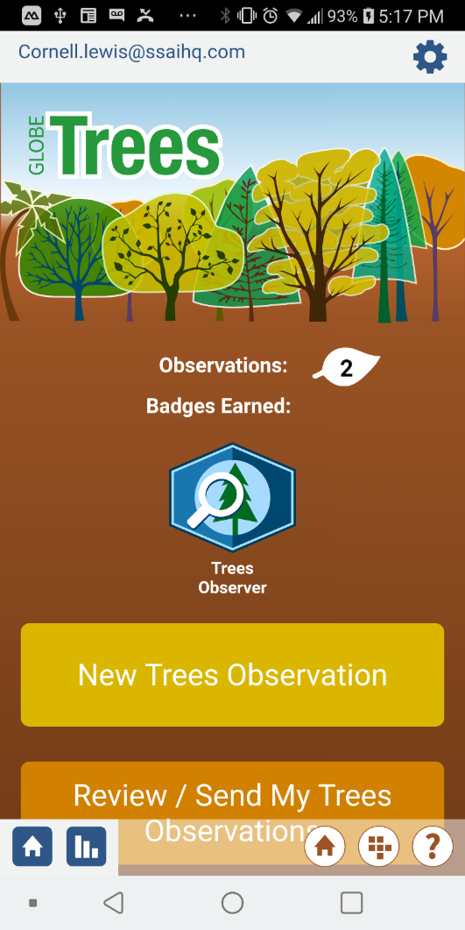
GLOBE Observer App – Tree Height
In collaboration with ICESat-2 mission.
The GLOBE Observer Trees App assists citizen scientists (GLOBE Observers) to catalog tree data, with an emphasis on measuring tree height.
Recording tree height provides 2 major benefits:
It is used to track how trees are changing over time, and can help estimate the amount of trees that make up an area’s biomass - the total mass of organisms in a given area or volume
NASA's ICESat-2 mission is measuring Earth’s height from space. Citizen science tree height observations provide useful validation data for NASA scientists to compare to what the mission is observing

Slide 9
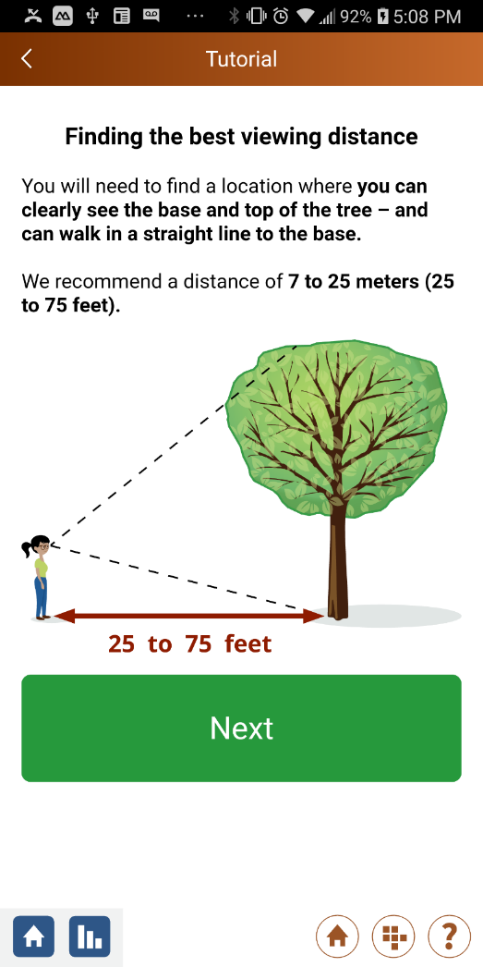
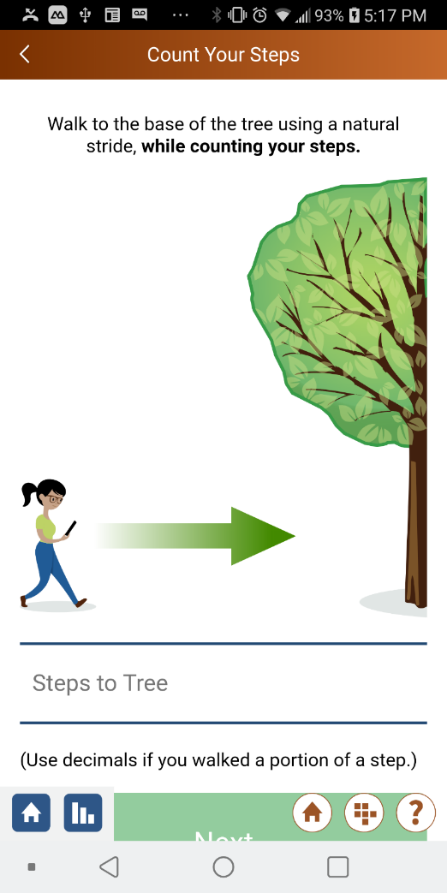
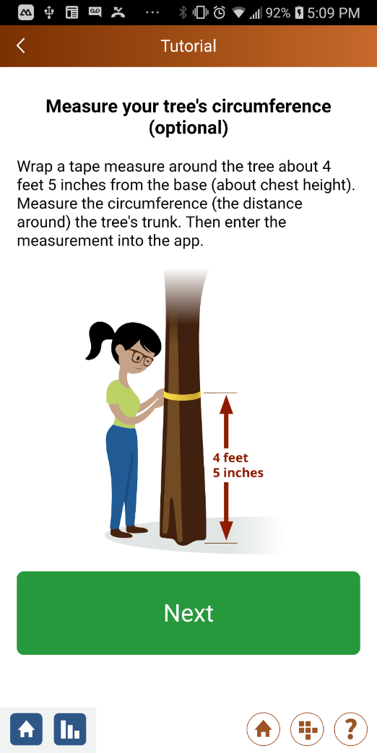
GLOBE Observer – Tree Height

Slide 10
What’s New - Website?

Slide 11
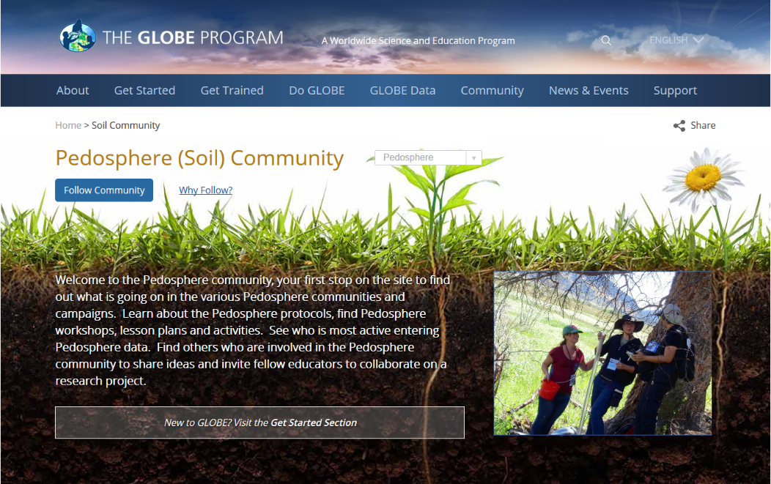
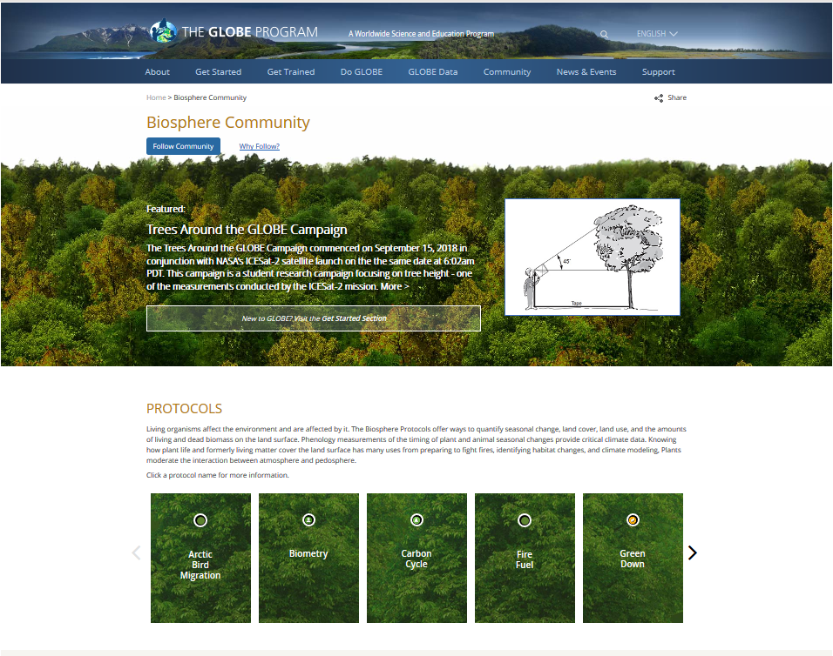
Website Enhancements
New Earth Sphere Communities
Your first stop to see what’s going on in a sphere community (Atmosphere, Biosphere, Hydrosphere, Pedosphere and Earth as a System)
Learn about sphere protocols
Find learning activities (new), lesson plans (coming soon) and other resources
See who’s active and entering sphere data
Find others to share ideas and collaborate on sphere projects
Do GLOBE > By Earth Sphere

Slide 12
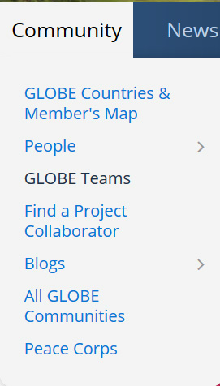
GLOBE Teams
All GLOBE participants can create a GLOBE ‘team’ organization (private or public).
Anyone can join a private team (with a referral code given out by the team manager) or a public team.
Users can associate their data with an organization that consists of friends, family and co-workers.
Each team has a page that shows total members, site locations and total observations by protocol.
The team creator can manage their team using an easy to use interface.
Future phases may include user identifiers like avatars to allow observations to be identified by member.

Slide 13
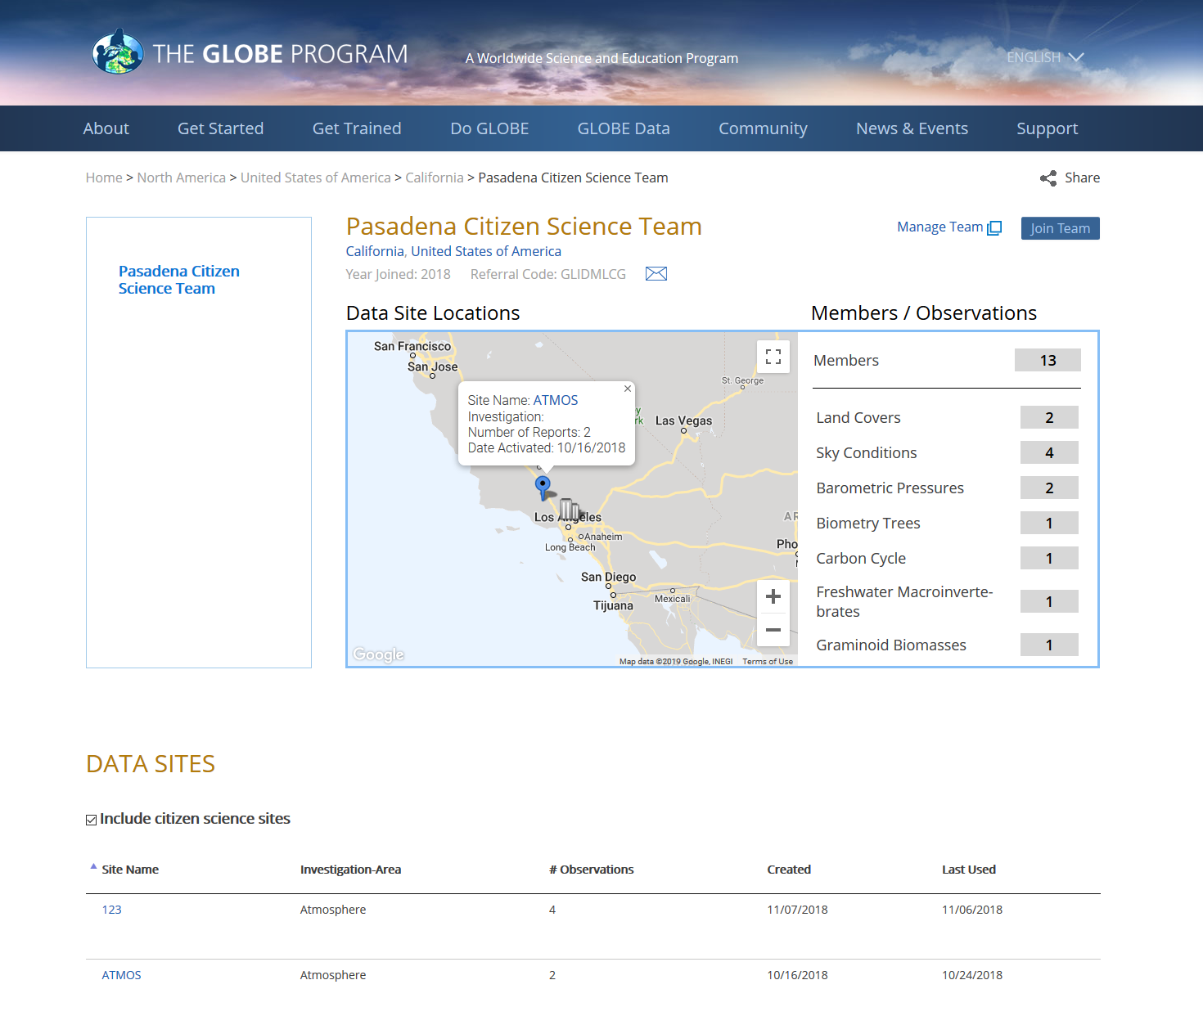
GLOBE Teams

Slide 14
Joining a School with a Referral code
All schools now have a referral code that can be used to join a school.
Referral codes can be entered on the school page, when creating a new account, or under user settings on the GLOBE Observer app.
Students, parents, citizen scientists can associate their data with a school.
If you are a teacher at the school or the partner/CC, you will see the referral code on the school page
Future phases may include user identifiers like avatars to allow teachers to track student measurements.

Slide 15
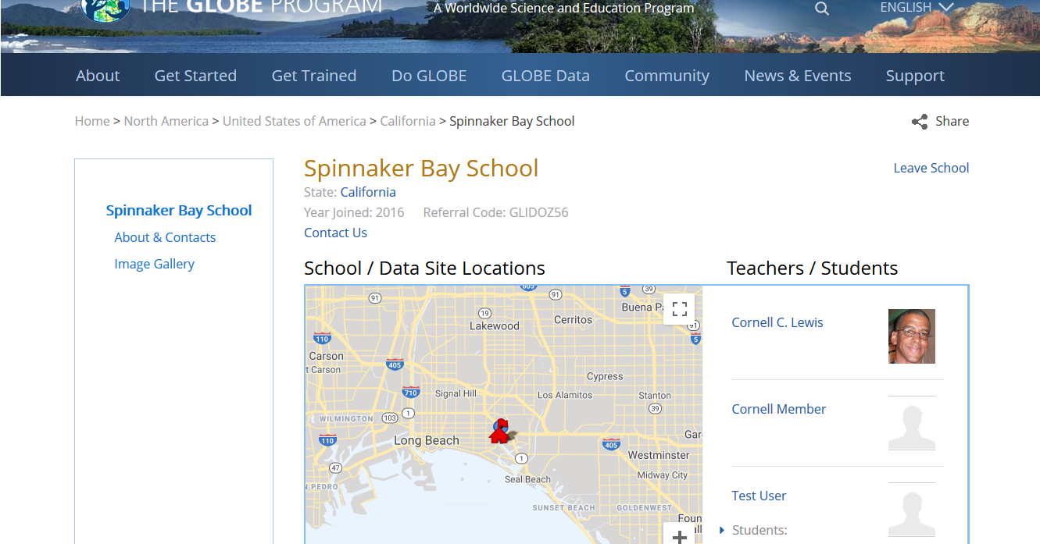
Joining a School with a Referral code

Slide 16
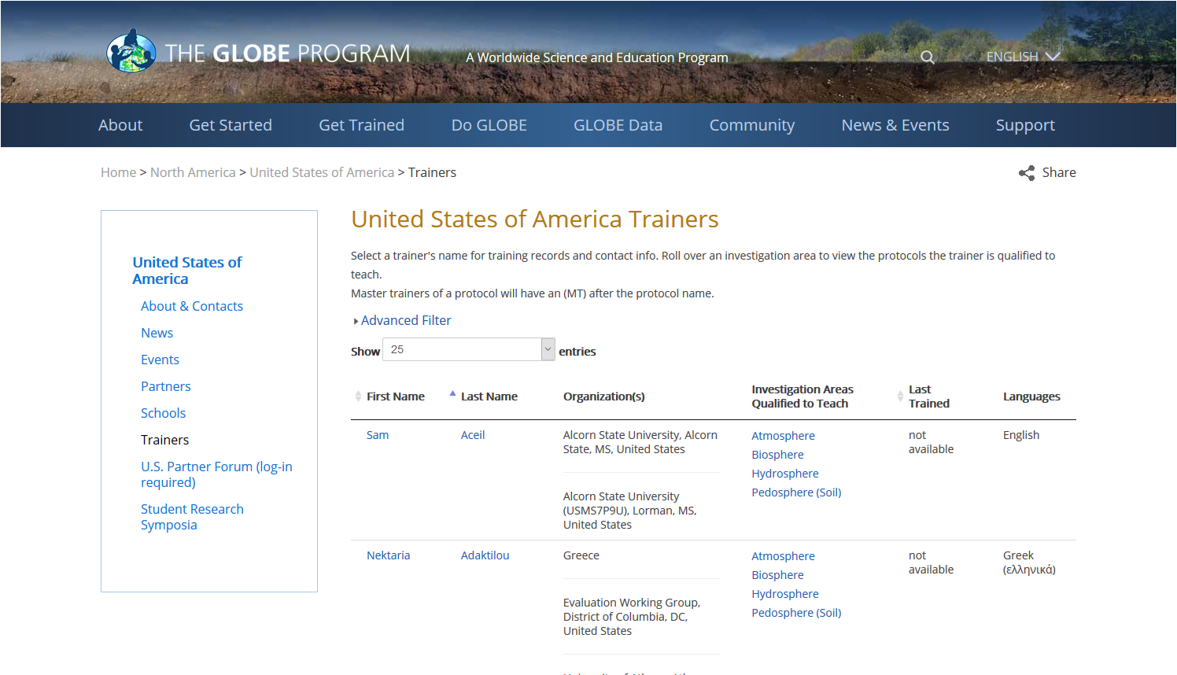
Website Enhancements
Find a trainer in a country – searchable list page with trainer’s name, organization, languages they speak and protocols they are certified to train

Slide 17
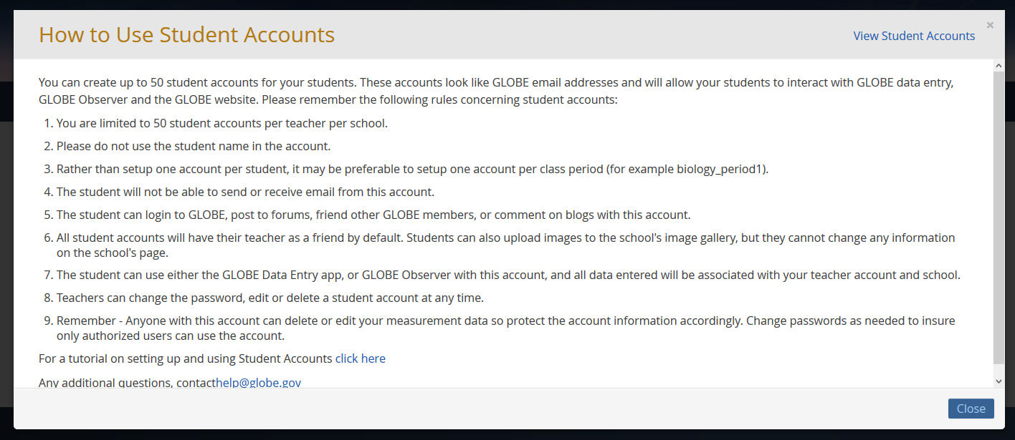
Website Enhancements
Increased the maximum number of student accounts to 50 (per teacher school account) and added help instructions.

Slide 18
Organization Management Tools
Partner/Country Coordinator Email Notifications
New Account Email Reminders –
Weekly email reminder if there are requested accounts that need approval
Monthly member report with a link to your partner dashboard
Workshop Email Reminders –
Pending workshop reminders
Workshop completion reminders

Slide 19
Partner Email Notifications
Member | Number | Description
Account Requested | 5 | Teachers who have requested to join GLOBE and are waiting for approval.
Account Approved | 15 | Teachers whose account has been approved but have not started the training process.
Pre-Candidate | 5 | New teachers who are registered for an upcoming workshop.
Candidate | 5 | New teachers who are registered for an in-process workshop.
Newly Workshop Trained | 7 | Teacher who have completed training at a workshop in the last 30 days (additional date filter options available).
Newly eTrained | 8 | Teachers who have been eTrained in the last 30 days (additional date filter options available).
GLOBE Members | 75 | Fully trained GLOBE Teachers.
Untrained GLOBE Observers | 20 | GLOBE Observers in your organization who are untrained (i.e. - have not completed eTraining) These are citizen scientists in your country/organization who have registered with the GLOBE Observer app.
Trained GLOBE Observers | 100 | GLOBE Observers in your organization who have been trained through the eTraining system.

Slide 20
Website Enhancements
Added ability for members to send a note with friend request
Improved search capabilities – now uses Google search
Can use map to enter organization lat/long
Modified how events are displayed – next event posted first. Separated upcoming and past events

Slide 21
Website Enhancements - Workshops
Workshop tool is now available in Spanish (others can added if Google translate is ‘good enough’)
Simplified Workshop Form
Workshop admins can search for teachers by email
Modified the workshop admin tool to allow CCs to manage GLOBE Observers who take their workshop
Modified system to allow trainers to administer workshops
All trainers were added to new trainer organization under their GLOBE country to facilitate managing workshops

Slide 22
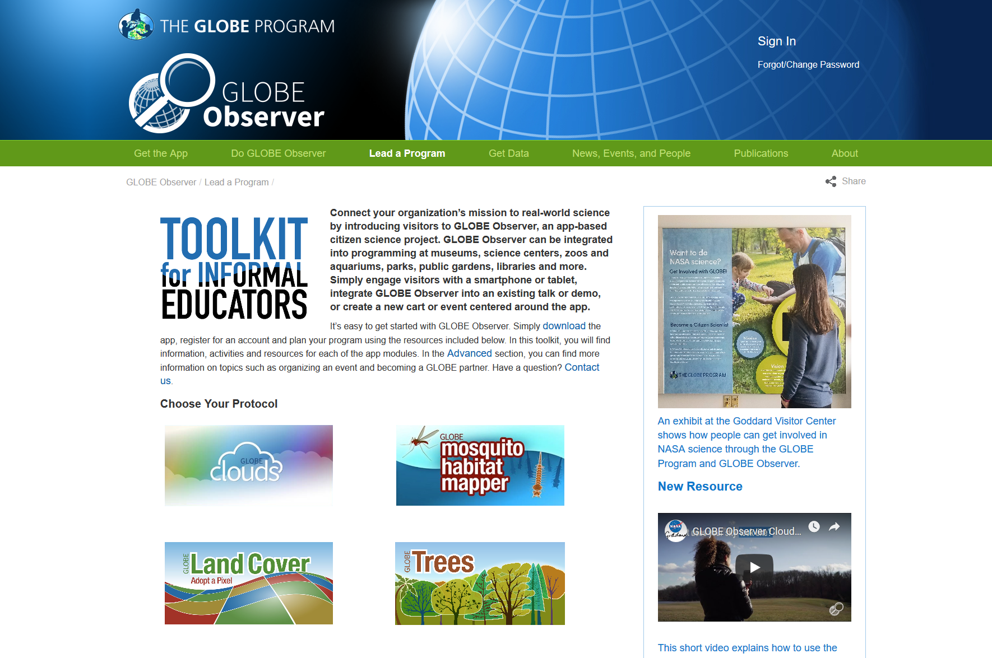
GLOBE Observer Website Enhancements
Improved site organization and navigation

Slide 23
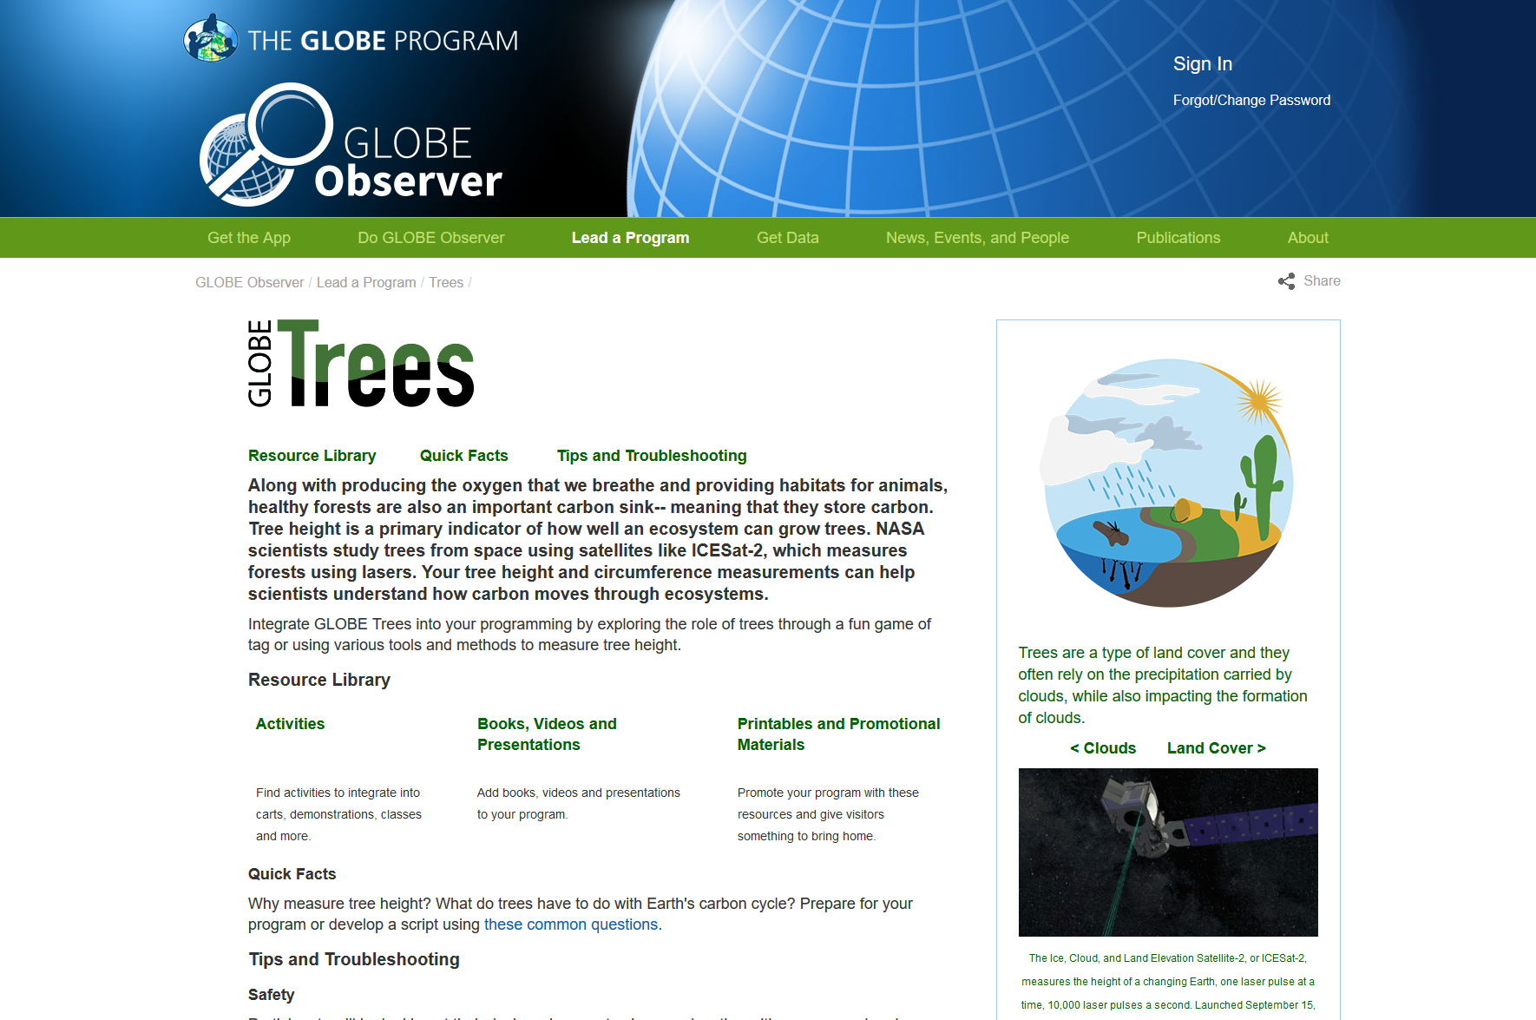
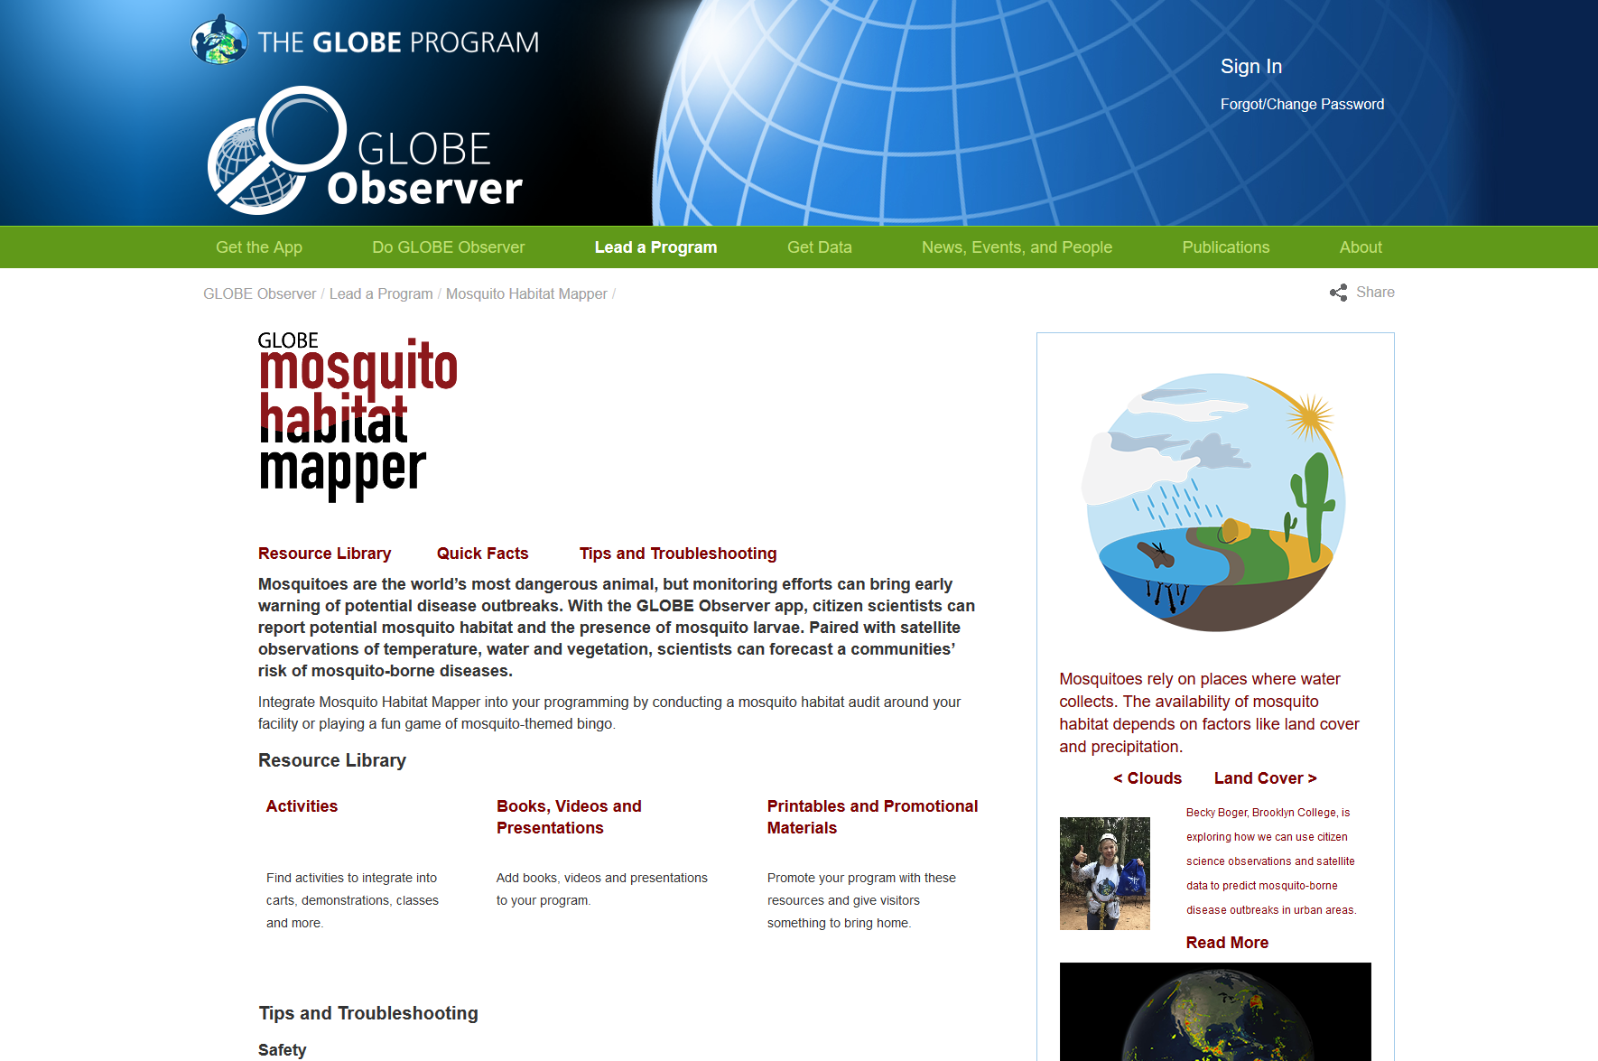
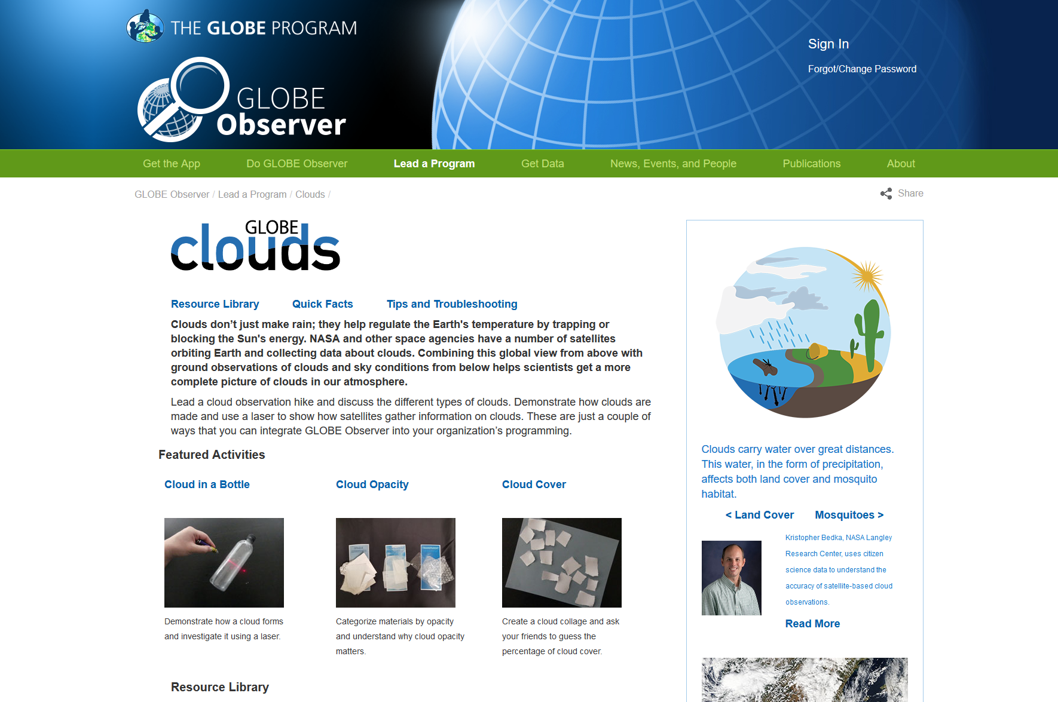
GLOBE Observer Website Enhancements

Slide 24
What’s New – Visualization / ADAT?

Slide 25
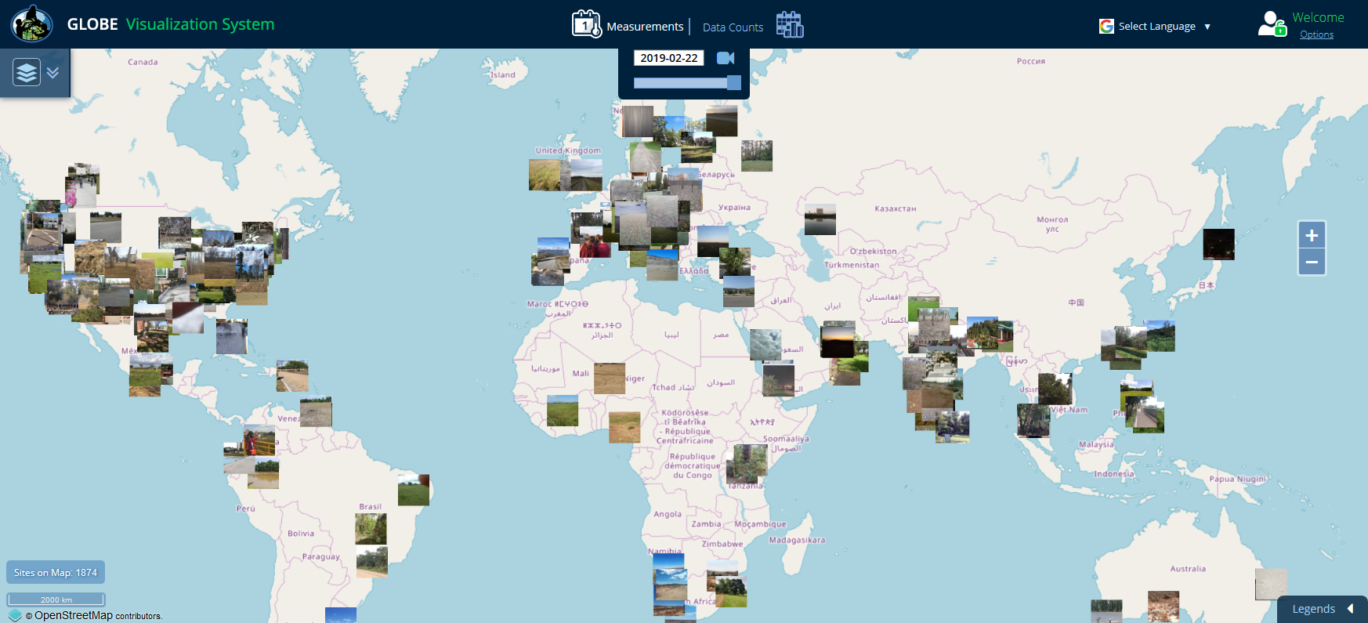
Vis Enhancements
New photo layers for Clouds, Mosquito Habitat Mapper and Land Cover and Trees

Slide 26
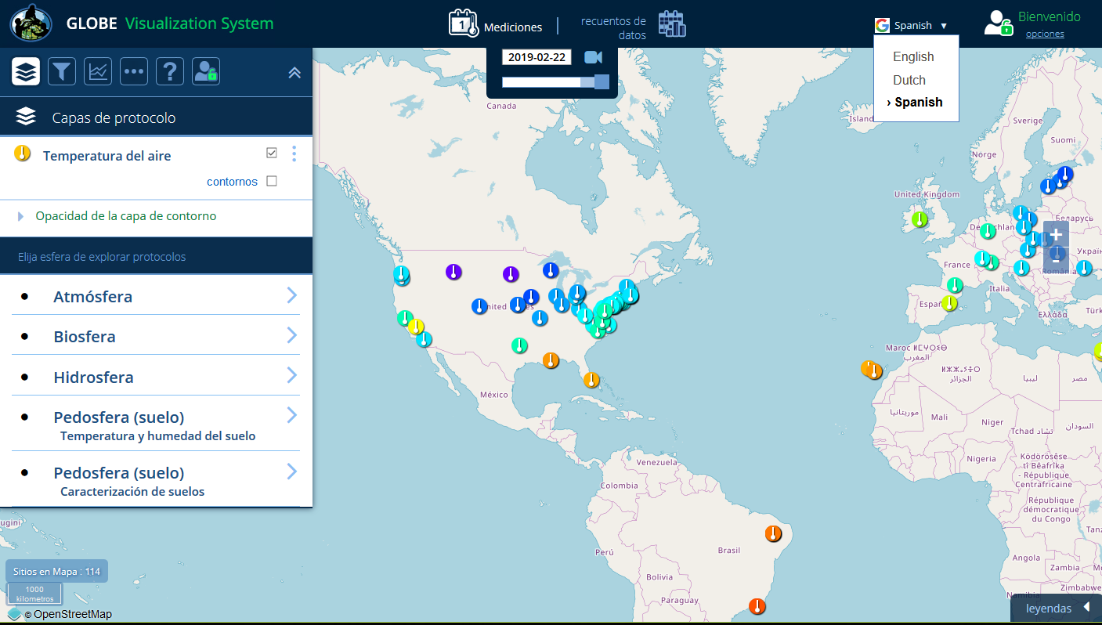
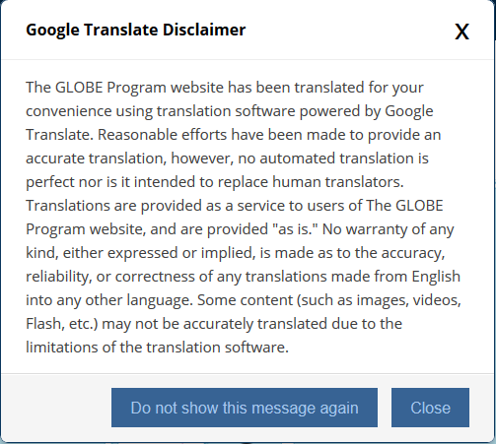
Vis Enhancements – Language Translations
Available in Spanish and Dutch (Others can be added if google translations are “good enough”)

Slide 27
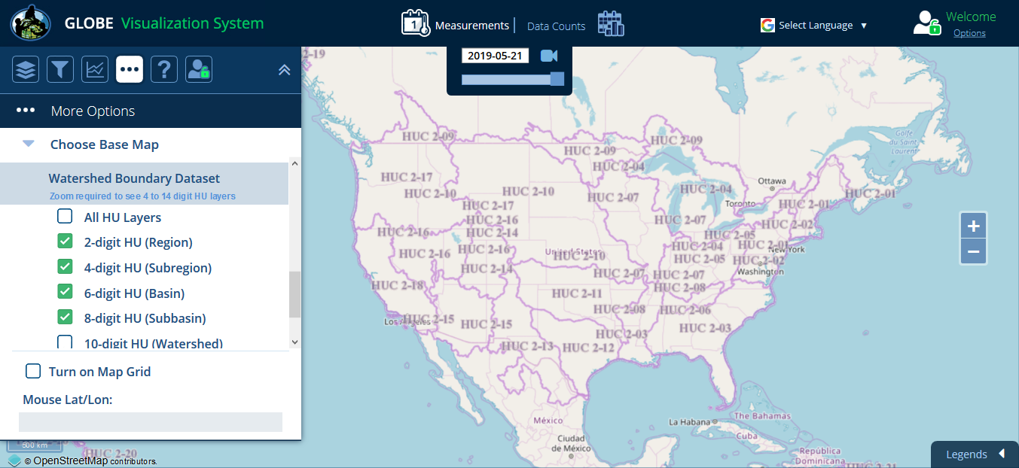
Vis Enhancements – Watershed Boundary Base Map
Only US currently but base layers for other countries can be added

Slide 28
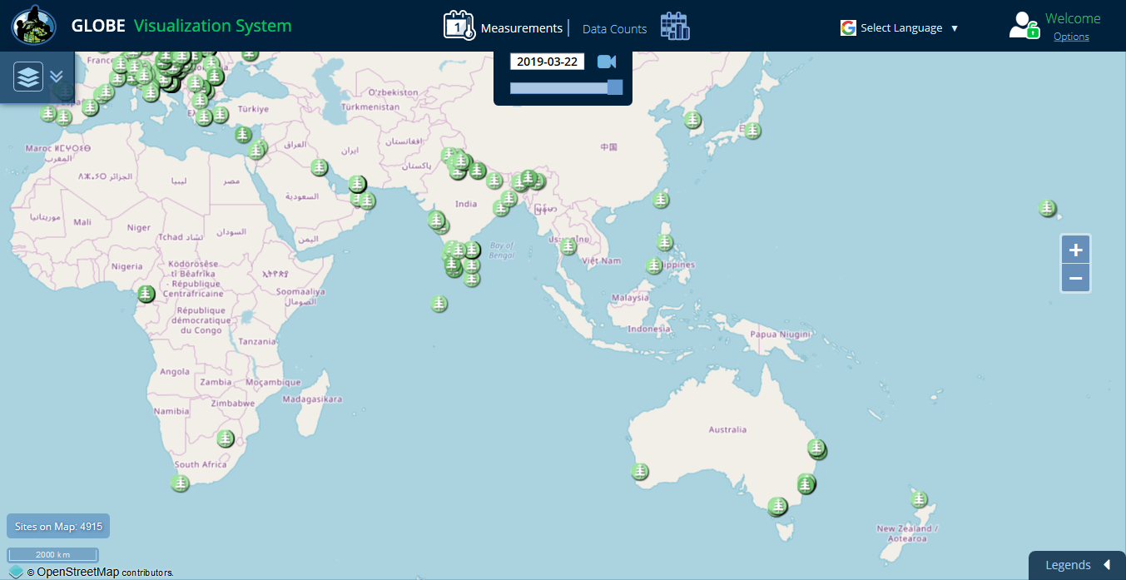
Vis Enhancements – Tree Height

Slide 29
Vis Enhancements
Tree Height protocol added
Visualize all observations under a school or schools
Customizable Y-Axis ranges for multi-site plots
Time intervals for Land Cover data – 1 day, 1 month, 1 yr, 5 yr or All

Slide 30
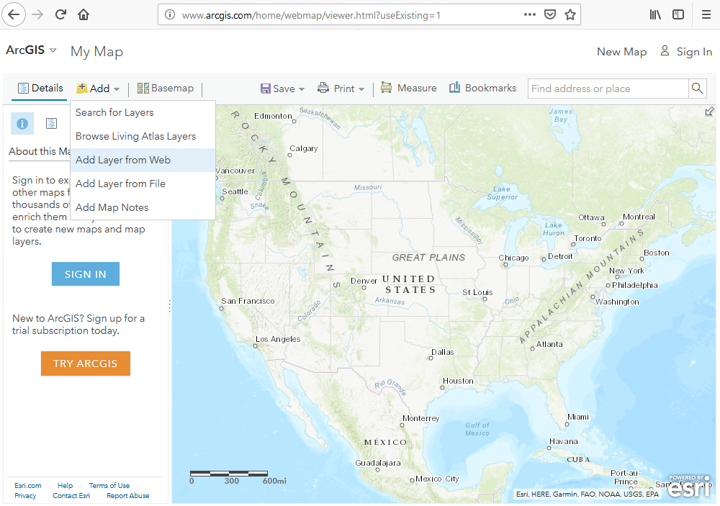
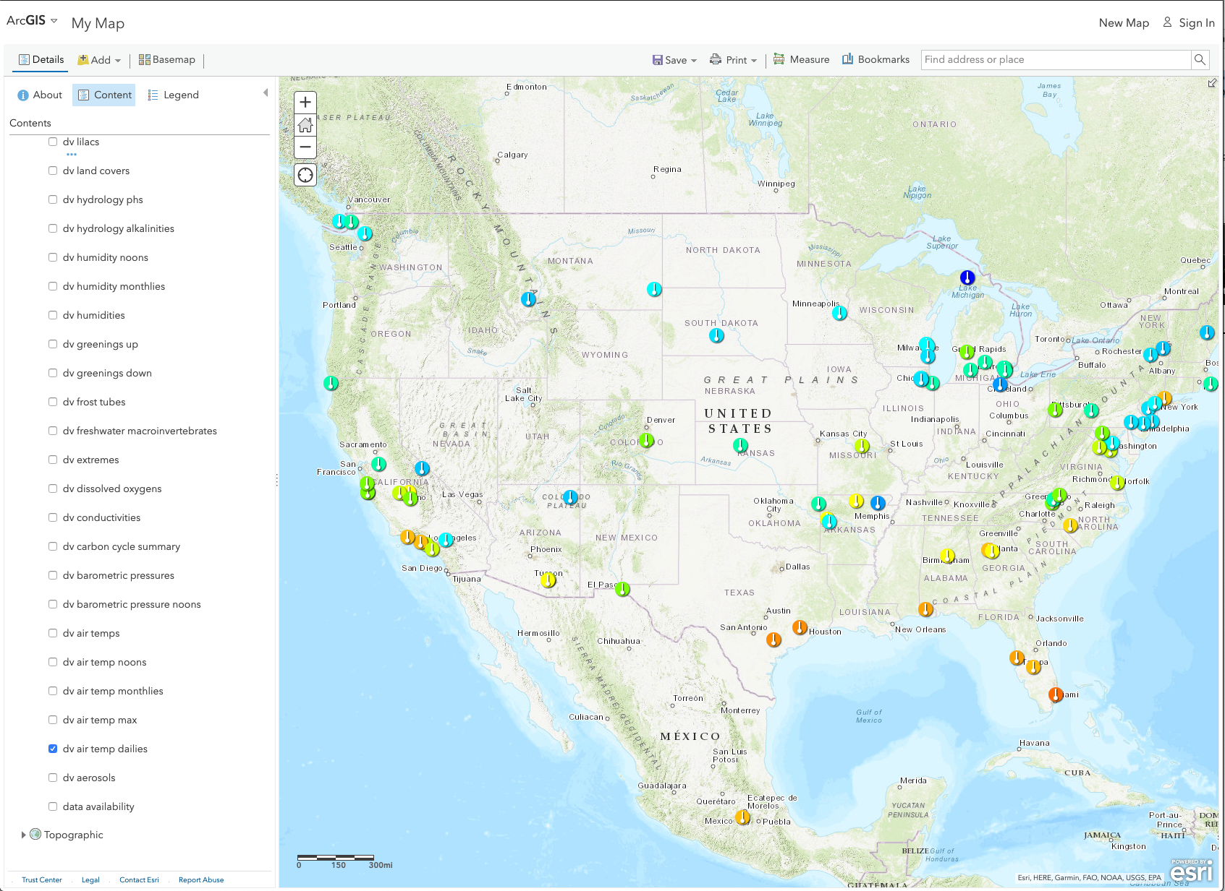
Vis Enhancements – Import Vis layers as Overlays into the ArcGIS System
https://www.globe.gov/globe-data/visualize-and-retrieve-data

Slide 31

ADAT System Enhancements
Filter ADAT using ‘And’ option for protocols (i.e. find all sites with aerosol and air temp)
Added Spanish and Dutch language with Google translate disclaimer (others can be added)
Improved interface for mobile viewing
Added units/descriptions to column headers on export
Re-organized the data export columns
Added Tree Height protocol
Added photo URLs to output files
Significant performance improvements

Slide 32
API-Out (Application Programming Interface)
API allows users to pull data from GLOBE programmatically
Programmatically = something I can call via a program/script/URL
Simple but useful interface
Fast
Provides support for getting data that is similar to ADAT
Info: https://www.globe.gov/globe-data/globe-api
Tool: https://api.globe.gov/search/swagger-ui.html

Slide 33
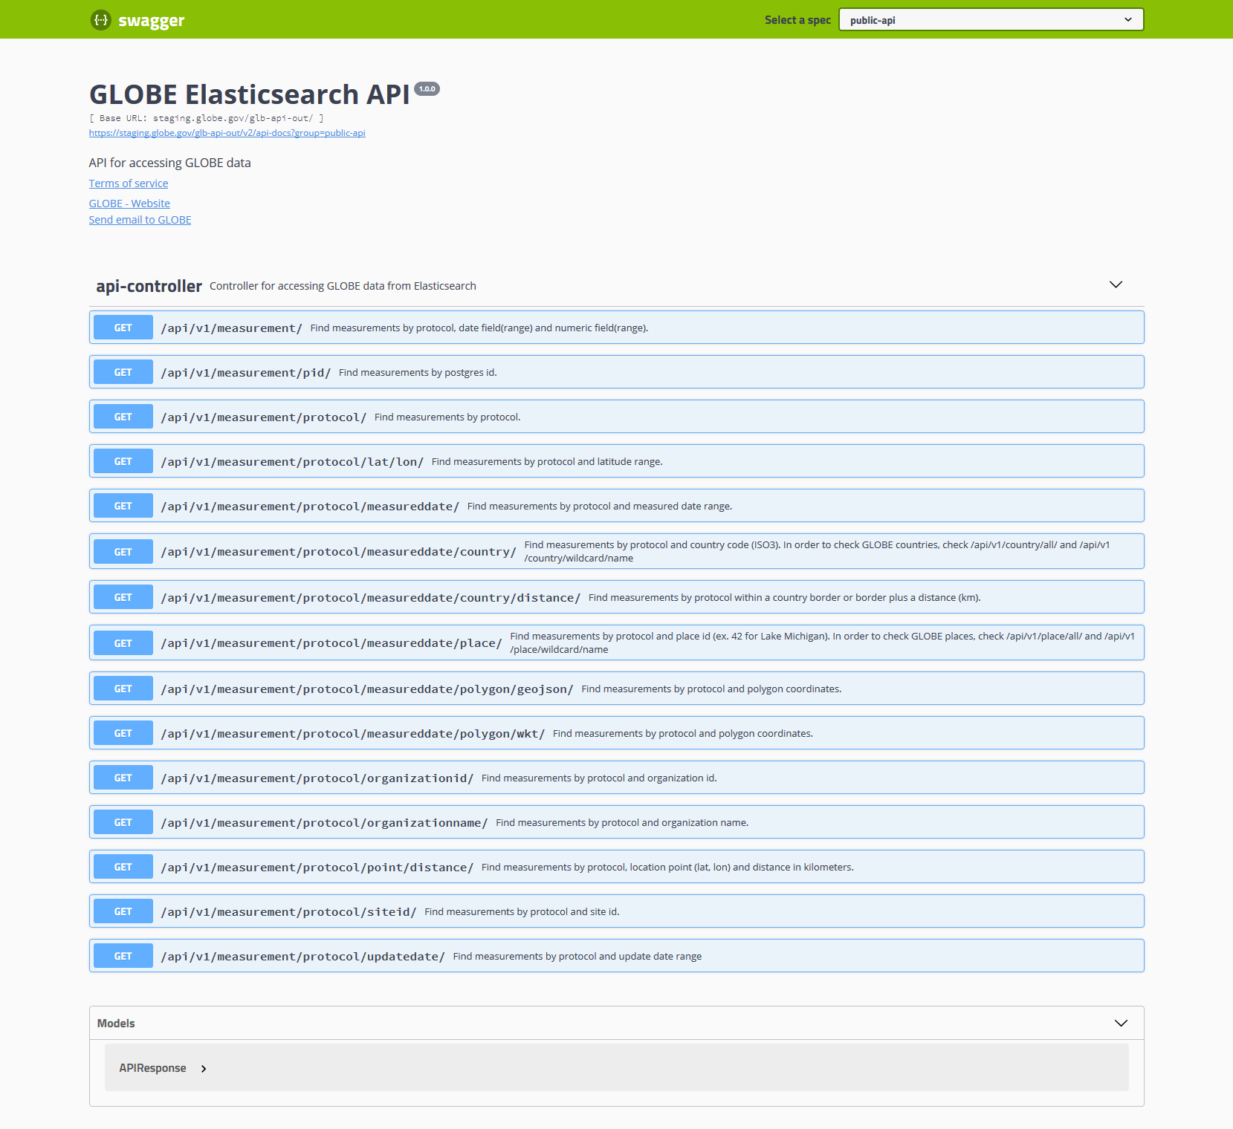
API-Out

Slide 34
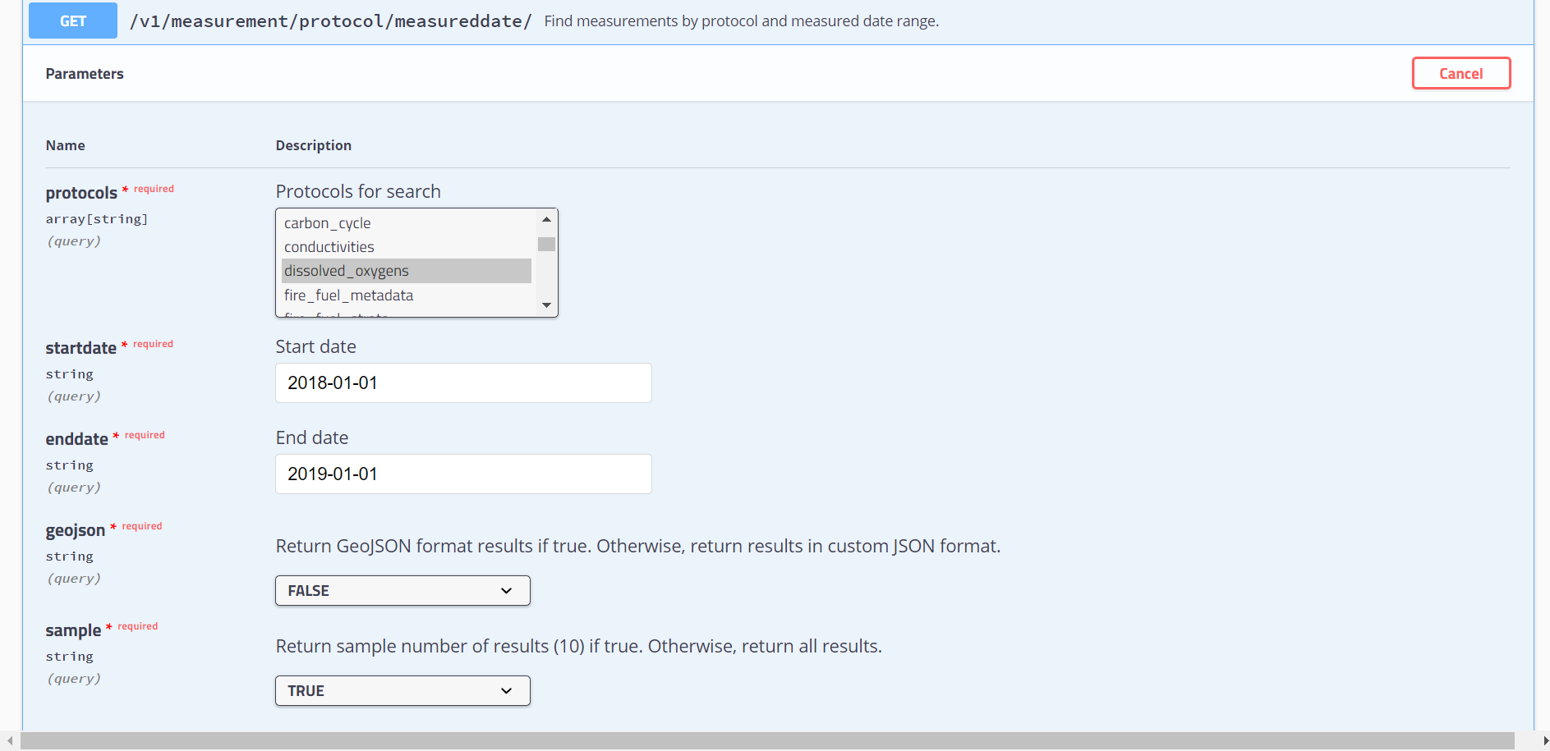
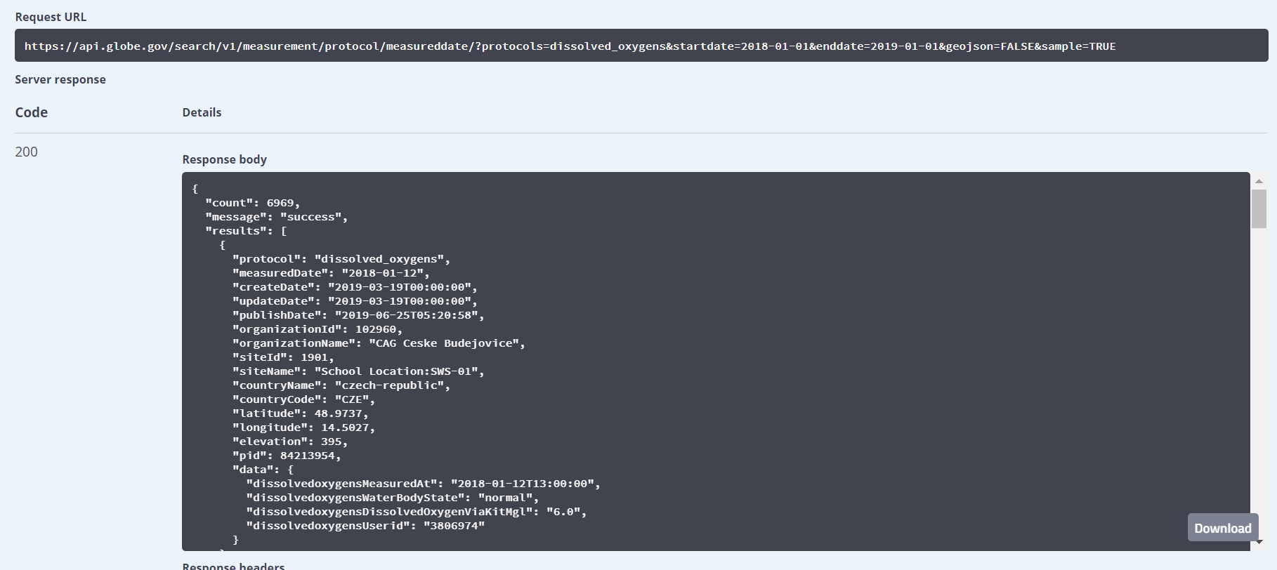
API-Out
https://api.globe.gov/search/v1/measurement/protocol/measureddate/?protocols=dissolved_oxygens&startdate=2018-01-01&enddate=2019-01-01&geojson=FALSE&sample=TRUE

Slide 35
Future Enhancements

Slide 36
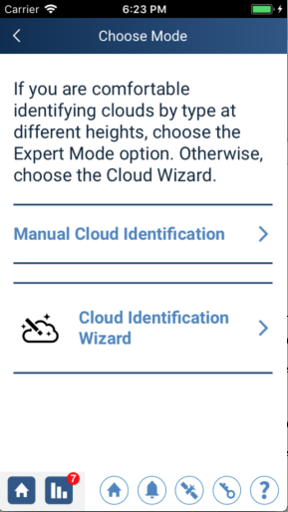
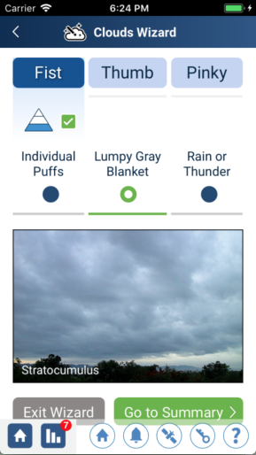
GLOBE Observer App - Clouds Wizard
Tool within the clouds app to help users better identify the cloud types observed

Slide 37
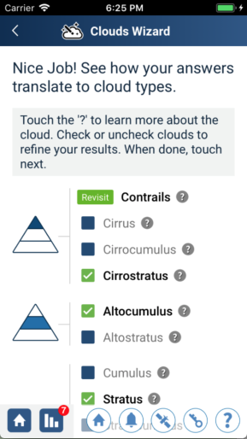
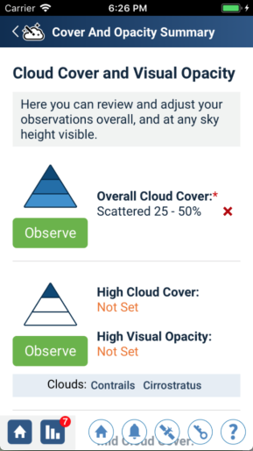
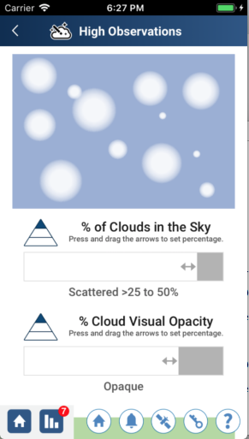
GLOBE Observer App - Clouds Wizard

Slide 38
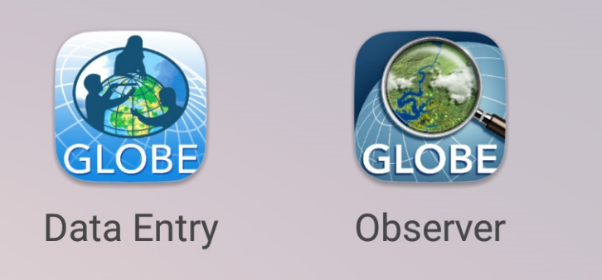
Data Entry – Streamlining and Improving DE
Leverage the lessons of the GLOBE Observer app to further simplify GLOBE Data Entry
Working to merge the two apps (GLOBE Observer/GLOBE Data Entry) into a single app. Same code, similar interface for App and Desktop
Easier to create sites
Easier to enter protocol data
Customize data entry with the protocols you use
All Atmosphere protocols will be done first

Slide 39
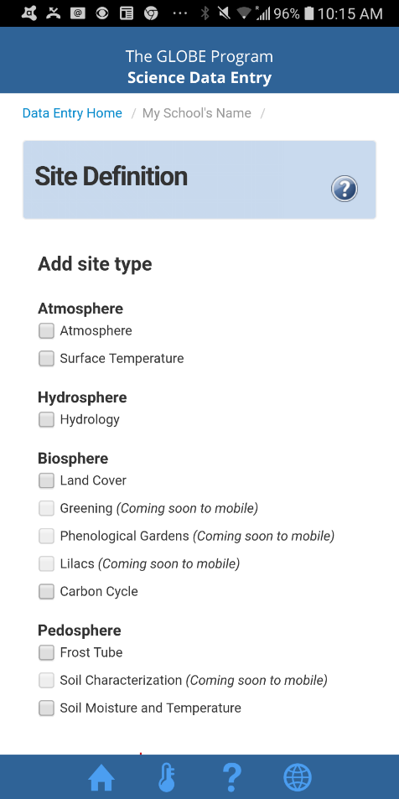
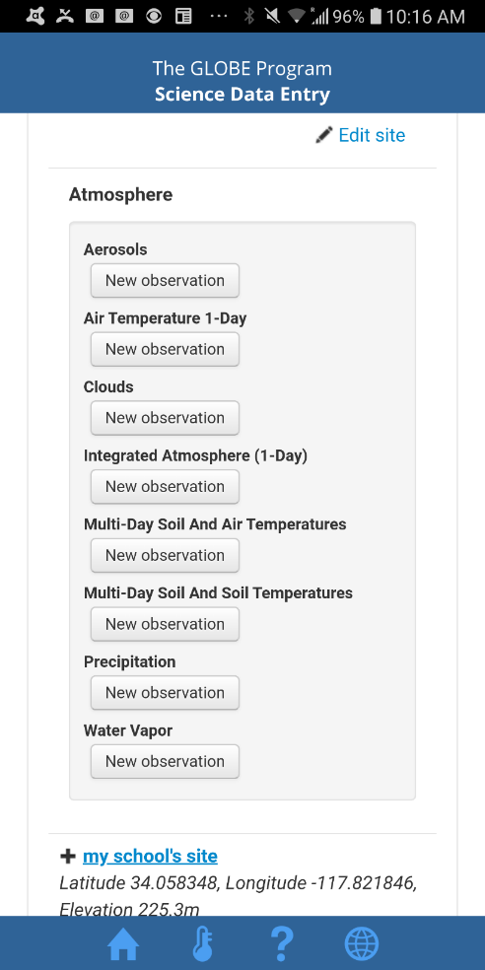
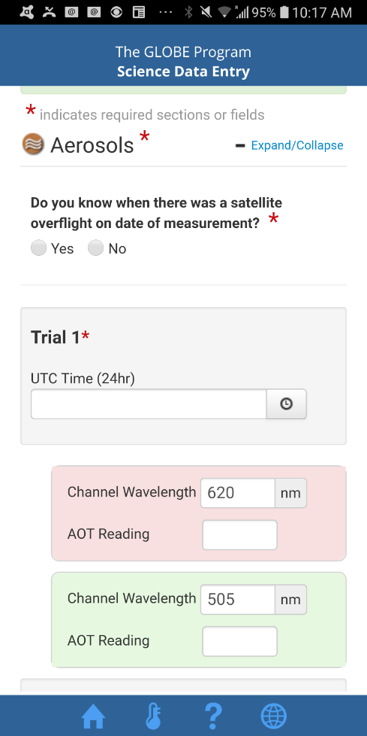
Data Entry – Streamlining and Improving DE
Current Data Entry App

Slide 40
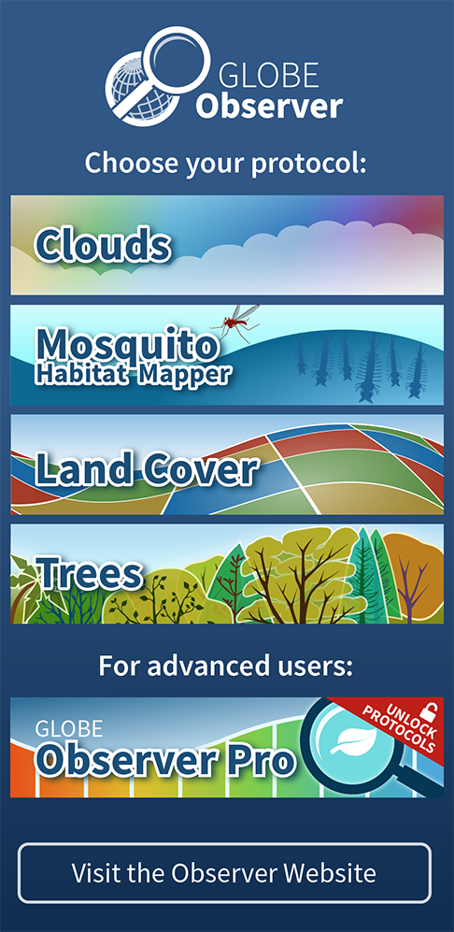
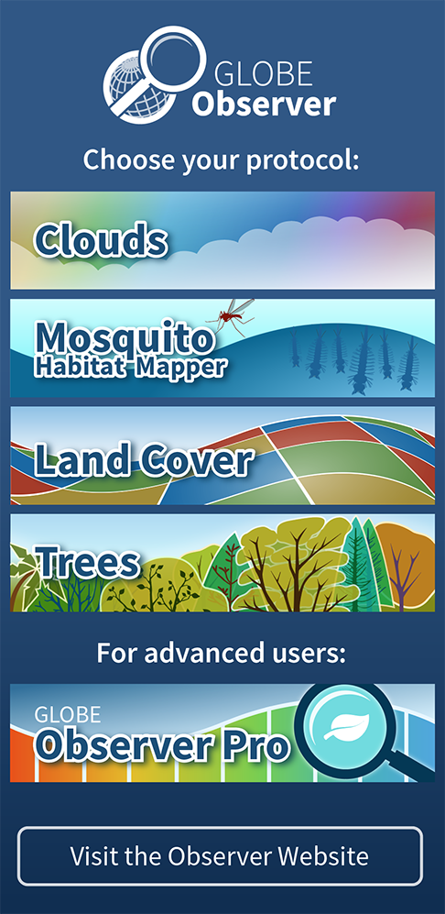
Data Entry – Streamlining and Improving DE
Untrained
Trained

Slide 41
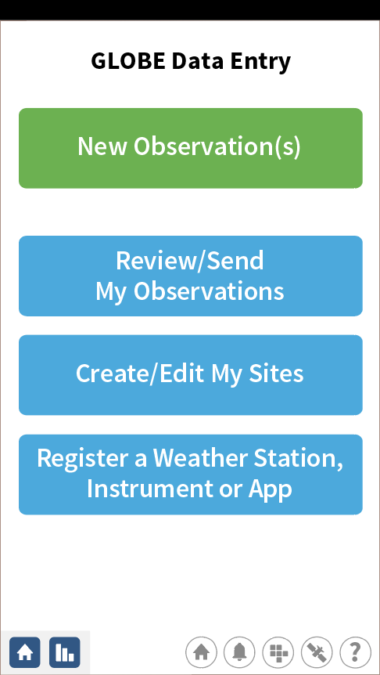
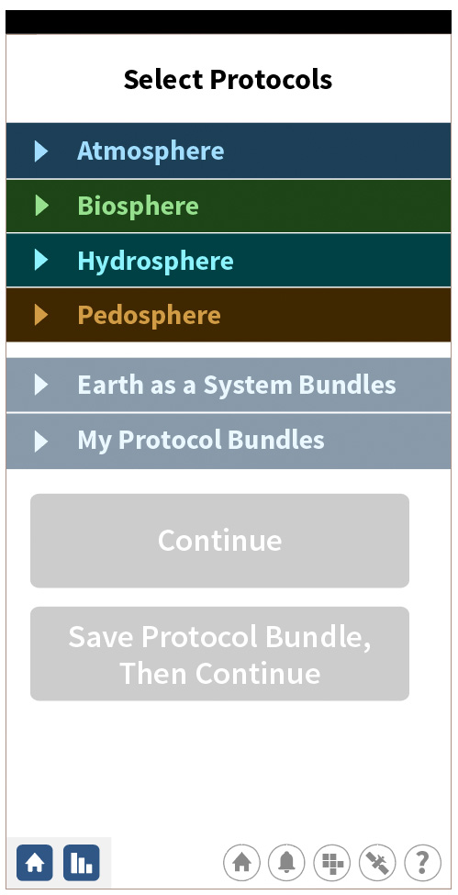
Data Entry – Streamlining and Improving DE

Slide 42
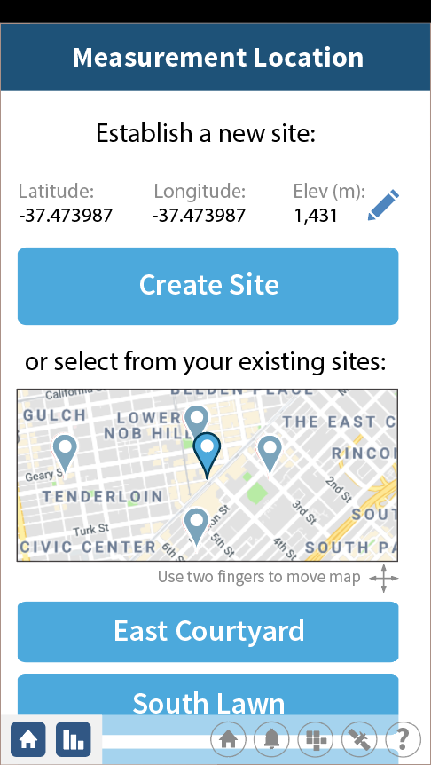
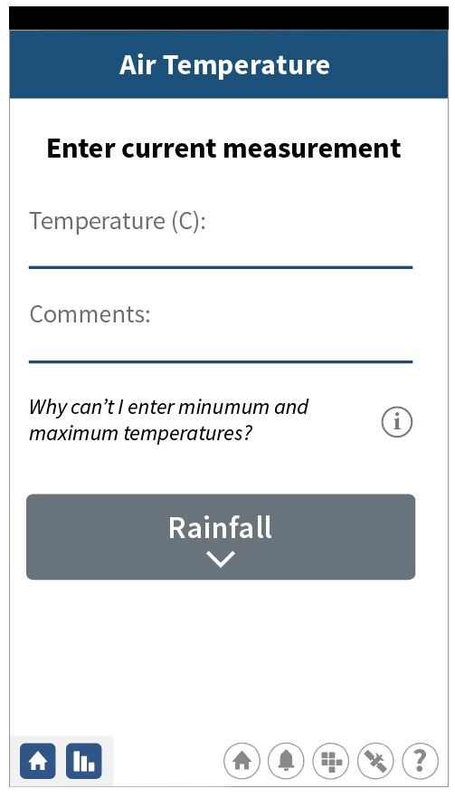
Data Entry – Streamlining and Improving DE

Slide 43
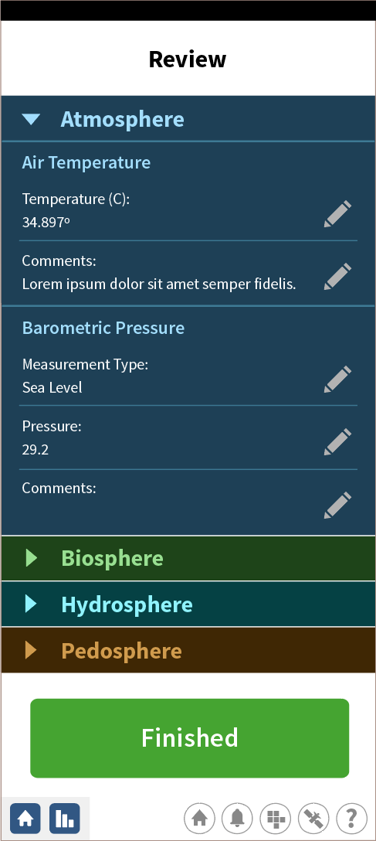
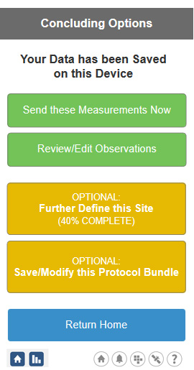
Data Entry – Streamlining and Improving DE

Slide 44
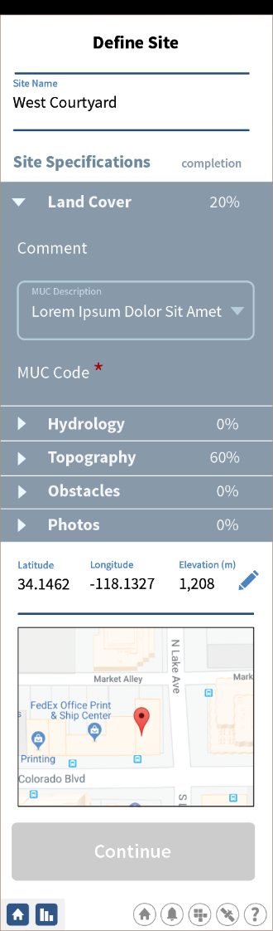
Data Entry – Streamlining and Improving DE

Slide 45
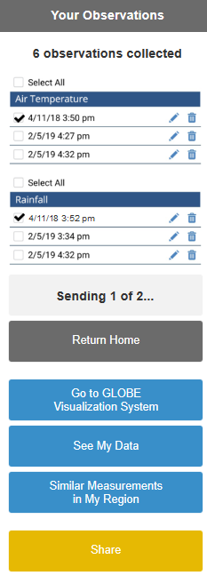
Data Entry – Streamlining and Improving DE

Slide 46
Future Web Enhancements
Avatars and other identifiers to allow school and team managers to track the observations of students and members.
Badging system for school pages.
Language Translations – using Google translate, the entire web site will be translated into other languages. Initially, we will offer the languages found on the Data Entry app (10 languages).
Simplification of User account types and the approval process.
Data Reporting tool – display observations at the protocol level for users (similar to the school reporting tool).

Slide 47
Future Web Enhancements
A new version of the website software (Liferay 7.1) is coming with an improved admin interface and new tools and features.
This is a significant upgrade which will require involvement from all Liferay developers.
No new enhancements will be introduced to the website while the upgrade is taking place (scheduled to be completed in December 2019).
Enhancements/updates will continue on the app, visualization and ADAT systems.

Slide 48
Support during the Annual Meeting
Formal Sessions
Tuesday: Tech 1, Plaza C: Country Coordinators and Partners – Using the GLOBE website, 1:30-3 PM
Tuesday: Tech 2, Plaza C: GLOBE Treasure Hunt, 3-4 PM
Tuesday: Tech 3, Plaza C: Teachers – Using the GLOBE Website, 4-5 PM
Thursday: Tech 4, Vis/ADAT, Story Maps and the GLOBE API, 10:30-12 PM
Thursday: Tech 5, Citizen Scientist Involvement, 1:45 – 2:30 PM
Thursday: Tech 6, Open Q&A, 2:30-3 PM
We’re here to assist and answer questions. Sometimes 5 minutes can save you a lot of frustration…please ask questions, make suggestions…Available for one-on-one training if something doesn’t seem right, or you need a tip.
Ideas for what would make things better? Questions?

Slide 49
David.Overoye@ssaihq.com Autumn.Burdick@ssaihq.com Cornell.Lewis@ssaihq.com Science Systems & Applications, Inc

Slide 50
Social Media

