Slide 1
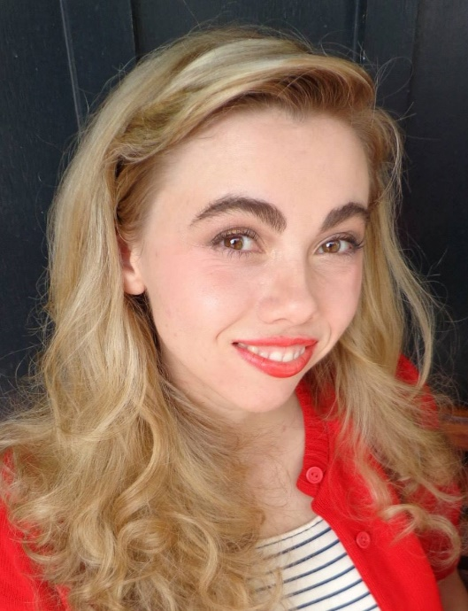
GLOBE Social Media Report
Autumn Burdick
Science Systems and Applications, Inc.
July 15, 2019
Science Writer, Editor and
Social Media Specialist

Slide 2
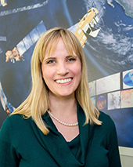
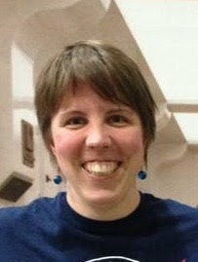
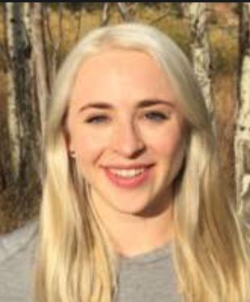
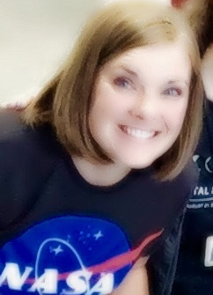
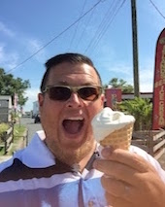
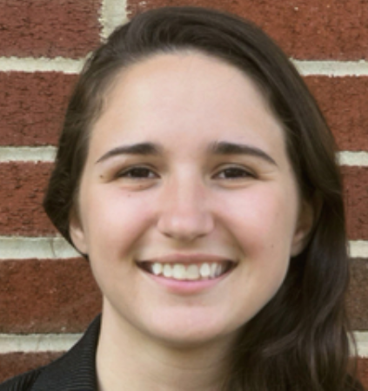
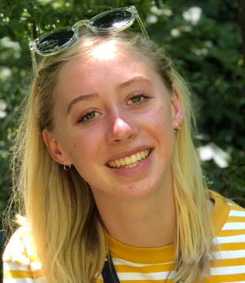
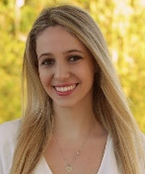
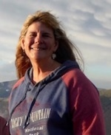
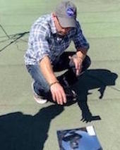
Social Team
Holli Kohl
– NASA GO
Kristen Weaver
– NASA GO
Amy Barfield
– GLOBE
Instagram
Tassia Owen
– NASA GO
Brian Campbell
– NASA GO
Heather
Mortimer
– NASA GO
Autumn Burdick
– GLOBE/NASA GO,
Social Media Lead
Since March 2019: Eve Terrill
and Richard Tirado, Interns
Additional support during this 12-month period from Jessica Beeli, Dorian Janney, and Peter Falcon.
Notes:
First, I want to extend a thank you and recognize the social team members, many of who are here today.

Slide 3
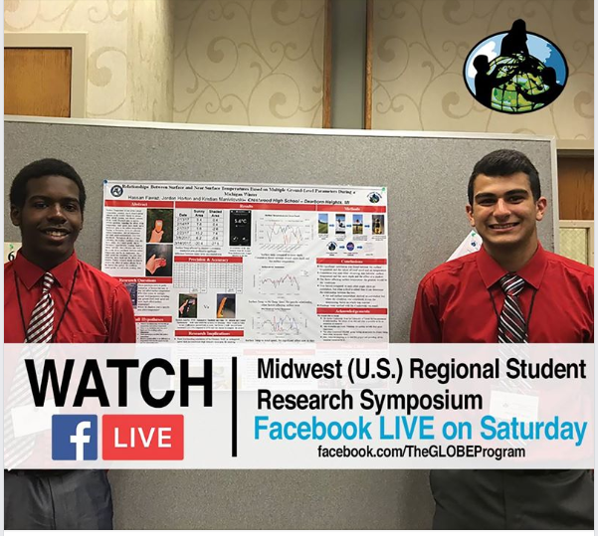
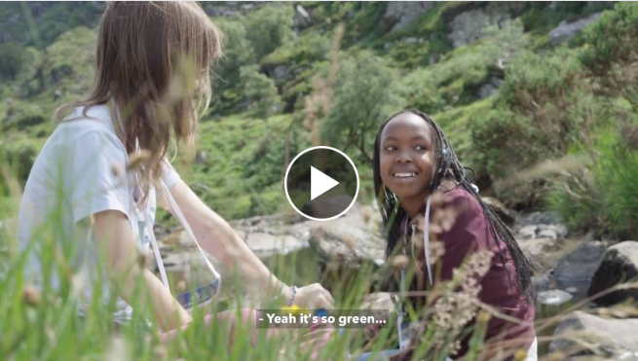
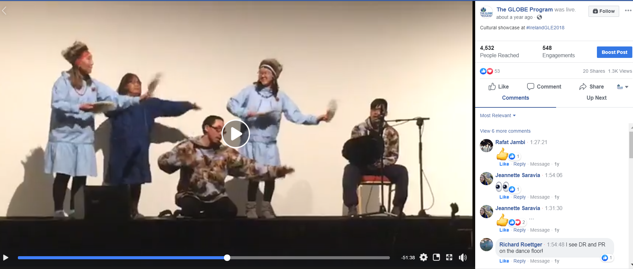
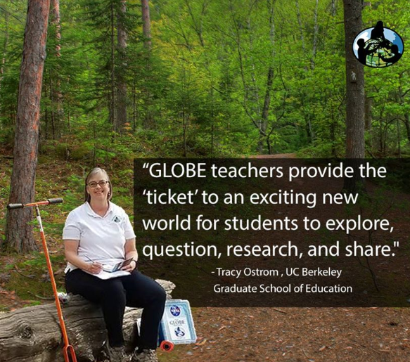
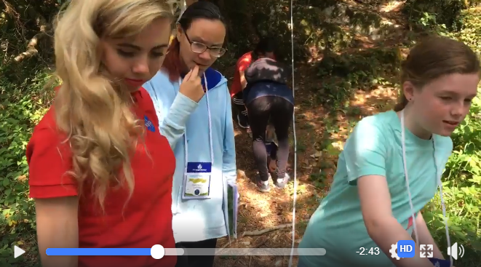
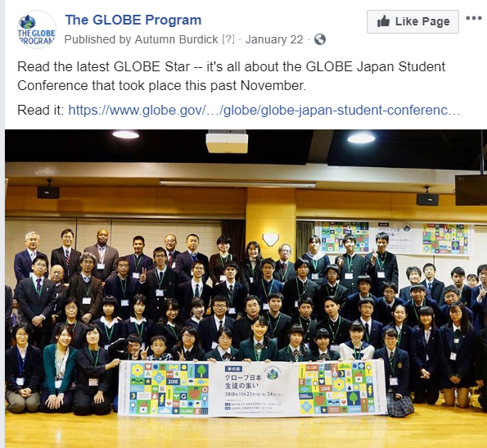
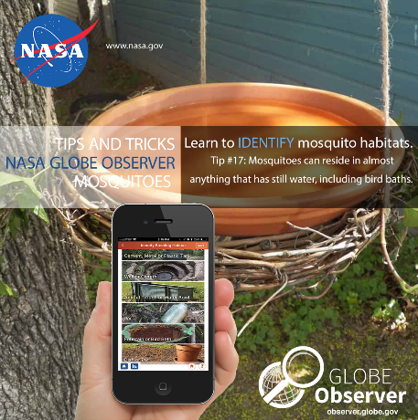
Social Report – GLOBE and GLOBE Observer
Here is just a sampling of all the great happenings we have covered on GLOBE and GO social since we last met!
GLE Coverage
GLOBE Zika, Mission Mosquito, Mosquito Habitat Mapper
Trees Around the GLOBE, the GO Trees tool
UHI
IOPs
The IVSS
The US Student Research Symposia (SRS)
Teacher Water Coolers
Mission Earth
Clouds
Land Cover
GO on a Trail
Challenges
Tuesday Tips and Thoughts
GLOBE Stars
Tech Updates
GLOBE Country Anniversaries
National Days/Weeks
Science Community Support
Research Contributions by the GLOBE Community
Community Blogs
Regional Meetings
The Eclipse in South America
Busy year, full of lots of activity!
Notes:
On social we supported and communicated about the following this past year.

Slide 4
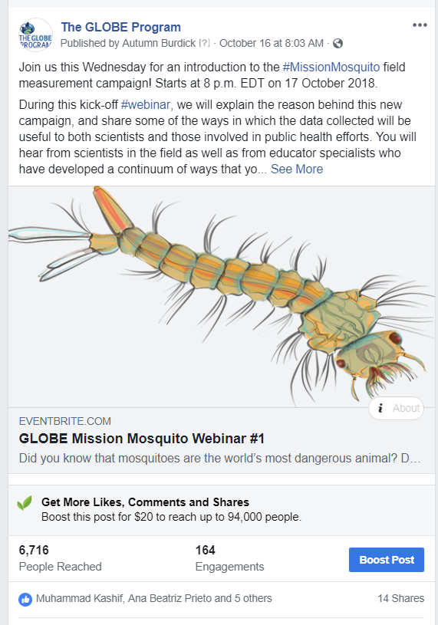
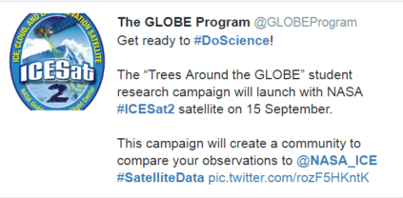
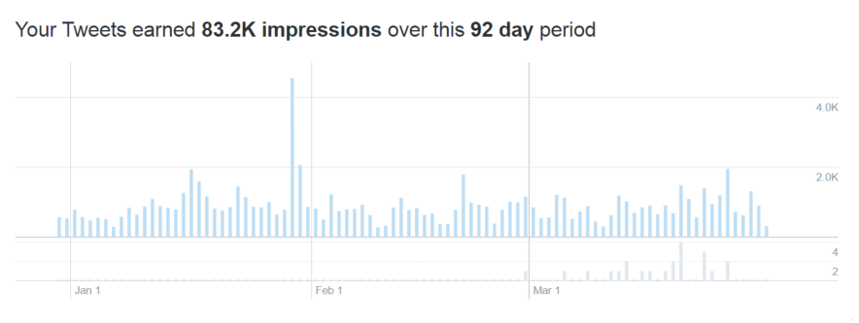
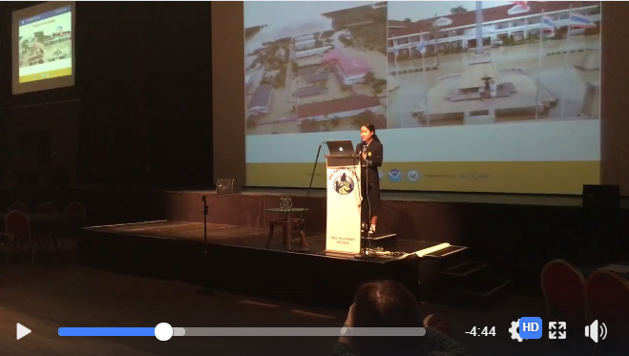
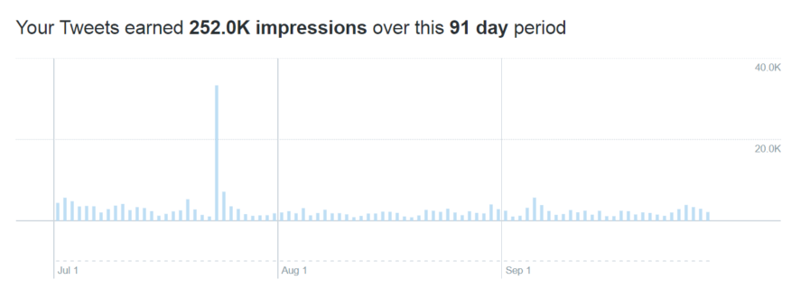
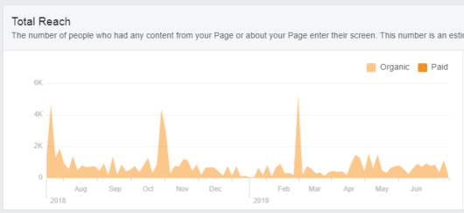
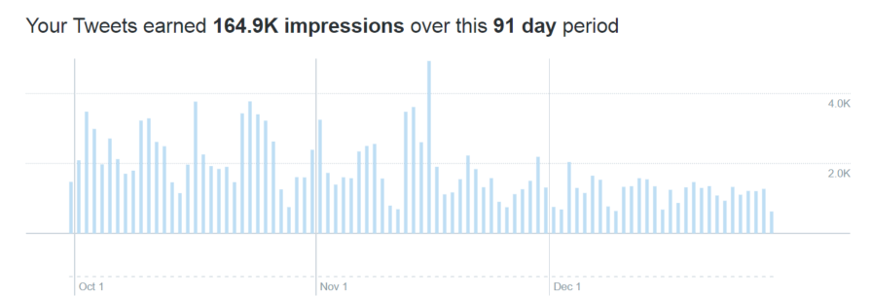
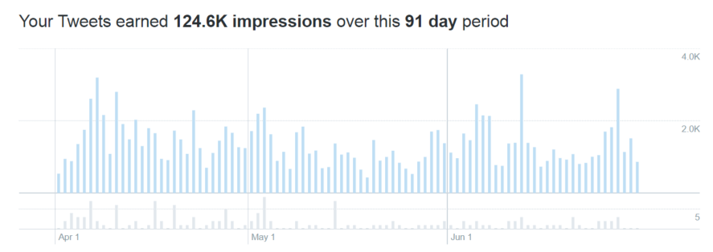
Social Report – The GLOBE Program
July 2018 –June 2019
TWITTER
Last 12 months: Gained 1,615 followers on Twitter
Averaged 134 new followers each month – about 4 per day
621 tweets written/shared since the last annual meeting
Our tweets impressed over 624.7K
The top tweet impressed >7K
FACEBOOK:
Last 12 months: Gained 2,954 followers on FB
Averaged 246 new followers each month – about 8 per day
410 posts written/shared since the last annual meeting
Our posts reached over 115.2K
The top post reached >6.7k
Top Tweet: TAG Campaign
Launch Tweet
Top Post: Mission Mosquito
Impressions
Reach
Since July of last year we broadcasted live out of GLOBE FB
18 times. Top GLOBE FB Live: Student Keynote from Ireland -- Reached: > 6K

Slide 5
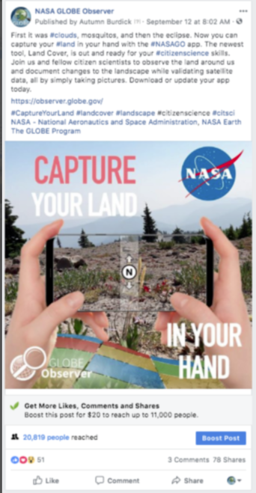
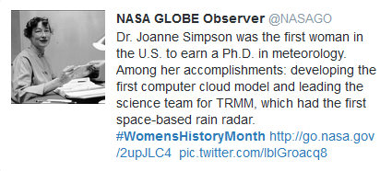
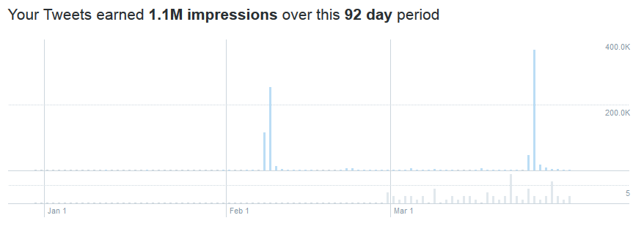
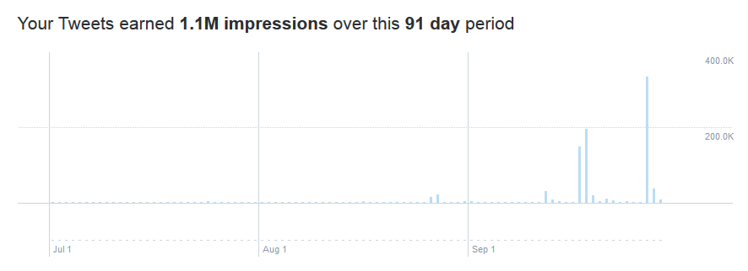
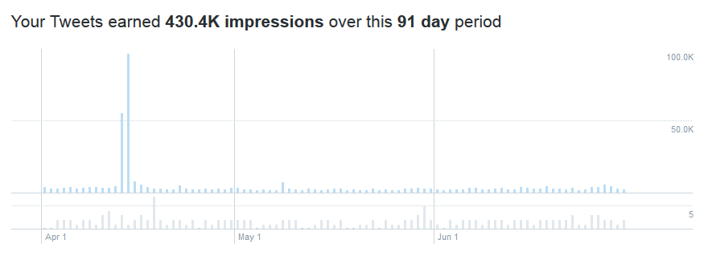
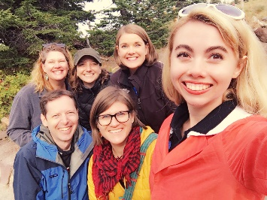
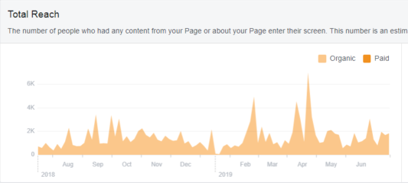
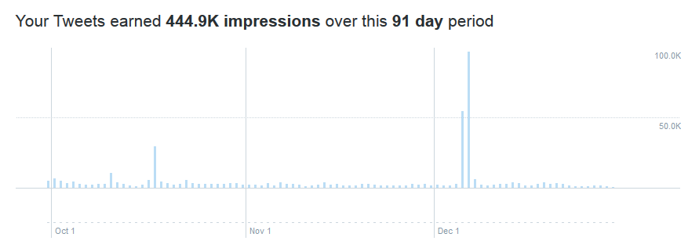
Social Report – GLOBE Observer
July 2019 –June 2018
TWITTER
Gained 1,988 followers on Twitter
Now averaging 165 followers each month – about 5 per day
634 tweets written/shared during this period
Our tweets impressed over 3 million people
The top tweet impressed >465K
FACEBOOK:
Gained 4,883 followers on FB
Now averaging 406 followers each month – about 14 per day
673 posts written/shared during this period
Our posts reached over 265.8 K with an additional > 411K from FB Lives broadcast out of the NASA Earth account, as well as the Land Challenge winners video, which reached >100K
Total: a reach of nearly 800K on FB these past 12 months!
The top non-FB Live post shared on our account reached >20K
Top Tweet:
Women History Month
Top Post
Impressions
Since July of last year we broadcasted, or shared, out of the NASA Earth FB five times. The top GO NASA Earth FB Live: Land Cover from Mt. Hood -- Reached: 205K
Reach
Notes:
Our top Facebook Live had more active viewers than any video concerning Hurricane Florence during the broadcast week and any video concerning ICESat-2 during this particular quarter on NASA Earth. This is significant.

Slide 6
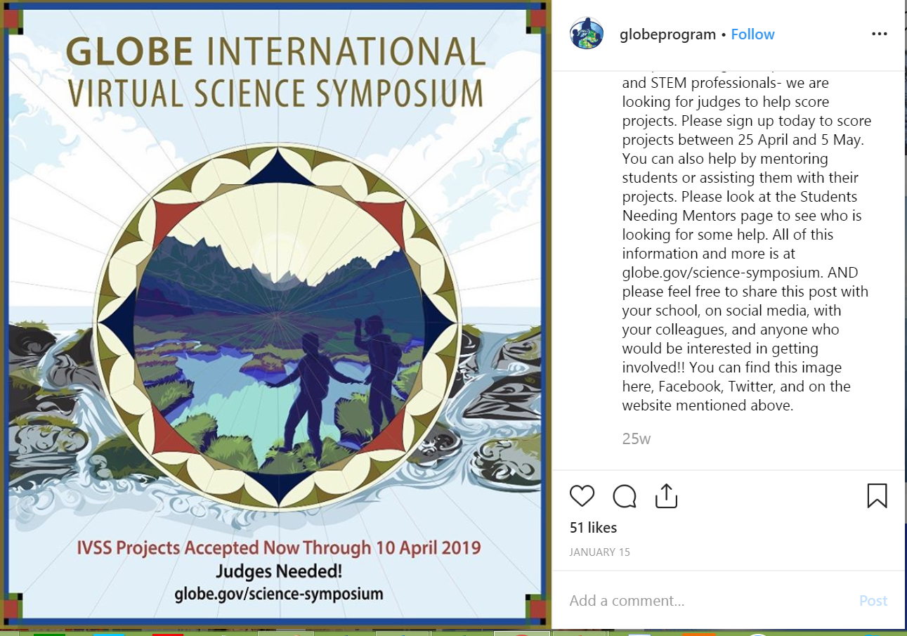
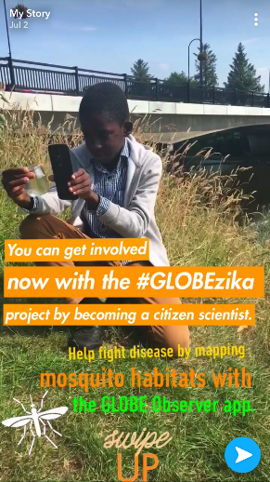
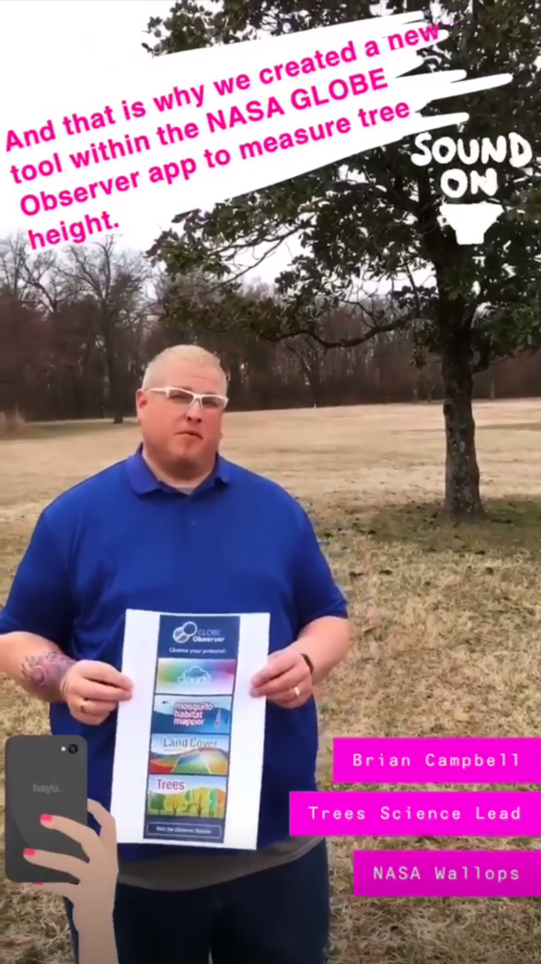
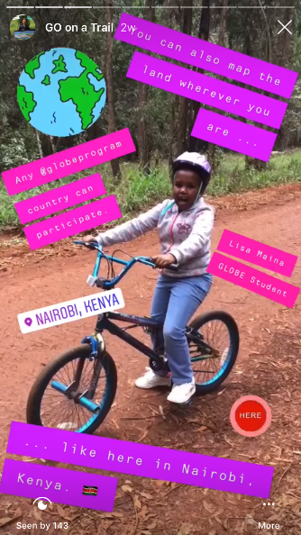
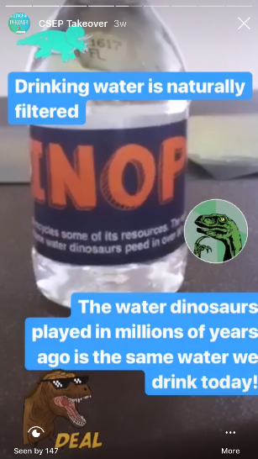
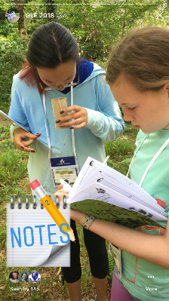
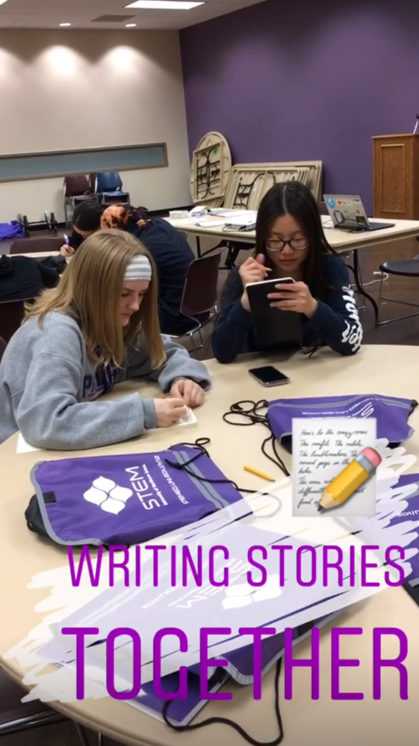
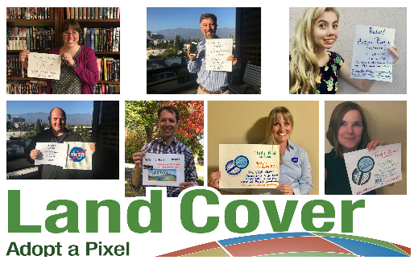
INSTAGRAM and SNAPCHAT
Since we met last year we posted to the GLOBE Instagram 62 times (once a week (plus some additional posts)) produced 20 “stories” (these are monthly unless special events call for more) for the GLOBE Instagram and 4 for NASA’s Snapchat, Instagram and Facebook accounts (one each quarter).
July 2018: GLE GLOBE
Story on the NASA
accounts
September 2019: GO Land
Cover Tool Release/
Challenge Story
for the NASA accounts
March 2019: GO Trees
Tool Release Story for the
NASA accounts
June 2019: GO on a
Trail Story for the NASA
Accounts
When on the NASA accounts, these “stories” reach between 1.8 and 2.1 million people each!.
In addition, we also did a Reddit AMA this year and reached over 1.48 million
with that piece.
Ex: July 2018 through June
2019 Protocol and
National Day Stories
Ex: Daily stories from
five of the US SRS’s
CSEP Takeover Story!
Notes:
So about a reach of an additional 10 million with these other products. So about 14.5 million reach from social media posts and products created for and about GLOBE and GLOBE Observer.

Slide 7
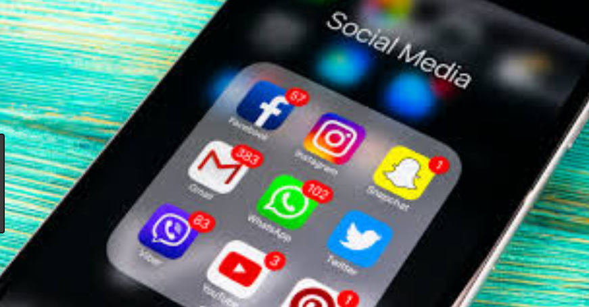
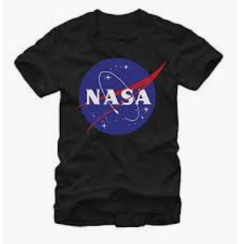
How to Participate this Year
Use the hashtag: #GLOBE23
Tune in:
Facebook Lives (daily) and Watch Parties (7:00 am ET most days starting Tues.,
Twitter – Join the conversation
Instagram
Watch our daily stories and tag us (@globeprgram) in yours and we will share your stories on the GLOBE Instagram daily
HOW TO WIN!
Earn entries by adding
us on each social platform.
And for being the most social!

Slide 8
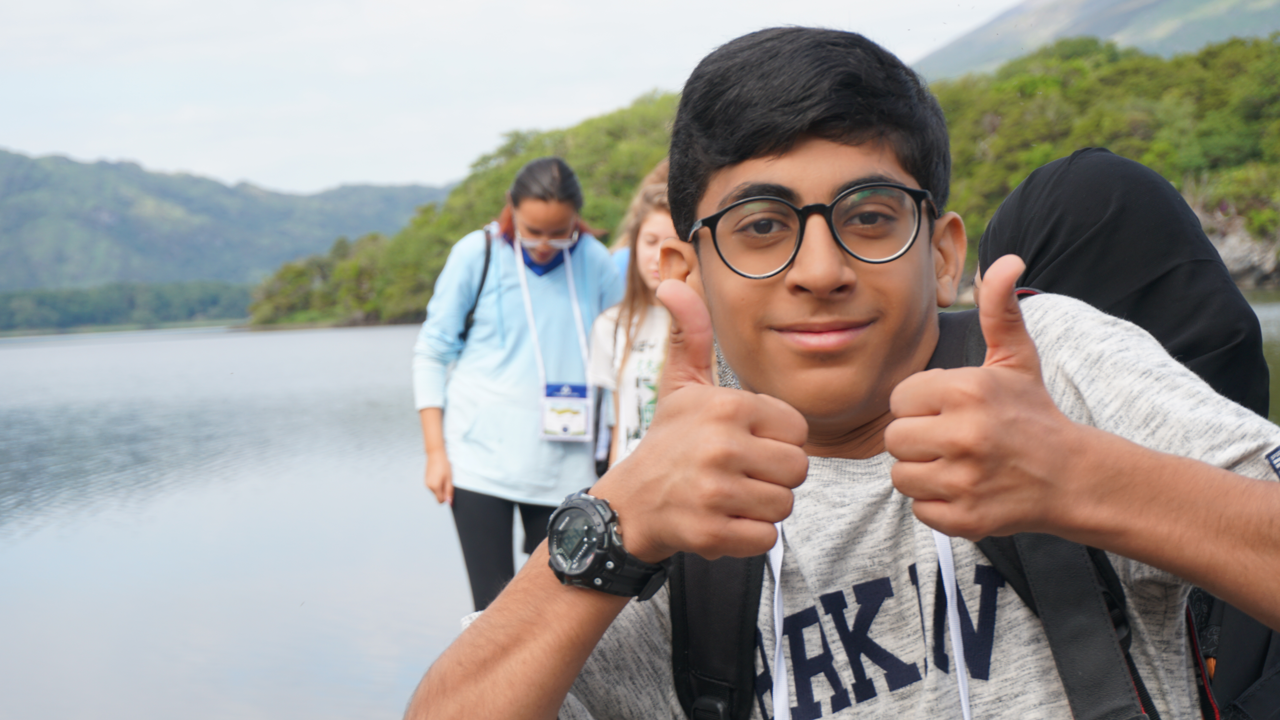
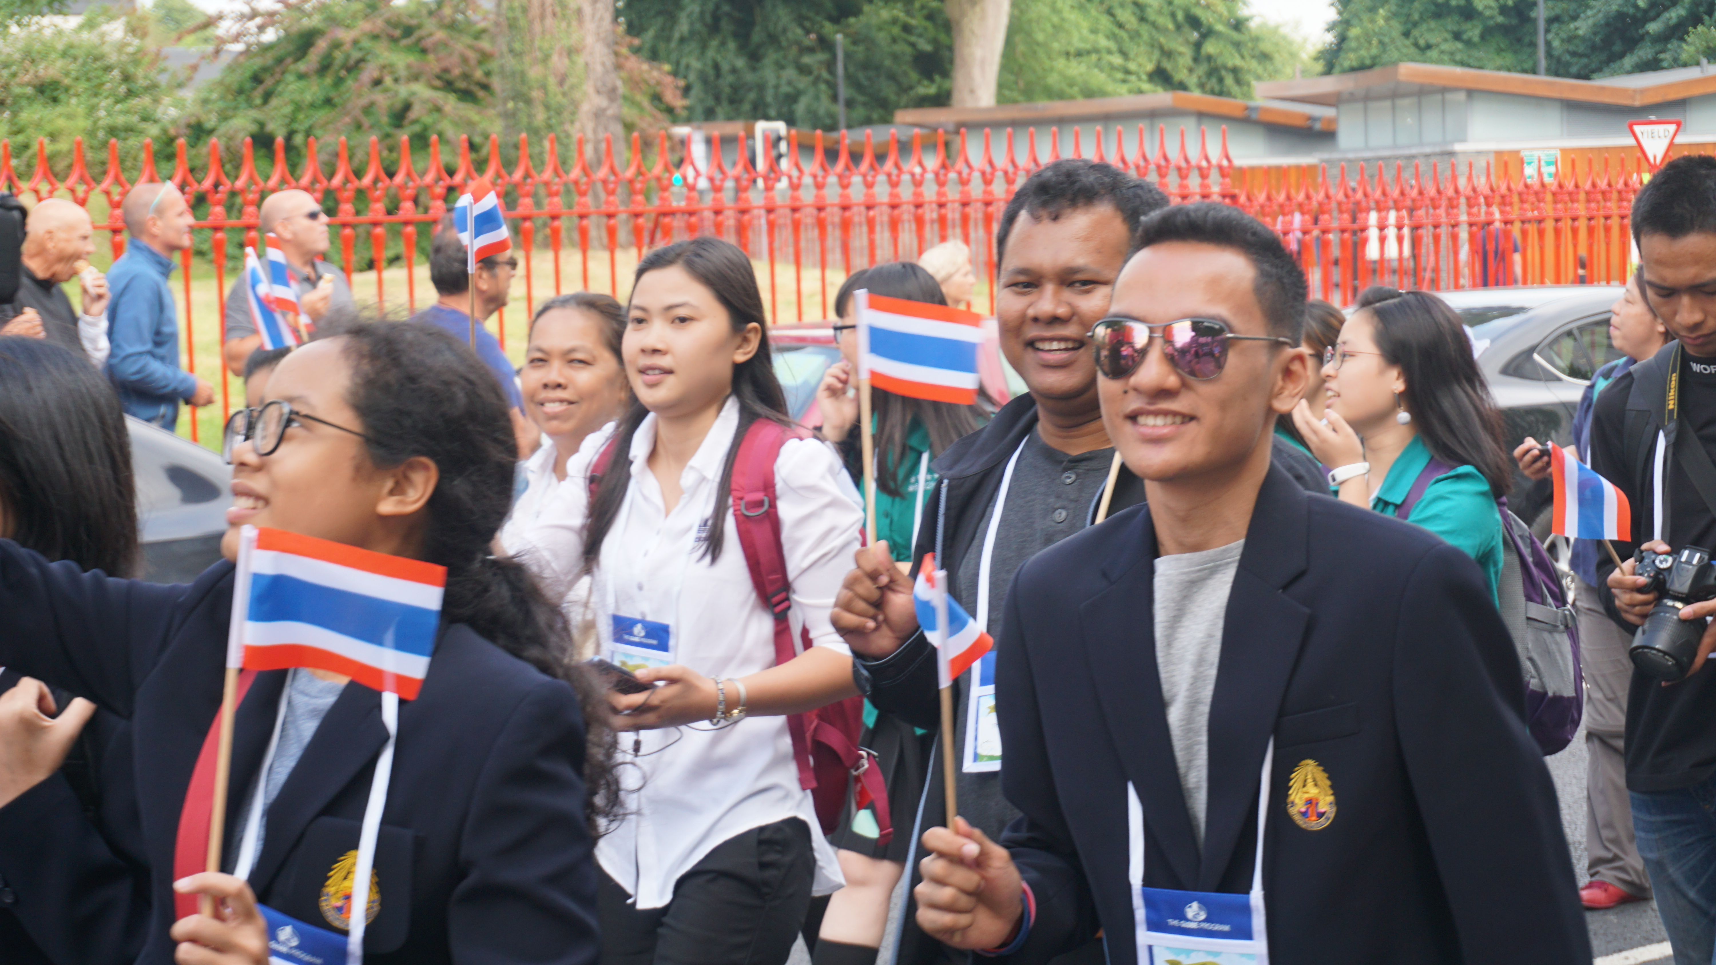
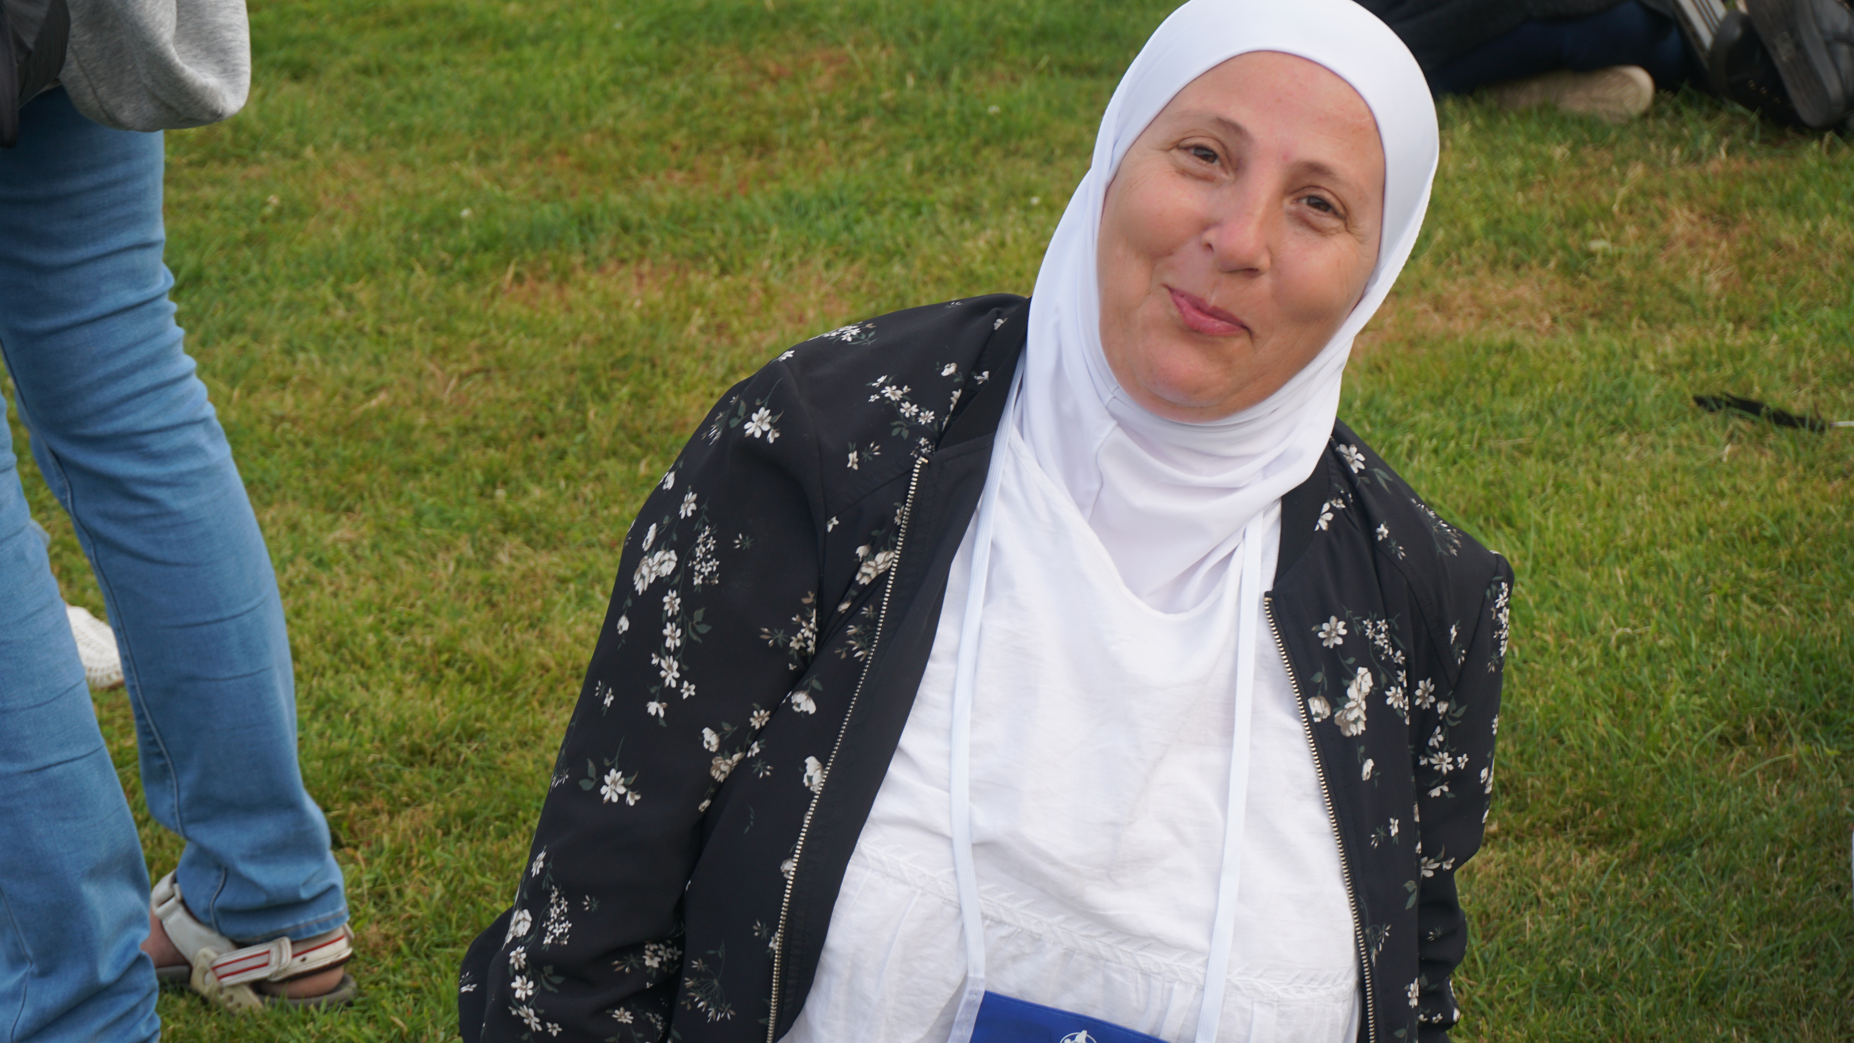
Photos from the Meeting
How to Access:
Go to: www.globe.gov/globe23
Download professional imagery from each day to share on social media, or text to friends and family

Slide 9
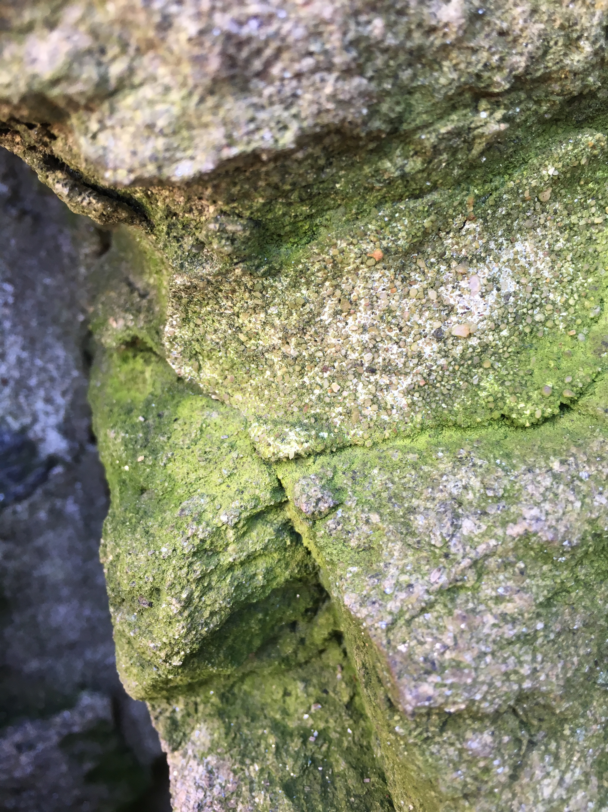
A Thought for You All

Slide 10
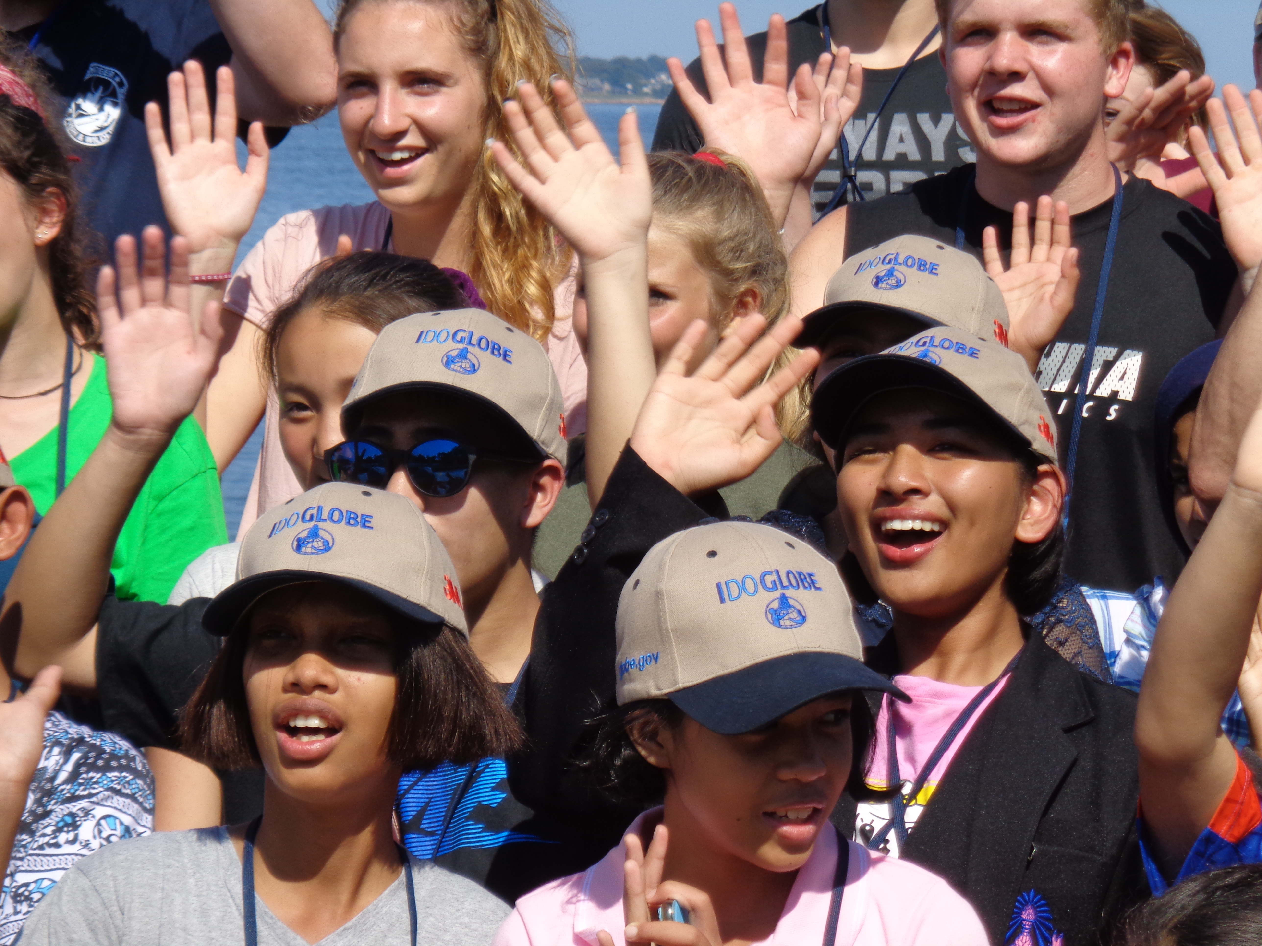
Be social!
“Be genuinely interested in everyone you meet and everyone you meet will be genuinely interested in you”
― Rasheed Ogunlaru, Author and Life Coach

Slide 11
Autumn.Burdick@ssaihq.com Science Systems & Applications, Inc

