Slide 1

Arctic and Earth SIGNs
Elena B. Sparrow
The international Arctic Research Center
University of Alaska Fairbanks
July 15, 2019

Slide 2
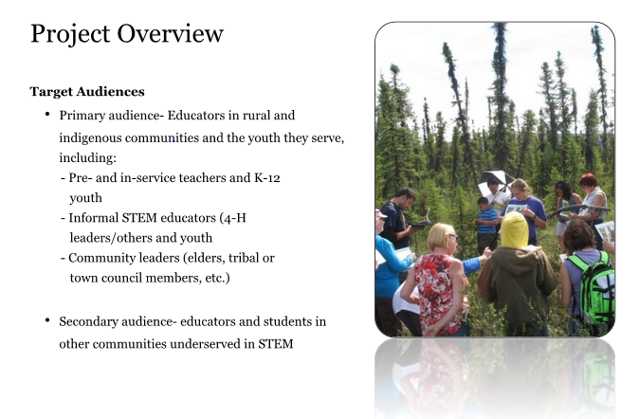

Slide 3
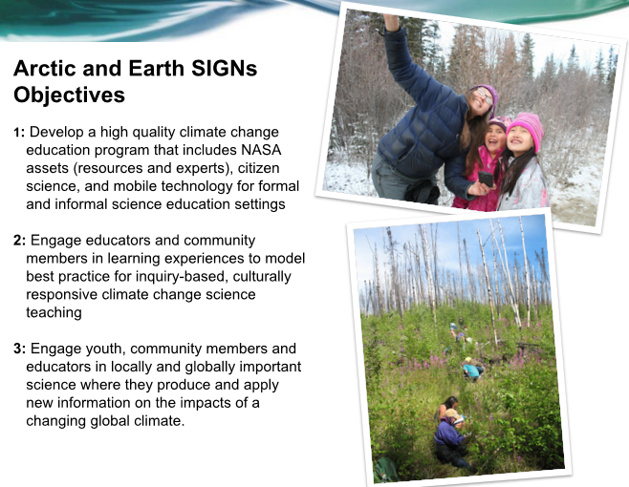

Slide 4
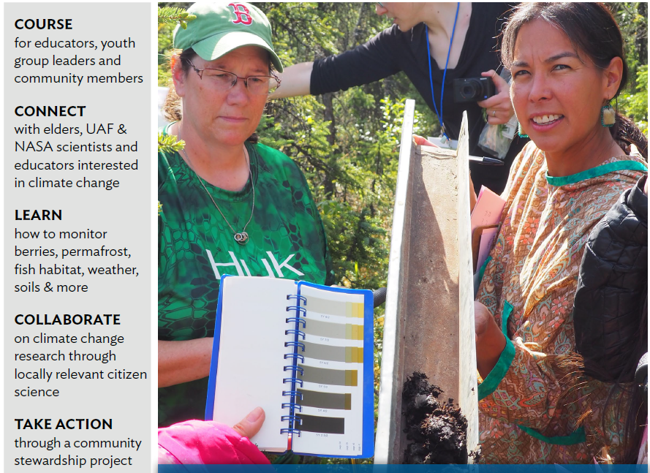
Climate Change and My Community

Slide 5
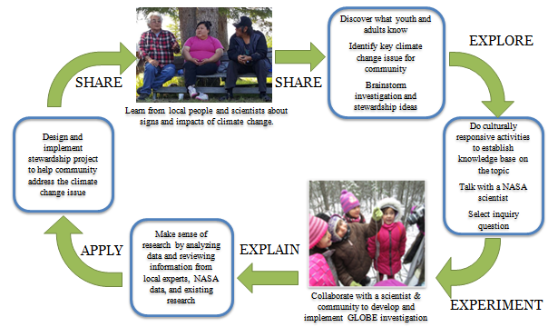
Arctic and Earth SIGNs Learning Model
(figure modified from Stephens 2003 and OLCG 2002; published in Spellman et al. 2018)
Notes:
We have an evolving inquiry-based model that builds upon prior projects and is being refined and strengthened for use for community team training as well as for in-community research and stewardship projects.

Slide 6
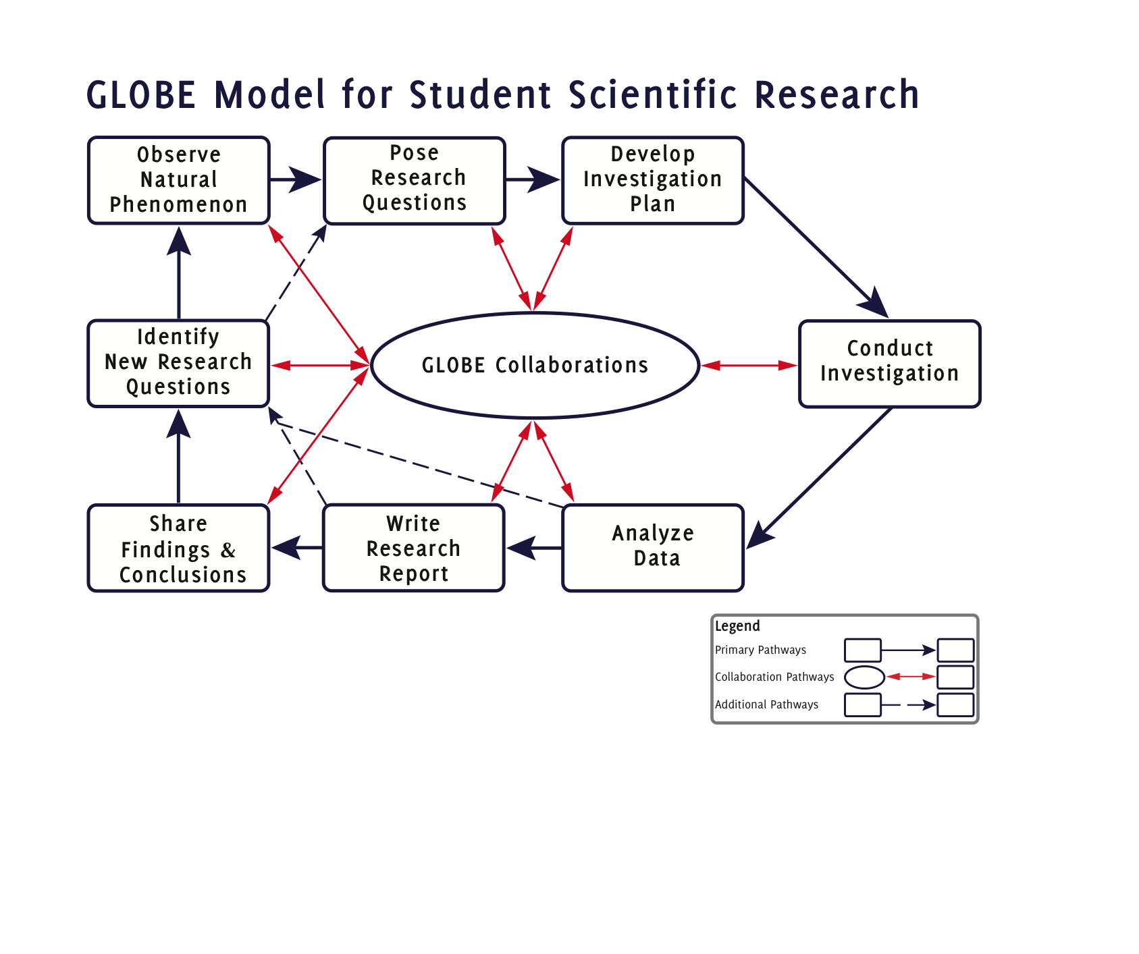

Slide 7
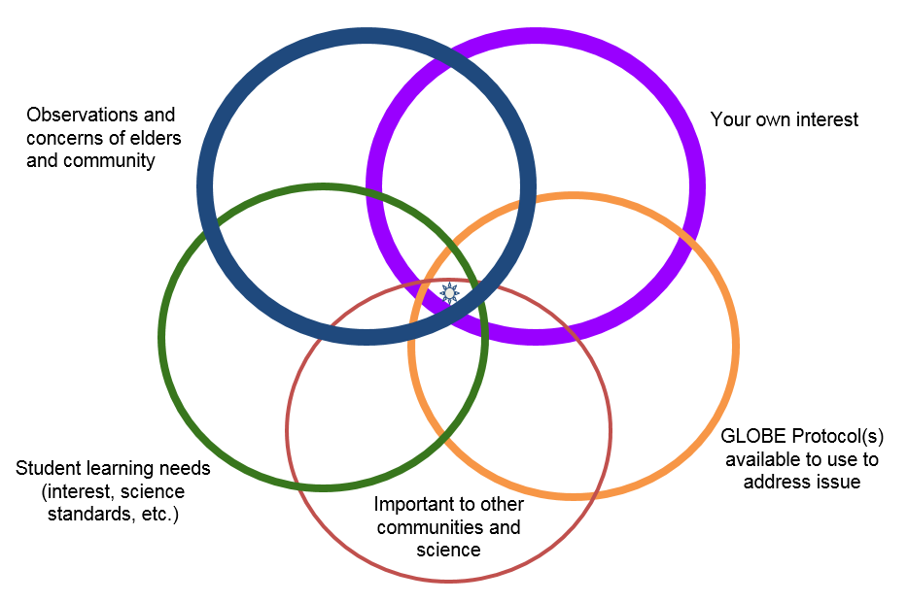
Stewardship Project
Find the sweet spot for a GLOBE project with an impact

Slide 8
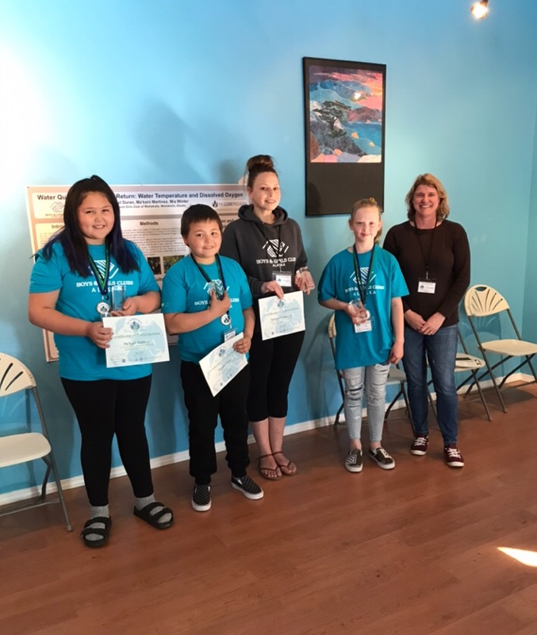
This team from Metlakatla , Alaska did!
Come see their project poster tonight and to our Arctic and Earth SIGNs workshops.

Slide 9
Elena B. Sparrow
Research Professor & Education and Outreach Director
The International Arctic Research Center
University of Alaska Fairbanks https://sites.google.com/alaska.edu/arcticandearthsigns/ ebsparrow@alaska.edu

Slide 10

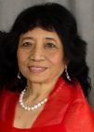
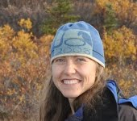
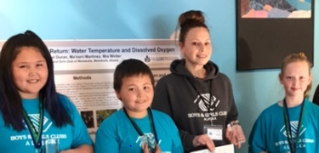
Team Members at this Conference
Elena Sparrow
Katie Spellman
Ma’karii Martinez, Michael Duran, Sesilynn Schleusner, Mia Winter

