Slide 1
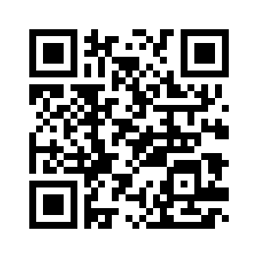
Let’s Go Fly a Kite and Learn More About Our Earth
AREN Project
http://globe.gov/web/aren-project

Slide 2
Tuesday – 8:30 am
or
Wednesday – 8:30 am

Slide 3
AREN Project Team Introduction
Geoff Bland – NASA Goddard
David Bydlowski – Wayne RESA
Brian Campbell – NASA Goddard
James Moon-Dupree – Wayne RESA
Andy Henry – Wayne RESA
Kay Rufty – NASA Goddard
Mimi Spahn Sattler – Public Lab
Jeff Warren – Public Lab

Slide 4
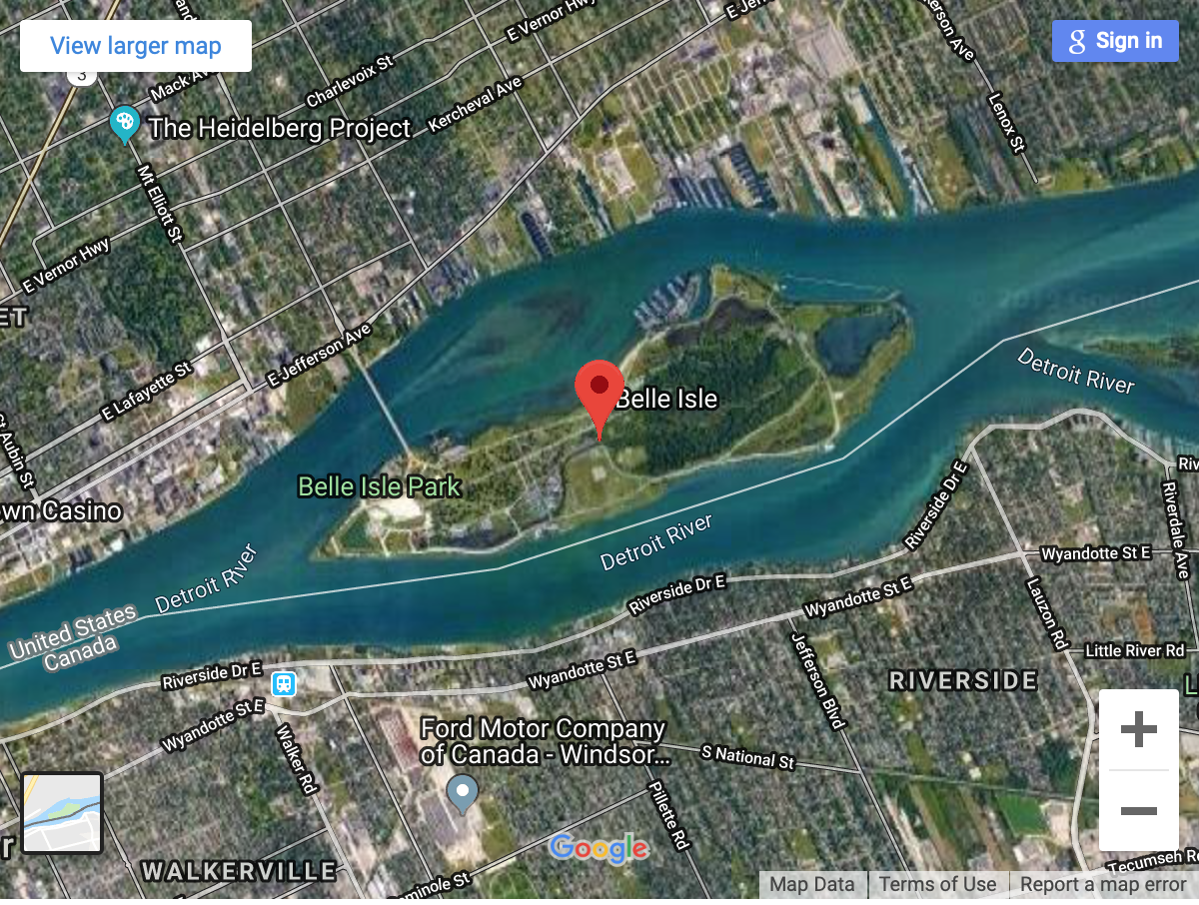
Outdoors On Belle Isle Bus Leaves at 8:30 am AREN Project from 9:00 am – 11:30 am Bus Returns at 11:30 am

Slide 6
AREN Project Objectives
Learn about the AREN Project
Operations and Safety
Mission Objective
Collecting Pre-Flight Data
Fly a Kite
Fly an Aeropod
Collect Atmospheric Data
Post – Mission Debrief

Slide 8
Collect Site Data

Slide 9
Launch

Slide 10
Attach Aeropod

Slide 11
Aerial Imaging

Slide 12
Aerial Imaging

Slide 13
Landing

Slide 14
Tuesday – 8:30 am
or
Wednesday – 8:30 am

Slide 15
Outdoors On Belle Isle Bus Leaves at 8:30 am AREN Project from 9:00 am – 11:30 am Bus Returns at 11:30 am

Slide 16
Reminders
Bring:
Water
Sunscreen
Hat
Closed Toed Shoes
Insect Repellent
Take care of Personal Needs Before Loading Bus – We will be outside.

