Slide 1

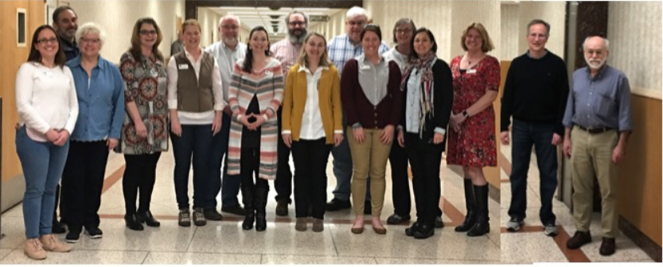
GLOBE Mission EARTH: Fusing GLOBE and NASA Assets to Build Systemic Innovation in STEM Education
PI: Kevin Czajkowski, The University of Toledo Project Manager: Janet Struble
Co-I: Peter Garik, Boston University Evaluator: Nektaria Adaktilou
Co-I: David Padgett, Tennessee State University
Co-I: Svetlana Darche, WestEd/UC Berkeley
Co-I: Jessica Taylor, NASA Langley Research Center
Notes:
Introduce GME individuals who are present.
Introductions by audience members
Name / Location

Slide 2

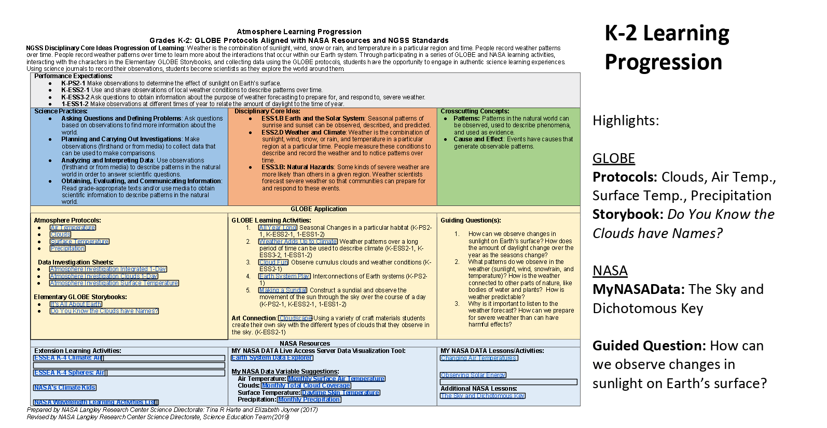
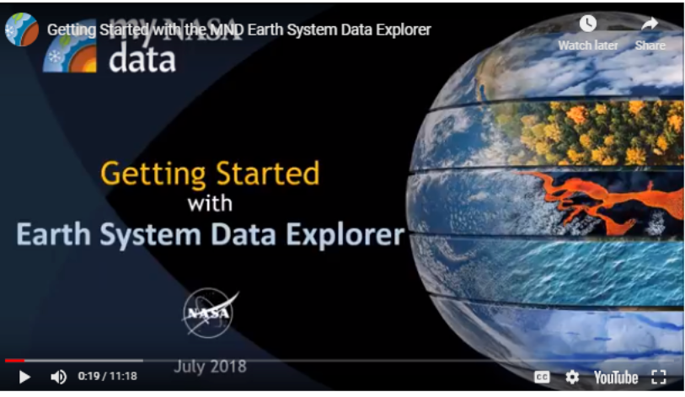
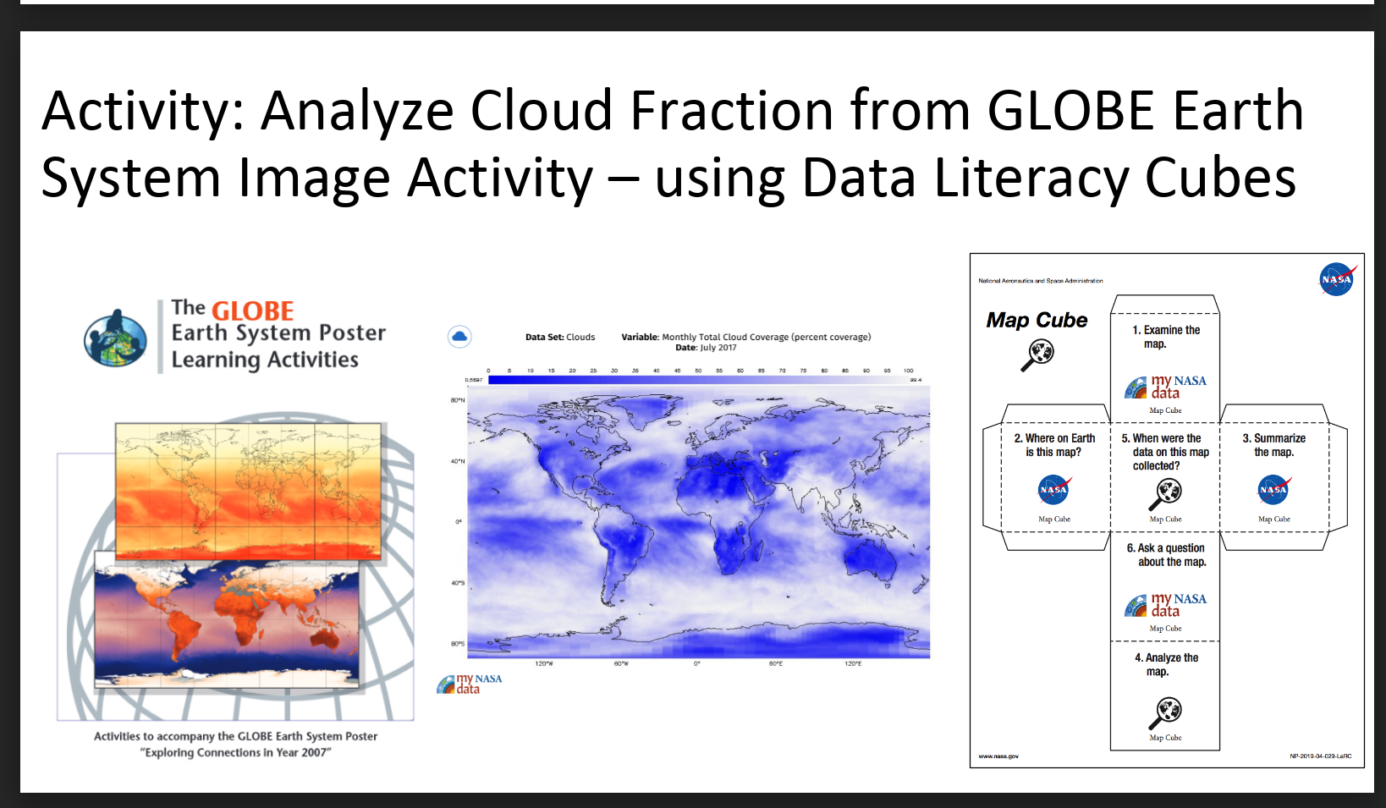
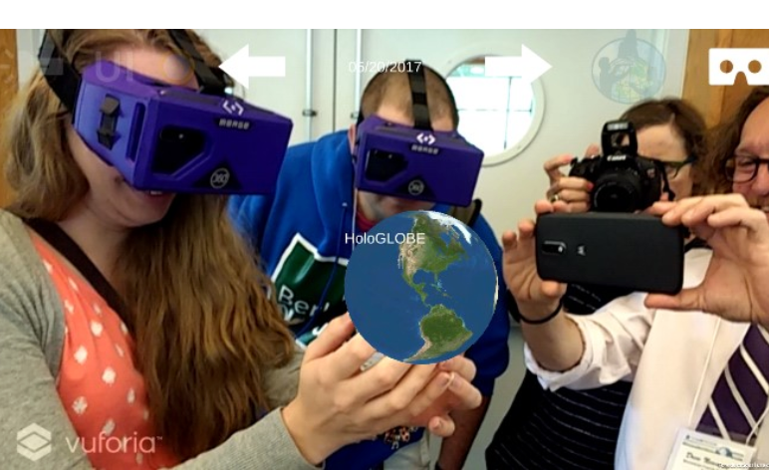

GLOBE Mission EARTH:
NASA Resources to Support
Student Learning: Clouds Example
When: Tuesday
Time: 8:30 am -12:00 pm
Where: Grand BC
NASA and How Cloud Properties Impact Energy Budget
Resources:
GLOBE Cloud Satellite Match
NASA GLOBE Clouds
Atmosphere Learning Progressions
Activities:
Cloudy vs Clear Demonstration
Using Graph Cube to Analyze Cloudy vs. Clear Data
Cloud Clues-Opacity
How Global Scale Can Support Local Learning
Resources:
Data Literacy Progression
Remote Sensing
My NASA Data
HoloGlobe
Activities:
Create an Image from Numbers
Using the Map Cube to Analyze Cloud Fraction

Slide 3
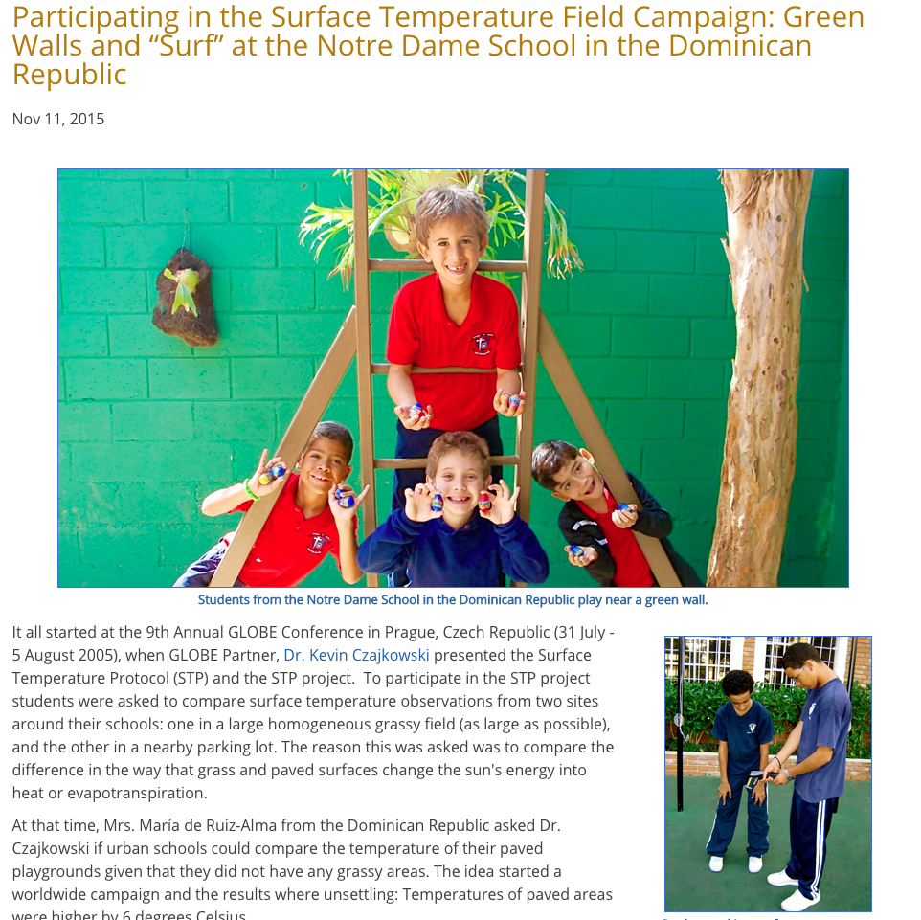
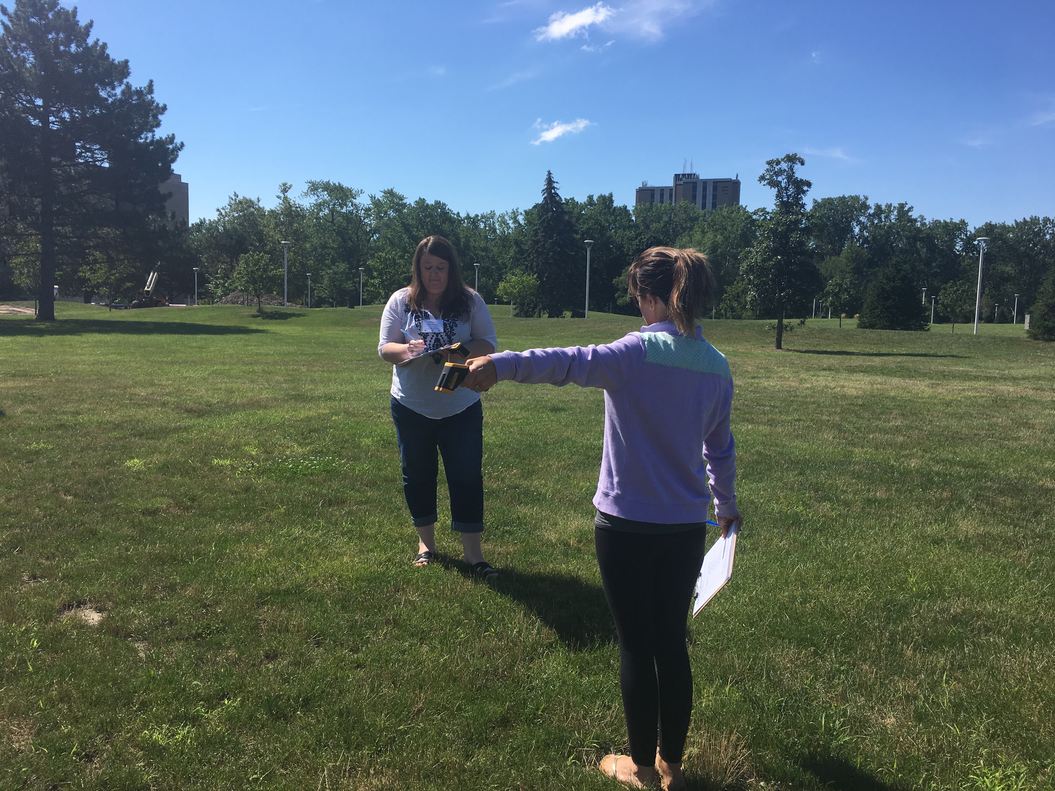
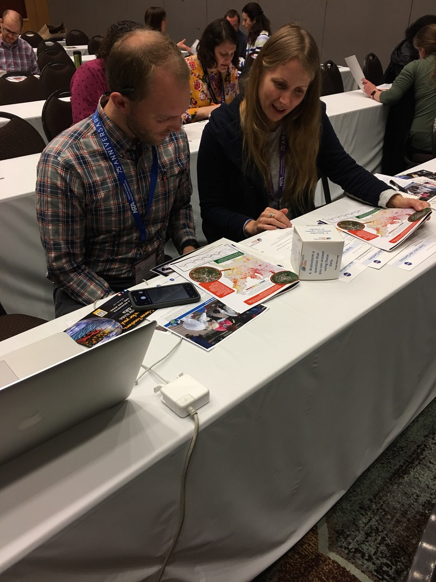
End Goal
Students Doing Research
Info
Meet Lead Scientist & Team
Training
Surface Temperature Protocol
Science Content
Collect & Enter Data
NASA
Data
Classroom Resources
GLOBE Missiong EARTH: Study the Urban Heat Island Effect
When: Wednesday
Time: 8:30 am -12:00 pm
Where: Grand BC

