Slide 1
NASA Earth Science Education Collaborative (NESEC)
GLOBE Annual Meeting 2019

Slide 2
Overview
Tuesday morning field trip to Belle Isle learning GO protocols
Wednesday morning panel on NASA campaigns and activity demonstrations
Presentations and posters
Wednesday afternoon event at Michigan Science Center

Slide 3

Tuesday Morning SciAct Belle Isle Field Trip
Training Stations on GLOBE Observer Protocols
  Clouds
  Mosquito Habitat Mapper
  Land Cover
  Trees
  Fire Fuel pilot
Before Tuesday morning, please:
Download (or update) the GLOBE Observer app and login
Bonus points: complete the Land Cover tutorial

Slide 4
Wednesday Morning SciAct Training
Panel presentation and discussion on NASA GLOBE campaigns (Terrace C from 8:30-10:15)
  From Observations to Maps and Decisions, Peder Nelson
  Clouds, Marilé Colón Robles
  U.S. Air Quality, Tina Rogerson
  GO on a Trail, Holli Kohl
  Mission Mosquito, Dorian Janney
  Trees Around the GLOBE, Brian Campbell
Station activities and demos of toolkits for informal educators (Grand A from 10:30-12:00)

Slide 5
Presentations & Posters
Teaming up with GLOBE, Holli Kohl, Tuesday at 5:00 PM, GT7, Plaza AB
Introducing the User Guide for GLOBE Data, Helen Amos, Thursday at 8:45 AM, GT12, Plaza AB
Using NASA Earth Observing Satellite Data to Predict, Monitor, and Respond to Disease, Dorian Janney, Thursday at 9:30 AM, GT15, Plaza AB
Students, Teachers, Citizen Scientists, and NASA Observing the Height of our Planet, One Tree at a Time, Brian Campbell, Thursday, 10:30 AM, FNUL8, Terrace B
GLOBE Observer updates, Holli Kohl, Thursday, 1:45 PM, Tech 5, Plaza C
Posters, Monday 6:30 – 8:30 PM
  GLOBE Goes to Camp
  One Tree at a Time
  NASA’s GPM Mission
  GLOBE Clouds
  Air Quality Campaign

Slide 6
Pop-up Science with NASA! Bringing Space Down to Earth
Michigan Science Center
Wednesday, July 17 from 3-5
Presentations by NESEC (GLOBE Observer), Mission Earth, and AREN Project
Table top activities
GLOBE demonstrations and data collection outside
Location: Michigan Science Center, 5020 John R Street – Bus and Rail accessible from conference center (Qline or Bus 016 or 004)
Admission is FREE and 4D and Planetarium shows are discounted.

Slide 7
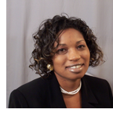
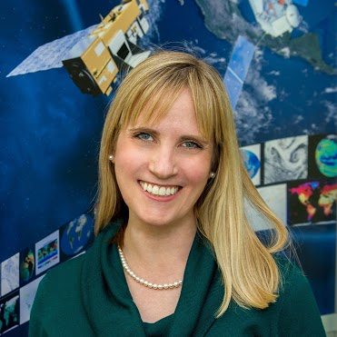
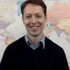
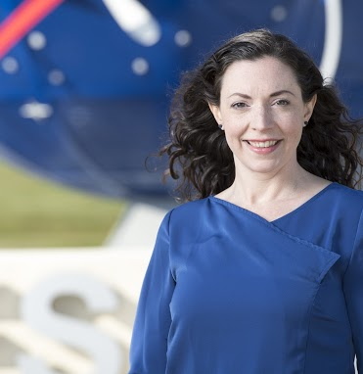
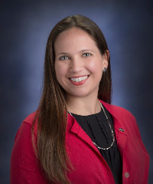
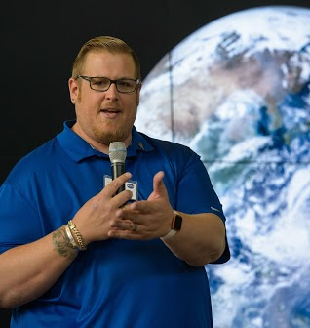
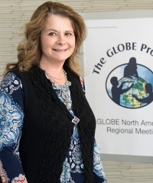
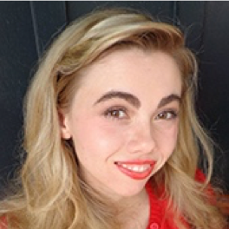
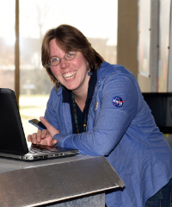
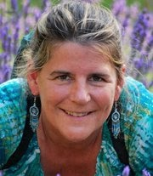
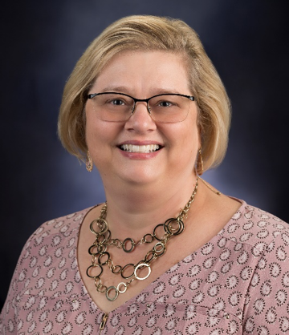
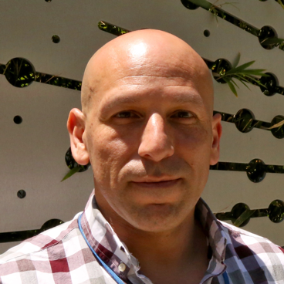
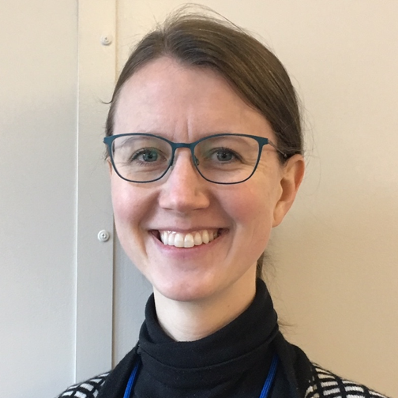

NESEC Team at GLOBE Annual Meeting
Top Row
Trena Ferrell
Holli Kohl
Peder Nelson
Jessica Taylor
Marilé Colón Robles
Middle Row
Brian Campbell
Tina Harte
Autumn Burdick
Kristen Weaver
Dorian Janey
Bottom Row
Angie Rizzi
Peter Falcon
Helen Amos
Tina Rogerson

