Slide 1




Sabrina Moore
&
Anthony Purcell
GLOBE Air Quality Investigation
Notes:
Introductions: Anthony, Sabrina, Mary – An Taisce, GLOBE Country Coordination, Env. NGO
The purpose of this presentation is to inform you about a GLOBE Ireland Air Quality Campaign that we ran earlier this year.

Slide 2
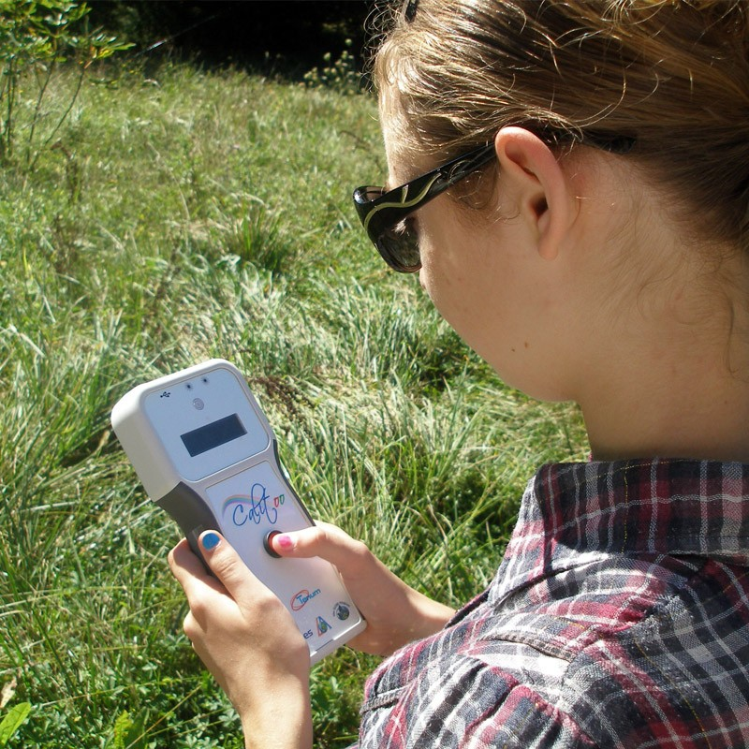


Context
Notes:
EPA – Partners & Sponsors
Focus on Atmosphere
Air Quality & Citizen Science – raise awareness of Air Quality among the public
Expansion of the National Air Quality Monitoring programme
Aerosols Campaign 2018

Slide 3

Background
Notes:
Developed the 2019 GLOBE Ireland Air Quality Campaign
Curieuzen Nuezen Project - Belgium
European level – EEA
Sourced suitable monitoring equipment – NO2 tubes Gradco
Trialed the monitoring equipment with staff
Recruited Schools: GLOBE registered, Green-Schools, Other events
Good Mix

Slide 4
Design
Accurate instruments
Supporting protocols
Database
Visualisation
Posters
Resources, Ideas, Visits
Notes:
Timing
Duration
Relevance: local, national
Promoted supporting protocols – weather
Supported schools with resources, ideas, equipment
Designed the methodology to follow the scientific method and GLOBE protocols: Record data, analyse, visualize, report, posters

Slide 5
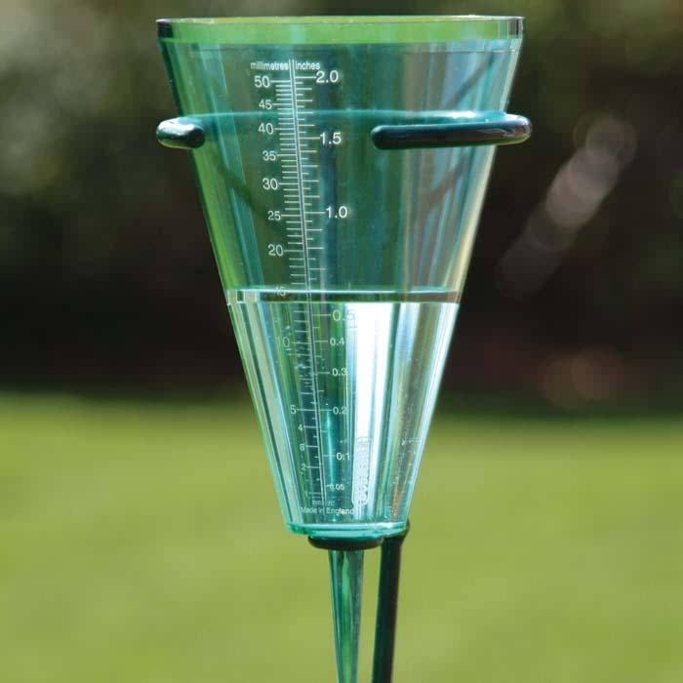
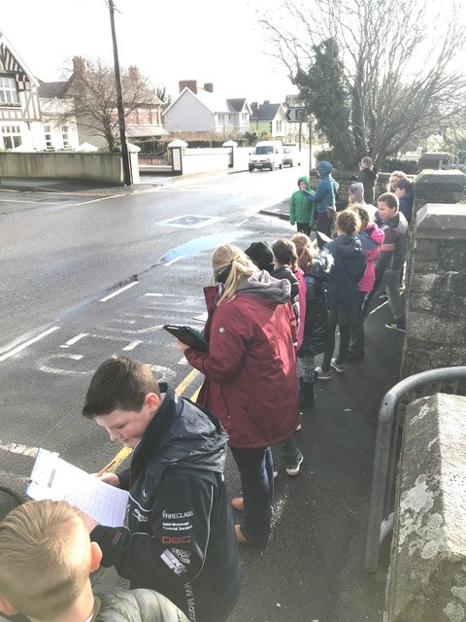
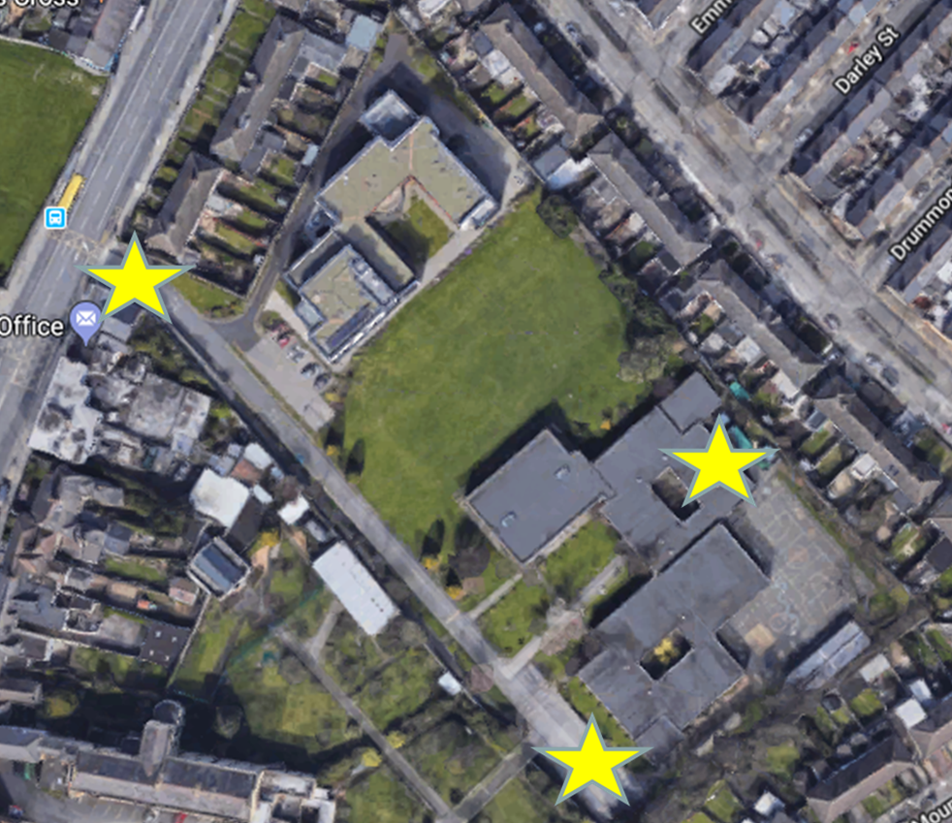
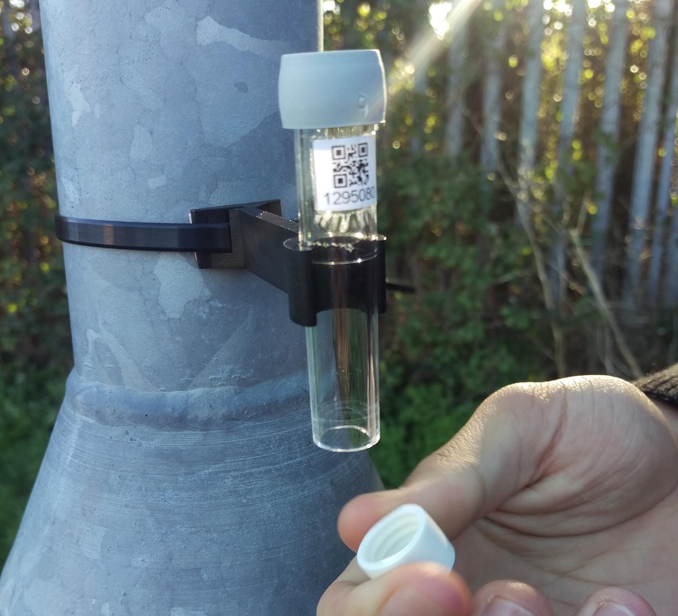
Measurements in February
Notes:
In February 2019, 30 schools took part in data collection. Each school deployed three samplers to measure nitrogen dioxide for a month; NO2 is a main component of traffic-based air pollution. Some schools also measure the weather and traffic levels as they both have an impact on air pollution.

Slide 6
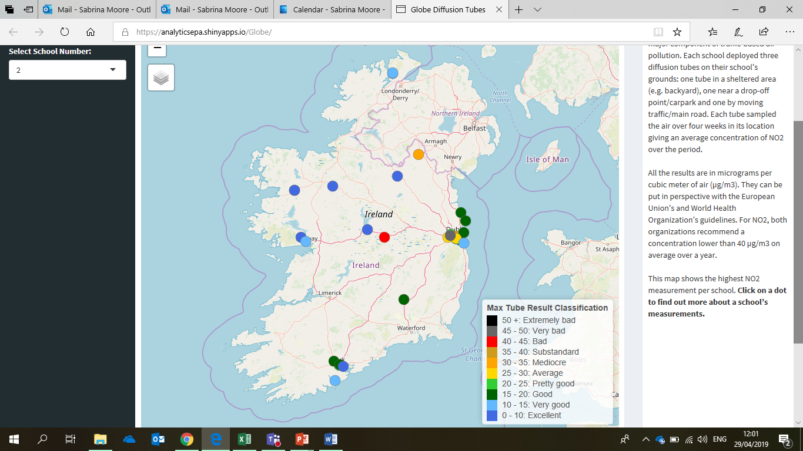
Results in March

Slide 7
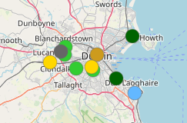
Higher levels in city & by major roads
Notes:
Finding number two: schools in rural areas and towns generally measured lower NO2 levels. Traffic-based pollution is experienced in densely populated areas (cities and suburbs) and close to major roads.

Slide 8
Less NO2 away from the road
Notes:
Finding number three: at a given school, NO2 levels are lower in the sheltered area compared to the area near a major road/moving traffic.
These three findings are in line with current research on NO2.

Slide 9
Notes:
1) Why is the school in Offaly in red (bad)?

Slide 10
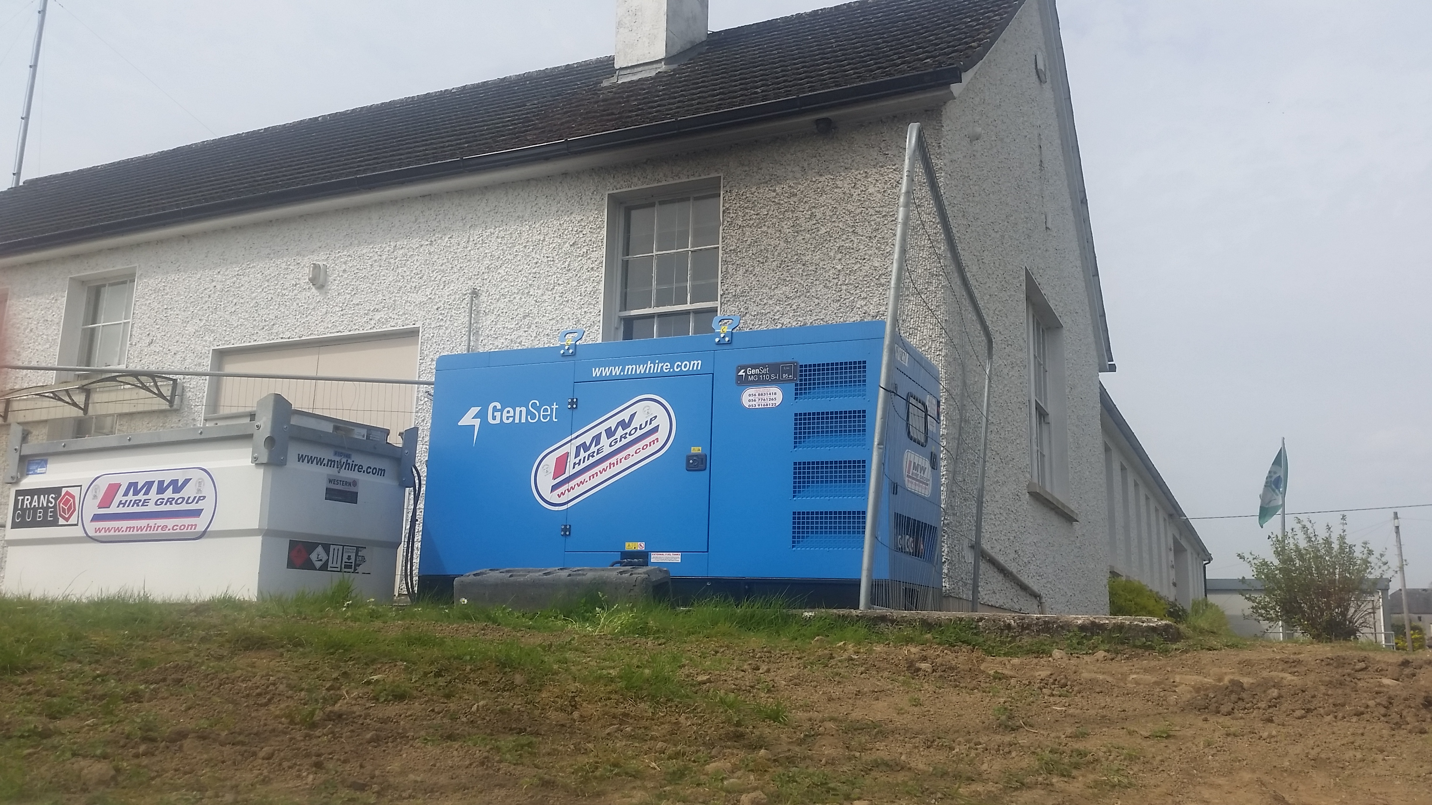
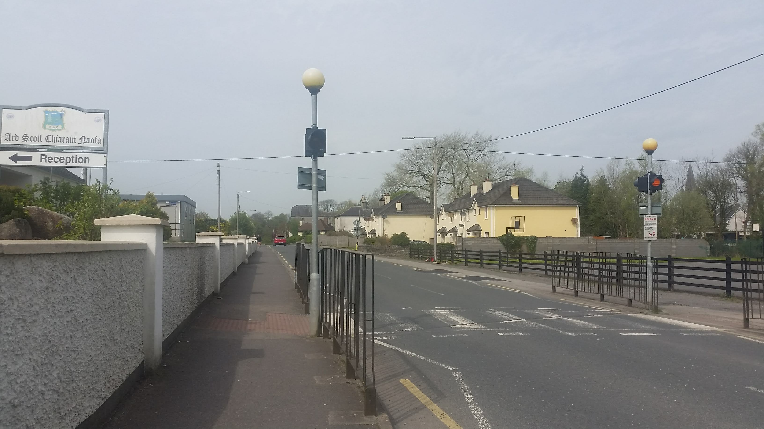
Notes:
This is the road in front of the school on a busy day!!
It turns out that two temporary electricity generators were in operation during the measurement campaign. They are fuel-based and also emit NO2 air pollution. This illustrates how there can be unexpected sources of air pollution.

Slide 11

Notes:
2) Another puzzle question was the following: one school in Dublin close to major roads, including the M50 (which is the ring road around Dublin) measured Very bad levels of NO2. However, a school also located close to the M50 measured Pretty good levels. What could explain the difference?

Slide 12
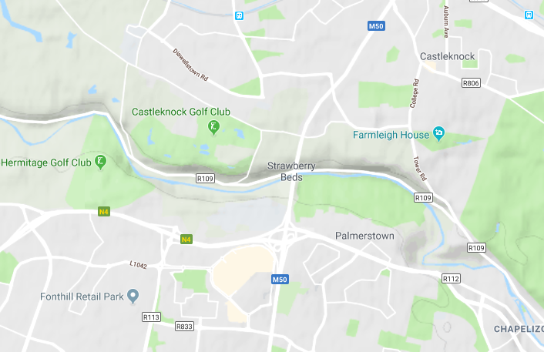
Hill
Valley
Notes:
One hypothesis is the physical environment of both schools:
The school experiencing poor air quality is located in a valley – air pollution may be somewhat trapped in the valley
The school with better air quality is located on a hill with better air circulation

Slide 13
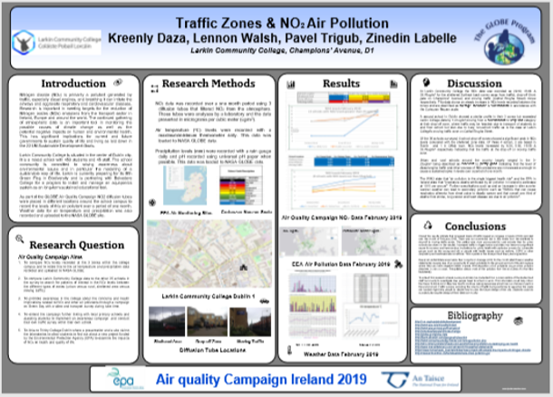
Engagement
30 schools
500 data points
12 projects

Slide 14

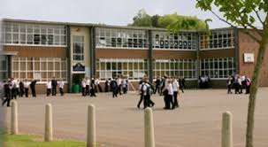


Action plan for active travel
You!
Your school
The State
Notes:
Work with your Green-school committee to find out what the challenges to active travel are.
You: Convenience / weather
State: not safe to cycle, too far for active travel -> public transport
School: heavy bags or school uniform
2) Beyond data, many of you have shared solutions to reduce air pollution locally by travelling to school differently:
What you and your family can do: cycling, walking, scooting; car sharing and public transport. If you are not using these options now and they are possible, I’ll invite you to consider making a change: maybe try it once or twice and trade-off 15 minutes more in bed for active travel once a week.
You have also mentioned how infrastructure is key: good cycle lanes for example or public transport are necessary for more people to make a change. Now is a good time: it is election time, so make sure to ask candidates for better infrastructure.
I would add a third point: what can each school do to foster active travel? What are the barriers that you can potentially act upon such as access to changing facilities for students and staff.

Slide 15
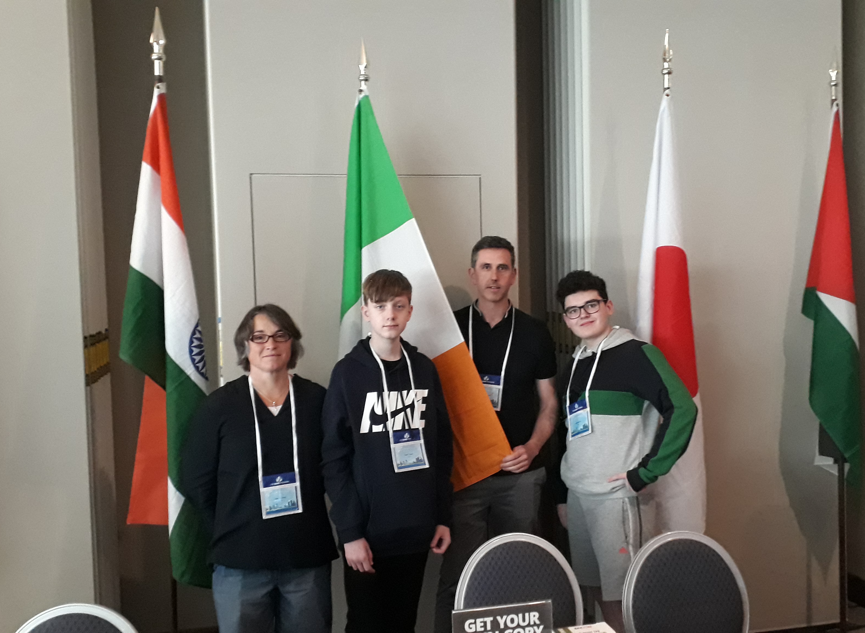
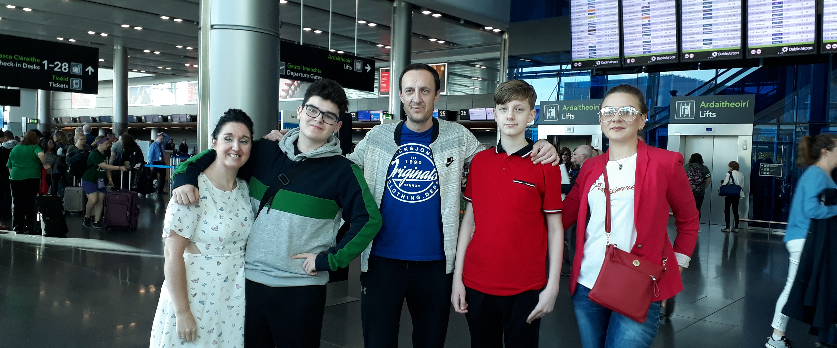
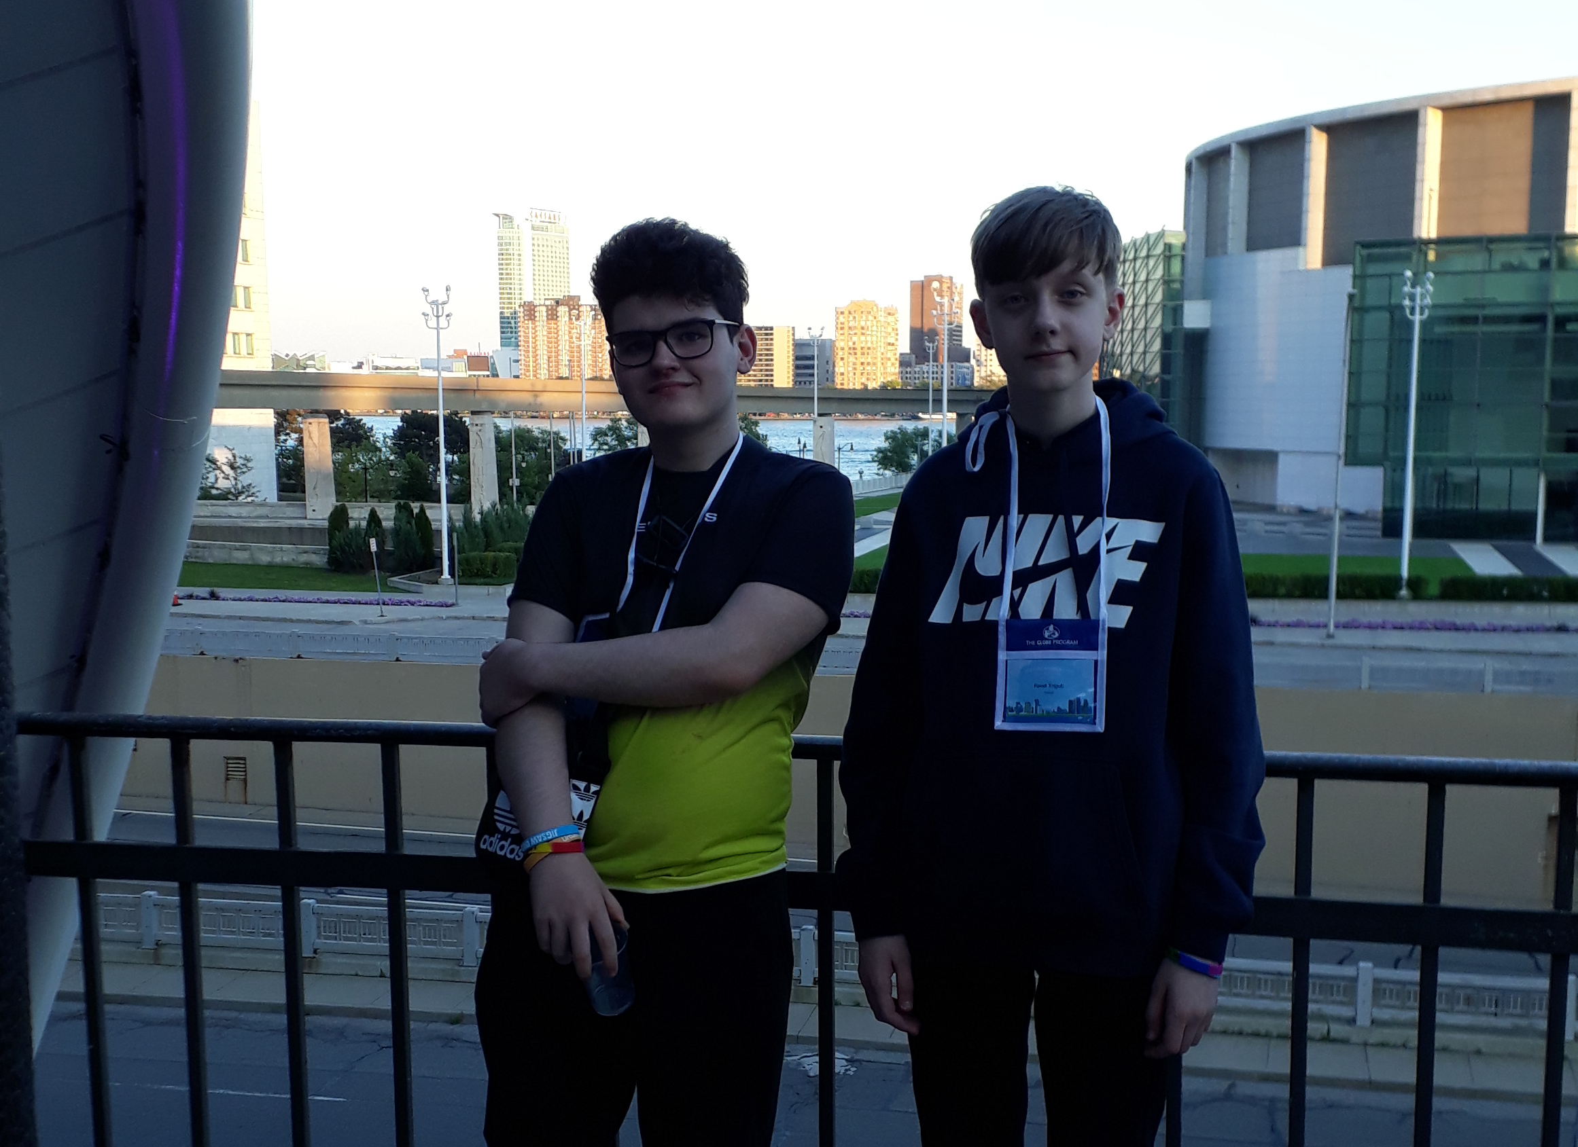
Mary Conway –
Larkin Community College

Slide 16
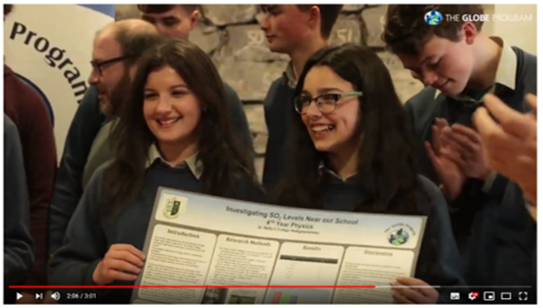
Celebration Event
https://youtu.be/cyW6Jp4t7M4
Notes:
Extend the campaign Autumn
Other countries
GLOBE Protocol

Slide 17

Notes:
New Schools & Repeat Schools
European EPAs Campaign
H2020 funding application
Collaborate with other GLOBE countries
GLOBE Protocol??

Slide 18


Slide 19
Contact Details
globe@eeu.antaisce.org

