Slide 1
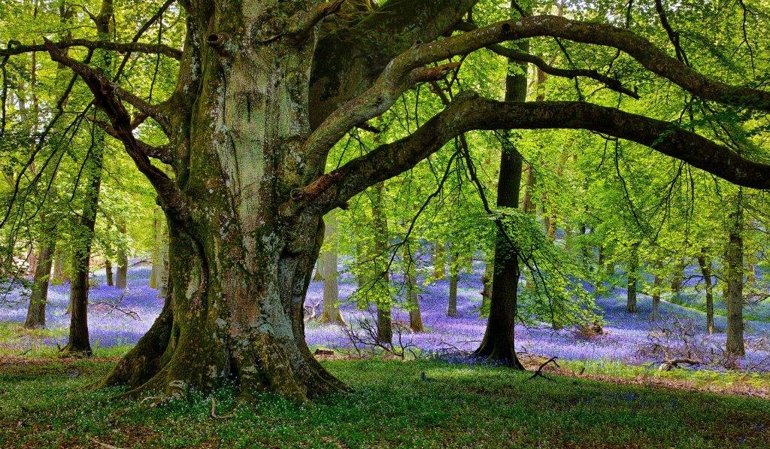
TREES ARE BEAUTIFUL

Slide 2
European Phenology Campaign
Bara Semerakova
TEREZA, Educational Center Prague, Czech Republic
GLOBE Program
Europe and Eurasia
Region Coordination Office

Slide 3
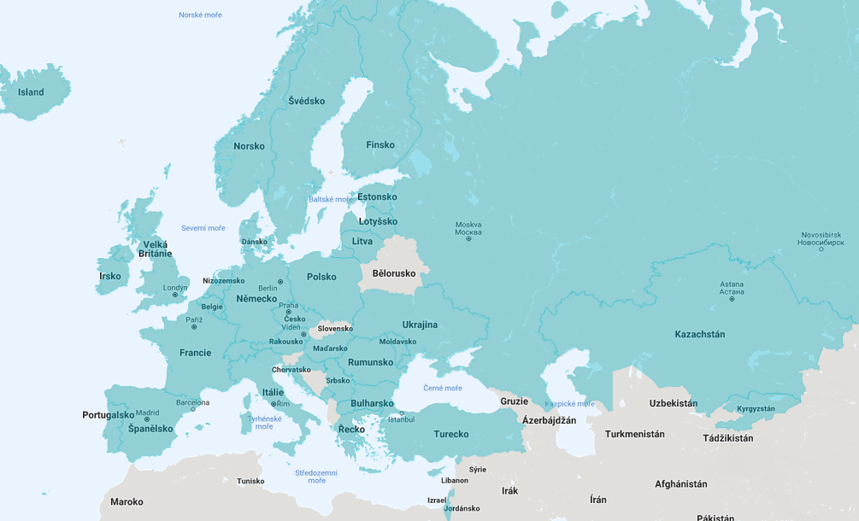
Europe and Eurasia Region
Notes:
24 active countries
Phenology campaign has been organized for last 4 years

Slide 4
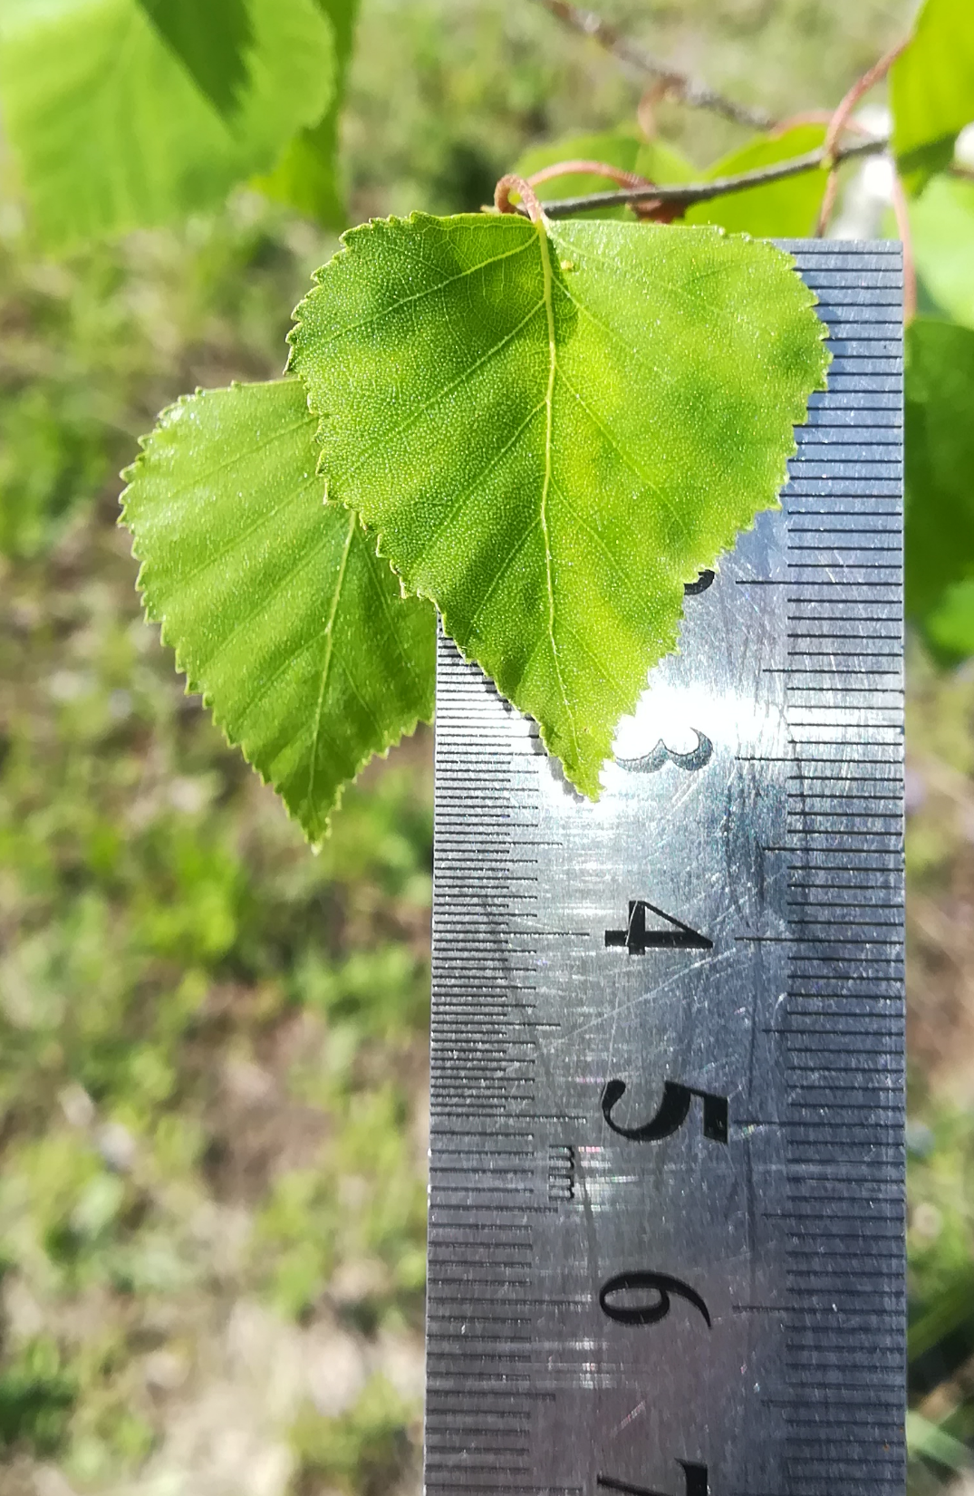
Students
Observe greening up in spring and leaf color change in autumn
GLOBE Green Up and Green Down
Enter data into the GLOBE database
Compare data from different locations and years
Student research projects
Notes:
Data are not only the numbers but also the photos ans animations

Slide 5
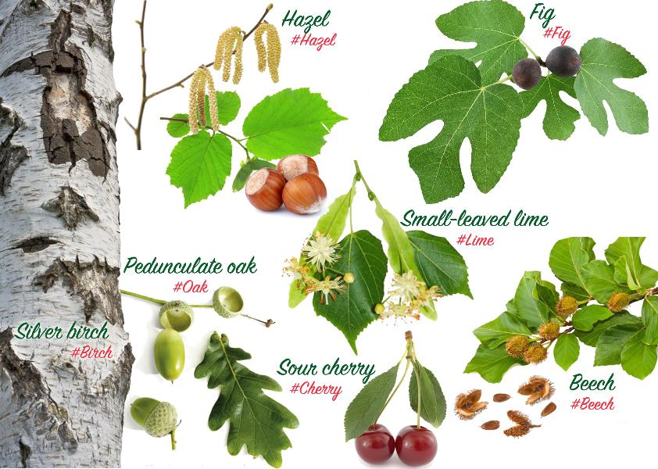
Notes:
Species with the wide distribution around the region – preselected together with scientists
Fig added last year on the request of the southern countries with subtropical climate

Slide 6
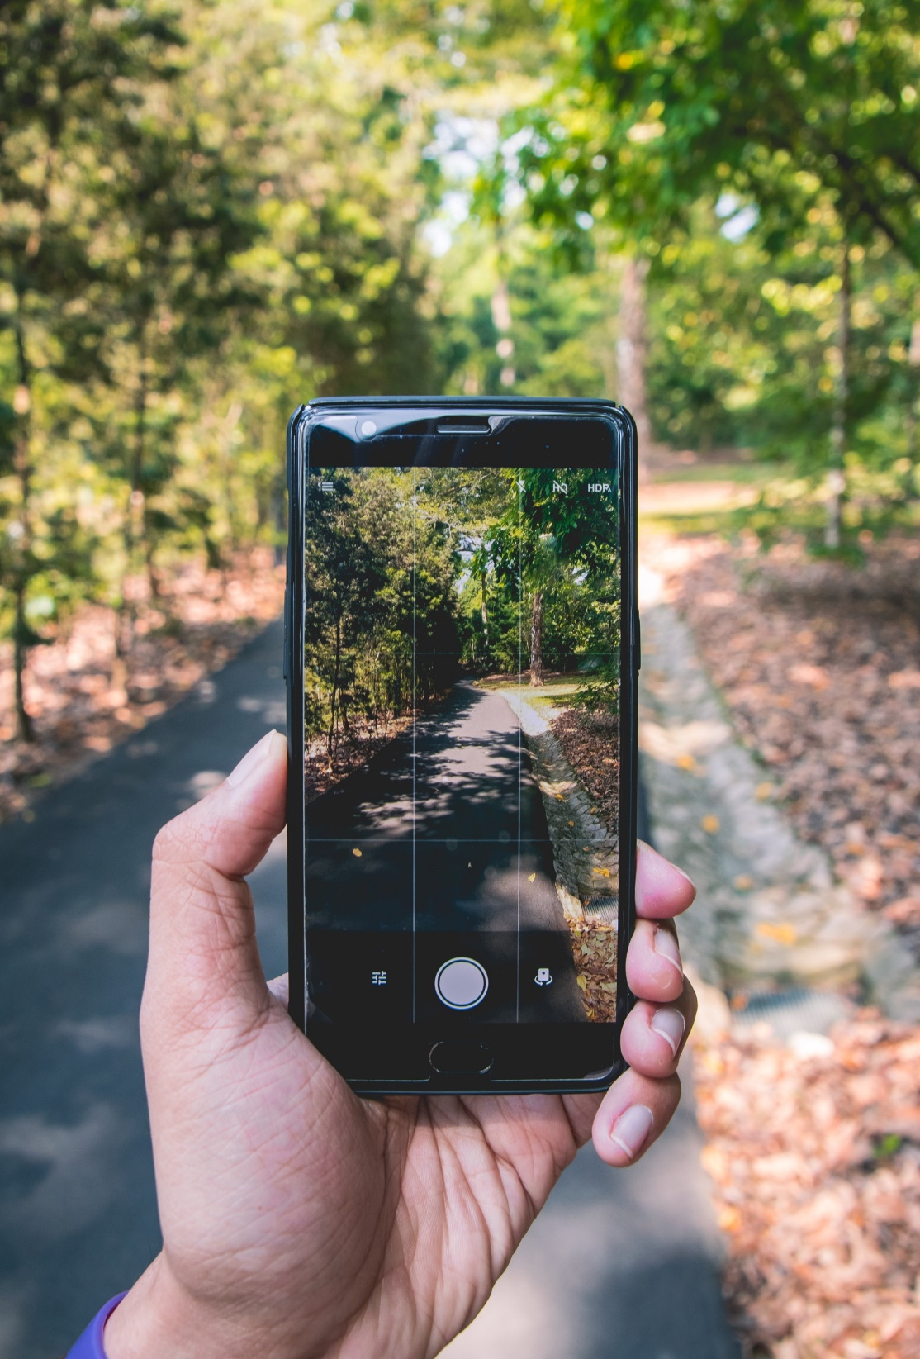
Students
Take pictures with Grow App
Make time-lapse animations and see them at www.growapp.today
Share photos and results at discussion forum at globe.gov

Slide 7
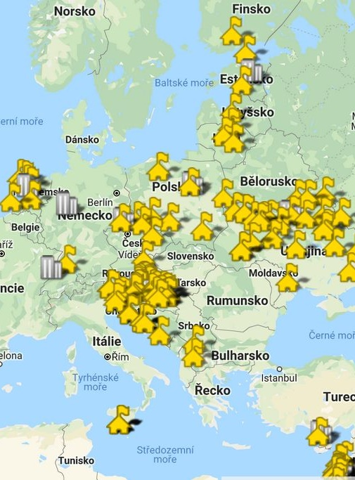
School Collaboration
2019 Spring Campaign:
156 school from 14 countries
More than 100 schools part of the Collaboration Group (paired up with 1-3 other partners)
Countries involved:
Croatia, Cyprus, Czech Republic, Estonia, Finland, Germany, Israel, Latvia, Lithuania, Macedonia, Malta, Netherlands, Poland and Ukraine
Notes:
The numbers are for registered schools from Europe and Eurasia Region, perhaps there are more who do phenology, but we do not know about them

Slide 8
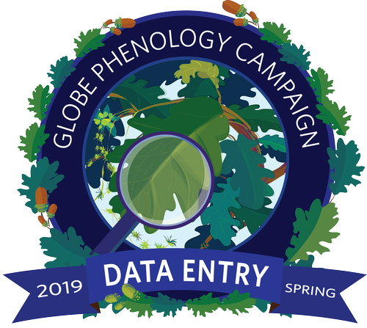
Activities and Badges
Joining the spring tree observation is easy:
5 short activities that will guide you
Activity 1: My Tree
Activity 2: Look at the Buds + Data Sheet
Activity 3: First Leaves
Activity 4: My Green Up Data + Data Upload Guide
Activity 5: Green Color Scale
Badges: Rewards for active schools
Notes:
The language of protocols is too complicated. Remade to several activities + Data Entry Guide for Green Up
Badges – a great success, bit more work to post them on school pages but worth of it!

Slide 9
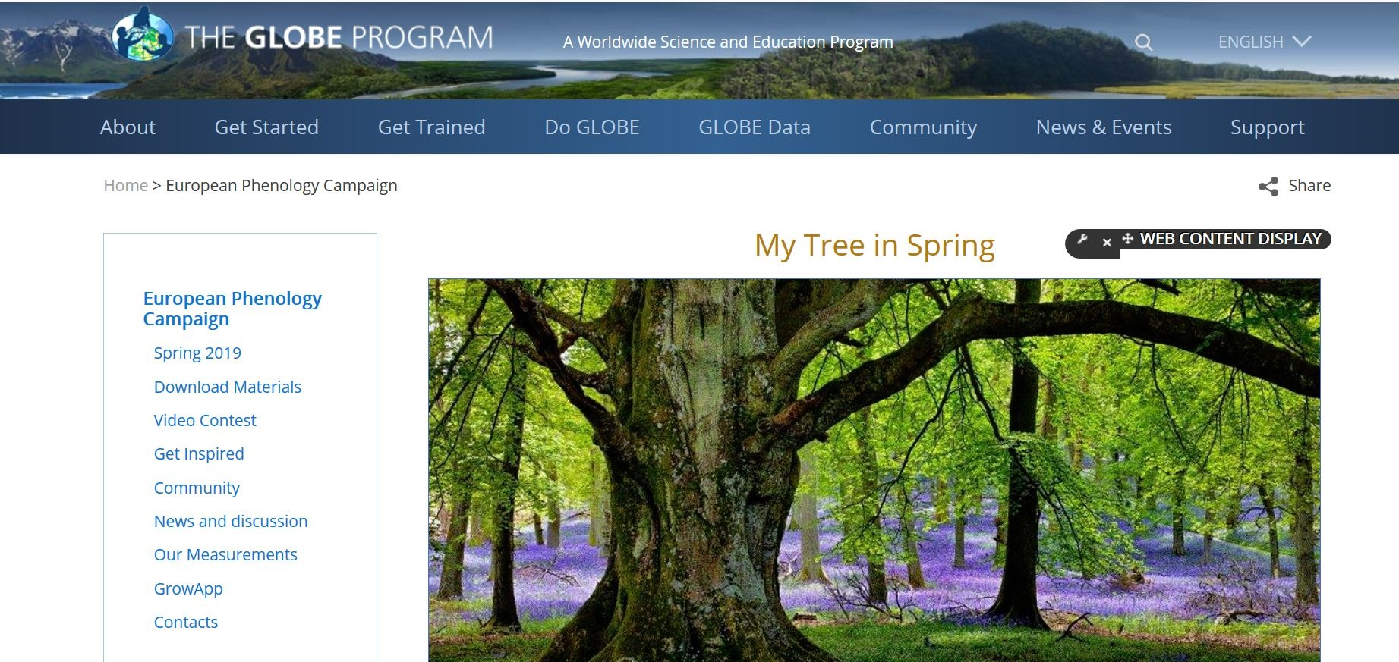
Website www.globe.gov/web/european-phenology-campaign
Notes:
New menu
Simplified texts
Download section – all together – activities, protocol full version, classroom lessons, data entry guides
Video Contest added later on
Good statistics of site visit - HotJar

Slide 10
Get inspired https://www.globe.gov/web/european-phenology-campaign/overview/get-inspired
Notes:
Good Practices – most of the teachers are practical hands-on types ☺

Slide 11
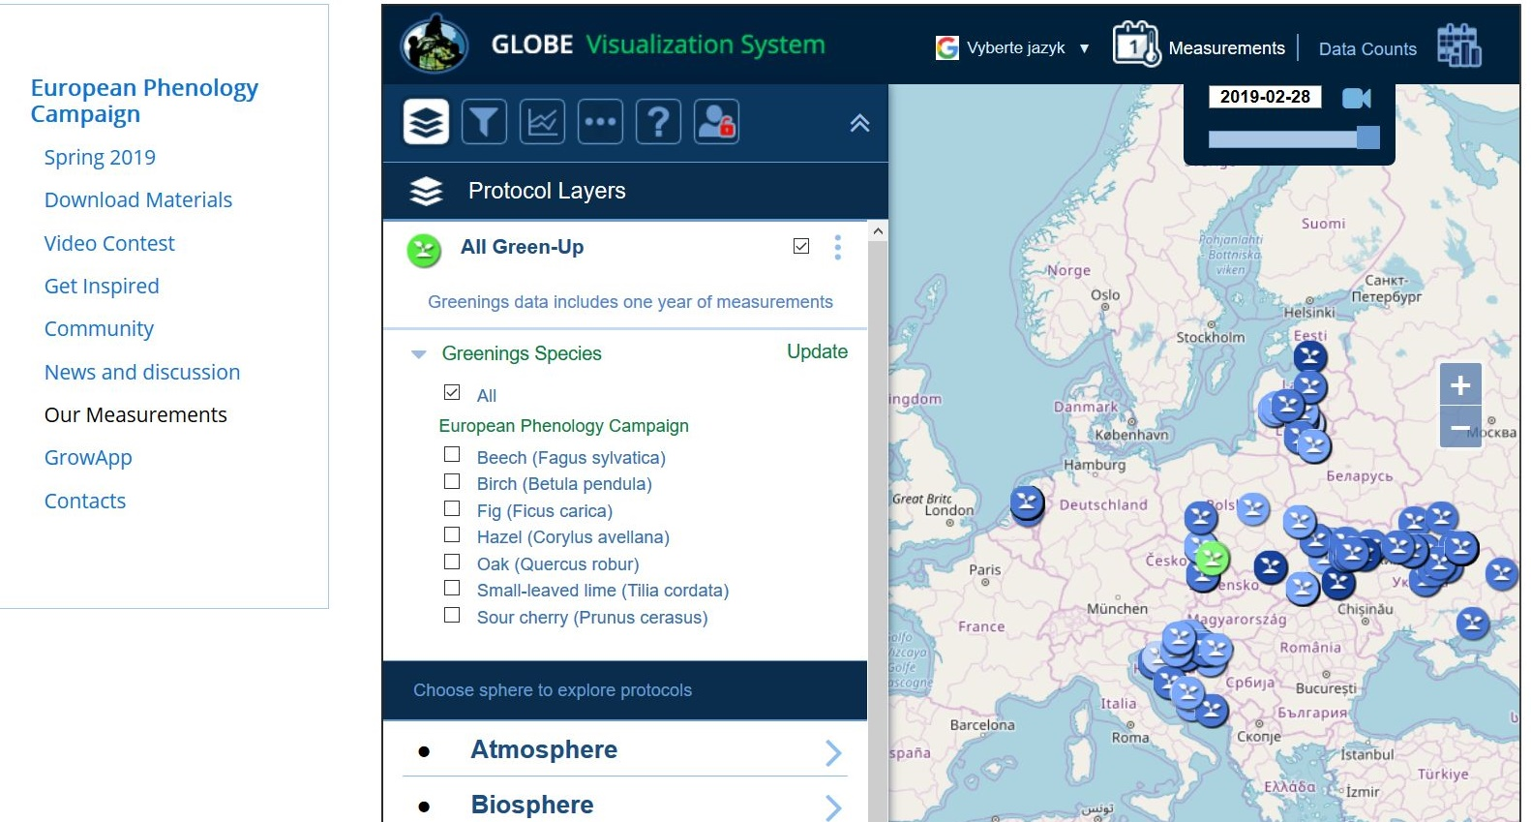
Our measurements https://www.globe.gov/web/european-phenology-campaign/overview/our-measurements
Notes:
Shortcut to Viz – teachers can get idea about Viz if they did not see it before

Slide 12
Video Contest
Videos from 25 teams from 4 countries
Students explain why they have chosen their tree, share both their joy and findings of their research, talk about what they have learned.
All videos can be viewed at web page NEW
Notes:
Some schools are more into research and outdoor, some more into arts and communications
Release forms

Slide 13
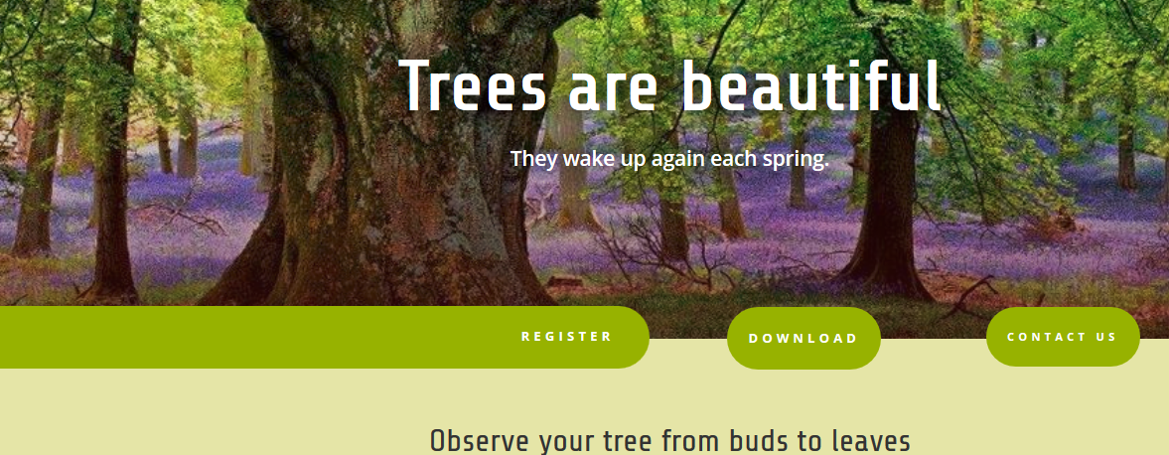
New site: www.globetree.eu
Notes:
Why we come with a new site when we already have one on globe.gov?

Slide 14
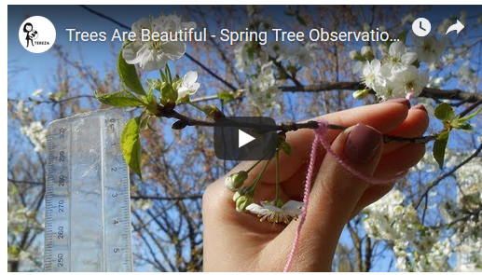
New site: www.globetree.eu
It is designed to attract teachers who
never heard about the campaign or
they never found it attractive or
they are afraid it is too complicated.
Main task: make a teacher to register
Potential to attract even the schools who are not yet in the GLOBE Program
Video-teaser
Notes:
https://www.youtube.com/watch?v=SlZjTc1XJvk

Slide 15
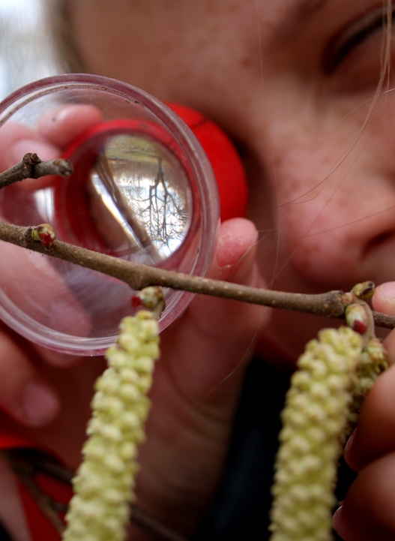
Impact
Number of participating schools increased
More countries involved
Excellent interaction on the discussion forum
New collaborations across countries: stronger sense of community
Data entry in Green Up protocol went up
Documentation collected on schools involvement
Notes:
European schools scored very well in Trees Around the GLOBE Campaign as they uploaded so many data for Green Up!
2662 data submitted from Jan to June 2019 – only Europe and Eurasia
292 posts at discussion forum from Feb to June 2019
RCO collected documentation on schools involvement (videos, photos, forum posts, feedback from teachers)
Badges: 49 for Data Entry and 36 for Collaboration

Slide 16
Lessons Learnt
Clear&Simple communication (language might be a challenge)
Sell the idea through positive emotions (easy, fun, meaningful)
Advertise the idea to key people (Country Coordinators)
Reward schools – they love badges and certificates!
Compare data counts stats from ADAT and Viz tool
Keep individual approach to participants
Mind diversity of the Region (tree species, seasons, languages)
Notes:
Google translator used, skype calls with no language skills
Marketing, Copywriting
Thanks to Country Coordinators
Thanks to Jan and Jen Paul for badges

Slide 17
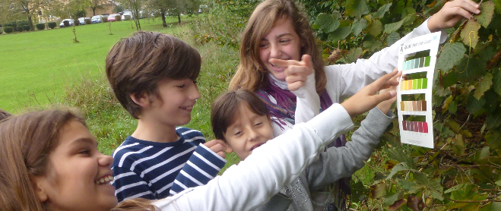
Thank you!
Phenology campaign will continue in autumn 2019 and spring 2020:
https://www.globe.gov/web/european-phenology-campaign/overview
Contact: europe@globe.gov
Photo Courtesy: GLOBE schools and Unsplash.com

Slide 18
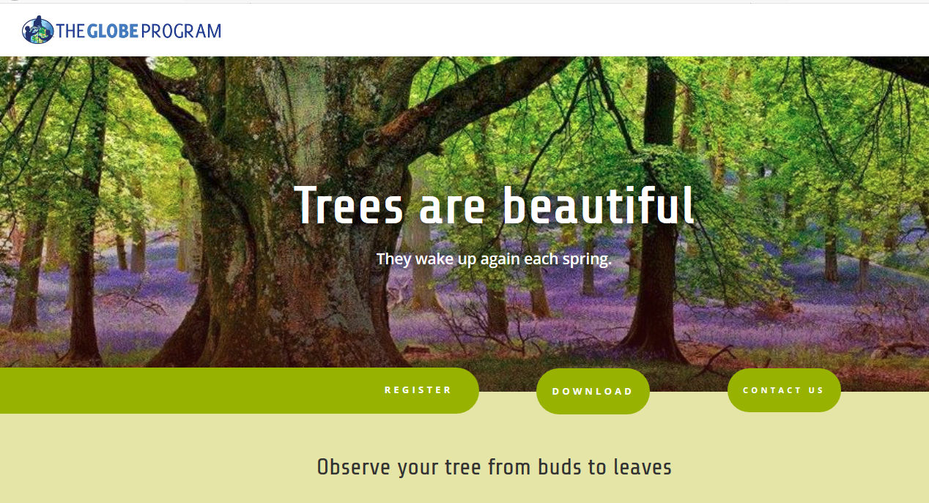

Slide 19
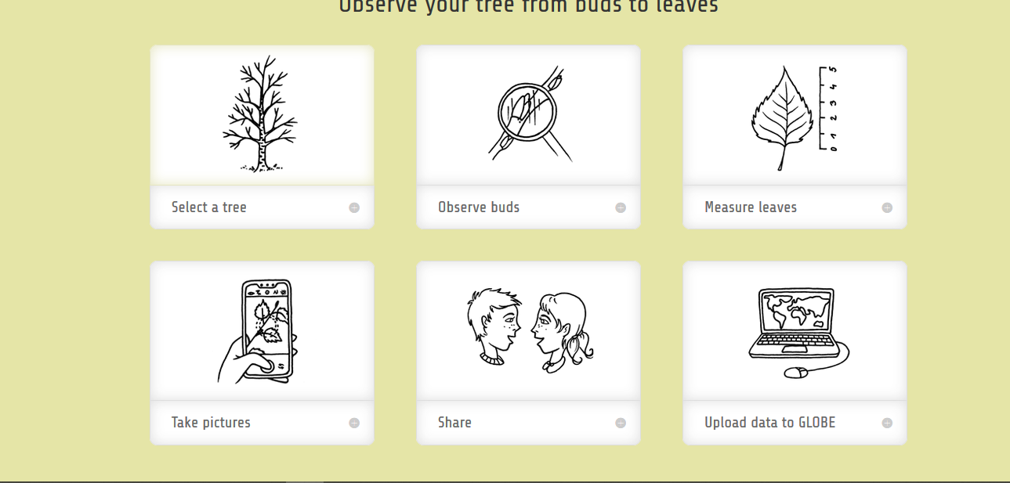

Slide 20
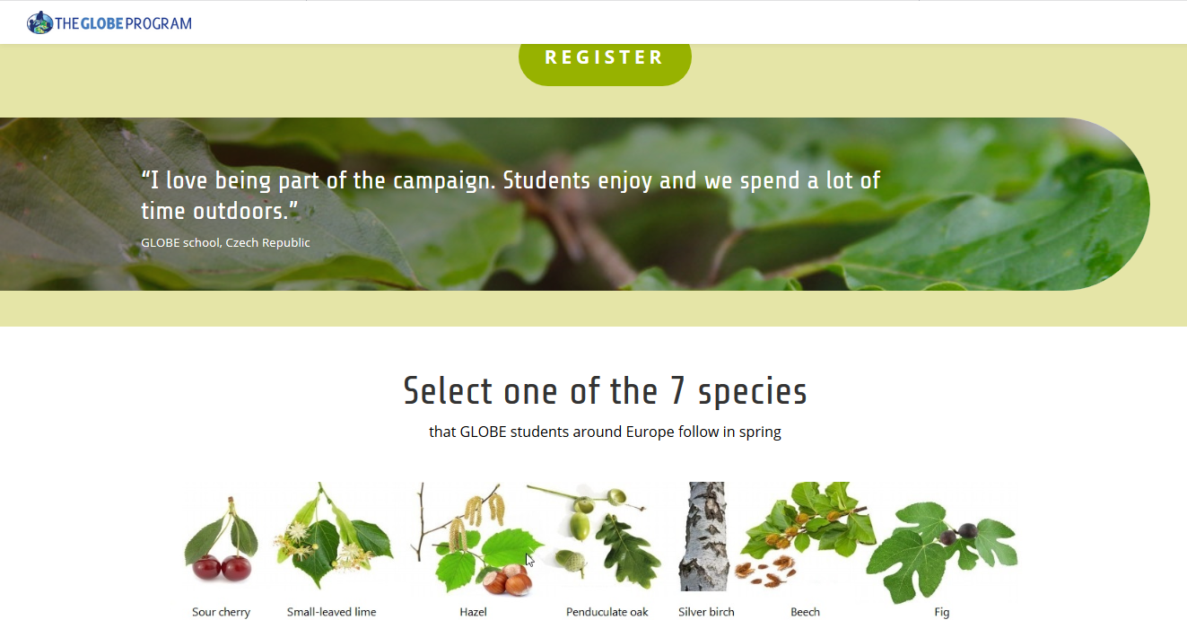

Slide 21
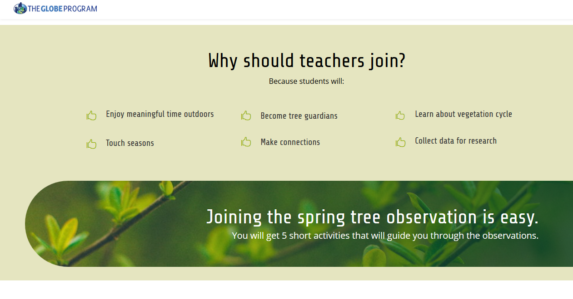

Slide 23
