Slide 1
Teaming Up with GLOBE
Holli Kohl and Cornell Lewis
July 18, 2019

Slide 2
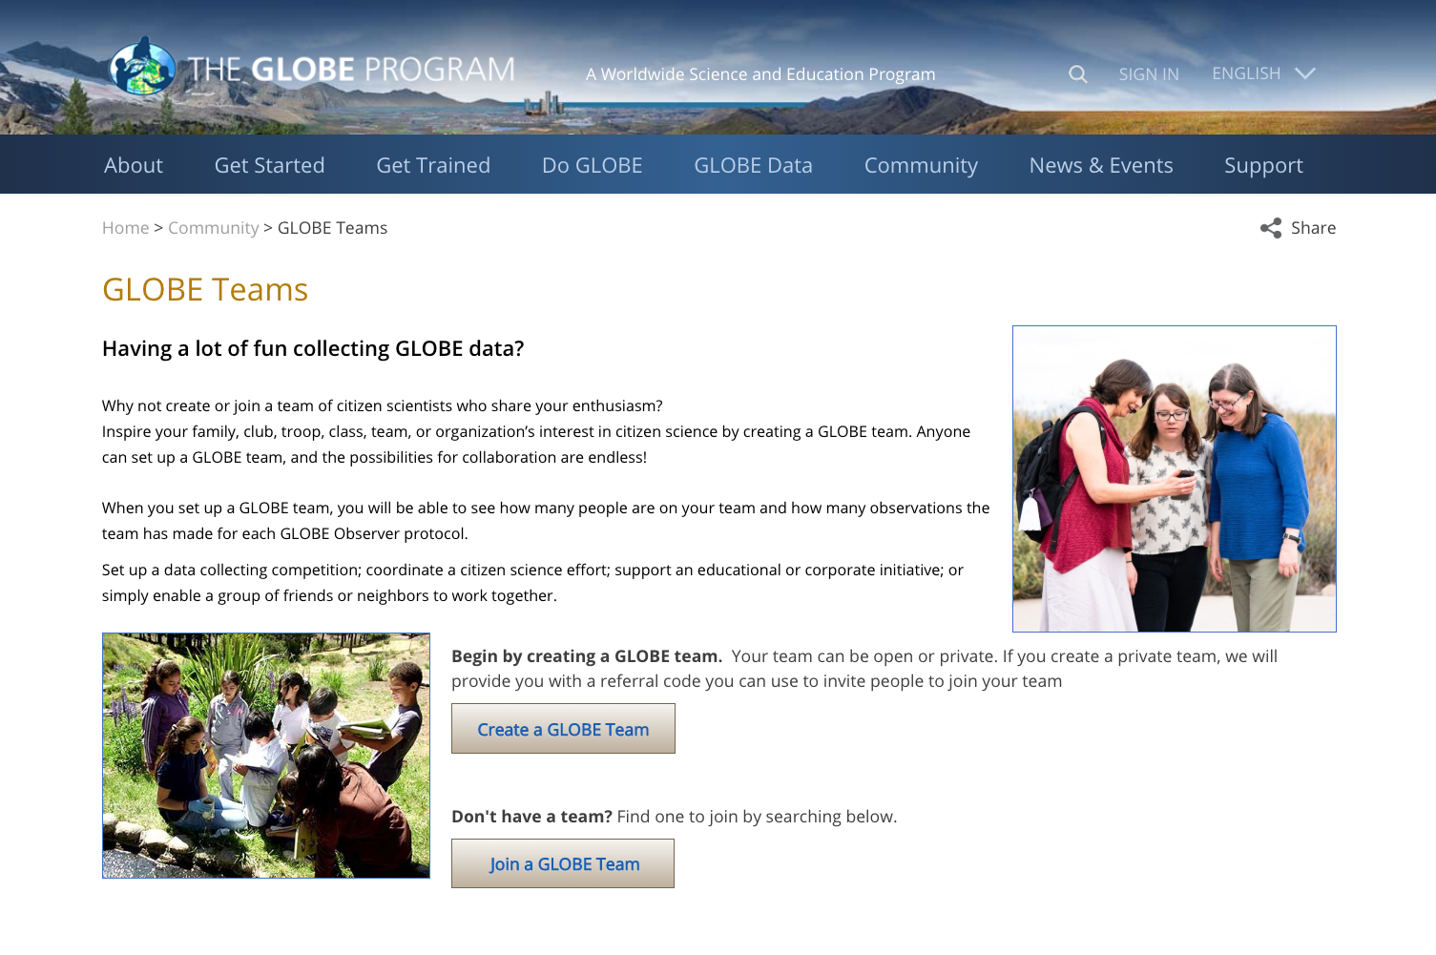

Slide 3
Teaming up with GLOBE: Overview
What is a GLOBE team?
Where can you find GLOBE teams?
How do you join a GLOBE team?
How do you create a GLOBE team?
Why would you use the team tool?

Slide 4
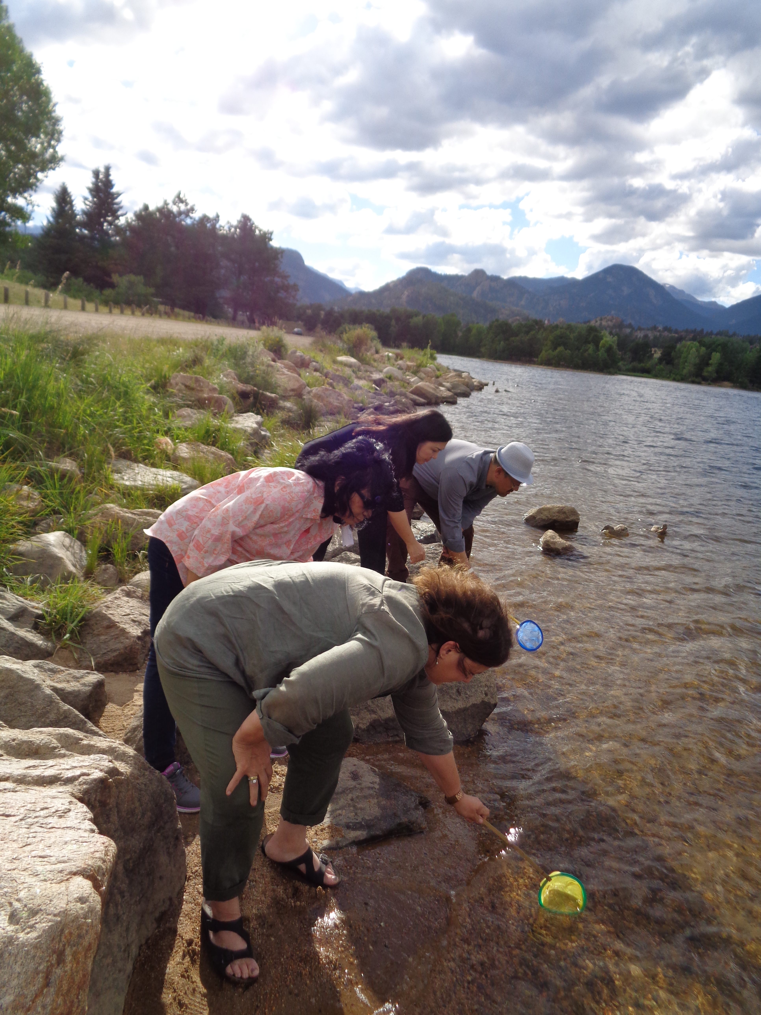
What is a GLOBE Team?
A GLOBE Team is a group of citizen scientists working together as an organization. Teams can be used to set up a competition, coordinate a community’s citizen science efforts, support an educational or corporate initiative, or simply enable a group of people to work together. Teams may include GLOBE schools and GLOBE Observer volunteer scientists.

Slide 5
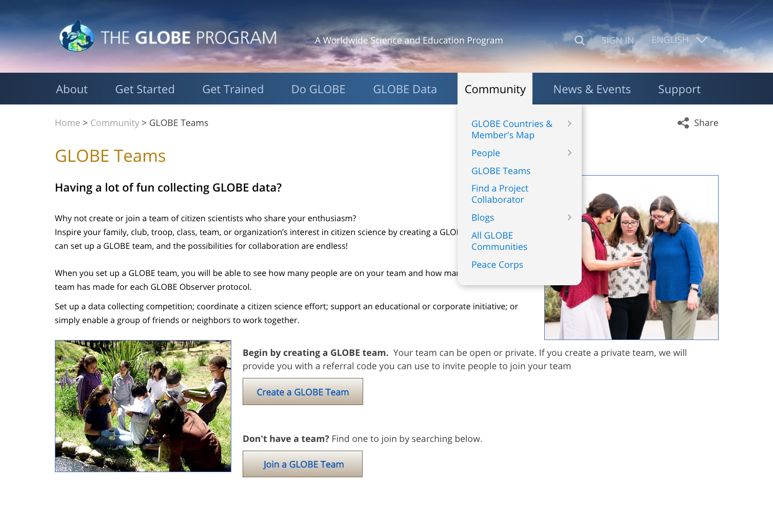
Where can I find a GLOBE Team?

Slide 6
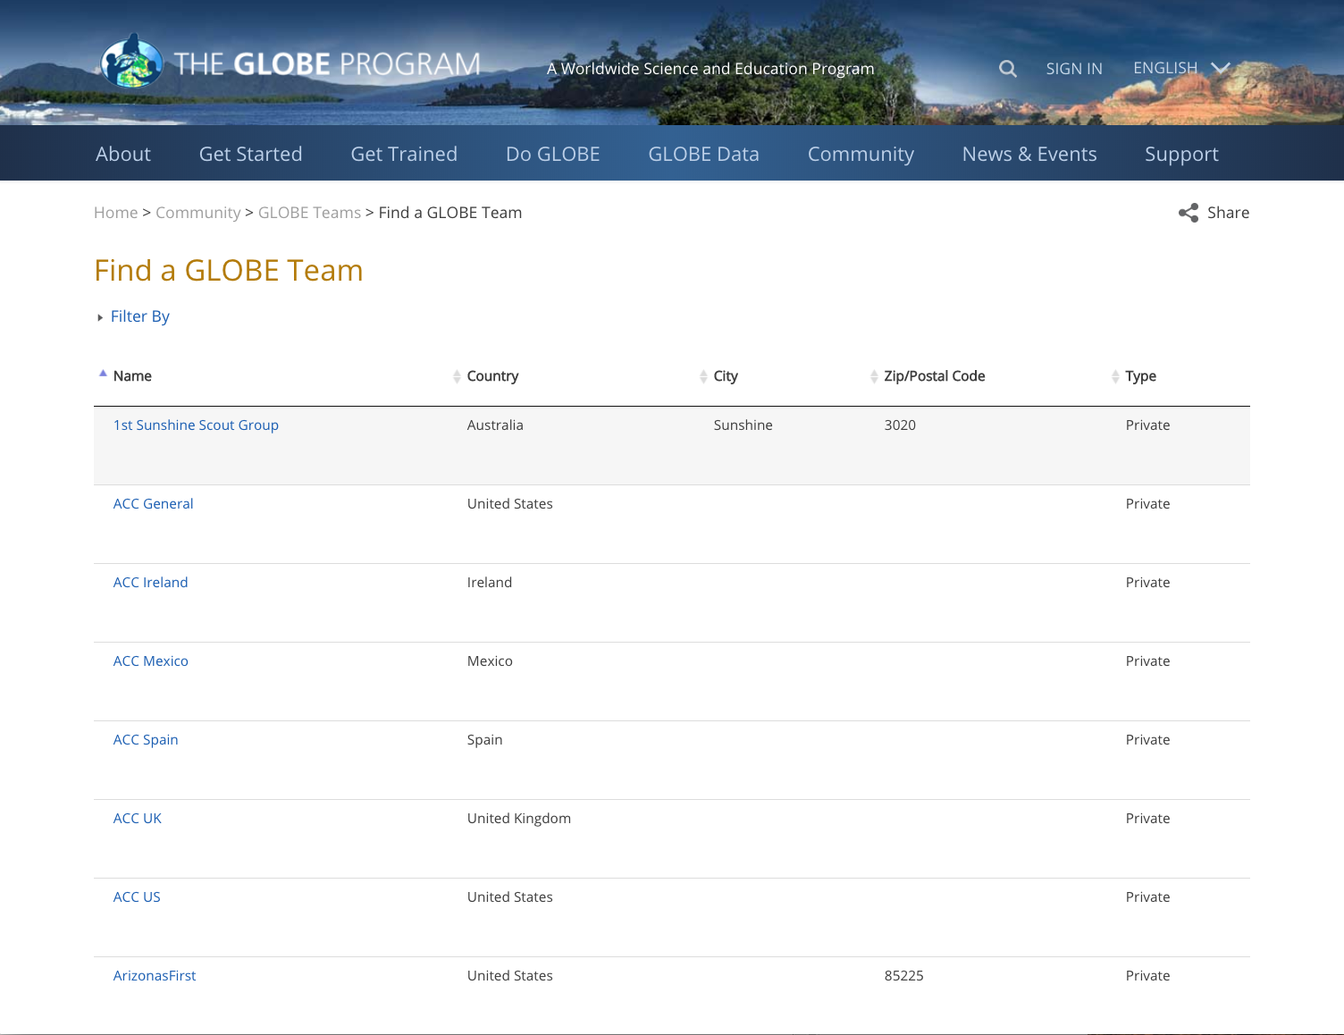

Slide 7
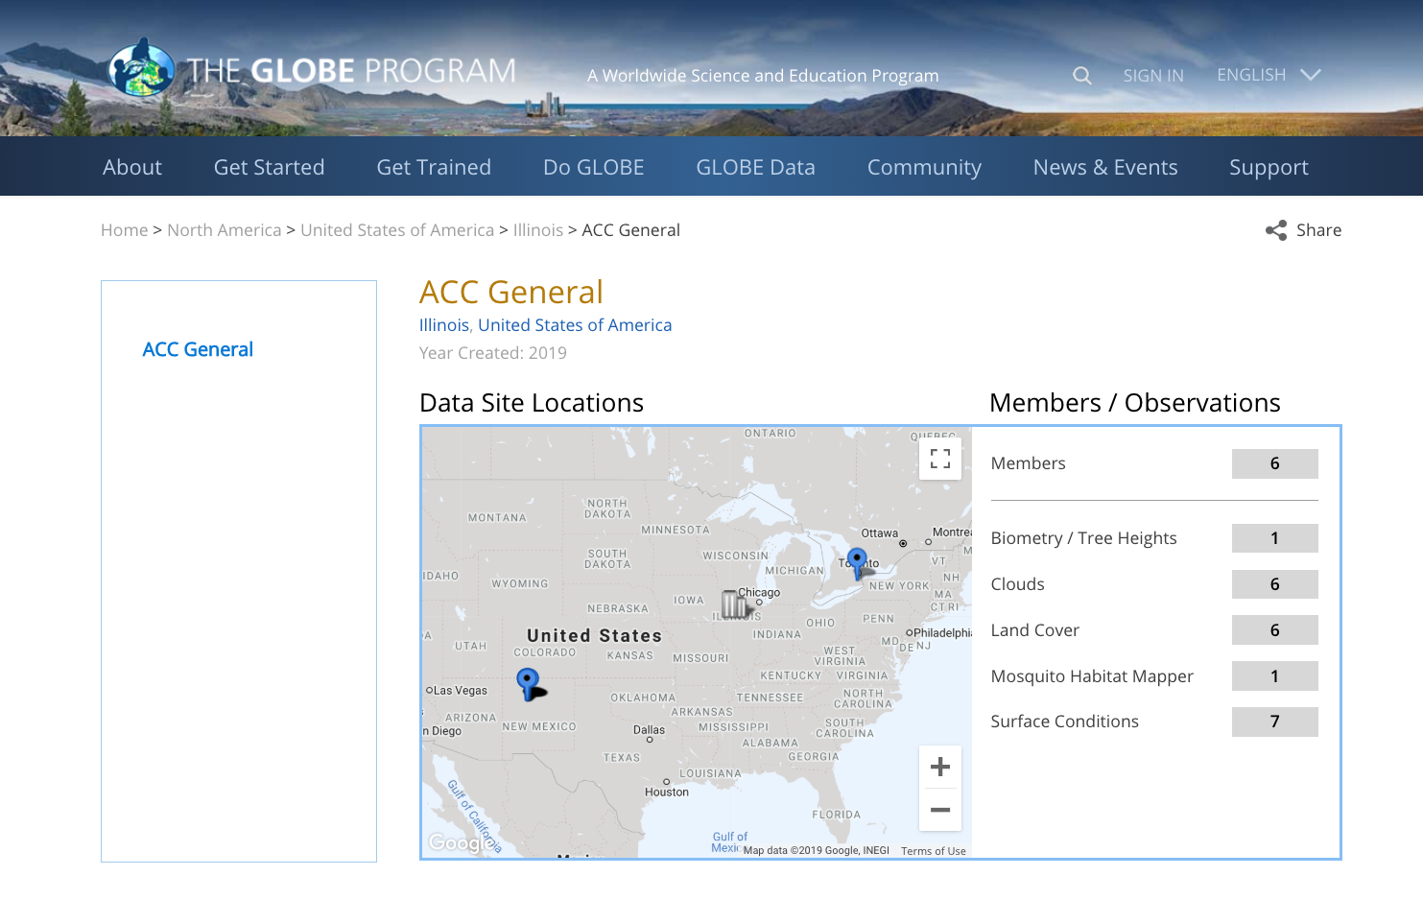

Slide 8
How do I Join a GLOBE Team
Private Team
Open Team
Open only to those who are invited to join
Requires a referral code (given out from the team manager)
Includes GLOBE schools
Anyone can join through publicly posted referral code

Slide 11
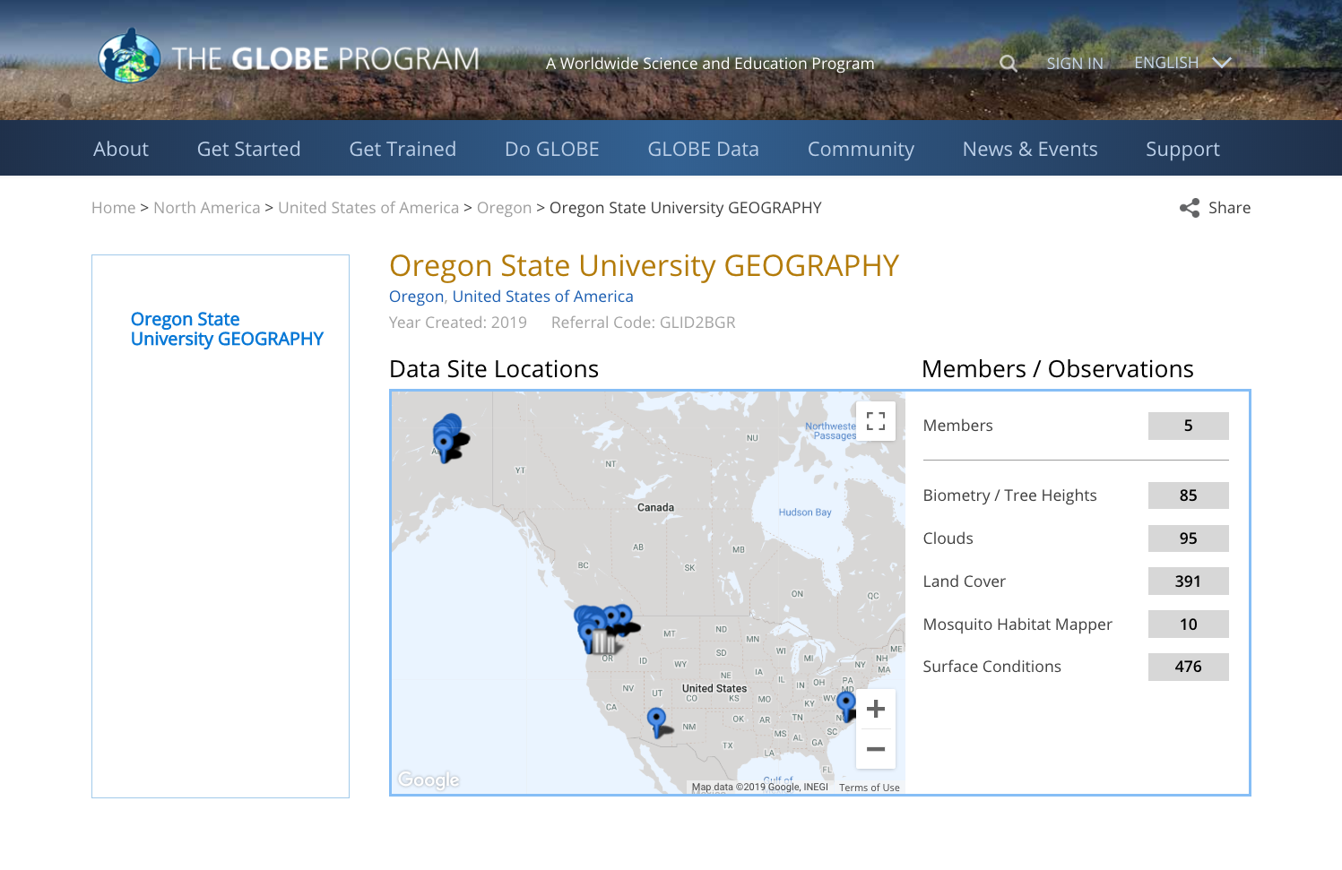

Slide 12
Exploring the team pages and functions

Slide 13
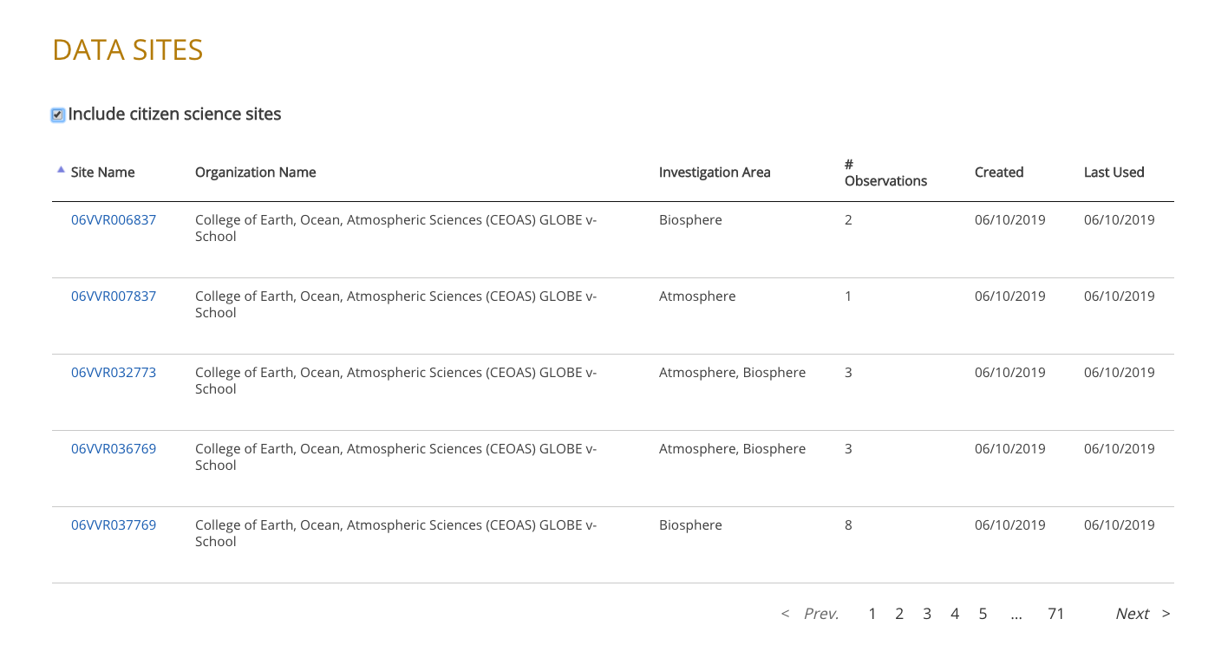
Exploring the team pages and functions

Slide 14
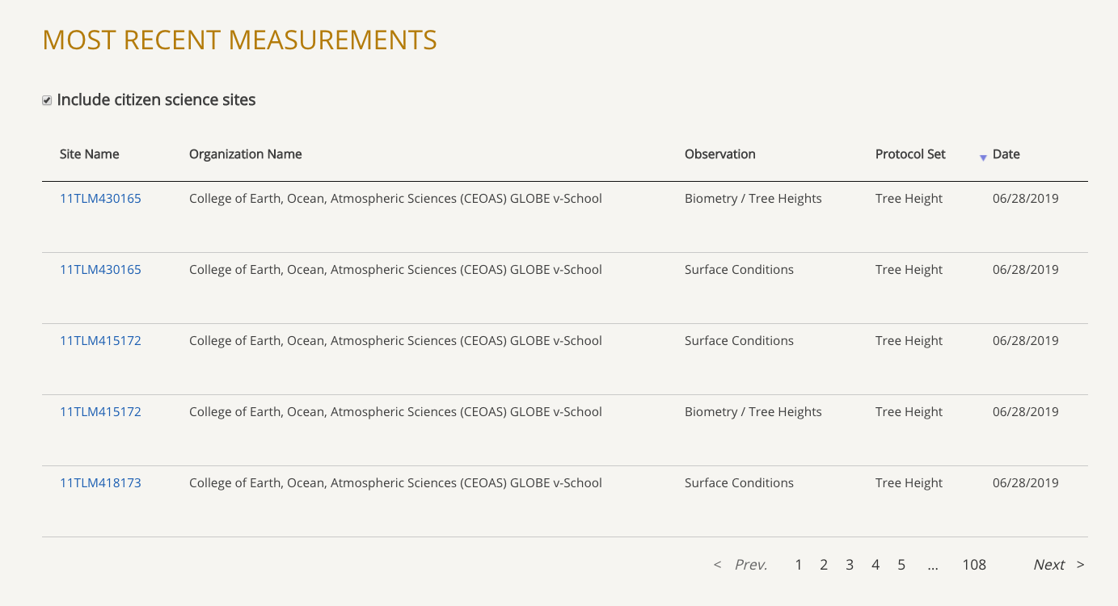
Exploring the team pages and functions

Slide 15
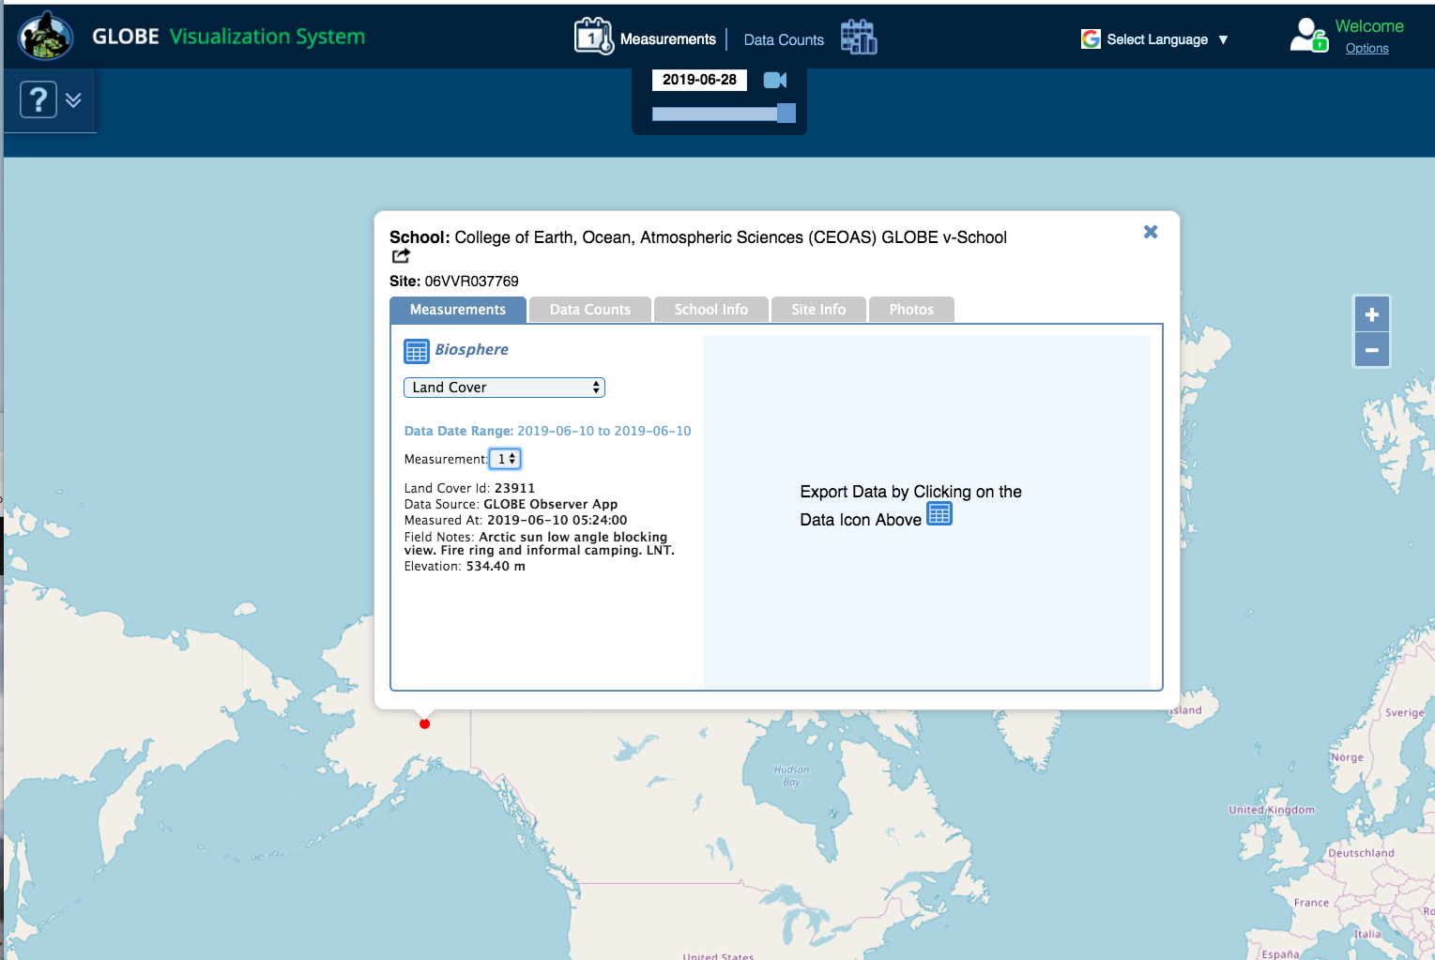

Slide 16
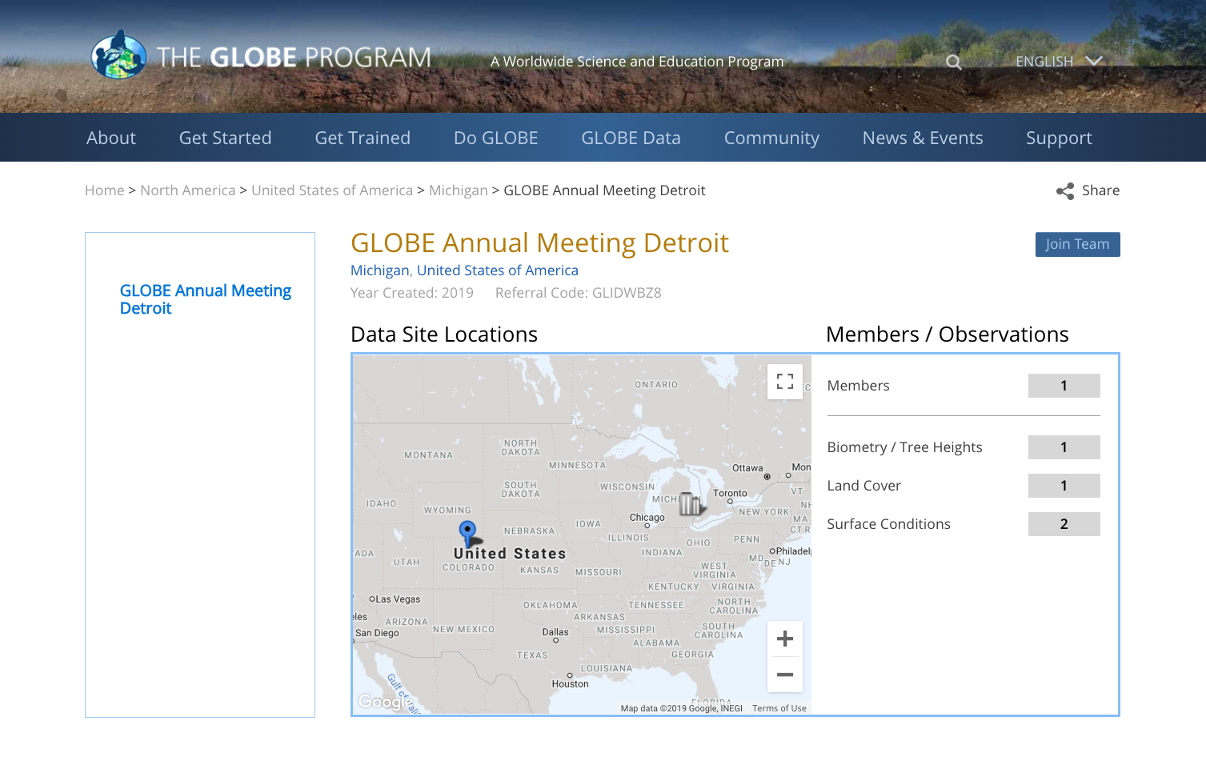
Join an Open GLOBE Team
Login to the GLOBE website
Go to Teams
Filter to show open teams
Select the team name
Click “Join Team”
(only visible if you’re logged in)
You are added to the team and will see “Leave Team” replace the “Join Team” button
Join as many teams as you like!

Slide 17
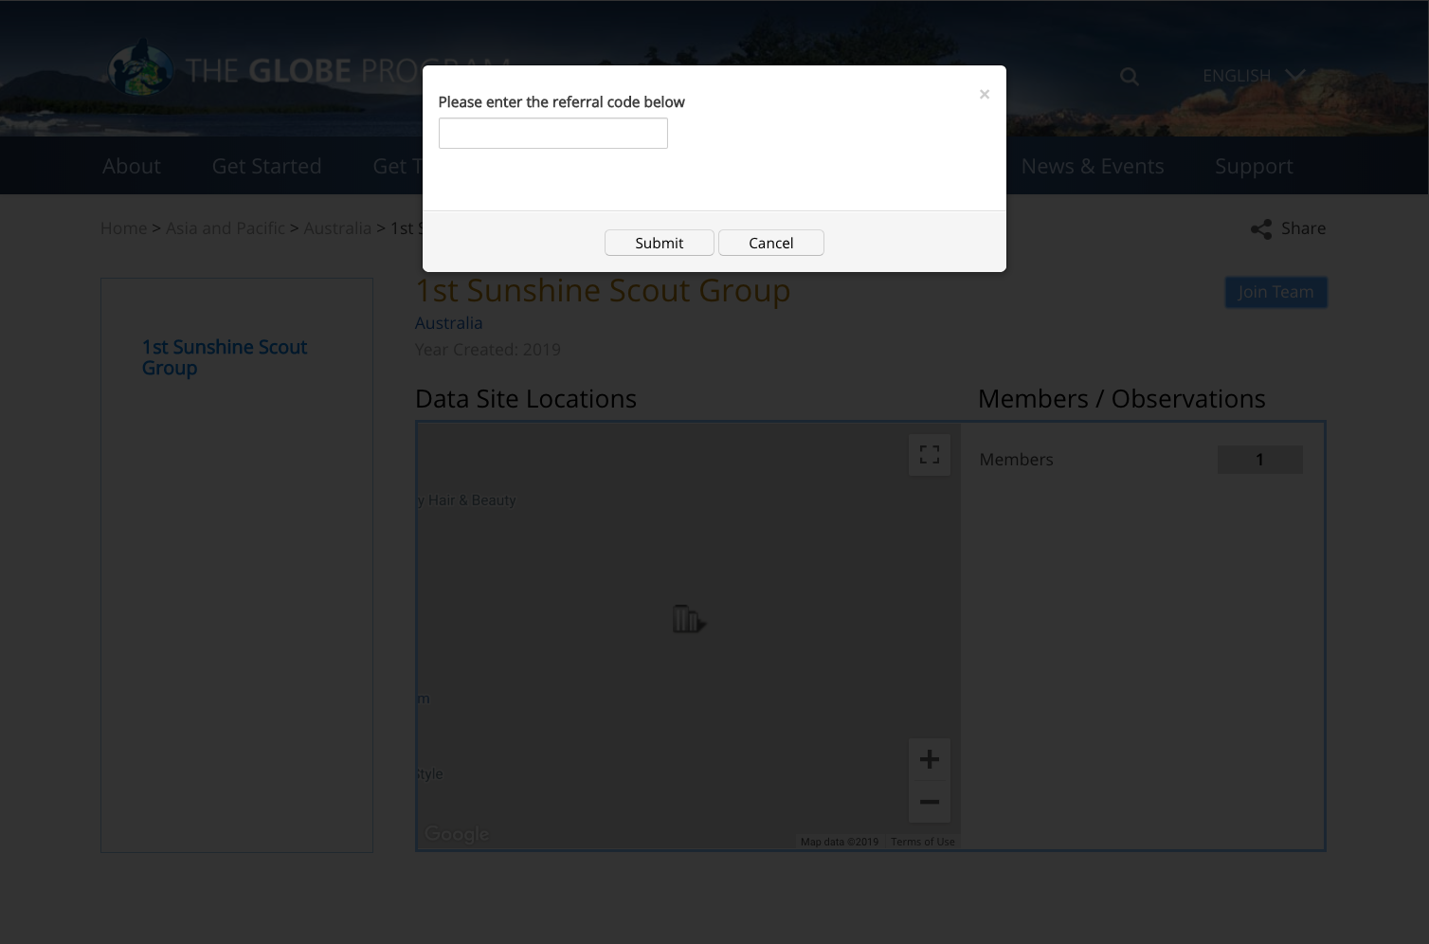
Join a Private GLOBE Team
Get the team’s referral code from the team manager
Login to the GLOBE website
Go to Teams
Filter to show open teams
Select the team name
Click “Join Team”
(only visible if you’re logged in)
Enter the team’s referral code
You will be added to the team and will see “Leave Team” on the team page

Slide 18
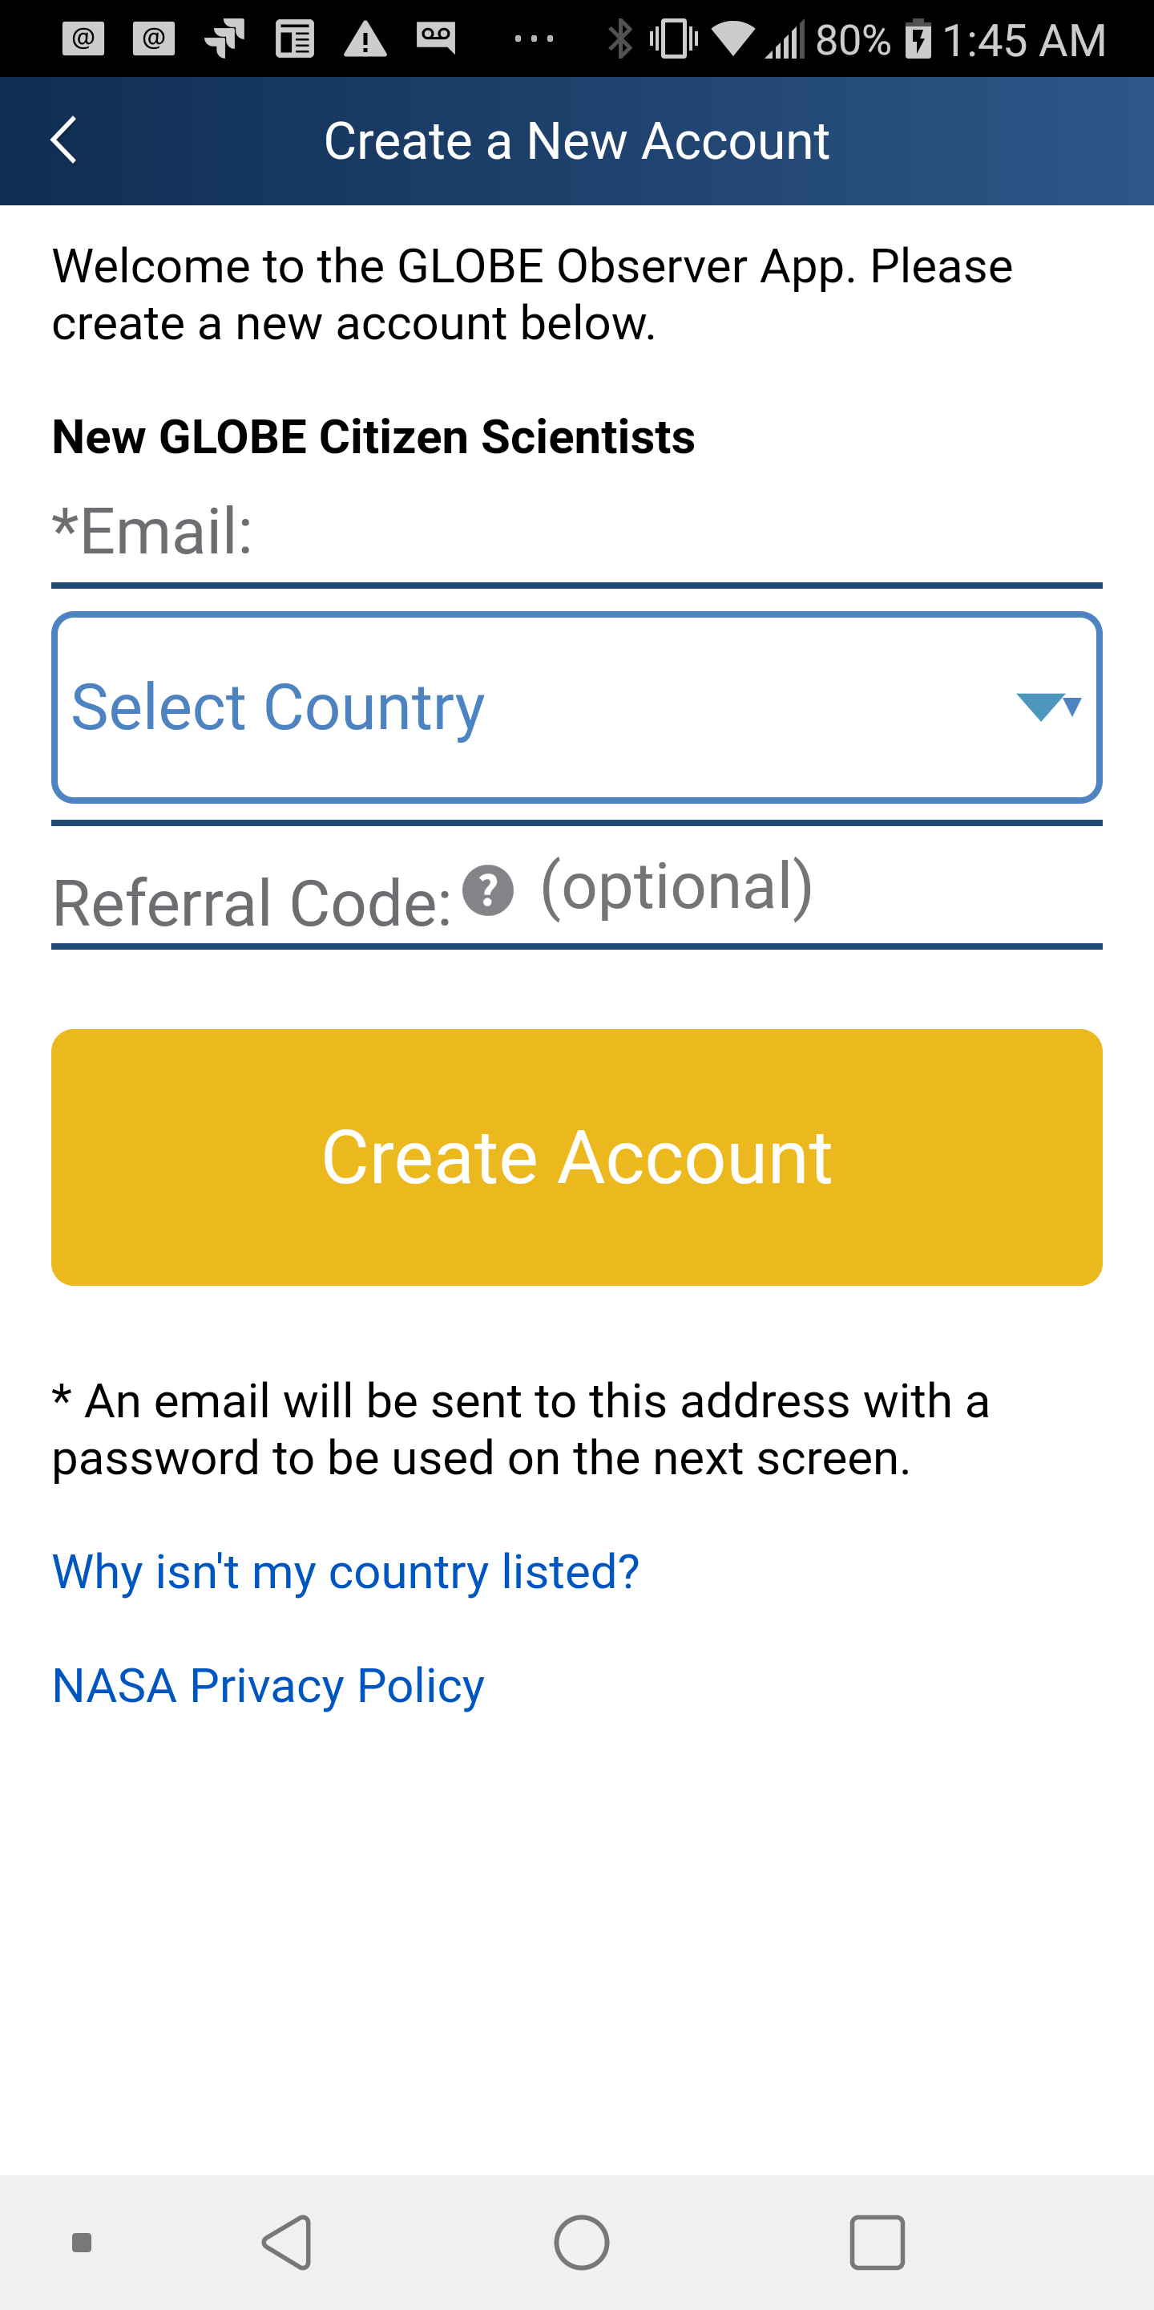
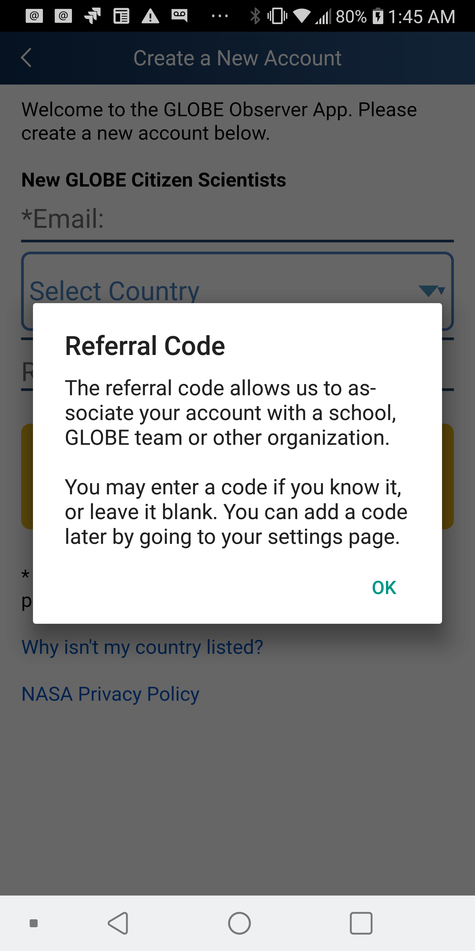
Join a GLOBE Team through the GO App

Slide 19
Create a GLOBE Team
Anyone can create a team
You decide if the team is open or private
You manage the team and can change the name or team type
You can deactivate the team
You can add or remove managers
You can choose to display your contact information or not
You can remove team members

Slide 20
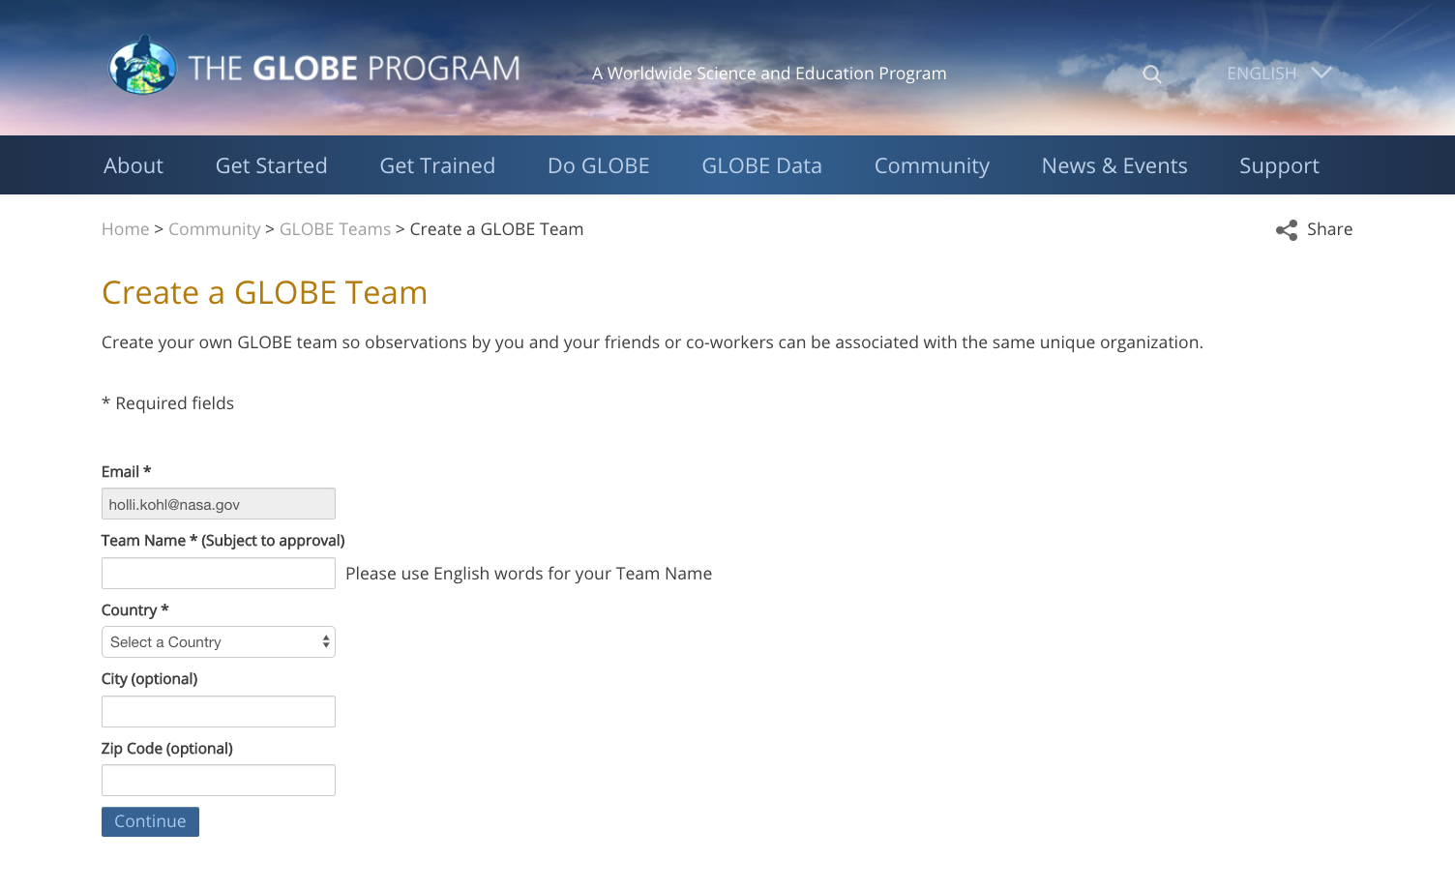
Create a GLOBE Team

Slide 21
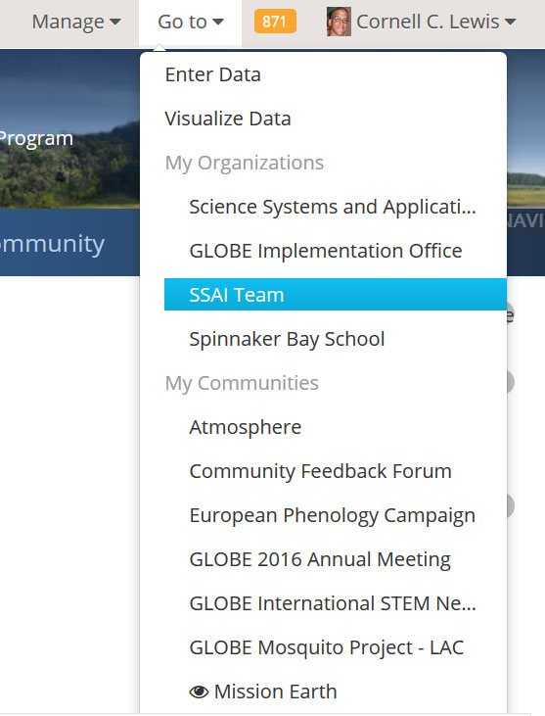
Manage your GLOBE Team
Use the ‘Go to’ menu to navigate to your team page (must be logged-in)

Slide 22

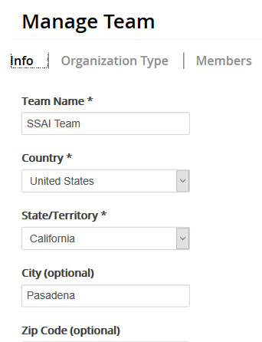
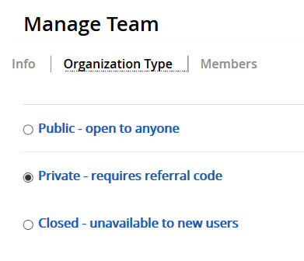
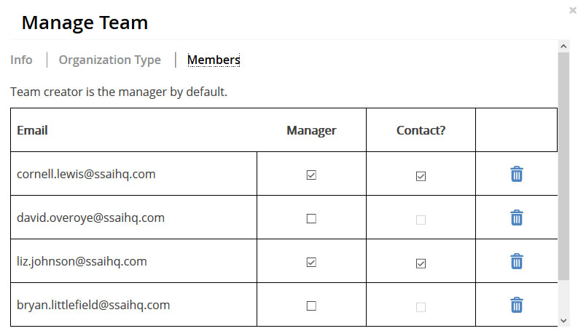
Manage your GLOBE Team
Click on the ‘Manage Team’ link at the top right of your team page

Slide 23

Why Teams?
Corporate Volunteer Program
Corporate volunteer challenge across the company
Staff interested in environmental volunteerism, but wanted something that could be done anywhere in the company
GLOBE Clouds!
Country-based teams in competition for most observations

Slide 24
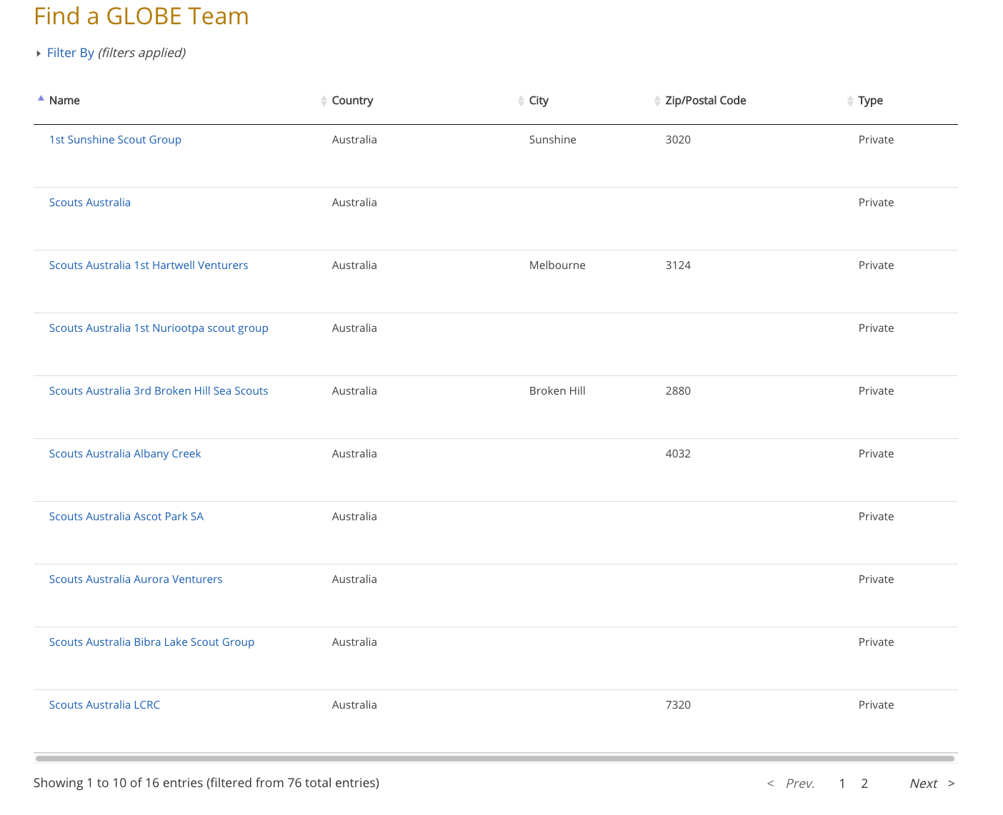
Why Teams?
Australia Scout Data Challenge
Scouts Challenge, sponsored by Dr. John Pring, Geoscience Australia
Land cover challenge because he wants Australia land cover data
16 teams participating
Troops who get the most observations will be recognized at a ceremony during the GEO Summit November 4-9, in Canberra, Australia

Slide 25
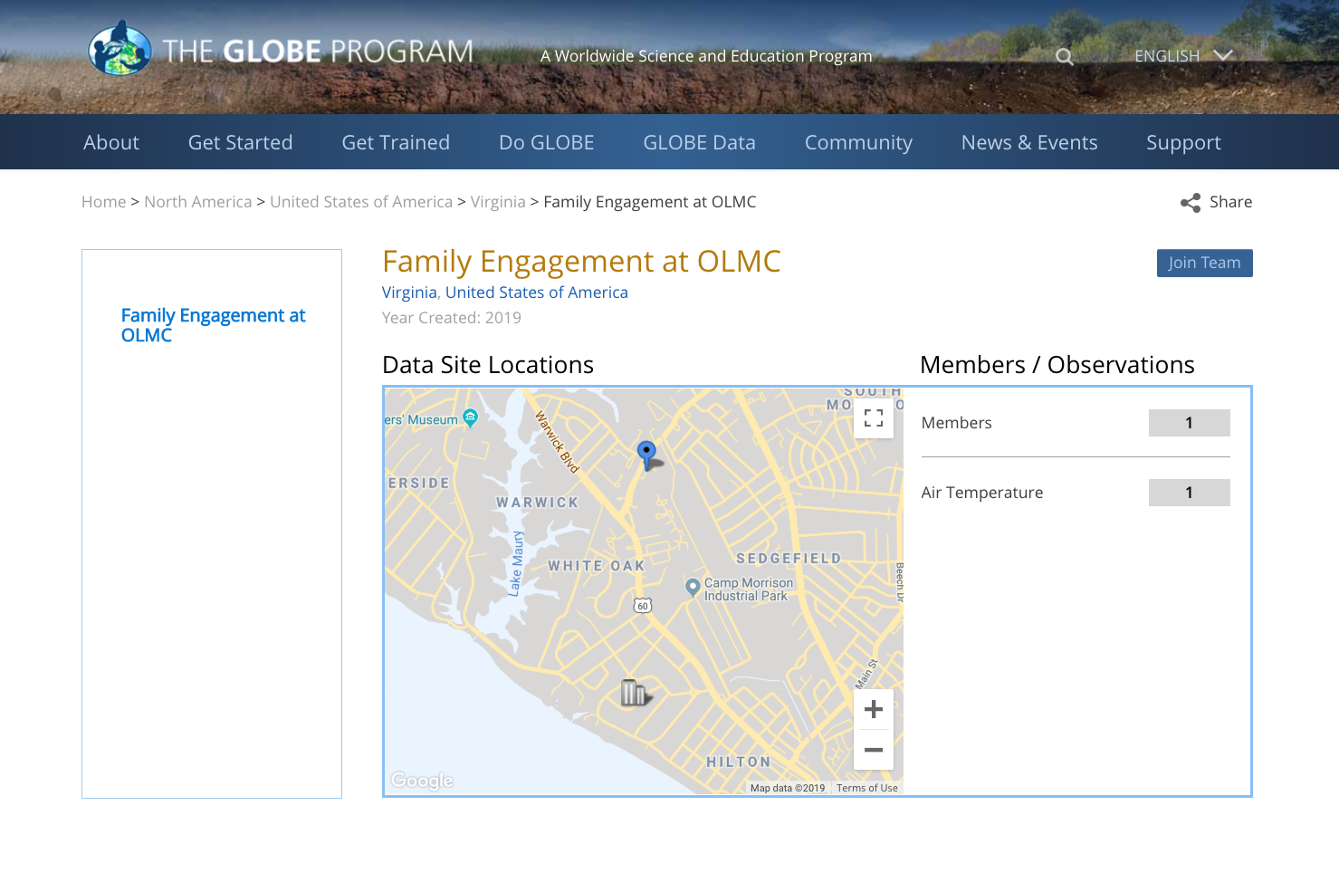
Why teams?
Tracking Impact
Track impact from an event or training
Take science home and maintain connection to institution
Examples:
  GLOBE Annual Meeting Team
  Museum team or Library team
  Family engagement at a church

Slide 26
Questions for discussion
How would you use a GLOBE team?
GLOBE Schools and community?
Other ideas?
What support would you need to implement GLOBE teams?
Other questions or thoughts?

