Slide 1
Implementing GLOBE in College/University Courses
Kevin Czajkowski
The University of Toledo
David Padgett
Tennessee State University
Michael Jabot
SUNY Fredonia
Sherry Herron
University of Southern Mississippi
Notes:
Wednesday 1:45 pm Implementing GLOBE in a University;

Slide 2
Undergraduate and Graduate Courses
Engineering
Science Content
Science Education
Notes:
GLOBE Mission EARTH formed a Pre-Service Working Group where college educators share how they implement GLOBE in their university courses. This presentation encompasses all the information from that group.

Slide 3

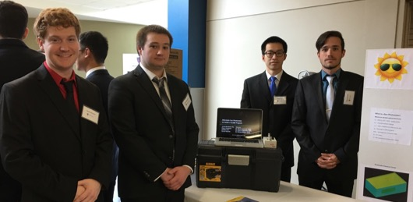
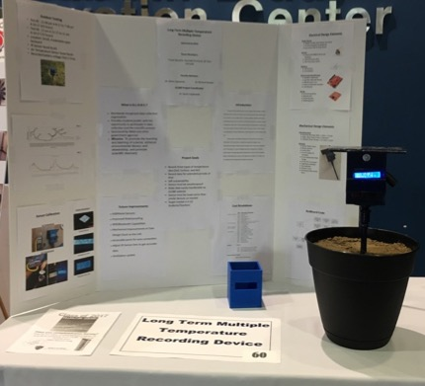
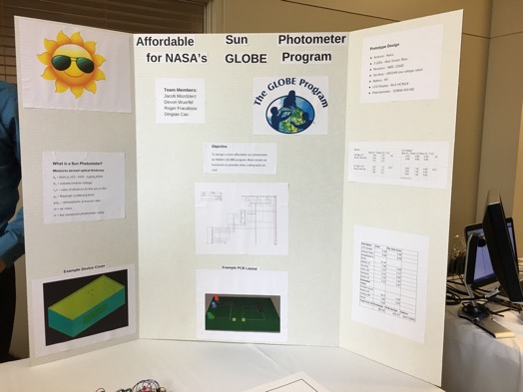
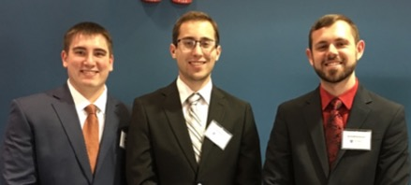
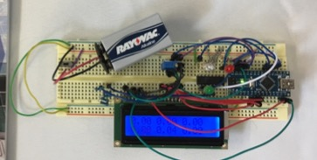
Engineering
Dr. Glenn Lipscomb
Undergraduate Research and Senior Design Engineering Project Exposition
Friday, April 28,

Slide 4
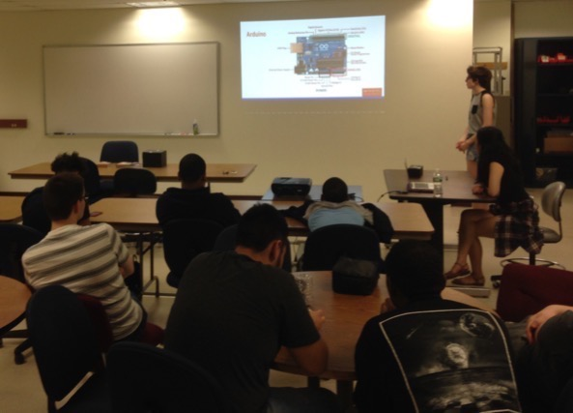
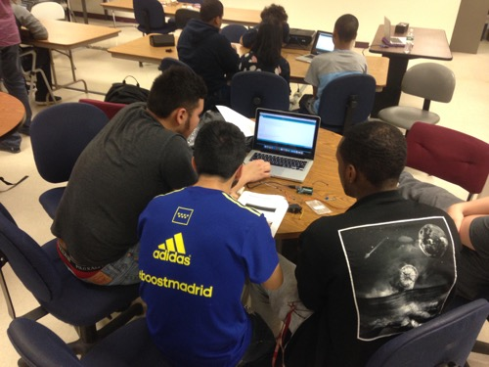
Dr. Caleb Farny
Science Day Workshop - Fenway High School
12 high school students ranging from freshmen to junior year, along with 3 science teachers
worked in teams of 3, ultimately building 4 weather stations that will be incorporated into the Fenway school’s science curriculum.
BU seniors: Chitanya Gopu, David Martinez, Hayley Walker, and Michelle Ye.
Notes:
a public school in the Boston school district. 12 high school students attended, ranging from freshmen to junior year, along with 3 of their science teachers. The students worked in teams of 3, ultimately building 4 weather stations that will be incorporated into the Fenway school’s science curriculum. The BU students who ran the workshop are all seniors: Chitanya Gopu, David Martinez, Hayley Walker, and Michelle Ye.

Slide 5

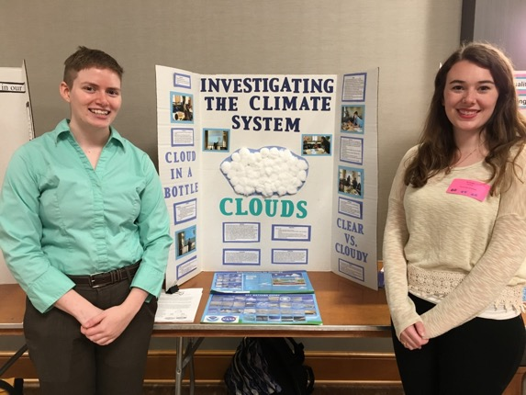
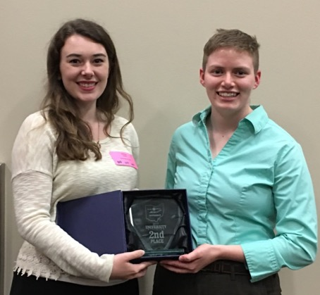
Science Content
SATELLITES CONFERENCE
May 3
Dr. Kevin Czajkowski
Weather and Climate Course
Students taught the sessions on how to do the GLOBE protocols
Students took observations and did projects on El Nino (2016 or 1998). Looked for data and did PPTs.
Students went to schools in the spring.
One group presented their pre-education project

Slide 6
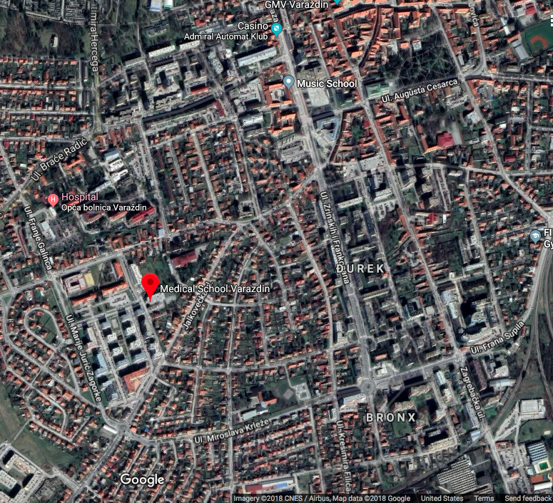
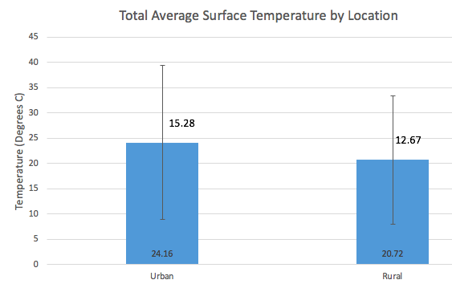
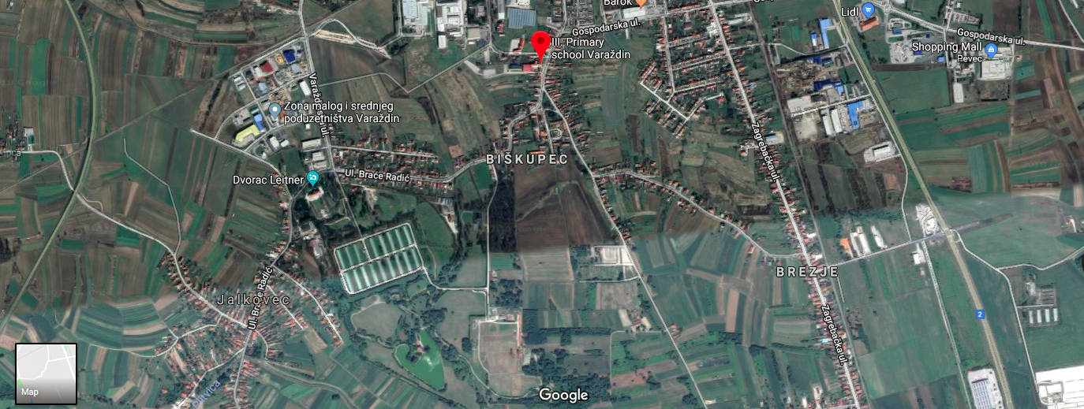

GLOBE - Urban Heat Island Effect:
Croatia Case study
By Jordan Doore
Urban Area:
Medicinska Skola Varazdin
Urban Rural
Rural Area:
Ill. Osnovna Skola Varazdin

Slide 7
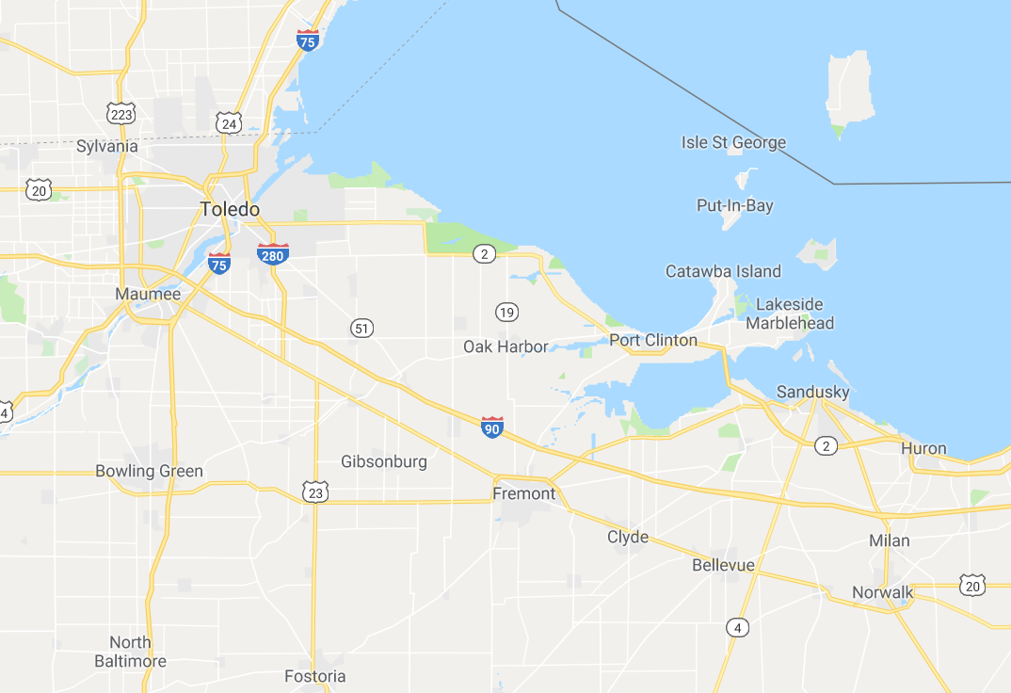
Urban Heat Island Effect & Population
Hannah Fritsch
Weather and Climate Final Project
Norwalk was warmer than Toledo and Sandusky on average.

Slide 8
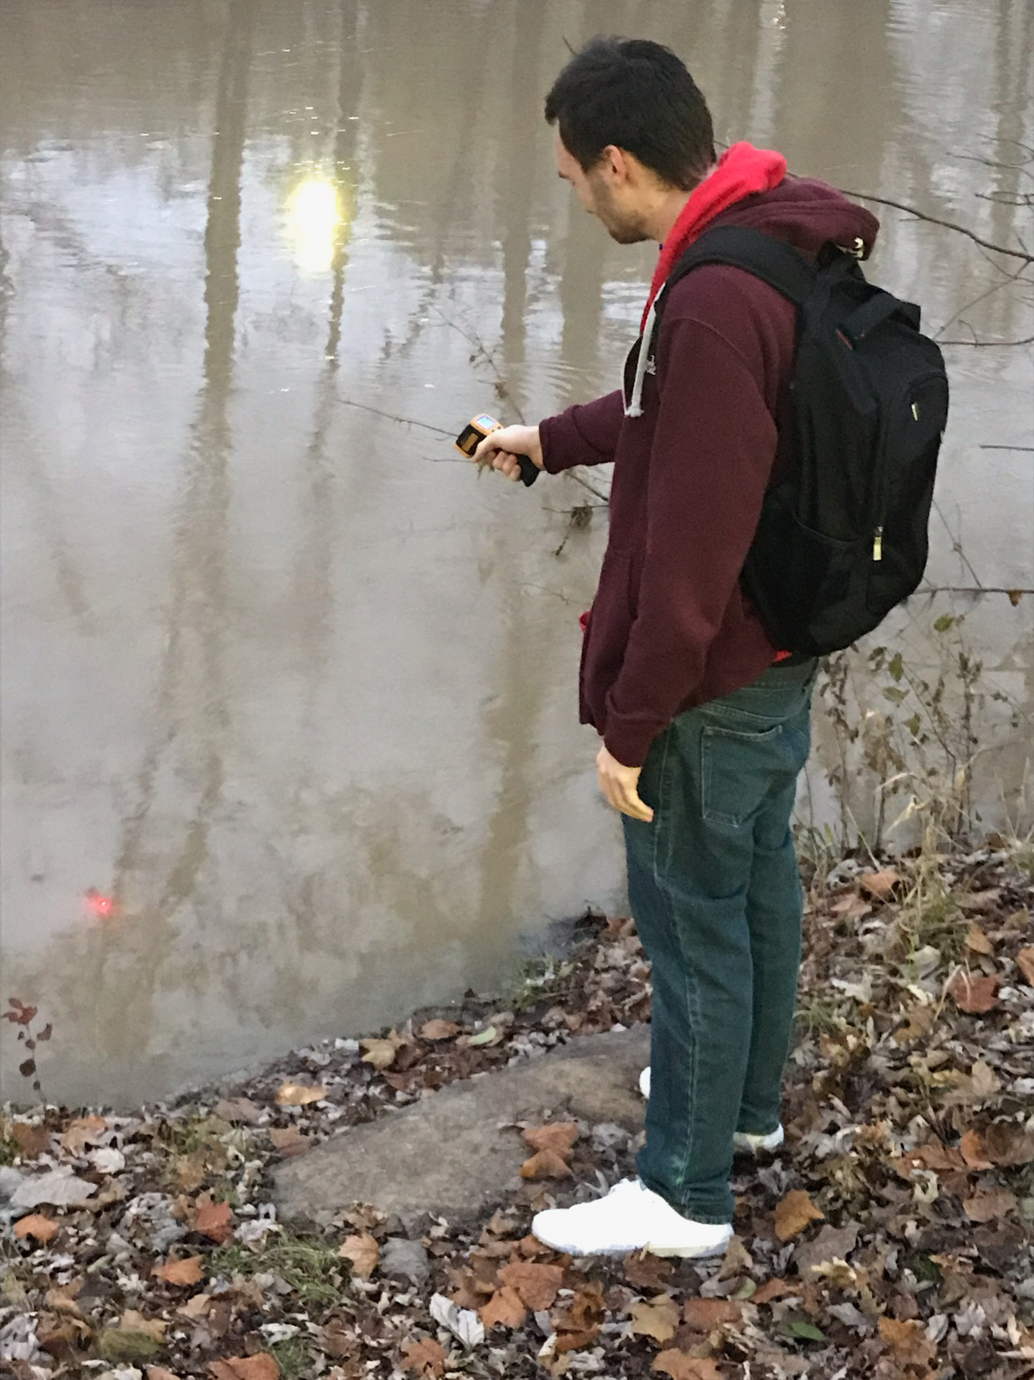
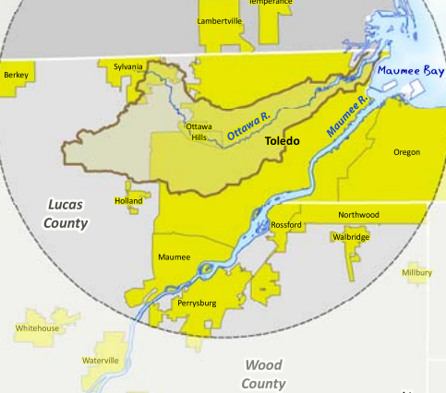
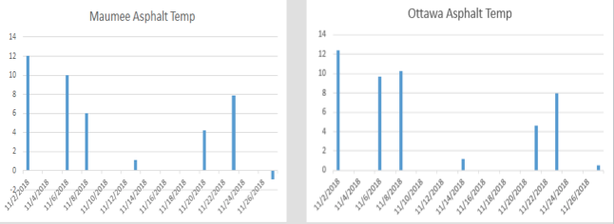

Urban Heat Island Effect: River Temperature Study
Corey Alexander & Kimberly Hasapes
The Ottawa River (more urban/smaller) was slightly warmer than the Maumee River (more rural/large)

Slide 9
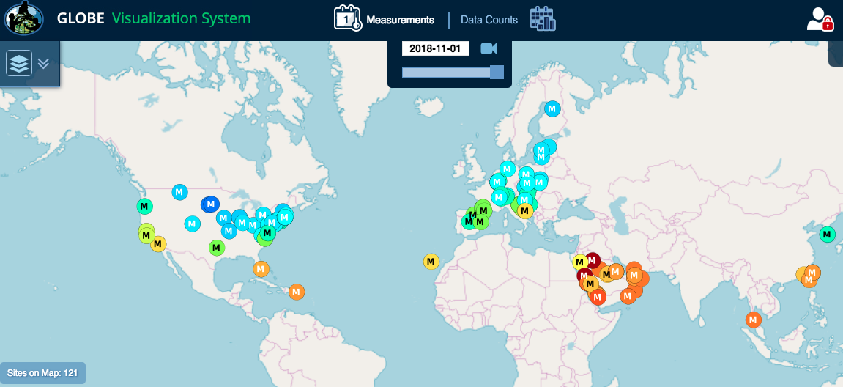
Future Directions
Continue GLOBE UHIE Campaign in December and March
Look into other ways to study the UHIE
  Air Temperature using
  automated weather stations
Link to satellite imagery

Slide 10
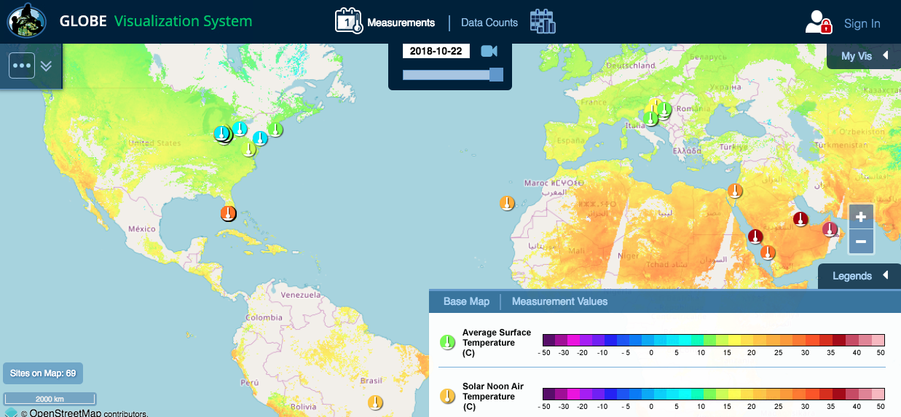
MODIS Terra LST vs. student surface temperature

Slide 11

Science Education - SUNY Fredonia
Dr. Michael Jabot
Large preservice teacher education program.
All candidates are trained as GLOBE Teachers through the Science Methods course(s)
Use of GLOBE helps ensure the “3D” of learning for NGSS
Strong link of preservice candidates with classroom teachers …. “GLOBE Disciples”
Notes:
Michael Jabot, Ph.D.
Professor, Science Education
US Partner - GLOBE Program
NASA Earth Ambassador
Director, Institute for Research in Science Teaching
State University of New York at Fredonia

Slide 12

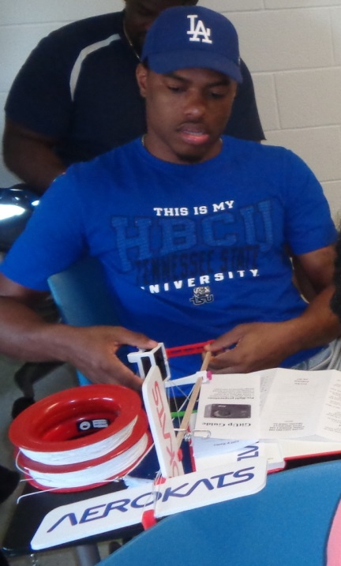

Geographic Information Systems Learning Activities for Pre-Service Teacher Science, Technology, Engineering and Math Professional Development
David A. Padgett
Associate Professor of Geography
Director of the TSU Geographic Information Sciences Laboratory
Notes:
12

Slide 13

Problem
Tennessee State University produces more teachers than any other of the approximately 100 Historically Black Colleges and University (HBCU) Institutions. However, very few specifically choose to become science teachers. The persistent “STEM achievement gap” between Black kindergarten – 12th grade (k-12) and other racial/socioeconomic groups persists in part due to the dearth of science teachers at the k-12 level.

Slide 14

Current Solutions
The Global Learning and Observations to Benefit the Environment (GLOBE) Program
Tennessee State University has been a Global Learning and Observations to Benefit the Environment (GLOBE) program Partner Institution
since October 2001. “Dr. David A. Padgett is a GLOBE Trainer.” Pre-service teachers are certified in the GLOBE Atmosphere Protocols after successfully completing “hands-on” GLOBE exercises.
Dr. Padgett’s introductory World Regional Geography (GEOG 1010/1020) courses are required for pre-service teachers. ArcGIS Online-based learning activities involving scientific inquiry are part of the course content. The goal is for pre-service teachers’ interest in science education to be piqued via hands-on GIS lessons requiring them to create and analyze earth systems data visualizations.

Slide 15

Summer 2016 – Summer 2021 – Mission Earth Project
The TSU Mission Earth project focuses upon the implementation of the GLOBE Program Atmosphere Protocols at local partner schools.
Dr. Padgett is working in collaboration with faculty from TSU’s College of Education to develop a model for pre-service teacher certification in the GLOBE Atmosphere Protocols.
TSU’s GLOBE Mission Earth Team is working to establish GLOBE Partnerships at other HBCUs.

Slide 16
Current and Future Solutions:
ArcGIS Online Exercises
World Regional Geography (GEOG 1010/1020)
1.) “North American Hometown Geography Map” Introductory
ArcGIS Online Exercise
2.) GLOBE Surface Temperature Data Mapping Assignment
Using ArcGIS Online and GPS
3.) AEROKATS/GLOBE Course Content Development for the
Geospatial Applications (GEOG 3200) and Weather & Climate
(GEOG 3500) courses.
4.) Revised GLOBE Climagraph Data Exercise with ArcGIS Online
and Story Maps

Slide 17
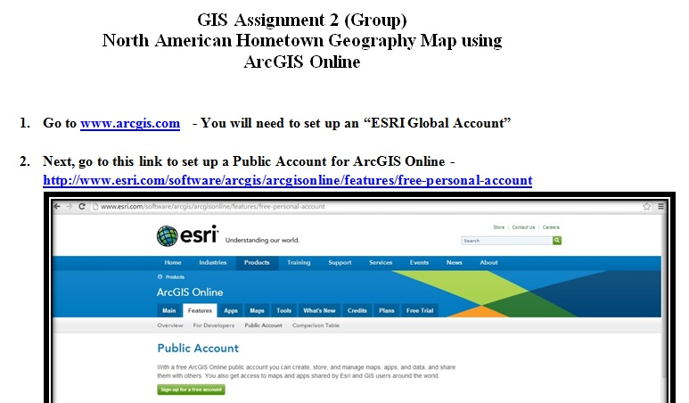
“North American Hometown Geography Map”
Introductory ArcGIS Online Exercise

Slide 18
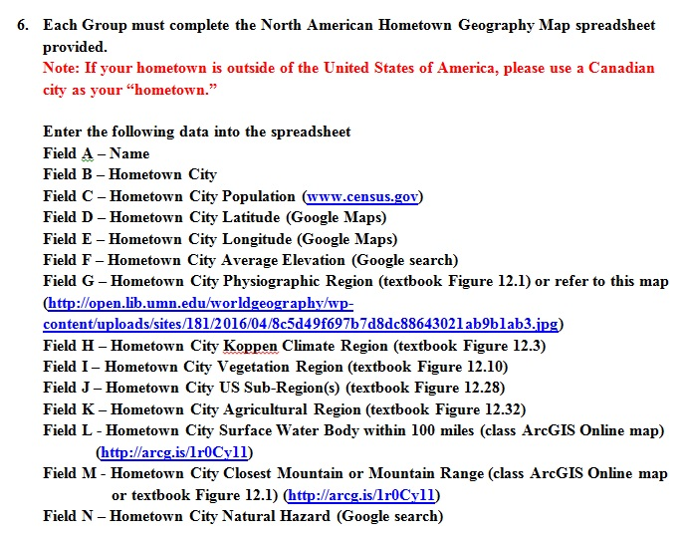
“North American Hometown Geography Map”
Introductory ArcGIS Online Exercise

Slide 19
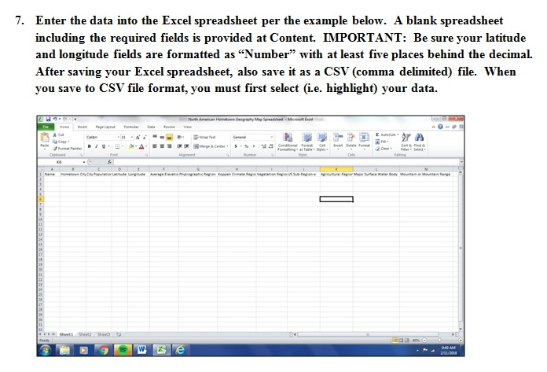
“North American Hometown Geography Map”
Introductory ArcGIS Online Exercise

Slide 20
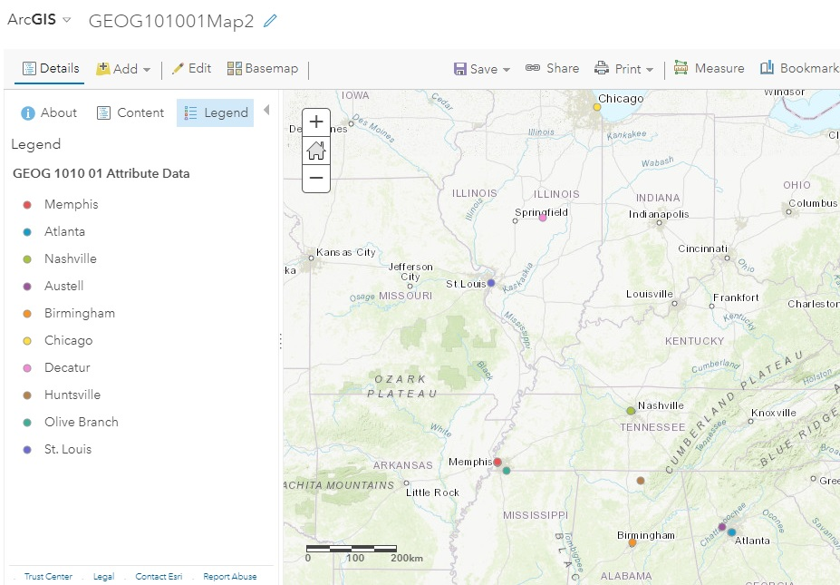
“North American Hometown Geography Map”
Introductory ArcGIS Online Exercise
http://arcg.is/1mCSnS

Slide 21
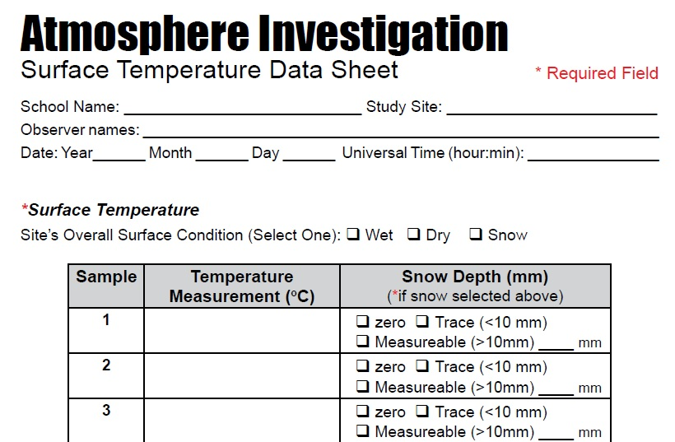
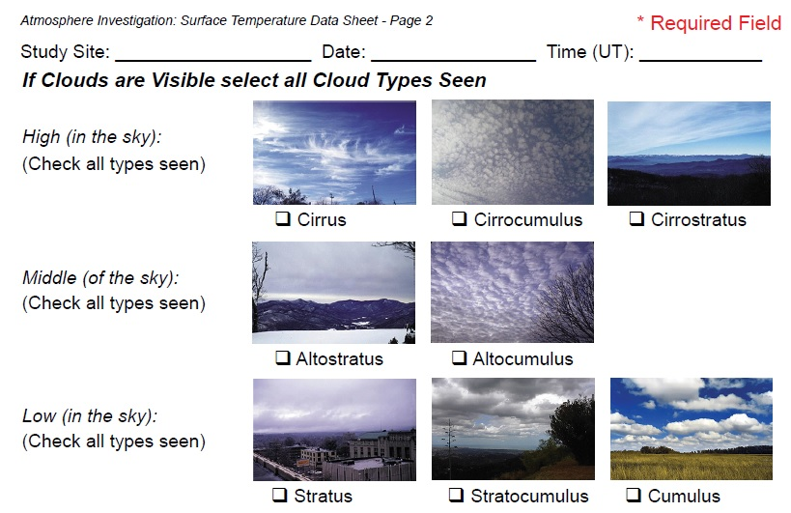
GLOBE Surface Temperature Data Mapping Assignment
Using ArcGIS Online and GPS
GLOBE data entry forms…

Slide 22
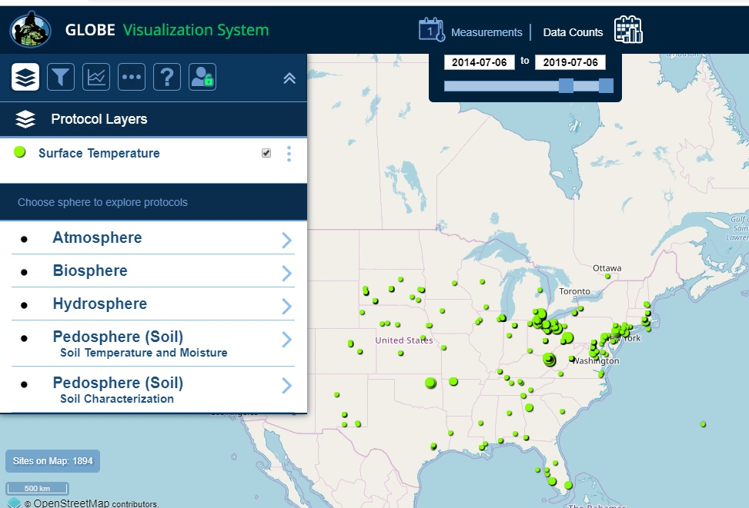
GLOBE Surface Temperature Data Mapping Assignment
Using ArcGIS Online and GPS
GLOBE Data Visualization System

Slide 23
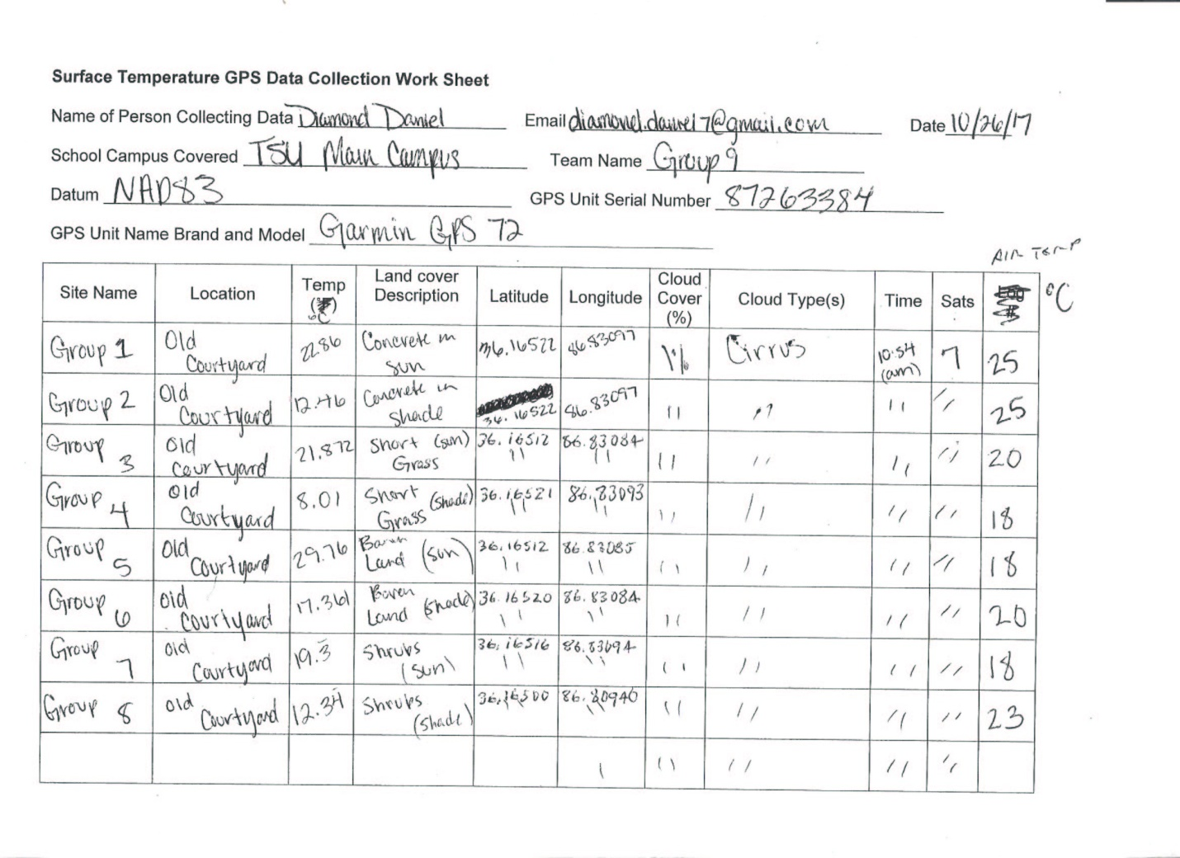
GLOBE Surface Temperature Data Mapping Assignment
Using ArcGIS Online and GPS
Modified GLOBE Data Entry Form

Slide 24
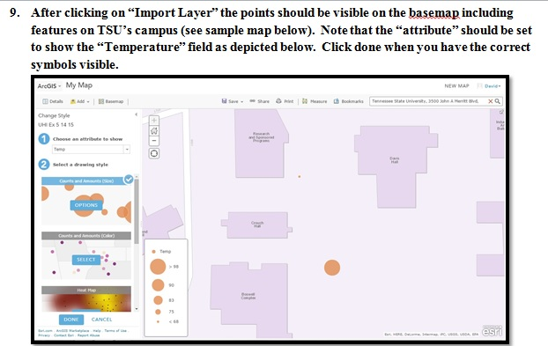
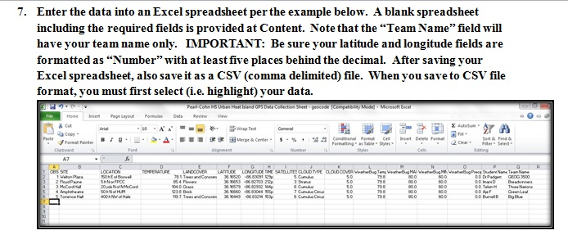
GLOBE Surface Temperature Mapping Assignment
ArcGIS Online Attribute Table Development Steps…

Slide 25
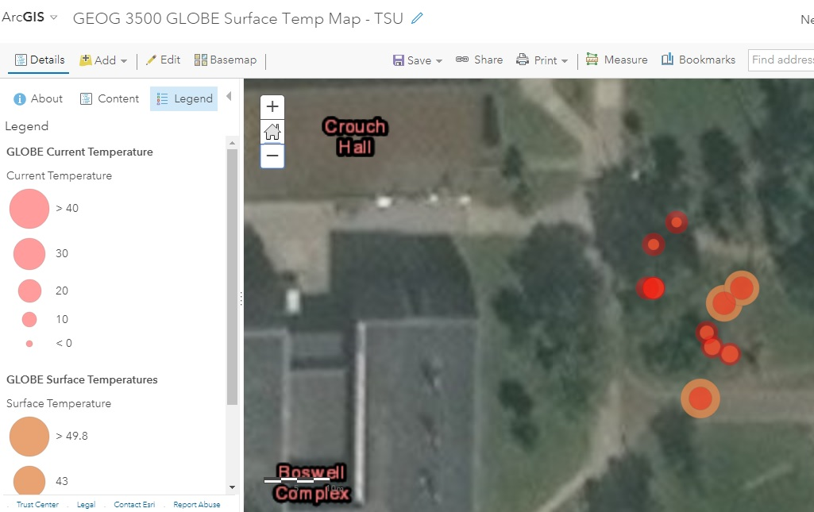
GLOBE Surface Temperature Data Mapping Assignment
Using ArcGIS Online and GPS
Final ArcGIS Online Map with GLOBE Surface Temperature Data
http://arcg.is/1P1Sra

Slide 26
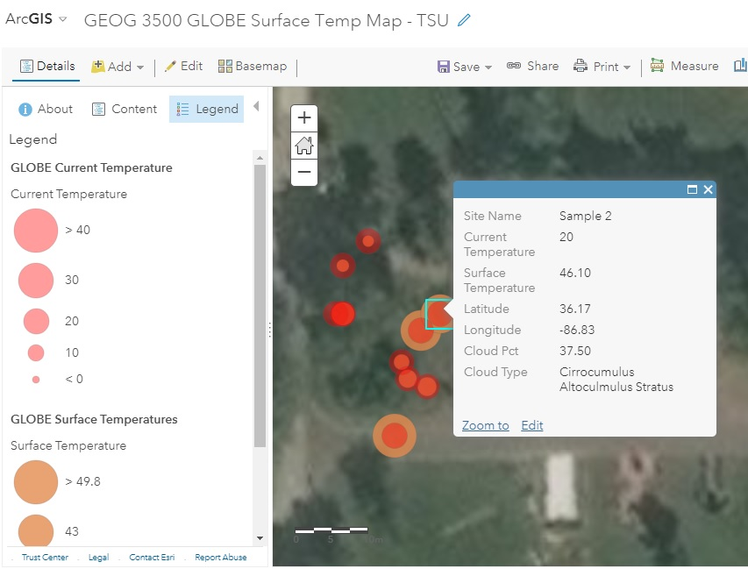
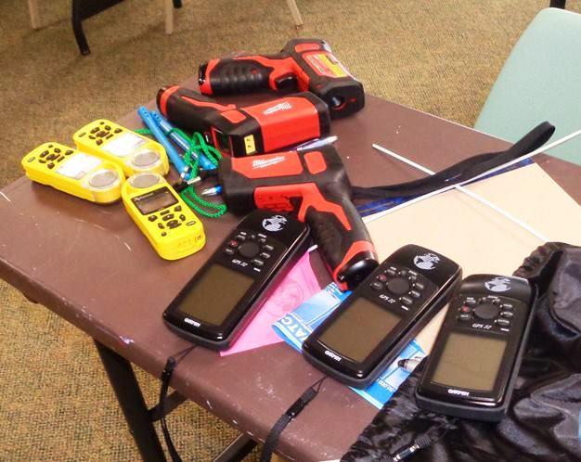
Near-Peer GLOBE Surface Temperature Exercise
Tennessee State University pre-service teachers lead
Stratford STEM Magnet High School 9th grade class in modified GLOBE Atmosphere and Surface Temperature Protocol Urban Heat Islands (UHI) Data Mapping Activity.

Slide 27
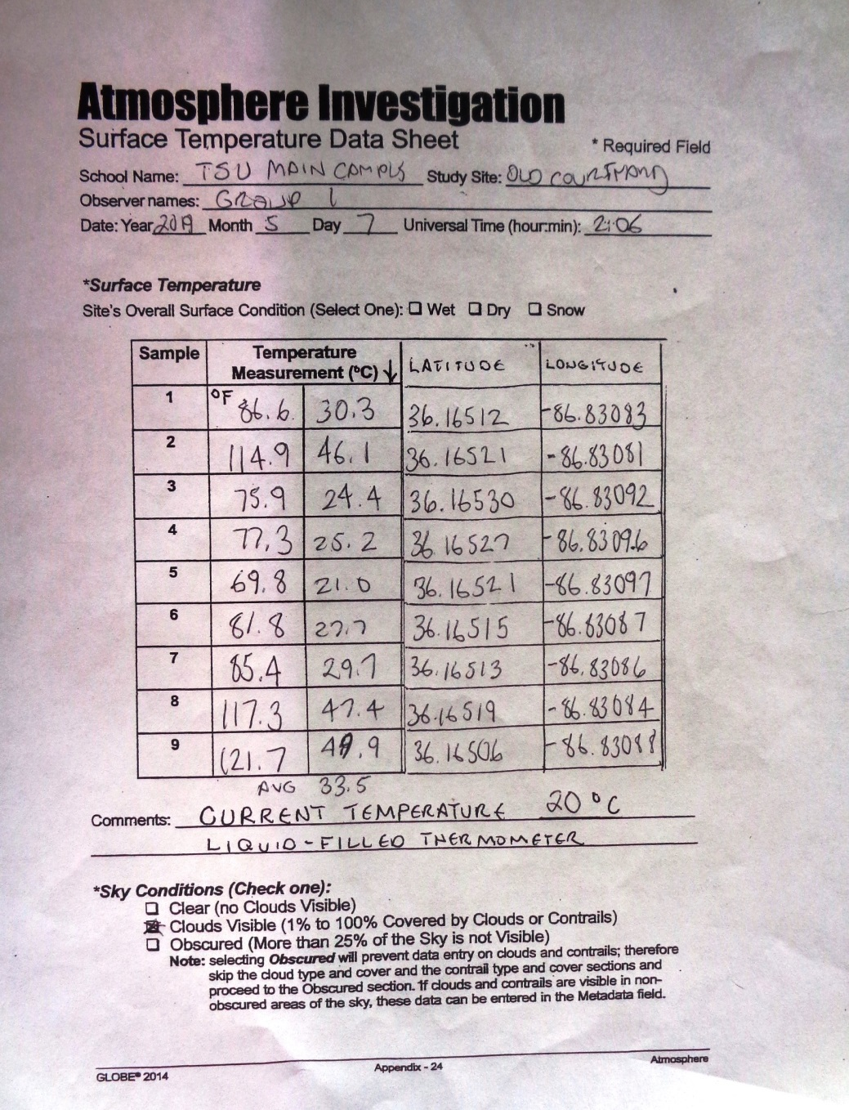
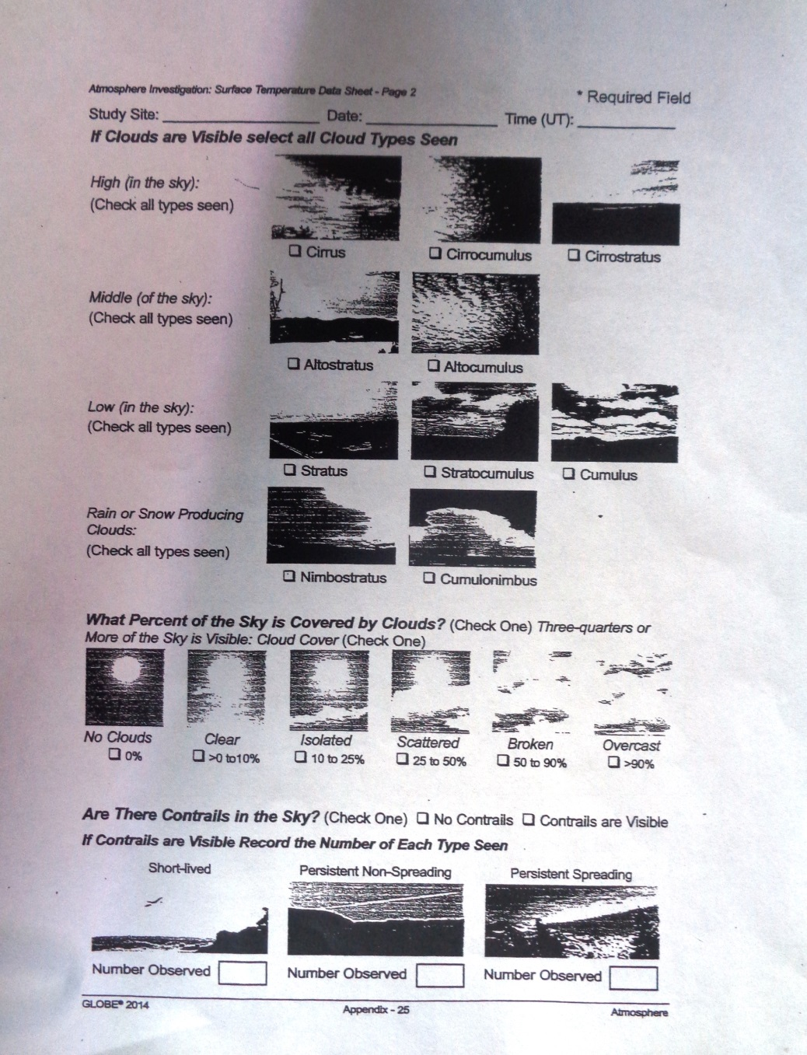
“Modified” GLOBE Atmosphere/Surface Temperature
Protocol Data Sheet for ArcGIS Online Mapping

Slide 28
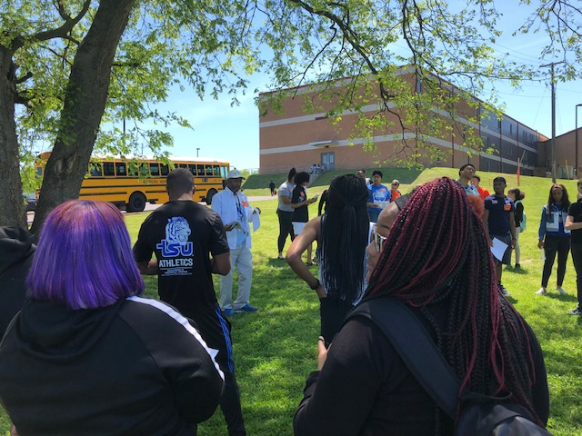
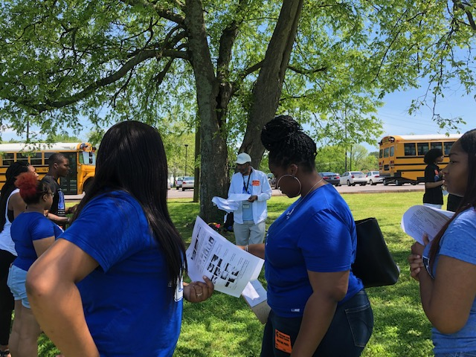
Tennessee State University pre-service teachers lead
Stratford STEM Magnet High School 9th grade class in modified GLOBE Atmosphere and Surface Temperature Protocol Urban Heat Islands (UHI) Data Mapping Activity as part of their GLOBE certification process.

Slide 29
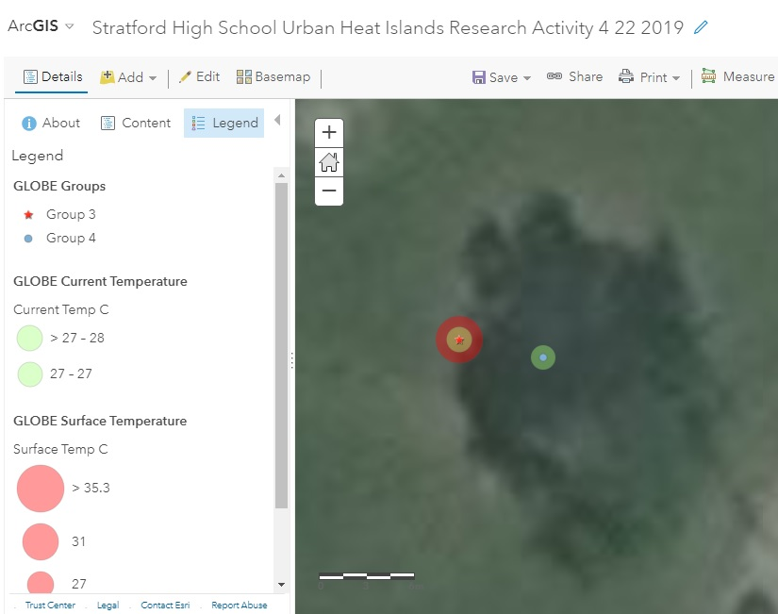
GLOBE Atmosphere and Surface Temperature Protocol Map
created using modified GLOBE Atmosphere and Surface Temperature Protocol Data Sheets during an Urban Heat Islands (UHI) data mapping activity by TSU undergraduates and Stratford High School students.

Slide 30
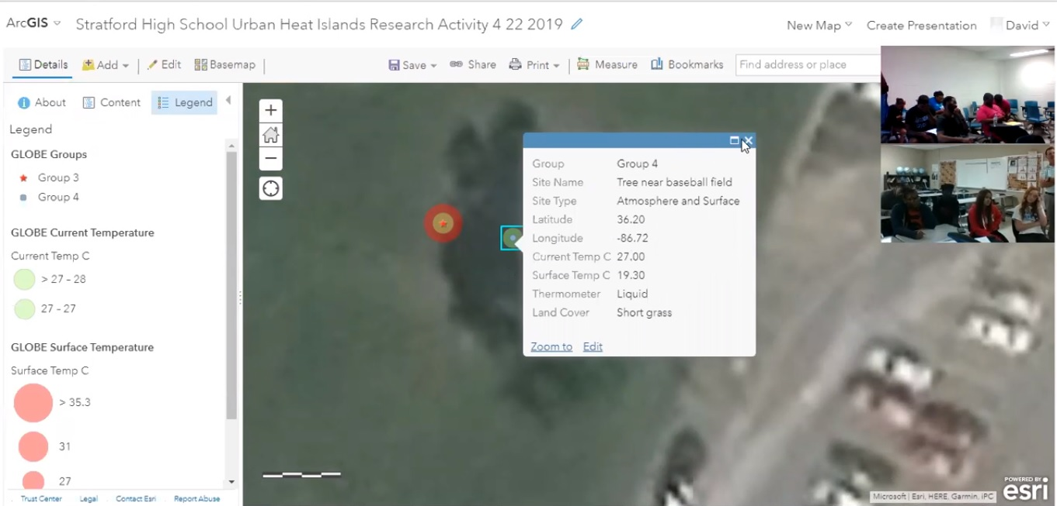
Live Interactive UHI Learning Activity:
GLOBE Surface and Current Temperature Data Mapping
Tennessee State University pre-service teachers led Stratford STEM Magnet High School ninth grade students in a live discussion using ZOOM Meeting software.

Slide 31
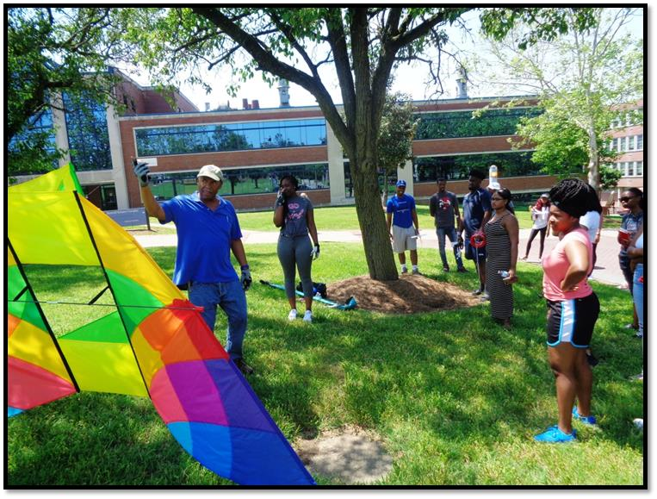
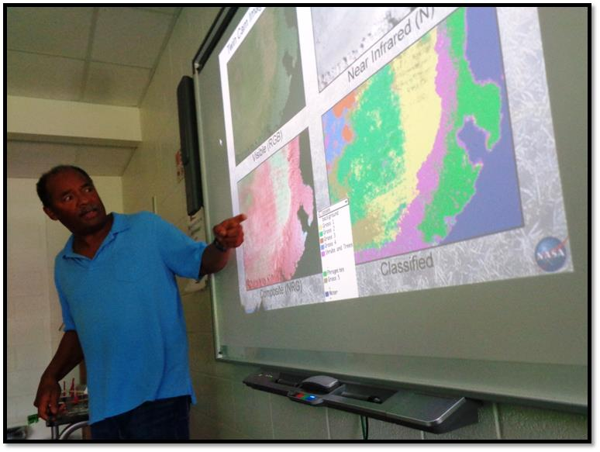
Future Solutions
AEROKATS/GLOBE Course Content Development
Summer 2018 – A preview of potential GLOBE/AEROKATS course
content was conducted with students enrolled in TSU’s Weather and
Climate (GEOG 3500) course engaging in a two-day on-site exercise
led by NASA Engineer Geoff Bland, creator of the AEROKATS program.

Slide 32
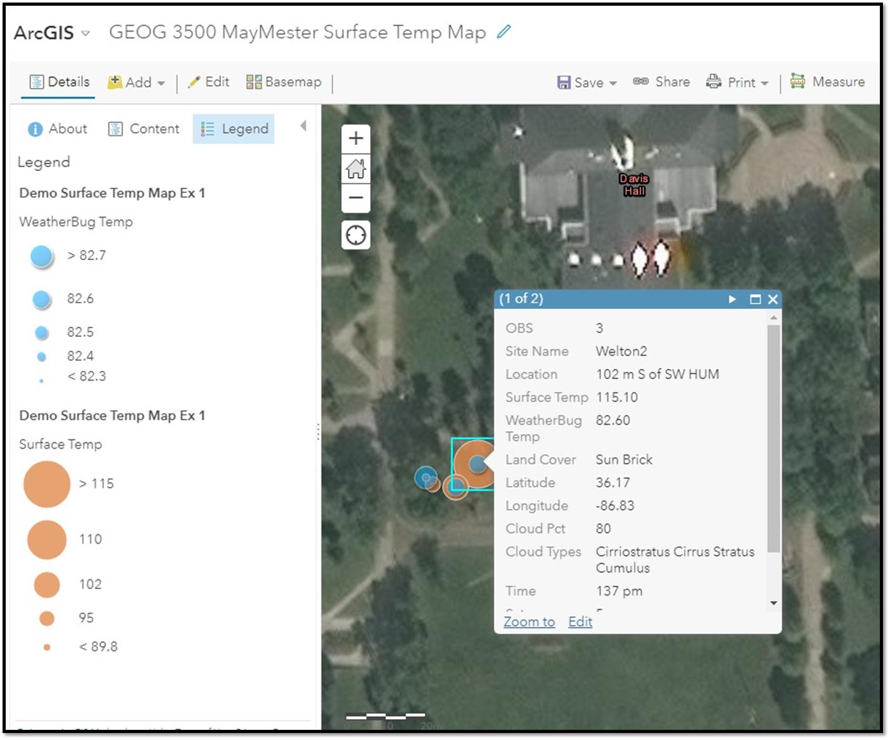
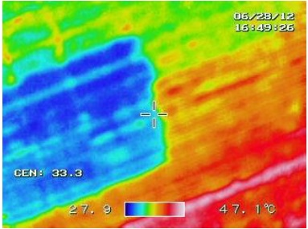
Future Solutions
AEROKATS/GLOBE Course Content Development
ArcGIS Online map produced by Weather & Climate (GEOG 3500) students for a modified GLOBE Current Temperature and Surface Temperature Protocol exercise. Course content is under development combining the GIS GLOBE data map with AEROPOD remote sensing imagery captured using a Thermal Imager and/or Twin Cam Image Processing (at right).

Slide 33
Conclusions & Next Steps
The course Geospatial Applications (GEOG 3200) will be offered beginning with the fall 2019 semester. GLOBE-certified pre-service teachers will be a target audience. Students will be exposed to advanced geospatial technology applications.
The course Weather & Climate (GEOG 3500) will return to the regular Geography course rotation beginning with the Spring 2020 semester. GLOBE-certified pre-service teachers will be a target audience. Students will get hands-on experience in geospatial technology applications with atmosphere and hydrosphere systems data.
The GLOBE Data Explorations “How to Make A Climagraph” exercise is being updated to include ArcGIS Online and Story Maps with GLOBE schools data. Students will engage in a comparative analysis of climagraphs they create with GLOBE data versus those they create using weather station data. Students will report their findings in Story Maps captions.

Slide 34
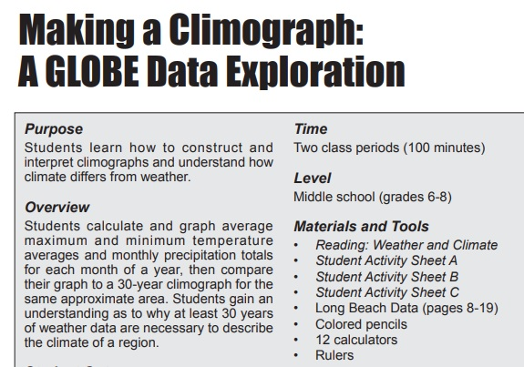
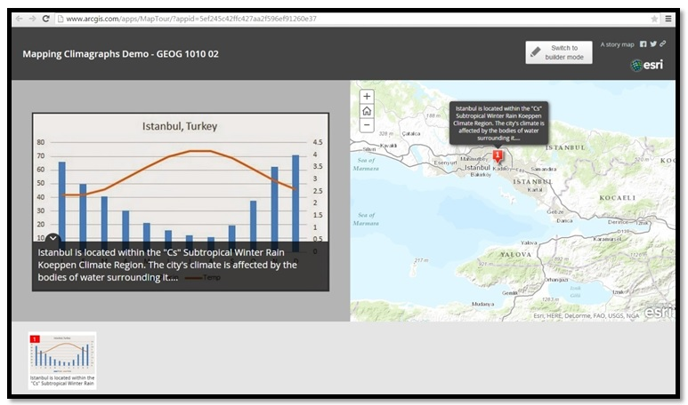
The GLOBE Data Explorations “How to Make A Climagraph” exercise is being updated to include ArcGIS Online and Story Maps with GLOBE schools data.

Slide 35

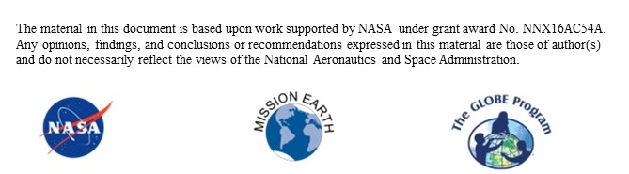
Thank you!
Tennessee State University
GLOBE Mission Earth Site
https://www.globe.gov/web/mission-earth
tsuglobeme@gmail.com

Slide 36
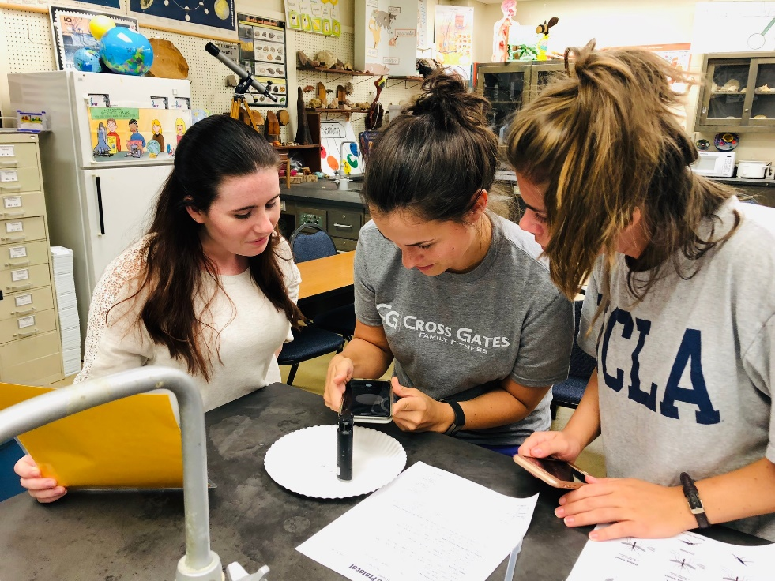
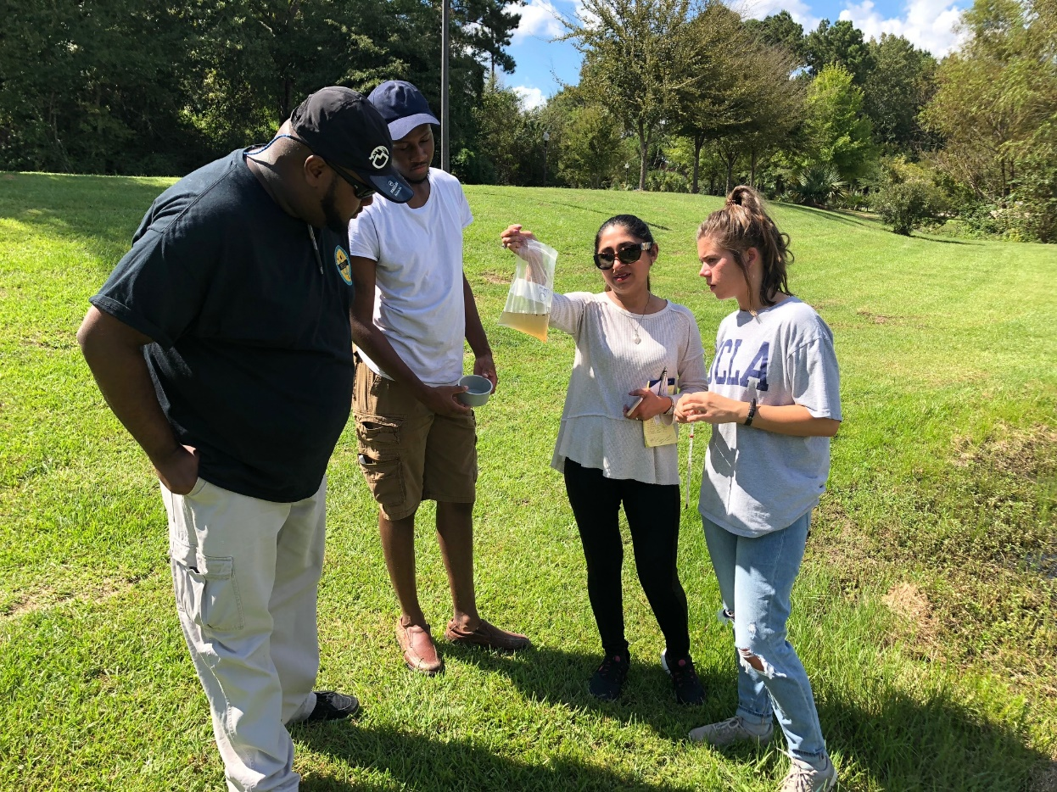
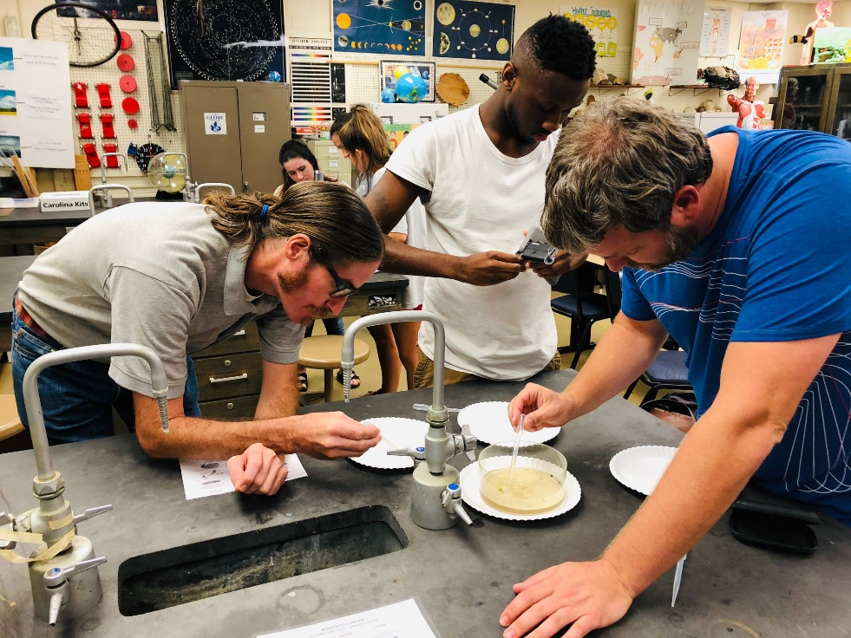
University of Southern Mississippi Fall 2018 Herron: Biology Methods
Mosquitoes – Sherry Heron

Slide 37
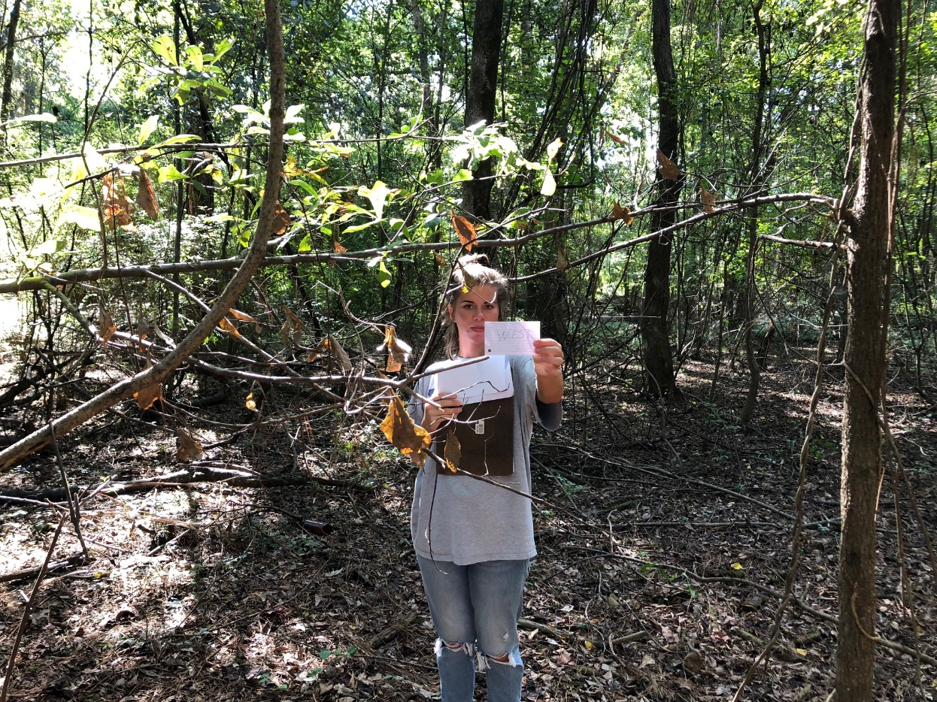
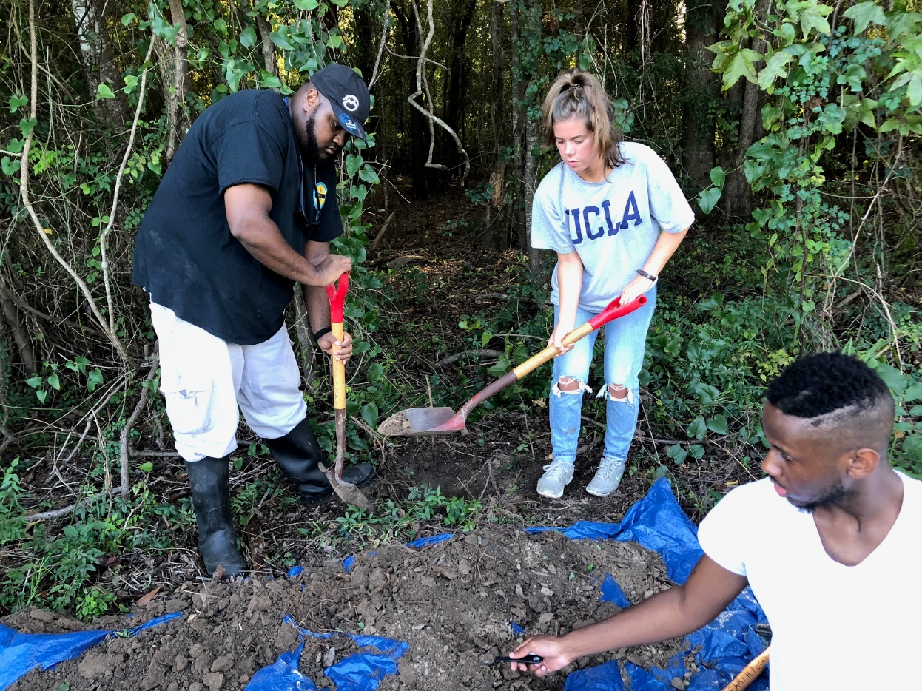
University of Southern Mississippi Fall 2018 Herron: Biology Methods
+ Land Cover, Soil, Hydrology, Clouds

Slide 38
Questions
Are you a GLOBE partner at a university?
What obstacles do you face to implement GLOBE in your curriculum?
How can GLOBE fit into your university courses? What courses?
Some professors suggested to create a GLOBE MOOC class. What are your thought on this?

Slide 39
Contact Information

