Slide 1
Using GLOBE to Support Diversity, Inclusion, and Equity in STEM through ECLIPSE (Exploring Careers and Learning Informally to Prepare for STEM Employment)
This material is based upon work supported by the National Science Foundation under Grant No. 1713456

Slide 2
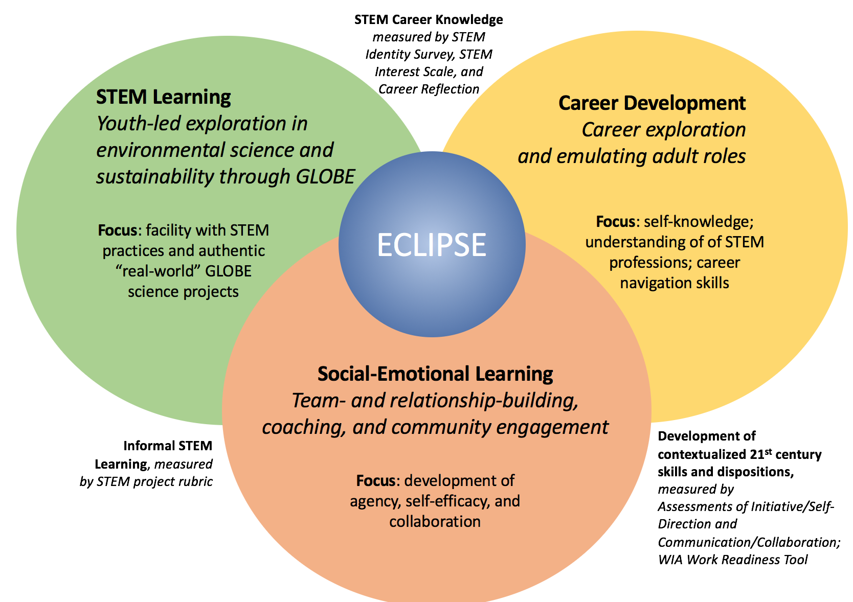
Program Framework
3 Focal Aspects of the ECLIPSE Program:
STEM Learning
Career Development
Social-Emotional Learning

Slide 3
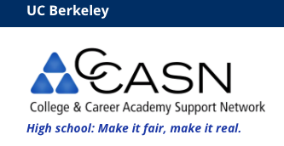
The Team

Slide 4
Student Demographics
Antioch:
50% Female
67% Non-White
Skyline:
54% Female
85% non-white

Slide 5
STEM Learning
Youth-led exploration in environmental science and sustainability through GLOBE
Protocols
Hydrology
Atmosphere
Soils
Projects
Participation in SRS

Slide 6
Social-Emotional Learning
Team- and relationship-building, coaching, and community engagement
Peers
Coaches
Adult professionals
All working together

Slide 7
Career Development
Career exploration and emulating adult roles
Understanding Skills & Interests
Career preparation activities
Resumes
Engaging in professional behavior
Interactions with Subject Matter Experts

Slide 8
Research Questions
To what extent, if at all, is ECLIPSE promoting growth in the development of scientific practices, socio-emotional learning, and career skills
What aspects contribute to growth with STEM practices, key social-emotional outcomes needed in work and civic life, and career development knowledge?
To what extent does ECLIPSE offer opportunities to meet the needs of learners from diverse backgrounds?
How do we accurately measure development of scientific practices, socio-emotional learning, and career skills?

Slide 9
Instruments

Slide 10
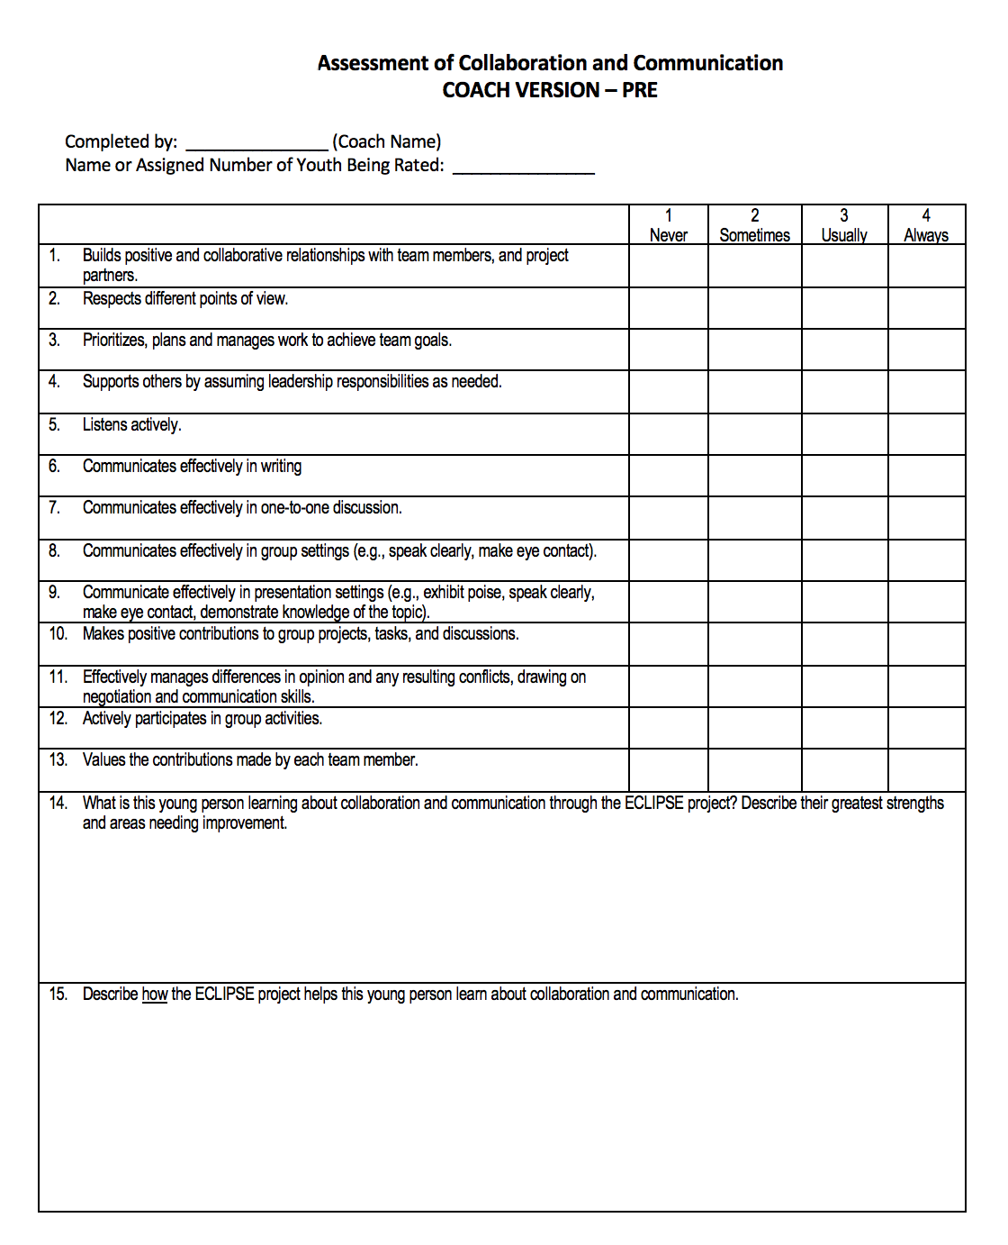
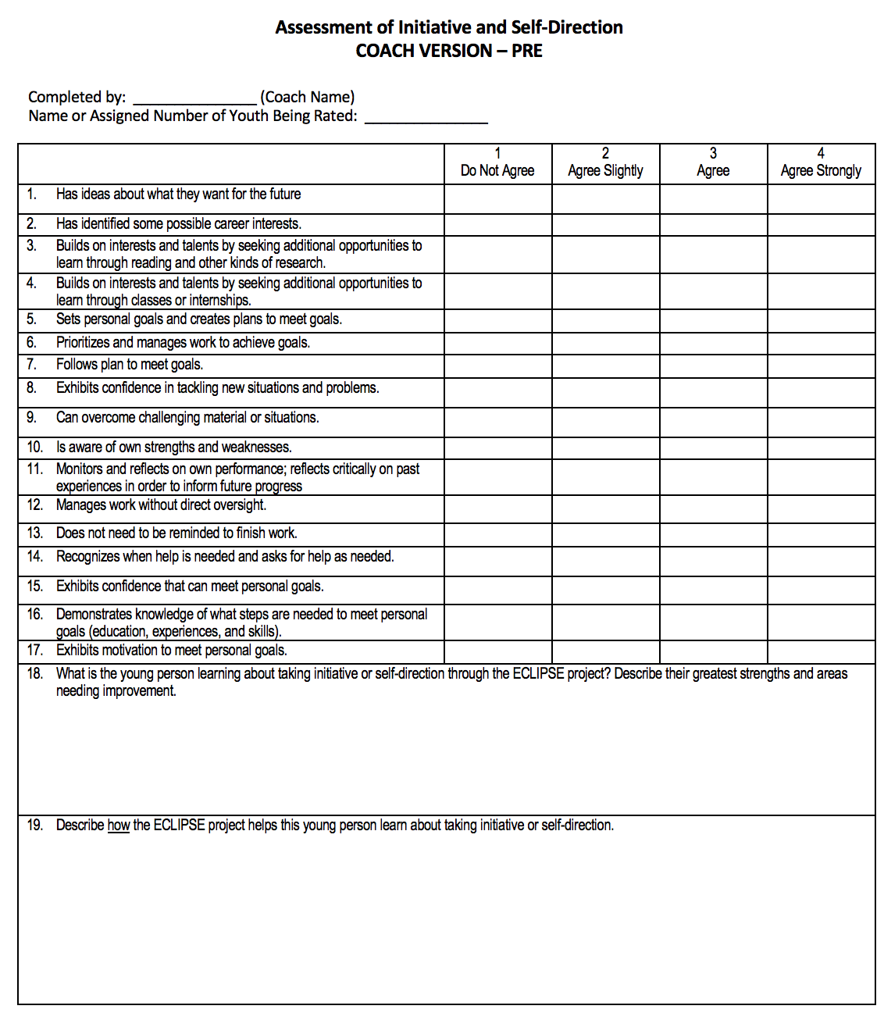
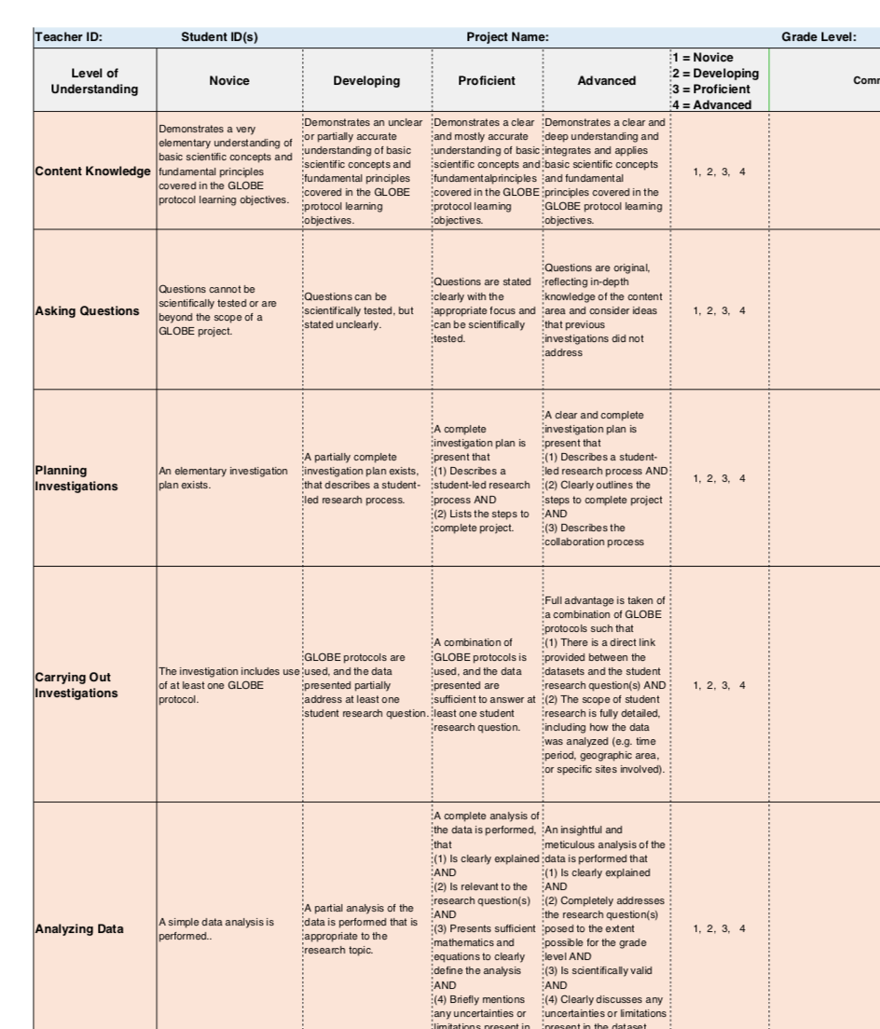
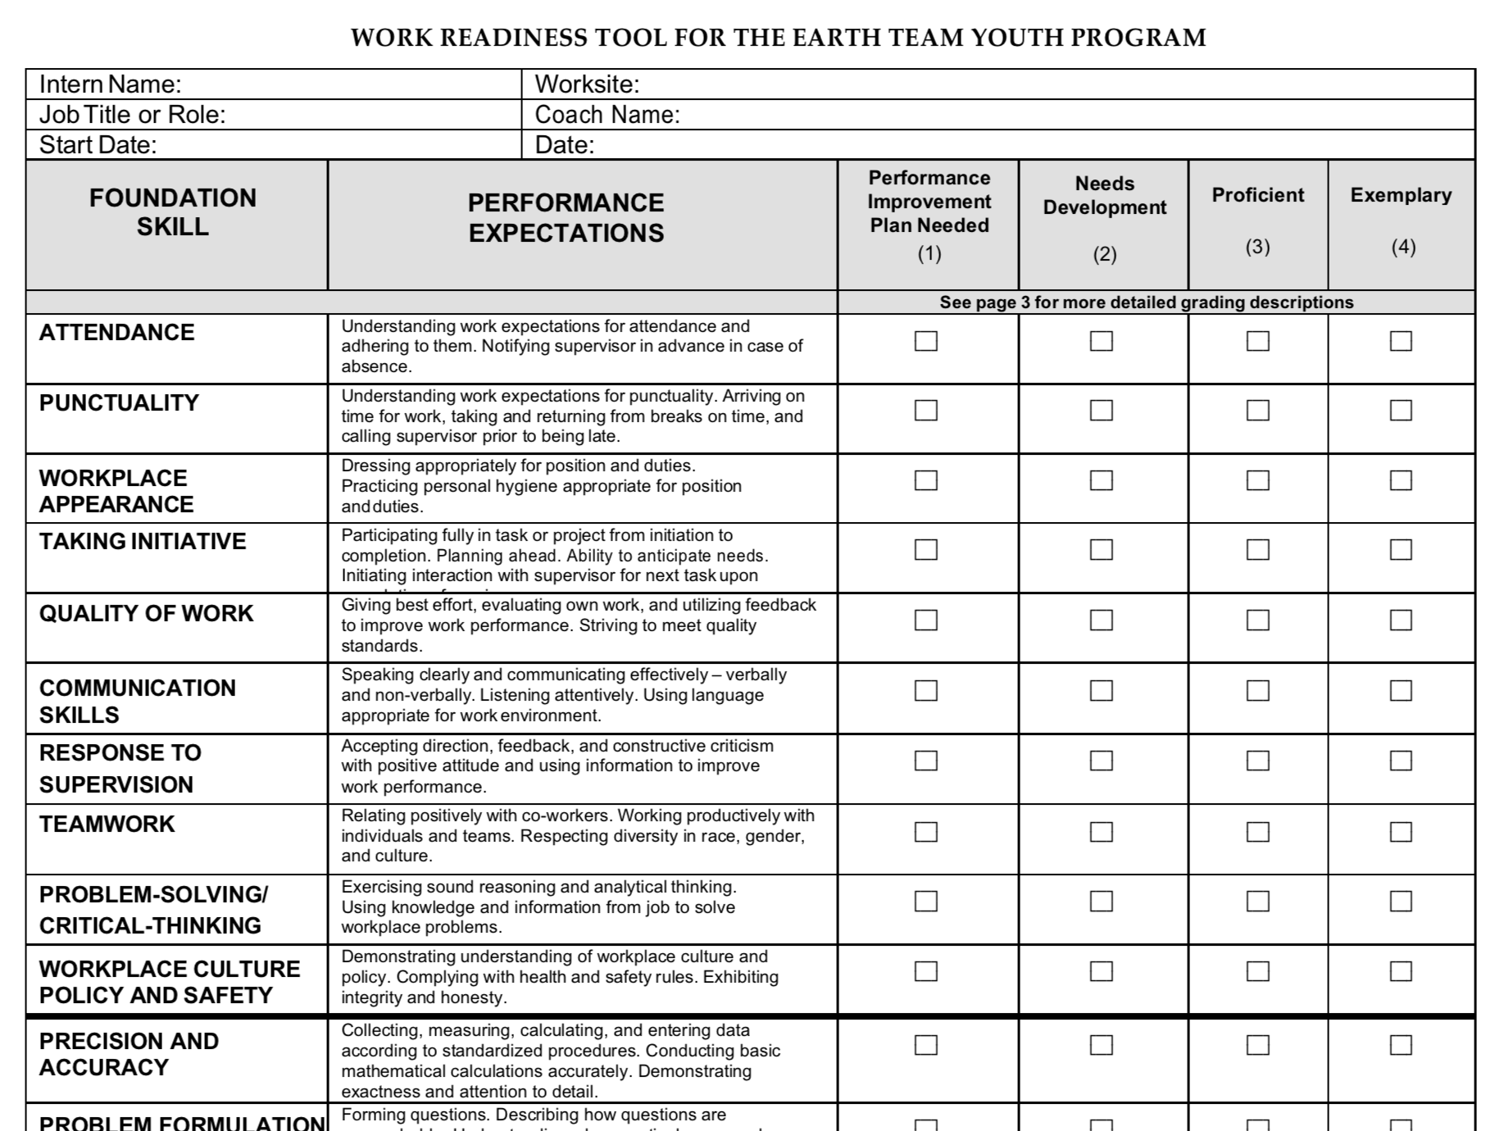
Coach Instruments (for evaluating youth learning)

Slide 11
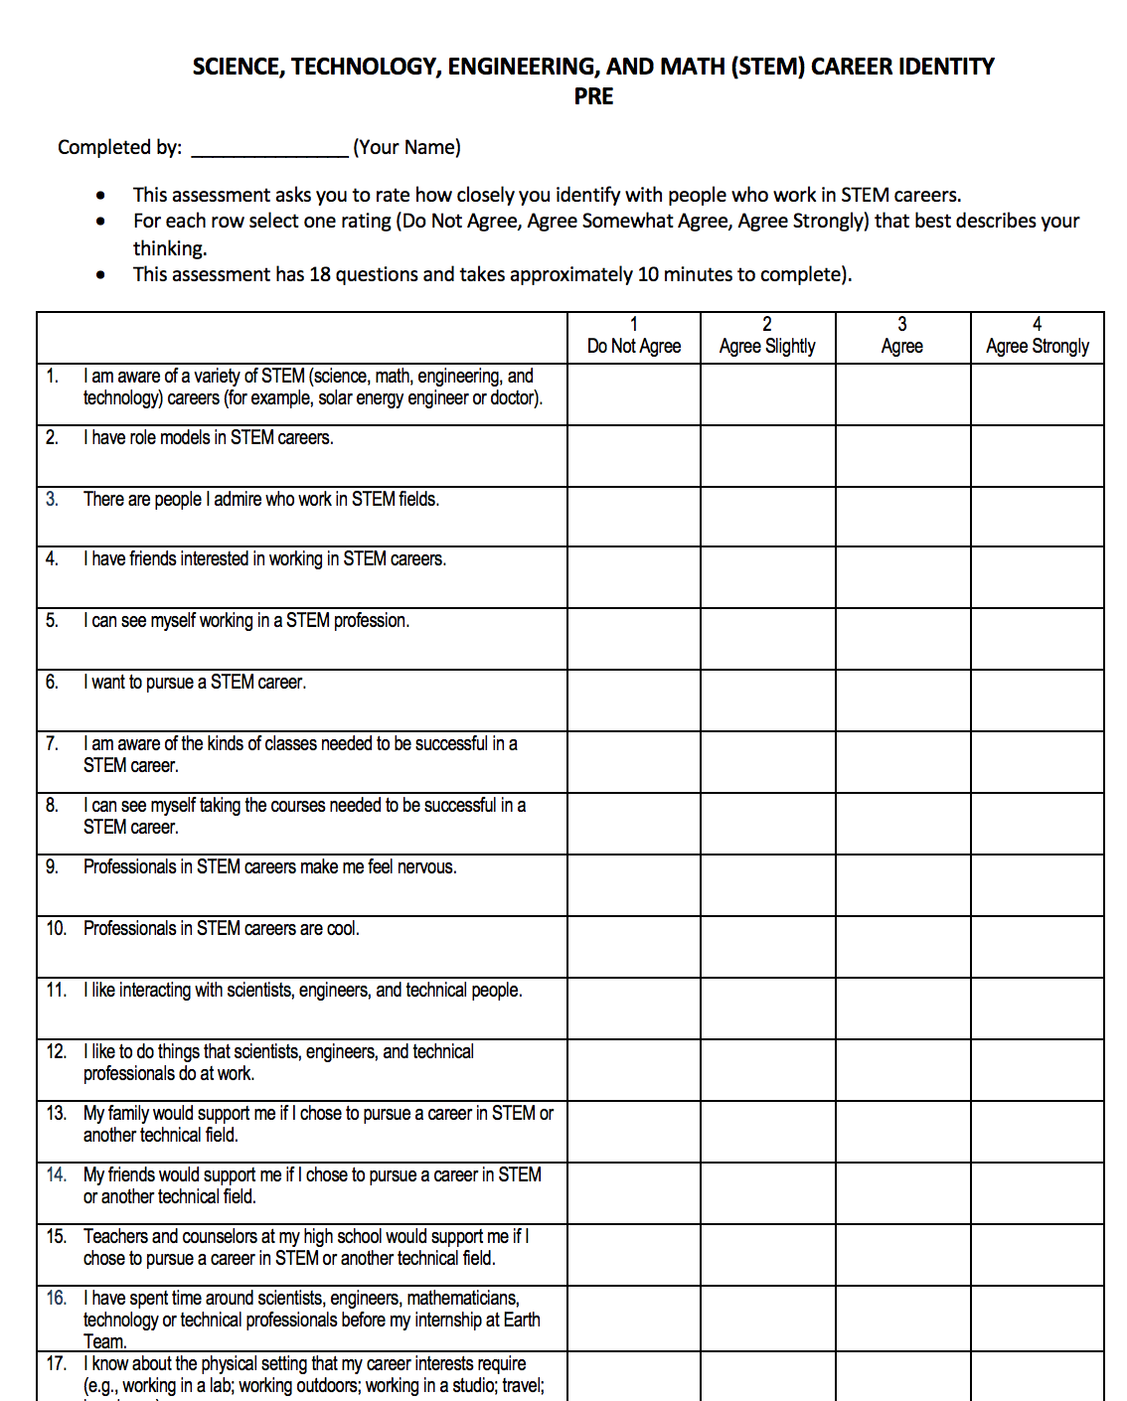
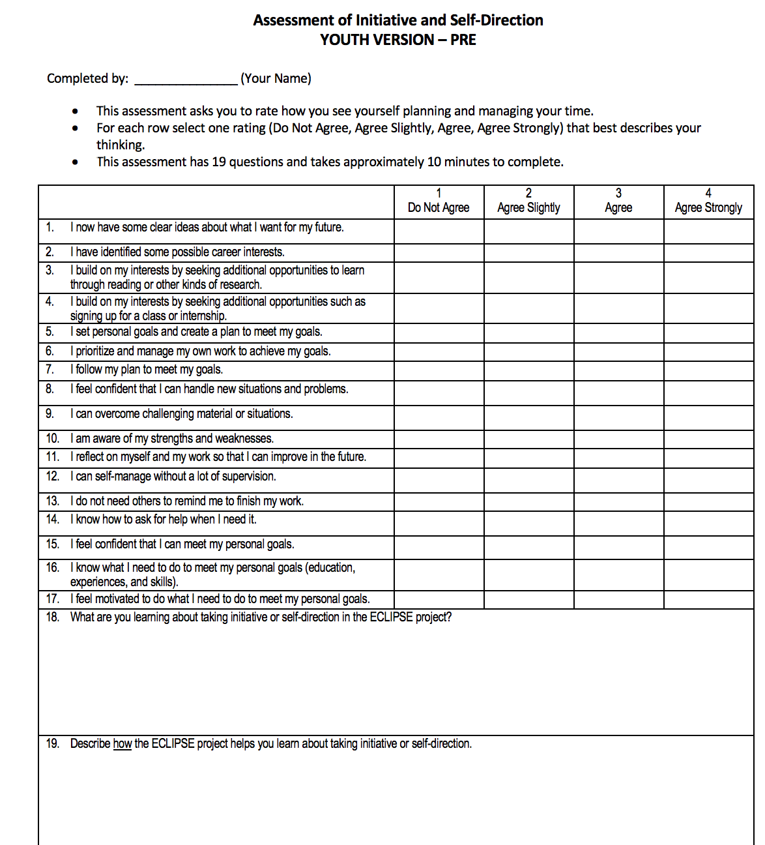
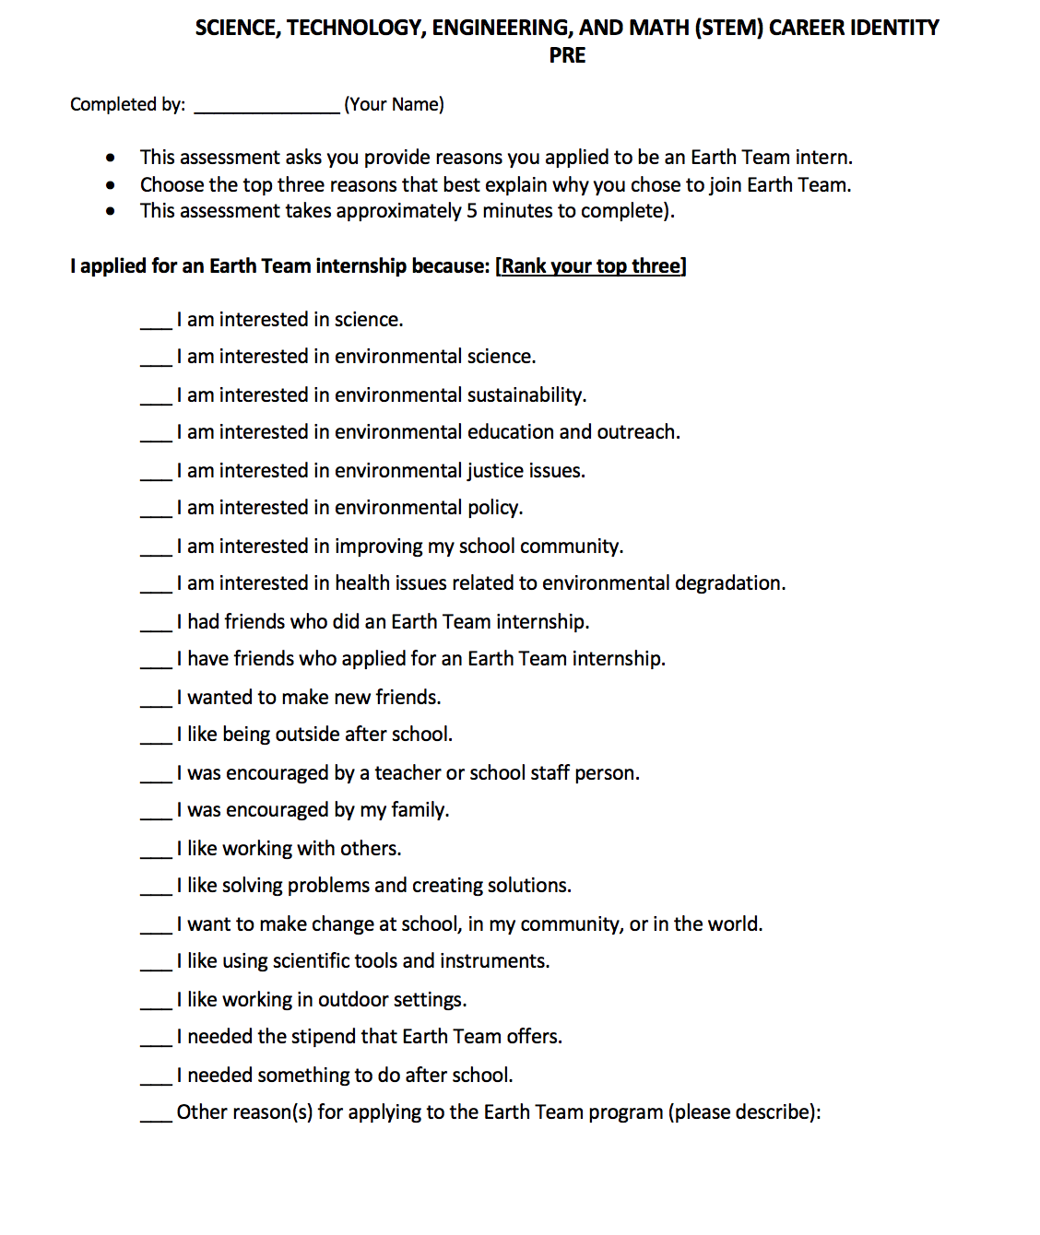
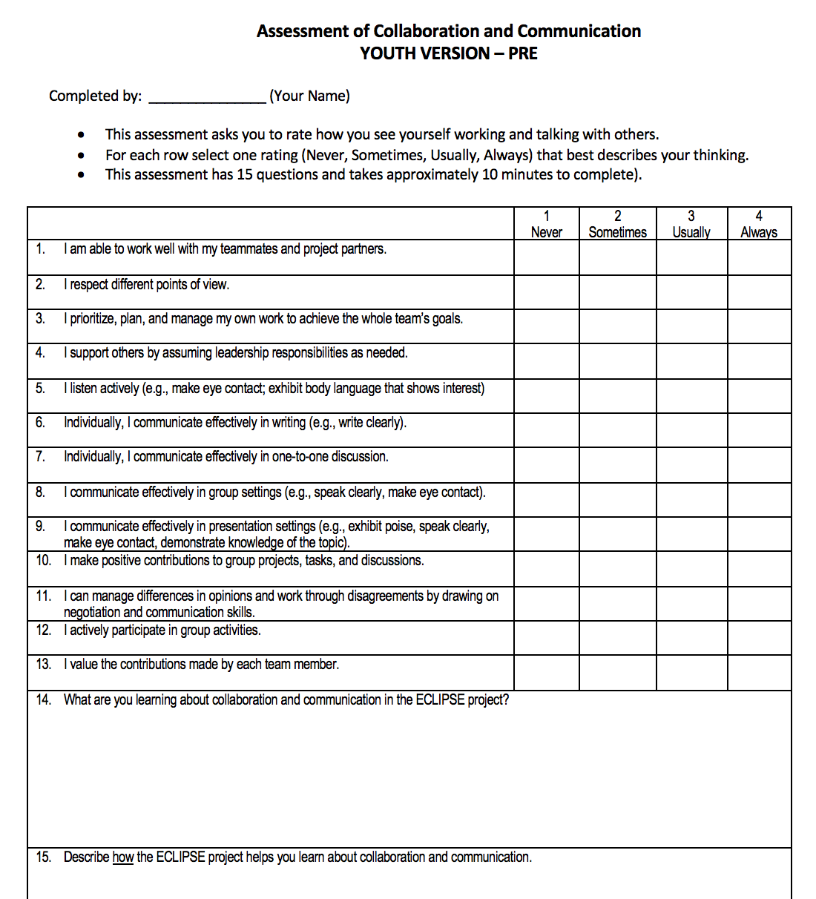
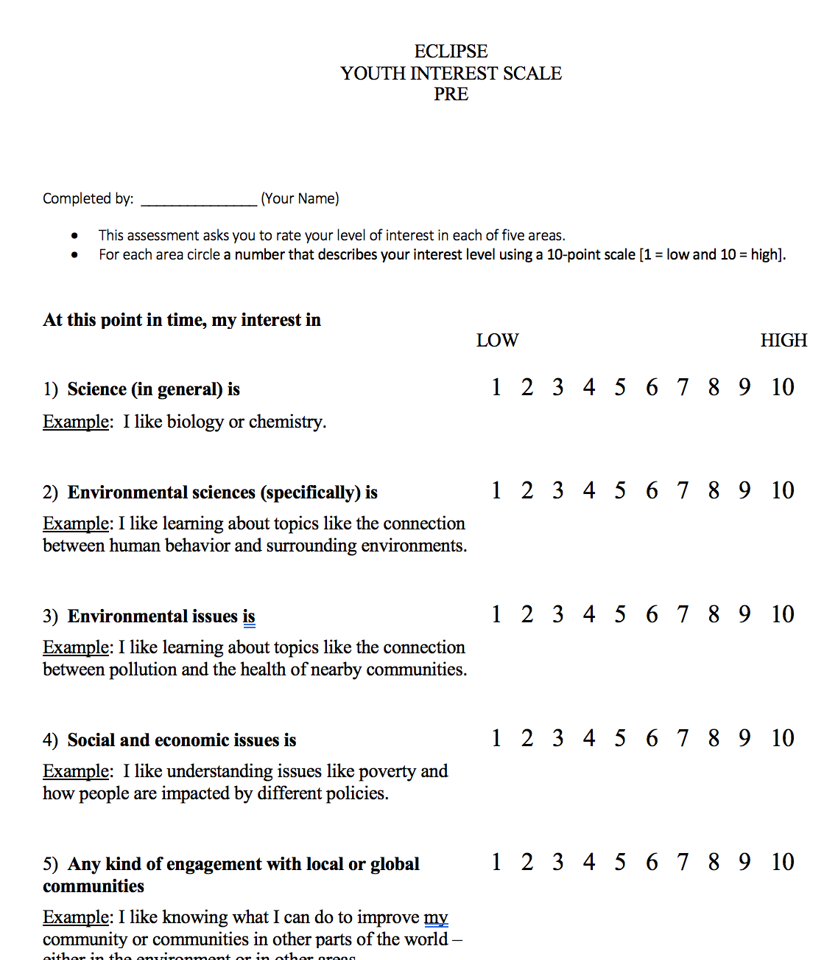
Youth Instruments (self-report)

Slide 12
Preliminary Findings
STEM Learning

Slide 13
STEM Interest (youth self report)

Slide 14
GLOBE Student Research Symposium
Second year of exemplary performance!

Slide 15
Preliminary Findings
Social-Emotional Learning

Slide 16
Collaboration & Communication (coach rating of youth)

Slide 17
Preliminary Findings
Career Development

Slide 18
STEM Identity (youth self–report)
Notes:
Overall, STEM identity, as we defined it through this set of items, increased significantly.
You will notice that only 2 items show a decrease
(one is a negative item so it actually is a net gain – feeling nervous went down over time).
The decrease is observed in liking interactions with scientists, engineers and technical people. We expected the responses to go up, since the youth expressed great appreciation in the focus groups for working with scientists in the field. We don’t know if including engineers and technical people in that item is what caused the scores to drop.
Students’ awareness of STEM careers went up.

Slide 19
STEM Careers Interest (youth self report)
Environ-mental Engineer
Chemical Engineer
Accountant
Electrical Engineer
Educator
Detective
Environ-mental Scientist
Marine Biologist
Notes:
Engineering, scientists, and technicians were most frequently mentioned, and over time the specific types of jobs in these domains tended to be related to environmental work (Environmental Engineer, for example).
“I have learned that I deeply care about working with the the environment and its [sic] something I want to continue doing after I graduate. These people have helped open up for me through working and talking with these professionals.” -Youth
“I have learned that I need to do more work to one day be a professional in a subject.” -Youth
“It’s an internship so [my experiences] will help me move into other job opportunities”. [The career-focused nature of the program] “helped me see what career I may want to major in college”. –Youth
[I learned] “about lab standards [offering] a glimpse of what it might be like to work in a lab”. -Youth

Slide 20
Youth and Coaches…
“I gained love for the environment” [and became] “more interested and learning more about it” through “experience of being outside”. [ECLIPSE] “gets people exposed to the environment that wouldn’t otherwise”. -Youth
“In STEM they are learning accurate, safe, and usable data collection. They’re learning how to carry themselves in STEM careers. They’re learning about what STEM careers actually look like…They learn hard skills like data collection, data analysis, and how to create good data visualization tools…” -Coach

Slide 21
Why is this Program Working for Youth?
Relationships
Choice
Embodied Learning
Relevance
Notes:
Relationships. [The coach] “created a positive work environment, is a good motivator, and helped us keep going if it got boring…She is one of us!” -Youth
“I was doing a community service opportunity – I was with a bunch of 6th graders – [and now] I have so much appreciation for what [our coach] has done. -Youth
[Peer interactions] were “friendly and playful [in a community] where we all get along…It is nice to work with everyone…the great teamwork and great communication skills” [helped the youth] “build friendships”. “We go out and play games and interact outside and see each other outside of school”. -Youth
Choice. [In classroom-based GLOBE activities] “we did cloud cover and we didn’t have as much flexibility. [I learned the most through ECLIPSE because we have] more freedom to pick our own research.” -Youth
Embodied Learning. “Hands-on makes it easier to learn, rather than sitting in class”. -Youth
[First hand experiences are formative because] “you see why the data you collect matters and what the data affects and why…[being there in person to do the work means] “you are actually being able to see how the data is collected.” -Youth
“Seeing things with your eyes has more impact than seeing a picture. It connects not only with the environment and our community, it helps you feel nature. If you can’t feel it you can’t learn about it.” –Youth
Relevance. “Before I didn’t like the planet, but after this great opportunity – it has helped me a lot, including [experience to] put on my resume, and helped with college and connected me spiritually with the environment. And now I think about my actions. The future needs environmental scientists. We need more students more involved in the environmental field and to be more active in helping to save the planet”. -Youth - the stipends also

Slide 22
Next Steps
2019-2020 expand to 3rd school
Better integration of Career Development into weekly activities
More real-time student data collection (fewer pre/post)

Slide 23
Thank You
Svetlana Darche – WestEd
sdarche@wested.org
Tracy Ostrom - CCASN at UC Berkeley tostrom@berkeley.edu

