Slide 1
Ministry of education
Education Department, Al-Zulfi City
Prince Sultan Intermediate School
the scientific activity
GLOBE Section
International Virtual Science Symposium
( IVSS 2022 )
7th – 9th Grades ( Middle School, ages 13-15 )
Atmosphere and pedosphere
Theme :
The effect of afforestation with local plants
in preserving the genetic origins of those desert plants in the Riyadh region
Globe Teacher Responsible Student
Swaeid Mohammed Albatel Muhammad Abdul Rahman Al-Roumi
Other students
Iyas Abdul Rahman Al Hijab
Hossam Fahd Al-Faham
Phone : +966554224433
Email : s.m.albatel@gmail.com
Academic year : 2022

Slide 2
Index
3 | Article title ……………..………………………………… | 1
4 | Abstract ………………………….………………………. | 2
5 | Research questions …………………….…………………. | 3
6 | Introduction ………………………………..…………….. | 4
10 | Research methods ………..…………………………….. | 5
21 | Results …………………………………….………………. | 6
23 | Discussion …………………………..…….……………… | 7
24 | Conclusion …………………………………….………….. | 8
25 | Thanks and appreciation …………………………….…… | 9
26 | Bibliography …………………………………….………… | 10

Slide 3
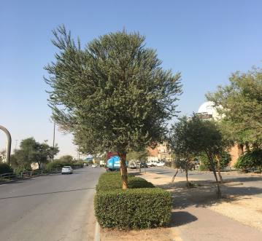
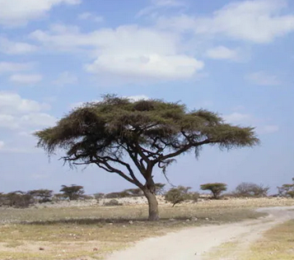
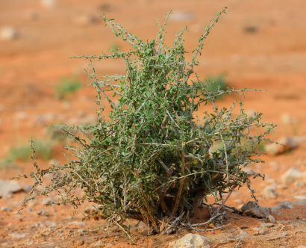
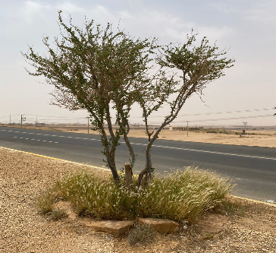
1- Article title
The effect of afforestation with local plants in
preserving the genetic origins of those desert plants in the Riyadh region

Slide 4
2- Abstract
The Kingdom is moving seriously to reduce the phenomenon of desertification, and work to encourage environmentally friendly practices, in response to the Kingdom’s Vision 2030, which is one of its most important pillars to preserve the environment, and to maintain standards of sustainability in general, by motivating and encouraging the community with all its institutions and entities to plant afforestation to increase green spaces in order to preserve The environment, and this should not be limited to desert areas, but rather bringing desert environmental plants and cultivating them inside cities, which preserves their genetic assets from extinction. These factors include urban and agricultural expansion, the construction of industrial cities, the construction of airports on large areas, and the construction of paved roads for vehicles in large numbers, all of which contributed to the decline and disappearance of types of plants in those areas.
Keys words : desert plants , hereditary origins , Riyadh region

Slide 5
3 - Research questions
The Riyadh region is located in the center of the Kingdom of Saudi Arabia, with an area of ​​412 thousand square kilometers, which is about 22% of the Kingdom's area. With a population of 5,455,363, it is the second largest region in the Kingdom in terms of area and population density. Riyadh is the capital of the Kingdom of Saudi Arabia. The Riyadh region includes many provinces, villages, industrial cities, airports and highways, and thus this human activity led to the occupation of most of the lands that were the environments in which these plants lived, and this was negatively reflected in the disappearance of many desert plants that lived in those lands.
The researcher wonders: Is it possible to return these plants to their original habitats and habitats through the process of afforestation of squares, streets, gardens and all facilities with these types of plants, thus preserving their genetic assets and not becoming extinct

Slide 6
4 - Introduction
Many bodies concerned with the environment in the Kingdom of Saudi Arabia, including: the Ministry of Environment, Water and Agriculture, the General Authority for Meteorology and Environmental Protection, and many voluntary bodies concerned with the environment, have monitored the disappearance of some major local plant species from their natural sites, as a result of the factors of desertification, urban expansion and urban activities.

Slide 7
The most influential human factor due to the expansion in the use of these lands, which is increasing year after year, and its exploitation in the service of its activities and meeting its various needs.An example of this was the town of Riyadh in 1950 AD with a population of 83 thousand people on an area not exceeding 13 km² .Now, in 2022, the population of the city of Riyadh reached 6 million, on an area of ​​more than 5961 km². This expansion in the area applies to the rest of the study site (Riyadh region) and the villages and governorates it contains, and to contain the negative impact resulting from this expansion on the desert environment, whose characteristics are the scarcity of herbs, shrubs and trees whose loss cannot be easily compensated due to the difficult climatic conditions of a significant rise in the temperature Heat and scarcity of rain.

Slide 8
Dr. Abdul Rahman Al-Sugair, who has been a member of the Board of Directors of the National Center for Research and Development of Sustainable Agriculture since 2019 AD to date, asserts that the harsh desert environment that prevails in most parts of the Kingdom of Saudi Arabia requires dealing with the issue of afforestation more seriously, taking into account the environmental aspect, presenting it on the aesthetic aspect. So that the plants that used to live in the same place during the afforestation process are selected, and this contributes to the survival of the original species in their environments and not disappearing and extinction.

Slide 9
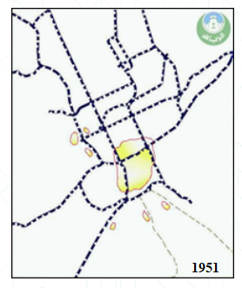
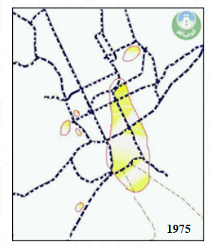
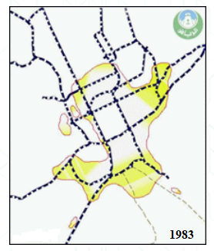
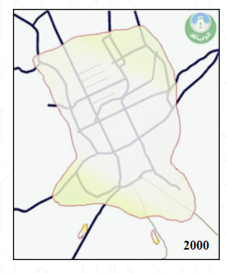
Increasing the area of the city of Riyadh from 1951 AD to 2000 AD

Slide 10
5 - Research methods
The Riyadh region occupies a privileged location in the center of the Kingdom of Saudi Arabia, with an area of ​​about 375,000 square kilometers and includes within its scope (47) cities and (1383) population centers that include many centers and villages. The Riyadh region is located between 4200 and 4817 degrees east longitude and 1900 and 2745 degrees north latitude. Altitude above sea level: 600 m. The population of the Riyadh region exceeds 10 million people, the weather: a continental climate that is very dry in summer, cold in winter, characterized by low humidity throughout the year, and a great discrepancy between the temperature of the night and the temperature of the day, where we find that the maximum temperature in summer exceeds 49 degrees Celsius, While the temperature at night drops to less than 21 degrees Celsius. In winter we find a daytime temperature of 28°C, while the night temperature drops to -1°C.

Slide 11
Annual precipitation varies between 11.5 and 14.9 cm and varies from year to year.The region is characterized by the diversity of environmental elements in it, where we find plateaus such as the plateau (Najd) and sedimentary mountains such as the (Twaiq) mountains, which are interspersed with some valleys, reefs and sand dunes such as (Al-Dahna) and kindergartens such as Rawdah (Al-Tanhat) that thrive in the grass after the rains .The vegetation cover extends in the region in various forms, most notably afforestation within the urban area, and the existing agricultural areas. Given the importance of the vegetation cover, the relevant government agencies are seeking to restore and rehabilitate it, while making more efforts to preserve the available areas and rehabilitate the degraded areas. With a focus on cultivating plants that used to grow in the area and not bringing in exotic plants that are not compatible with the soil and climate of the desert area.

Slide 12
Work methods: The work relied on a number of sources and projects to collect data, including:
Studies and research that dealt with this field in the Kingdom of Saudi Arabia. Accredited government websites that supervise or are interested in studying environmental changes such as the Ministry of Environment, Water and Agriculture - General Department of Biological Diversity and Combating Desertification-Riyadh Municipality - National Center for Research and Development of Sustainable Agriculture - Royal Commission for Riyadh City - Saudi Wildlife Authority - General Authority for Meteorology and Environmental Protection. Scientific trips to document the changes in the desert lands surrounding the Zulfi Governorate.

Slide 13
Afforestation within the governorates of the Riyadh region with local species is one of the most important long-term investment methods, as desert plants are characterized by their low need for irrigation, their high ability to withstand high temperatures in summer, low humidity in the air, and their physiological structures that resist desert environmental conditions.
In order to achieve environmental sustainability, increase biodiversity and improve the aesthetic aspect of the Riyadh region, the implementing agencies have adopted 72 types of local trees, examples of which are :

Slide 14
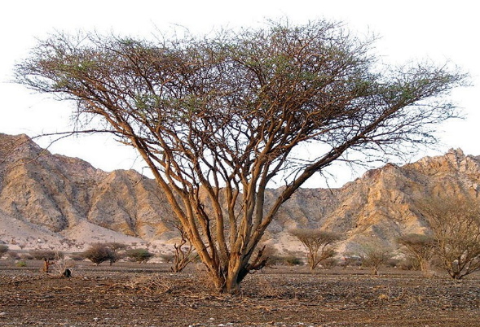
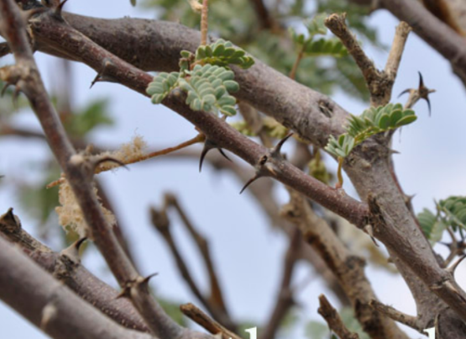
Scientific name : Vachellia tortilis
It is a tree with a flat top. It is one of the It is a tree with a flat top. It is resistant to the harsh climate in the desert. In addition to tolerating frost. It grows in valleys and flat sands and in low areas. It prefers to grow in sandy soil. It has deep roots. It is one of the distinctive species that covers the desert areas of the Middle East. And it is important in coordinating sites as a fence or windbreak and resistance to desertification. Not suitable for cultivation on the roads of pedestrians because of its sharp thorns. It needs little care.

Slide 15
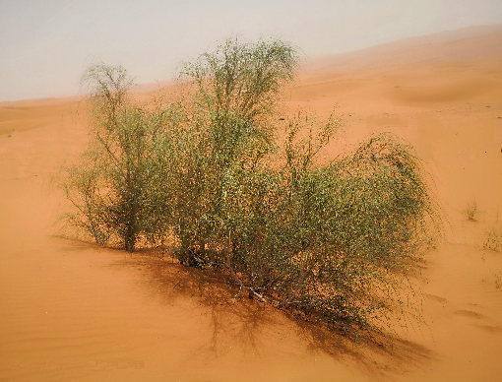
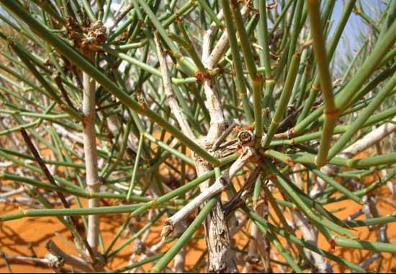
Scientific name : Calligonum comosum
Evergreen shrub. Widespread in the deserts of Saudi Arabia. Contribute a lot to the stabilization of the surrounding sand dunes. They are planted around farms to reduce the impact of the wind. It is covered with yellowish white flowers that appear in the spring, and they are beautiful and edible and have a pleasant smell. It has long and branched roots. The plant needs small amounts of water. Resist high salinity. Contribute to the improvement of sites. No maintenance required.

Slide 16
The importance of reforestation with desert plants that used to live in their environments is evident due to the high temperatures that characterize the Riyadh region and water scarcity due to lack of rain or a decrease in groundwater that is barely sufficient for local agriculture. Thus, the physiological properties of these plants can be invested in providing plants that grow and thrive with small amounts of water and with lower maintenance costs.

Slide 17
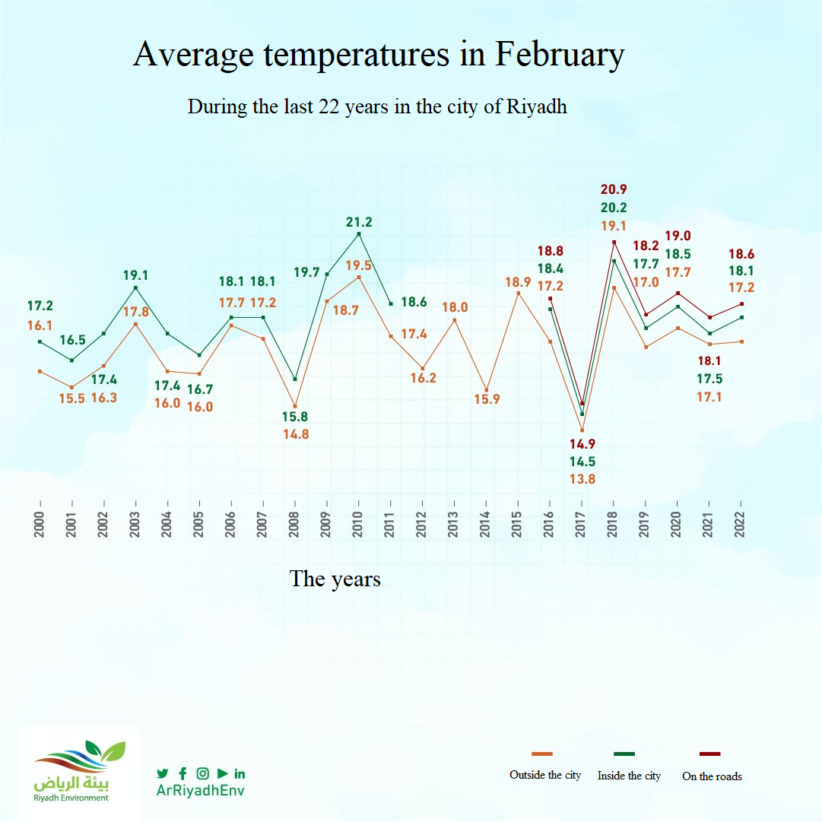
shows the recorded temperaturesin the city of Riyadh from 2000 to 2022

Slide 18
Air quality stations monitor 10 dusty cases in the city of Riyadh during March 2022, compared to 7 cases in March 2021.
This report emphasizes the importance of continuing to preserve plants in their natural environments and to continue cultivating them in areas that are exploited by humans and their various activities.
When plants disappear, the surface layer becomes loosened, and therefore dust particles are easily carried by air currents, which helps to raise dust cases in desert areas.

Slide 20
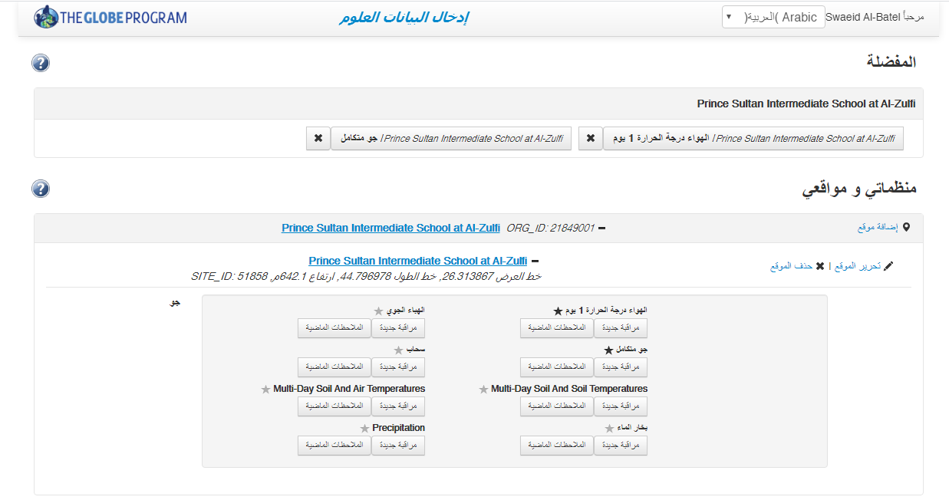
The data entry page from the Globe website
Prince Sultan Intermediate School at Al-Zulfi

Slide 21
6- Results
Plants are one of the most important components of an ecosystem. It is more important in desert areas with scarce vegetation cover and fragile ecosystems. One of the most important functions of the vegetation cover is to protect the soil from erosion and erosion. According to what was reported by the Ministry of Environment, Water and Agriculture in the Kingdom of Saudi Arabia on its official website, 80% of the natural vegetation cover has deteriorated during the past 40 years. Because of several factors, the most important of which are unorganized grazing, mining activities, logging, urban expansion and other human activities. Dr. Abdulaziz Abu Zinada, consultant and member of the board of directors of the Khalid Bin Sultan Foundation for the Preservation of Life in the Oceans. He indicated that during the last half century, more than (23) species of plants became extinct from the environment of the Kingdom of Saudi Arabia.

Slide 22
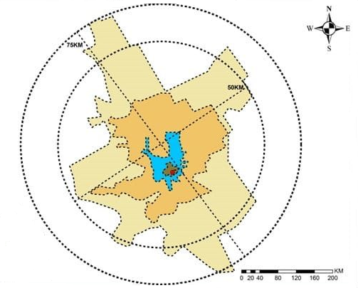
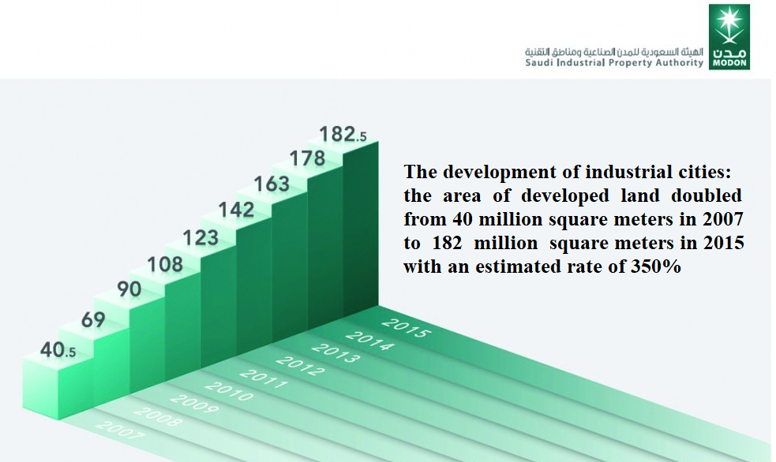
We also find that the industrial cities in the Kingdom of Saudi Arabia began more than forty years ago, in 2007 the number was approximately (14) industrial cities, and in 2015 the number increased to approximately (35) industrial cities so that these cities occupy large areas of land that were Full of many herbs, shrubs and desert trees.

Slide 23
7 – Discussion
In one of the studies conducted by the High Authority for the Development of the City of Riyadh recently in Al Thumama Wild Park during the average rainy season, more than 195 species of plants were recorded, including herbs, shrubs and trees, and they were documented with their scientific names globally approved in Latin, and the genus of each plant, and the family to which it belongs. The plant life in the wilds of the Riyadh region does not stop, throughout the seasons of the year, as each season has its own wild plants that grow and flourish.
through this work. The efforts of the government of the Kingdom of Saudi Arabia are highlighted in reducing the negative effects of human activity, which is represented in urban and industrial expansion and other development requirements, as government agencies concerned with the environment seek to invest in afforestation of roads and parks and encourage the population to grow desert plants that lived in this region and thus Preserving its genetic assets and working together to prevent its extinction.

Slide 24
8 – Conclusion
In conclusion. We agree that human activity in all its forms should not cause harm to other important elements in the ecosystem, whether they are vital components such as animals and plants, or abiotic components such as soil, water and air. Where we find that many desert plants that were present in abundance. And it flourishes in the rainy season in the research area (Riyadh region). It has greatly decreased or disappeared due to the burial of its environments under residential buildings or industrial facilities or the many roads whose areas increase with the passage of time.

Slide 25
9 – Thanks and appreciation
Thanks and appreciation to the Globe program coordinator in the Department of Education in Zulfi Governorate and to the government agencies that gave the subject of this research a lot of care and attention and provided us with a lot of data and directions, such as: the Ministry of Environment, Water and Agriculture, the Municipality of Zulfi Governorate, and many voluntary bodies such as the Friends of the Environment Association.

Slide 26
10 – bibliography
Mobil Application: Globe Observer, Globe Land Cover Adopt a Pixel, Globe Program, NASA
https://www.alriyadh.com/1750439
https://www.moi.gov.sa/wps/portal/Home/emirates/riyadh
https://www.my.gov.sa/wps/portal/snp/aboutksa/environmentalProtection
https://www.rcrc.gov.sa/ar/magazine_topic/006058
https://www.alriyadh.gov.sa/ar/riyadh/popudev
https://www.alriyadh.gov.sa/ar/riyadh
https://www.albayan.ae/across-the-uae/1998-03-27-1.1027725
https://estidamah.org.sa/about-us/board/prof-dr-abdul-rahman-al-saghir
https://estidamah.org.sa/
https://www.riyadhenv.gov.sa/
https://twitter.com/arriyadhenv/status/1500096275651481601/photo/1
https://ncvc.gov.sa/

