Slide 1
GLOBE’s new Data Entry System

Slide 2
Features
Modernizes the data entry forms
Clearly shows data ranges and checks data “on the fly”
Brings GLOBE Observer and GLOBE Data Entry apps together. You will only need one app – GLOBE Observer
Supports protocol “bundles” – grouping of protocols
Create your own Bundle
Use GLOBE specified bundles

Slide 3
Features
Simplifies site creation and data entry
Takes advantage of lessons learned from GLOBE Observer
One set of code for us to maintain ☺
Looks the same on mobile and desktop, iOS and Android

Slide 4
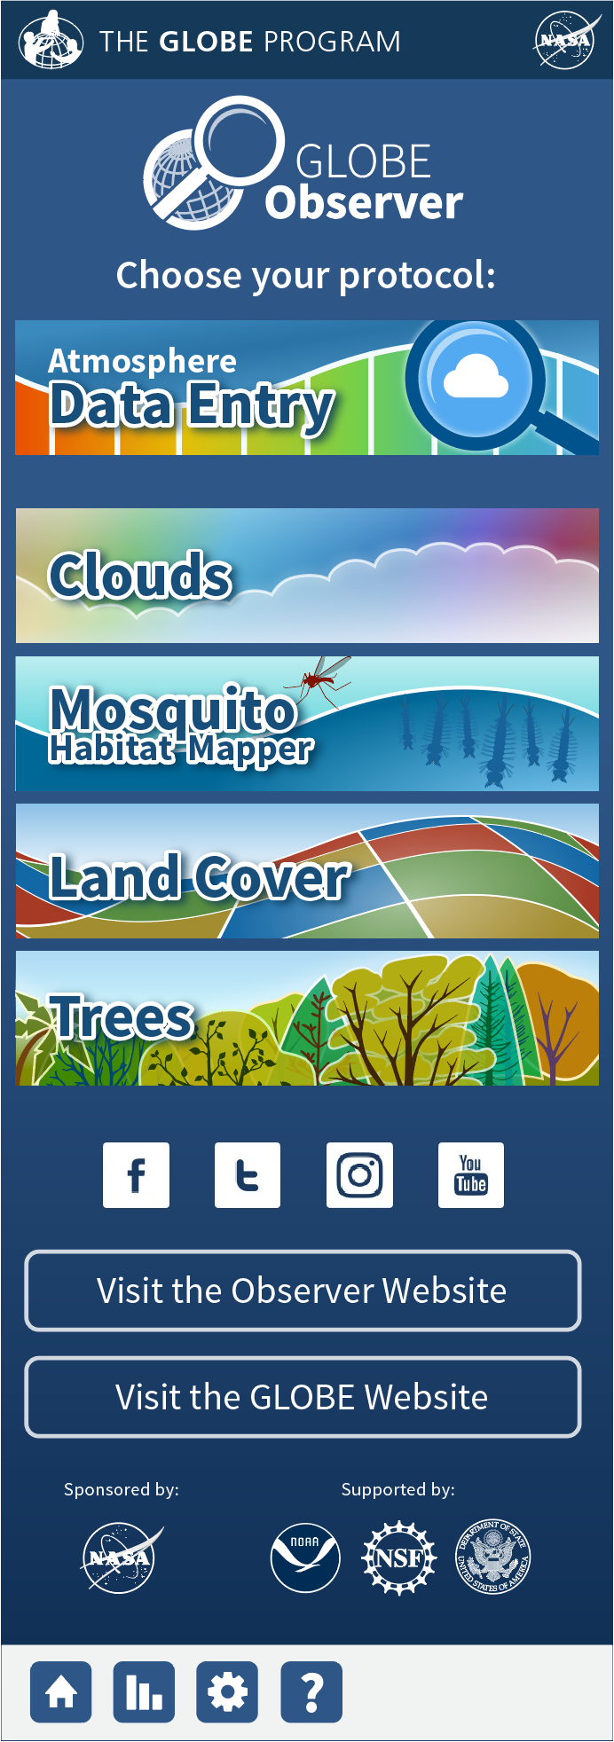
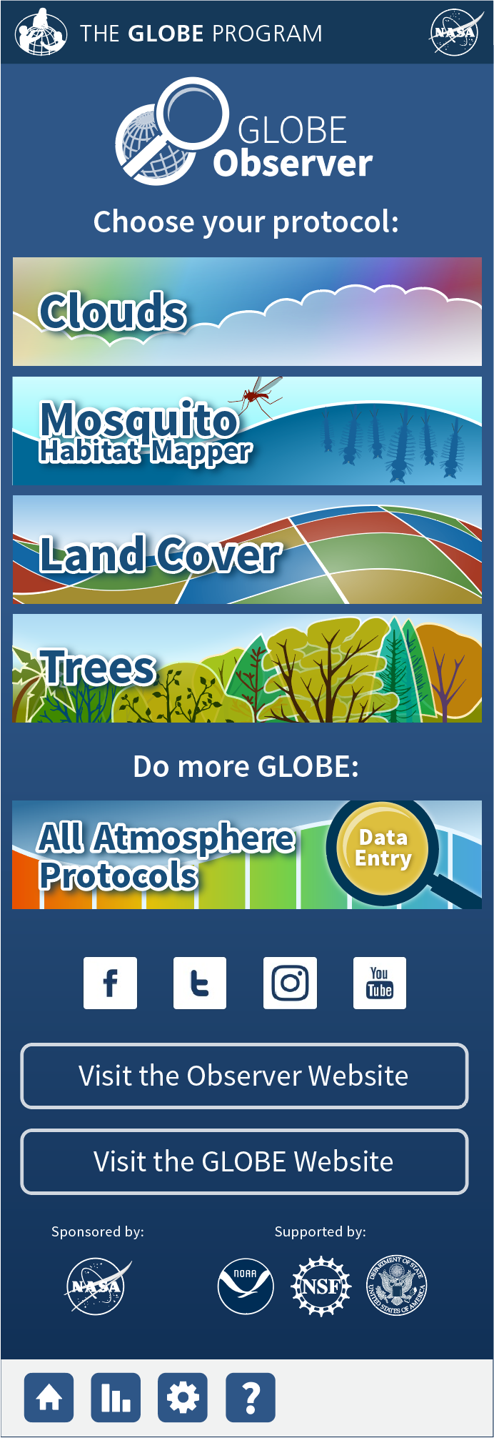
How will it work with GLOBE Observer?
One view for trained/certified GLOBE users
Link at the top to all of GLOBE Data Entry
One view for GLOBE Observers
Link at the bottom to learn more
Both can do GLOBE Observer from the home page immediately

Slide 5
Working with Sites
All your existing sites will still be there
But for new sites…
You will only need to enter site definition parameters for the protocols you choose.
You won’t have to remember “I need to setup a xxxx site for this protocol”..just choose the protocols you want to do and the system will walk you through the rest.
How does that work?

Slide 6
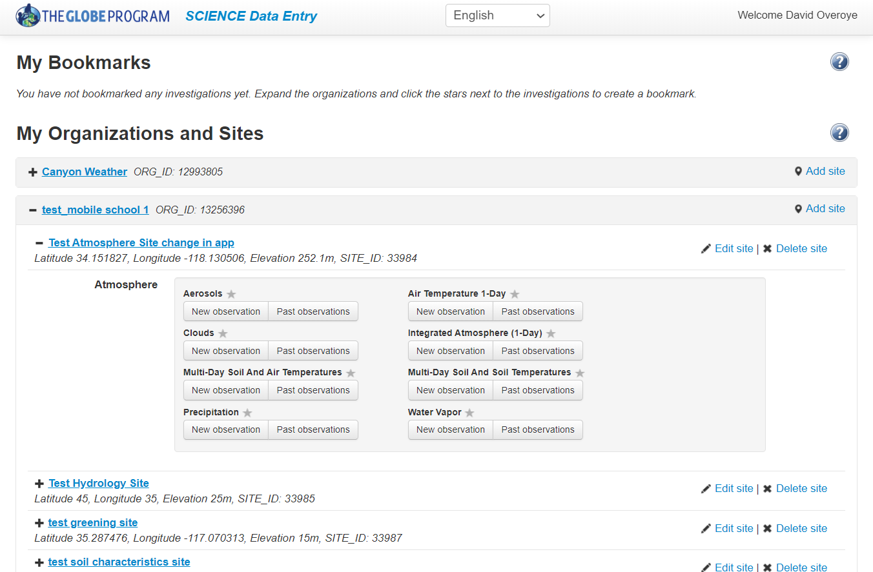
Current System
Choose School
Choose Site from a list
Choose Protocol

Slide 7
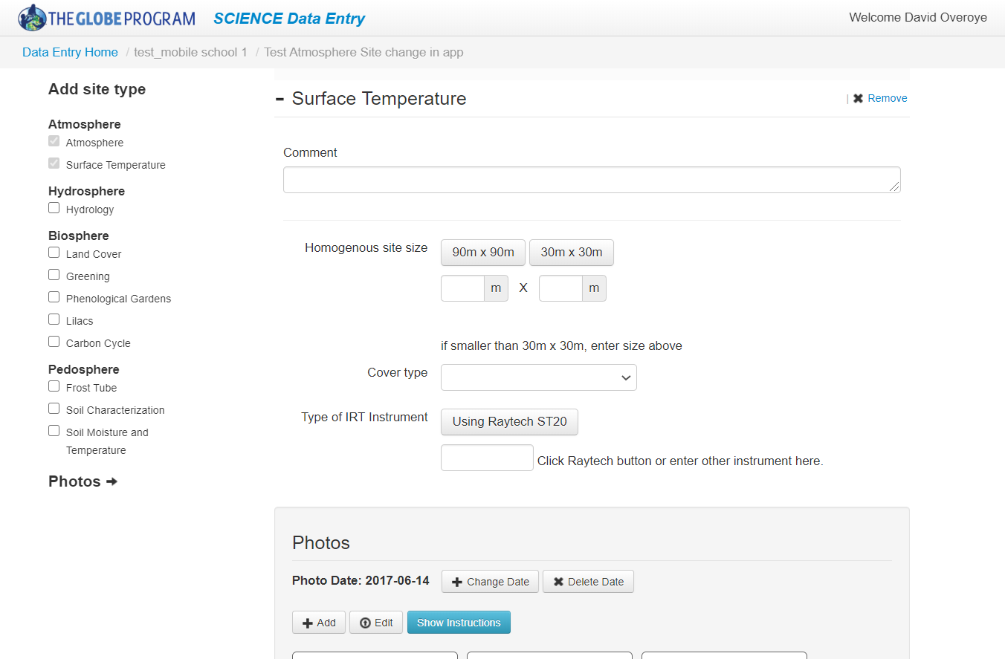
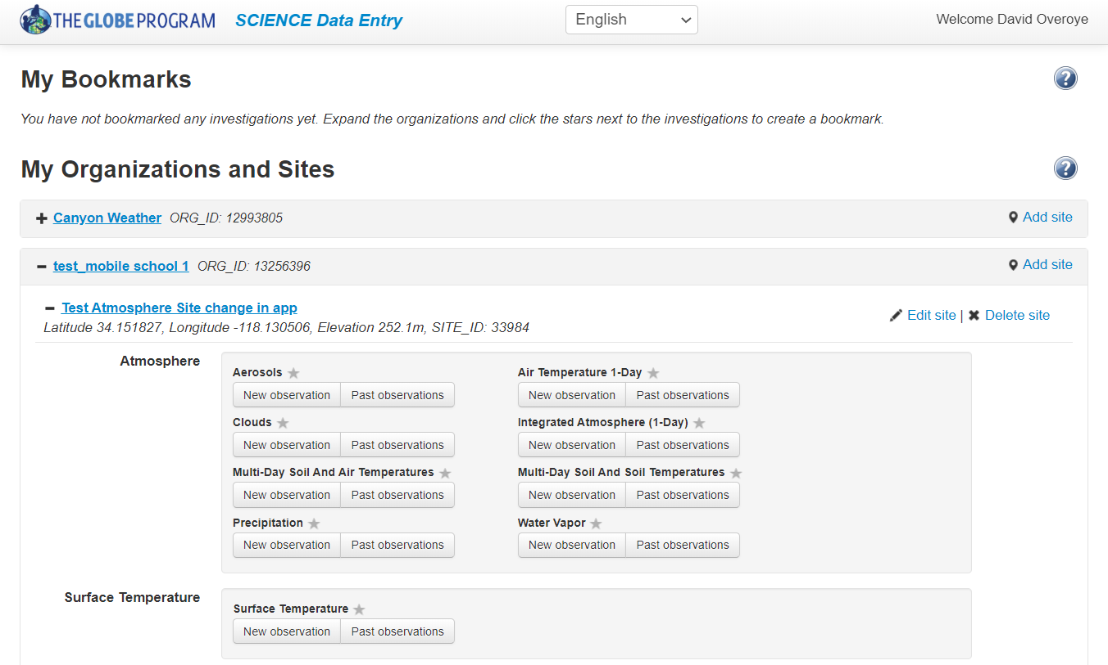
Current System
If you want to do a different protocol:
Edit Site
Update the site with a new site type for the protocol you want to do
Return to home page
Choose the modified Site
Choose the Protocol

Slide 8
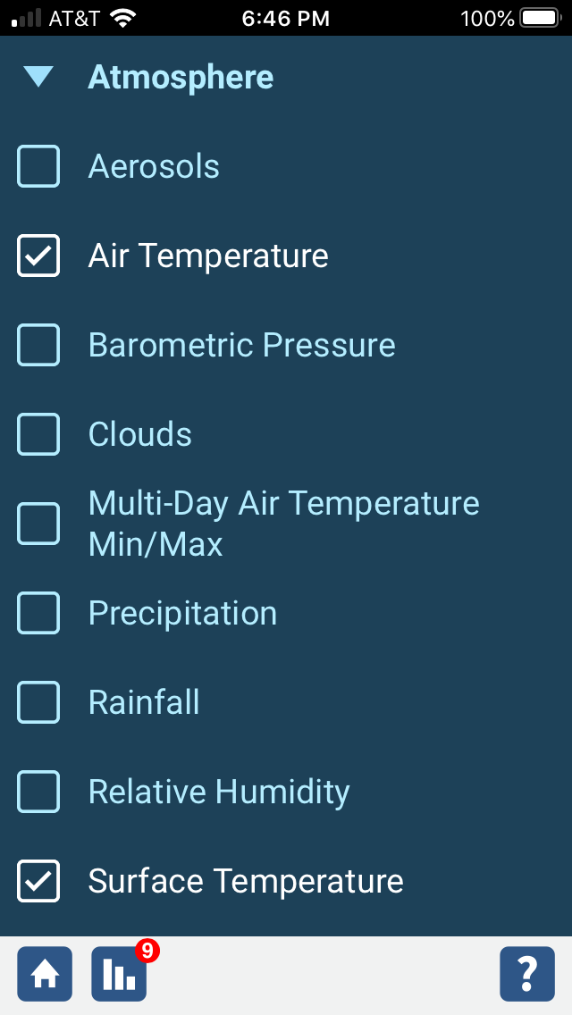
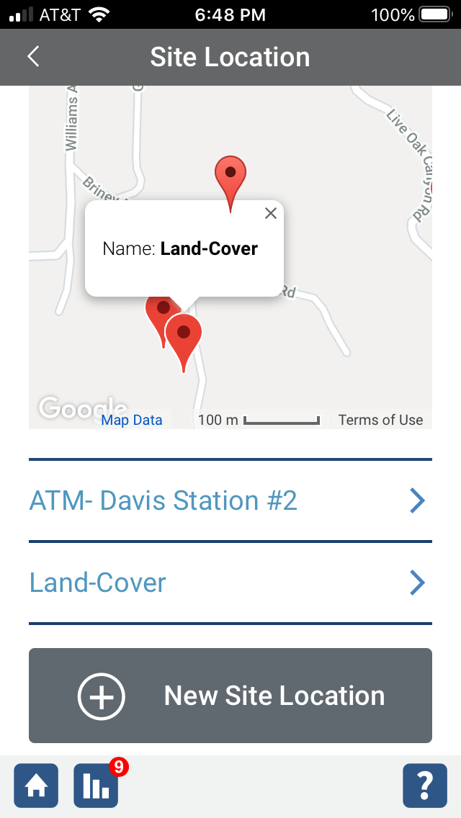
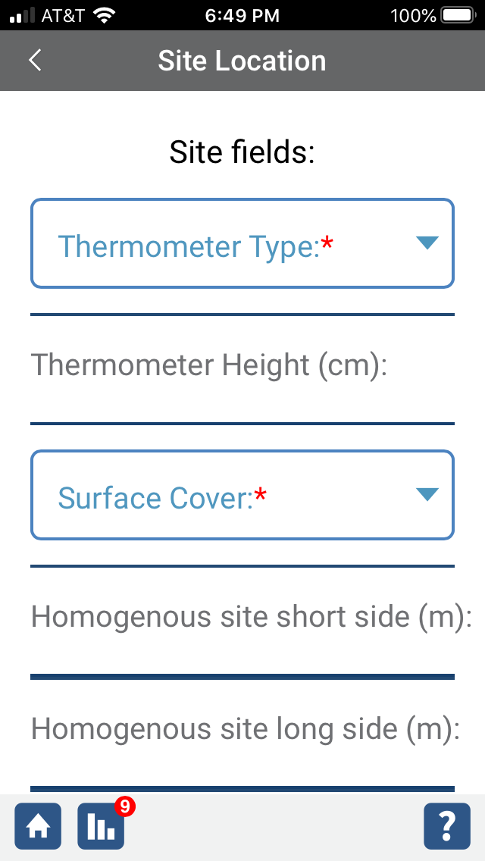
New System
Choose School if more than one school
Choose the protocol(s) you want to do
Choose the site from list or map
If you’ve never done that protocol before at that site, the system will prompt you with any required site definition fields (many protocols don’t have any)
Enter data

Slide 9
Current Status
Atmosphere only (remaining spheres rolled out in the months ahead)
Coming very soon:
Editing/Deleting past submissions (only while you are online)
Adding additional site information like topography
Create/Edit/Delete Sites

Slide 10
Demonstration

Slide 11
Ready to Try it?
Go to the annual meeting Tech Corner page and follow the instructions to download the beta version of the app to your phone.
https://www.globe.gov/news-events/meetings_symposia/annual-meetings/2020-globe-virtual-meeting/tech-corner

