Slide 1
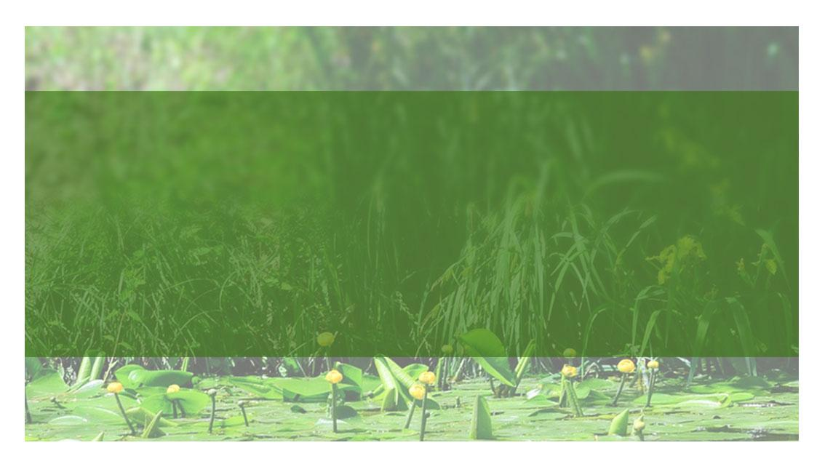
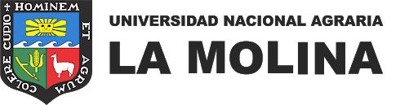


2020 GLOBE VIRTUAL MEETING STUDENT SHOWCASE
Alert! Mosquito risk on the campus of the National Agrarian University La Molina (UNALM)
¡Alerta! Riesgo por mosquitos en el campus de la
Universidad Nacional Agraria La Molina, Perú
Students: Abdon Ayuque, Mary Quispe, Danixa Rosado, Milagros Orellana, Ector Rivadeneyra
Teachers: Richar Morales, Claudia Caro

Slide 2


Abstract
Introduction
The National Agrarian University La Molina (UNALM), located in Lima, Perú is characterized by its vast diversity of landscapes that offer habitats for many species, between them, ponds and irrigation channels that mosquitoes use to breed.
Due to the constant complaints from workers and students about mosquitoes' bites, we decided to investigate the following research question: Do any of mosquitoes present at the university campus belong to a genus which transmits pathogens?
After we used the Mosquito Habitat Mapper App we found that most of the mosquitoes belonged to genus Culex and that irrigation channels were the most important breed habitats
"Mosquito" is the name to several families of insects of the Diptera order (Harbach, 2007). They are characterized by having a partially aquatic life cycle and a wide distribution in tropical and subtropical climates (Kamal et al., 2018). These insects take advantage of artificial or natural water accumulations to lay eggs (Beserra, et al., 2009) . Mosquitoes can be vectors of various pathogens such as dengue (Aedes), lymphatic filariasis (Culex) and malaria (Anopheles) (Gómez Garcia, 2018); for the need to feed on blood to promote the development of eggs (Jason Pitts, 2014).
Abdon Ayuque, Mary Quispe, Danixa Rosado, Milagros Orellana, Ector Rivadeneyra

Slide 3
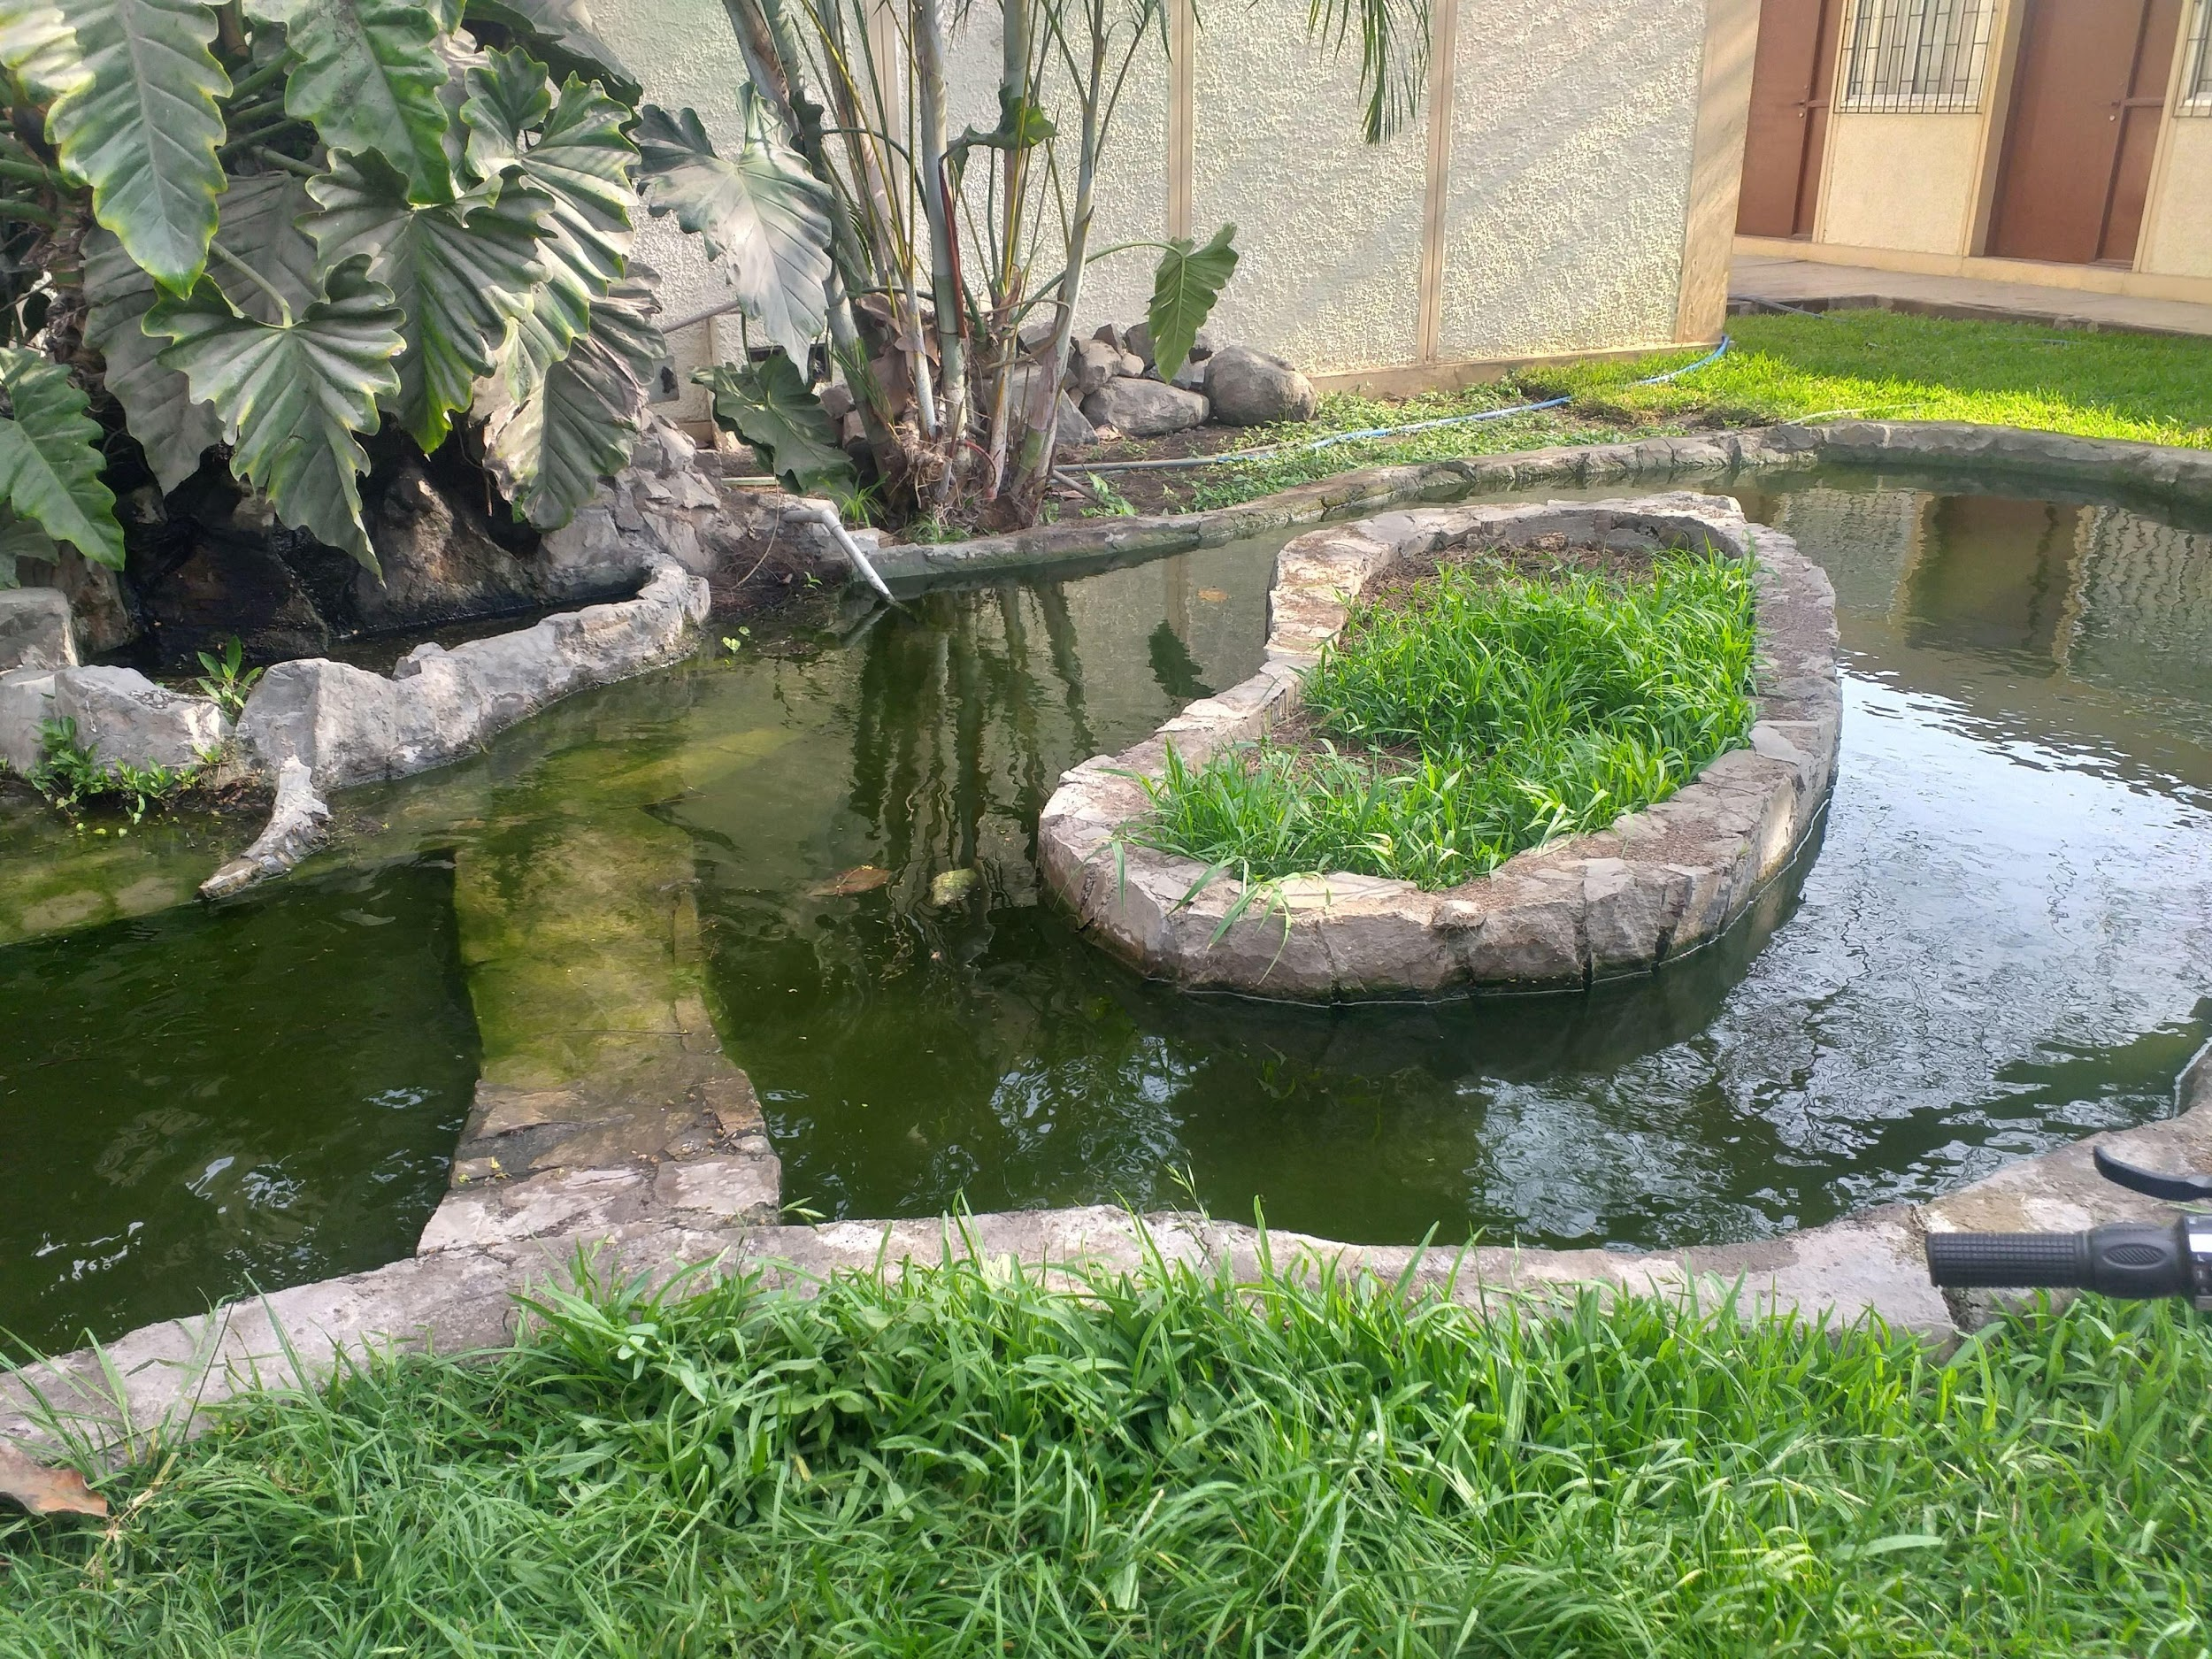

O N E
Is culex the most common genus of mosquito at the campus of the UNALM?
O N E
R Q
esearch uestions
R Q
What is the distribution of mosquitoes at the campus of the UNALM?
T W O
T H R E E
What is the importance of irrigation channels in the spreading of mosquitoes at the campus of the UNALM?
T H R E E
Abdon Ayuque, Mary Quispe, Danixa Rosado, Milagros Orellana, Ector Rivadeneyra

Slide 4

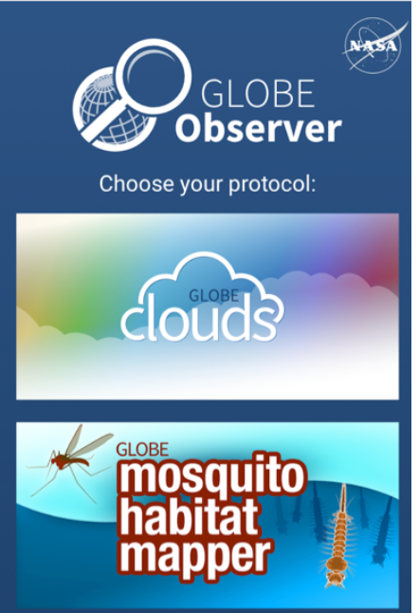
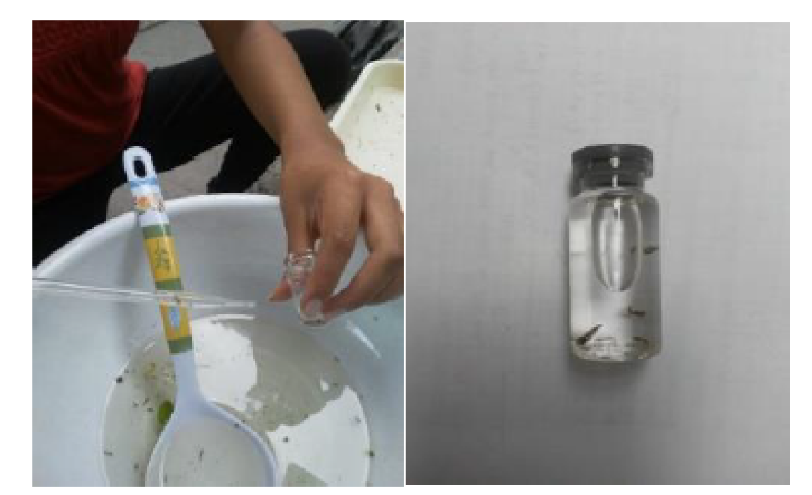
Research Methods
FIELD WORK
Mosquito larvae were monitored at two times of the year (November 2019 and January 2020), with at least three field trips each, following the steps of the GLOBE Observer APP. (GLOBE, 2020).
The location was reported, and three samples were taken from each source using a plastic ladle and putting the content in a white container.
LAB WORK
Samples were counted, and subsequently identified by using a magnifying glass following the GLOBE Observer APP key; after that, some individuals were kept in a glass bottle with alcohol for future improvements in the classification process.
Abdon Ayuque, Mary Quispe, Danixa Rosado, Milagros Orellana, Ector Rivadeneyra

Slide 5
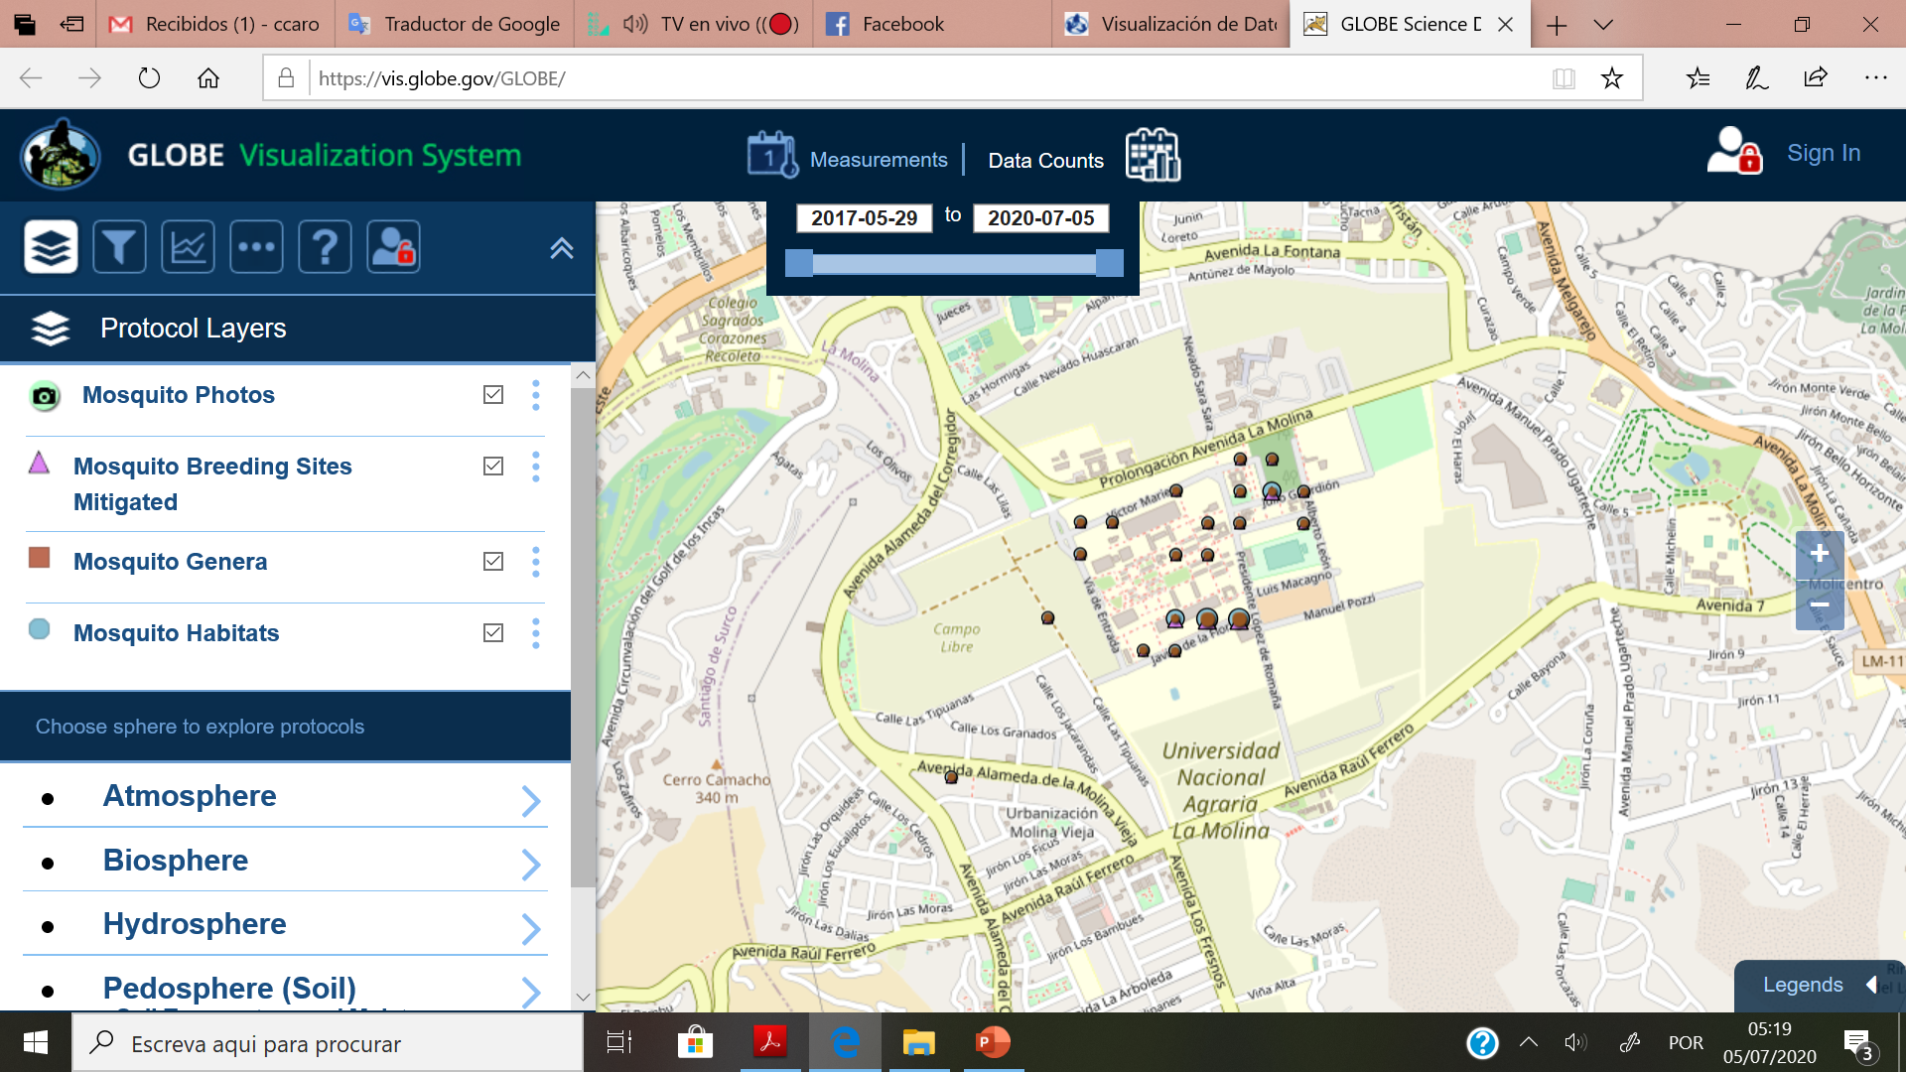
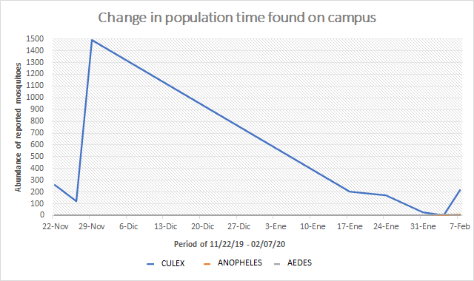
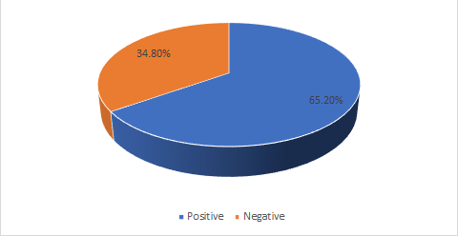
Data / Results
Abdon Ayuque, Mary Quispe, Danixa Rosado, Milagros Orellana, Ector Rivadeneyra
Changes in measured population
Number of sampled sites with mosquitoes larvae
Produced by: Rivadeneyra cardenas, Ector Adrian

Slide 6
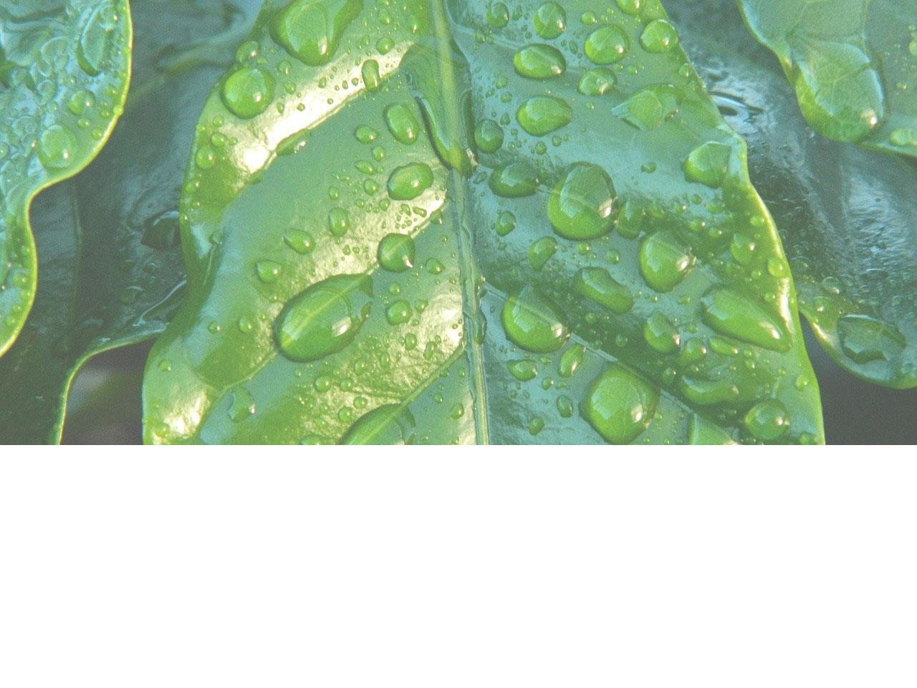
Discussion
Abdon Ayuque, Mary Quispe, Danixa Rosado, Milagros Orellana, Ector Rivadeneyra
The UNALM campus is mostly occupied by mosquitoes of the Culex genus. In addition to Culex, Anopheles and Aedes genus were found only in January 2020.
Irrigation channels are usually contributing with dispersion of mosquitoes´ larvae
Mosquito larvae appear preferably in body waters with the following characteristics: vegetated areas, dissolved organic matter, and shade
Fishponds or reservoirs with tadpoles are free from mosquito larvae.
Some macroinvertebrates larvae that feed mosquitoes larvae were found in some irrigation channels. These could be used as biological controllers

Slide 7
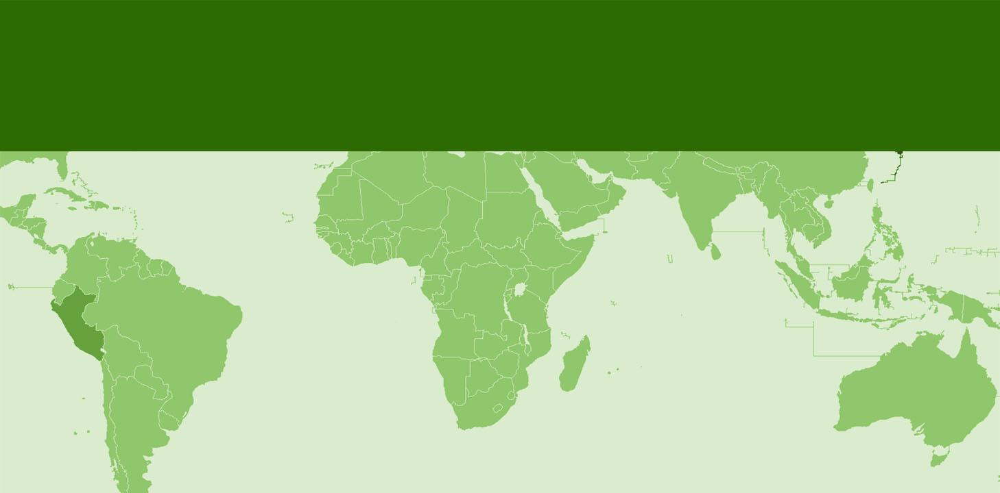
Conclusions
Abdon Ayuque, Mary Quispe, Danixa Rosado, Milagros Orellana, Ector Rivadeneyra
Culex is the dominant genus at the UNALM campus.
The Culex genus was found at two different times of the year (November and January), while the Anopheles and Aedes genus were found only in the month of January.
Irrigation canals are the main habitats for mosquito larvae.
The UNALM recreation pools were not identified as breeding habitats for mosquitoes, due to the presence of fish and tadpoles.

Slide 8

References
Beserra, E. B., Freitas, E. M. De, Souza, J. T. De, Fernandes, C. R. M., & Santos, K. D. (2009). Ciclo de vida de Aedes (Stegomyia) aegypti (Diptera, Culicidae) em águas com diferentes características. Iheringia. Série Zoologia, 99(3), 281–285. https://doi.org/10.1590/S0073-47212009000300008
Harbach, R. E. (2007). The Culicidae (Diptera): a review of taxonomy, classification and phylogeny*. Zootaxa, 1668(1), 591–638. https://doi.org/10.11646/zootaxa.1668.1.28
GLOBE -The Global Learning and Observations to Benefit the Environment. (2020). GLOBE Mosquito Project. Available in https://www.globe.gov/web/globe-mosquito-project. Consultado en febrero, 2020
Jason Pitts, R. (2014). A blood-free protein meal supporting oogenesis in the Asian tiger mosquito, Aedes albopictus (Skuse). Journal of Insect Physiology, 64(1), 1–6.
https://doi.org/10.1016/j.jinsphys.2014.02.012
Gómez Garcia, G. (2018). Aedes (Stegomyia) aegypti (Diptera: Culicidae) y su importancia en salud humana. Rev Cubana Med Trop, 70(1), 55–70. Retrieved from http://scielo.sld.cu/scielo.php?script=sci_arttext&pid=S0375-07602018000100007
Kamal, M., Kenawy, M. A., Rady, M. H., Khaled, A. S., & Samy, A. M. (2018). Mapping the global potential distributions of two arboviral vectors Aedes aegypti and Ae. Albopictus under changing climate. PLOS ONE, 13(12), e0210122. https://doi.org/10.1371/journal.pone.0210122
Abdon Ayuque, Mary Quispe, Danixa Rosado, Milagros Orellana, Ector Rivadeneyra

Slide 9

Community Involvement
The research report was sent to the Dean of the Sciences Faculty to draw a plan to mitigate the mosquitoes´ population in the campus of the UNALM
A malaria disease students research group is going to use this investigation for improve its own work.
We Would like to say thank you to the following persons who contributed to improve our work :
Dr. Dorian Janney for inspire us with her presentation about Mosquitoes
Dr. Heather Frankland who help us with our english
Professor Ever Menacho, dean of Sciences Faculty because he believee in our work and presents it to our university authorities
Abdon Ayuque, Mary Quispe, Danixa Rosado, Milagros Orellana, Ector Rivadeneyra

Slide 10
Thank you for your time
Questions
Abdon Ayuque, Mary Quispe, Danixa Rosado, Milagros Orellana, Ector Rivadeneyra

