Slide 1
Goddard Institute for Space Studies
Climate Change Research Initiative

Slide 2
Goddard Institute for Space Studies
Laboratory in the Earth Sciences Division (ESD) of National Aeronautics and Space Administration's Goddard Space Flight Center (GSFC).
Research in climate change, exoplanets and astrobiology.
Many scientists use satellite data for their research.
GLOBE work is very relevant as it can help validate satellite data.
(GISS)

Slide 3
Climate Change Research Initiative
The Office of STEM Engagement at GISS runs a program called Climate Change Research Initiative (CCRI).
Vertical Model: Each of 4 research teams is formed by graduate student and teacher, led by GISS scientist (Fall/Spring); then an undergraduate student and a high school student join to complete research (Summer). Teacher also develops Applied Research STEM Curriculum Portfolio.
An extension of the CCRI program is the CCRI Educator Ambassadors group, formed by outstanding STEM teachers, who meet monthly to learn about climate change research and educational resources such as GLOBE! One of our presenters today – Ms. Jillian Anderson- is part of this fantastic group!
(CCRI)

Slide 4
Developing a Research Question
Wade Phillips & Jillian Anderson
Lexington School for the Deaf

Slide 5
The Scientific Method
Research question
Background research
Hypothesis
Experiment
Data analysis
Conclusion
7. GLOBE IVSS!

Slide 6
IVSS Information...
TBC

Slide 7
GLOBE Program
Research Question Characteristics Worksheet
Points (0 or 1)
Image: the GLOBE Program “Research Question Characteristics Worksheet” displays a chart with thirteen questions and corresponding space to tally total points; at the top left is GLOBE’s icon displaying three shadows of people surrounding and putting their hands on a globe of the earth

Slide 8
A good research question is:
Interesting
Clear
Focused
Concise
Complex
Testable

Slide 9
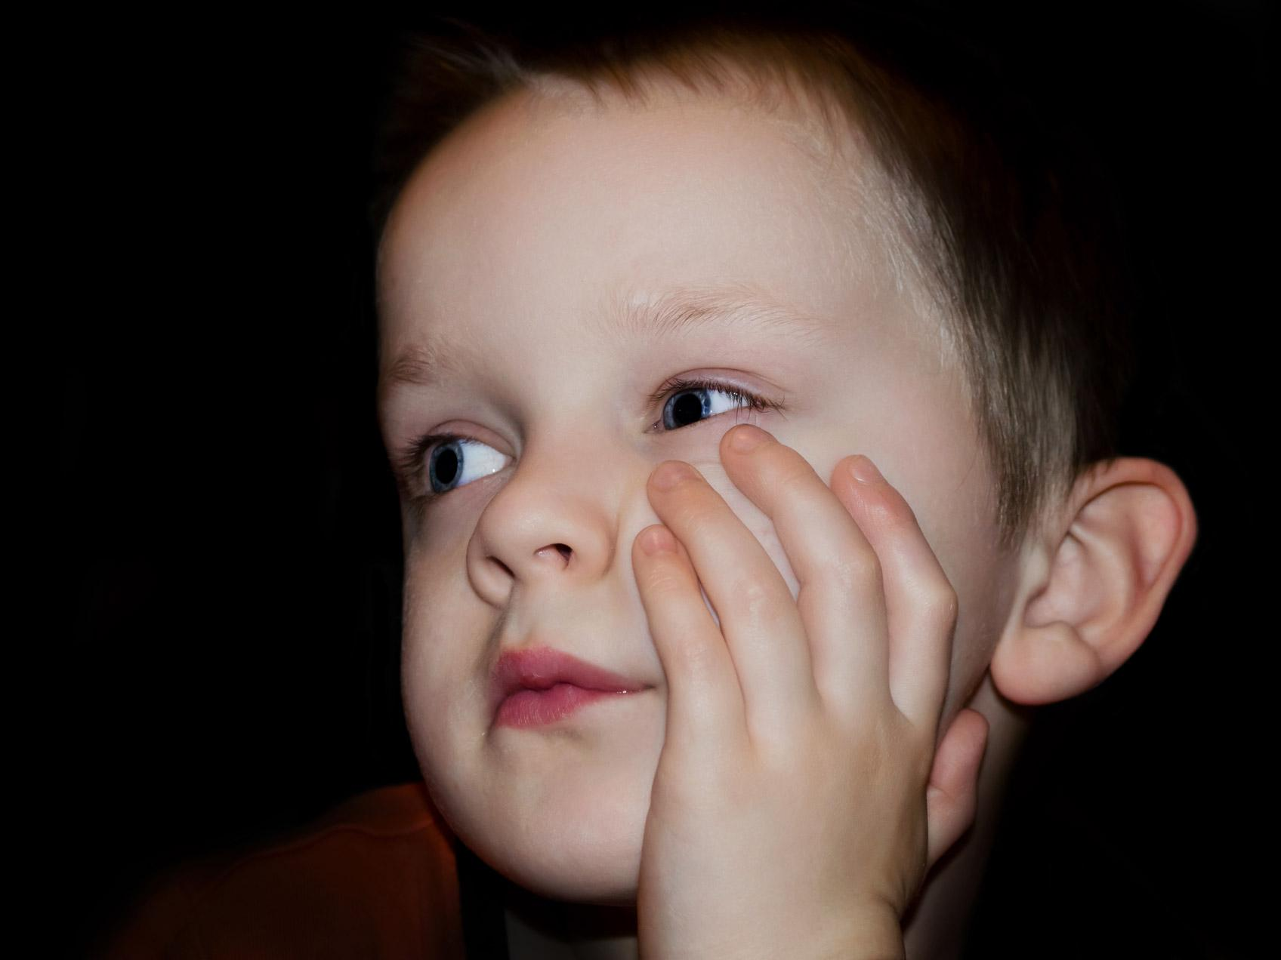
Interesting
Include keywords
Images: a fair-skinned, blue-eyed child stares to the corner with their head resting on a hand in apparent boredom; overlapped by the “Thinking Face Emoji”, a yellow smiley face with a quizzically raised eyebrow and a thoughtful palm resting on the chin

Slide 10
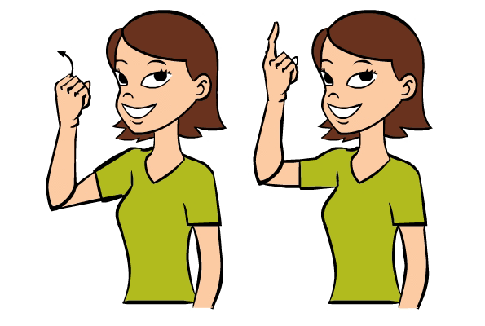
Clear
Easy to understand
Images: a light-skinned woman with long, dark hair in a braid cocks her head to the side and rests a thoughtful finger on her chin, with a large question mark hovering over the right of her head; replaced by a cartoon image of a woman with short brown hair in a green shirt in a side-by-side depiction of the ASL sign “understand” showing the motion of a closed fist by the temple with the pointer finger flicking up to a “1” handshape (credit: Baby Sign Language Dictionary)

Slide 11
Focused
Targeted
Centered
Image: square shapes in red, green, brown, orange, and yellow are scattered to the left but gather more closely to the right and bottom to form the shape of a person’s face and bust, with a pipe coming out of the mouth

Slide 12
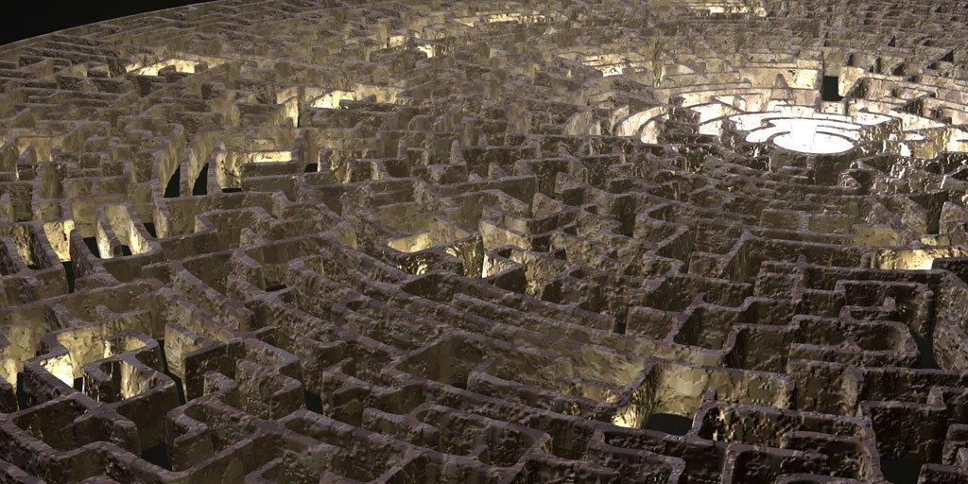
Concise
Short/brief
To the point
Summarized
Image: an aerial view of labyrinth-style maze with a light shining from the apparent center is replaced by a red arrow being drawn straight through a convoluted maze by a man wearing a suit

Slide 13
Complex
Not as easy as “yes” or “no”
Multiple parts
Image: two thick black checkboxes are present, the left has a red check mark and the right has a red X; this image is overlapped by a picture of a gray, puzzle with one enhanced red puzzlepiece sitting prominenetly in the center

Slide 14
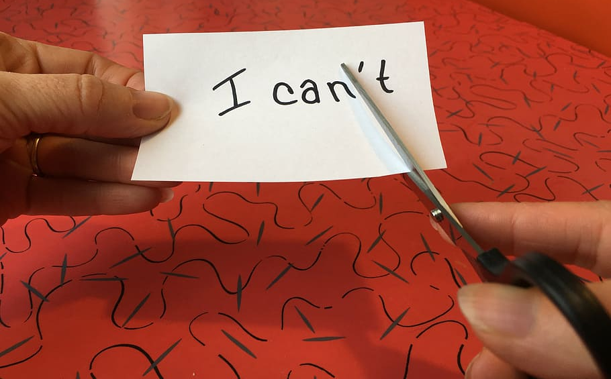
Testable
Possible!
time
resources
Image: a red background with black squiggly lines behind a white piece of paper reading “I can’t” is being held by a hand and cut with a pair of scissors to remove the “‘t”

Slide 15
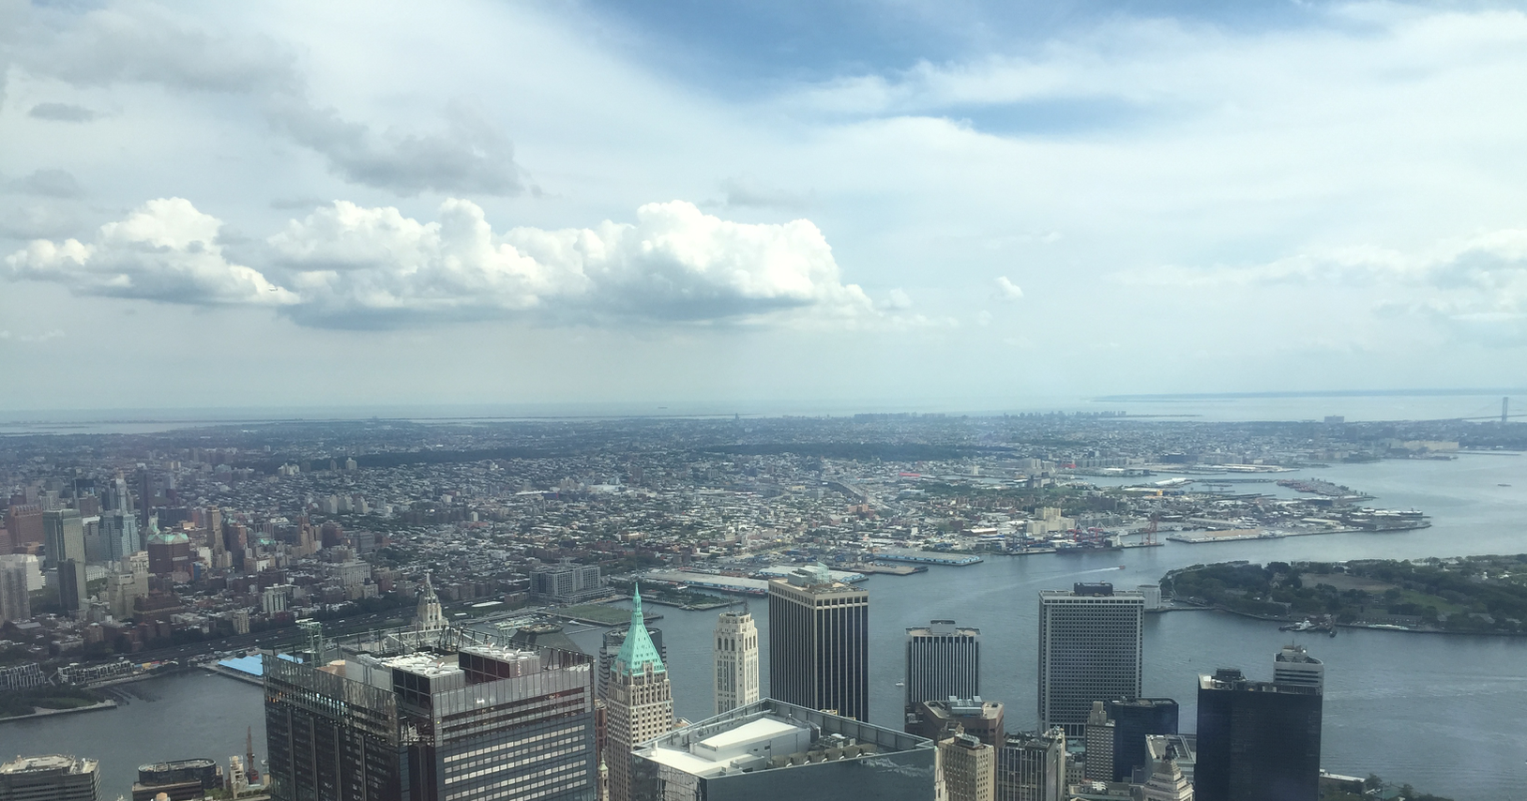
Example
Can you see clouds in New York?
Image: the photo of the skyline of New York City as viewed from the Empire State Building on a summer day with prominent opaque clouds in the light blue sky
Notes:
Not complex (simple yes or no)

Slide 16
Example
What are clouds made of?
Image: water droplets transposed upon a picture of a blue sky with white, puffy cumulus clouds (credit: NASA)
Notes:
Not testable

Slide 17
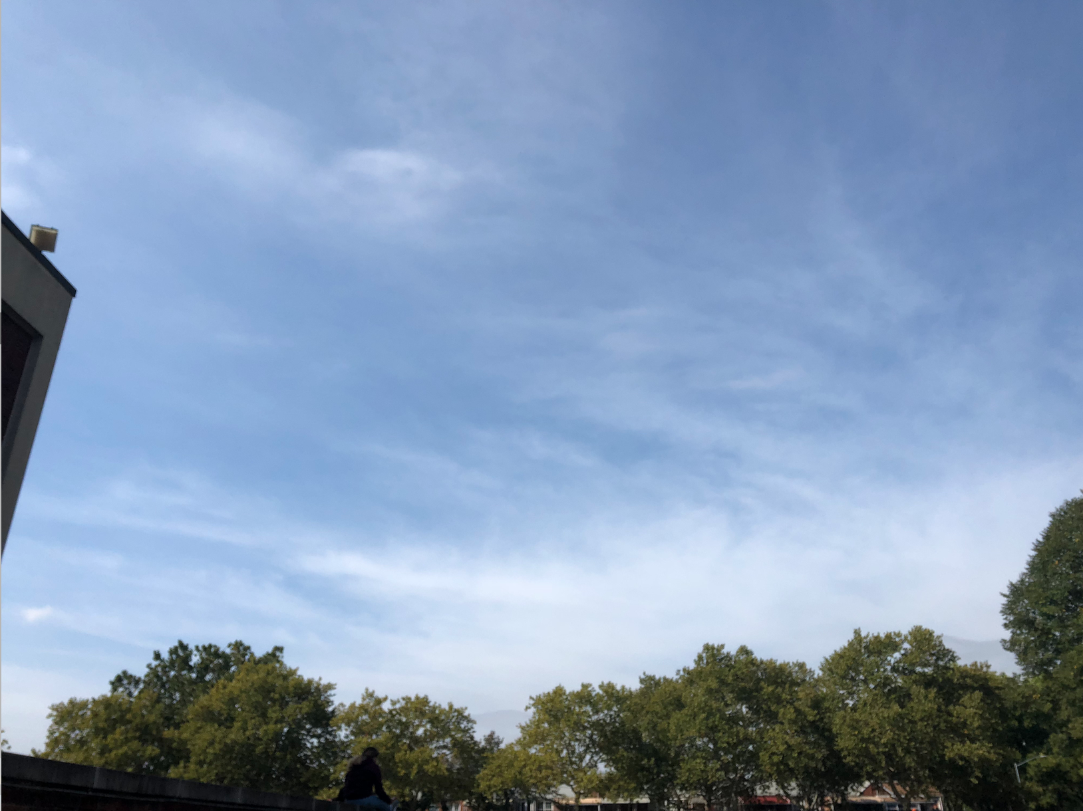
Example
Why do clouds form?
Image: a photograph of a blue sky with whispy, white, translucent cirrus clouds above a line of green-topped trees and the corner of Lexington School for the Deaf’s building on the left side
Notes:
Not complex

Slide 18
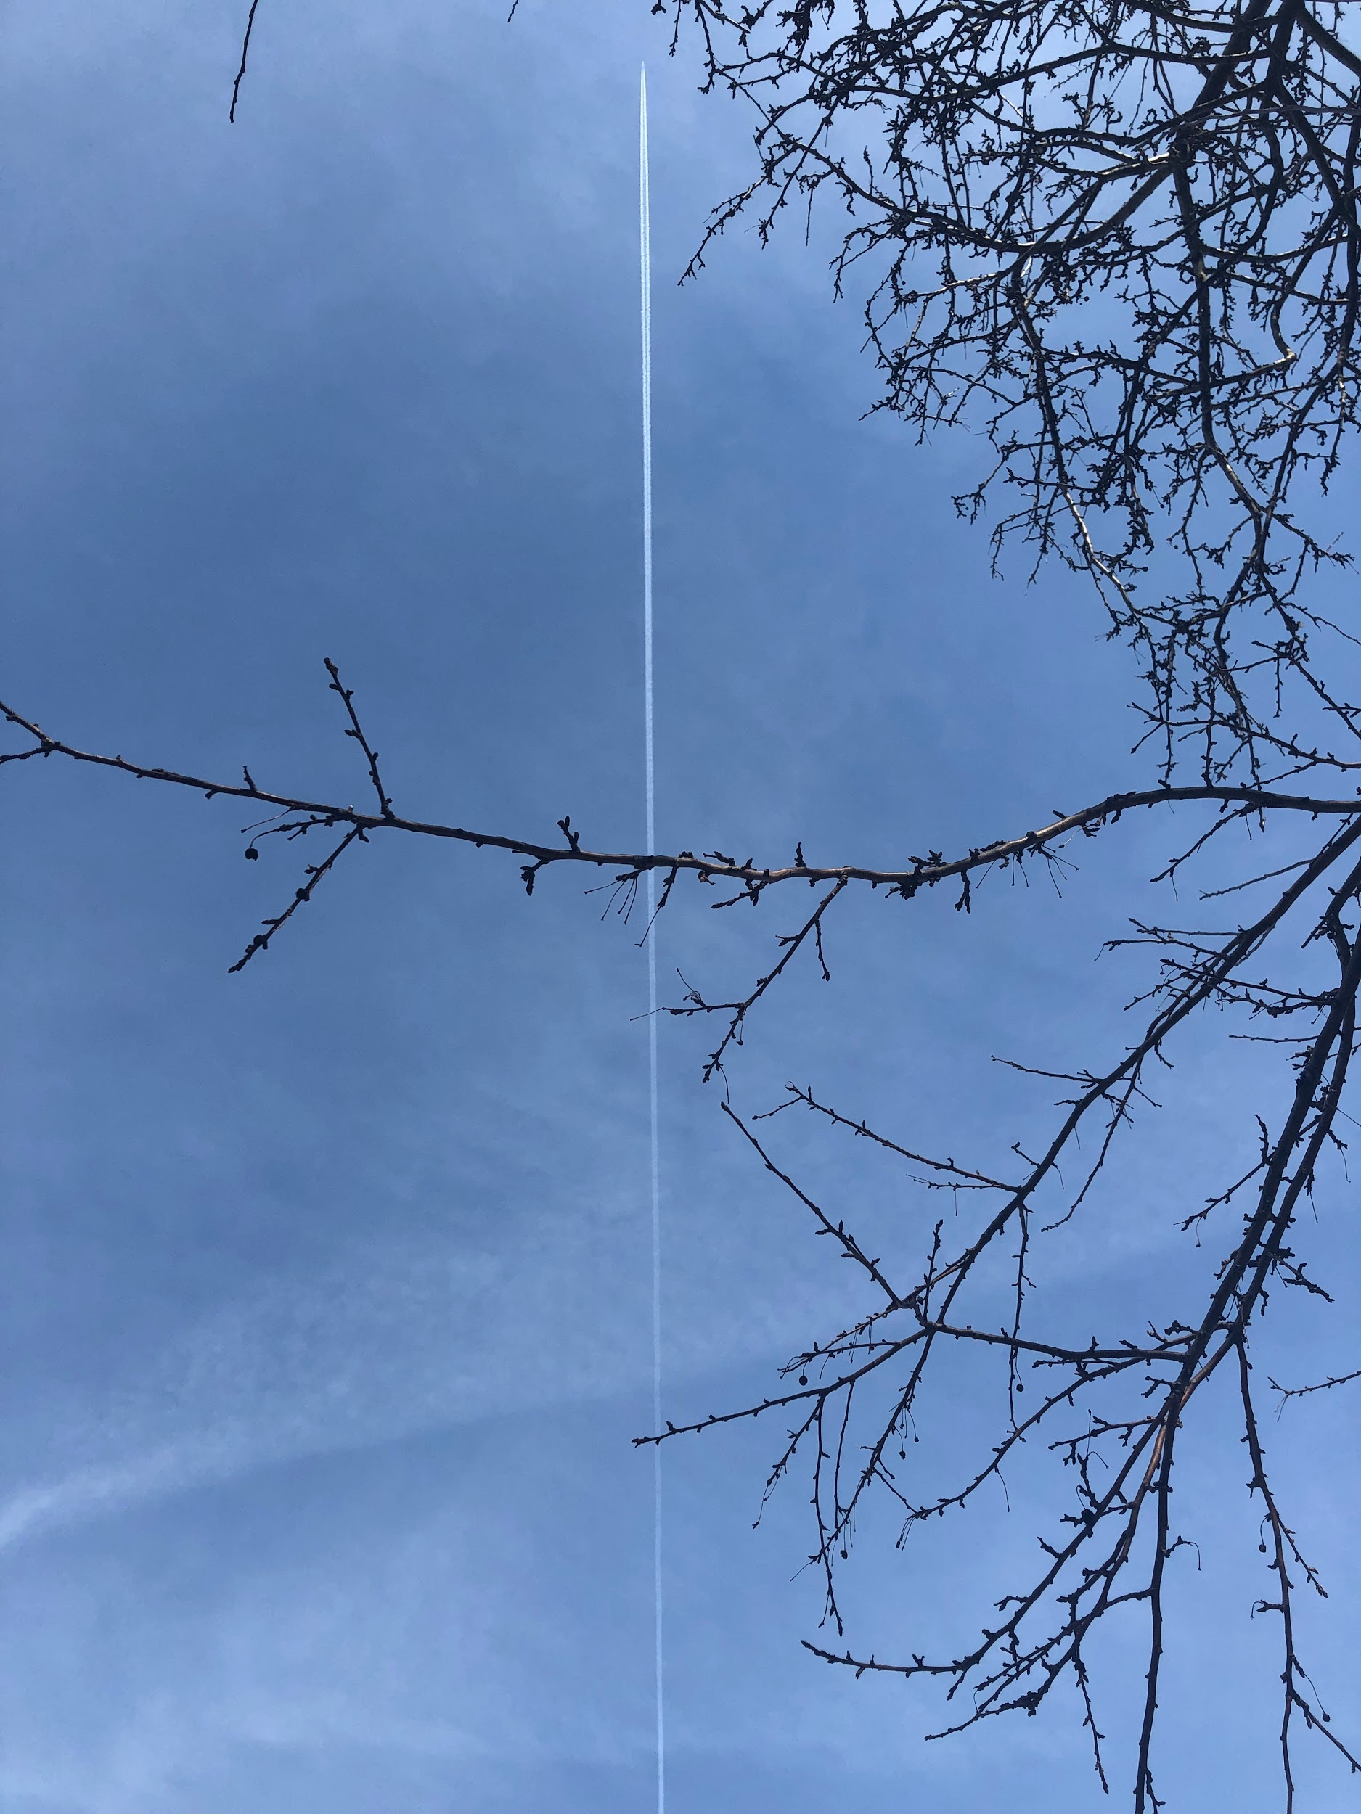
Example
In New York, why are there contrails?
Image: a photo of a blue sky with transparent cirrus clouds, a persistent non-spreading contrail is seen going straight to the top center of the photo, dissected by bare tree branches
Notes:
Not testable

Slide 19
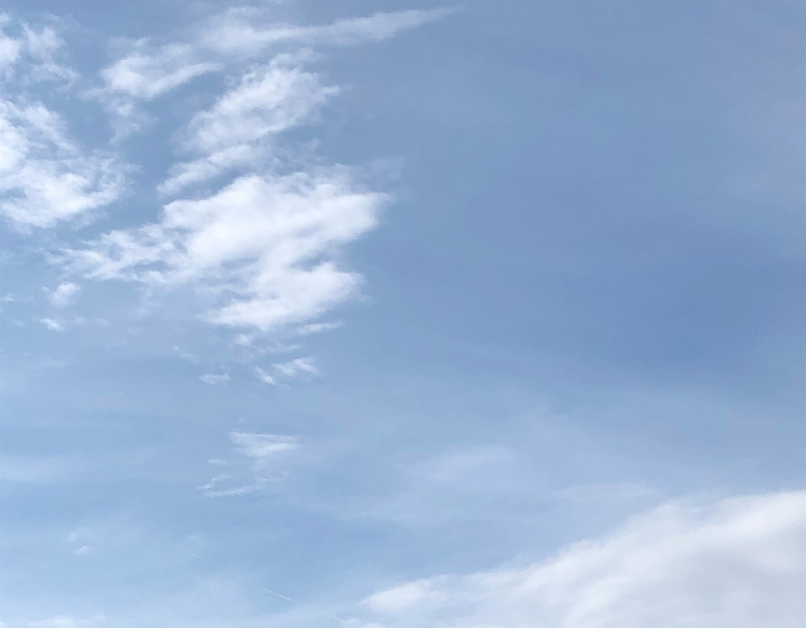
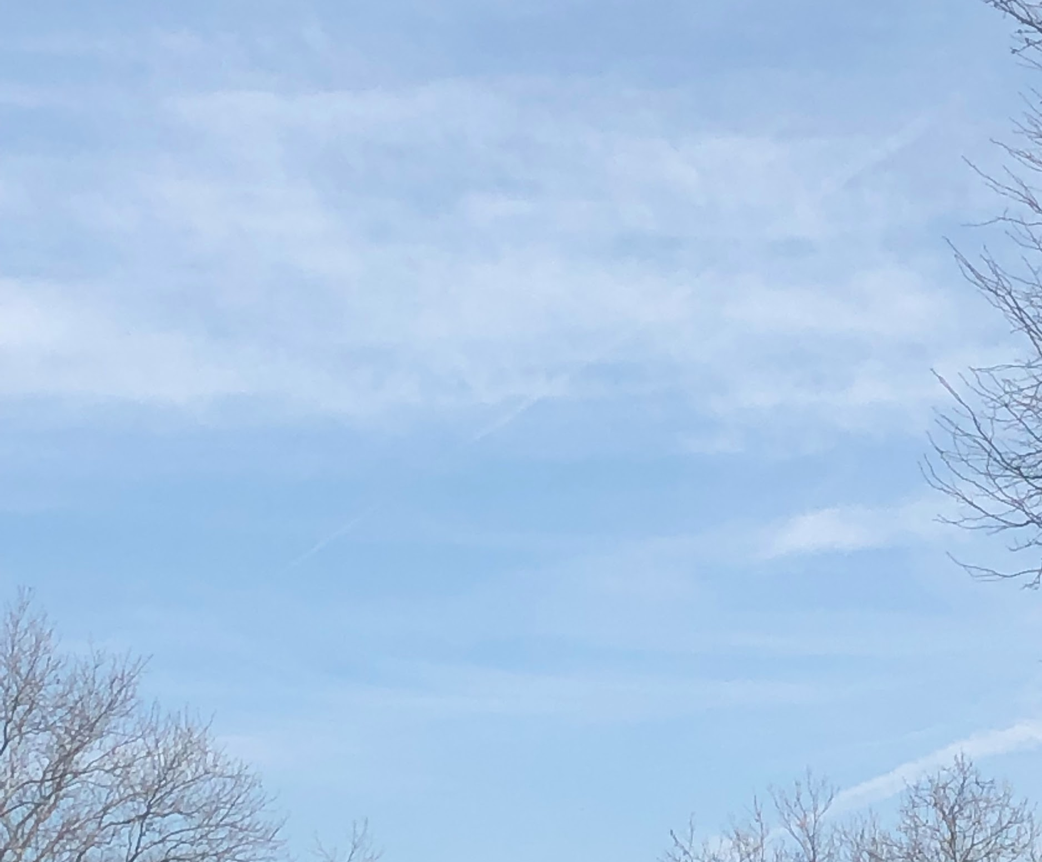
Example
When clouds are in the sky outside is it cold and sunny or warm and raining and are there also contrails from airplanes?
Images: (upper left) a photo of blue sky with white, opaque clouds; (upper right) a picture of a light blue sky with translucent and transparent clouds and bare tree branches lining the bottom and right edges
Notes:
Not clear/focused/concise

Slide 20
Example
Does temperature affect the number of contrails observed?
Image: a photo of a dark blue sky with transparent clouds and two short-lived contrails, one in the upper center and the other in the lower right corner of the frame, lined by dark bare tree branches on the bottom
Notes:
Good!

Slide 21
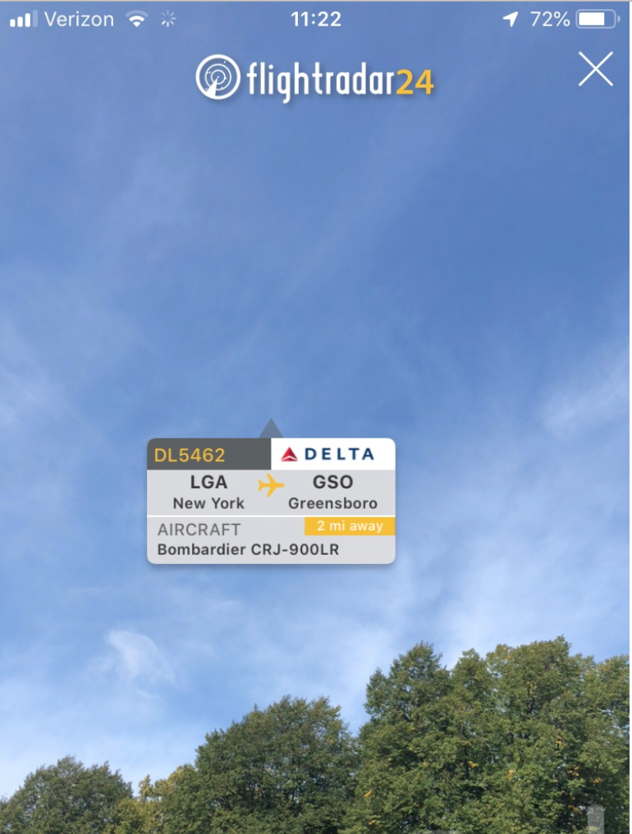
Example
Does airplane size affect the number of contrails produced?
Image: a screenshot image of a blue sky with transparent clouds, and a logo for “flightradar24” across the top of the screen with a radar icon to the left of the logo and a white “X” at the top right of the screen; there are green trees along the bottom of the photo, and in the middle of the image is a gray rectangle with the information identifying a Delta flight (DL5452) from New York’s LaGuardia Airport (LGA) to Greensboro Airport (GSO)
Notes:
Good!

Slide 22
In conclusion...
Developing a research question is an important part of every research project!
Make sure you ask yourself: is my question interesting? clear? focused? concise? complex? testable?
Use GLOBE’s “Research Question Characteristic Worksheet” to help you!
Image: (repeated) the GLOBE Program “Research Question Characteristics Worksheet”

Slide 23
Question
Q: What is the difference between a hypothesis and a research question?
A: Your hypothesis is a possible answer to your research question.

Slide 24
Question
Q: Where is a good place to start in developing a research question?
A: Your own interests! What do YOU want to learn about?

Slide 25
Question
Q: What are some helpful resources for developing a good research question?
A: GLOBE Program’s “Research Questions Characteristic Worksheet” or a website like Science Buddies’ Science Fair Project Questions

Slide 26
THANK YOU!
We hope you enjoyed our presentation and that it helps you with your research project!
Please let us know if you have any questions :)

