Slide 1
GLOBE Website - Software Update
Cornell Lewis & David Overoye
Science Systems and Applications, Inc.
July 14, 2020

Slide 2
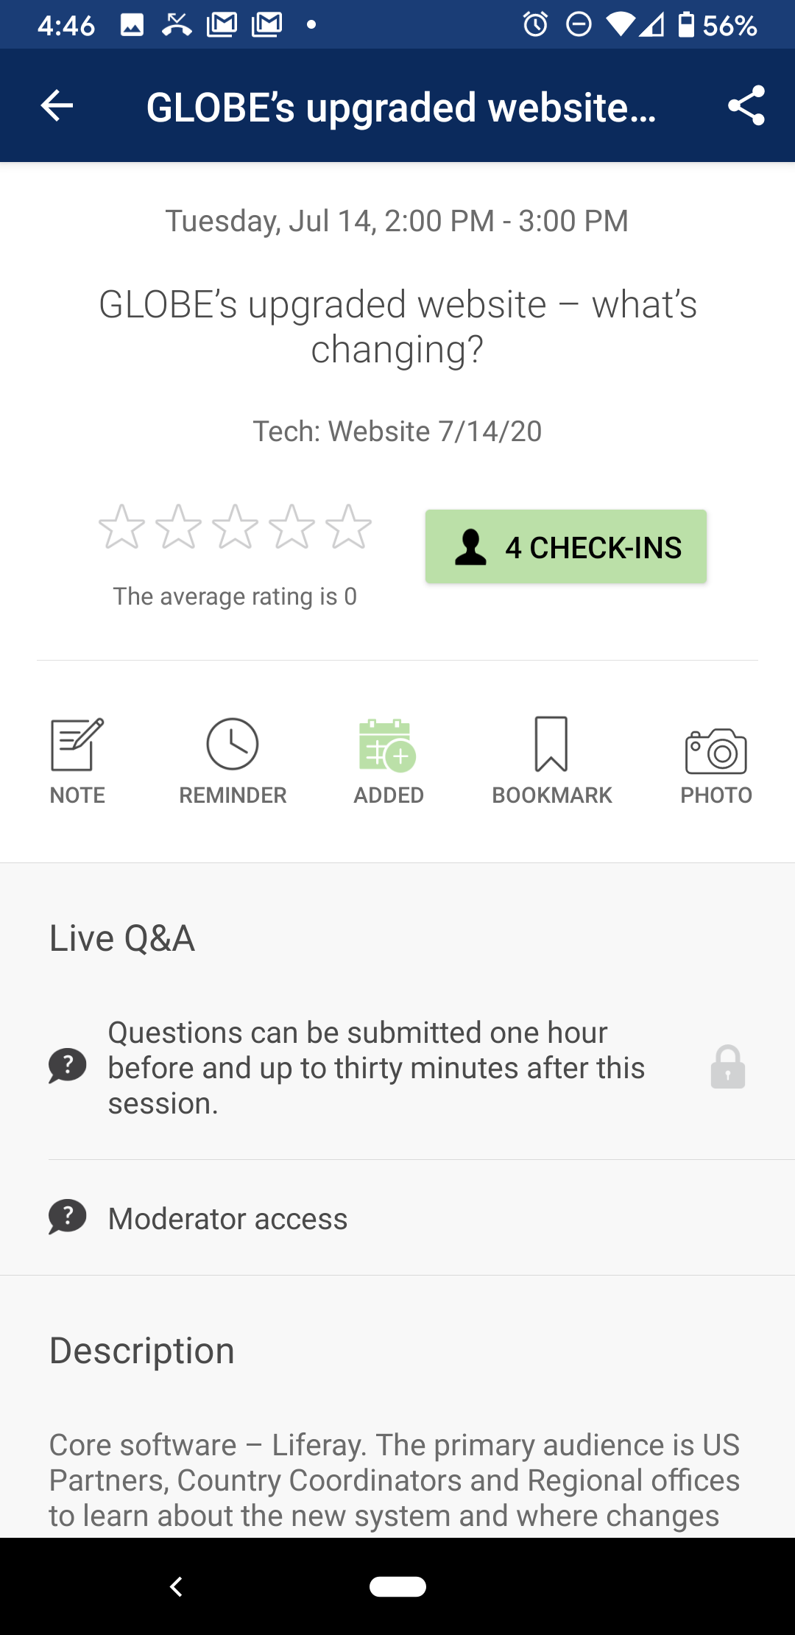
Participate live through our Mobile App!
Login to the mobile app NOW to participate live during this presentation.
Click on this session on the app and then click the link under Live Q&A to post your questions.

Slide 3
New Software Version
A new version of the website software (Liferay 7.2) is coming with an improved admin interface and new tools and features.

Slide 4
New Software Version
This Presentation will:
  Review some of the Country Coordinator, Partner and Teacher Admin tasks highlighting changes to the admin interface.
  Show what’s changed and what hasn’t.
  Demo new features and functionality.

Slide 5
New Software Version
  The public view of the website will look and function like the current site.
  Site structure will remain as is.

Slide 6
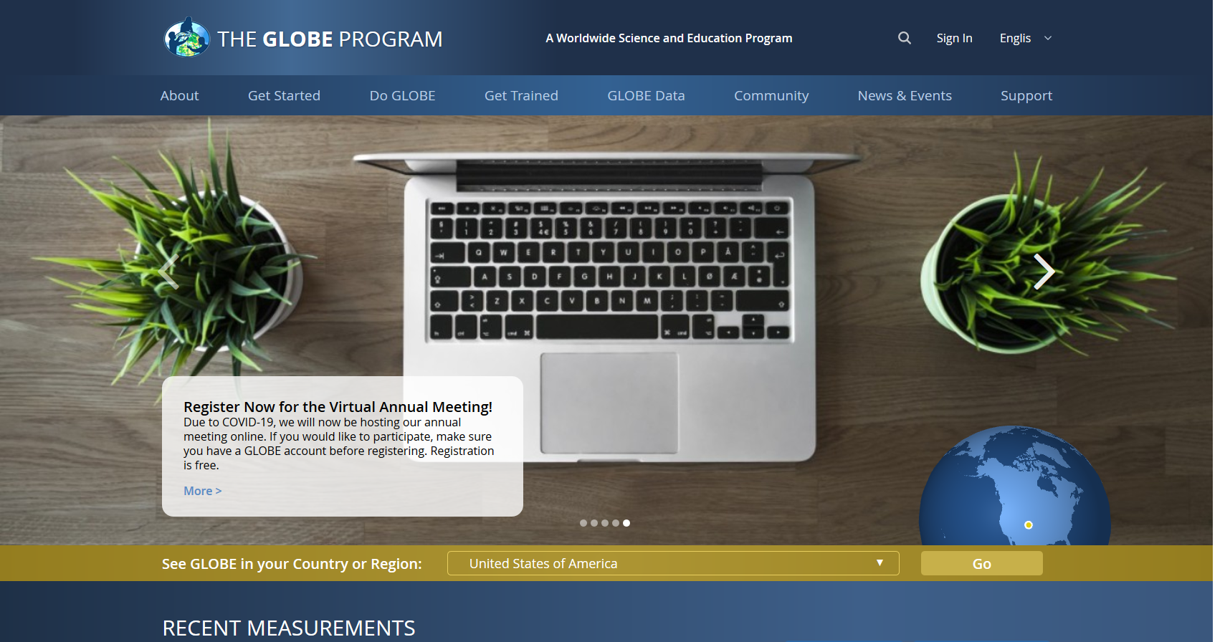

Slide 7
Admin Controls: Similar but Some Changes
All current admin functionality will still be available.
But look and feel and location of some admin tools have changed.

Slide 8
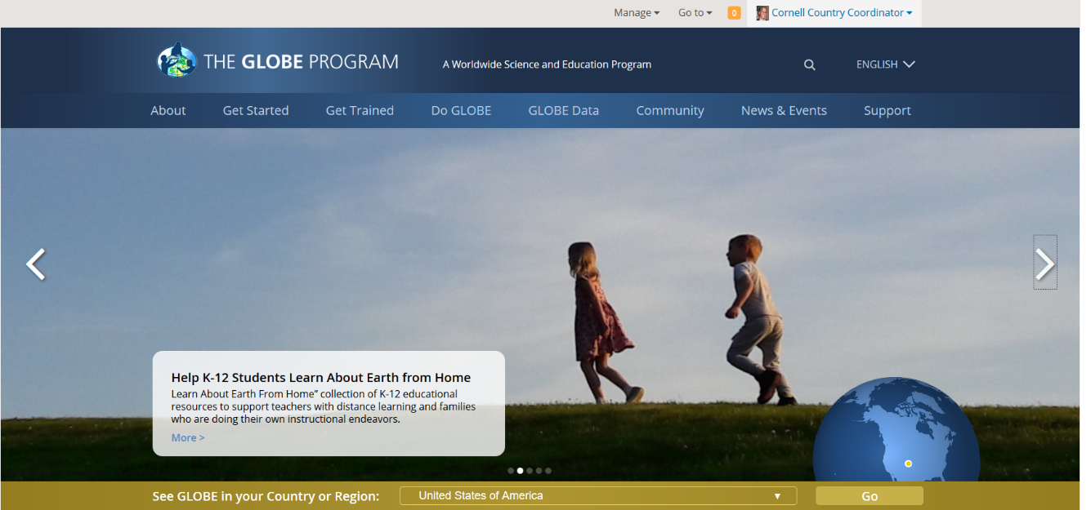
Admin Controls: Current Version

Slide 9
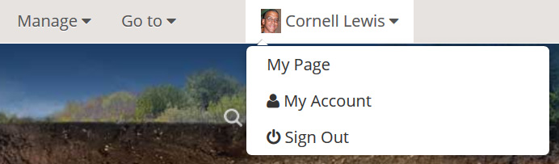
Admin Controls:
Manage Your Information - Current Version

Slide 10
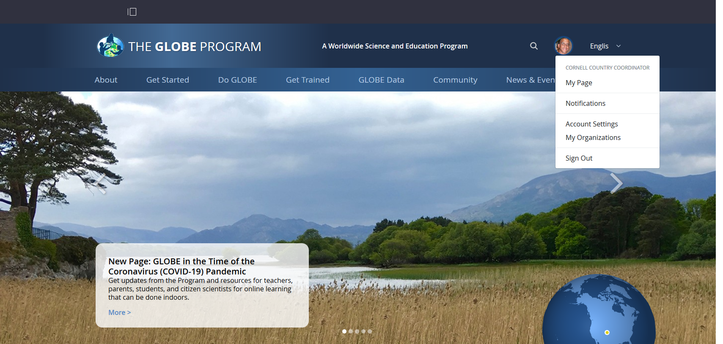
Admin Controls:
Manage your Information – New Version

Slide 11
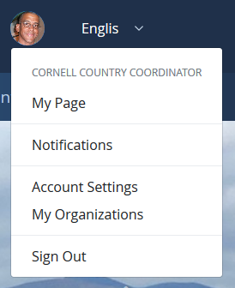
Manage your Information – New Version
My Page - links to your profile page
Notifications- manage your notifications (improved functionality)
Account Settings – manage your account
My Organizations – list of organizations you are a member of

Slide 12
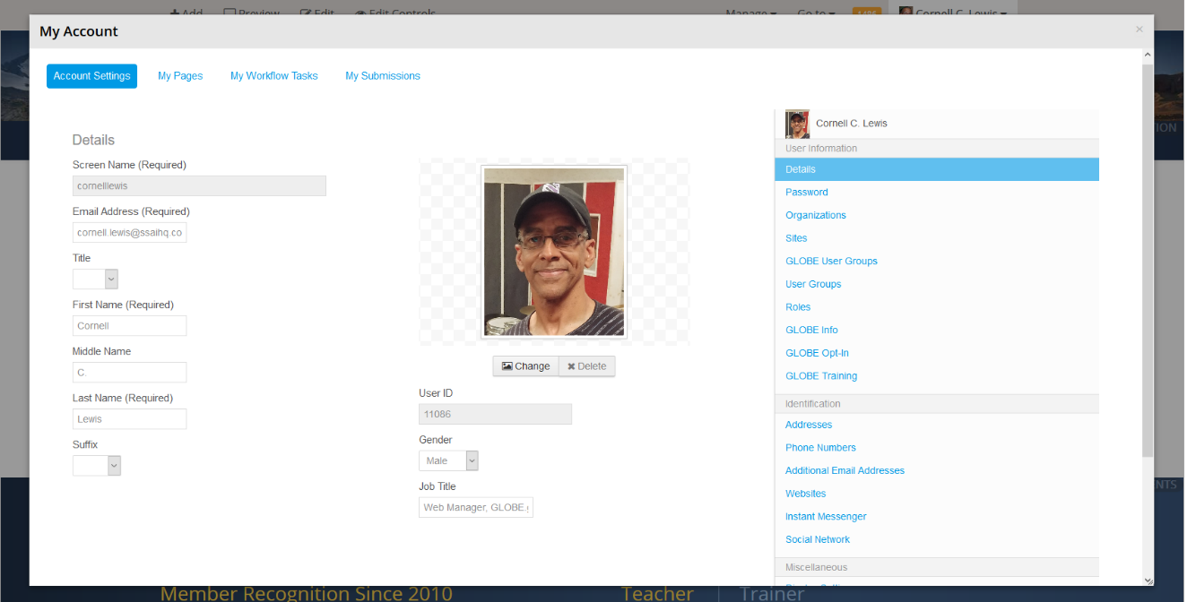
Account Settings – Current Version

Slide 13
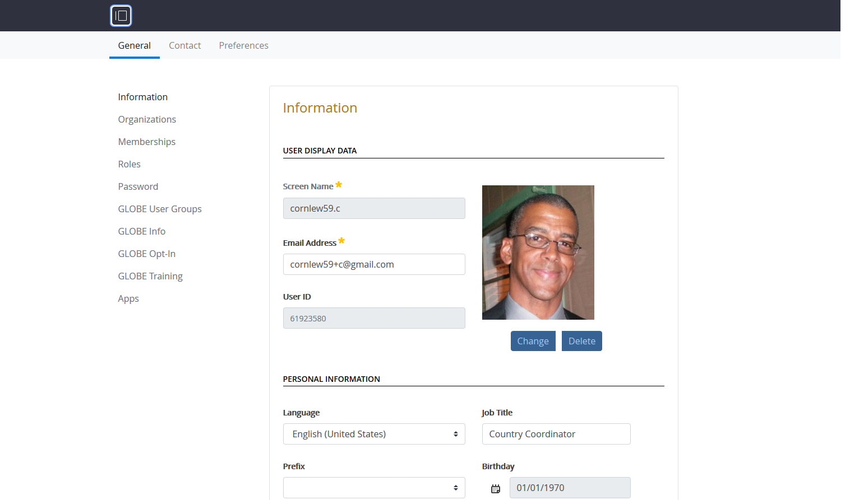
Account Settings – New Version

Slide 14
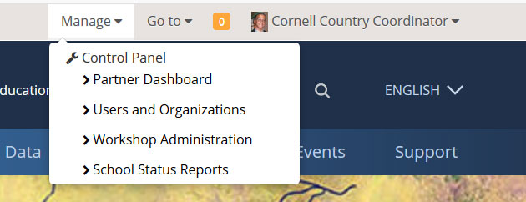
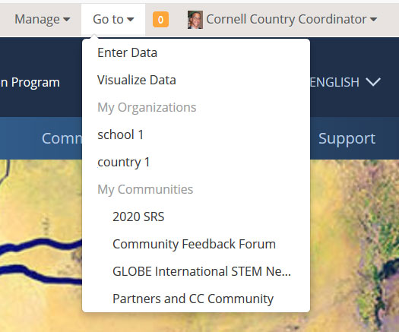
Manage and Go To Menus - Current Version

Slide 15
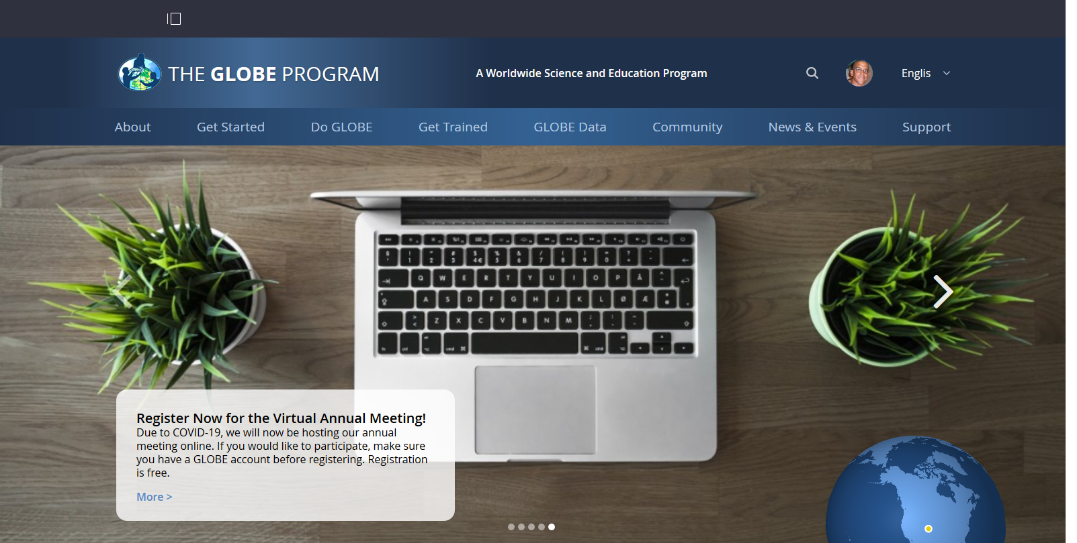
Manage and Go To Menus - New Version
New admin control menu Icon

Slide 16
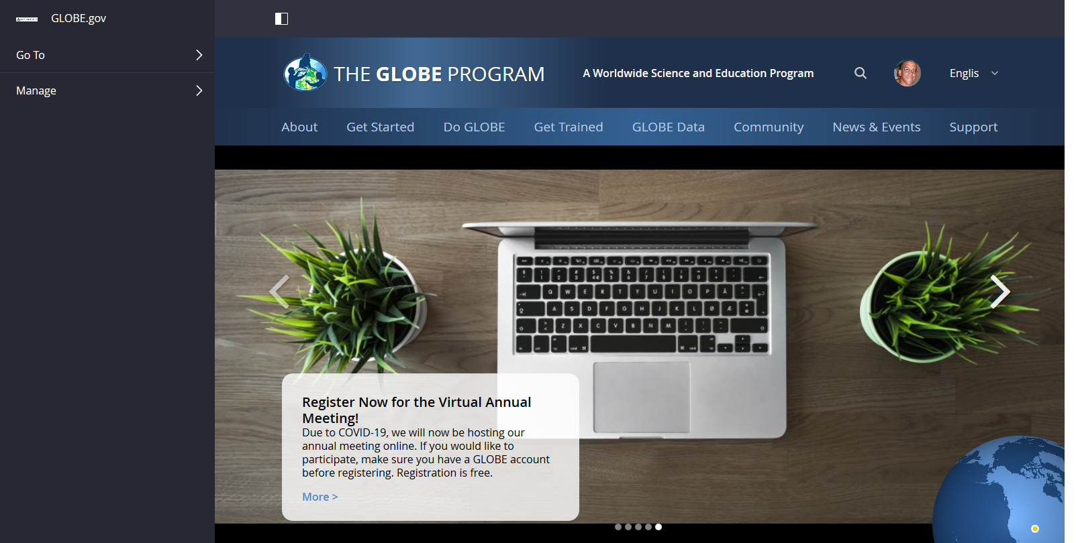
Manage and Go To Menus - New Version

Slide 17
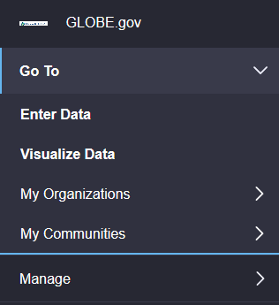
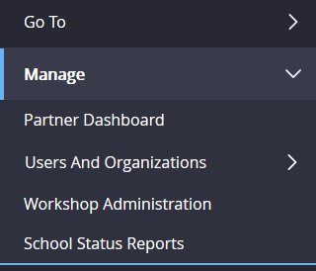
Manage and Go To Menus - New Version
Go To
  Still quick links to Vis, Data Entry and your orgs and communities
Manage
  Partner Dashboard – no changes
  Users and Organization – layout has changed but still for managing your users and organizations
  Workshop Admin – no changes
  School Status Reports – no changes

Slide 18
Manage and Go To Menus - New Version
Let’s look at Users and Organizations
  Layout is new (and improved) but functionality to manage users and orgs is the same

Slide 19
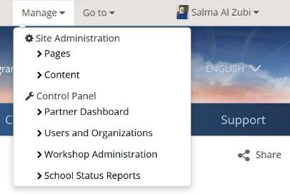
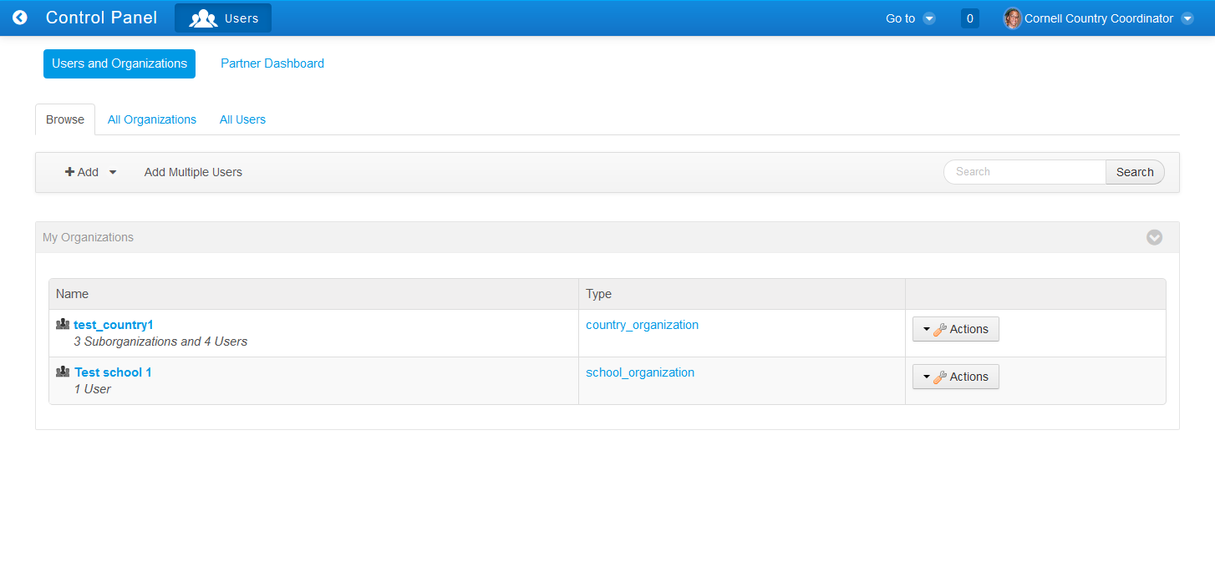
Users and Organizations - Current Version

Slide 20
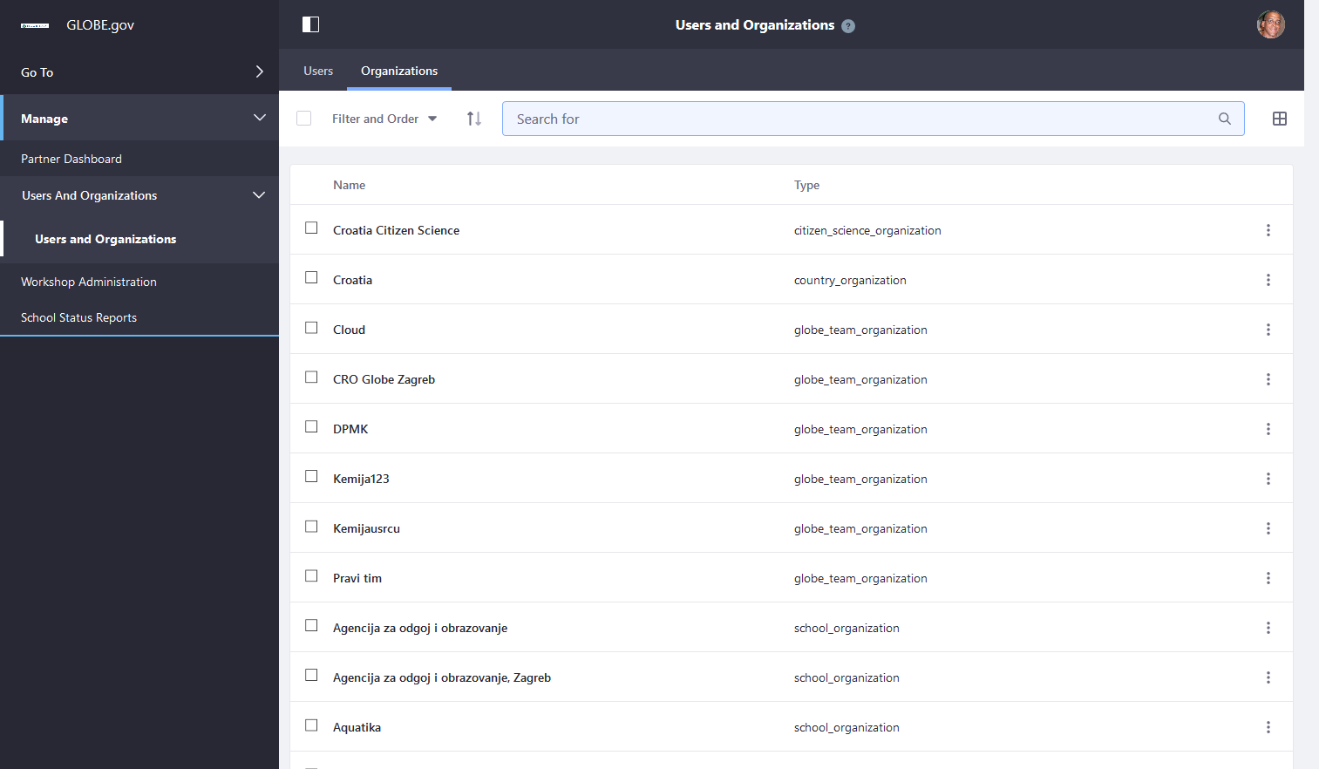
Users and Organizations - New Version

Slide 21
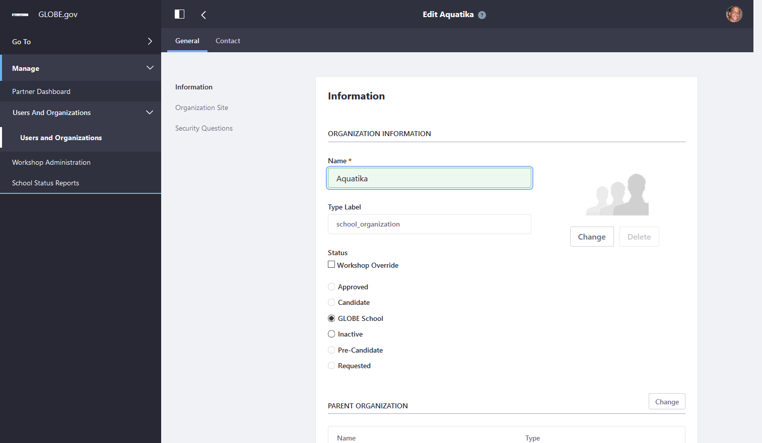
Users and Organizations - New Version

Slide 22

Your Country/Partner Site – Current Version
When on your org site, you see - Site Administration: > Pages > Content

Slide 23
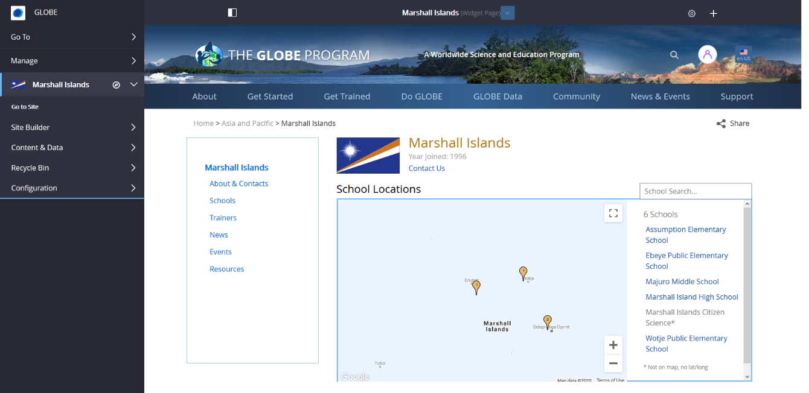
Your Country/Partner Site – New Version
When on your org site, admin functions for your org will display on the side navigation

Slide 24
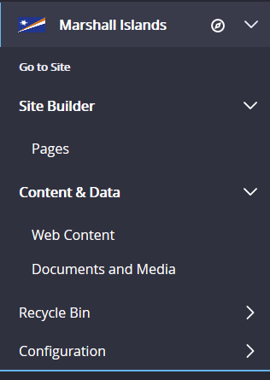
Your Country/Partner Site – New Version
Site Builder > Pages - Manage your organization pages
Content & Data
  Web Content - create and manage all of your content (standard web content, News, Events)
  Documents and Media – manage your documents and images
Configuration – site settings

Slide 25
Your Country/Partner Site – New Version
Let’s look at Org Pages

Slide 26

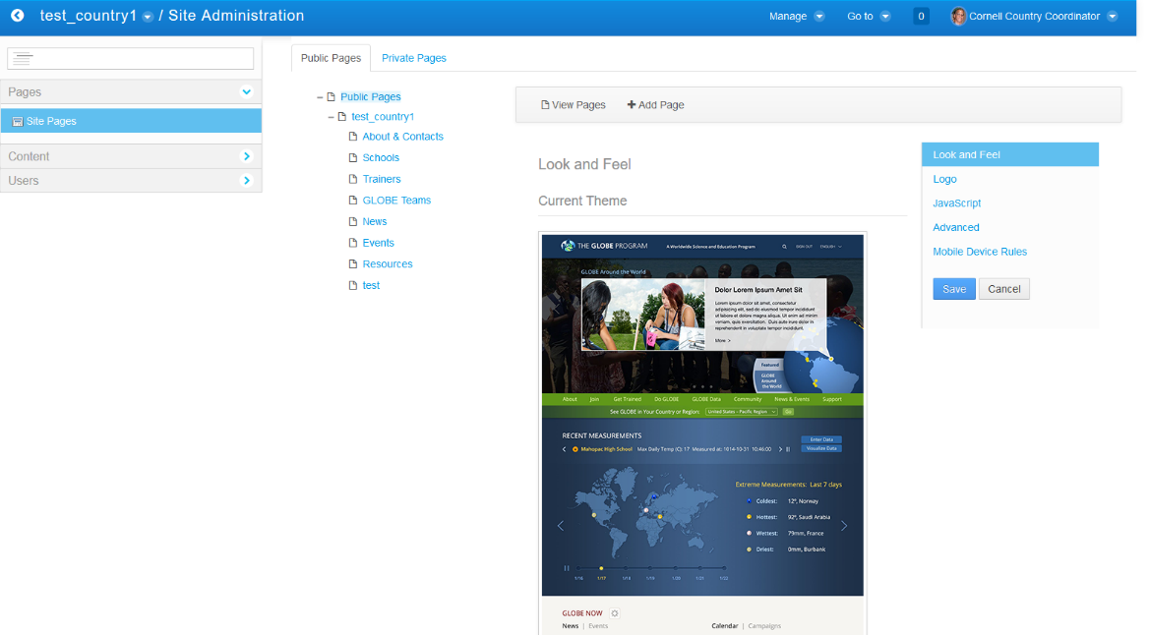
Page Management – Current Version

Slide 27
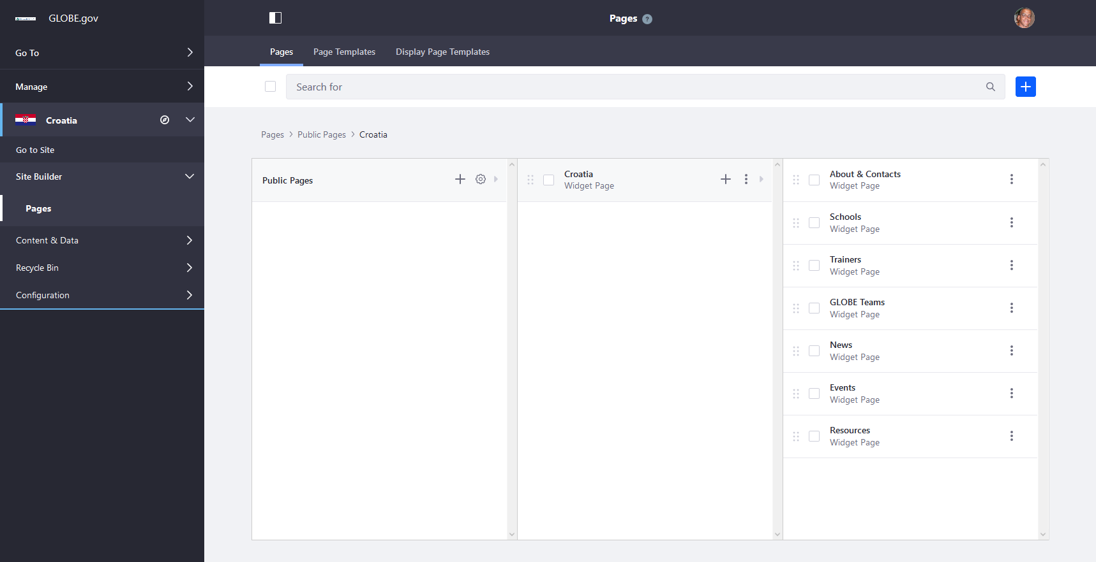
Page Management – New Version

Slide 28

Page Management – New Version

Slide 29
Your Country/Partner Site – New Version
Managing Web Content

Slide 30

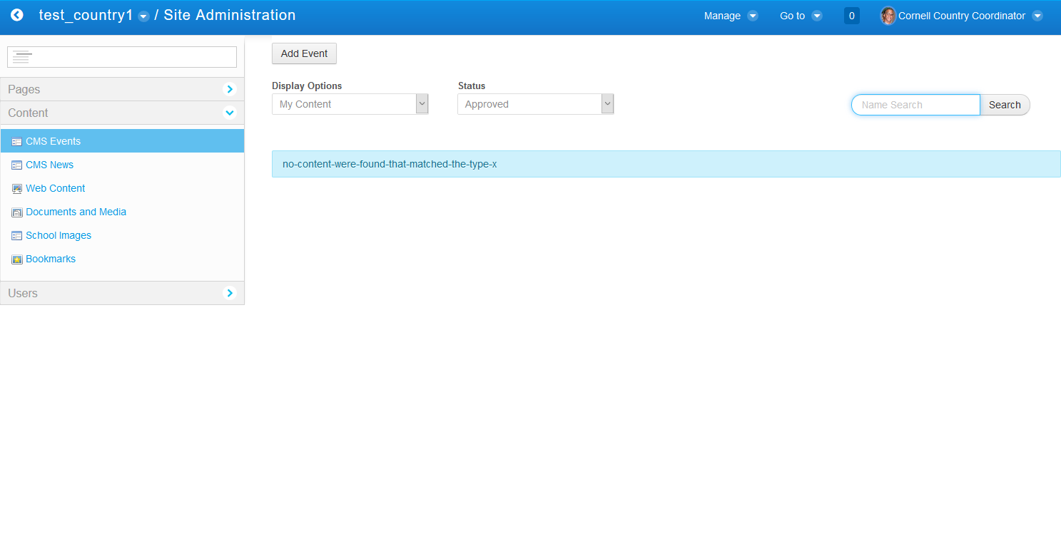
Managing Web Content – Current Version

Slide 31

Managing Web Content – New Version

Slide 32

Filtering Web Content – New Version

Slide 33
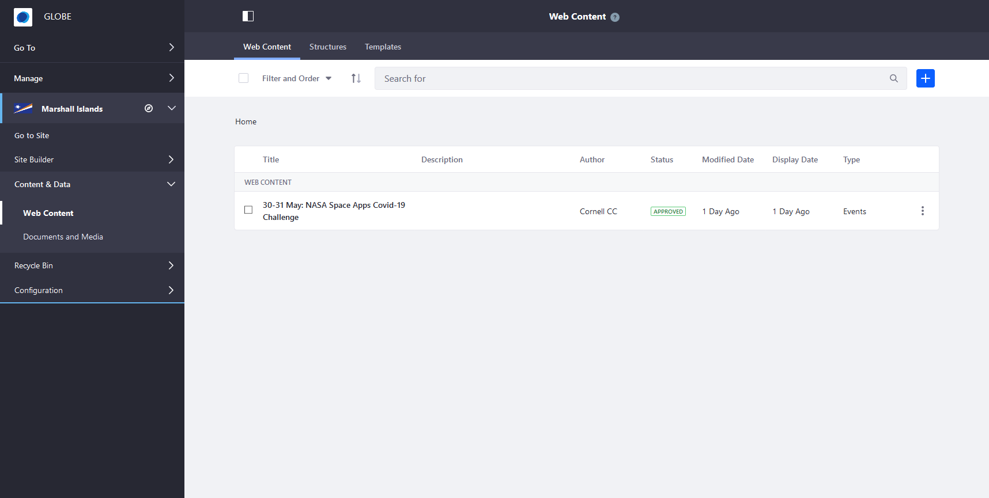
Filtering Web Content – New Version

Slide 34
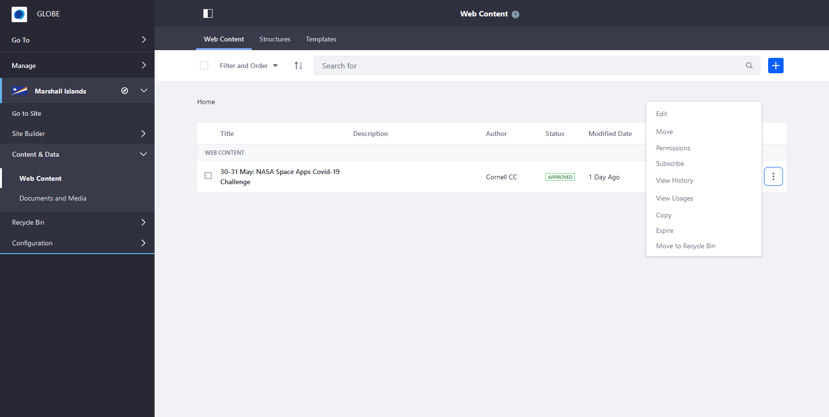
Editing a News Story – New Version

Slide 35
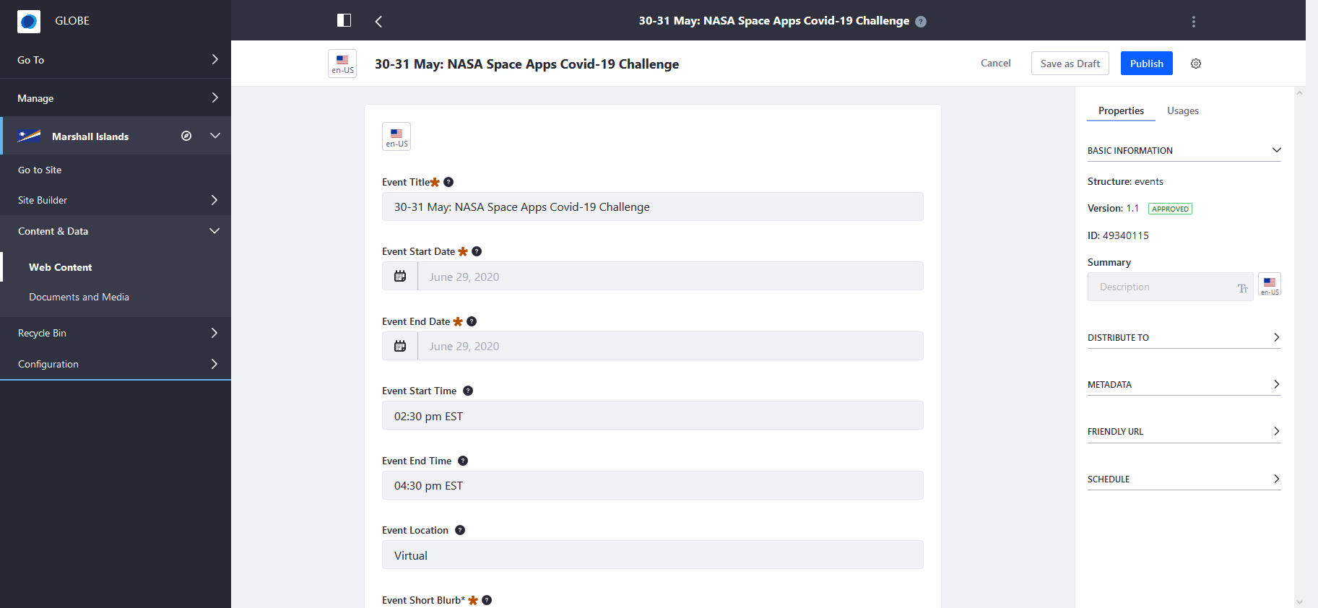
Editing a News Story – New Version
Slide showing editing a News item

Slide 36
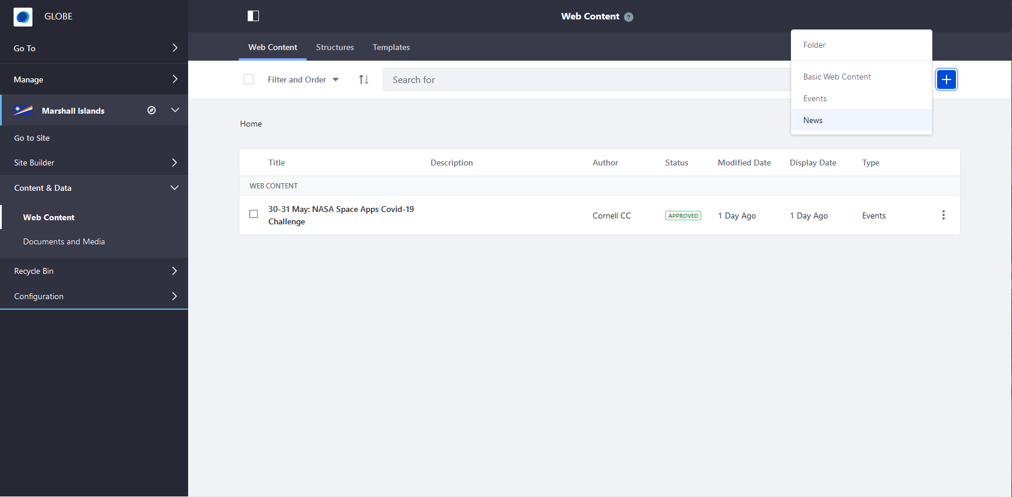
Creating a News Story – New Version

Slide 37

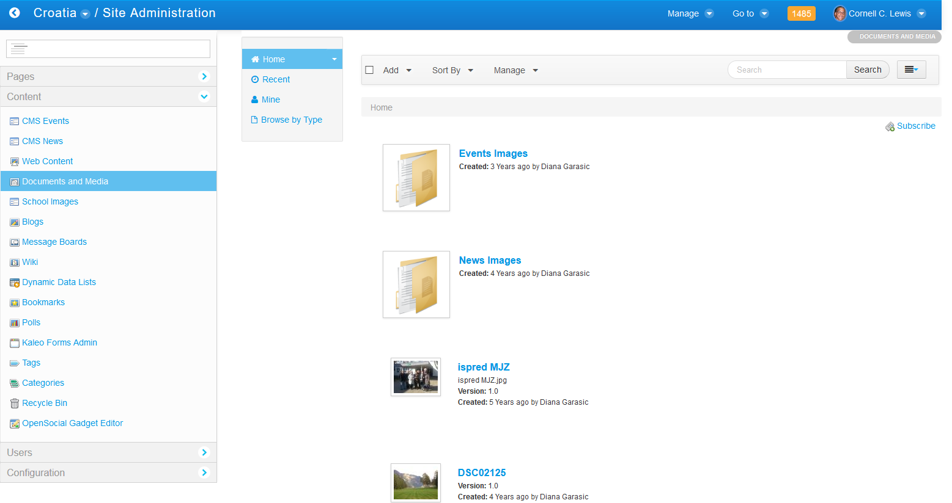
Managing Documents and Media – Current Version

Slide 38
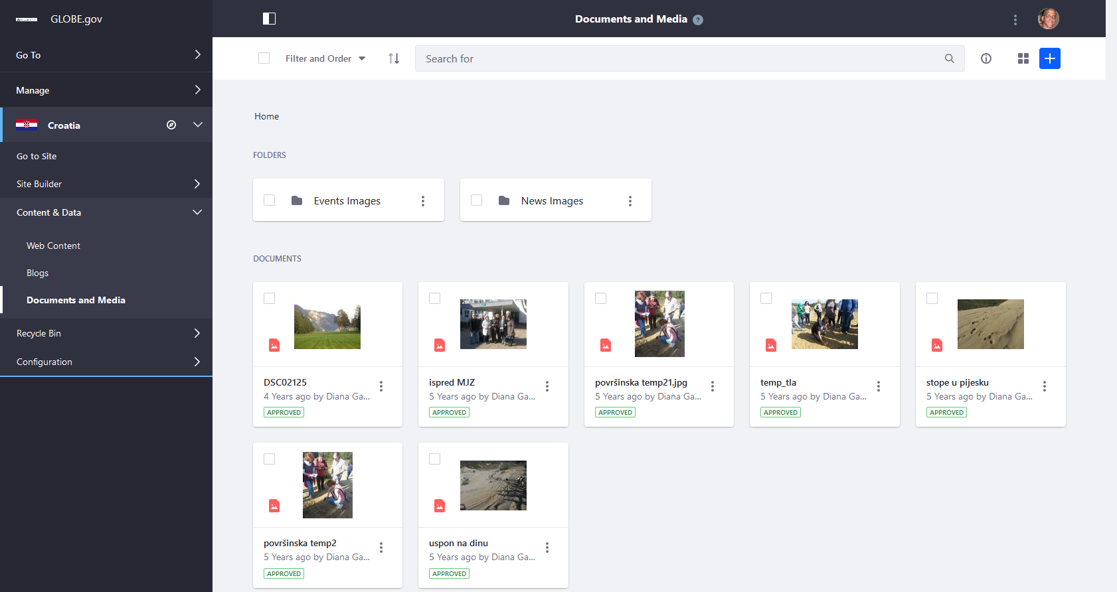
Managing Documents and Media – New Version

Slide 39
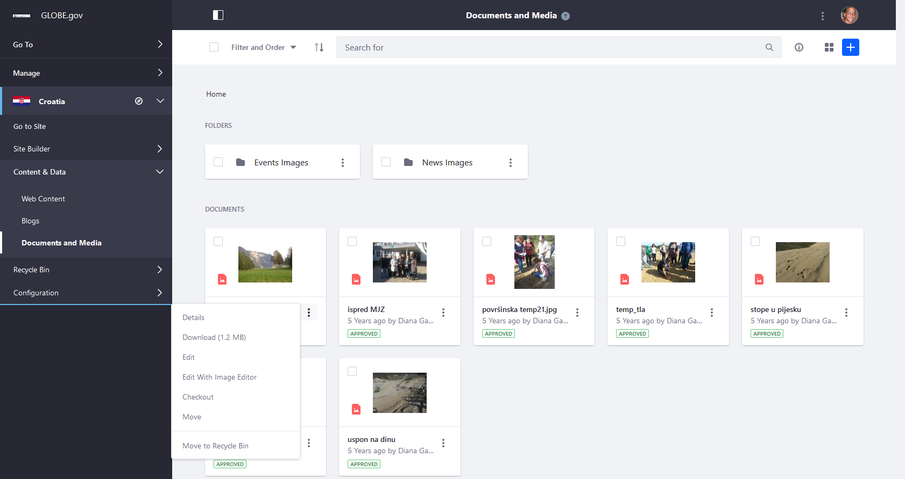
Managing Documents and Media – New Version

Slide 40
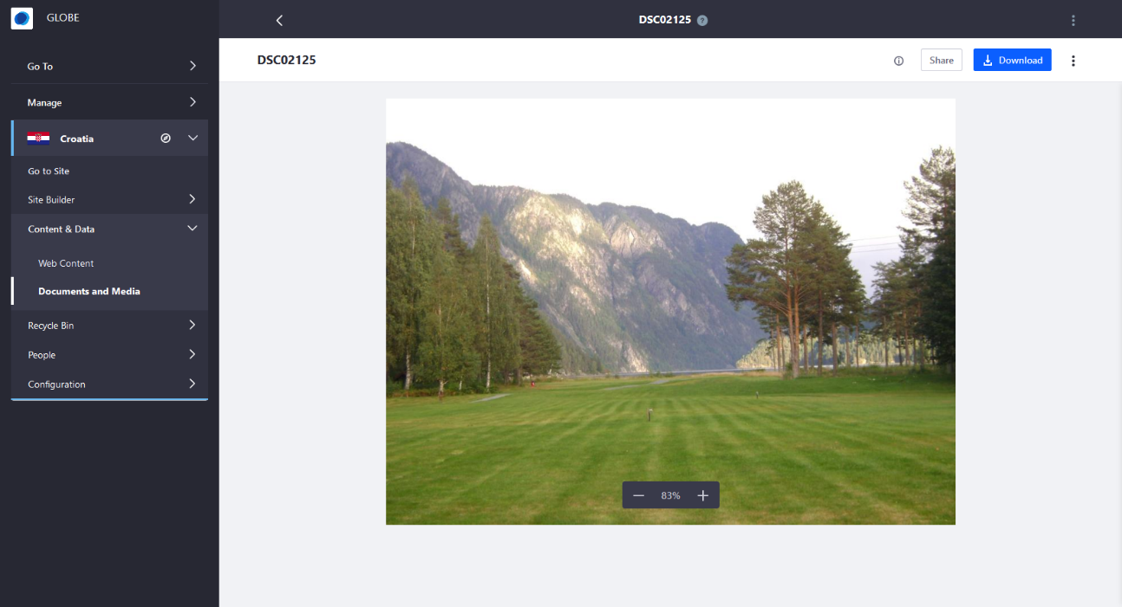
Managing Documents and Media – New Version

Slide 41
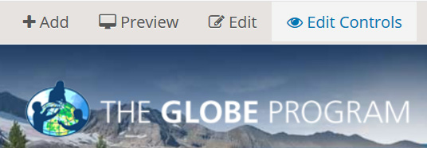
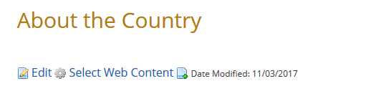
Editing Your Web Content – Current Version
Clicking this
Turns on this

Slide 42
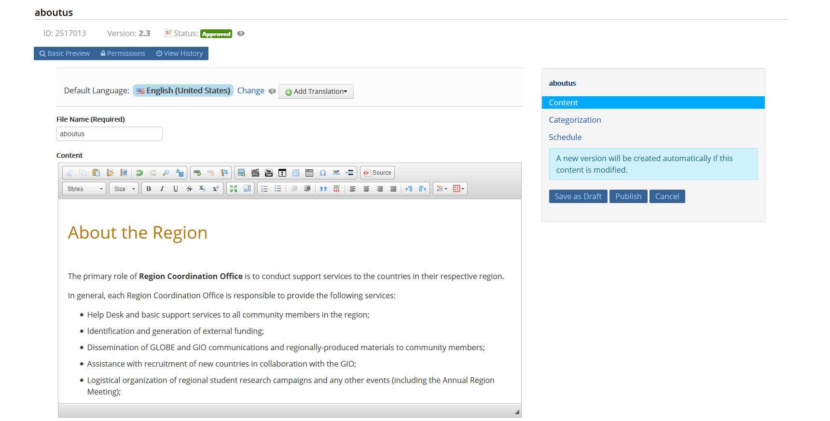
Editing Your Web Content – Current Version

Slide 43
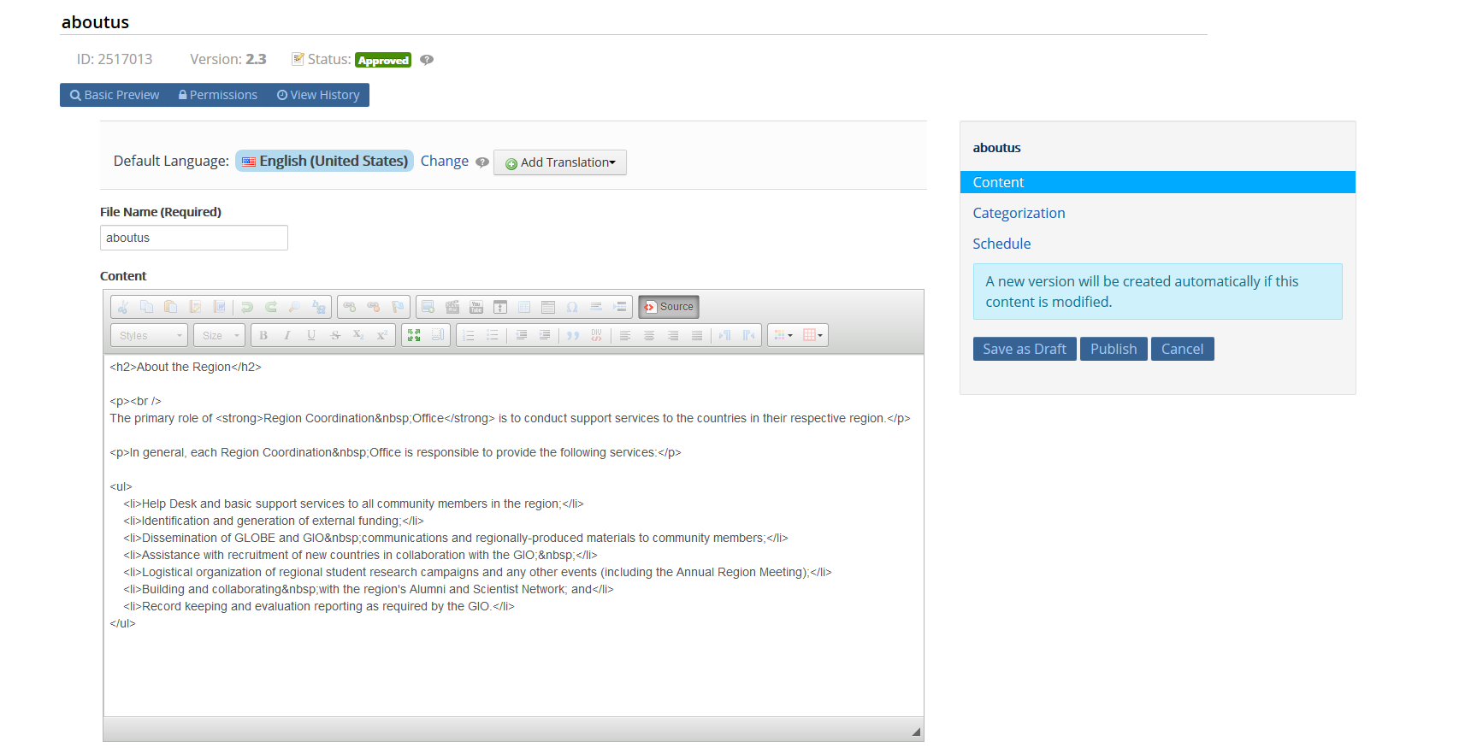
Editing Your Web Content – Current Version

Slide 44
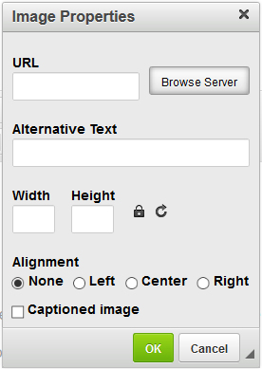
Editing Your Web Content – Current Version

Slide 45
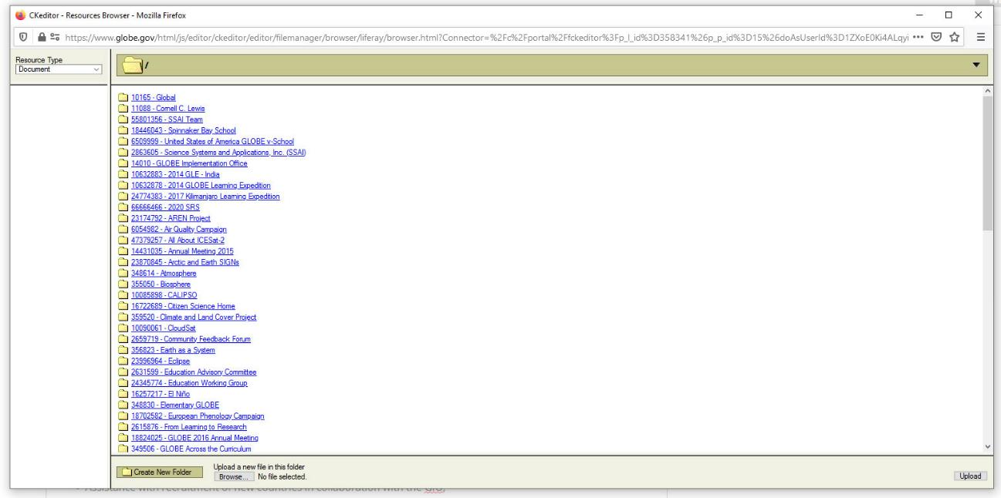
Editing Your Web Content – Current Version

Slide 46
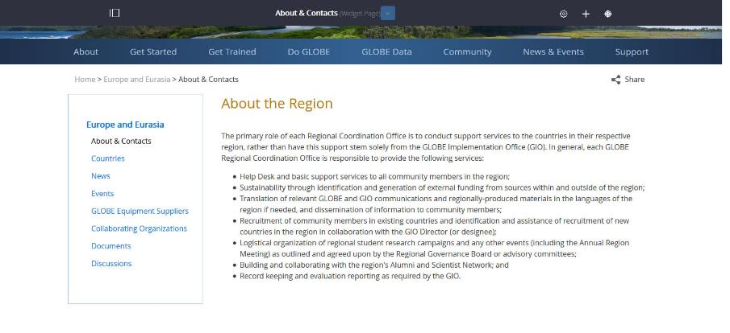
Editing Your Web Content – New Version
On Desktop:
Roll-over your content
On Mobile:
Click on edit controls

Slide 47
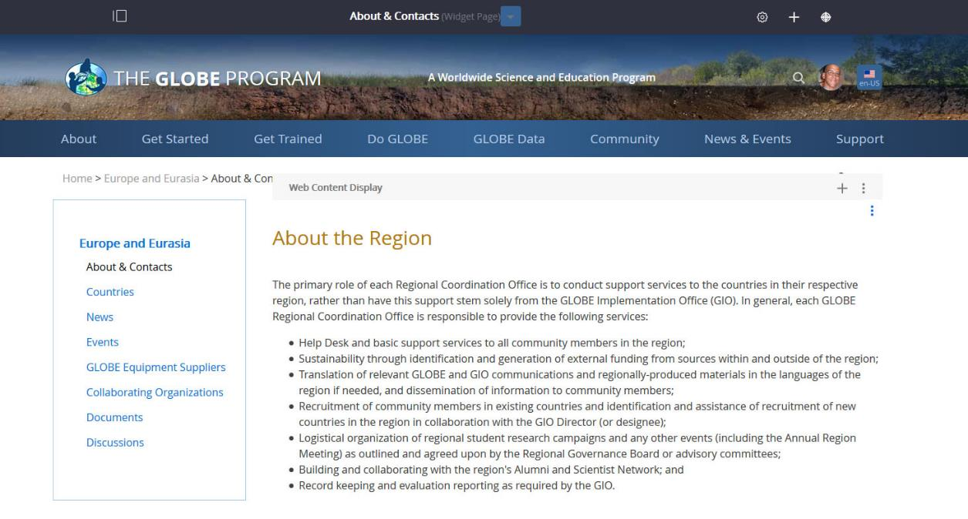
Editing Your Web Content – New Version

Slide 48
Editing Your Web Content – New Version

Slide 49
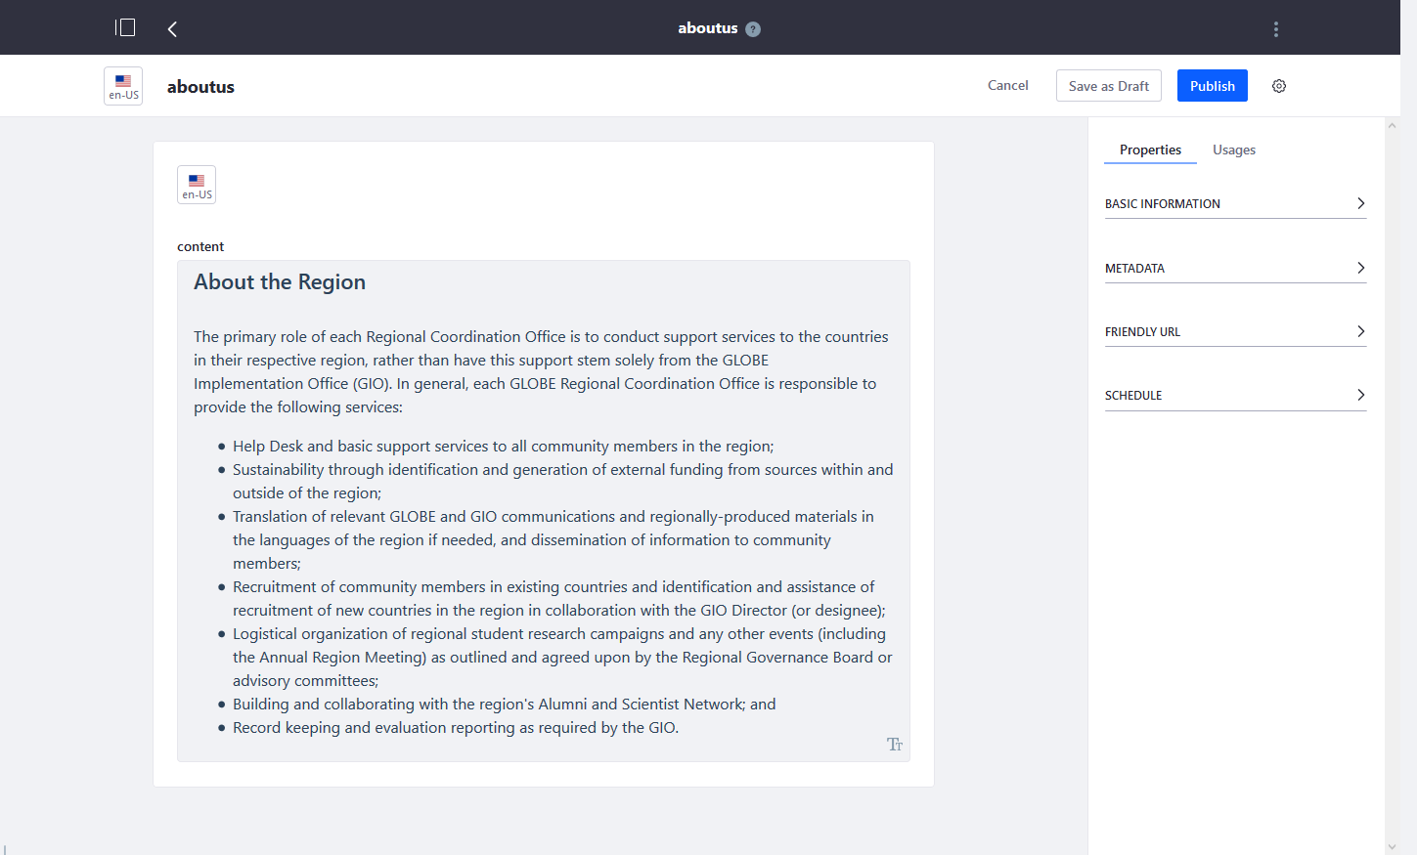
Editing Your Web Content – New Version

Slide 50
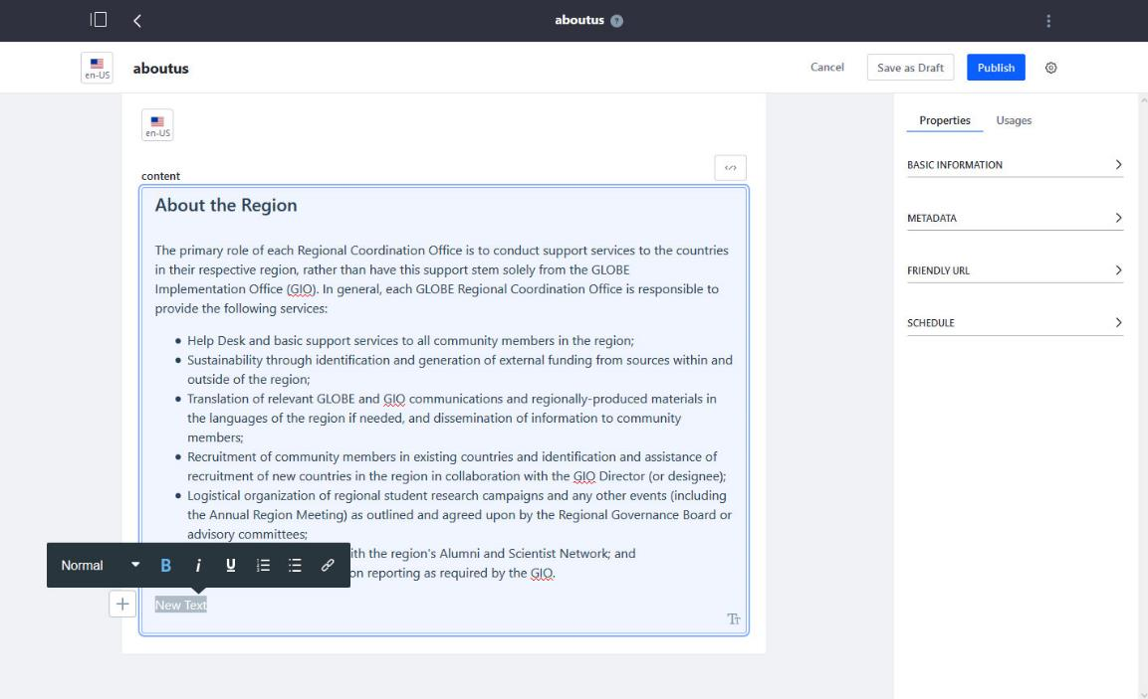
Editing Your Web Content – New Version

Slide 51
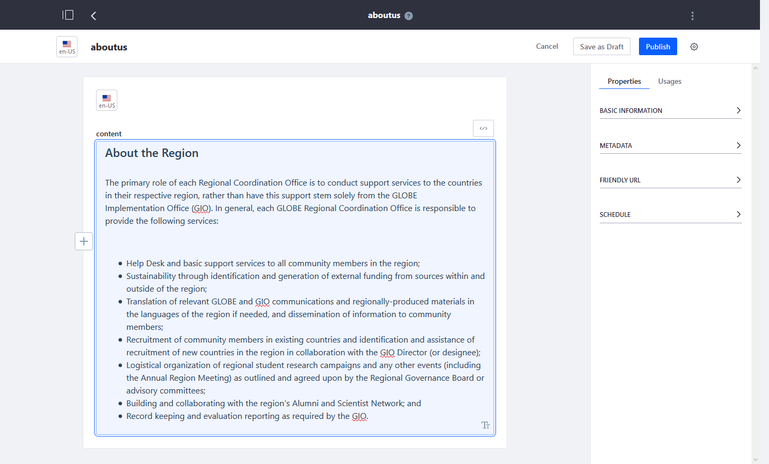
Editing Your Web Content – New Version

Slide 52
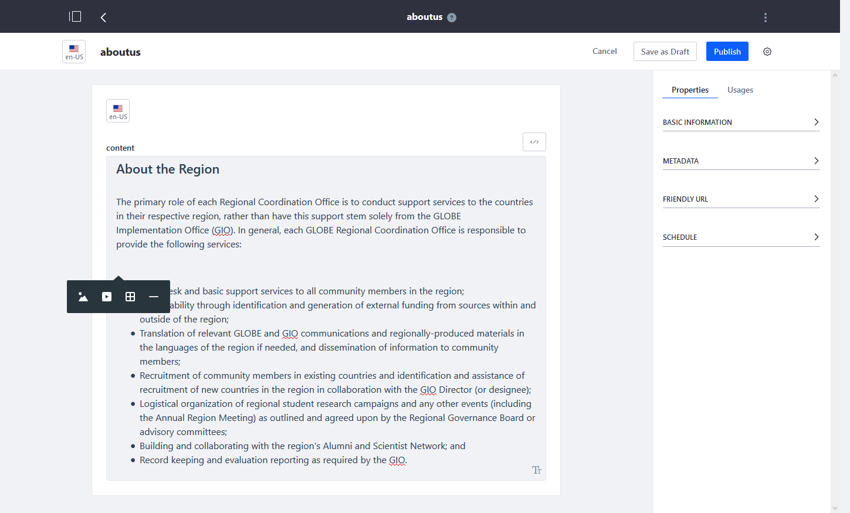
Editing Your Web Content – New Version

Slide 53
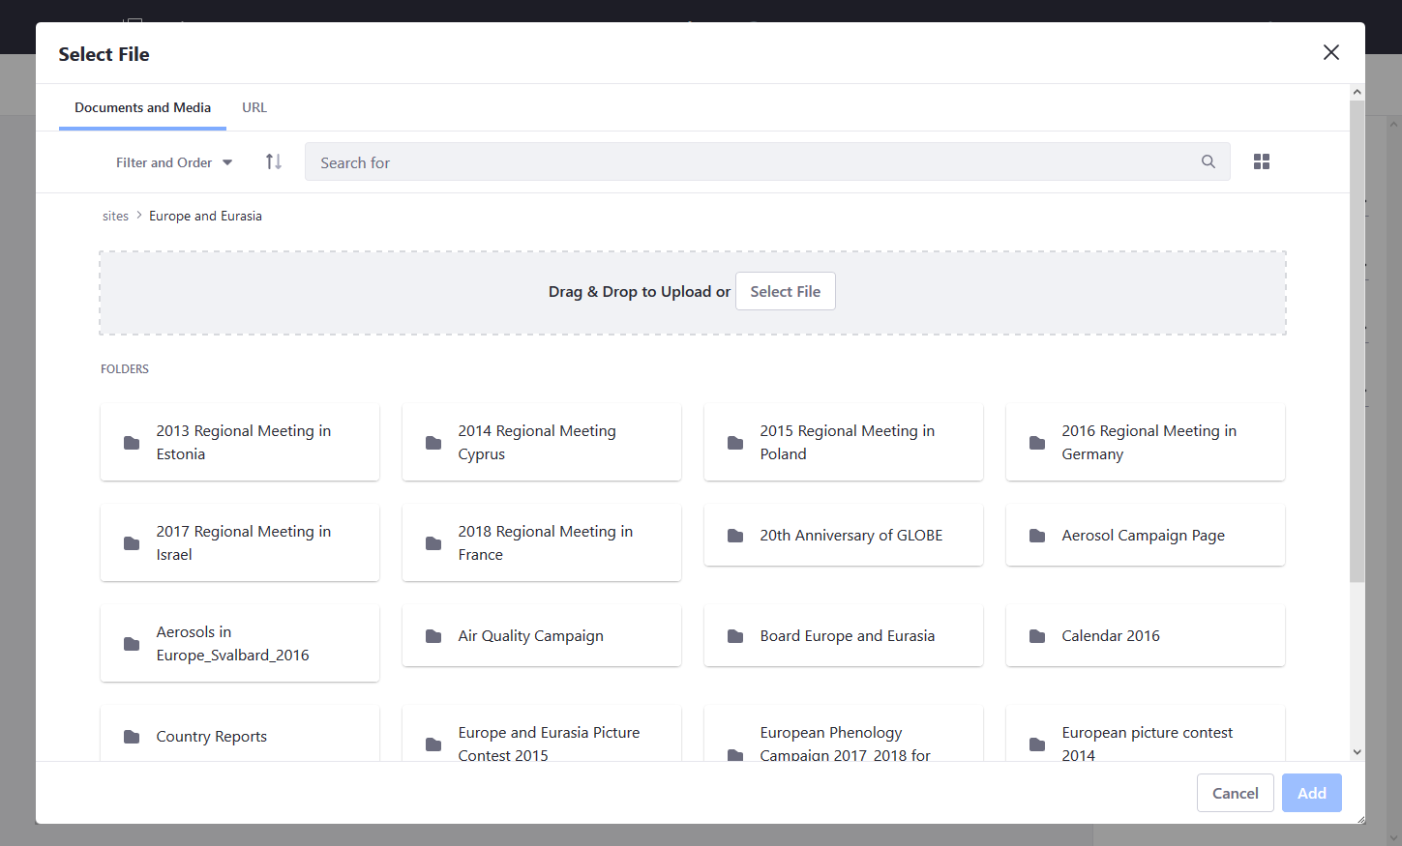
Editing Your Web Content – New Version

Slide 54
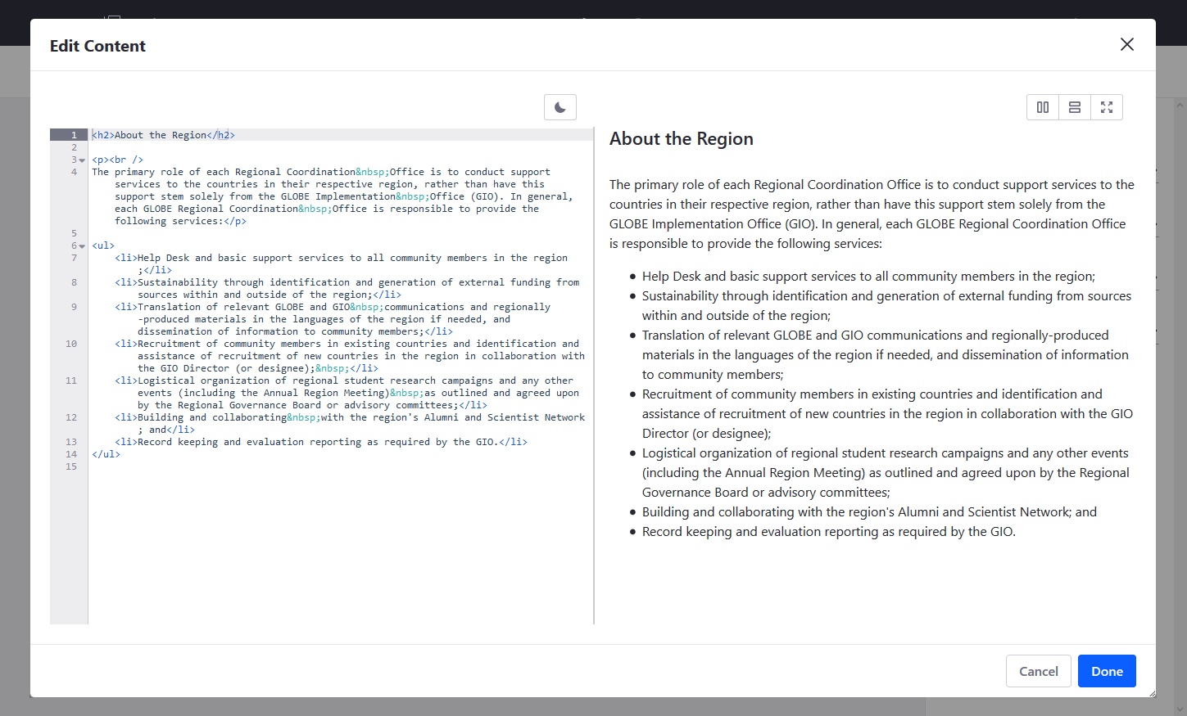
Editing Your Web Content – New Version

Slide 55
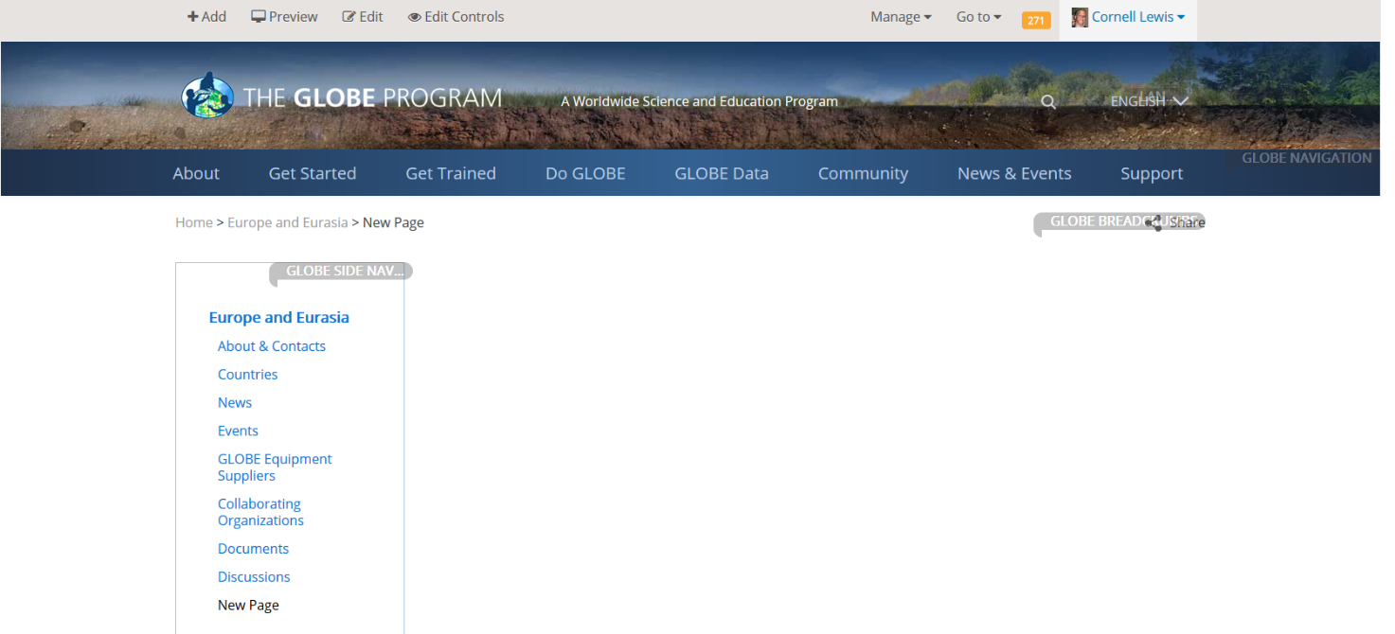
Adding Web Content/Portlets – Current Version

Slide 56
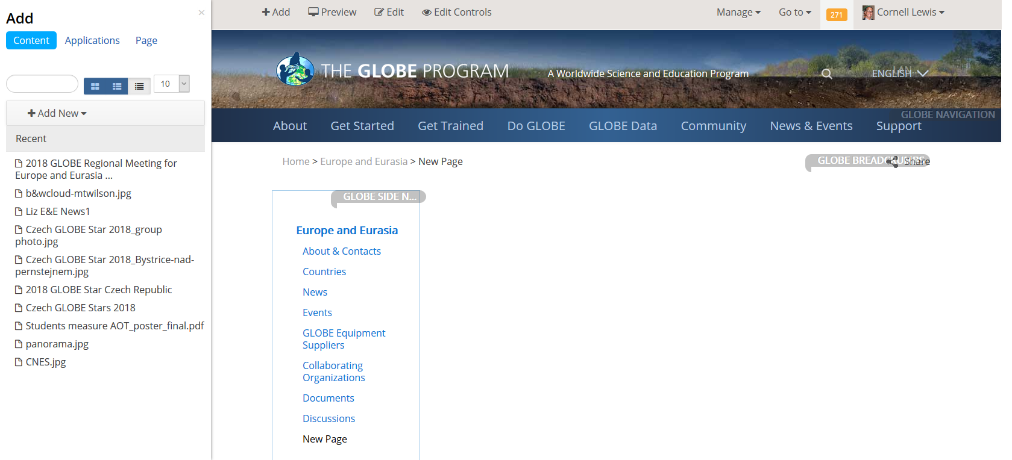
Adding Web Content/Widgets – Current Version

Slide 57
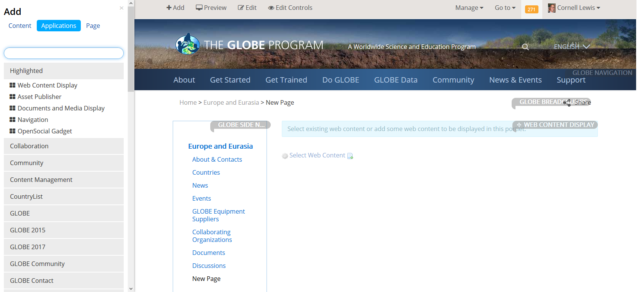
Adding Web Content/Widgets – Current Version

Slide 58
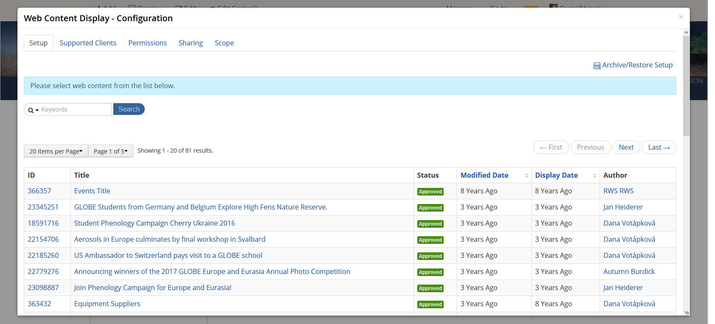
Adding Web Content/Widgets – Current Version

Slide 59
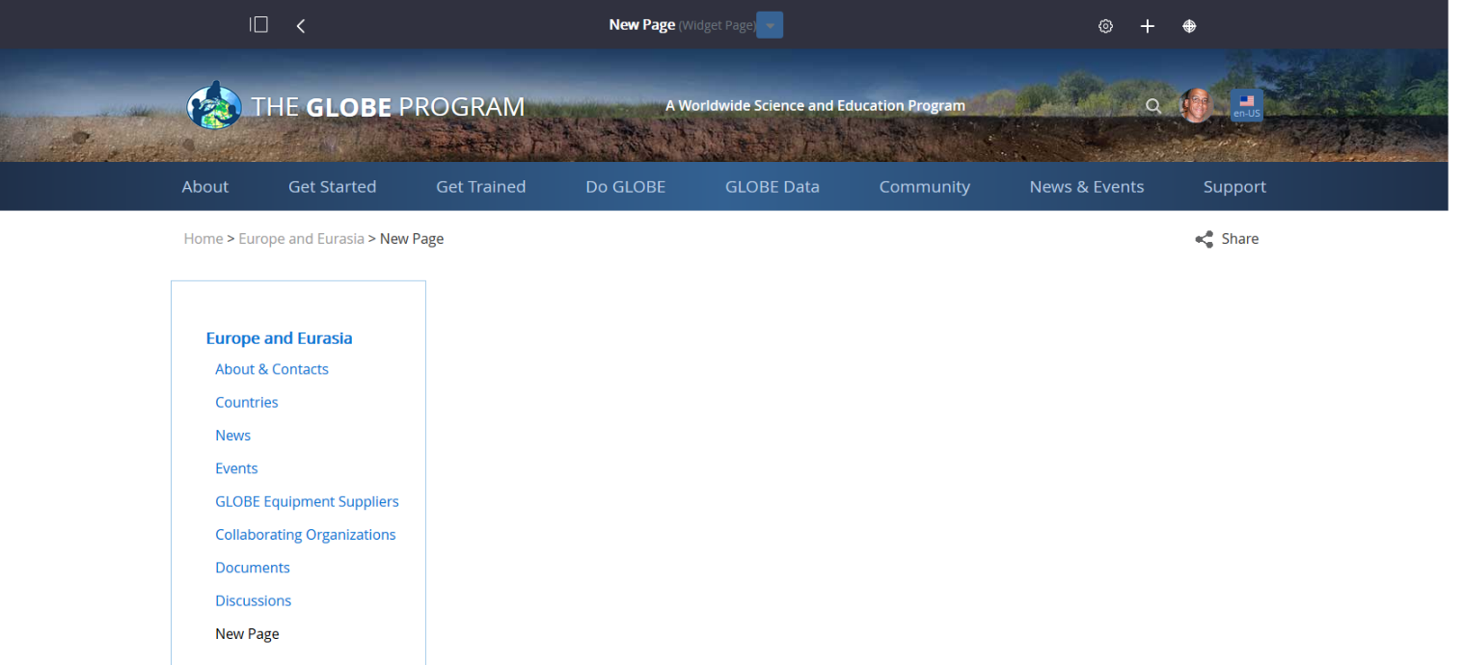
Adding Web Content/Widgets – New Version

Slide 60

Adding Web Content/Widgets – New Version

Slide 61

Adding Web Content/Widgets – New Version

Slide 62

Adding Web Content/Widgets – New Version
Selecting Existing Content
Creating New Content

Slide 63


Adding and Editing Blogs – Current Version

Slide 64


Adding and Editing Blogs – New Version

Slide 65


Improved Layouts
Documents Library

Slide 66


Improved Layouts
Message Boards

Slide 67
Web Site Demo

Slide 68

Virtual Meeting Notes
  Feedback and more information on how to see the demo – in the Annual Meeting ‘Tech Corner’
  Scroll down to New GLOBE Website – “Liferay 7.2” to download this presentation.

Slide 69
Questions?

Slide 70
David.Overoye@ssaihq.com
Cornell.Lewis@ssaihq.com
Science Systems & Applications, Inc

