Slide 1
Bringing GLOBE and Scientific Questions to the Classroom!
Alaura Fetterman
Kari Cooley
Keeley Hughes
Gabriella Nusbaum
Notes:
Located in Toledo, Ohio
Mrs. Tsporpranis’ Classroom
GLOBE teacher
Approximately 16-20 students

Slide 2
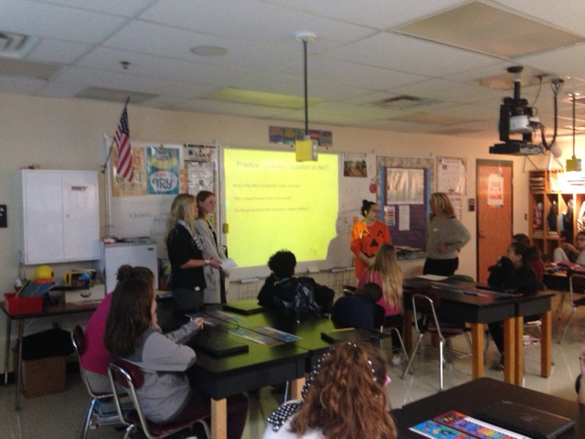
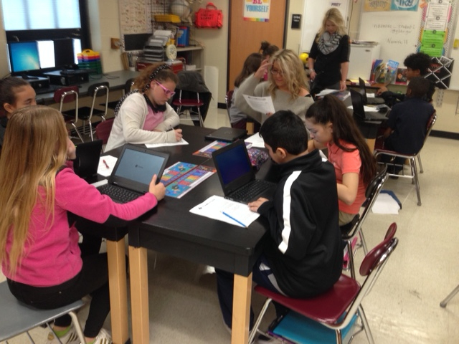
What makes a good Scientific Question?

Slide 3
Introduction
Why is the world’s best color blue?
Notes:
Alaura
To start the lesson we first went over an interactive powerpoint about what makes a good scientific question. Then we had the students fill in notes.
Students were also given GLOBE worksheets to help distinguish the types of scientific questions.
The following list of questions was given to the students to decide whether or not they make good scientific questions:
Which sunscreen is the best?
Which sunscreen has the most SPF?
Why is blue the best color in the world?
Why does it rain so much?
What types of clouds produce the most precipitation?

Slide 4
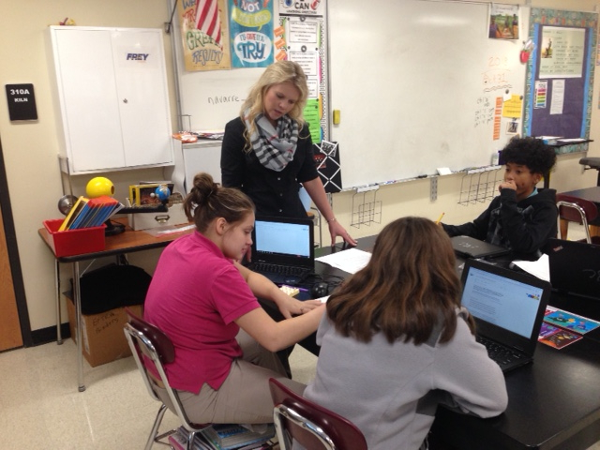
Types of Questions
Verification Questions
Is it cold today? Is the sun still out? Is a flame hottest when it is blue?
Significant/ Theory Questions
Why should you point a car's wheels toward the curb when parking on a hill? Do clouds have to be in the sky for it to rain? Why do you add acid to water instead of water to acid?
Experimental Questions
If salt is added to water, would the solution still boil at the same temperature? or If Suntan lotion is put on ultraviolet detecting beads, will the beads still change color?
Notes:
Alaura

Slide 5
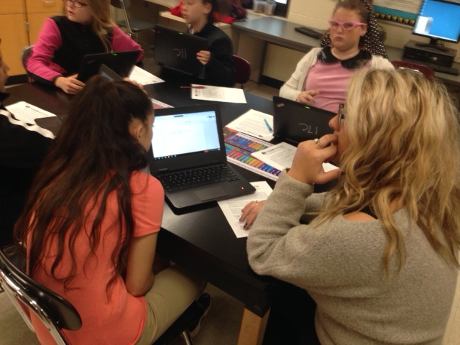
Guidelines for writing good
scientific questions
A good question has an answer and can be tested.
It can be tested by an experiment or measured.
The question builds on prior knowledge.
Lastly, when answered, it leads to other good questions.
Notes:
Kari

Slide 6
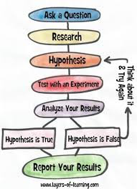
Scientific
Method

Slide 7
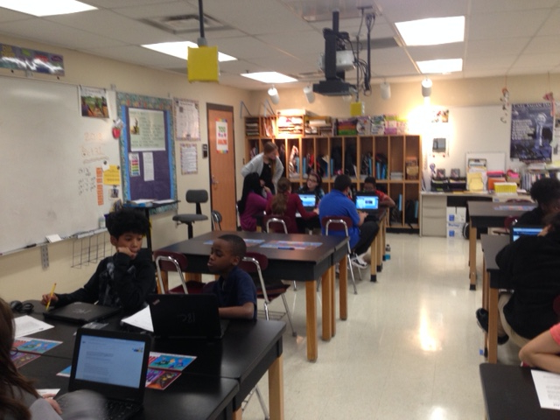

Slide 8
Research and Process
Create a generalized/basic scientific question
Is this a good scientific question?
Think about what you've learned about Globe in class
What do you want to learn?
Create the scientific question
Is this a good scientific question?
Research the topic in globe
Find the answer
Share within the group
Notes:
As a group split, the four of us went to the group of kids and explain different scientific questions and they responded from my group that they learned about clouds. then I told the group to make up a scientific question that was basic enough so they can build off of it. some kids came up with how much sugar is in a chocolate bar. Then I explain to them that Globe is a great resource for them to look up different things and their science class and learn it more information about it. they told me they learn about clouds so I asked him what you want to learn about clouds. The students came up with ideas like how much does it snow in December then we share with the group

Slide 9
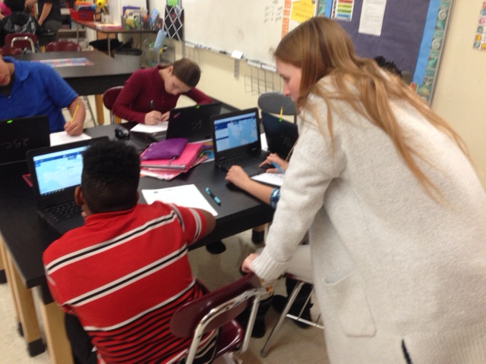
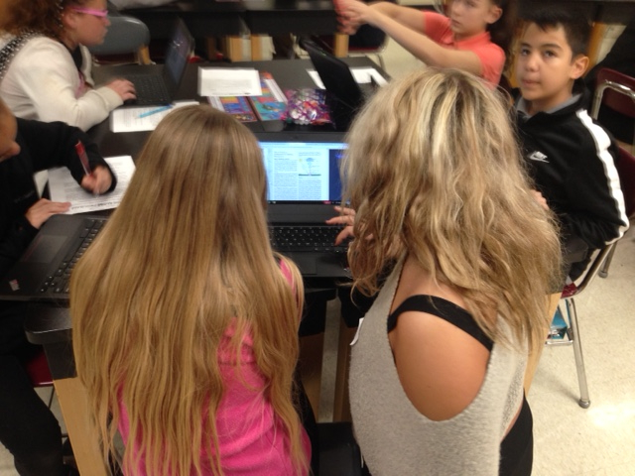
GLOBE Research
Notes:
We also use this tool they were getting a class from our teacher. It was a guideline to go off the gold program so the kids wouldn't reach her something that was an unnecessary. keeley

Slide 10
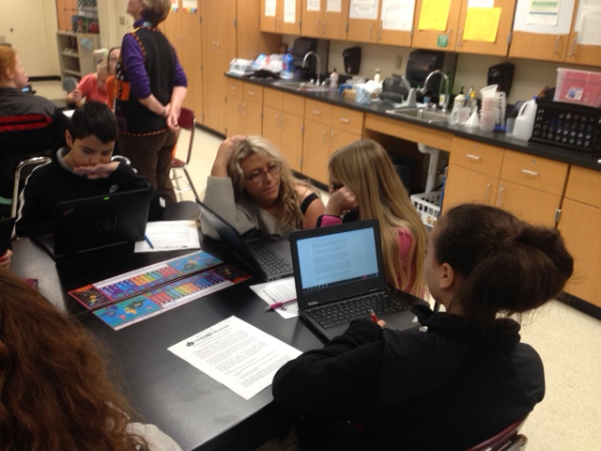
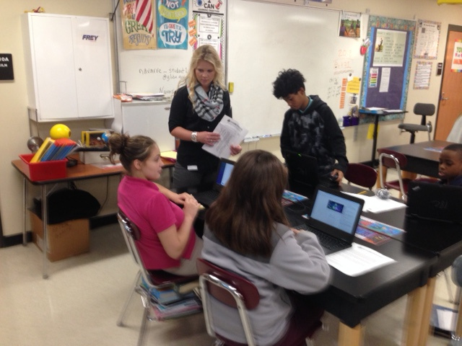
The students are looking up ideas and researching GLOBE protocols.

Slide 11
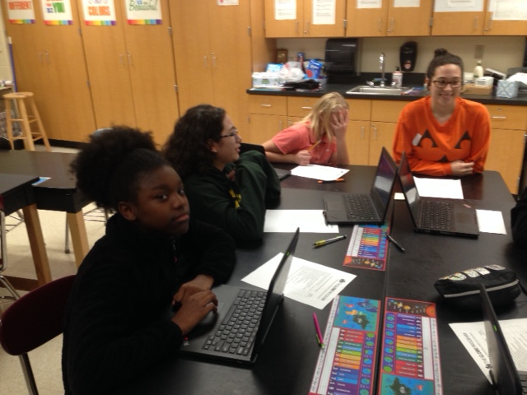
Student Outcomes
After students thought of their own scientific questions and researched them through GLOBE, they shared their best question to their group.
Each group then decided on which was the best scientific question amongst them, to share with the class.
Notes:
Gabi

Slide 12
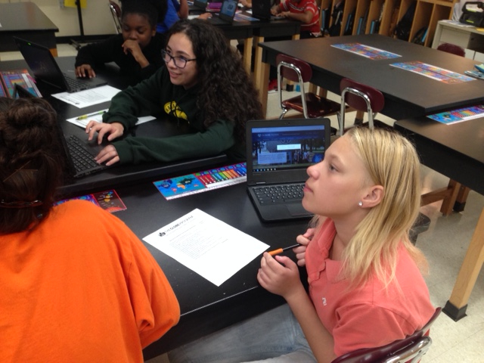
Our Scientific Questions
What effect will aerosols have on our climate over time?
How will surface temperature change when taken from different outside surfaces (Ex. black top vs. grass)?
What is the long-term effect of releasing more greenhouse gasses on climate?
How does weather affect a clouds shape?

Slide 13
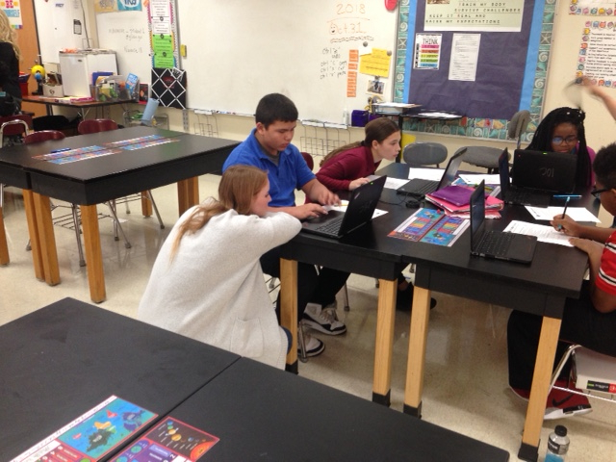
Conclusions
Students learned about what makes a good scientific question.
Using prior knowledge and GLOBE, students made their own scientific questions.
They then presented their best findings to the class, in which other groups commented upon.
Throughout the lesson all students seemed to be engaged and interested in furthering their science knowledge through GLOBE!
Notes:
Gabi

