Slide 1
What causes particulate matter concentrations in our region?
?

Slide 2
Hello!
We are Tibbe, Jurjen Maximo and Damian
And we will tell you about our research

Slide 3
Concise
Let’s start with the consice

Slide 4

Context of Research
Why did we start in the first place?

Slide 5
Research Questions
What causes particulate matter in our region?
What day has the highest concentrations of particulate matter?
Which neighbourhood generally has the highest concentration of particulate matter?

Slide 6
Methods description
1: Building a particulate matter sensor with Arduino
2: Install the particulate matter sensor in different locations throughout our city and note the results. This happens in a time span of 1 week.
3: Comparing the results and calculating the differences.
4: Investigating the potential causes of the differences between the results by comparing multiple factors that can have influence on the amount of particulate matter.
5: Determining the cause.
6: Drawing a conclusion about what the cause of the particulate matter in our region is.

Slide 7
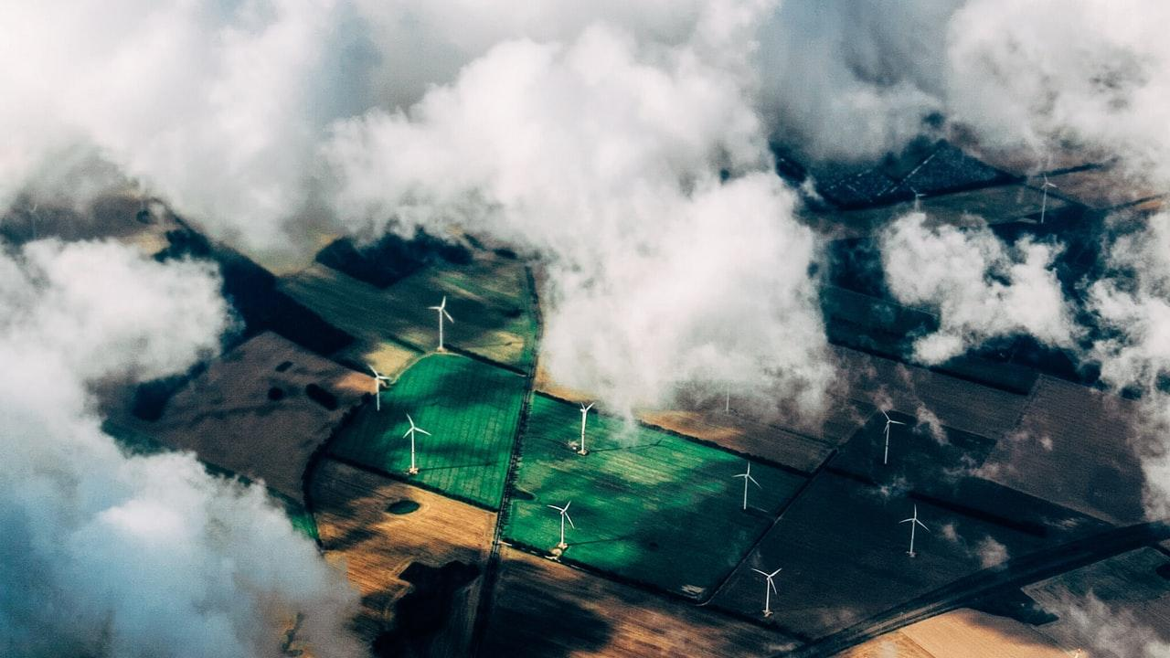
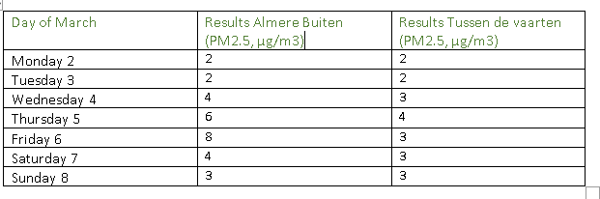
Results:

Slide 8
Discussion
What can we discuss?

Slide 9
Conclusion
Let’s end with a conclusion

