Slide 1

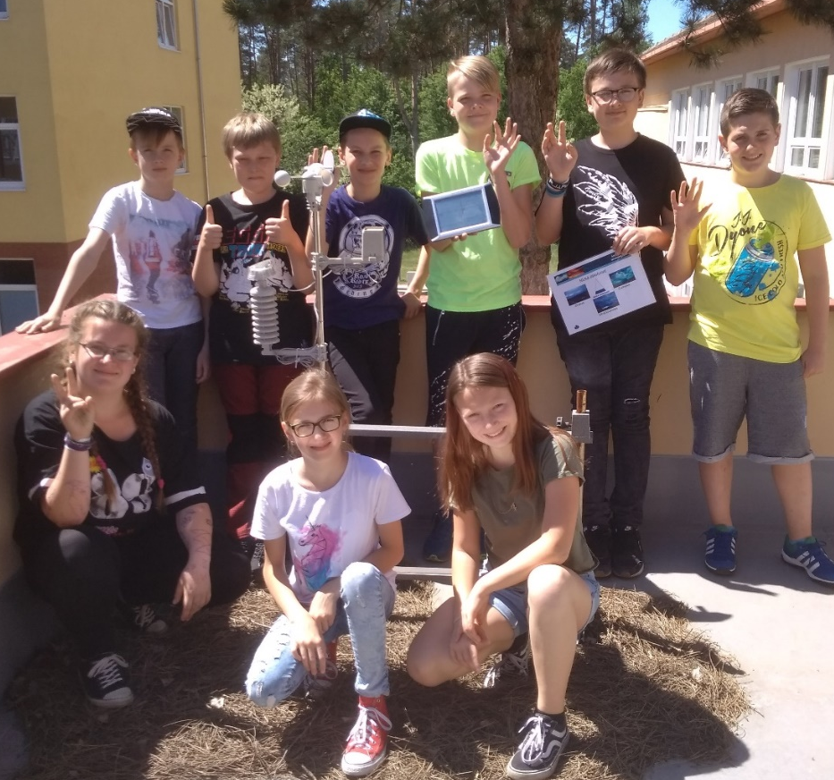
Základní škola
Dubňany
Secondary school Dubňany
Hodoninska 925 696 03
Czech republic
GLOBE GAMES 2018 HUMPOLEC
GLOBE TEAM: Adam Antoš, Nikol Kryštofová, Lenka Vaculíková,
Gabriela Hvožďová (6.B)
GRAPHIC: Aleš Lunga, Filip Jančík
GLOBE TEAM

Slide 2

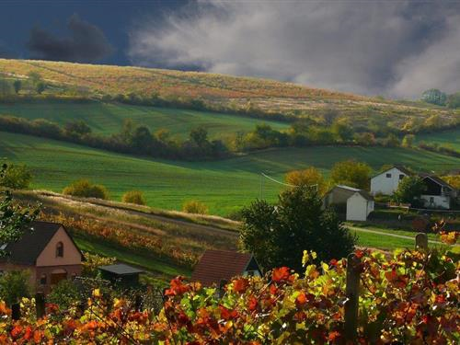
IS DUBNANY WARM?
Research question: Is our town warm?What weather and climate is in Dubňany?
Our hypothesis: There is a hot and dry climate in Dubňany.

Slide 3
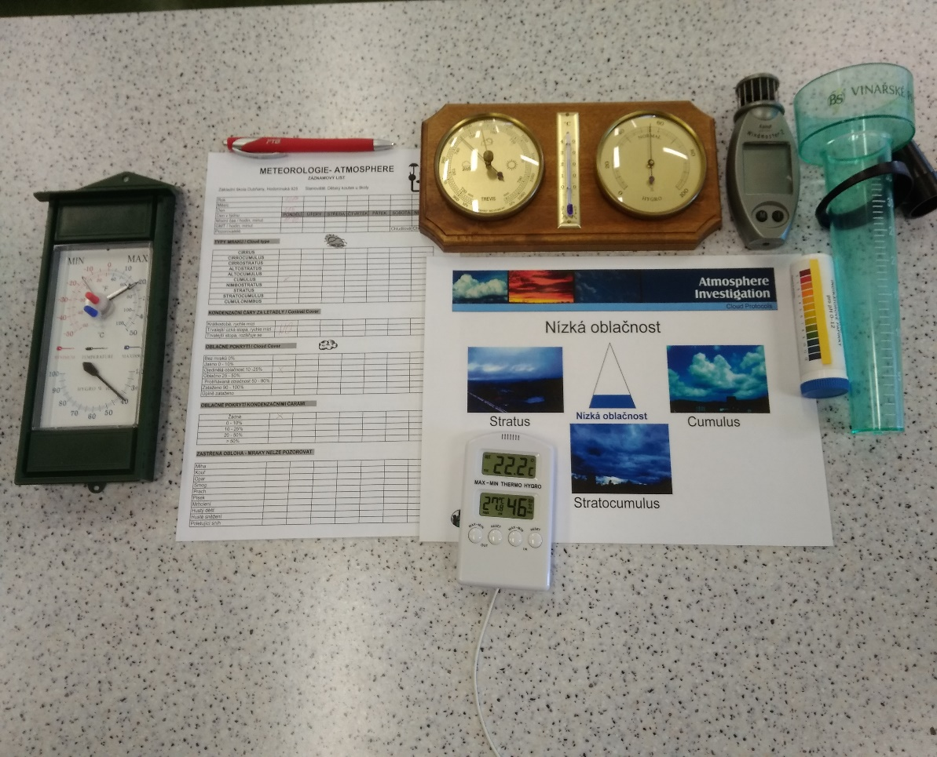
How did we search?
What did we use?
We found out our knowledge about this topic, we found out our abilities to this searching ☺
We learnt research steps in Physics and Biology
We planned our procedurs and measurements
We learnt new things and we took photos
We were searching in books and on the internet
We were talking to some witnesses and we worked with CHMI expert
We made up our conclusions, we asked the new questions, we suggestedmeasurements and we presented our work

Slide 4
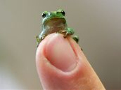
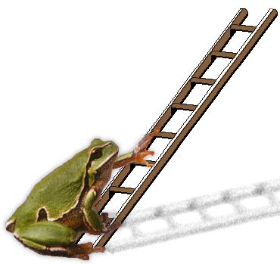
Meteorology examines the weather.
The weather is the instant state of the air.
The climate is a long- time state of the air.
Can you guess the weather forcast by the nature?
The swallows and martins fly high – it will be …….
The spiders make large webs – it will be ……
We can hear the crickets a lot – it will be ……
The fish jump out off the water – it will be ….
There is a strong ring around the Moon – it will be…
The piegons don‘t fly a lot or they sit in groups – it will be…
What about the tree frog? What does it say?

Slide 5
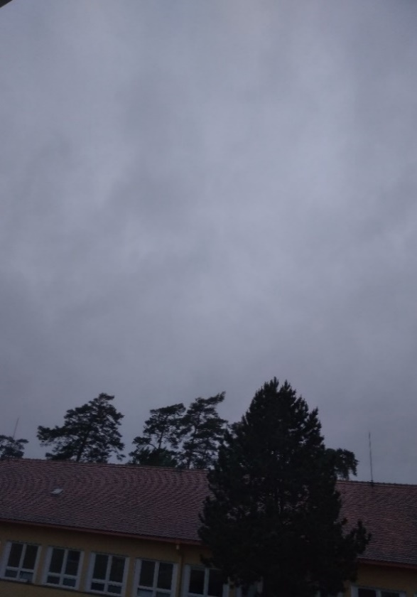
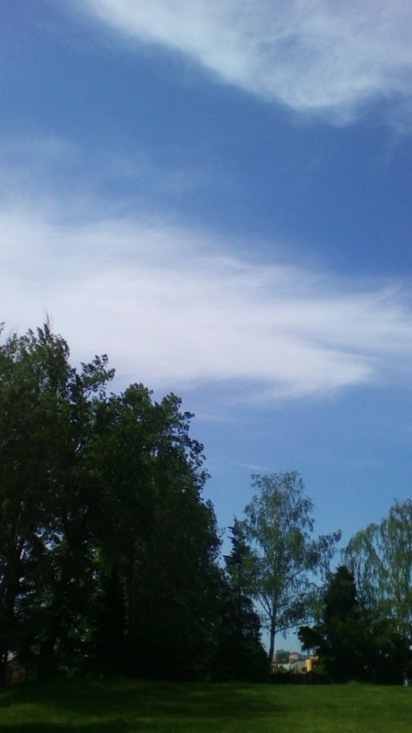
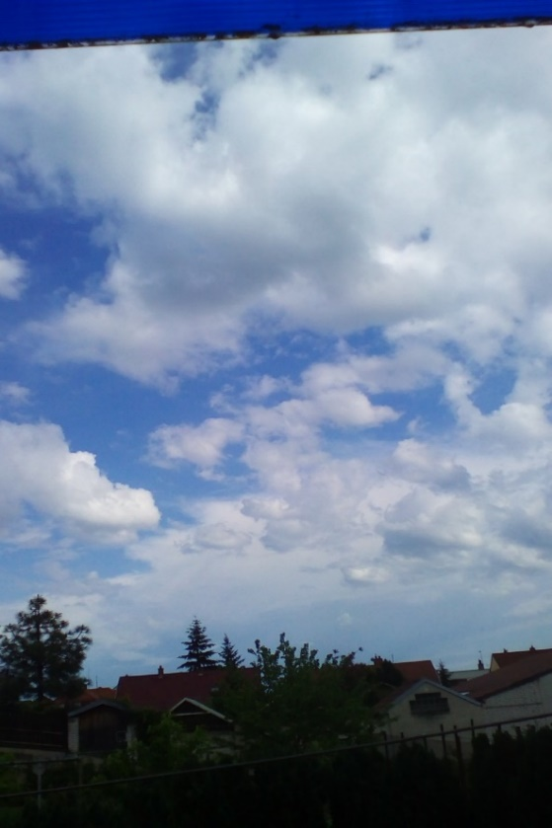
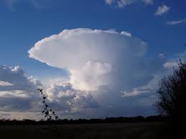
We are cloud hunters…
stratus cirrus
300 m above the terrain 7 – 9 km
cumulus cumulonimbus
up to 2 km up to 12 km

Slide 6

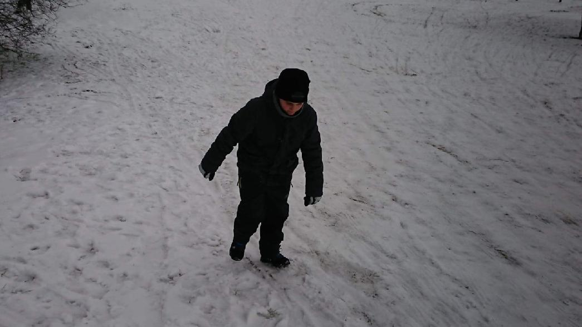

Weather lore(prognosis) comes from the history. People predicted the weather according to their long time observation.
Names put in the calendar help to remember the weather
(in our culture we celebrate namedates)
5th February 2018 - St. Agatha is rich of snow.
Our own prognosis:
19th March 2018 – Joseph
It‘s St. Joseph‘s date – plant the potatoes.
The temperature this day -1°C

Slide 7
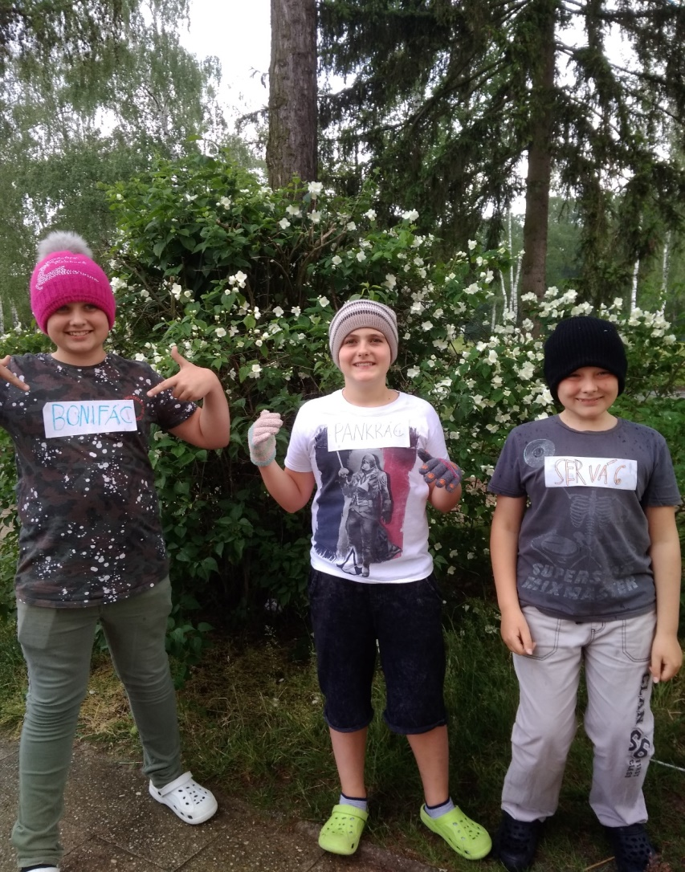
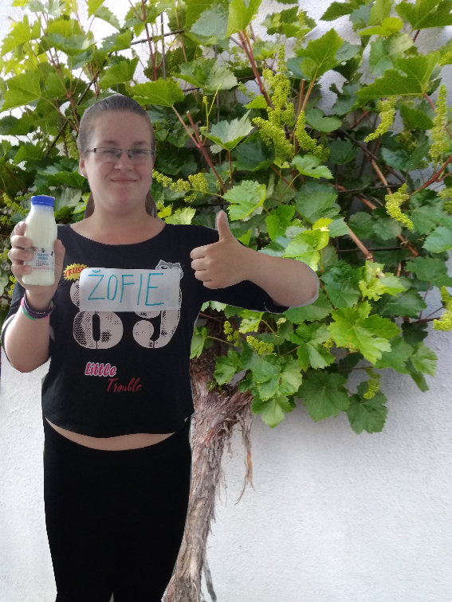

Weather lore – touching our bodies
12 th – 14th May: Pankrac, Servac a Bonifac
The Ice Men – burn fruit and roses with a frost
15 th May - Žofie – drinks wine

Slide 8
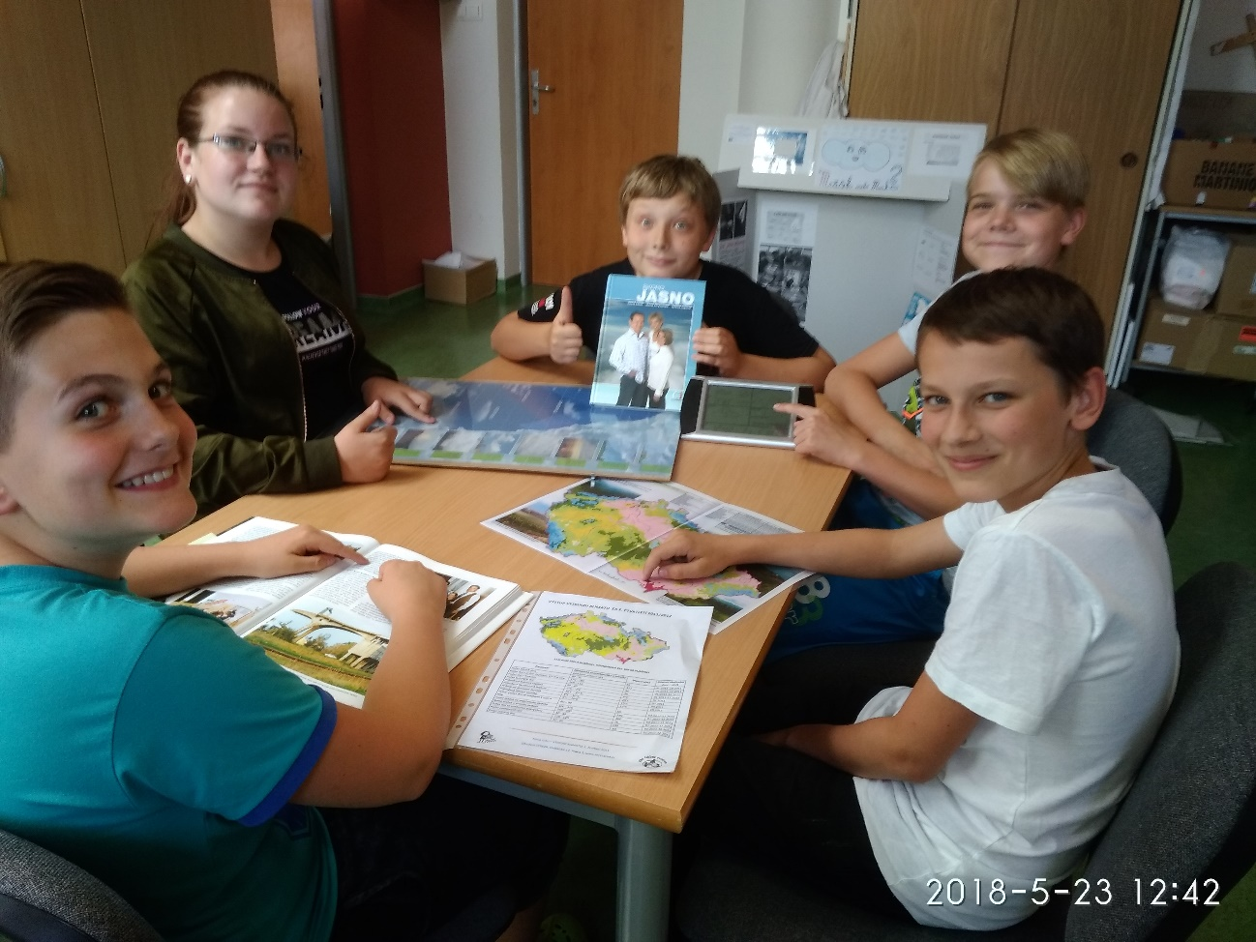


Hypothesis from Dubnany according to our grannies.
The question: Why is so little rainfall in Dubnany?
because people don‘t pray enough
because the forests around drive the clouds away
because there is a coal site and it drives the clouds away

Slide 9

Description of the climate in Dubnany: in history and in present
History: Hodonin area is a part of hot climate, with average year temperature
+ 9,5°C - in 1999
2017: average year temperature in Straznice was + 10,1°C
Meteorologic station in Dubnany (our school station) recorded in 1905 the maximal number +34,5°C, minimal number -21,4°C.
2017: in August there was maximum 37°C and minimum -15°C (January)
A year average rainfall value is about 500 mm – in 1905
Maximum in Dubnany station in July 1886 (167mm)
2017 : 676 mm rainfall
There is a lot of strong wind, mainly from north – west
The weather till Christmas is temperate. Winter comes in January and February. únoru
The high value of temperature and a long sunshine give a really good conditions for thermopholic plants

Slide 10
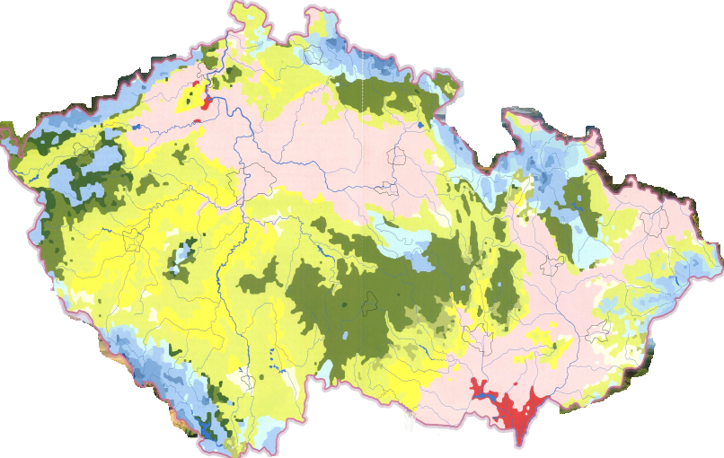
The climate classification according to Eugen Quitt. Based on data fromthe period 1901-1950, he devided The Czech republic into 23 climatic areas according to 14 different characteristics (cold, temperate,middle – warm and warm)
.

Slide 11
The climate numbers and conditions in Czechoslovakia from 1971, data measured in 2011
Parametr | Klimatická charakteristika z tabulky | Vlastní data | Období sledování (m.r. - m.r)
 | kód klim. oblasti: W4
Počet letních dnů | 60 - 70 | 82 | 05.2011–10.2011
Počet dní s prům. teplotou 10 °C a více | 170 - 180 | 172 | 01.2011–12.2011
Počet dní s mrazem | 100 - 110 | 90 | 01.2011-12.2011
Počet ledových dní | 30 - 40 | 30 | 01.2011-12.2011
Průměrná lednová teplota | -2°C - -3°C | 0°C | 01.2011
Průměrná červencová teplota | 19°C – 20°C | 20°C | 07.2011
Průměrná dubnová teplota | 9°C – 10°C | 15°C | 04.2011
Průměrná říjnová teplota | 9°C – 10°C | 12°C | 10.2011
Prům. počet dní se srážkami 1 mm a více | 80 – 90 | 60 | 01.2011-12.2011
Suma srážek ve vegetačním období | 300 - 350 | 280 | 01.2011-12.2011
Suma srážek v zimním období | 200 - 300 | 100 | 01.2011-12.2011
Počet dní se sněhovou pokrývkou | 40 - 50 | 10 | 01.2011-12.2011
Počet zatažených dní | 110 - 120 | 130 | 01.2011-12.2011
Počet jasných dní | 50 - 60 | 80 | 01.2011-12.2011

Slide 12


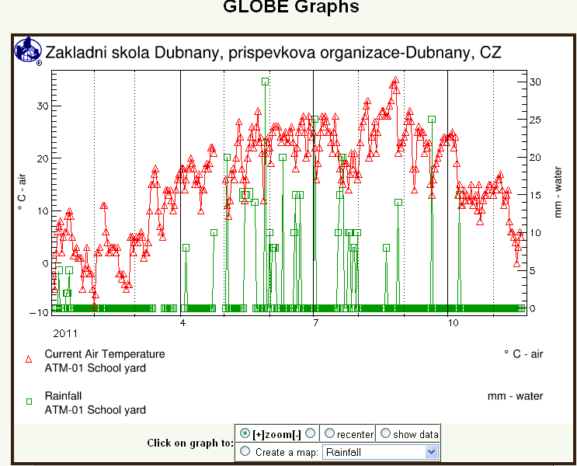
Climagram: average day – temperatures and rainfall in 2011

Slide 13

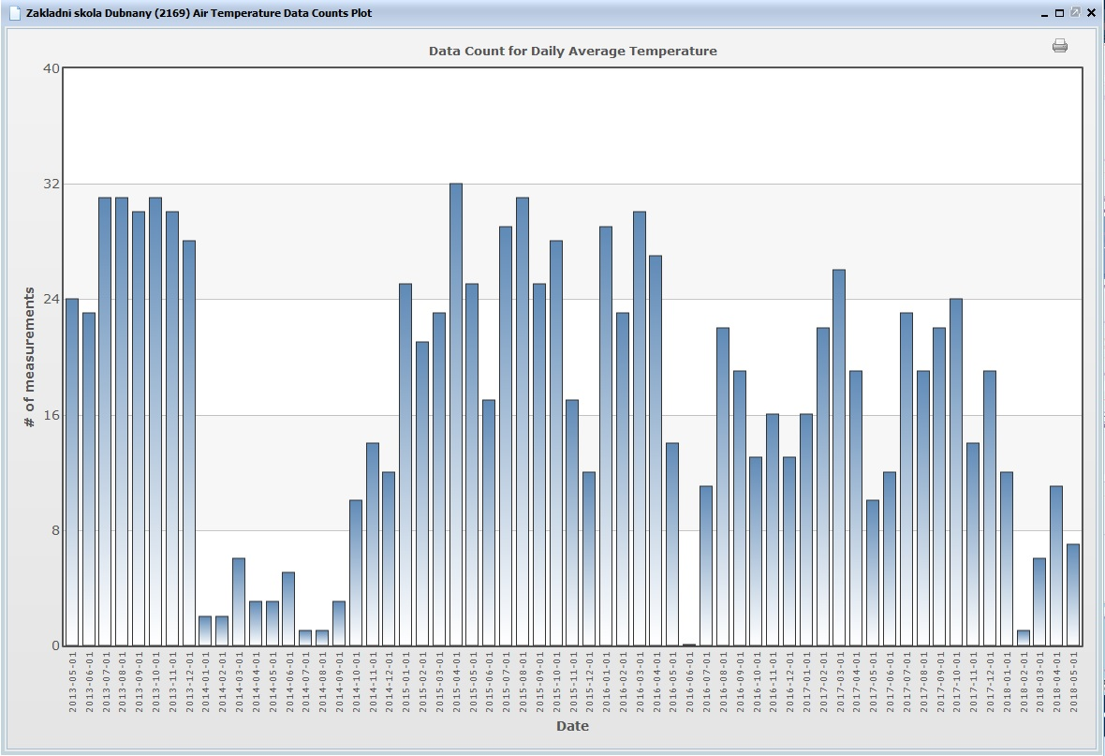

Slide 14
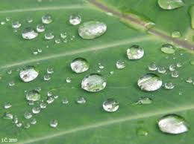
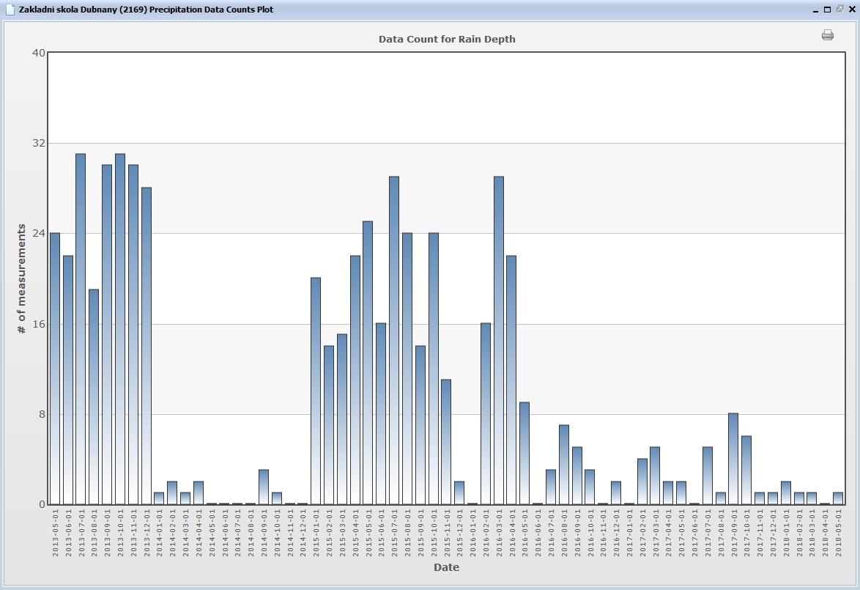

Slide 15
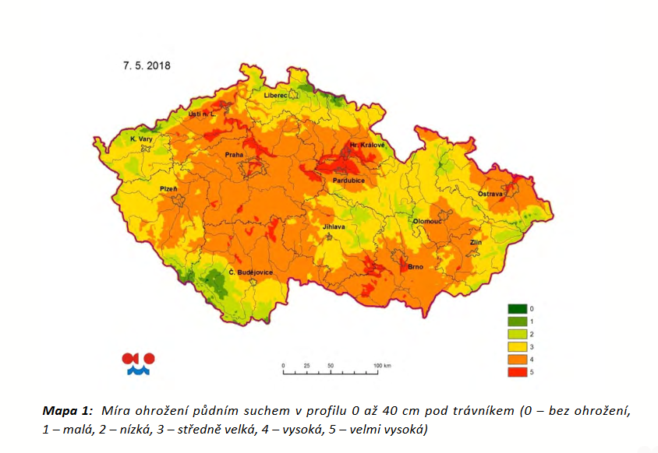
The reason of drought in 2018: long-term drought from 2014, low snowfall in winter and rainfall deficit

Slide 16

Resume:
According to Quitt‘s climate classification of long term notes and our own measurements during the last five years, we have found out that our town lies in a dry, hot climate zone
Our hypothesis was confirmed. ☺ ☺
We have found out that the climate changes not even in our town, but in the whole country
Our future steps : we will not have a swimming pool in each garden☹, we will use rain water more often, we will save the natural water
Will we have a lot of water? What kinds of thermophilic plants will we grow?
A lot of thanks to our older schoolmates for their help.

