Slide 1
GLOBE IVSS - 2018
A COMPARATIVE STUDY OF VEGETATION COVER UNDER TREES

Slide 2
STUDENTS NAMES
John Martin Mudambo
Joyann Makena
Titus Kasanda
Matthew Kwena
Jude Kigen
Isaac Otinga
Robert Ondigo
Lanise Ogega
Keziah Wambui
Becky Adalia
Henry Wanyoike
Charles Kamau
.

Slide 3
TEACHERS
Eric Nzioka – teacher
Amos Kaui – teacher
St. Scholastica Catholic School – Ruaraka
Nairobi- Kenya

Slide 4
Table of contents
Abstract
Purpose
Problem
Hypothesis
Procedures
Results
Conclusion
Bibliography.

Slide 5
ABSTRACT
The objective of this research is to find out why the vegetation cover is different under different trees yet within the same environment
This is a research analysis of the observations of the different areas under research.

Slide 6
ABSTRACT ….continued
The observations were made during the month of February 2018.
During this time, the atmospheric temperatures are high ranging between 26c and 29c
Objectively, by the end of this research we should be able to identify the relationship between the factors on study and the possible approaches to curb the problem.

Slide 7
ABSTRACT …..
Grass cover has a tendency of varying growth owing to the amount of moisture and access to direct sunlight. Any cover on top of the vegetation whether too close in contact or further distanced has a related influence on its general growth.

Slide 8
THE PROBLEM
Our problem is to draw an informed conclusion on the effect of tree-cover on grass growth under them..
The question is: ‘Can tree cover affect grass growth abilities?’

Slide 9
PURPOSE
The purpose of this study is to find out how different trees affect the growth of grass under them.

Slide 10
HYPOTHESIS
Different types of trees have different effects on grass cover growing under them.

Slide 11
PROCEDURES
Identify different areas of interest within the school compound.
Identify the different types of trees within the school environment.
Ascertain the atmospheric temperature under the different trees on Mondays, Tuesdays, Wednesdays, Thursdays and Fridays at 3p.m for three weeks.
Study the nature of the trees roots and leaves.
Check the amount of leaves on the ground.
Check the amount of sunlight reaching the grass growing under the trees.
Measure the air temperature under the trees.
Observe the grass cover under the trees.
Record the observations.

Slide 12
RESULTS
All data was taken within the school compound at St. Scholastica Catholic School, Ruaraka, Nairobi, Kenya.
Date: 1st February to 27th February, 2018.

Slide 13
ATMOSPHERIC TEMPERATURE IN DEGREE CELCIUS

Slide 14
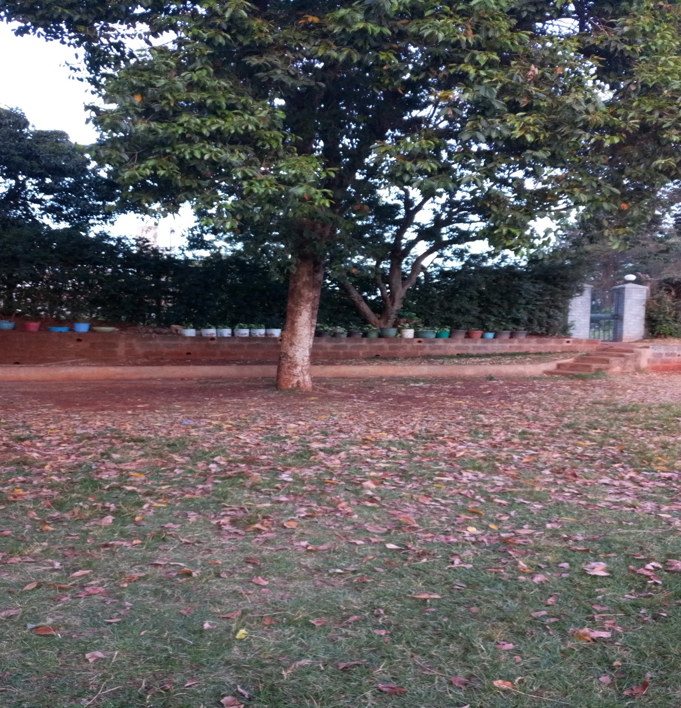
Broad leaved trees
Figure 1. mango tree
Figure 2. berry tree

Slide 15
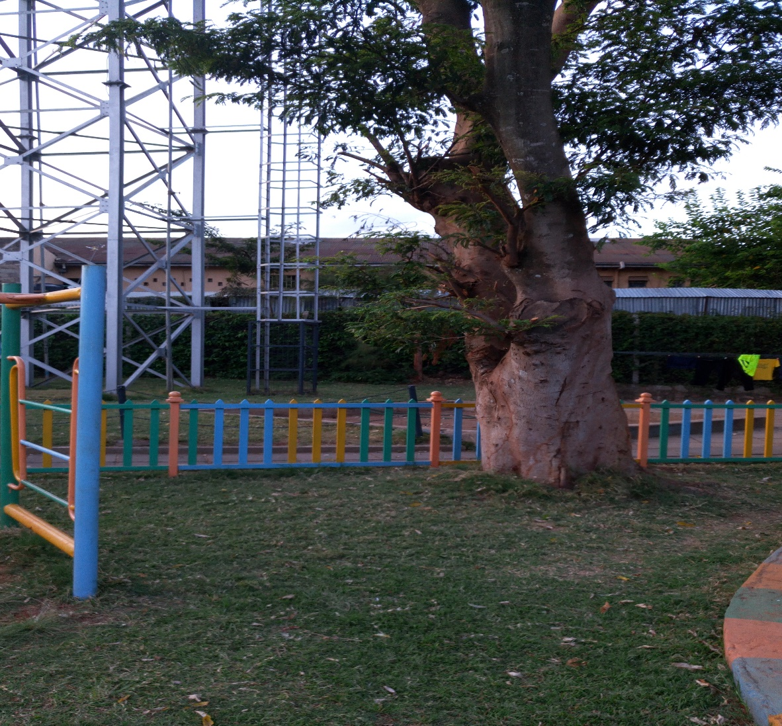
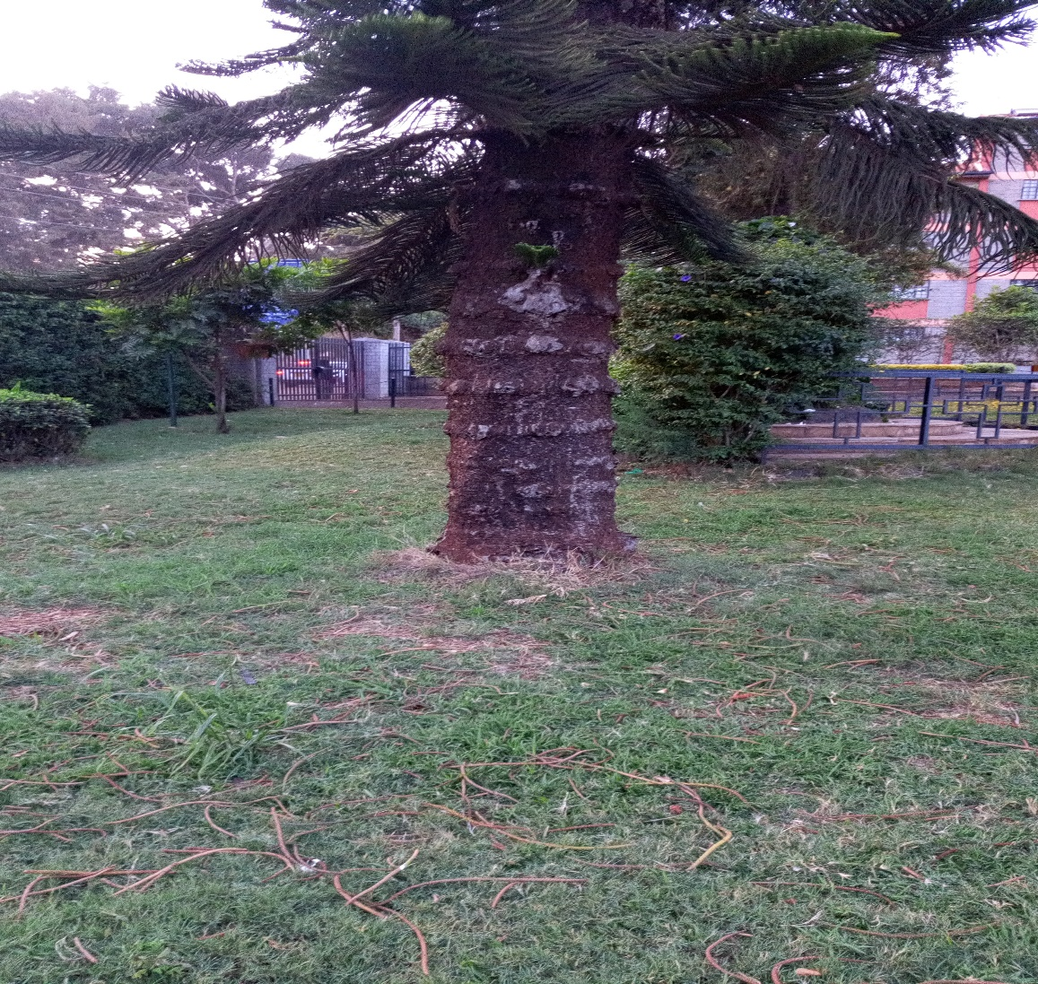
Narrow leaved trees
Figure 3. a narrow leaved tree
Figure 4. pine tree

Slide 16
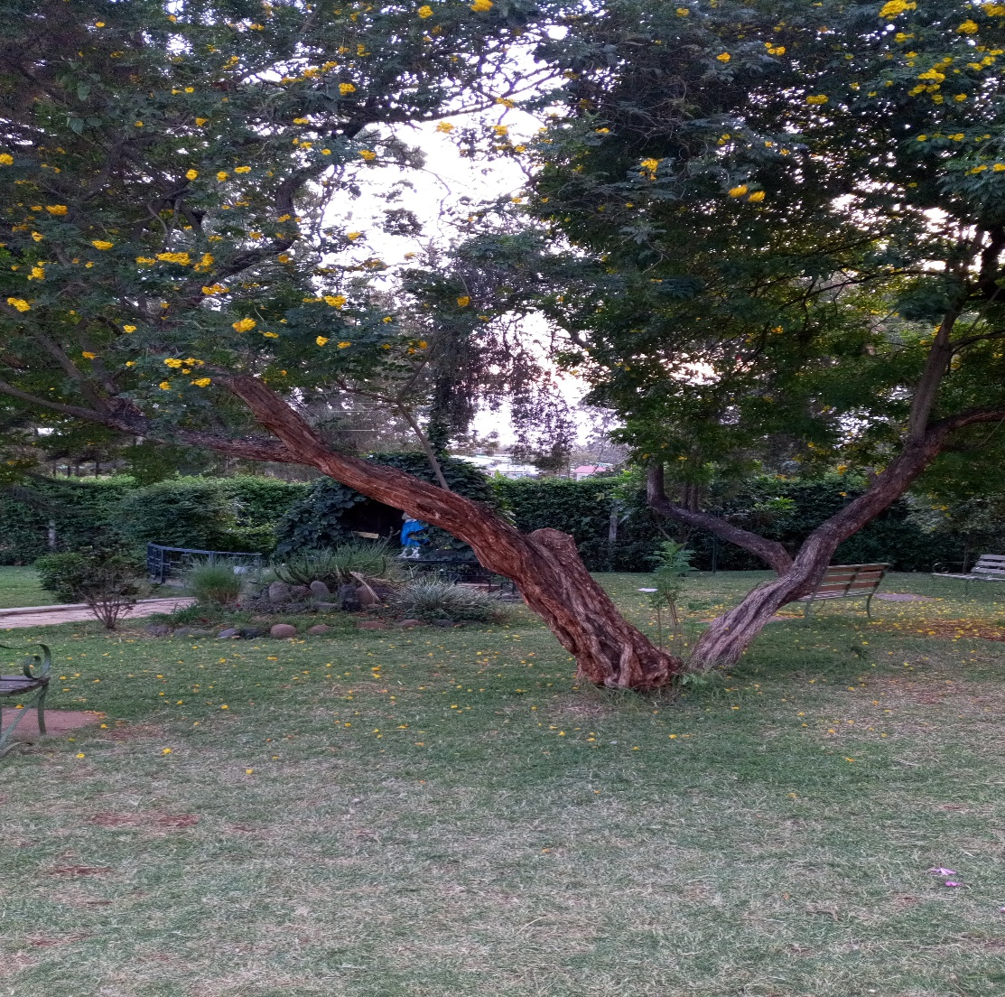
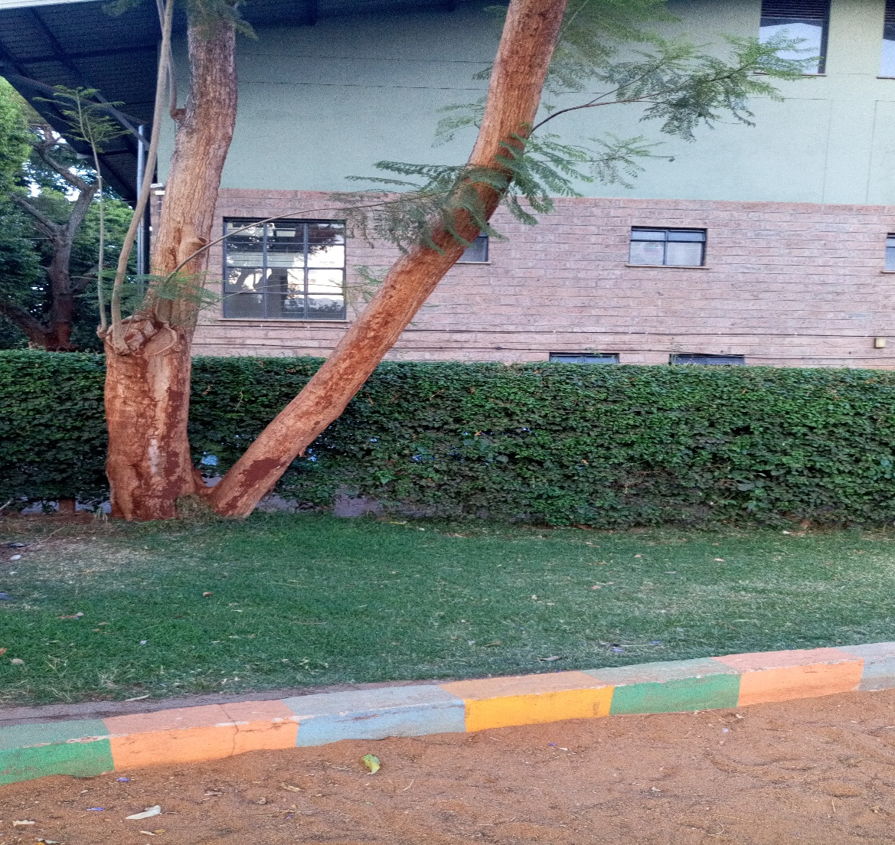
.
figure 8.
Figure 9. Jacaranda tree

Slide 17
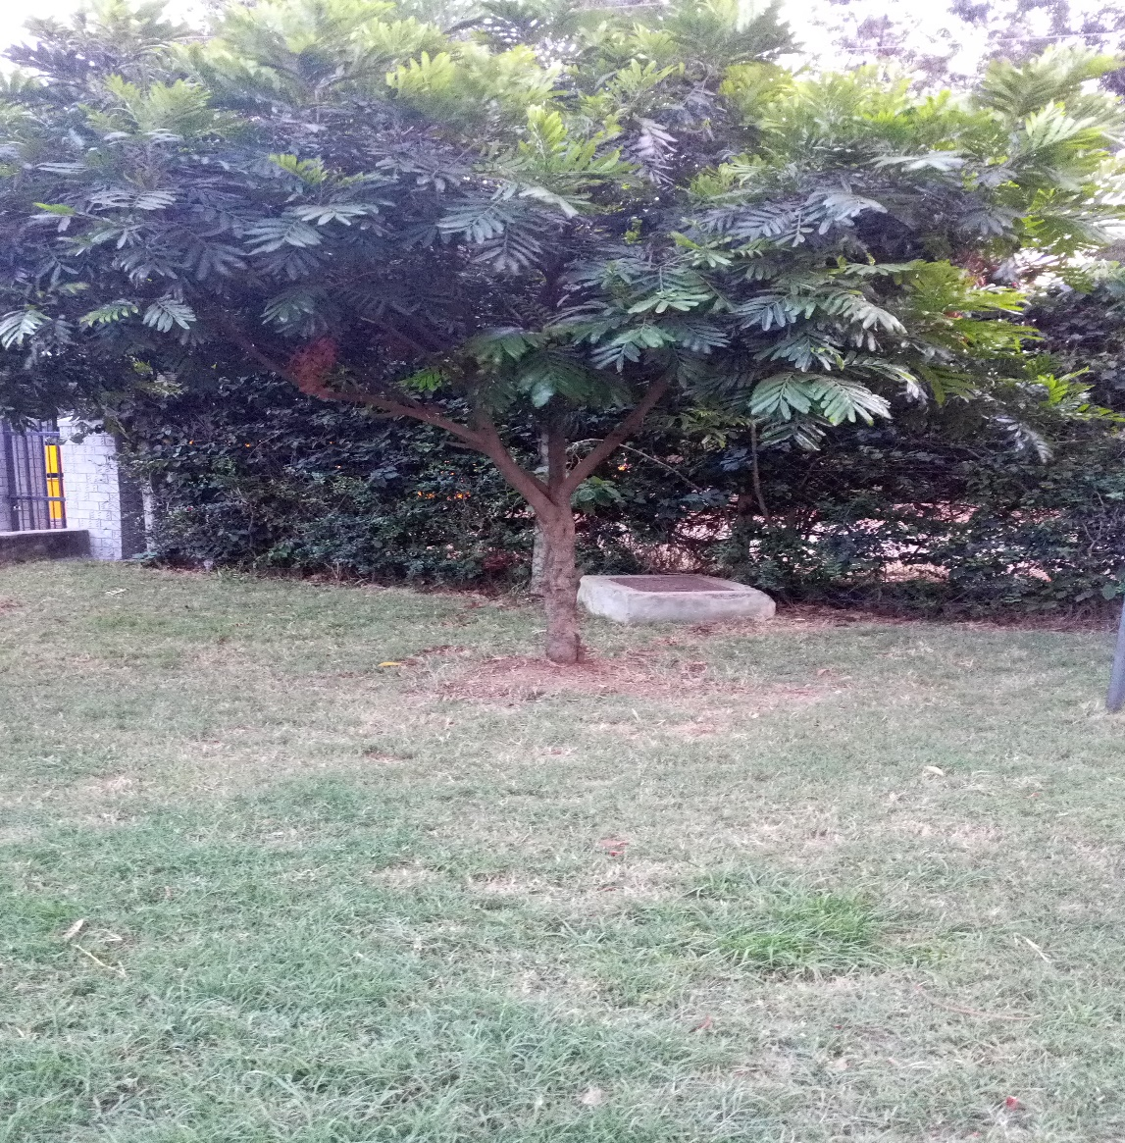
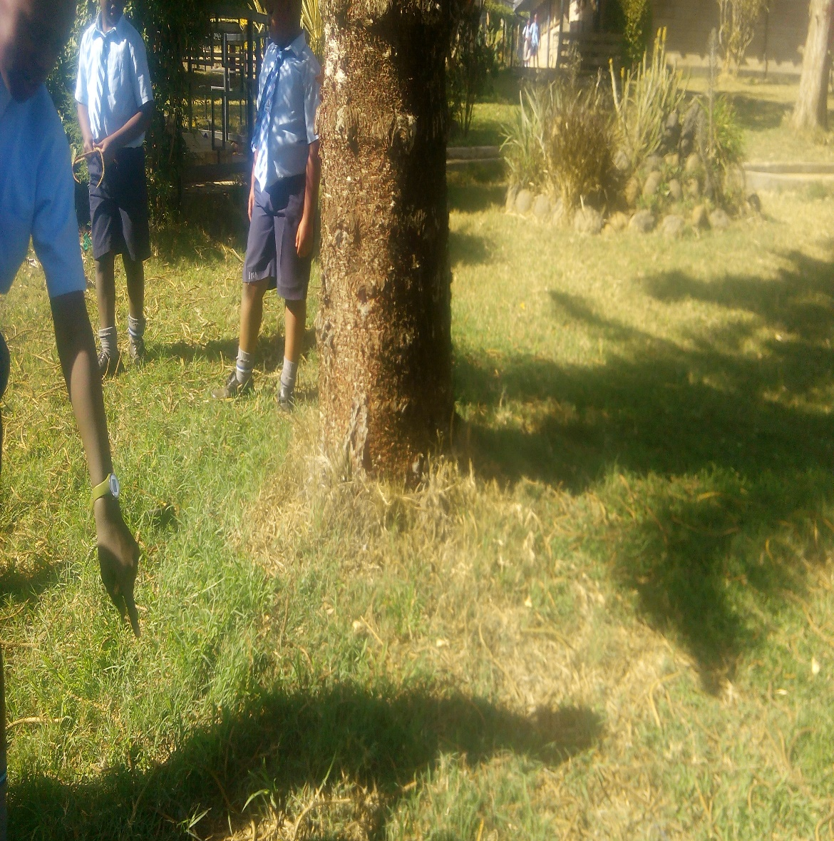
.
Figure 6. Hard wood tree
Figure 7. pine tree

Slide 18
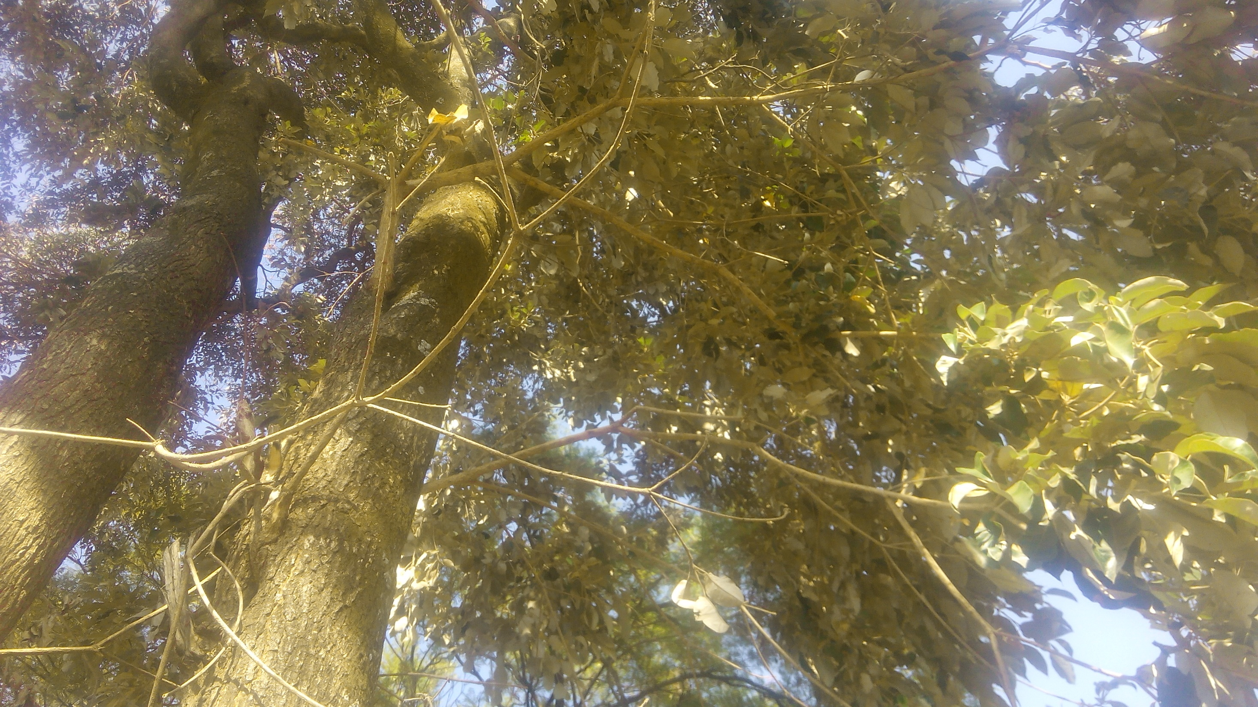
Figure 5. wood tree

Slide 19
DISCUSSION
Having conducted this study within the same time, during the same season in the same environment, an average atmospheric temperature and same type of soil:
trees with broad leaves like mango and berry trees in figure1 and 2 had little/patched or no grass growing thereunder. Trees with small in figure 3, 4 and 9 had narrow leaves hence had a fairly distributed grass cover under them.
Notably broad leaves may have affected the vegetation cover(grass) by obstructing direct sunlight from reaching the grass. The same trees had shed a lot of leaves which were lying on the ground thus mulching the soil hence making it hard for the grass to grow with ease.

Slide 20
Discussion…… continued
The broad leaves hold a lot of rain water which fall as heavy drops hence compacting the soil particles together, making it hard for the growth of the grass under the trees.
There was better penetration of light for trees with narrow leaves which probably enabled the grass to grow with ease.
The soil was also loose which may have allowed easy penetration of roots since the small leaves could not hold a lot of water which would fall as heavy drops hence compacting the soli particles together.

Slide 21
CONCLUSION
We finally conclude that:
1. Sunlight has a direct effect on plant cover.
2. The type of leaves a plant has affect the amount of grass cover under a given tree.
3. Trees with broad leaves shed a lot of leaves during the dry season due to high rate of transpiration. This high rate of transpiration could also have made the roots to absorb a lot of water from the ground making the ground drier than in those areas with trees that have narrow leaves.
Our question was thereby answered duly.

Slide 22
recommendations
We recommend that:
People who want to use ground vegetation/grass cover in their homesteads or compounds to plant narrow leaved trees since they have less effect on grass growing under them.
We encourage farmers who want to plant other ground covering crops to plant narrow leaved trees since they are not likely to affect the growth of crops negatively.
In dry areas, narrow leaved trees should be planted because they don’t absorb and loose a lot of water. This makes the soil maintain its moisture for a longer time.

Slide 23
BIBLIOGRAPHY
Kenya Literature Bureau, Primary Science. Book 5, pg 31-38 Ministry of Education, Kenya
Kenya Literature Bureau, Primary Science. Book 8, pg 32 -38, Ministry of Education, Kenya

