Slide 1
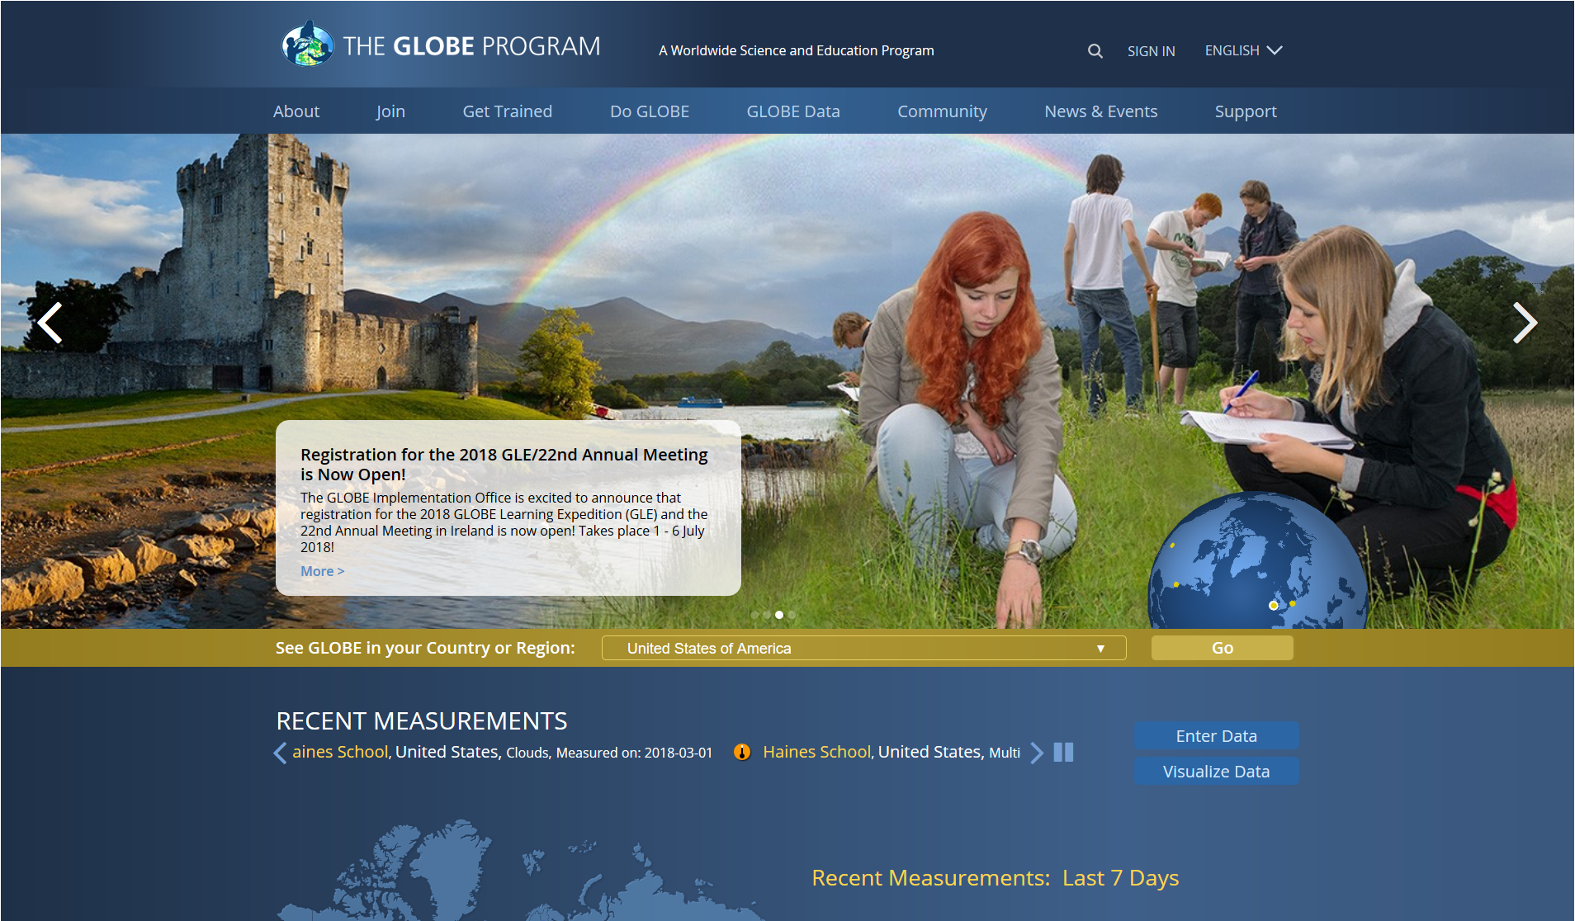
Using the GLOBE Visualization System
Notes:
Start at the GLOBE Program Homepage: www.globe.gov
*BOLD = first draft of the ‘script’ to accompany use of the ppt in a pd activity using this slide presentation (or doing these same actions live) with teachers.
non-bold = notes/questions about the slide or vis tool pr changes to the slides.

Slide 2
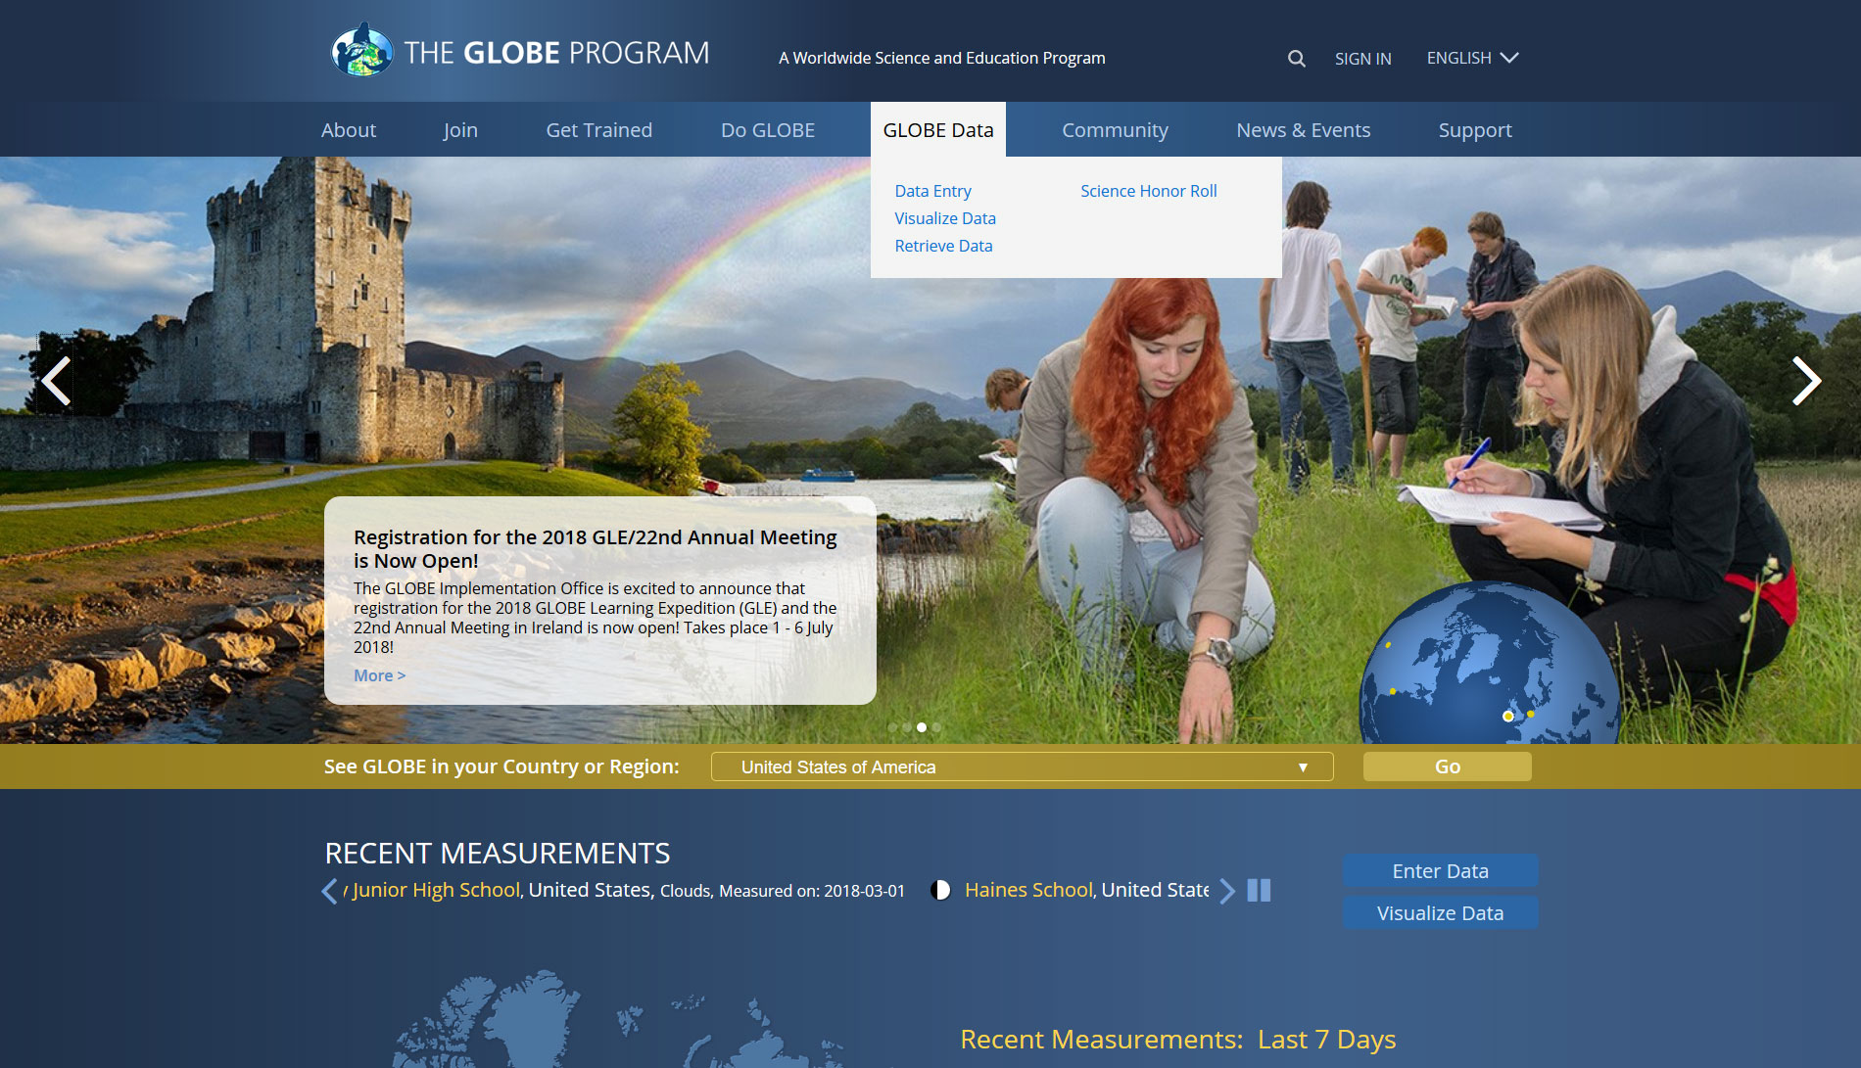
Hold the mouse over the GLOBE Data menu, then click on Visualize Data. Or,
use the quick link shown below.
Notes:
In this tutorial we will explore the GLOBE Visualizations Tool. The Visualizations tool allows us to look at GLOBE and other data on a world map, define our own data sets, create plots and tables of GLOBE data, and to export raw data for further analysis in other programs. To open the Visualization tool, mouse over the Explore Science menu and then click on the Finding GLOBE Data Link.

Slide 3
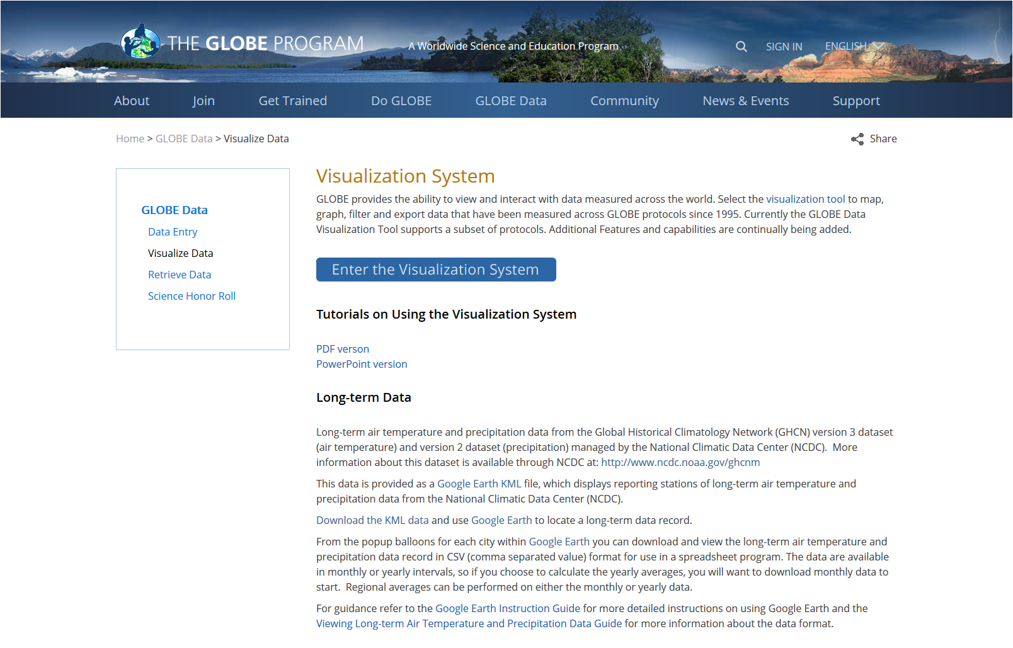
Click on Enter the Visualization System link. This page also contains a link to this tutorial.
Notes:
Next click on the map under GLOBE Data or the visualization tool or Visualize GLOBE Data link.
Changed Select to click on - Suggest keeping the mouse instructions consistent – always use “click on” for clicking a link. But “select” when choosing an item from a drop-down box.

Slide 4
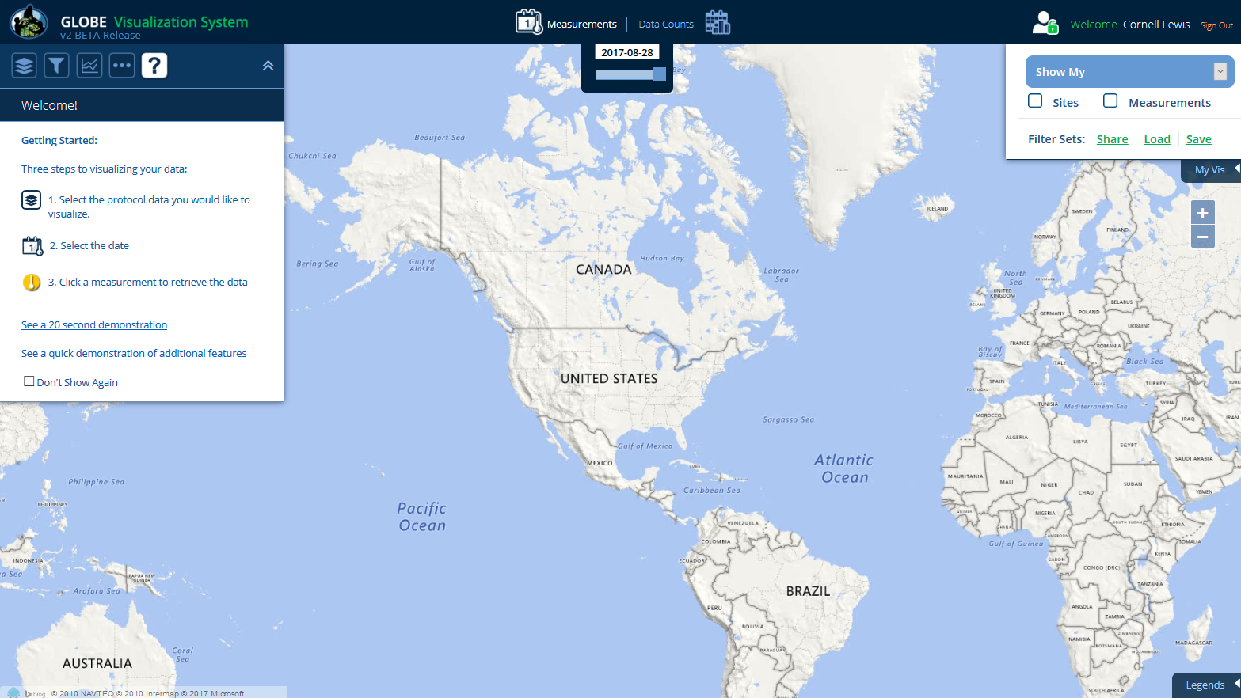

This is the GLOBE Visualization Landing Page. The help tab is the default tab when you first come to Vis. There are getting started steps, links to quick demonstrations and this complete tutorial. Check the ‘Don’t show again’ to default to the layer screen for future visits.
Notes:
Now we are looking at the Visualization Tool. The Welcome box will open each time you reload the tool unless you click the check box next to Don’t Show Again (please don’t do this). The Welcome box contains a reminder about how to add layers and basic filter options. It also contains a link to the Help page. For now, close the Welcome box.
Hmm, maybe the original text for this slide is better…it seems funny to say “close the welcome box” but then again we don’t want them to try adding layers until we get to that point….

Slide 5
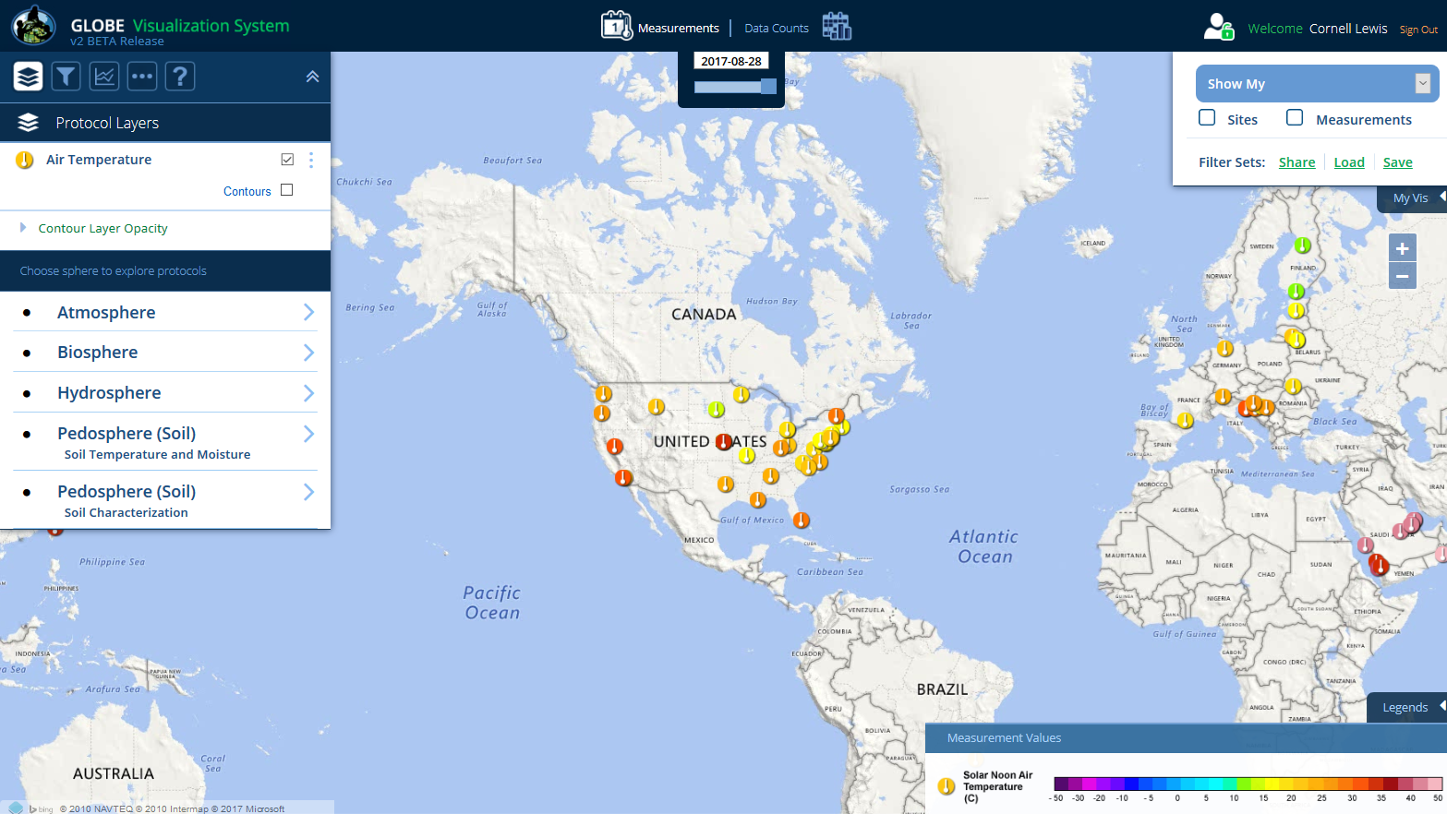
Overview of the Visualization Window Features (Desktop view)
Sign-in / Sign-out
Map Type
Map Date
Open/Close Layer and Filter Menus
Open/Close My Vis menu
Zoom Controls
Data Site Icons
Open/Close Legend
Notes:
Now let’s review the different sections of the Visualization Window. Besides the map itself there are 5 sections within the window:
The Top Bar
Layers Control Pop-out Box (left side)
Advanced Features Control Pop-out Box (right side)
Movement Controls (just left of Advanced Features)
Legend (bottom* only visible if there is at least 1 layer added)
Cursor Lat/Long report (bottom left)
Throughout the tutorial we will cover the options available in each section.
Added Slide.
Slide needs to be corrected to have the official names of each of these sections.

Slide 6

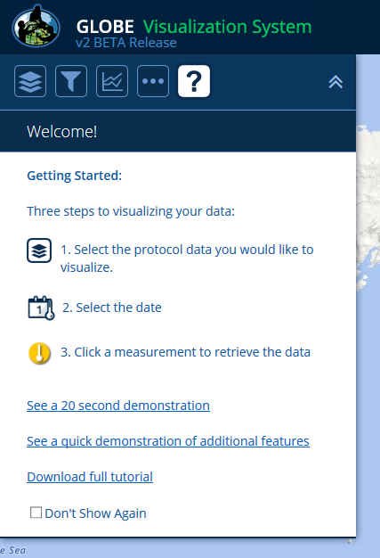
Layer and Filter Menu Icons
My Vis / Sign-in and out
(on phone and small tablets)
Layers
Welcome and
Tutorials
Open/close
menu
Filters
Multi-Site
Plots
Base Map, Language and
Map Grid Controls
Notes:
Now let’s review the different sections of the Visualization Window. Besides the map itself there are 5 sections within the window:
The Top Bar
Layers Control Pop-out Box (left side)
Advanced Features Control Pop-out Box (right side)
Movement Controls (just left of Advanced Features)
Legend (bottom* only visible if there is at least 1 layer added)
Cursor Lat/Long report (bottom left)
Throughout the tutorial we will cover the options available in each section.
Added Slide.
Slide needs to be corrected to have the official names of each of these sections.

Slide 7
The Basics of the Visualization System
Three Steps to Visualize your Data:
  Select the type of data you want to see (Add Layers)
  Select the Date you want to see the data for
  Click on a data point on the map to receive table and graph information

Slide 8
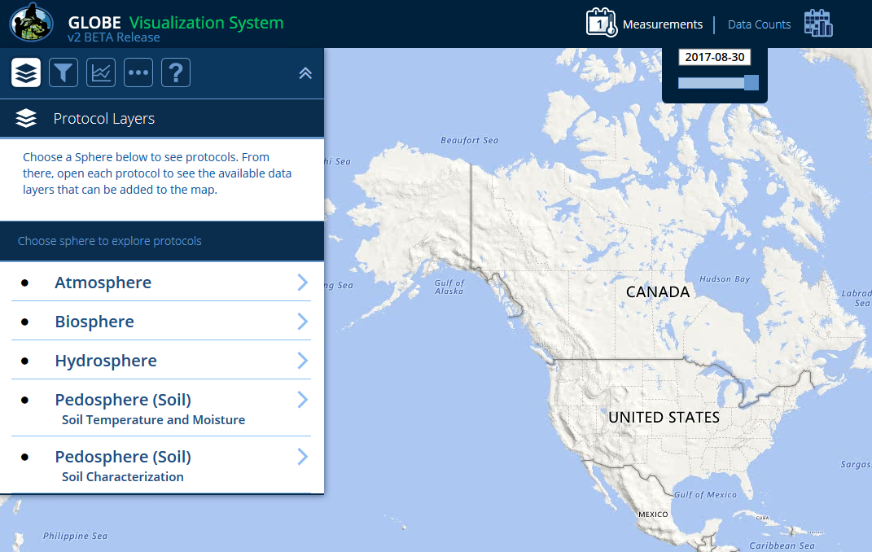
  First, make sure you’re on the ‘Measurements’ map (the measurements icon and text should be white). If not, select it.
Notes:
So far we’ve used the Visualization tool to find sites with lots of data.
What if we want to visualize data on the map? To do that we need to switch over to Measurement View by clicking on Measurement in the Top Bar.

Slide 9
  Next, click the Protocol Layers icon and then a sphere category. For this tutorial, select Atmosphere.
Notes:
So far we’ve used the Visualization tool to find sites with lots of data.
What if we want to visualize data on the map? To do that we need to switch over to Measurement View by clicking on Measurement in the Top Bar.

Slide 10
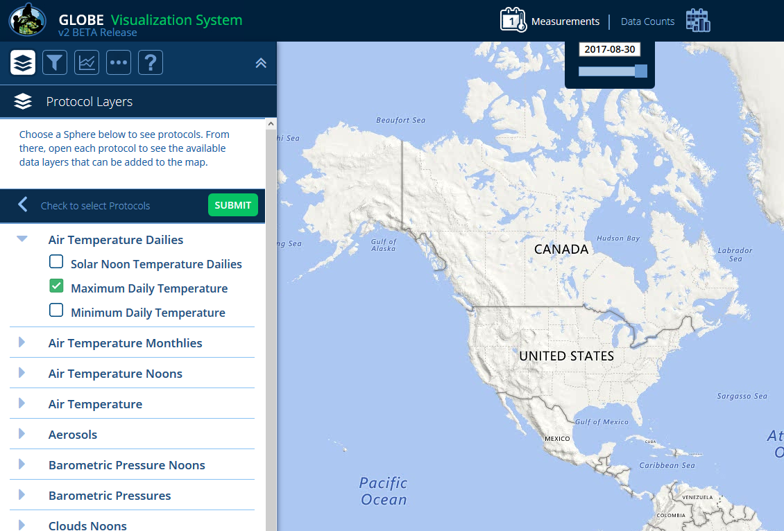
  Select the protocol layer(s) to add to the map (you can add multiple layers). For the tutorial, select Max Daily Temp and ‘Submit’.
Notes:
So far we’ve used the Visualization tool to find sites with lots of data.
What if we want to visualize data on the map? To do that we need to switch over to Measurement View by clicking on Measurement in the Top Bar.

Slide 11
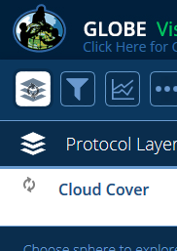
If there’s a lot of data, you may get an in-progress icon. Please wait until the system finishes before clicking or performing additional operations.
Notes:
So far we’ve used the Visualization tool to find sites with lots of data.
What if we want to visualize data on the map? To do that we need to switch over to Measurement View by clicking on Measurement in the Top Bar.

Slide 12
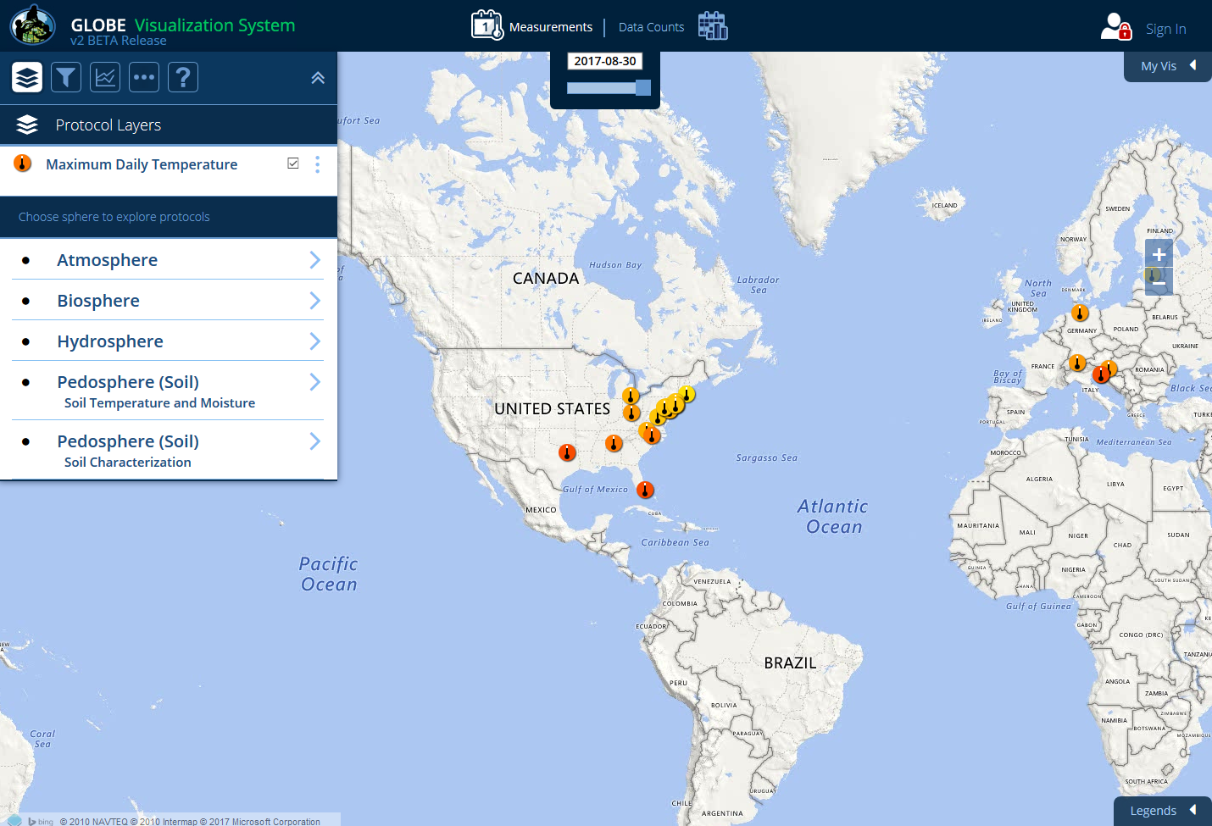

The Max Daily Temperature layer is added to the map. The map shows sites that have maximum air temperature measurements for the current day.
Notes:
So far we’ve used the Visualization tool to find sites with lots of data.
What if we want to visualize data on the map? To do that we need to switch over to Measurement View by clicking on Measurement in the Top Bar.

Slide 13
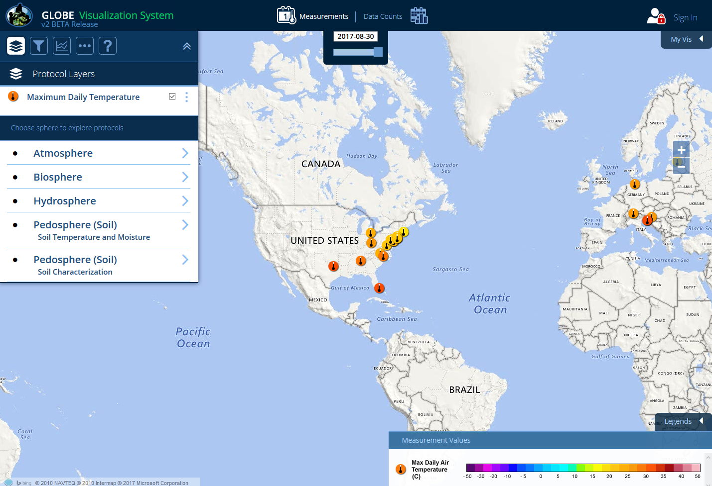
Open the legend to see the measurement values of the site icons. The colors in the scale correspond to the possible data values for that data type.
Notes:
So far we’ve used the Visualization tool to find sites with lots of data.
What if we want to visualize data on the map? To do that we need to switch over to Measurement View by clicking on Measurement in the Top Bar.

Slide 14
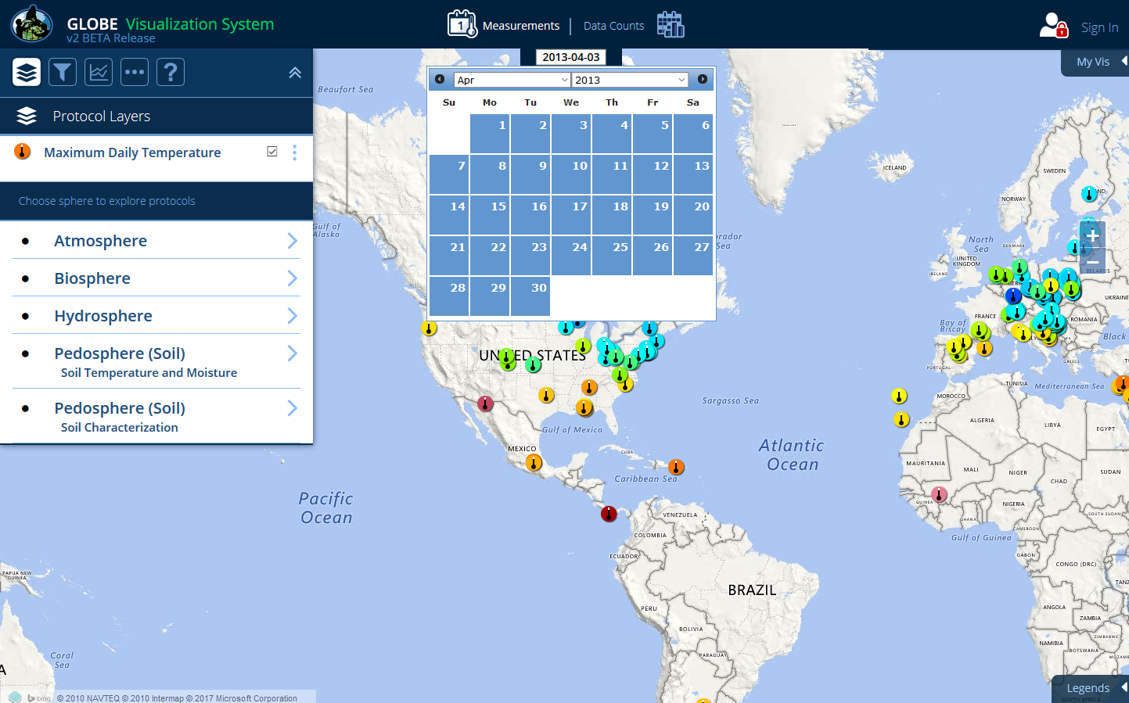

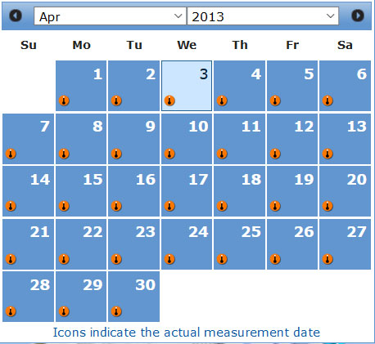
Click on the date window to change the map date. For the tutorial, change the date to April 4, 2013.
Notes:
So far we’ve used the Visualization tool to find sites with lots of data.
What if we want to visualize data on the map? To do that we need to switch over to Measurement View by clicking on Measurement in the Top Bar.

Slide 15
A small protocol icon will appear on the calendar indicating which day has measurements. In this example, a max daily temperature measurement occurred everyday in April.
Notes:
So far we’ve used the Visualization tool to find sites with lots of data.
What if we want to visualize data on the map? To do that we need to switch over to Measurement View by clicking on Measurement in the Top Bar.

Slide 16
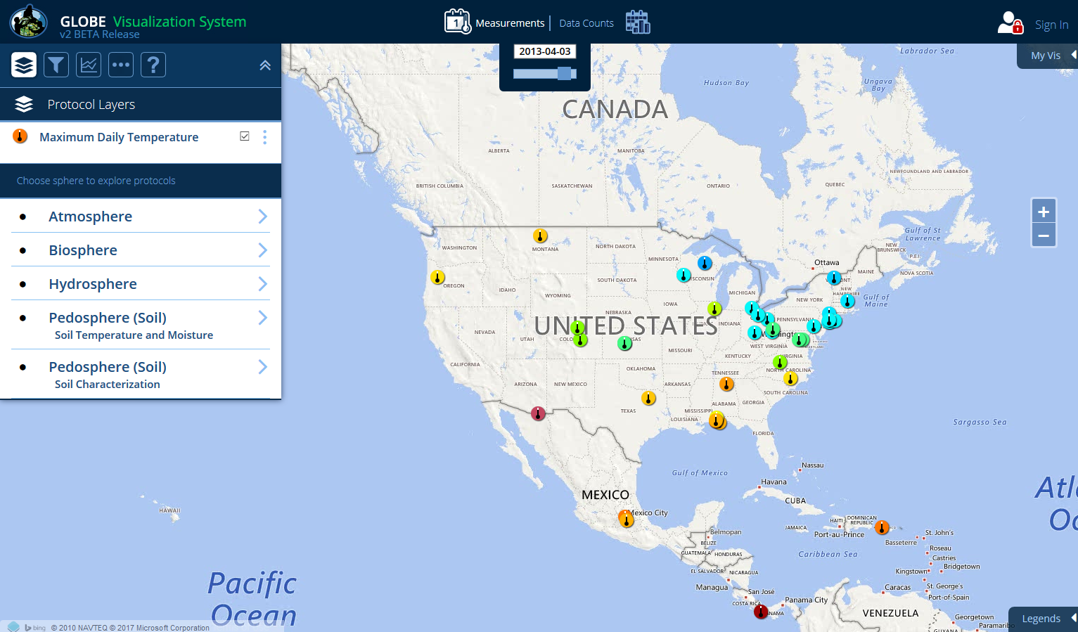
Zoom in to the U.S. and then click on the measurement icon in the state of Oregon
Notes:
So far we’ve used the Visualization tool to find sites with lots of data.
What if we want to visualize data on the map? To do that we need to switch over to Measurement View by clicking on Measurement in the Top Bar.

Slide 17
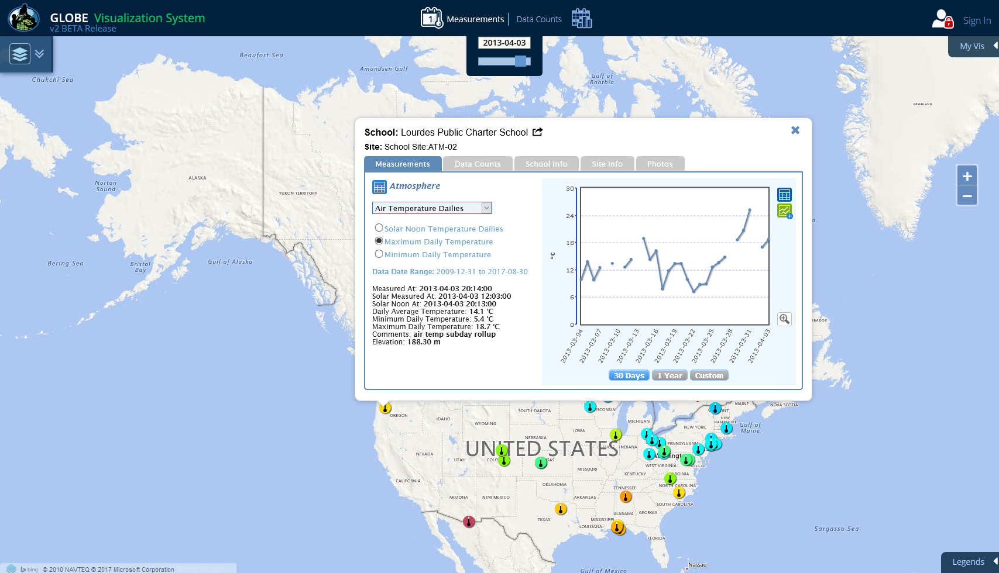
The site information window will open showing the measurement data at this site. Note: The layer/filter menu closes but you can open it by clicking on the menu arrow icon at the top left.
Notes:
So far we’ve used the Visualization tool to find sites with lots of data.
What if we want to visualize data on the map? To do that we need to switch over to Measurement View by clicking on Measurement in the Top Bar.

Slide 18
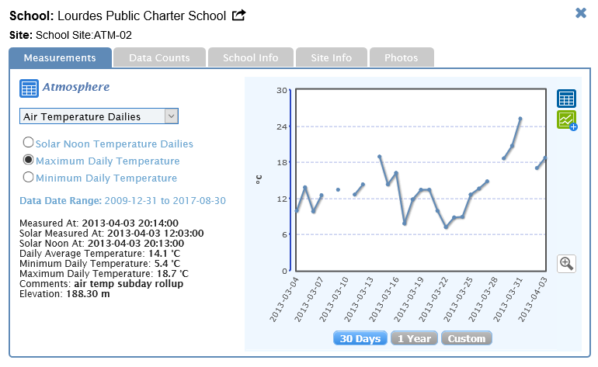
Measurements Site Info Window:
Click this icon to go to the school page
Click this icon to view the plot data in a table
Click this icon to view data tables for all of your data
Click this icon to add the site to a multi-site time series plot
Data at this site can be found in this date range
Roll-over a plot point to see measurement
value and date
Measurement info
for the selected
data type
Click the zoom icon for a larger plot view
Change plot time range
Notes:
Hmmm not sure if data type, parameter or something else would be best here…

Slide 19
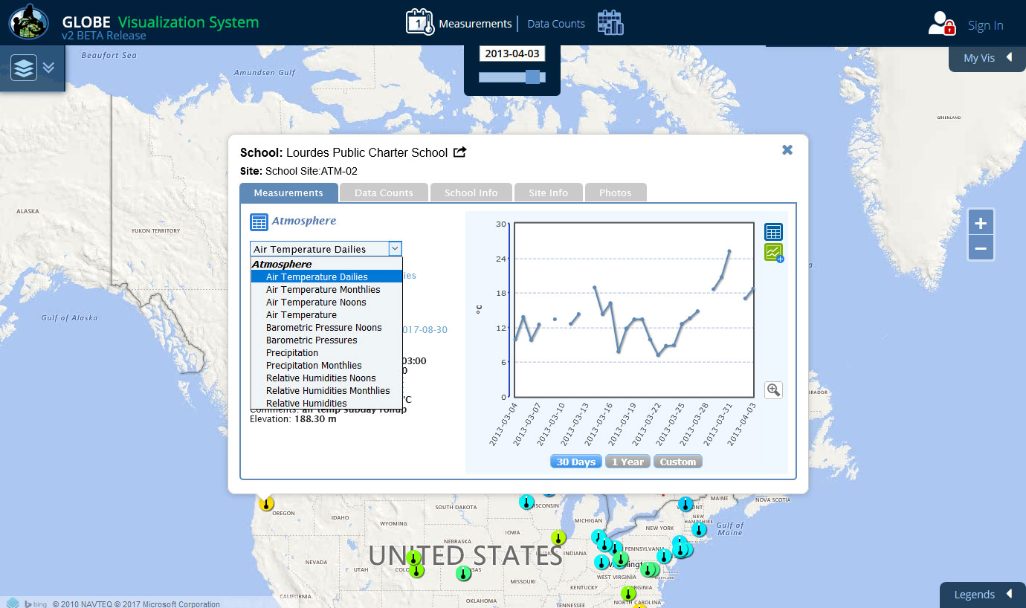
You can look at any measurement data at this site by selecting a data type in the drop-down menu.
Notes:
The Filters section of the Advanced Control Box allows us to change the date of the map and to narrow the displayed to just one school or site or to data from a specific elevation range or within a certain area. Let’s take some time to explore using the various Filter Features. Refer to the Help Page for specific instructions about each feature.
(and so here I would give them time to play around with Filters before moving into instruction about tables and plots.)

Slide 20
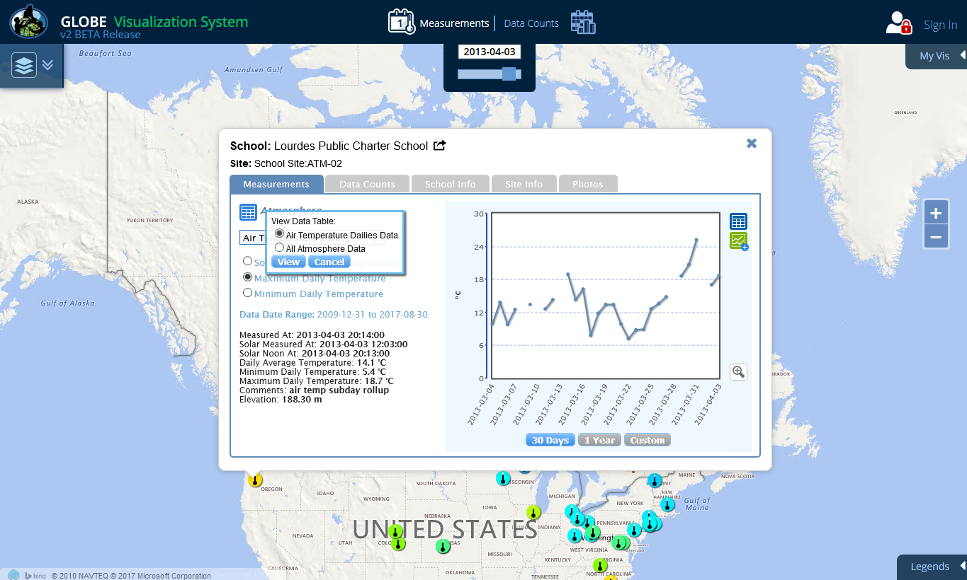
Click on the table icon next to the Atmosphere title. You can either view data tables for the selected data type (Air Temperature Dailies) or all of the Atmosphere data.
Select Air Temperature Dailies.
Notes:
The Filters section of the Advanced Control Box allows us to change the date of the map and to narrow the displayed to just one school or site or to data from a specific elevation range or within a certain area. Let’s take some time to explore using the various Filter Features. Refer to the Help Page for specific instructions about each feature.
(and so here I would give them time to play around with Filters before moving into instruction about tables and plots.)

Slide 21
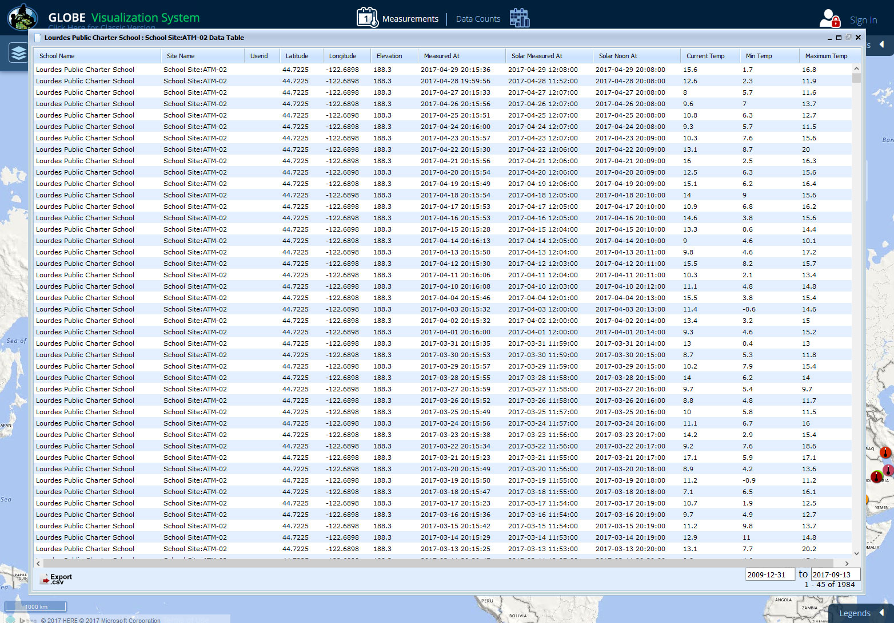
Note that this table gives values for local solar noon and minimum and maximum daily temperature. Clicking the button at the bottom will export the data in
a comma delimited format. Close this window.
Notes:
The Filters section of the Advanced Control Box allows us to change the date of the map and to narrow the displayed to just one school or site or to data from a specific elevation range or within a certain area. Let’s take some time to explore using the various Filter Features. Refer to the Help Page for specific instructions about each feature.
(and so here I would give them time to play around with Filters before moving into instruction about tables and plots.)

Slide 22

Next, check the button to see all of the atmosphere data in a table view.
Notes:
The Filters section of the Advanced Control Box allows us to change the date of the map and to narrow the displayed to just one school or site or to data from a specific elevation range or within a certain area. Let’s take some time to explore using the various Filter Features. Refer to the Help Page for specific instructions about each feature.
(and so here I would give them time to play around with Filters before moving into instruction about tables and plots.)

Slide 23
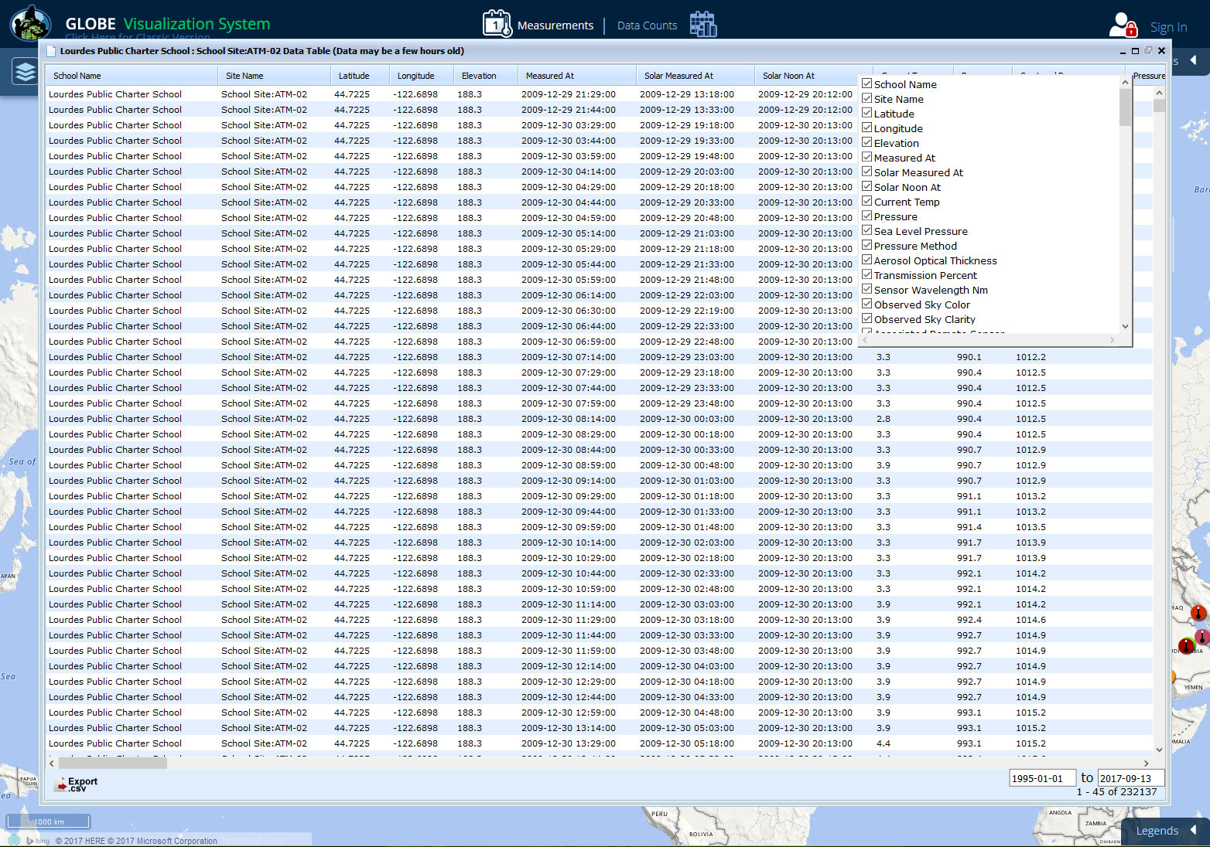
Now, all of your data is displayed in the table (this may take awhile). If you right click any column header (desktop only), a window will open to allow you to filter the data columns.
Notes:
The Filters section of the Advanced Control Box allows us to change the date of the map and to narrow the displayed to just one school or site or to data from a specific elevation range or within a certain area. Let’s take some time to explore using the various Filter Features. Refer to the Help Page for specific instructions about each feature.
(and so here I would give them time to play around with Filters before moving into instruction about tables and plots.)

Slide 24
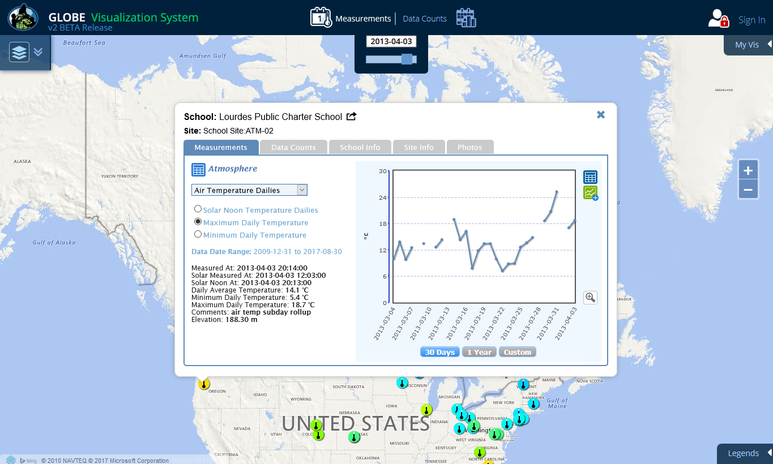
To compare this site data to other sites, you can add the site to a multi-site time series plot by clicking on this button. Keep the plot range at 30 days
and then select the button
Notes:
The Filters section of the Advanced Control Box allows us to change the date of the map and to narrow the displayed to just one school or site or to data from a specific elevation range or within a certain area. Let’s take some time to explore using the various Filter Features. Refer to the Help Page for specific instructions about each feature.
(and so here I would give them time to play around with Filters before moving into instruction about tables and plots.)

Slide 25
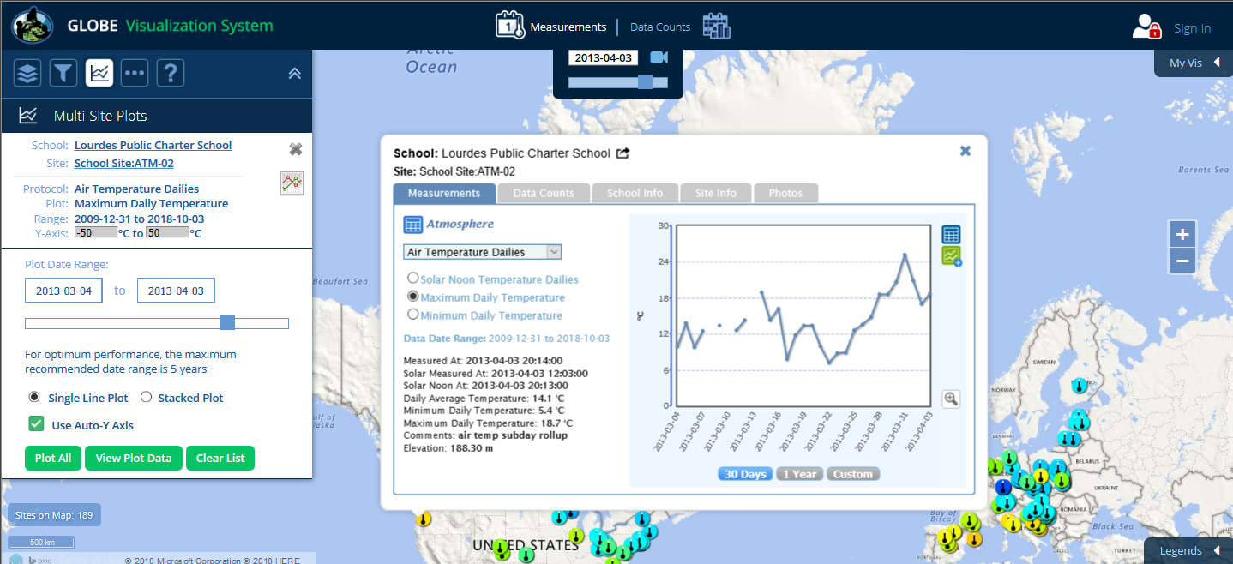
The site is added to the Multi-Site Plots list with the date range from the site plot pre-selected. You can change the dates by clicking on the date fields or by using the slider.
Notes:
The Filters section of the Advanced Control Box allows us to change the date of the map and to narrow the displayed to just one school or site or to data from a specific elevation range or within a certain area. Let’s take some time to explore using the various Filter Features. Refer to the Help Page for specific instructions about each feature.
(and so here I would give them time to play around with Filters before moving into instruction about tables and plots.)

Slide 26
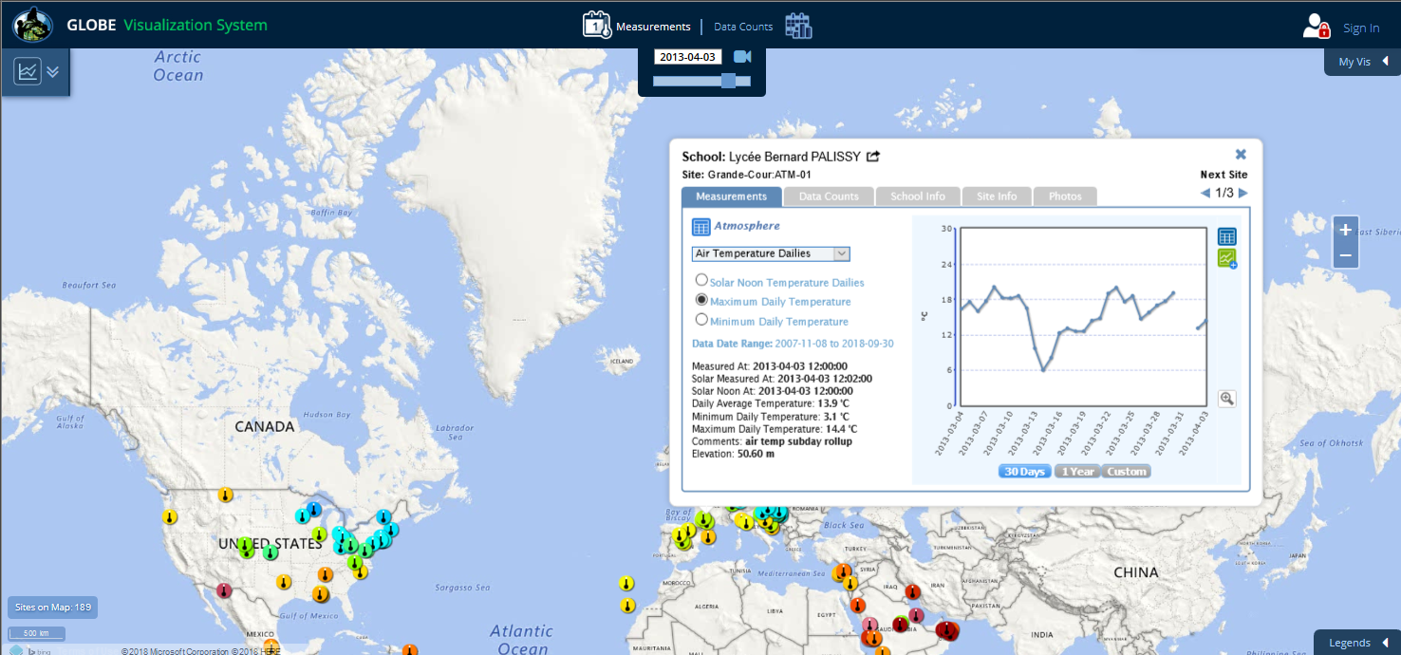
Now let’s select another site. Close the site info window of the U.S. site and then select one of the sites in France. Again click on the icon to add the site to the multi-site time series plot.
Notes:
The Filters section of the Advanced Control Box allows us to change the date of the map and to narrow the displayed to just one school or site or to data from a specific elevation range or within a certain area. Let’s take some time to explore using the various Filter Features. Refer to the Help Page for specific instructions about each feature.
(and so here I would give them time to play around with Filters before moving into instruction about tables and plots.)

Slide 27
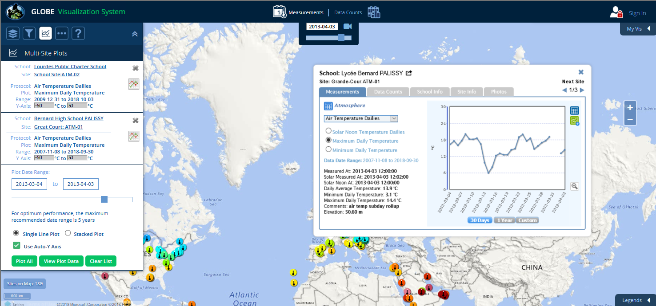
The second site is now added. Now click on the ‘Plot All’ button to view the time series plot.
Notes:
The Filters section of the Advanced Control Box allows us to change the date of the map and to narrow the displayed to just one school or site or to data from a specific elevation range or within a certain area. Let’s take some time to explore using the various Filter Features. Refer to the Help Page for specific instructions about each feature.
(and so here I would give them time to play around with Filters before moving into instruction about tables and plots.)

Slide 28
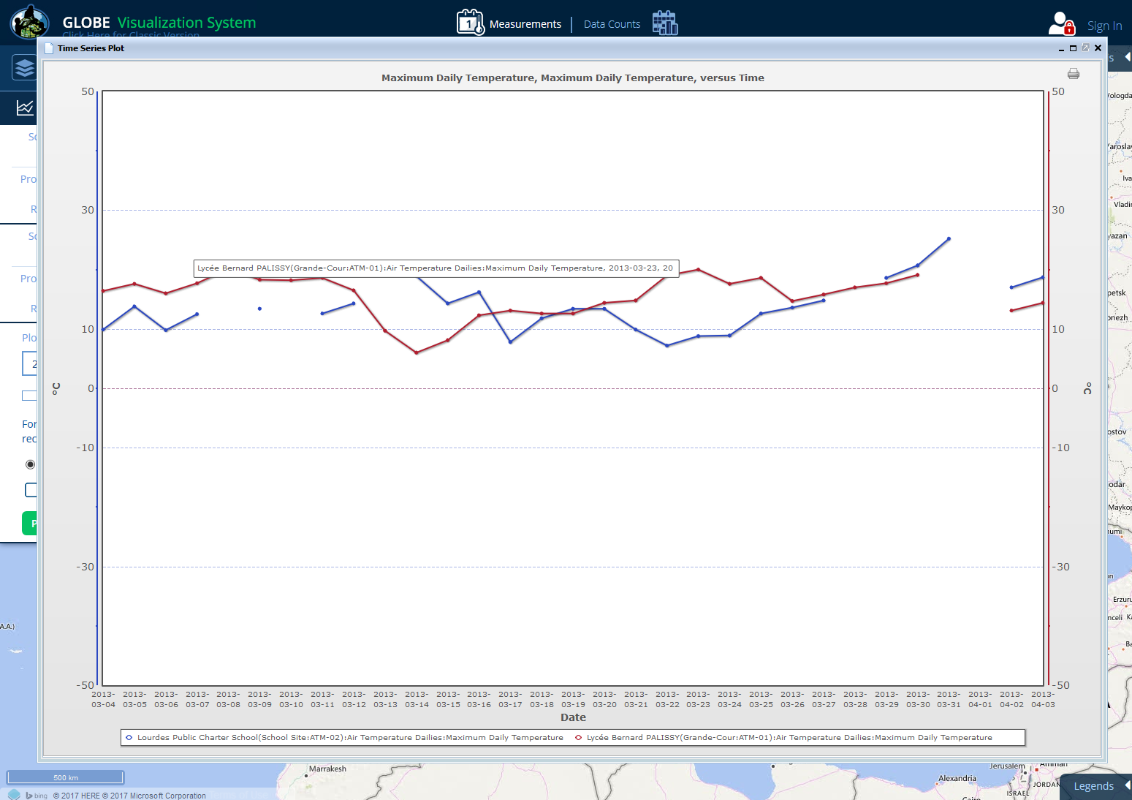
Here is the result. A maximum of 6 datasets can be added to the plot list and the maximum plot date range recommended is 5 years. Clicking the print button will print out a copy of this graph.
Notes:
The Filters section of the Advanced Control Box allows us to change the date of the map and to narrow the displayed to just one school or site or to data from a specific elevation range or within a certain area. Let’s take some time to explore using the various Filter Features. Refer to the Help Page for specific instructions about each feature.
(and so here I would give them time to play around with Filters before moving into instruction about tables and plots.)

Slide 29
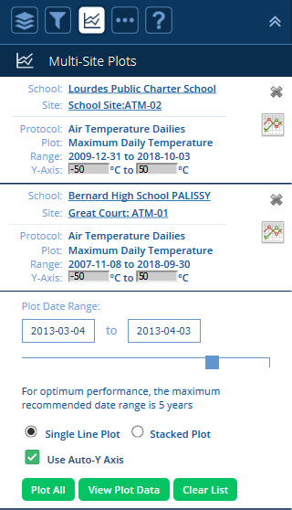
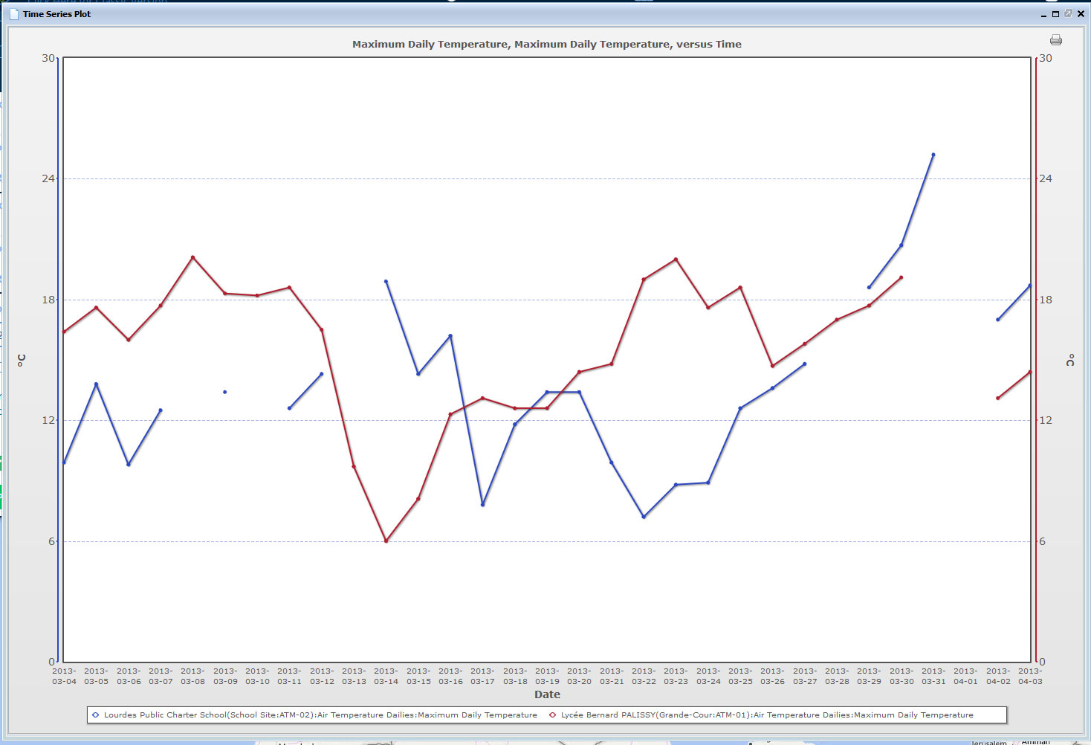
By default, the use Auto Y-axis box is checked so the software adjusts the y-axes individually to spread the data vertically on the graph. You can elect to un-check the Auto Y-axis and manually adjust the Y-axis for each site.
Notes:
The Filters section of the Advanced Control Box allows us to change the date of the map and to narrow the displayed to just one school or site or to data from a specific elevation range or within a certain area. Let’s take some time to explore using the various Filter Features. Refer to the Help Page for specific instructions about each feature.
(and so here I would give them time to play around with Filters before moving into instruction about tables and plots.)

Slide 30
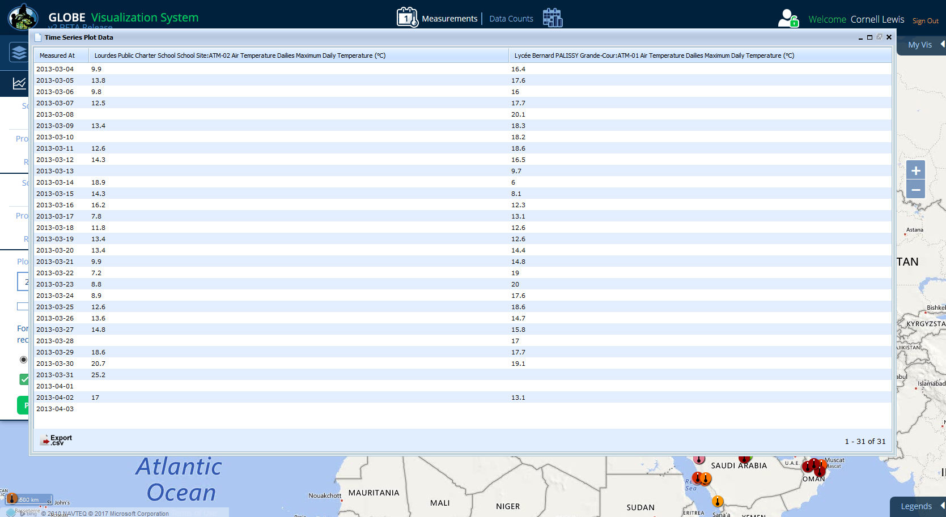
Here is the data table showing the two sites.
Notes:
The Filters section of the Advanced Control Box allows us to change the date of the map and to narrow the displayed to just one school or site or to data from a specific elevation range or within a certain area. Let’s take some time to explore using the various Filter Features. Refer to the Help Page for specific instructions about each feature.
(and so here I would give them time to play around with Filters before moving into instruction about tables and plots.)

Slide 31
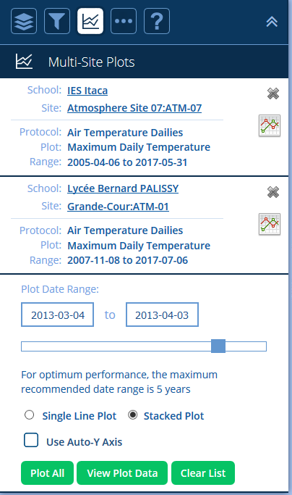
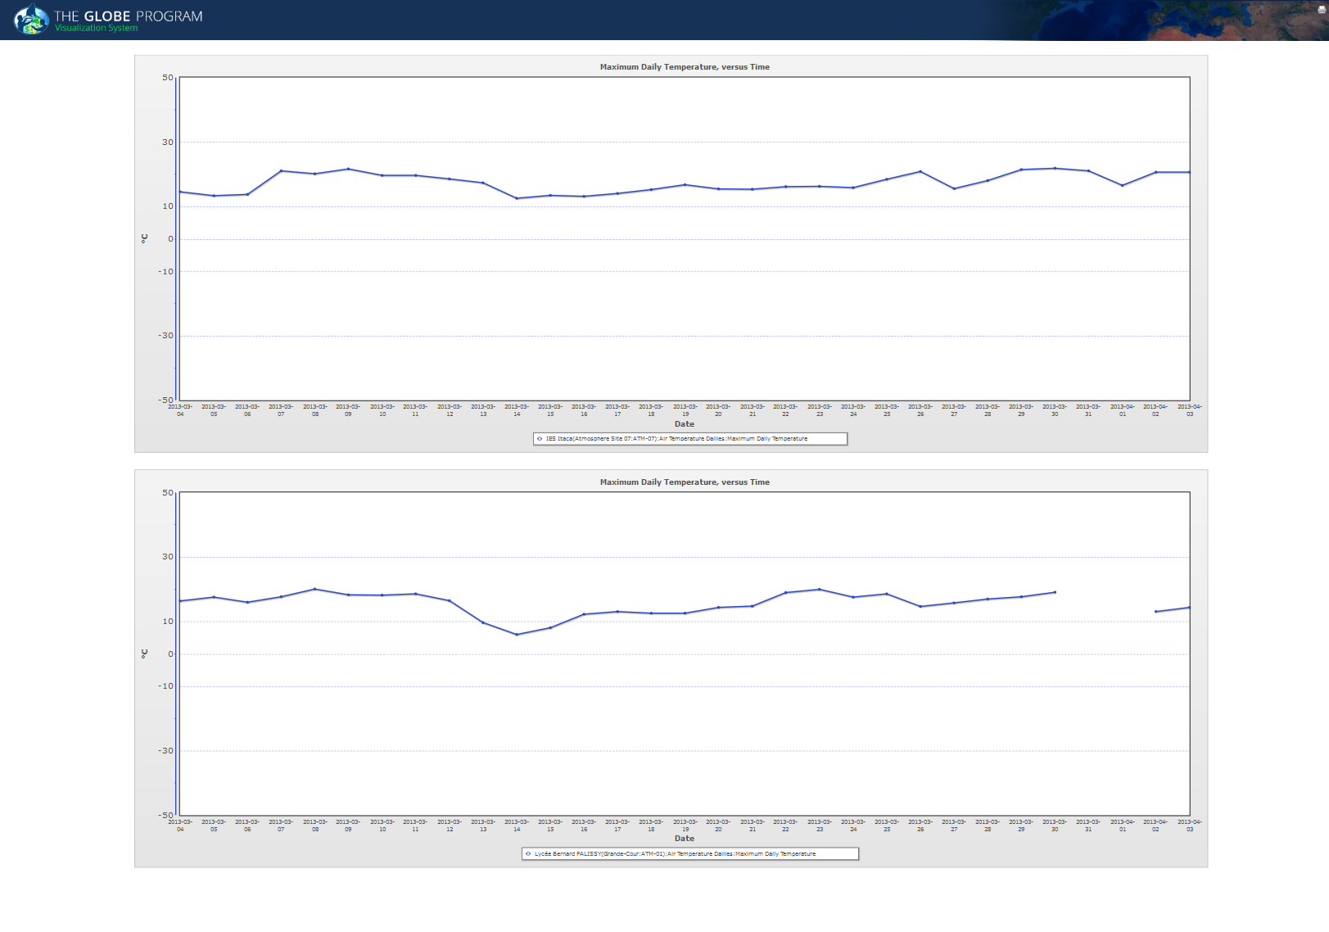
Click ‘Stacked Plot’ to plot the two sites on separate graphs
Notes:
The Filters section of the Advanced Control Box allows us to change the date of the map and to narrow the displayed to just one school or site or to data from a specific elevation range or within a certain area. Let’s take some time to explore using the various Filter Features. Refer to the Help Page for specific instructions about each feature.
(and so here I would give them time to play around with Filters before moving into instruction about tables and plots.)

Slide 32
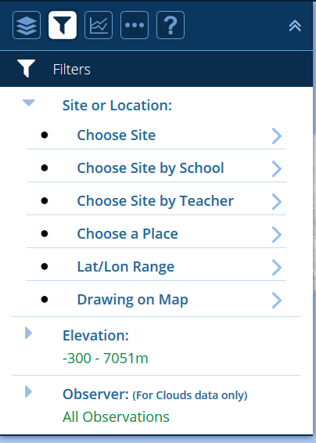
The Filters box is where you refine which data is shown on the map. Click on the filter icon at the left. You can limit the map to display only data at a specific location
(such as a country) or at a specific elevation range.
Notes:
Notice when we switched to Measurement View the top option in the Filters Controls changed from a date range to a single date. The map will only display reported data values for one day at a time.

Slide 33
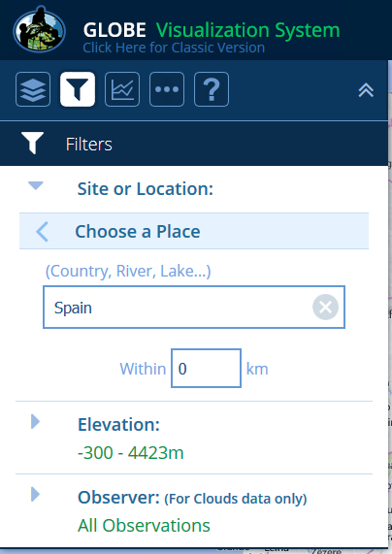
Let’s first display only schools in a country, select ‘Places’ in the Location/Site filter and then enter in Spain.
Notes:
Notice when we switched to Measurement View the top option in the Filters Controls changed from a date range to a single date. The map will only display reported data values for one day at a time.

Slide 34
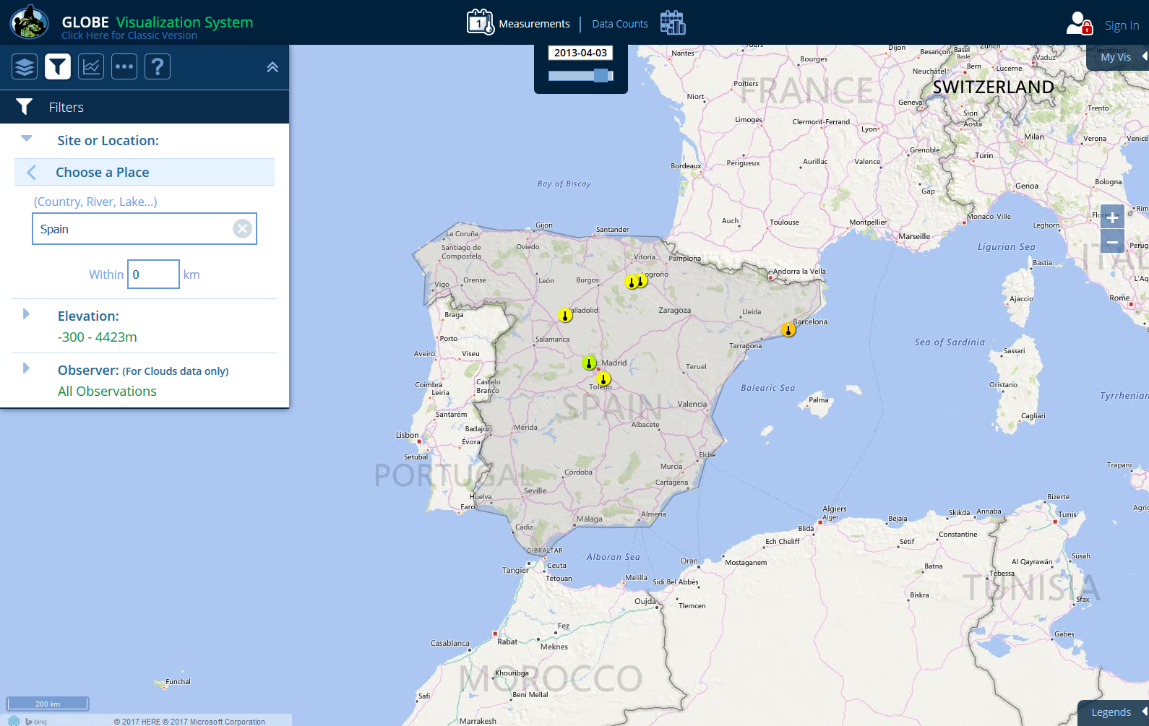
The map will zoom into the selected place and only display sites in Spain. Select the back arrow to return to the main Site or Location menu.
Notes:
The Filters section of the Advanced Control Box allows us to change the date of the map and to narrow the displayed to just one school or site or to data from a specific elevation range or within a certain area. Let’s take some time to explore using the various Filter Features. Refer to the Help Page for specific instructions about each feature.
(and so here I would give them time to play around with Filters before moving into instruction about tables and plots.)

Slide 35
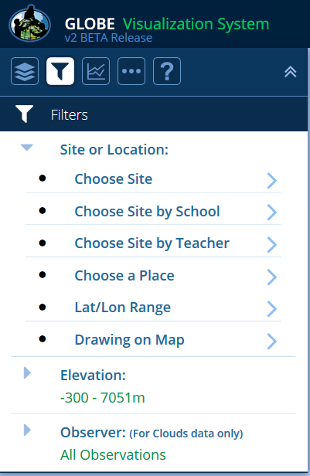
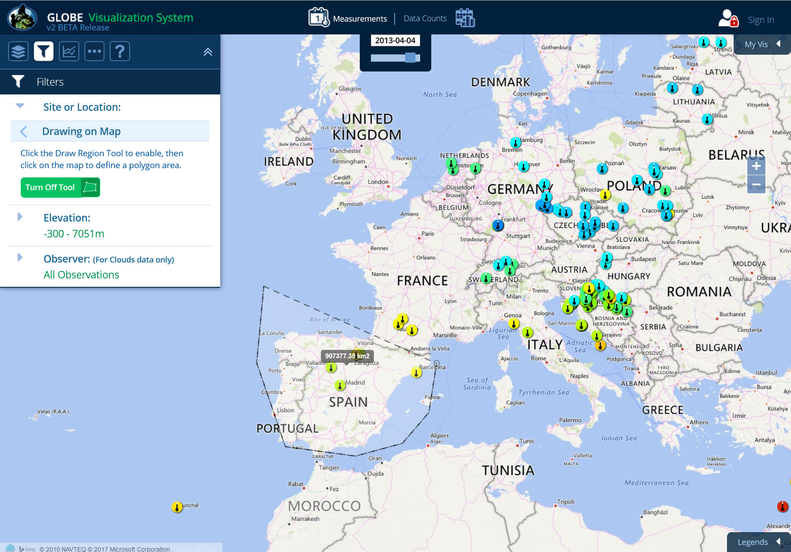
You can also filter data sites using the ‘Drawing on Map’ option. Click on the ‘Drawing on Map’ option. Turn on the tool and then draw a polygon around the site you want to isolate.
Notes:
The Filters section of the Advanced Control Box allows us to change the date of the map and to narrow the displayed to just one school or site or to data from a specific elevation range or within a certain area. Let’s take some time to explore using the various Filter Features. Refer to the Help Page for specific instructions about each feature.
(and so here I would give them time to play around with Filters before moving into instruction about tables and plots.)

Slide 36
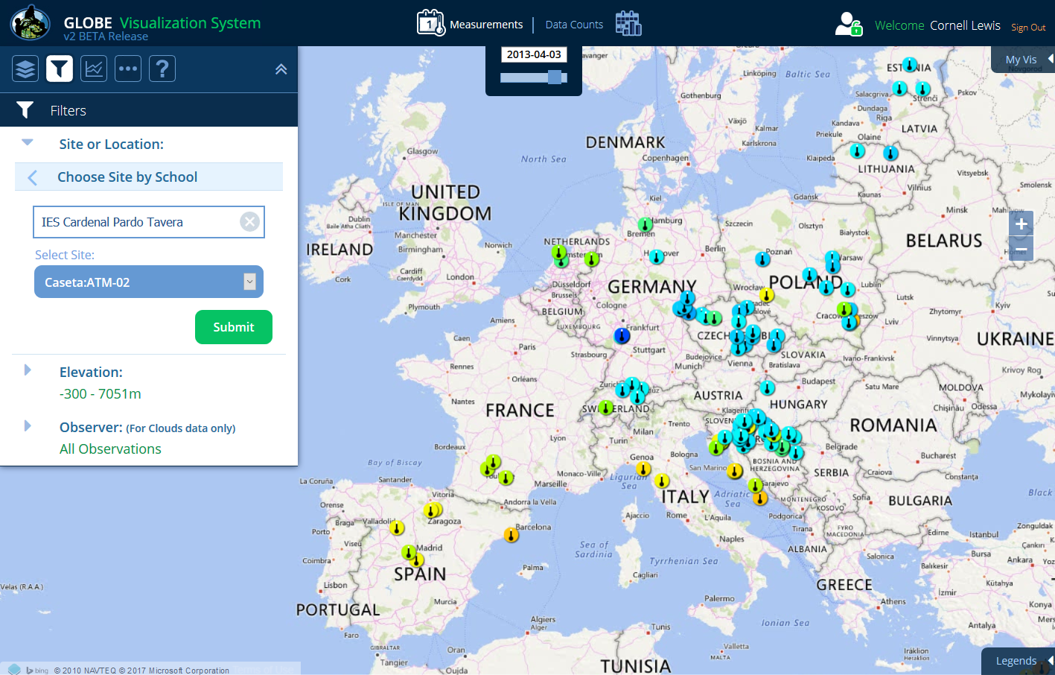
You can also search for a particular school by name. Return to the Site or Location menu and select ‘Choose Site by School’. Type in ‘IES Cardenal‘ in the school name field. The system will auto-complete to show a list of schools that have that name in the title. Select ‘IEC Cardenal Pardo Tavera’ and the site ‘Casteta: ATM-02’ and Submit.
Notes:
The Filters section of the Advanced Control Box allows us to change the date of the map and to narrow the displayed to just one school or site or to data from a specific elevation range or within a certain area. Let’s take some time to explore using the various Filter Features. Refer to the Help Page for specific instructions about each feature.
(and so here I would give them time to play around with Filters before moving into instruction about tables and plots.)

Slide 37
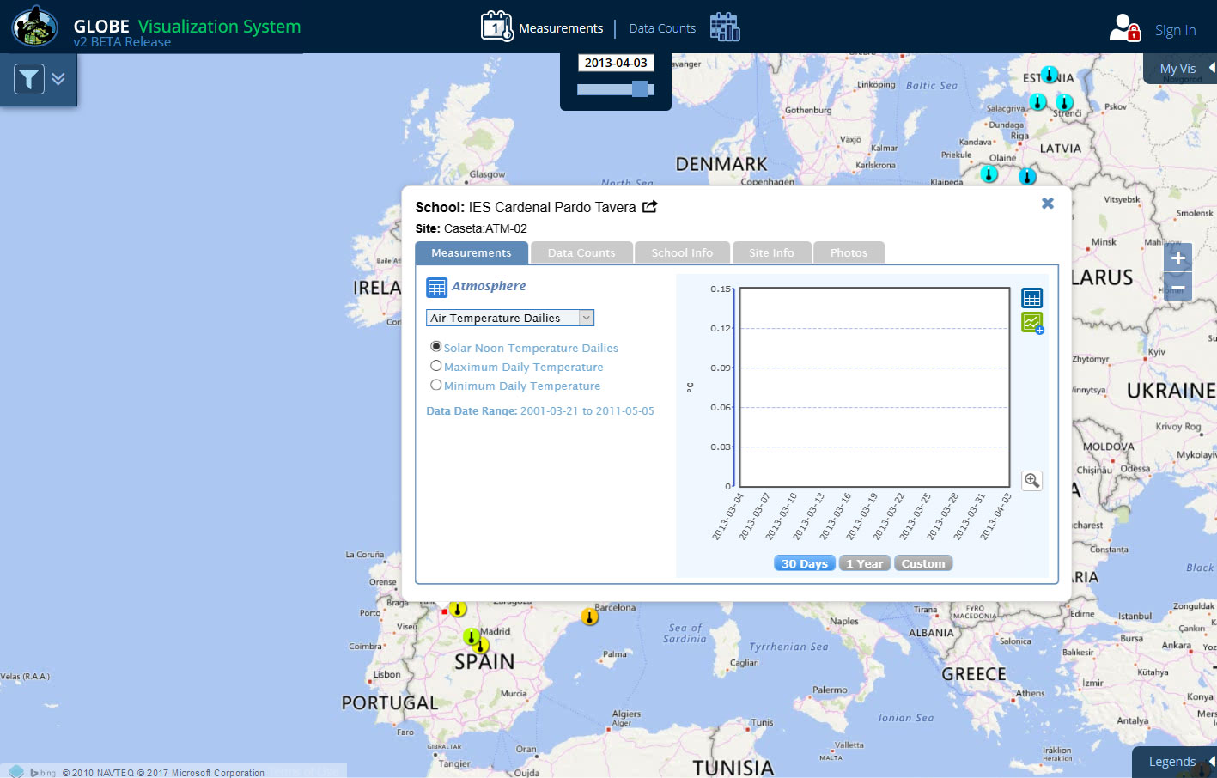
The site information window of the selected site will open. Note how the site icon is a small red dot. This indicates that no data for the added protocol layer(s) was entered on the measurement date selected (2013-04-03).
Notes:
The Filters section of the Advanced Control Box allows us to change the date of the map and to narrow the displayed to just one school or site or to data from a specific elevation range or within a certain area. Let’s take some time to explore using the various Filter Features. Refer to the Help Page for specific instructions about each feature.
(and so here I would give them time to play around with Filters before moving into instruction about tables and plots.)

Slide 38
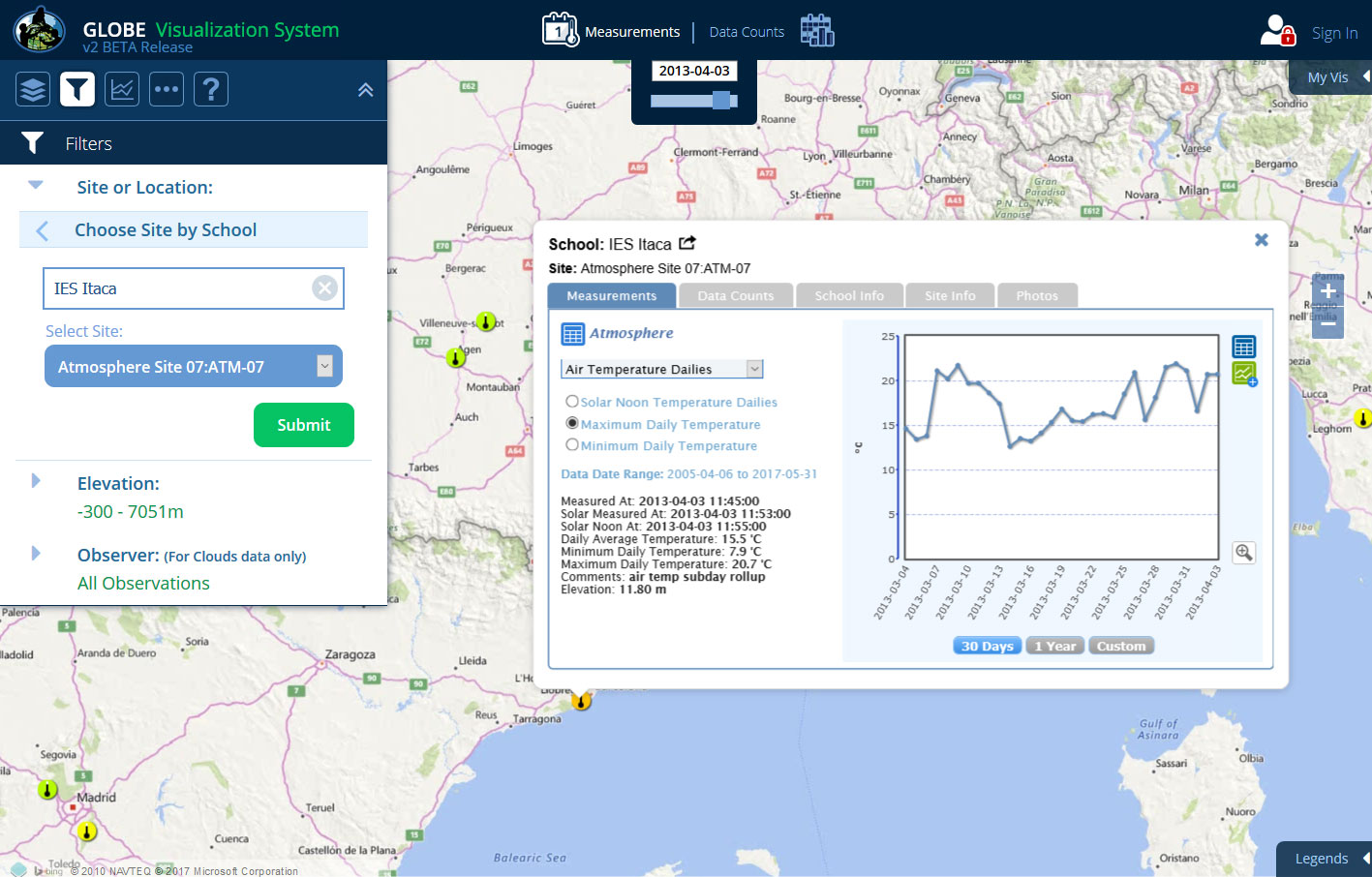
Let’s search for another school. Type in ‘Itaca‘ in the school name field
select ‘IEC Itaca’ and then the site ‘Atmosphere Site 07: ATM-07’.
Notes:
The Filters section of the Advanced Control Box allows us to change the date of the map and to narrow the displayed to just one school or site or to data from a specific elevation range or within a certain area. Let’s take some time to explore using the various Filter Features. Refer to the Help Page for specific instructions about each feature.
(and so here I would give them time to play around with Filters before moving into instruction about tables and plots.)

Slide 39
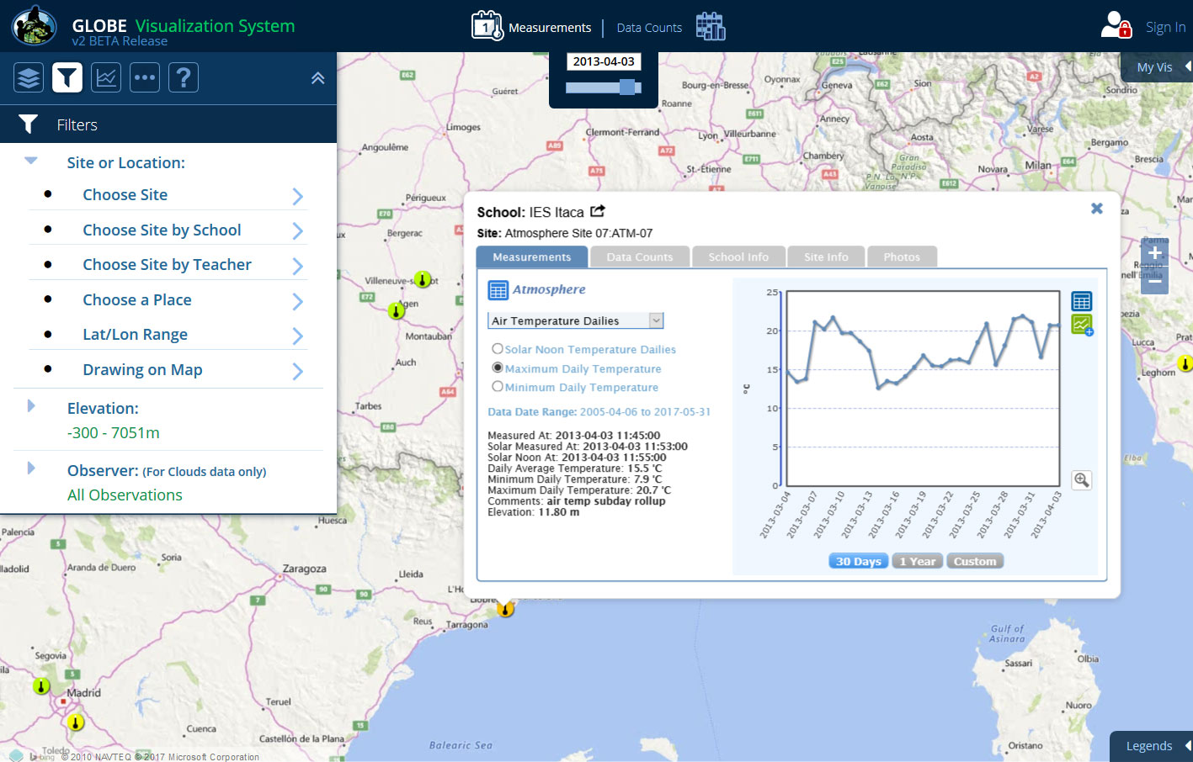
The site info window is now pointing at a Max Daily Temperature icon because temperature data was recorded on the current date.
Notes:
The Filters section of the Advanced Control Box allows us to change the date of the map and to narrow the displayed to just one school or site or to data from a specific elevation range or within a certain area. Let’s take some time to explore using the various Filter Features. Refer to the Help Page for specific instructions about each feature.
(and so here I would give them time to play around with Filters before moving into instruction about tables and plots.)

Slide 40
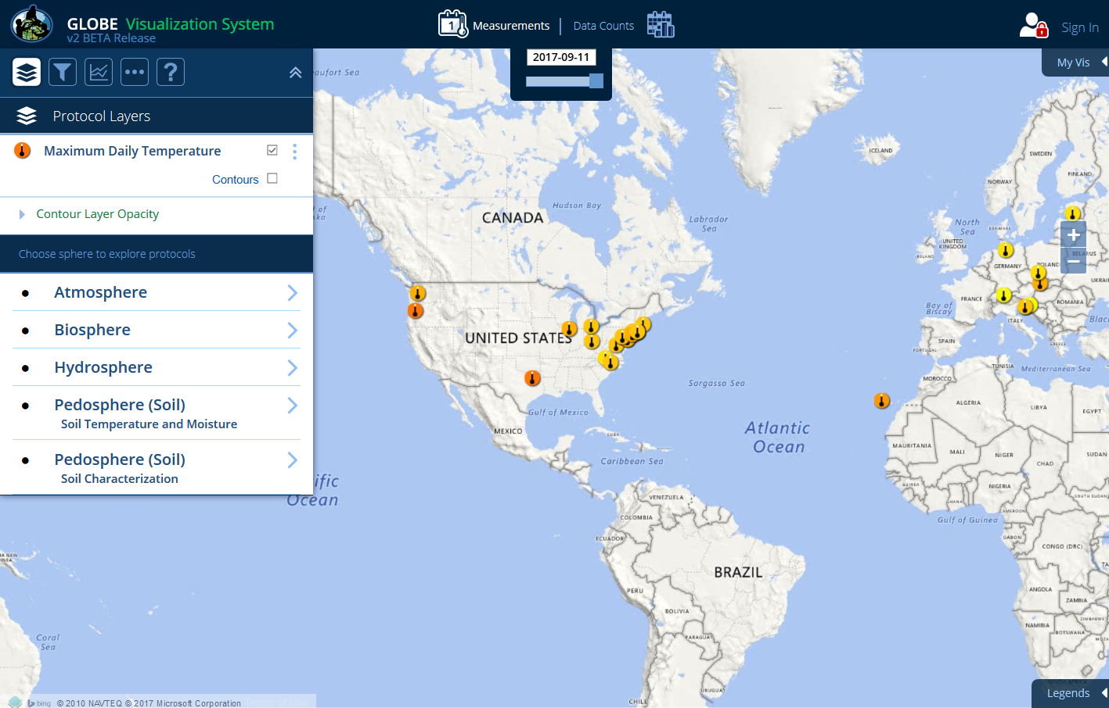
Another way to output data is to view all data of a layer in a table. To do so, click on the ‘more’ icon (the 3 dots).
Notes:
The Filters section of the Advanced Control Box allows us to change the date of the map and to narrow the displayed to just one school or site or to data from a specific elevation range or within a certain area. Let’s take some time to explore using the various Filter Features. Refer to the Help Page for specific instructions about each feature.
(and so here I would give them time to play around with Filters before moving into instruction about tables and plots.)

Slide 41
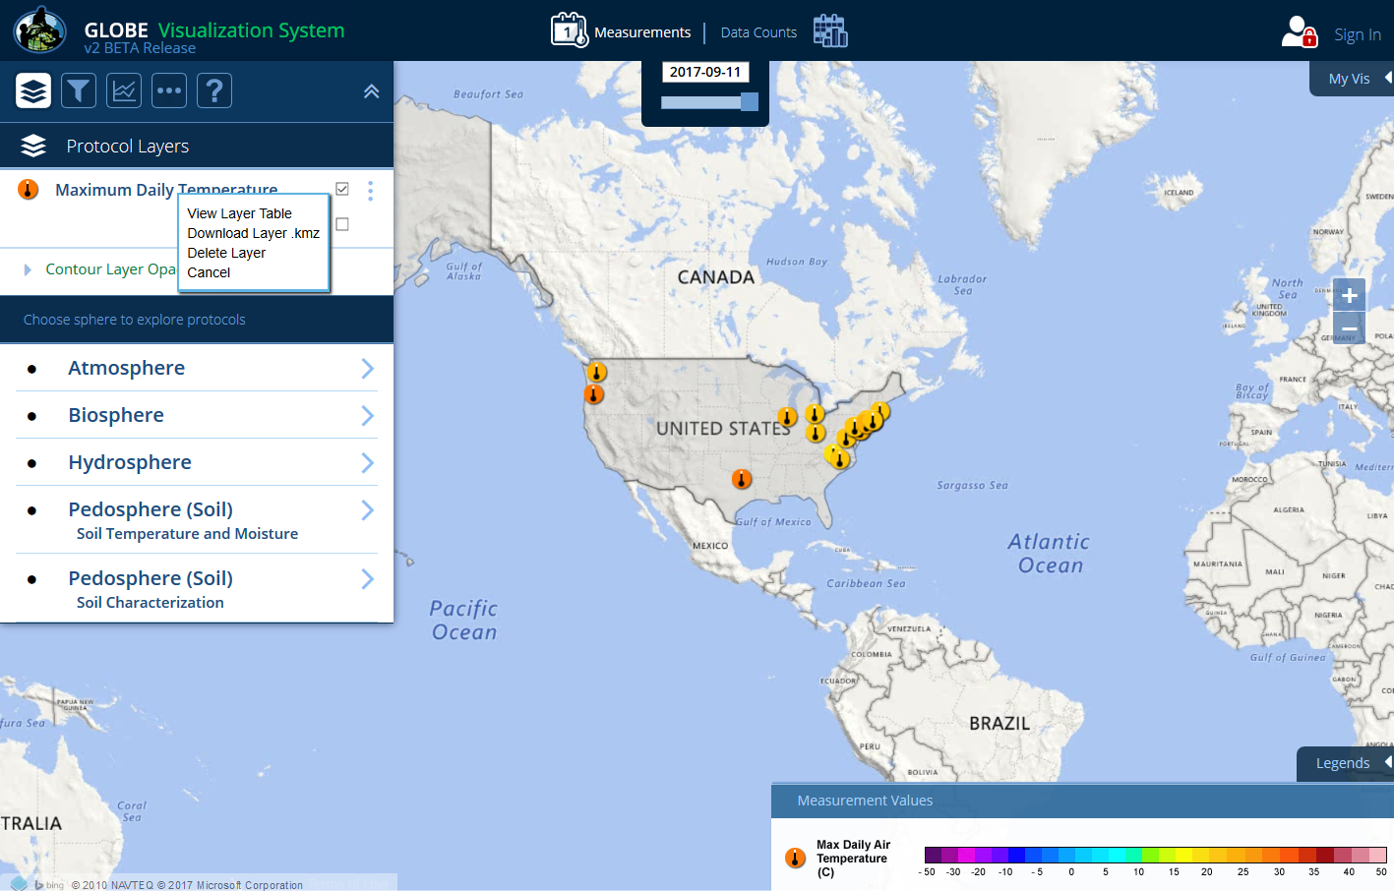
A selection pop-up box appears. Click on View Layer Table. In this example we used the Place filter to just show U.S. sites. Note – data can also be downloaded to a .kmz file
Notes:
The Filters section of the Advanced Control Box allows us to change the date of the map and to narrow the displayed to just one school or site or to data from a specific elevation range or within a certain area. Let’s take some time to explore using the various Filter Features. Refer to the Help Page for specific instructions about each feature.
(and so here I would give them time to play around with Filters before moving into instruction about tables and plots.)

Slide 42
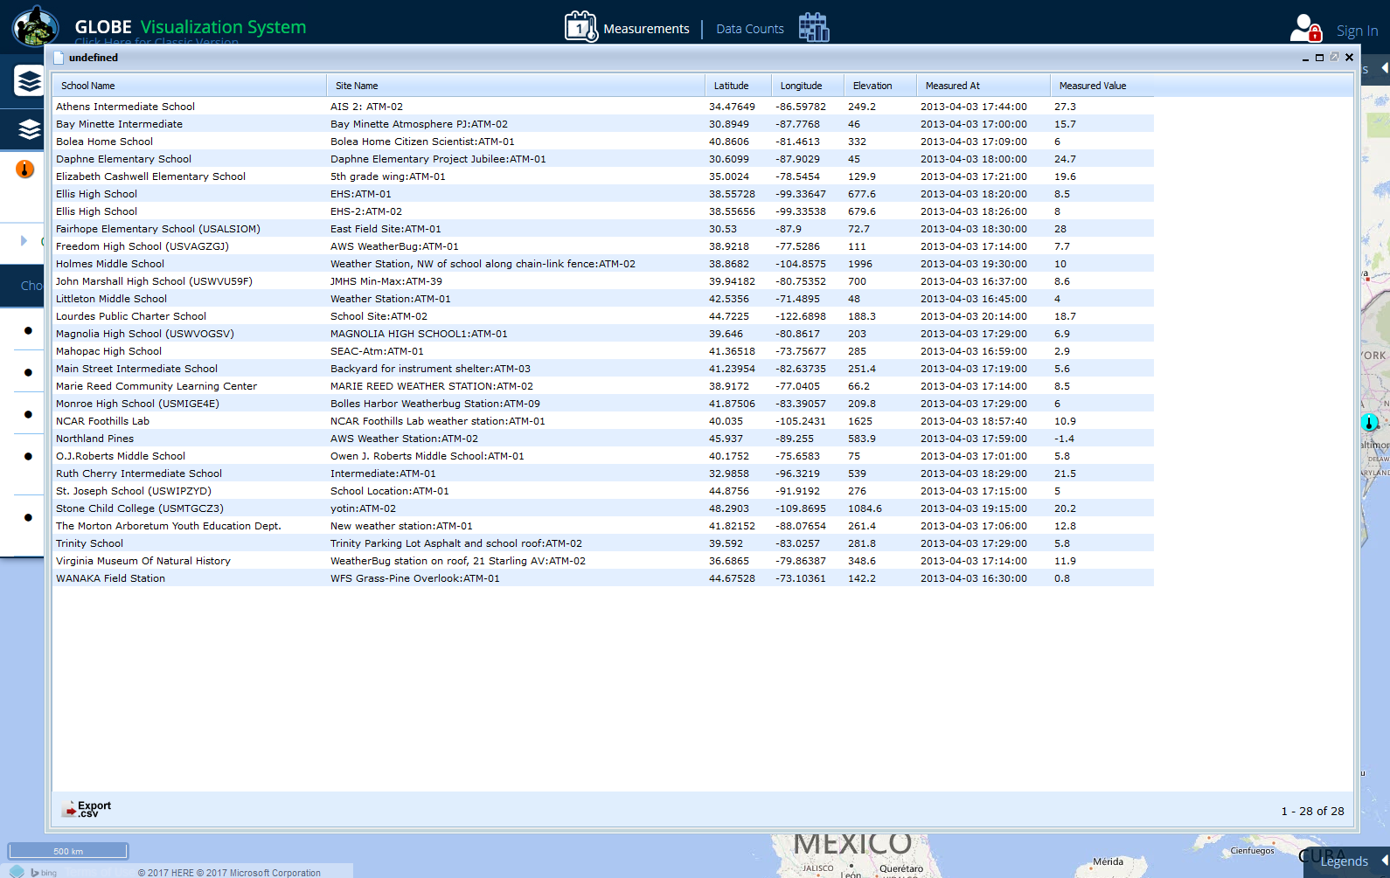
The sites in the U.S. for the layer and measurement date selected are listed in the table and can be sorted by any field name (School Name, Site Name, etc.) and can be exported to a .csv file.
Notes:
The Filters section of the Advanced Control Box allows us to change the date of the map and to narrow the displayed to just one school or site or to data from a specific elevation range or within a certain area. Let’s take some time to explore using the various Filter Features. Refer to the Help Page for specific instructions about each feature.
(and so here I would give them time to play around with Filters before moving into instruction about tables and plots.)

Slide 43
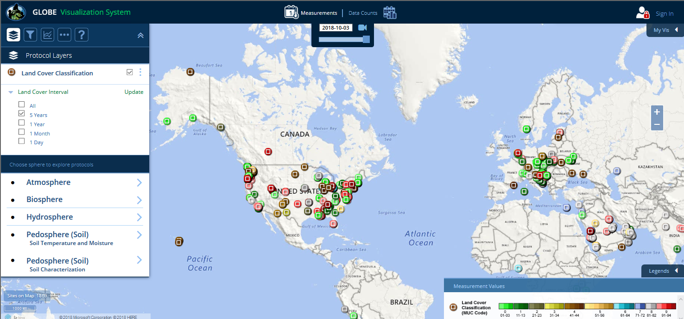
Let’s take a look at Land Cover Classification. Add the Biosphere > Land Cover Classification Layer. The default view shows measurements entered the past year, but you can change the time interval as shown here.
Notes:
DELETED SLIDE 37 and merged text with this slide.

Slide 44
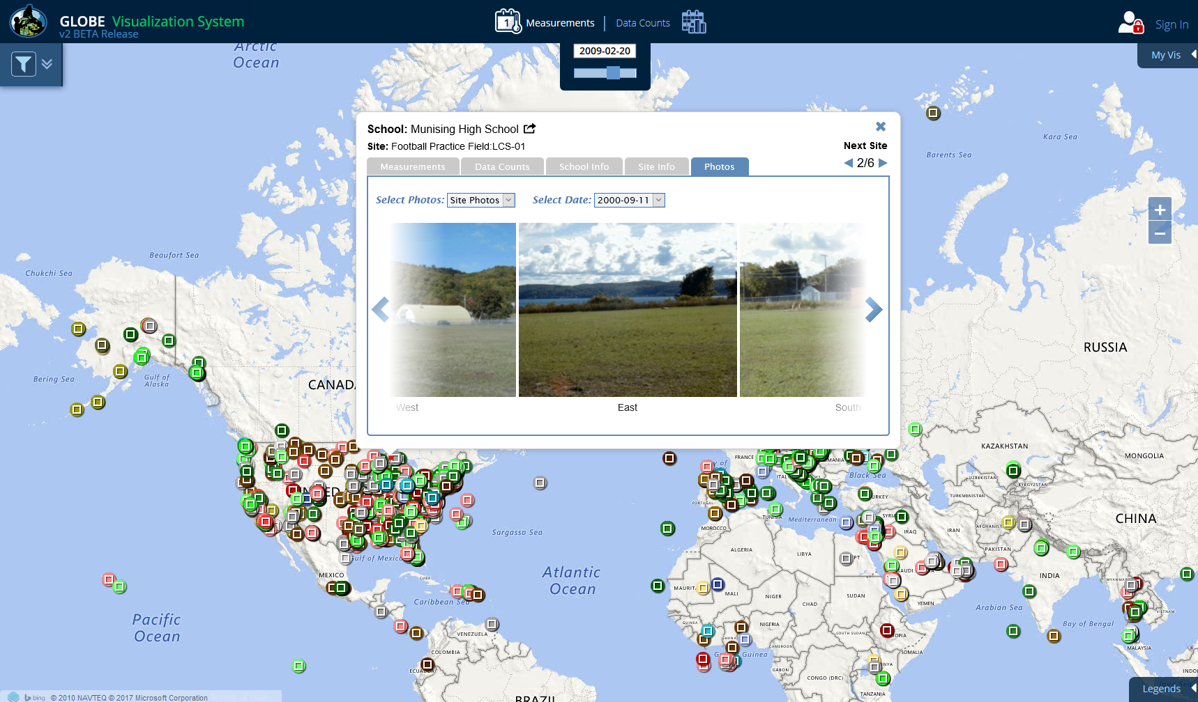
Now, click on a measurement icon and click on the Photo tabs to view available photos. Click on a photo to see a larger view.
Notes:
DELETED SLIDE 37 and merged text with this slide.

Slide 45
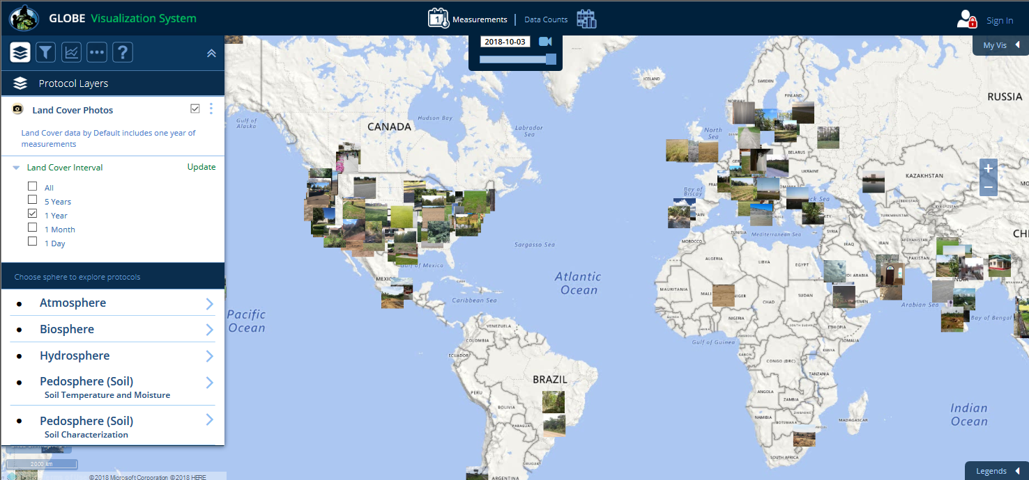
Three protocols (Land Cover, Cloud cover and Mosquito Habitat Mapper) have a photo layer that shows sites with photo observations. Click a site to see all of the photos.
Notes:
DELETED SLIDE 37 and merged text with this slide.

Slide 46
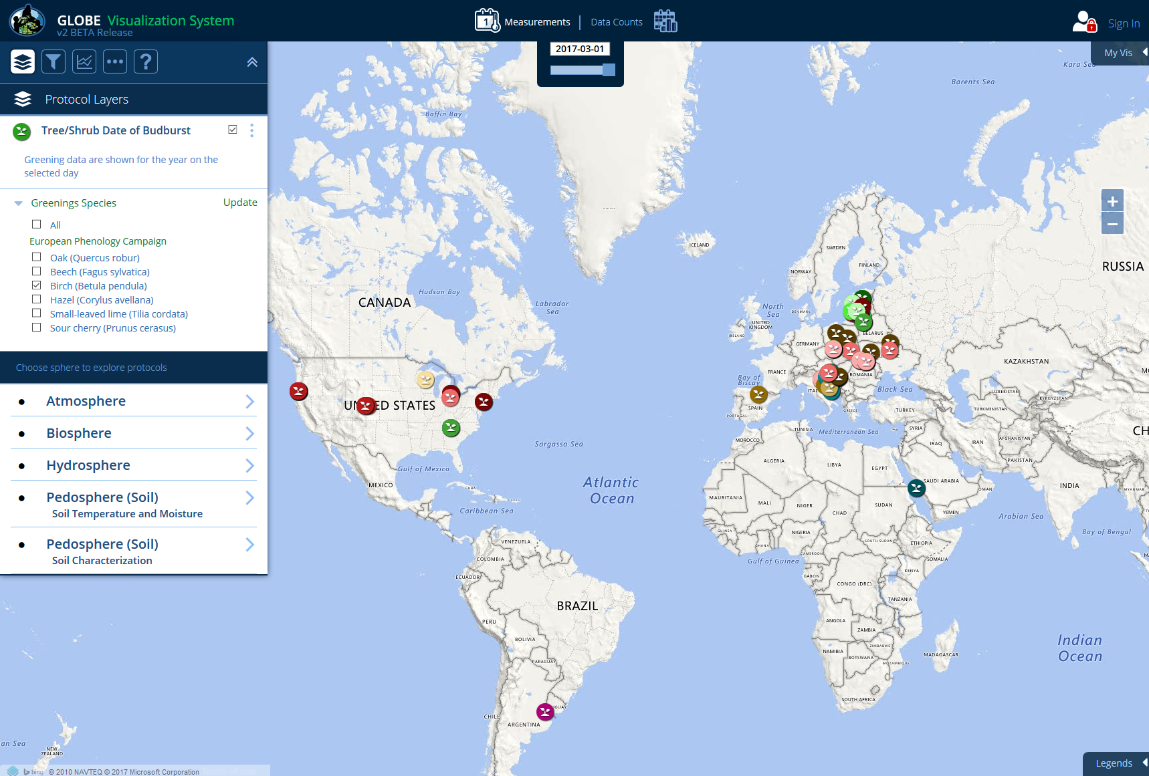
Some protocol layers have sub-layers to further filter the data. Tree/Shrub Date of Budburst, for example, can be filtered by species.
Notes:
DELETED SLIDE 37 and merged text with this slide.

Slide 47
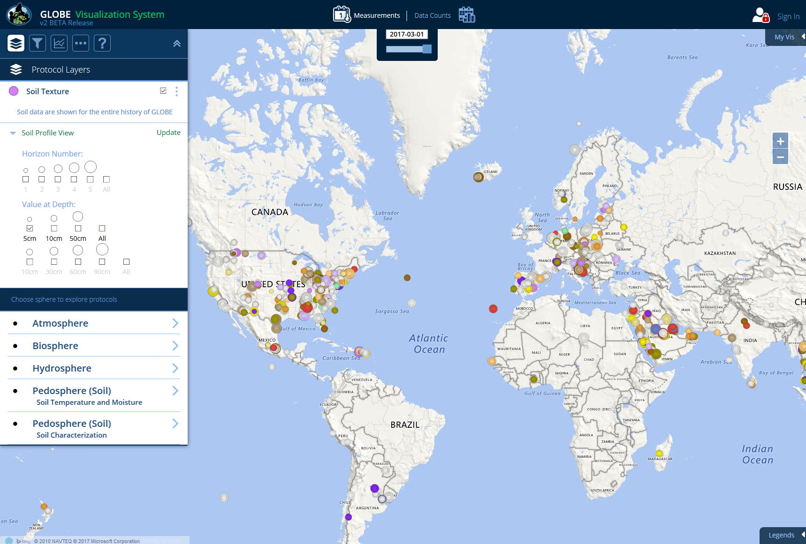
Soil characterization layers such as Soil Texture can be filtered by Horizon Number and Value at Depth
Notes:
DELETED SLIDE 37 and merged text with this slide.

Slide 48
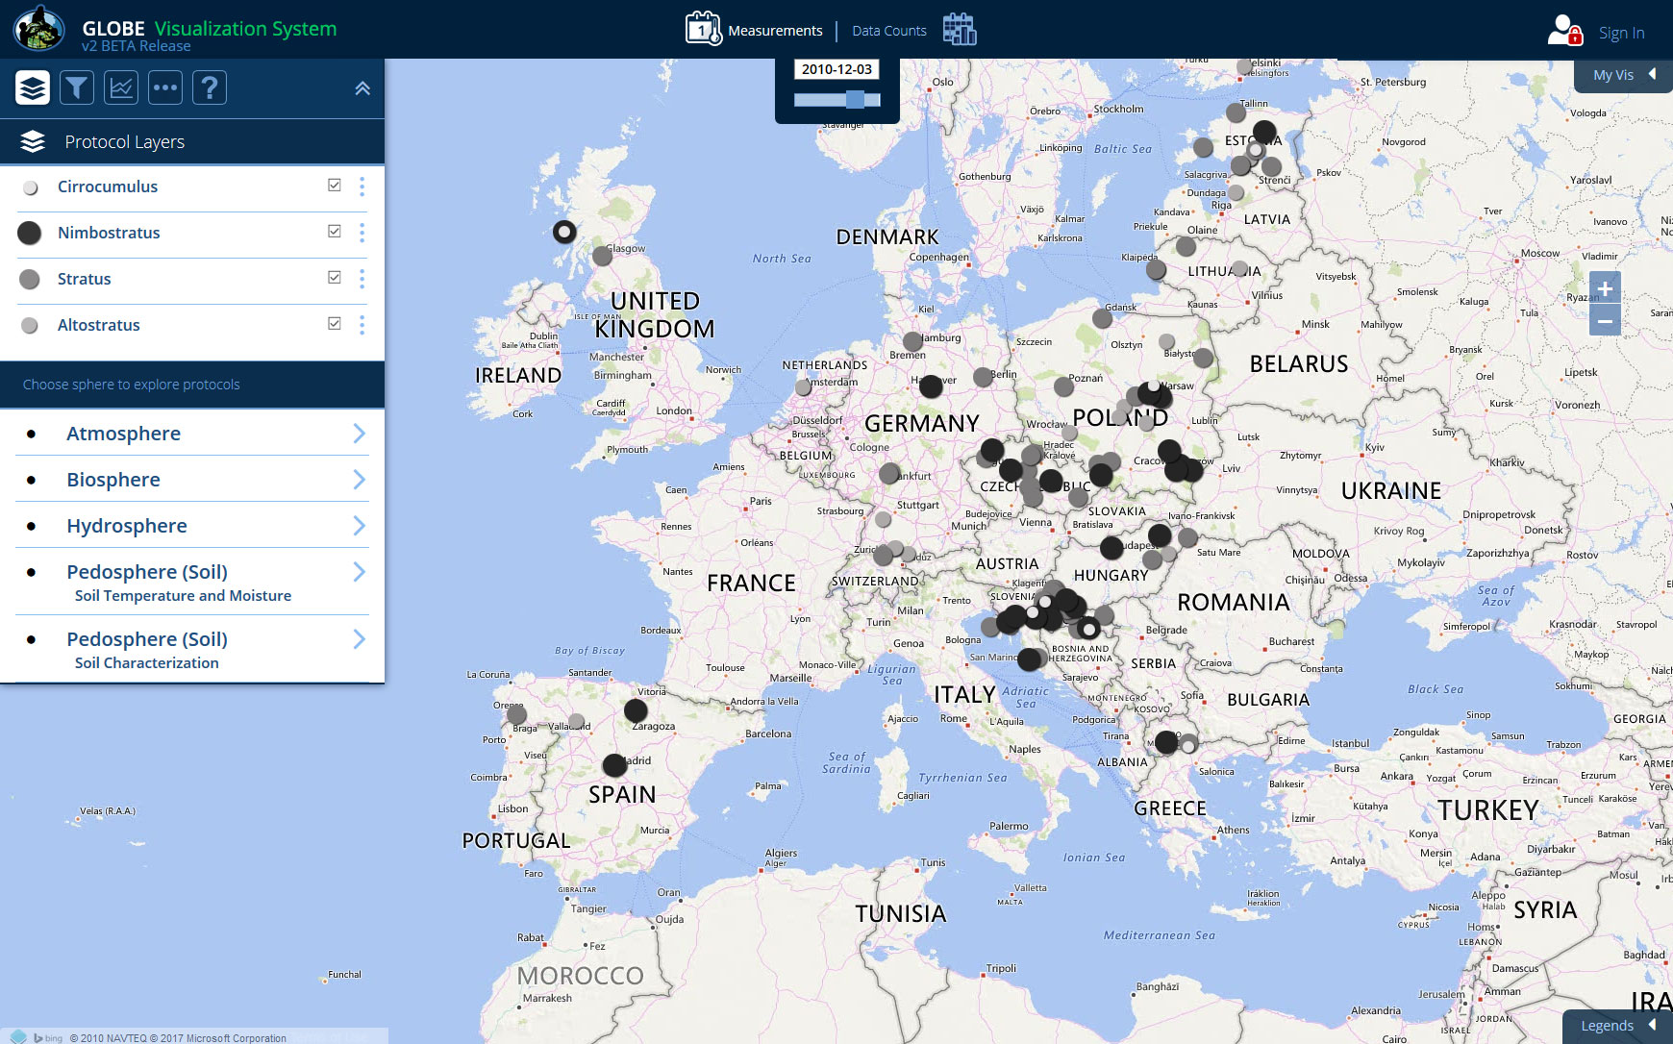
Cloud Observations and other measurement types (Soil Properties, etc.) utilizes different layer sizes and colors so one can see up to 5 layers at a single site. Since different Cloud Observations can be made at the same site on the same day, layer icons can be hidden.

Slide 49
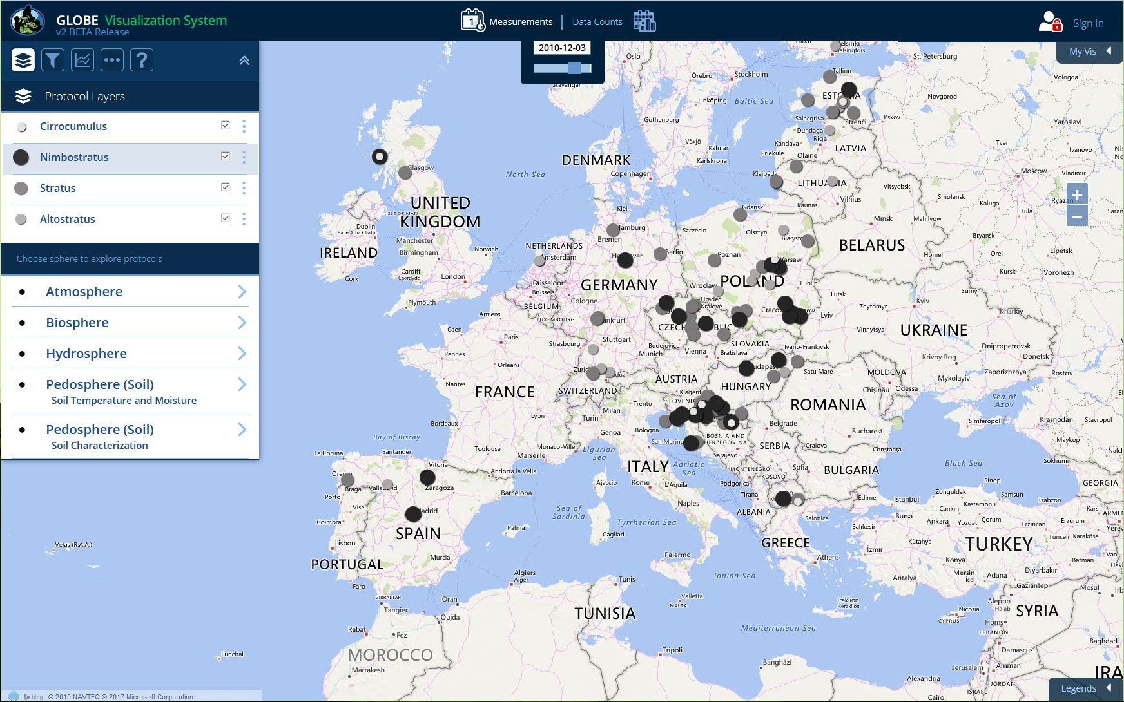
To re-order a layer, click and hold a layer name. Now drag the layer to the new position

Slide 50
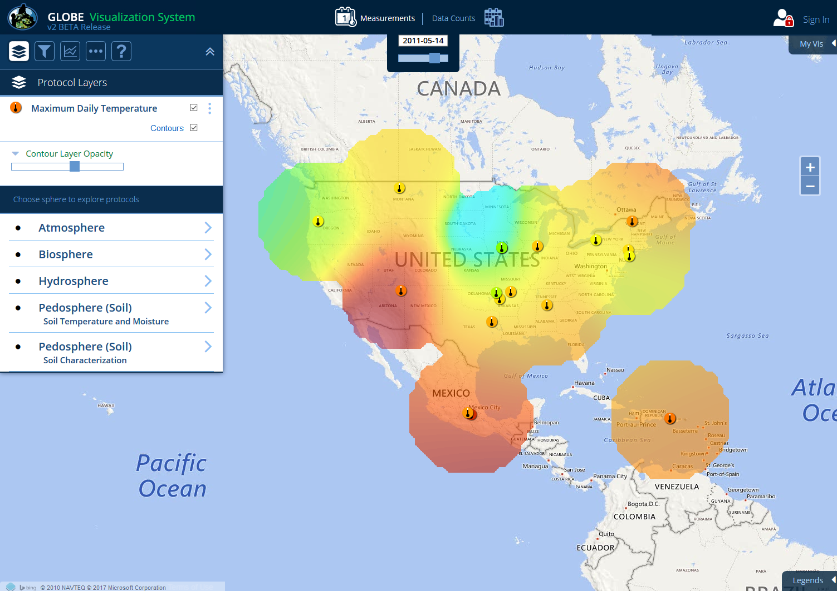
On the Layers menu, contours of some data sets may be shown by clicking the Contours box. The contour opacity can be adjusted by clicking on the opacity link.
Notes:
DELETED SLIDE 37 and merged text with this slide.

Slide 51

Data can also be viewed by looking at data counts – How many measurements were recorded at a site in a given time frame? Click on ‘Data Counts’ at the top to switch the map view. The default date range is 5 years.
Notes:
The new layer will be added to the map. Now that there is data on the map, the legend will pop-out of the bottom right corner and the Advanced Features Control will pop-out of the right side of the screen. The Filters Controls will be open by default with the Map Date Range set to the entire history of GLOBE.
In Data Count View each icon on the map represents the number of data reports for that data type at a specific GLOBE site. Smaller circles are sites with less of that type of data, larger circles are sites with more of that type of data. Sites that have not reported the visible data types will not show up on the map.
Original Text:
3 pop-out boxes are open and Data Layer values for a date range are now shown on the map.
The pop-out box to the right, Filters, has Map Date Range at the top.
The default date range covers the whole history of GLOBE.

Slide 52

The larger the circle icon, the greater number of measurements reported. These sites offer better possibilities for study in research projects.
Notes:
If your students are looking for GLOBE data to use in their own investigations, then they will likely want to find sites with lots of data over specific time periods.
Let’s look at an example of how we might use Filter by Map Date Range in Data Count view to find sites with specific data available. Narrow the data range to 2010-08-15 – 2013-06-01 and zoom in over North America. No sites could be represented by the largest circle from the legend over this time period because we are looking at data over fewer than 2500 days. However, sites with the second largest circle might be good candidates for use in our investigations because they have reported data for every or nearly every day of the last 3 school years.
I changed bigger to larger… not sure if that is “more right” or not. Grammar websites say bigger and larger are basically synonyms but bigger is more often used for “more important” and larger is more often used to “more quantity”.

Slide 53

Clicking on an icon on the map opens a site info window. Since the map type is Data Counts, that is the default selection. A plot of the selected data type is displayed showing data counts for the last 5 years for the selected site. You can also select total years or a custom date range.
Notes:
Now that we know which sites have a lot of Max. Air temperature data, we probably want to know more about each site before we select it for our investigation. Click on the data icon on the map and the site pop-box opens. From here we can learn more about the site and about the school that collected the data.

Slide 54

Data Counts Site Info Window:
This site info window gives information about the site and is the
gateway to creating tables and plots of site data.
Click icon to go to
school organization
page
Cycle through sites
whose icons are on top of each other
Data Type and
(total #
of measurements)
Roll-over bar graph to see the total # of measurements
for each interval
Datasets (select
a dataset to
change the plot
view )
Change plot time range
Notes:
Hmmm not sure if data type, parameter or something else would be best here…

Slide 55

Share your layer and filter parameters with others by sending them a URL. When the URL is entered, the system will load your filter sets automatically. To get the URL, open the ‘My Vis’ tab and click ‘Share’. A popup will appear with the URL.
Notes:
Now that we know which sites have a lot of Max. Air temperature data, we probably want to know more about each site before we select it for our investigation. Click on the data icon on the map and the site pop-box opens. From here we can learn more about the site and about the school that collected the data.

Slide 56

On your phone and small tablets, click on the My Vis icon in the menu bar to see the share link
Notes:
Now that we know which sites have a lot of Max. Air temperature data, we probably want to know more about each site before we select it for our investigation. Click on the data icon on the map and the site pop-box opens. From here we can learn more about the site and about the school that collected the data.

Slide 57

If you’d like to save your filter sets, log-in using your GLOBE.gov username and password
Notes:
Now that we know which sites have a lot of Max. Air temperature data, we probably want to know more about each site before we select it for our investigation. Click on the data icon on the map and the site pop-box opens. From here we can learn more about the site and about the school that collected the data.

Slide 58

Once logged-in, click ‘Save’ to save your current filters. Enter a filter name and submit.
Notes:
Now that we know which sites have a lot of Max. Air temperature data, we probably want to know more about each site before we select it for our investigation. Click on the data icon on the map and the site pop-box opens. From here we can learn more about the site and about the school that collected the data.

Slide 59

To load a filter set, click the ‘Load’ link.
Notes:
Now that we know which sites have a lot of Max. Air temperature data, we probably want to know more about each site before we select it for our investigation. Click on the data icon on the map and the site pop-box opens. From here we can learn more about the site and about the school that collected the data.

Slide 60

A pop-up window will display where you can load, edit, delete and copy the URL of the saved filter set
Notes:
Now that we know which sites have a lot of Max. Air temperature data, we probably want to know more about each site before we select it for our investigation. Click on the data icon on the map and the site pop-box opens. From here we can learn more about the site and about the school that collected the data.

Slide 61

When logged-in, you can display just the sites where you have entered data. On the My Vis tab, click the ‘Sites’ checkbox and make sure ‘Show My’ is selected in the drop down menu. All of your sites will be identified with a red circle on the map. Changing the drop down to ‘Show My Organization’s will display all sites where anyone is your organization(s) has entered data.
Notes:
Now that we know which sites have a lot of Max. Air temperature data, we probably want to know more about each site before we select it for our investigation. Click on the data icon on the map and the site pop-box opens. From here we can learn more about the site and about the school that collected the data.

Slide 62

To see just your sites that have measurements of the active protocol layer(s) for the current map date, click the ‘Measurements’ check box on the My Vis tab. In the example below, only the user’s cloud cover measurements are shown on the map.
Notes:
Now that we know which sites have a lot of Max. Air temperature data, we probably want to know more about each site before we select it for our investigation. Click on the data icon on the map and the site pop-box opens. From here we can learn more about the site and about the school that collected the data.

Slide 63

Under the ‘More’ menu are additional options – Base maps, language selector (English and Spanish, with more to come), map grid and a lat/long cursor position.
Notes:
Now that we know which sites have a lot of Max. Air temperature data, we probably want to know more about each site before we select it for our investigation. Click on the data icon on the map and the site pop-box opens. From here we can learn more about the site and about the school that collected the data.

Slide 64

Want to see your measurements over time? Click on the movie icon to open the timeline animation tool
Notes:
Now that we know which sites have a lot of Max. Air temperature data, we probably want to know more about each site before we select it for our investigation. Click on the data icon on the map and the site pop-box opens. From here we can learn more about the site and about the school that collected the data.

Slide 65


Timeline animation tool
1
3
4
5
2
Select a date range (make sure you have already added the desired protocol layers). Click a date to open the calendar interface.
You can also select a date range by moving the date range slider on the timeline.
Determine the time interval (each day, 1 day per month or 1 day per year).
Press the play button to preview the animation.
Press record to create an animation to save to a file.
Once recorded, press the download icon to save an animated gif to your computer.
6
Notes:
Now that we know which sites have a lot of Max. Air temperature data, we probably want to know more about each site before we select it for our investigation. Click on the data icon on the map and the site pop-box opens. From here we can learn more about the site and about the school that collected the data.

Slide 66


Timeline animation tool – sample animated gif file
Notes:
Now that we know which sites have a lot of Max. Air temperature data, we probably want to know more about each site before we select it for our investigation. Click on the data icon on the map and the site pop-box opens. From here we can learn more about the site and about the school that collected the data.

Slide 67

Timeline animation tool - continue
7
10
9
8
Change the current map date by clicking the arrows to go to the next or previous day or click the current day to open a calendar interface.
You can also change the map date by adjusting the current date slider bar on the timeline (to see the current date slider bar, click the calendar icon to close the date range selector).
Click the center icon to re-center the map date to the center of the timeline.
Press X to close the timeline.
Notes:
Now that we know which sites have a lot of Max. Air temperature data, we probably want to know more about each site before we select it for our investigation. Click on the data icon on the map and the site pop-box opens. From here we can learn more about the site and about the school that collected the data.

Slide 68
Your Assignment
On April 7, 2004, how many schools in the Czech Republic reported a water pH reading less then 5?
Which measurement technique did the school(s) use?
What was the range of pH values reported for this site in 2003 and 2004?
Pick one Czech school with a pH value less than 5 and another nearby school reporting water pH on April 7, 2004 and plot the data from the two schools for January to May 2004. What does the graph illustrate?
Which school in Poland has reported the most water pH data?
Plot water pH, conductivity, and alkalinity for this site for January to May 2004.
What does this graph illustrate?

Slide 69
Answers
One (Filtered by Czech Republic using the place filter and date and then used the ‘View Table Layer’ tool).
Paper (Clicked on the site on the map, it’s the lightest color icon. Value found in site info window).
3 – 6 pH units in 2003, 3-6.5 in 2004 (Opened the site information window and clicked on the ‘View data table’ icon to view the data table. Then selected the data date range from Jan-Dec 2003 and then for 2004).
The pH level for the school with the higher pH lever on April 7th on was consistently higher from Jan to May
XI Liceum St. Konarskiego in Wrocław (Filtered by Poland, switched to Data Counts map. It has the largest circle)
The pH remains fairly constant despite significant changes in alkalinity and conductivity (Added each dataset to the plot list by selecting each one in the site info window)

