Slide 1


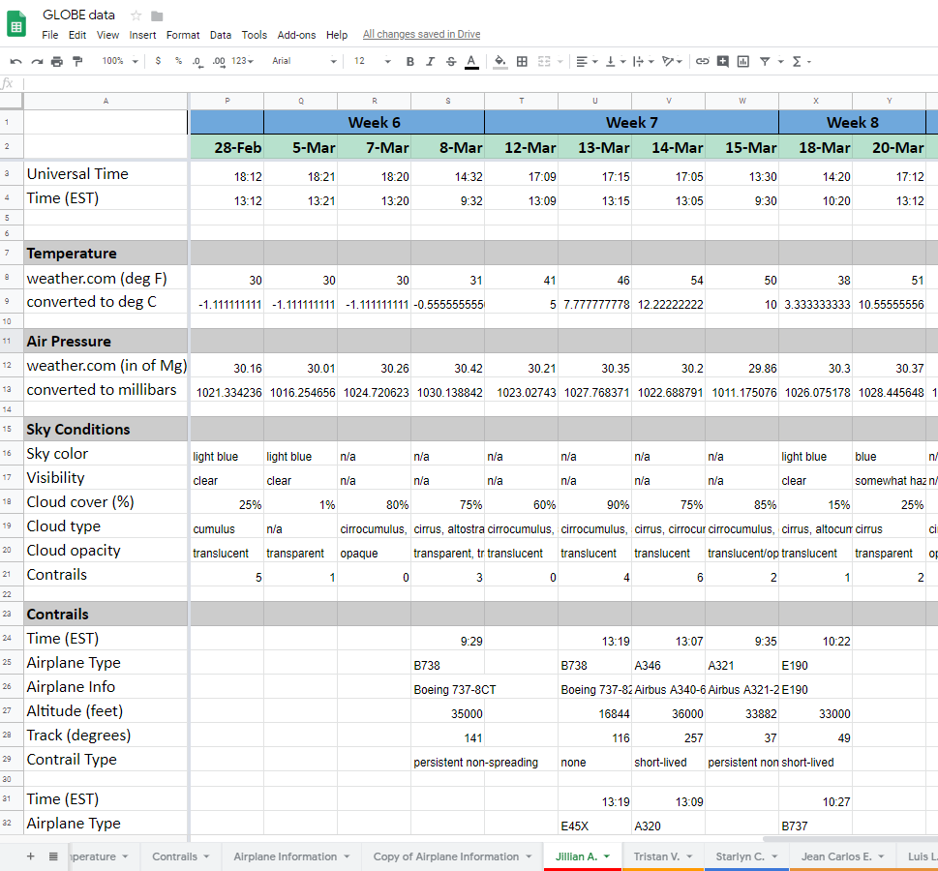
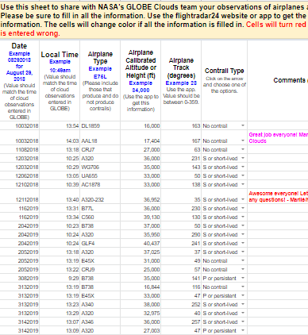
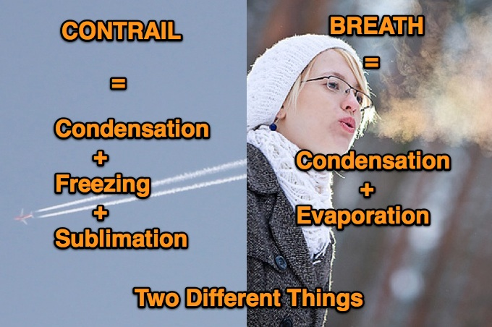
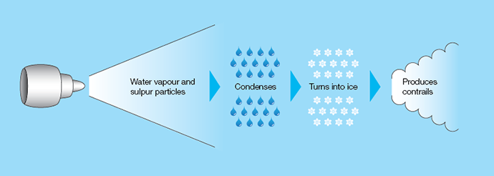
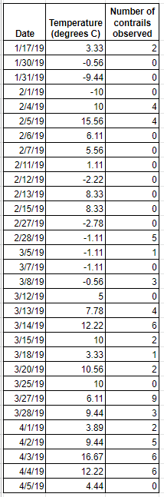
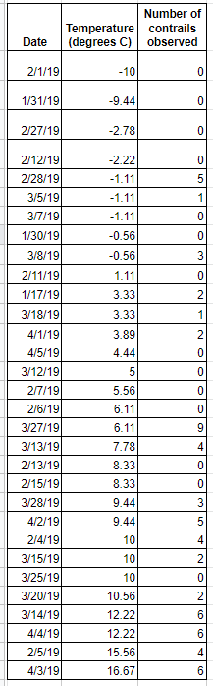
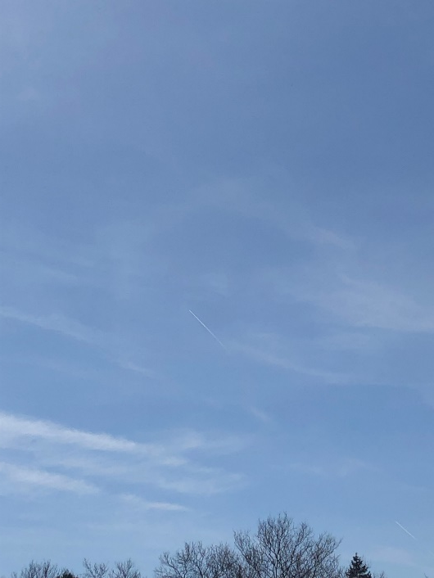
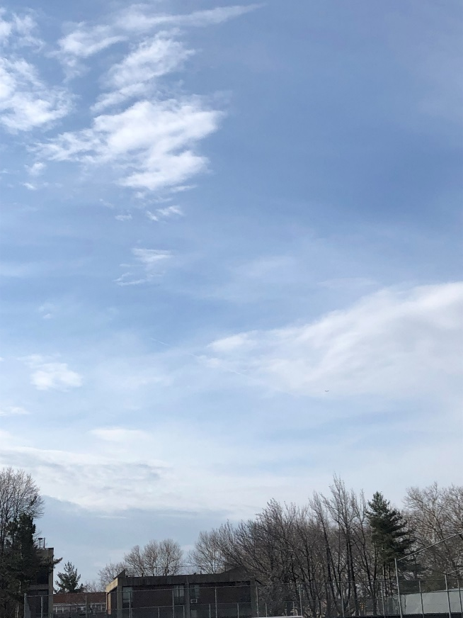
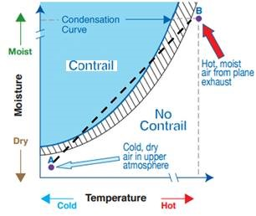
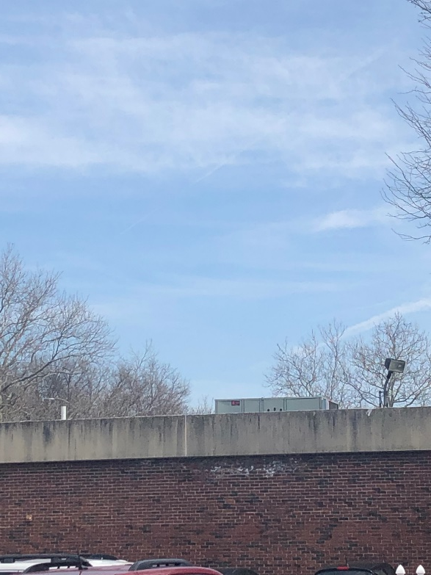

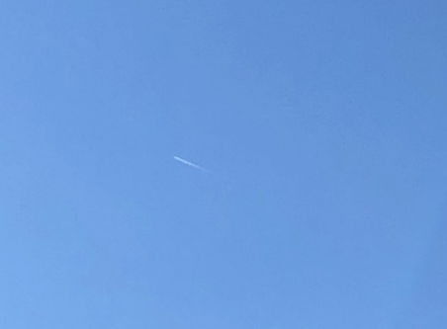


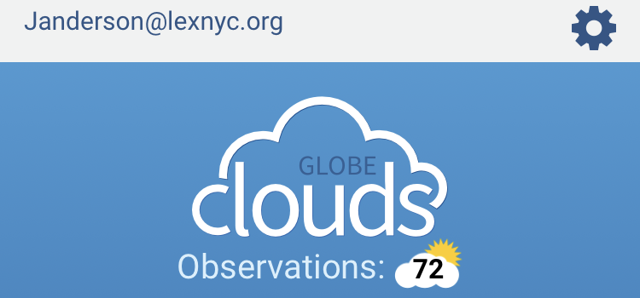
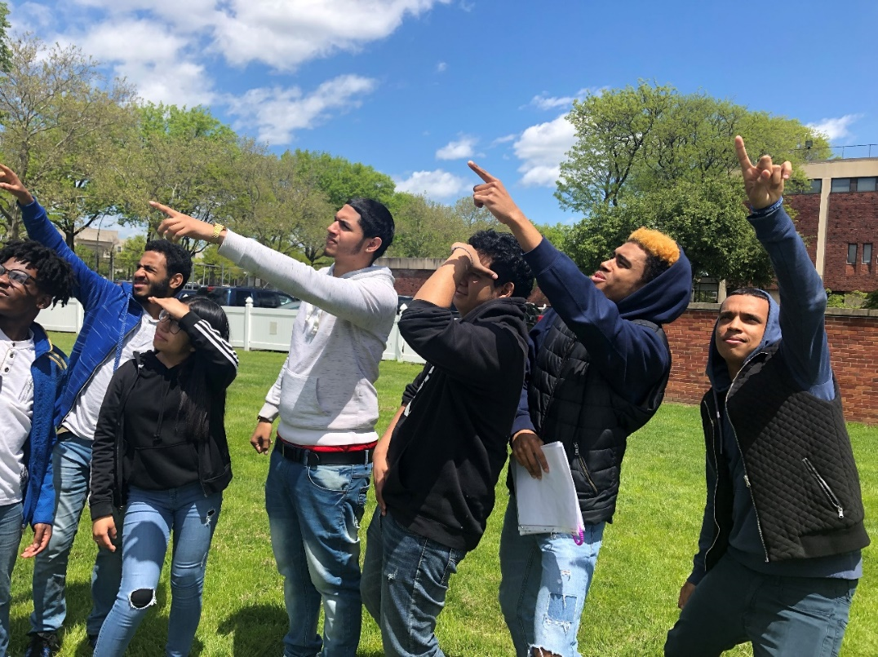
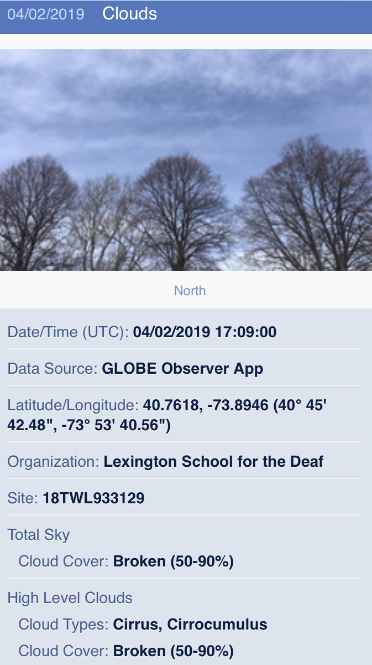
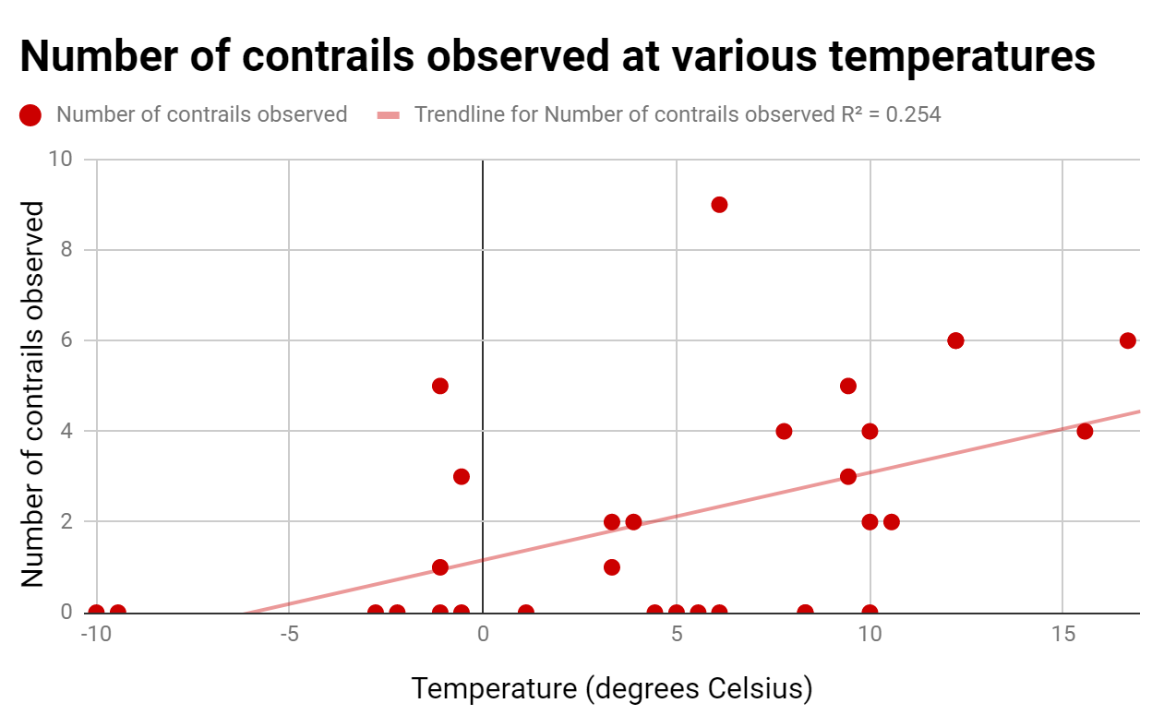
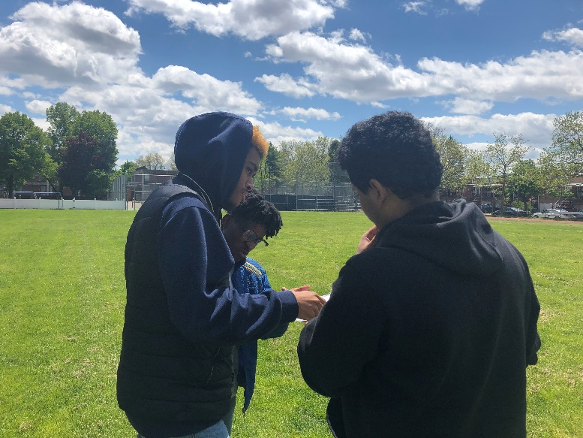
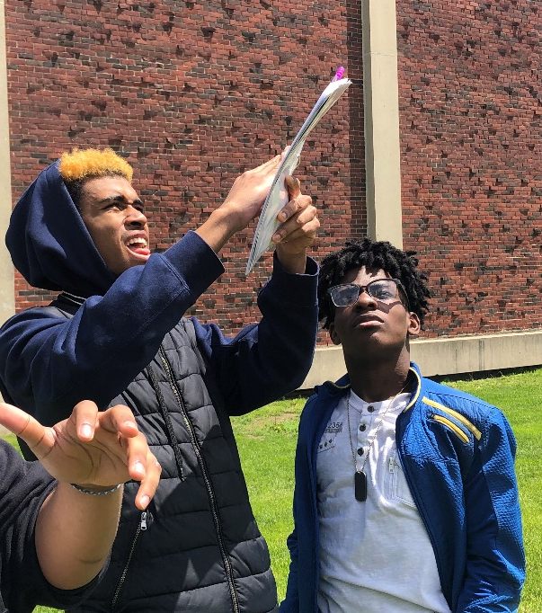
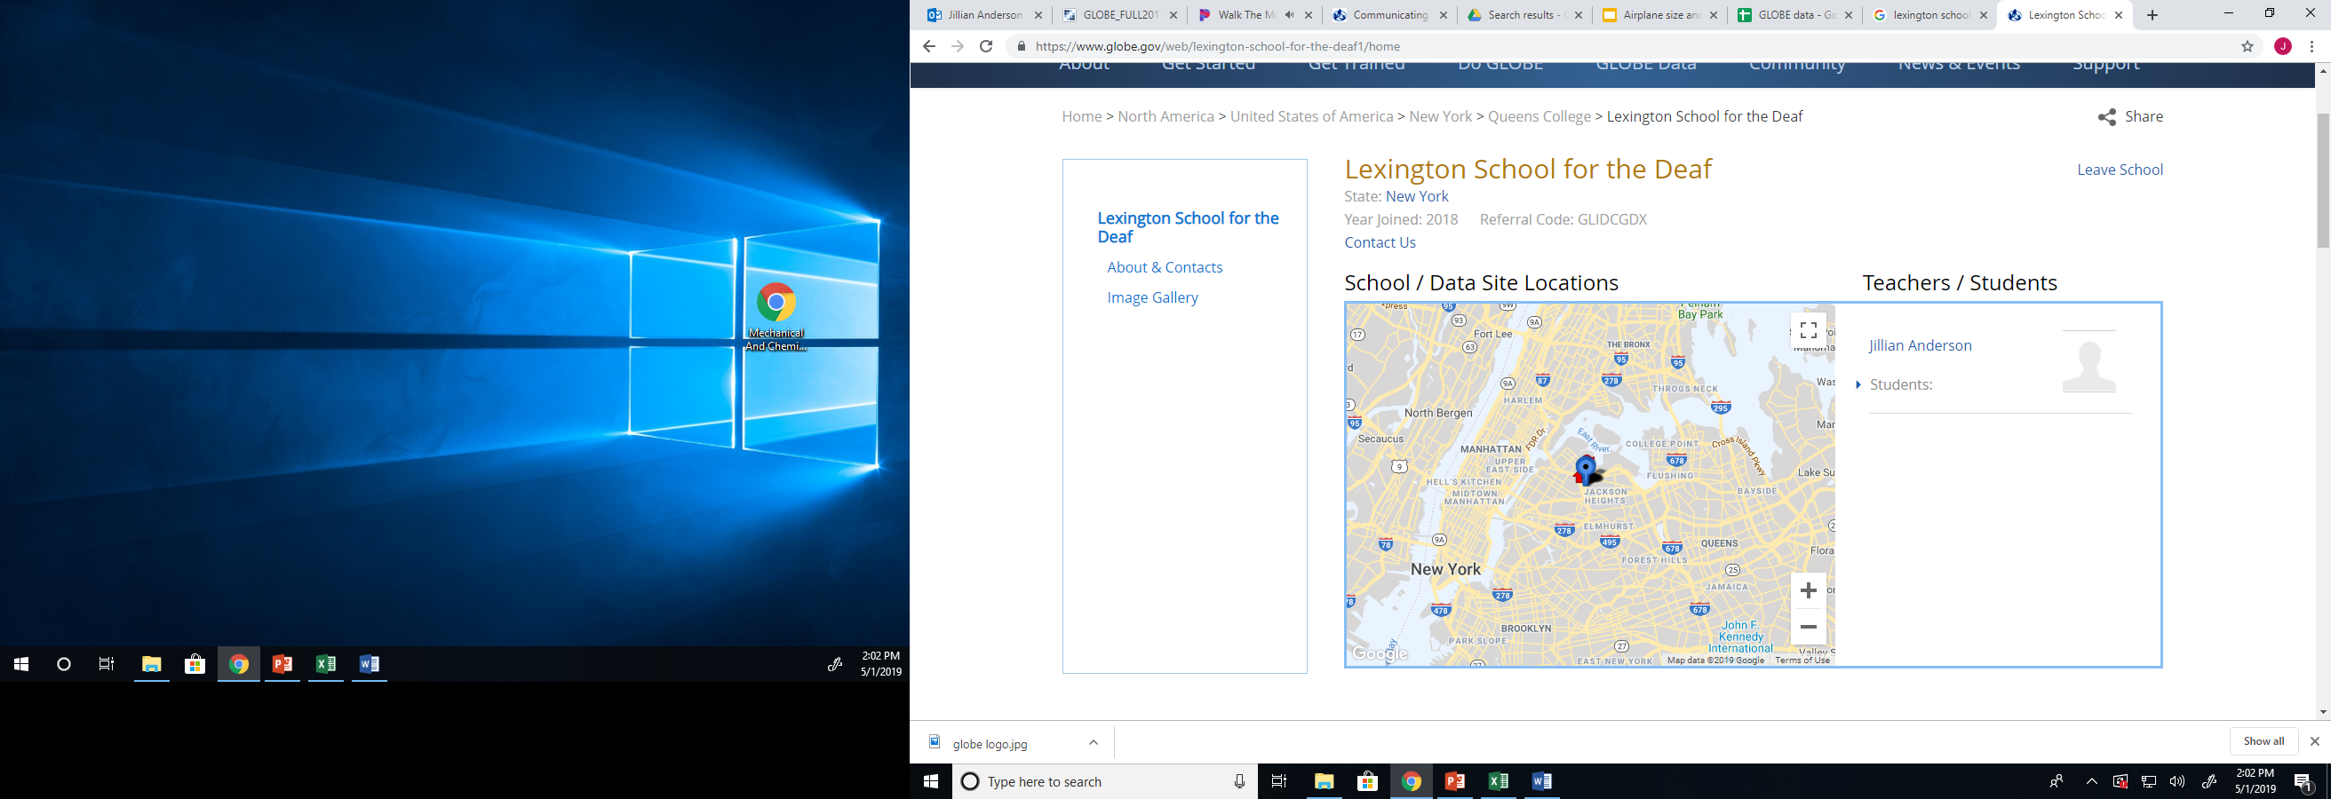
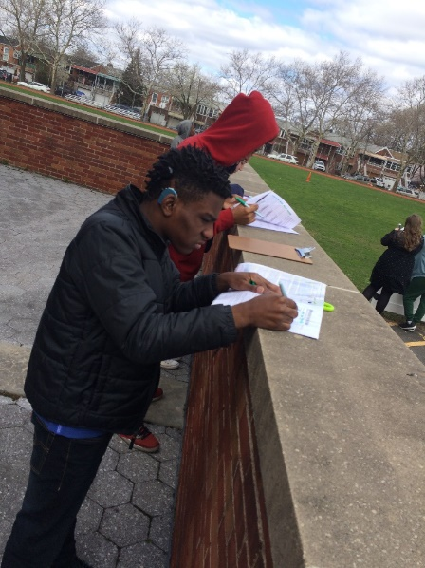
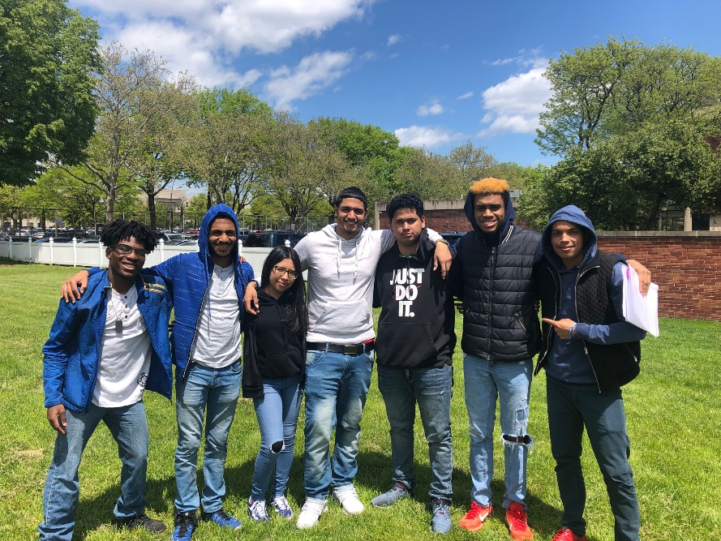
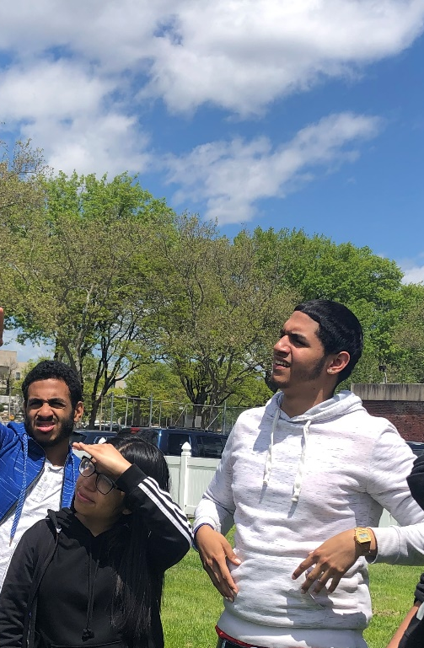
A Comparison of Daily Air Temperature and Number of Observed Contrails
Tayqwan R., Omar J.F., Starlyn C., and Vanessa R.
Lexington School for the Deaf
Queens, NY
Abstract
Research Methods
Results
Discussion and Conclusions
  The intent of this research project was to compare the local daily air temperature, as recorded from Weather.com, to the number of contrails observed by a set of students at Lexington School for the Deaf. The hypothesis that more contrails would be observed when the temperature was lower (colder) was not supported by the data collected during this experiment.
Experimental Plan
My classmates collected the Globe Contrail Chart and Cloud Identification Chart.
We went outside in the school field, then we observed the sky to find any visible clouds and contrails.
We recorded data information about what type of clouds, cloud cover percentage, sky color, and contrails we saw.
We checked Weather.com for the temperature and air pressure.
We went to Google Drive; we recorded data information about clouds, cloud cover percentage, sky color, and contrails in GLOBE Google Sheet.
We used data from 31 days of observations to make a graph representing the trend between temperature and contrails.
Study Site
Lexington School for the Deaf is located in Queens, New York.
This is an urban area that is a borough of New York City.
The school is located in an area that is characterized by typical climate patterns following the four seasons of the northeastern region of the United States of America.
There are a few trees and buildings that block the view of a small portion of the sky for daily observations while on the school grounds. However, more area of the sky is visible than would typically be possible at an urban school location.
Lexington School for the Deaf is located approximately 2 miles from LaGuardia Airport.
Observations were collected in accordance with GLOBE’s Cloud Protocols, including the use of: GLOBE S’Cool Cloud Identification Chart, GLOBE Contrail Chart, GLOBE Field Guides, and the GLOBE Observer app; to record information about airplanes in the area, the Flightradar24 app was used.
Data were organized into a class-wide GoogleSheet.
Data were collected as often as possible (weather permitting) during weekdays that school was in session. On Mondays and Fridays, data were collected between 9:30am-11am EST and Tuesday-Thursday data were collected between 1pm-2pm.
Figure #1 and 2: Field Observations
Class Google Sheet Data of Clouds and Atmosphere
Contrail Observations
Discussion
We went outside to record cloud observations and look for contrails. We observed the sky and observed contrails then we recorded data on the GLOBE chart.
Also, we used the Calitoo sun photometer to find the aerosol optical thickness of the atmosphere and recorded data.
We started our observations in November 2018 to April 2019. Our goal was to find what type of air temperature we would see more contrails.
Conclusions
Our hypothesis states that more contrails will form during cold weather but our results do not support this theory. Our data show that more contrails may form at higher temperatures. We expect to see more contrails with increase of temperature because of positive correlation on graph.
Error Analysis and Future Steps
Our data collection only took place during the winter and spring. That is one reason there is not enough data information to support our research project and draw detailed conclusions.
Students did not have WiFi connected to their phone to use during outdoor sky observations during the 4 months of data collection because school does not allow students to connect WiFi.. We could improve by having access to WiFi which would allow all students to use the GLOBE Observer app and Flightradar24 app. This would allow for more uniform data collection.
Research Question
Problem
At what type of temperature in the atmosphere do more contrails form?
Hypothesis
Our hypothesis is that we think that when the weather is colder we will see more contrails.
Figure #3 and 4: Daily Air Temperature and Number of Contrails Observed
Sky and Contrail Photos
Introduction
Airplanes need to be 25,000 feet or higher in the atmosphere to produce a contrail.
Scan this QR Code to see our ASL signs for contrails!
GLOBE Badges, Collaborations, and Credits
This research was completed with the help and support of a number of outside participants. This project would not have been possible without our collaborators. We would like to give special thanks to NASA’s Langley Research Center, including but not limited to Rosalba Giarratano, Marilé Colón Robles, Dr. Margaret Pippin, William Wood, Christina York, Tina Harte, and Jessica Taylor. We had the great privilege of having a video conference via Zoom with this amazing group of scientists in the spring of 2018 regarding our research and future interests and they have continued to provide support and encouragement.
We would also like to thank our family at the Lexington School for the Deaf for their continued support and interest in our endeavors. Special thanks to our administrators and staff who have continued to encourage our projects and goals, including but not limited to Don Galloway, Jane Moran, Frank Dattolo, Cindy Casson, Amanda Heinbaugh, Dolly Dominguez, and Bill Moran.
Last but not least, we would like to thank Jennifer Bourgeault and Haley Wicklein of the GLOBE Program for helping us obtain funding and make travel arrangements for our trip to be possible!
Field Photos
GLOBE Observer App
Figure #5: Graph Analysis
Map of Study Site
Bibliography
Study Site Key:
Lexington School for the Deaf
LaGuardia Airport
  Data Analysis
  References
We saw a trend that suggests a positive correlation between temperature and number of contrails observed. However, it is not a strong relationship, based on the R² linear regression value.
  GLOBE Cloud Protocols; GLOBE.gov; GLOBE Observer app
  GLOBE Clouds Contrail Investigation - https://www.globe.gov/web/s-cool/home/contrail-investigation
  Flightradar24.com; Flightradar24 app
  Skybrary.com
  Weather.com

