Slide 1
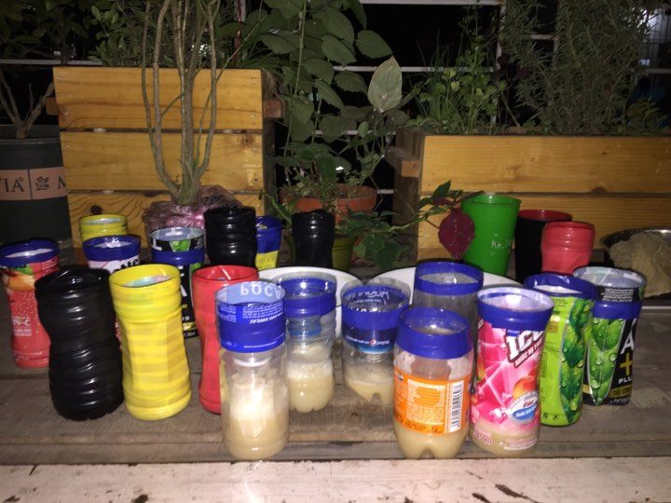
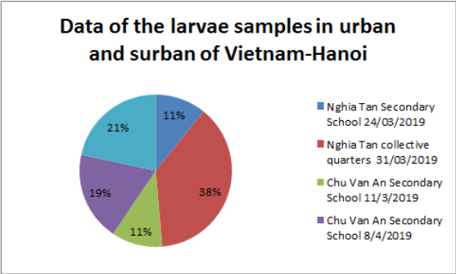
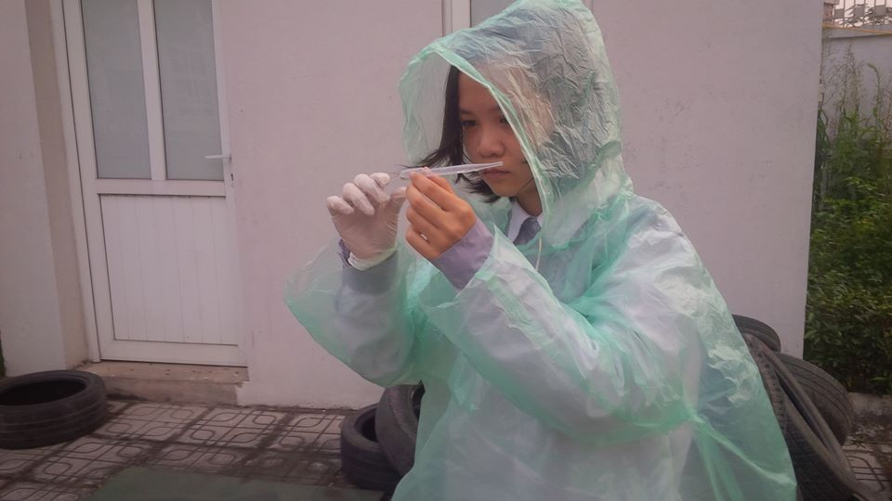
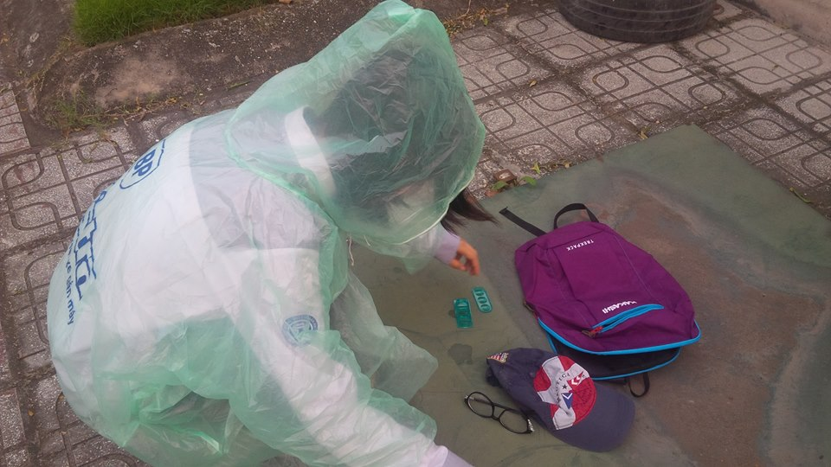
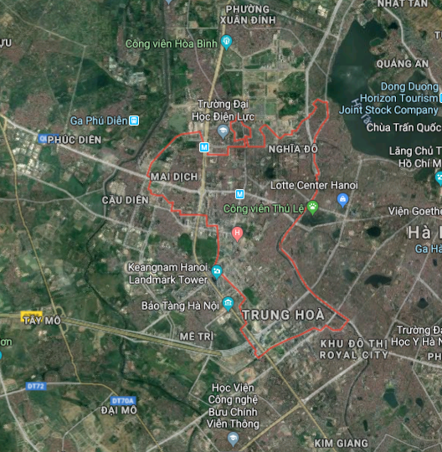
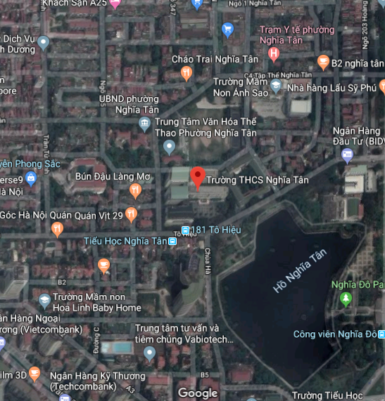
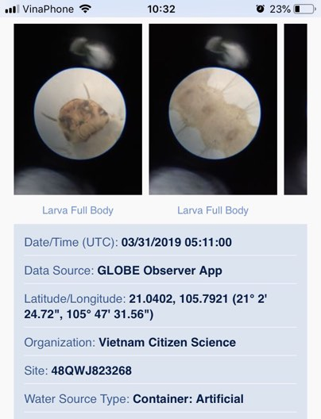
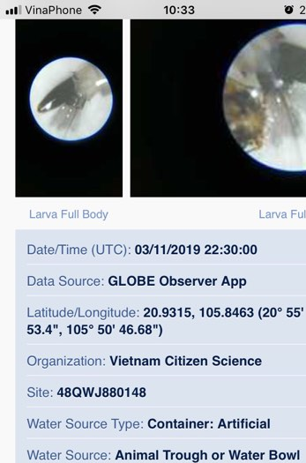
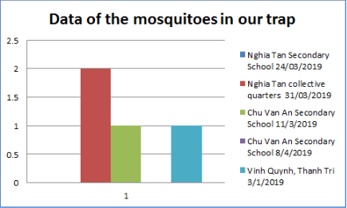
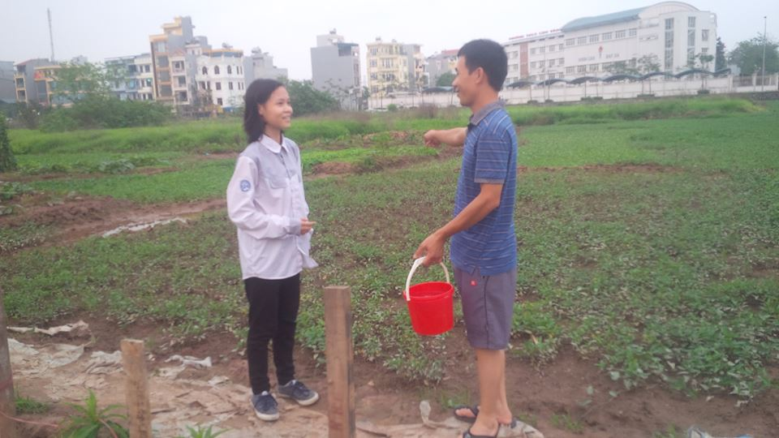
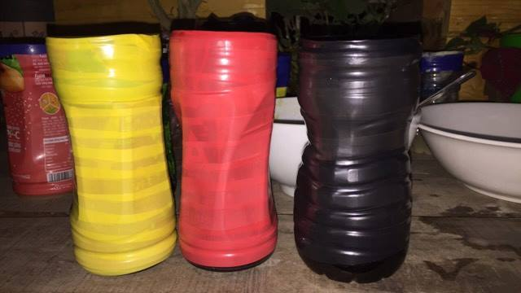
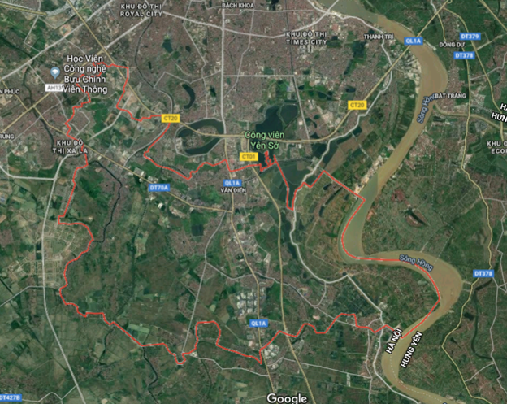
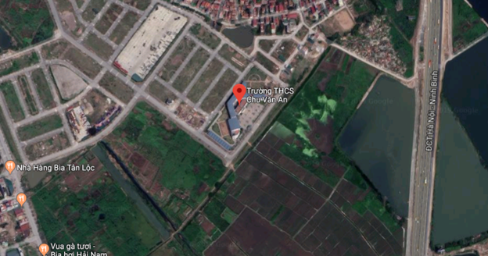
Initial research on mosquito and mosquito larvae characteristics, comparing mosquitoes in urban and suburban areas of Ha Hoi, Vietnam
Nguyen Quynh Anh – Chu Van An Secondary School
Quang Thanh Thu – Nghia Tan Secondary School
ABSTRACT
Materials and method
Result
Conclusion
Mosquitoes are familiar in Vietnam, like other tropical region. Mosquitoes often appear in March and April in Hanoi, Vietnam; mostly between spring and summer when there are high humidity condition. along with high population density, houses with small structure of houses, some people live under the first floor so mosquitoes often fly in the house and mosquitoes appear as a daily habit of people, at night go to sleep, if not using mosquito nets, mosquitoes will buzz uncomfortable, and bite young children. Furthermore last year, in 2018, some classmates in our school have dengue fever in the classroom, making their tired of affecting the health and education and increasing the financial resources for families. With the aim of reducing the number of mosquitoes and larvae, leading to reducing dengue fever to families and communities, increasing awareness for the community about diseases, the research team chose the time of the study to be the beginning of the season to provide effective ways to prevent diseases, study mosquito larvae, identity characteristics of three types of mosquitoes including aedes, anophenles and culex, which are the cause of about 17% of the total cases global infection according to ROB Grenfell CISRO. By spreading out mosquito traps. The study provides a practical, diverse approach to the location, sampling at places such as the school, sewages, and following the methods of sampling, collecting, statistics and consultation community. Thereby giving the results of mosquito place, recommended prevention of epidemics to different communities.
Materials
*The process of finding larvae
1. Microscope (type attached to the phone)
2. Deep white place
3. Pippet suction tube
4. Raincoat + gloves
5. Sample container
6. Alcoholic 75 degrees
*The process of making mosquito traps
Raw materials
1. Instant dry yeast
2. Refined sugar
3. Warm water
4. Coca-cola
5. Sugar cane
B. Tools
-Small electronic balance
-Teaspoon
-Bottle of assorted plastics (reused)
Method
Step 1: we went for actual sampling
Step 2: we observed the sample with a magnifying glass and we used app "Globe observer" to classify the larvae
Step 3: we did the community consultations
Step 4: we offered solutions for a future direction: using mosquitoes traps and give away our trap to the community. We also do community education and interview local farmers.
After 1 month research, we finally answer our research question and have some result with the community
-But, there is also some limitation in our research. Firstly, because this time is the beginning of the disease season, we can't have as deep research as we expected cause our health guarantee. Secondly because the research process may need more time than we expected, so the results we obtained are not quite as expected. However, we will continue to conduct research for the best results for the community.
*Answer to the research question
1. Which habitats attract mosquitoes
We collected a total of 4 adult mosquitoes from the traps we made. Of the two types of traps: wrapped in black and non-black tape, our mosquitoes collected in the first trap so we can conclude that mosquitoes like dark environments, are attracted to CO2 and the smell of glucose.
2. How to limit mosquitoes in our living environment?
There are three easy step to limit mosquitoes in our living environment:
-First, you should reduce stagnant water pond in your living environment.
-Secondly, you should plant some aromatherapy such as rosemary,…
-Finally, you should turn on light in your house and prevent your living environment from darkness.
*Result for the community
We gave away our mosquitoes traps (about 25 traps) to the community (our friends, famiily,…)
We also did community education communicate so that everyone can know what do mosquitoes cause to human’s health (also theirs)
We posted some post on facebook to raise awareness to the community.
-Through the project, although the mosquitoes we caught aren't as many as we expected, we have raise people (schoolmate, family, friends,...) awareness about mosquito and what they cause to the community's health and how to prevent them.-If one family use mosquito trap and catch 2 mosquitoes/day, my class have 55 students means 55 families, we'll prevent 55x2=110 mosquitoes My flat has 40 families so that one day we can catch 40x2=80. Totally a day with me, my friends and my neighbours catch 80+110=190 mosquitoes!
Source
1. https://www.youtube.com/watch?v=Yw8U_U2_BbU 2. https://www.youtube.com/watch?v=qn1Uu00Ax5g 3. https://www.youtube.com/watch?v=ycBv24djPDM 4. https://www.youtube.com/watch?v=Y1eGOwLVhTc 5. https://baomoi.com/hoc-sinh-lop-11-sang-che-dung-cu-bat-muoi-sieu-re-tu-phe-lieu/c/26766413.epi 6. https://www.globe.gov/ 7. http://www.moh.gov.vn/web/dich-benh/thong-tin-chung/-/asset_publisher/3hfjhpWJ5jW5/content/thong-tin-tinh-hinh-va-hoat-ong-phong-chong-dich-benh-sot-xuat-huyet?inheritRedirect=false 8. http://www.wpro.who.int/vietnam/topics/malaria/vi/ 9. http://www.moh.gov.vn/web/dich-benh/phong-chong-dich-benh-virus-zika/-/asset_publisher/70k4gMiVhXR2/content/thong-iep-khuyen-cao-phong-chong-dich-benh-do-vi-rut-zika?inheritRedirect=false&redirect=http%3A%2F%2Fwww.moh.gov.vn%2Fweb%2Fdich-benh%2Fphong-chong-dich-benh-virus-zika%3Fp_p_id%3D101_INSTANCE_70k4gMiVhXR2%26p_p_lifecycle%3D0%26p_p_state%3Dnormal%26p_p_mode%3Dview%26p_p_col_id%3Drow-0-column-2%26p_p_col_count%3D1 10. http://vncdc.gov.vn/vi/tin-tuc-trong-nuoc/2185/chu-dong-phong-chong-benh-viem-nao-vi-rut-trong-mua-he 11. https://khoahoc.tv/11-ly-do-muoi-la-loai-nguy-hiem-nhat-tren-trai-dat-53049
Research object&reason&location
Research object
We choose 3 types of mosquitoes and mosquitoes larvae to do the research: Culex, aedes, anopheles
Research reson
-Response the coming disease season
-The rate of cases of mosquito-borne diseases is increasing
-Vietnam is one of the red-spots of the number of cases of mosquito-related diseases according to WHO
Research location: Hanoi city (capital city of Vietnam)
-Urban of Hanoi: Cau Giay Distrcit consist of 8 wards (population: 269,637 people; density: 19,680 people / km²); main location: Nghia Tan Secondary School.
-Suburban of Hanoi: Thanh Tri district consist of 15 communes (total of 198,706 people, density: 3,145 people / km²); main location: Chu Van An Secondary School
Discussion
-Continuing to study mosquito larvae, constantly updating images of mosquito larvae characteristics to the Globe app, however in the season there should be facilities such as protective clothing to avoid exposure.-Continue to study the mosquito trap to get more mosquito attracting solution-Community education communication through the Vert Xanh page and events such as Earth Hour ... and extracurricular activities in schoolsProvide measures to kill larvae in schools, spread to households.

