Slide 1


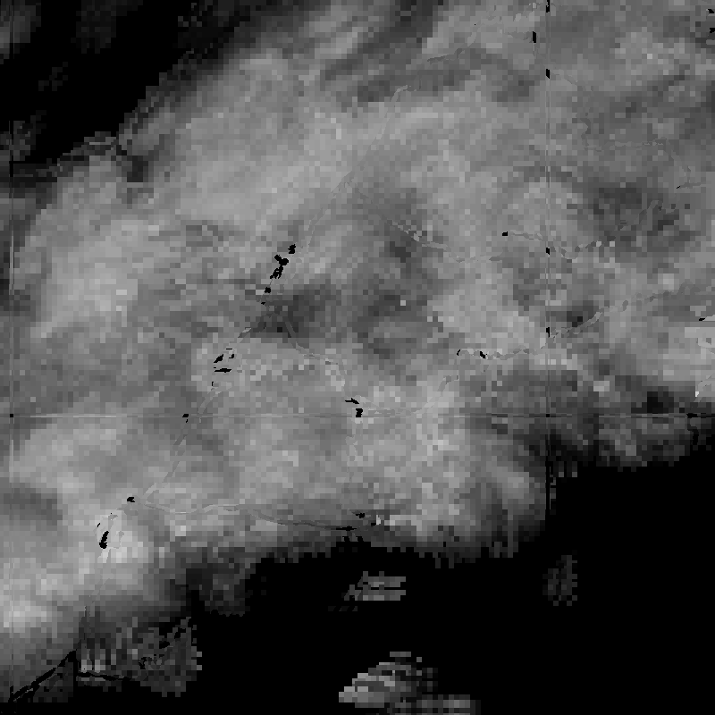
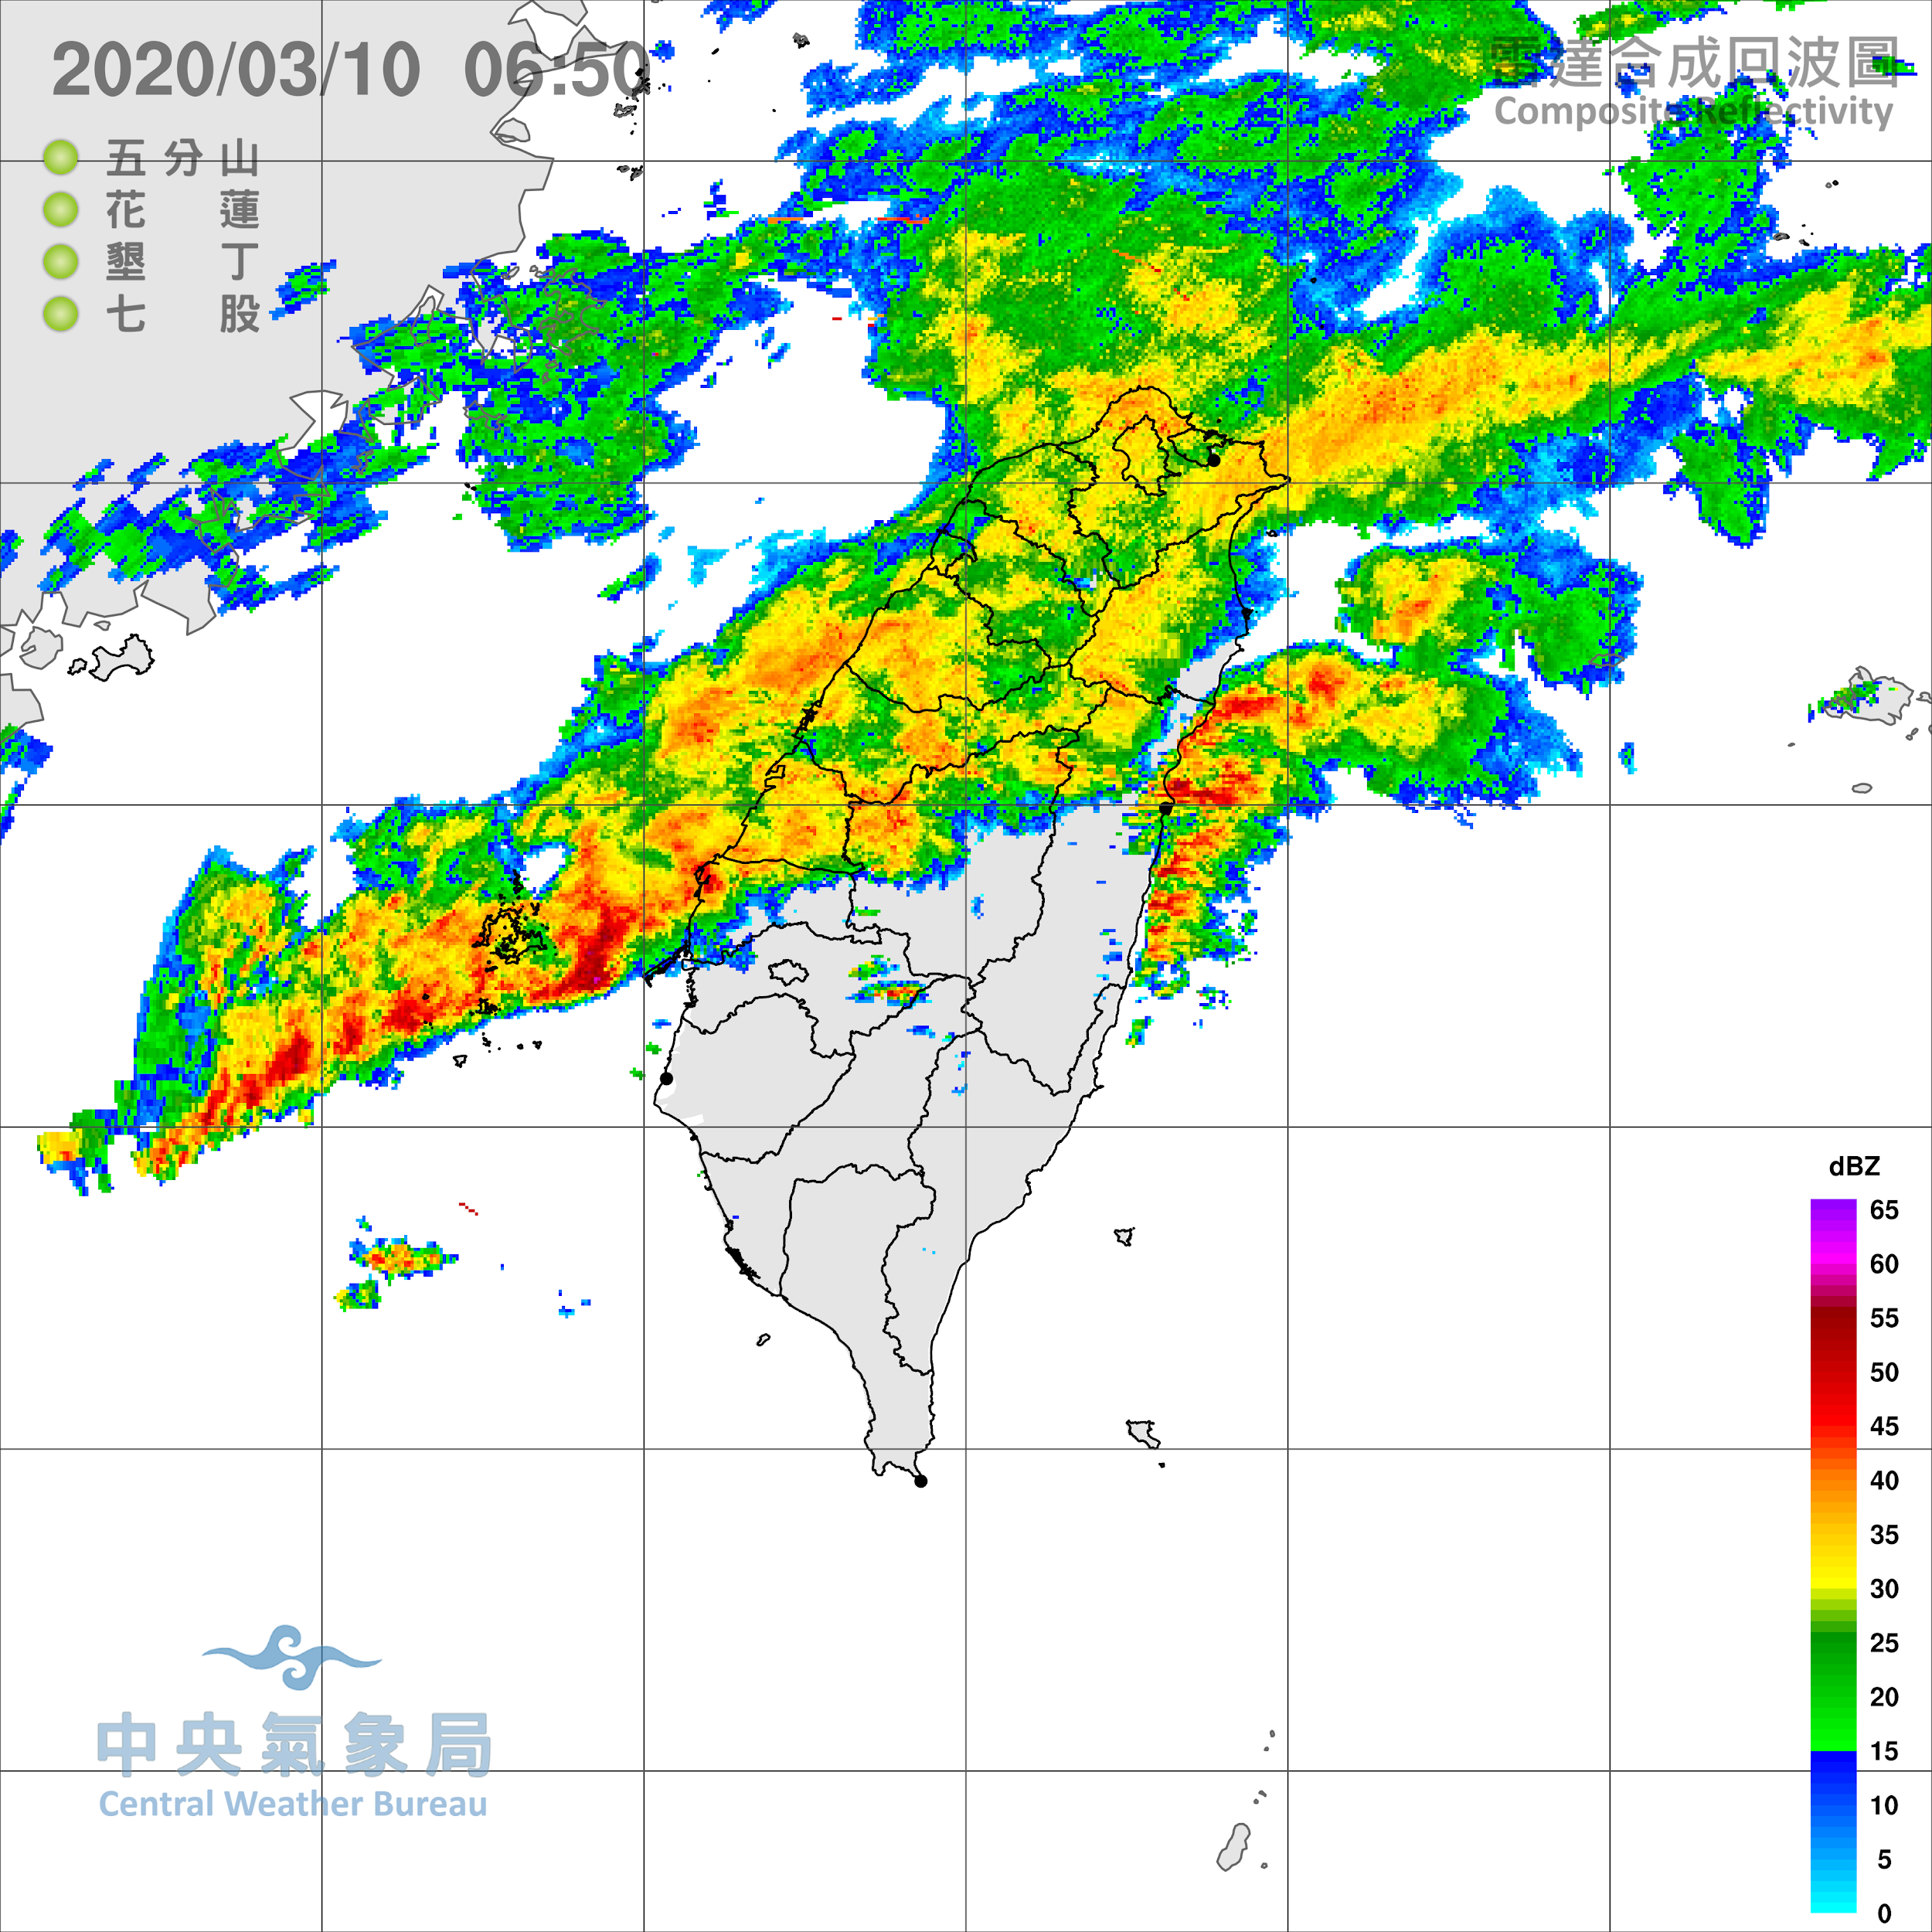

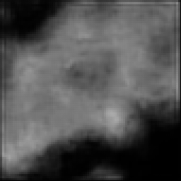
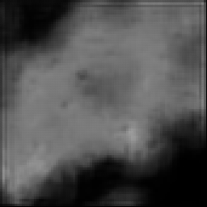
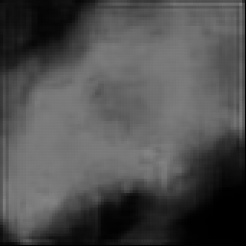
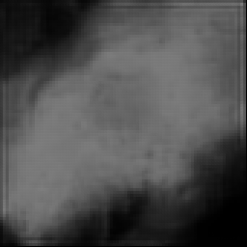
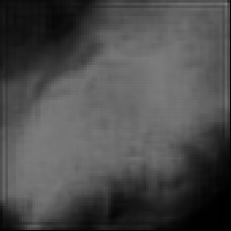
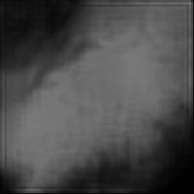
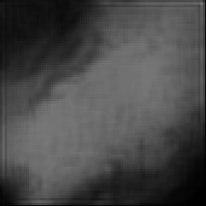
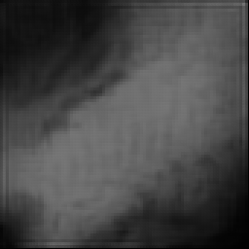
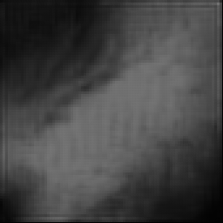
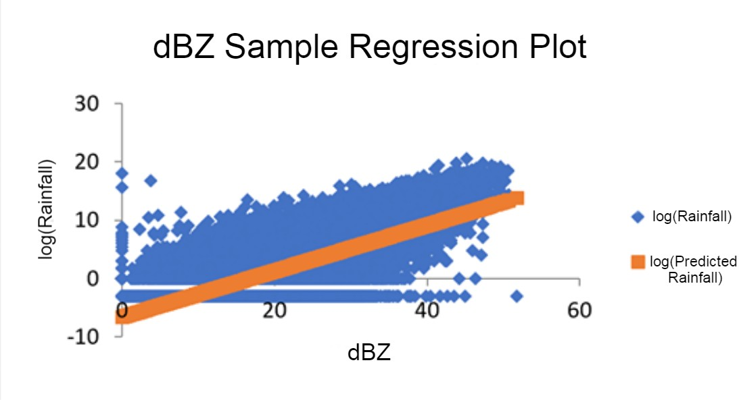
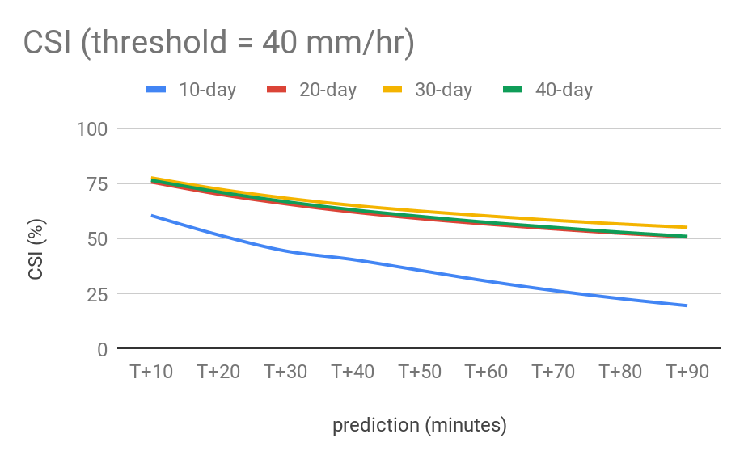
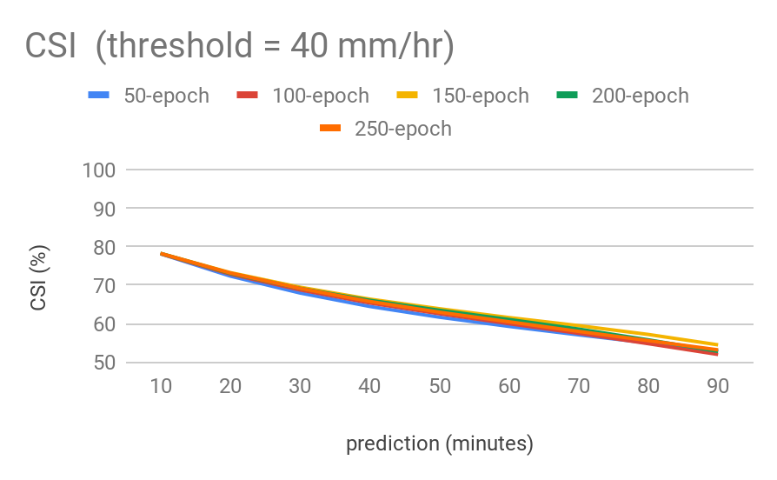
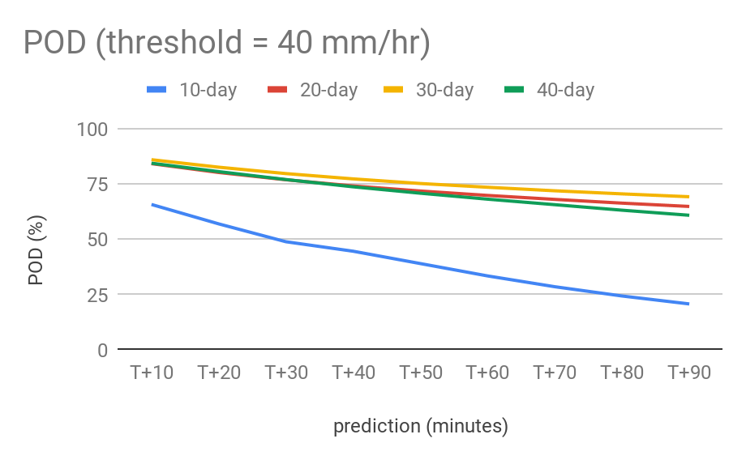
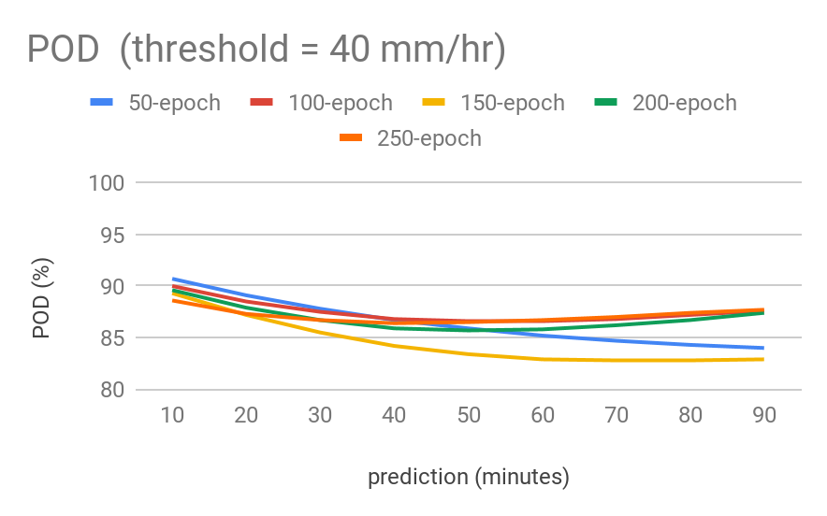
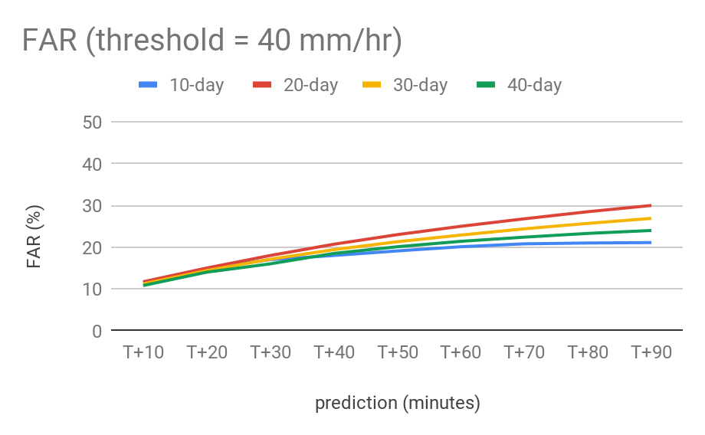
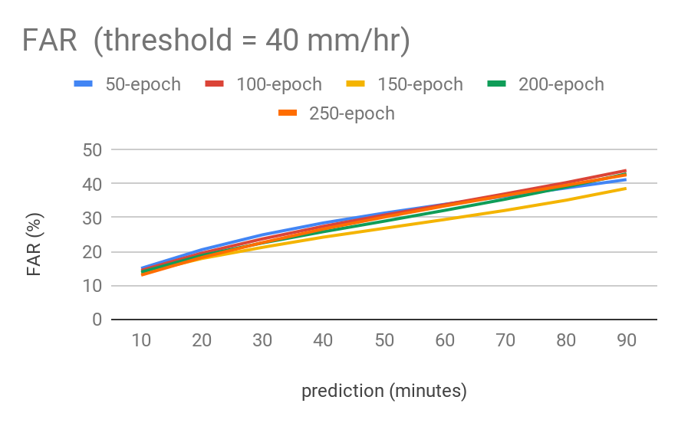
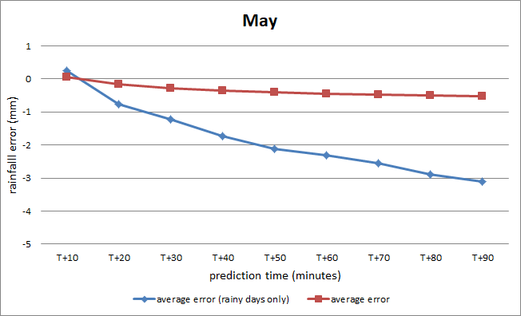
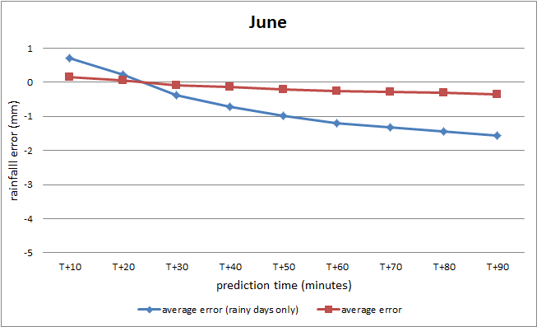
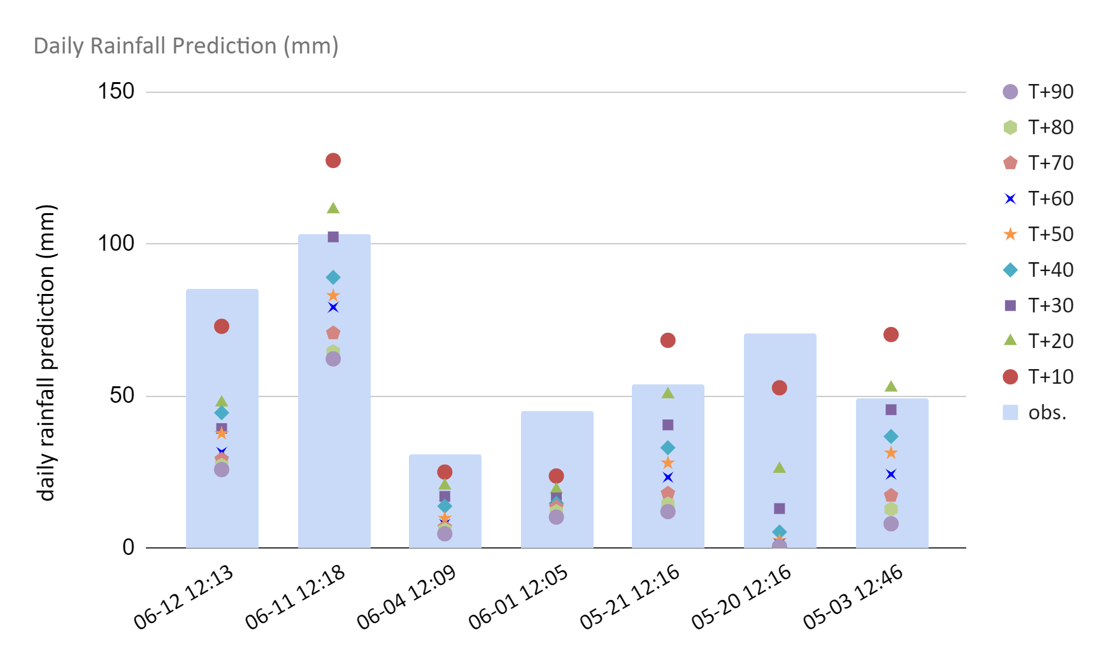
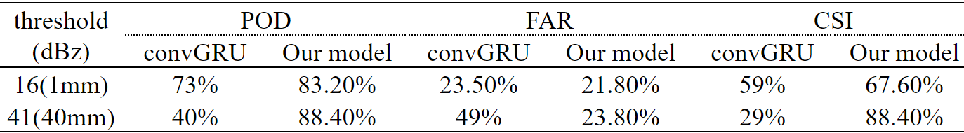
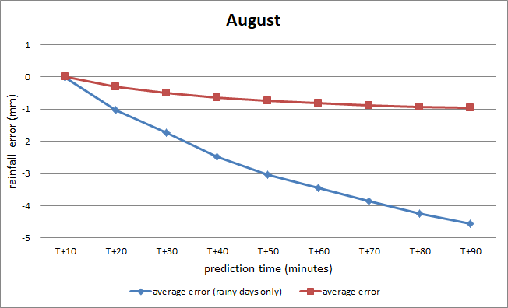
Mesoscale Precipitation Nowcasting Experiment Based on ConvLSTM Model
Chi Hsiao, Yi-Ta Tsai, Ting-Yi Lai, and Ying-Lung Liu
(The Affiliated Senior High School of National Chung Hsing University)
Abstract
This research is aimed to increase the precision of precipitation nowcasting by combining image processing with neural networks in machine learning. The ConvLSTM model (a kind of Recurrent Neural Network) we used is trained with lots of doppler radar images, and by using the Marshall–Palmer relation, we can calculate the converted rainfall at a given point, thus predicting the rainfall.
Results show that the model has over 60% hit rate for up to forecasting 60 minutes to the future when trained with 30 days of radar images for 250 epochs (almost 5000 radar images). And through calculating the values of a and b in the Marshall–Palmer relation (dBZ=10×log(a)+10(b)×log(Rainfall)) below 800 m in central Taiwan, we found that with a=87.97±0.35 (R²=0.52) and b=1.32, the model can predict rainfall the most accurately in 30 minutes.
Research questions
What are the values of a and b in the Marshall–Palmer relation (Z-R relation) in central Taiwan under the altitude of 800 meters? (dBZ=10×log(a)+10(b)×log(Rainfall))
By using deep learning Neural Networks, how does epoch (50, 100, 150, 200, and 250) and training set size (10 days, 20 days, 30 days, and 40 days) affect the accuracy of the model to predict precipitation?
How accurate can we predict rainfall through combining radar image prediction and the modified Marshall–Palmer relation?
Conv-LSTM Model
Convert image to grayscale, and crop out the needed area
(133 km x 133 km)
Down size the images to 256*256 pixel
Input 9 pieces of image to ConvLSTM model (the model was training by Neural Networks)
Output 9 pieces of predicted radar images in every 10 minutes, and the images transferred to be precipitation by the modified Marshall–Palmer relation in this study
Original radar image From CWB, Taiwan
Study A. Calculation of local a and b value
The rainfall data we used is from the automated rainfall station of Central Weather Bureau (CWB), and the dBZ data is captured from CWB’s radar image.
Using 38,729 pieces of data from CWB, we calculated the correlation coefficient between dBZ and log(Rainfall) to be about 0.72, which means they are near linear relational. For the calculation of the Marshall-Palmer formula (dBZ=10×log(a)+10(b)×log(Rainfall)), we brute forced the a and b value. Our final result is with a equaled to 87.97±0.35 and b equaled to 1.32, the loss comes to its lowest.
Study B. Effect of training set size on model accuracy
dBZ Residual
To create the system which can evolve to be able to adapt to other months, we need to know how much training data is needed as input to let the model create the most accurate nowcast.
Higher is better
Higher is better
According to the diagrams, we reason that the 10-day model’s poor score is due to the lack of diversity in weather system’s characteristic information included in the training set. The 30-day model has a better performance than the 40-day model is because the 40-day model contains more of the weather system’s variety that didn’t appear in the prediction time range.
Higher is better
Higher is better
Study C. Effect of epochs on model accuracy
After choosing the size of the training set, we need to decide the number of epochs to train so that it can nowcast precisely. So, we tried 50, 100, 150, 200, 250 epochs and observed their performance.
From the diagram we can infer that 150 epochs has the best result in CSI and FAR, but its POD is lower than others, so we consider 250 epochs as the best choice overall because even though it has a similar CSI and FAR values with 150 epochs, its POD is relatively higher.
Lower is better
Lower is better
Study D. Nowcasting rainfall comparison with weather stations
Discussions
It may be capable of nowcasting on precipitation from radar 9 images at different places.
This study shows that it is a new and reliable way to increase sharpness in radar image predictions.
The different rainy seasons may be a important factor on the model’s prediction accuracy.
Possible source of error is the accuracy of Globe’s rainfall measuring in such student project we run.
Table_Comparison between the two models (Our model and ConvGRU by Guo et al (2019)^{[2]})at 0.5 hr mark
Prediction error (mm) compared with Central Weather Bureau’s data in May, June, and August in 2019 was shown in following plot.
The blue line is calculated only with days that have rainfall, and the red one is calculated with all data.
Globe SHCH’s daily rainfall and our predicted rainfall graph comparison (T+10 ~ T+90 min) was shown in following plot.
The observed rainfall is the blue columns and the points represent daily rainfall predictions added up for every T+10 to T+90 min. Some prediction are a bit of over estimated.
Conclusions
When a = 87.97 and b = 1.32, dBZ-Rainfall has the minimum loss.
When the training set size is 30 days and the epoch is 250, the model has the most accurate prediction on radar images.
We can predict 90 minutes to the future rainfall within 5mm error by ConvLSTM model.
Acknowledgements
The authors would like to thank the service from the Ministry of Science and Technology & Chinese Culture University, Data Bank for Atmospheric and Hydrologic Research,and Globe for providing the rainfall data used in this study. Futhermore, the ConvLSTM code is adapted from github website, https://github.com/cxxixi/Precipitation-Nowcasting.
Reference / Bibliography
[1] Guo et al., Acta Meteorologica Sinica, 77(4), 2019 . [2] Shi et al., NIPS, 2015. [3] Marshall and Palmer, J. Meteorology, August, 1948.

