Slide 1
Comparing Macroinvertebrates In Toledo, Ohio (USA) and Chile
Ava Lytten , Paige Staler
Navarre Elementary
Toledo, Ohio
March 2017

Slide 2
Research Question: What differences exist in macroinvertebrate between Toledo, Ohio and Chile?
Purpose: to see if Elevation and latitude make a difference in the types of macroinvertebrates found in freshwater ecosystems
Hypothesis: the macroinvertebrates will be similar in both places.

Slide 3
Investigation Plan
Collected macroinvertebrate data from maumee river
Create a question and define our purpose
Search for Globe data (Globe Schools, times period that match the school)
Find information that match chile and Toledo
Research science topic (macroinvertebrates) that connects with our purpose
State our Hypothesis
Analyze data
Write conclusion
Create Abstract

Slide 4
Research Methods
We used Globe Data Access tool for data
We used Globe visualization tool for school info
Read and summarize Benthic macroinvertebrates Resource article

Slide 5
Research Methods
We went out to maumee river and collected,identified,and counted benthic macroinvertebrates
Used globe data tool
Used globe visualization tool
http://www.water.ncsu.edu/watershedss/about.html#auth
http://www.water.ncsu.edu/watershedssp/info/macroinv.html

Slide 6
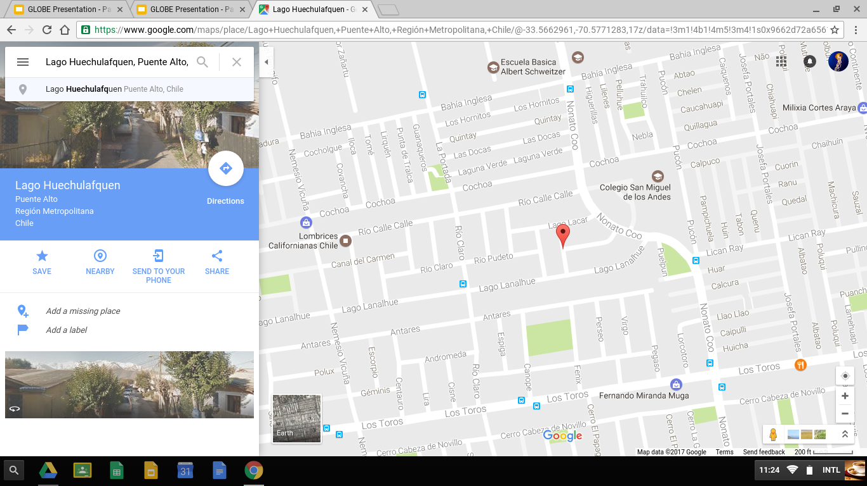
Research Information: Science Club of Huechulafquen
The science club of Huechulafquen
collected data from 7 different Locations.
Notes:
The Research Information

Slide 7
Research Information(benthic macroinvertebrates)
4 feeding groups:
Shredders,
filter collectors
Grazers,
Predators.

Slide 8
Satellite image of science club ofHuechulafquen

Slide 9
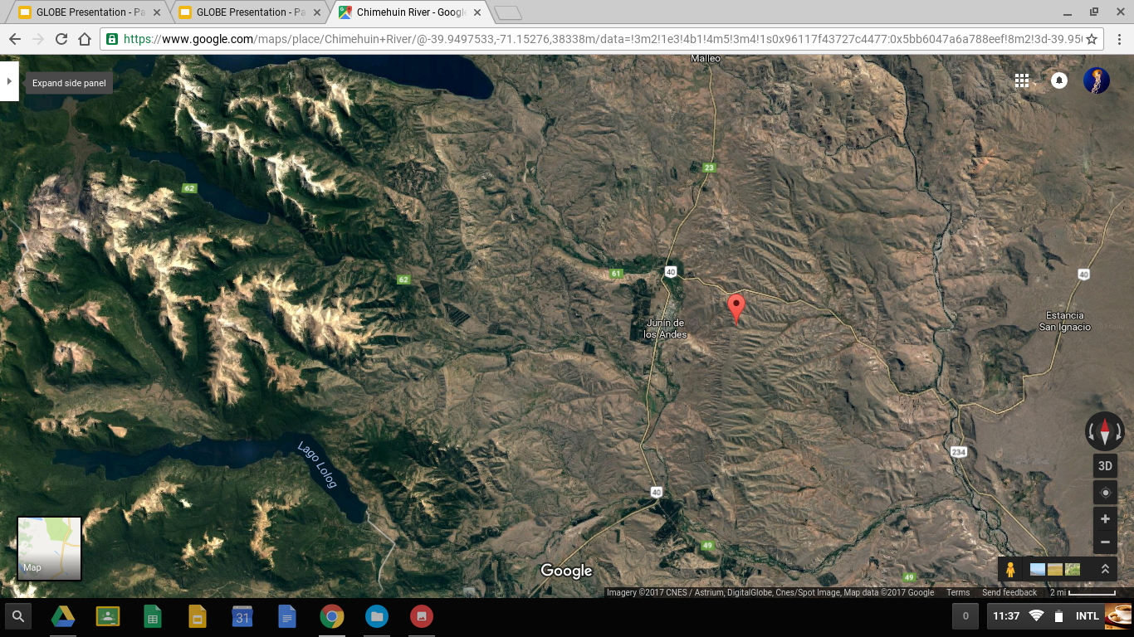
Satellite image of chimehuin river

Slide 10
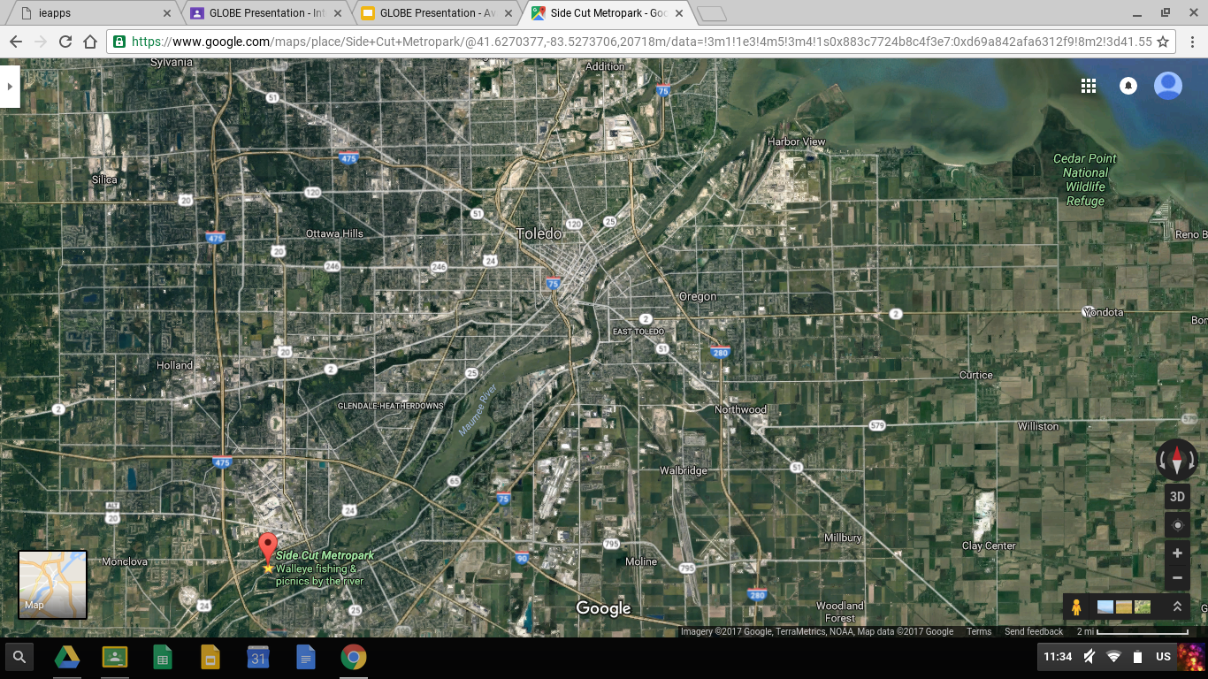
Satellite image ( navarre-side cut metropark)

Slide 11
Research Information: Macroinvertebrates
tolerable macroinvertebrates: can withstand pollution
Black fly larva, Midge larvae, Crustacea Sowbug/pillbug, Mollusca snail, and Annelida leeches
intolerable macroinvertebrates: cannot live in polluted water
Stonefly larvae, Dobsonfly larvae, Snipe fly larvae, Water spider, Mayflies, Caddis Fly larvae, Crustacea Scrubs

Slide 12
Research Information(benthic macroinvertebrates)
Pollution tolerance levels
Very Clean: stonefly larvae,dobsonfly larvae,snipe fly larvae,water spider,mayflies,Caddis Fly larvae crustacea scuds,.(intolerant)
Moderately Polluted: mayflies Caddis Fly larvae,Beetle larvae and adults,Dragonfly nymphs and damselfly nymphs,Crane Fly larvae,water boatmen,flatworms,crustacea crayfish, molluscs mussels and clams.
Fairly Polluted,:black fly larvae,midge larvae,crustacea sowbugs/pillbugs,mollusca snails,annelids leeches.
Very Polluted:annelids aquatic worms,leeches,molluscs snail.(tolerate).

Slide 13
Globe Badges
B1 Collaboration-we worked together on this project
B2 community impact-a certain kind of macroinvertebrates tell if the body of water is polluted
B3 connecting to a stem professional-we worked with:
University of Toledo / Globe: Dr. Czajkowski S. Struble, Ms. Mierzwiak
Fiat-Chrysler-Jeep (Toledo, Ohio): Environmental Scientists/Mentors
B4 Interscholastic connection- we told Every step we went through
B6 Exploring Stem Careers-
Toledo Public Schools: ms. schetter and Mrs. Sinift: career Exploration in Water Quality and other STEM fields

Slide 14
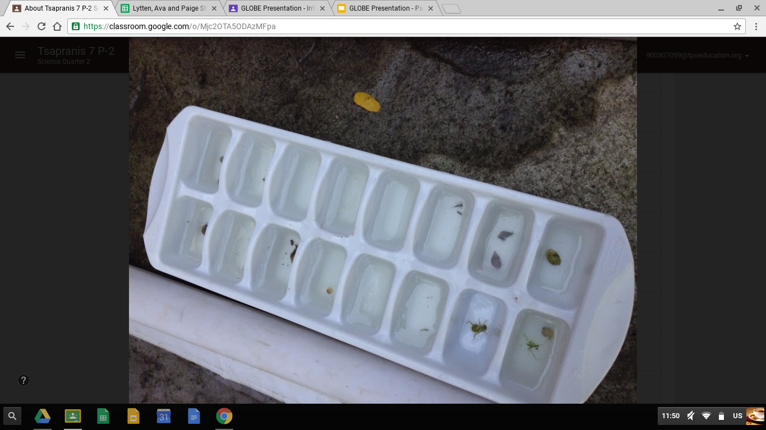
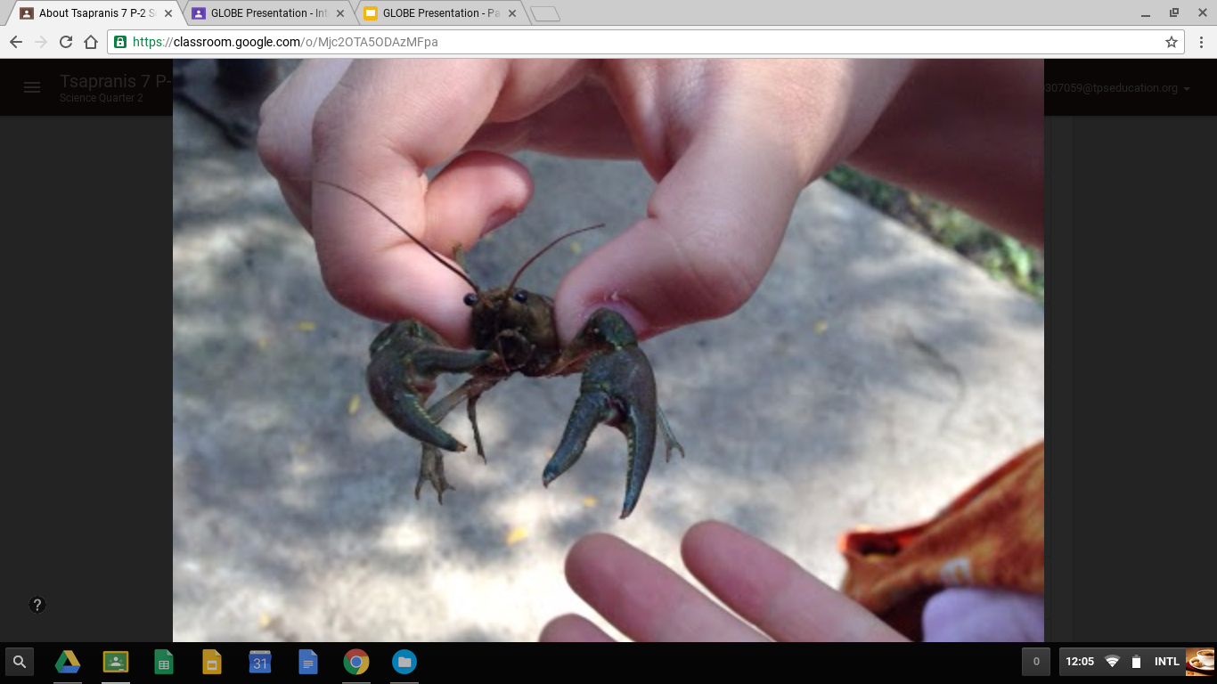
Field Photos October 2016
Notes:
October 2016

Slide 15
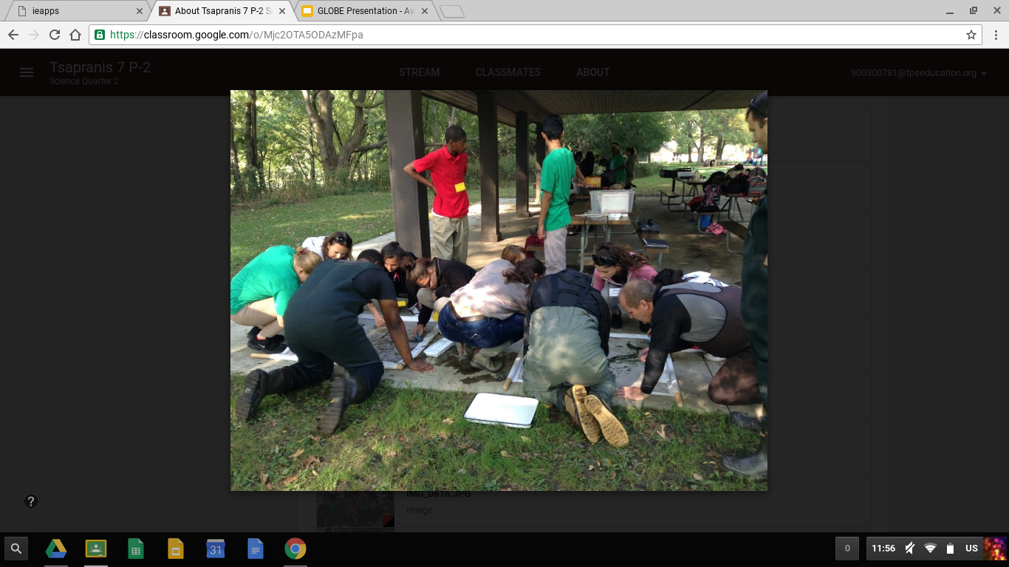
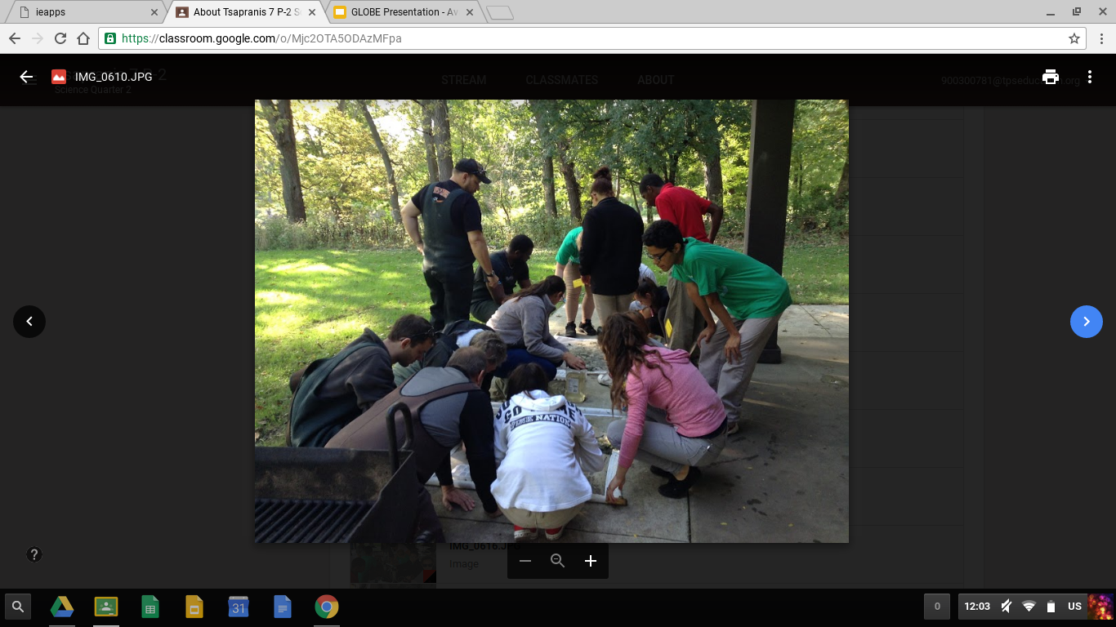
Field Photos october.2016 macroinvertebrates
Notes:
These are some field photos when we went side cut metro park and we identiflyed them with stem professional

Slide 16
Globe Data
science club Huechulafquen chile
Notes:
On this slide show it shows our globe data that we collected with

Slide 17
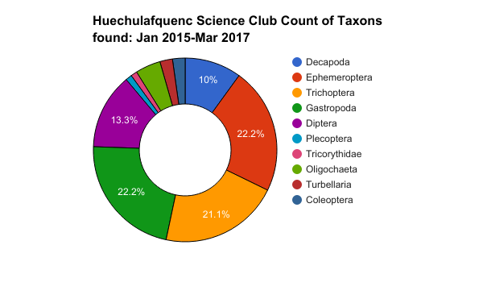
Data Data Summary of science club Huechulafquen
Summary

Slide 18
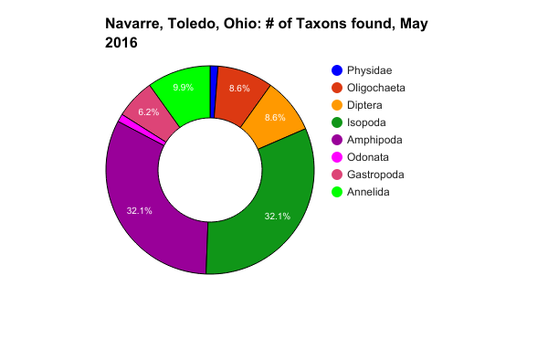
Data Summary(navarre)

Slide 19
Data Analysis: science club Huechulafquen
Ephemeroptera (Mayflies) (intolerant): 22.2% of the total collected
Trichoptera (caddisfly larvae) (intolerant):21.1% of the macros collected
Diperta ( snipe fly larvae) (intolerant):13.3% of the macros collected

Slide 20
Data Analysis:science club Huechulafquen
Gastropoda (pillbug, Mollusca snail) (tolerance):22.2% of the macros collected
Decapoda (Crustacea crayfish) (tolerance):10% if the macros collected
Oligochaeta (Annelida Aquatic worms) (tolerance):4.4% of the macros collected

Slide 21
Data Analysis
Data analysis (Navarre)
Oligochaeta (aquatic worm) (tolerant): 8.6% of total collected
Diptera(blackfly larvae) (tolerant)8.6% of total collected
isopoda(sowbugs/pillbugs)(tolerant)32.1% of total collected
Amphipoda(crustacea scuds)(intolerant)32.1%of total collected
annelids(aquatic worm)(tolerant)9.9%of total collected

Slide 22
Conclusions
The purpose of this project is to see if elevation and latitude makes a difference in the types of the macroinvertebrates found in a freshwater ecosystem. we chose the two places because the schools had similar north and south latitudes (Navarre: 41.55N at 175 meters; Huechulafquen: 39.79S at 1871 meters:) Hypothesis is that the macroinvertebrates are going to be similar in both places. Our Hypothesis was proven.

Slide 23
Limitations / Sources of Error
Power outage due to bad weather
Lack of chromebooks due to testing
Partner was absent(twice)
Solution we brought our own devices.

Slide 24
Works Cited / Bibliography
Freshwater Biology
CIA.gov Chile
https://www.google.com/maps/place/Chimehuin+River/@-39.9400905,-71.1060064,25026m/d,
http://www.water.ncsu.edu/watershedss/info/macreinv.html

Slide 25
Works Cited / Bibliography
http://www.water.ncsu.edu/watershedssp/info/macroinv.html
http://www.water.ncsu.edu/watershedss/about.html#auth

Slide 26
Abstract
The purpose of this project is to see if elevation and latitude makes a difference in the types of the macroinvertebrates found in a freshwater ecosystem. we chose the two places because the schools had similar north and south latitudes (Navarre, Ohio, USA: 41.55N, 175m: Science Club of Huechulafquen, Chile: 39.79S 1,871 m). Our Hypothesis was that the macroinvertebrates are going to be similar in : both places. Our research began when we went out to the Maumee River to collect macroinvertebrates as seen on slides 14 +15. After that we looked up what data that science club Huechulafquen had. We found that data and compared it. Both locations had similar macroinvertebrates. Our Hypothesis was proven.

