Slide 1
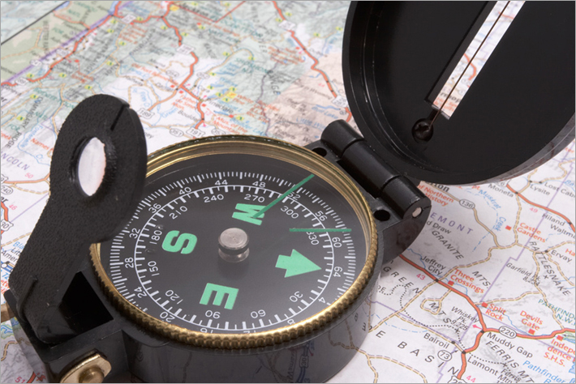
Navigating the new Data Entry tools

Slide 2
This tutorial will guide you in:
Locating the new Data Entry Tools
Defining a new site
Entering data
Bookmarking Data Entry Pages

Slide 3
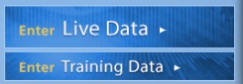
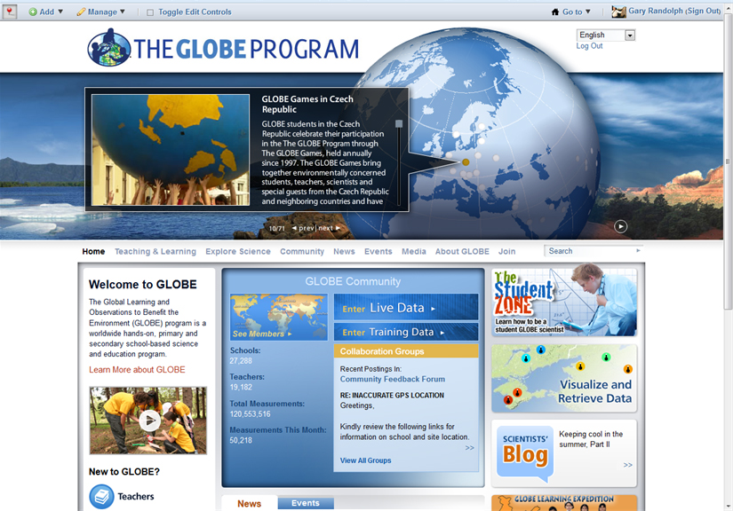
Locating the new Data Entry Tools:
Once logged in to the GLOBE website click on the appropriate Enter Data icon on the Home page. Note that there are two options: Enter Live Data and Enter Training Data. For the purposes of training, this tutorial will use the Enter Training Data option.

Slide 4
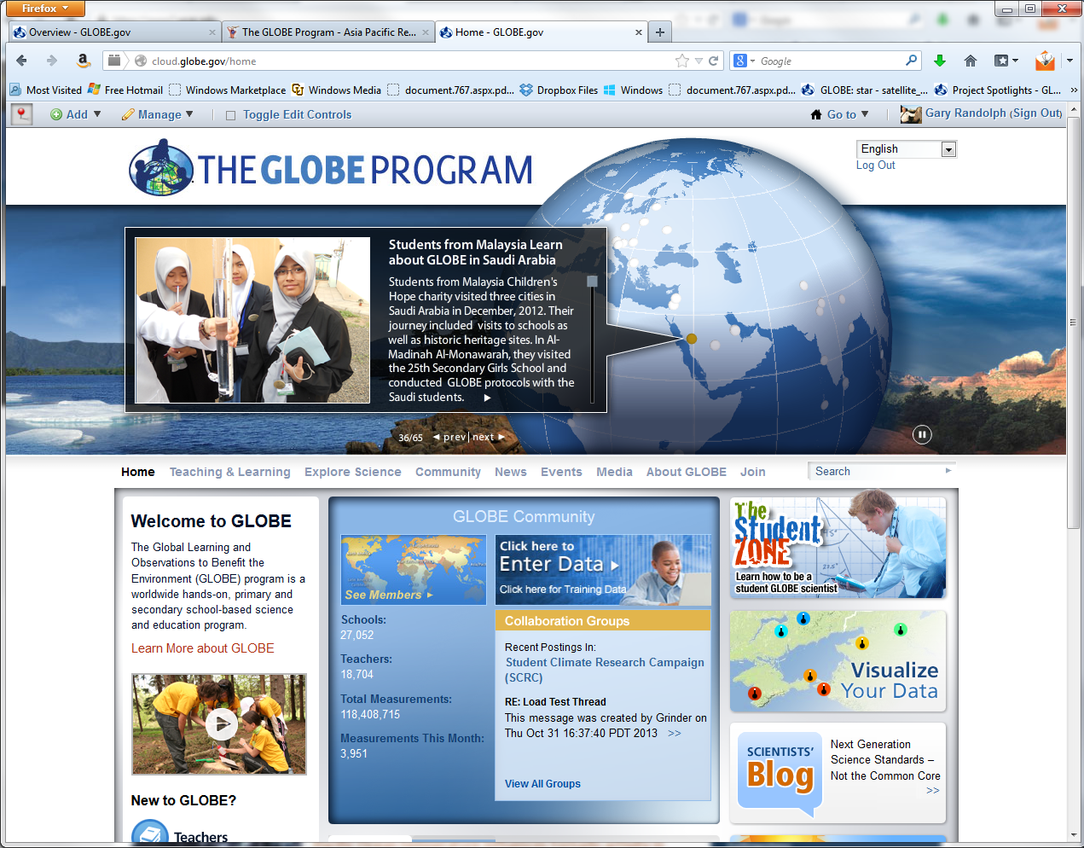
This page can also be found by clicking on the Go to arrow along the top right.

Slide 5
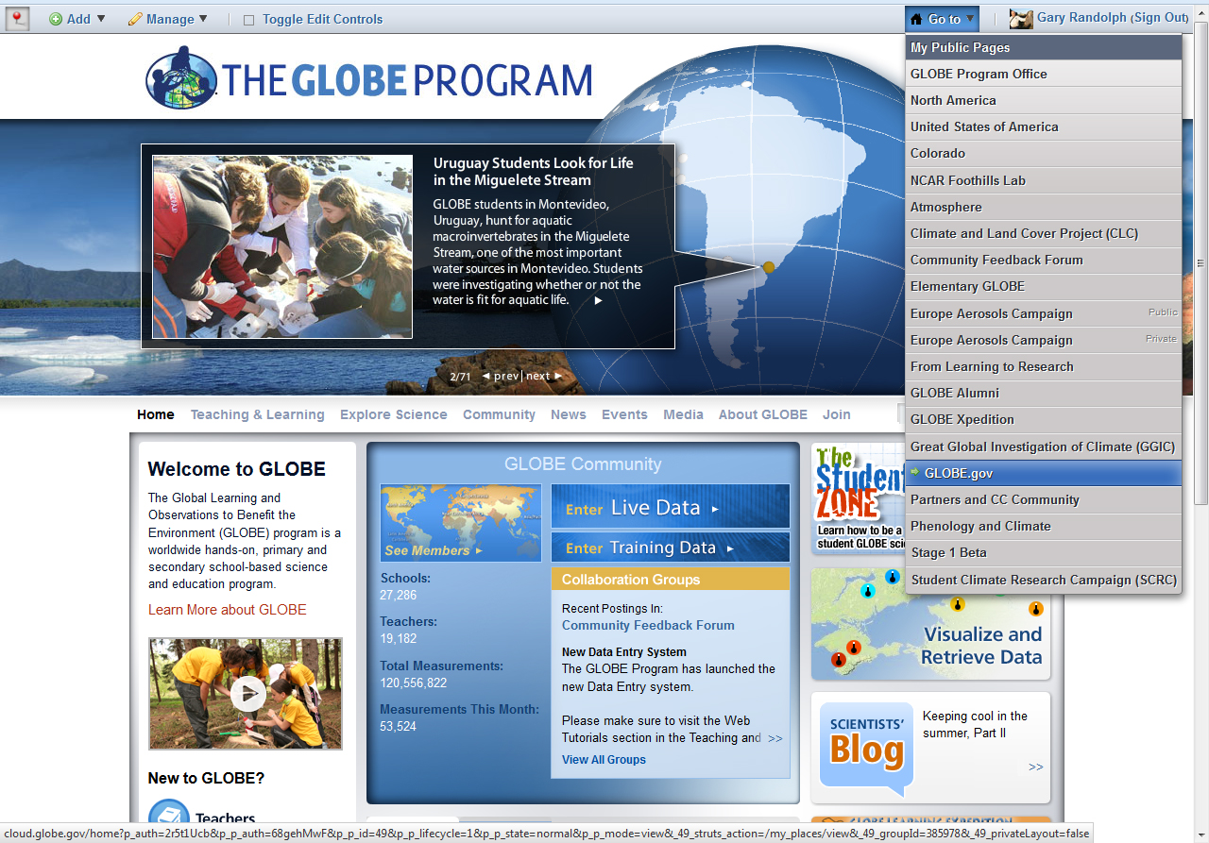
And select My Public Pages.

Slide 6
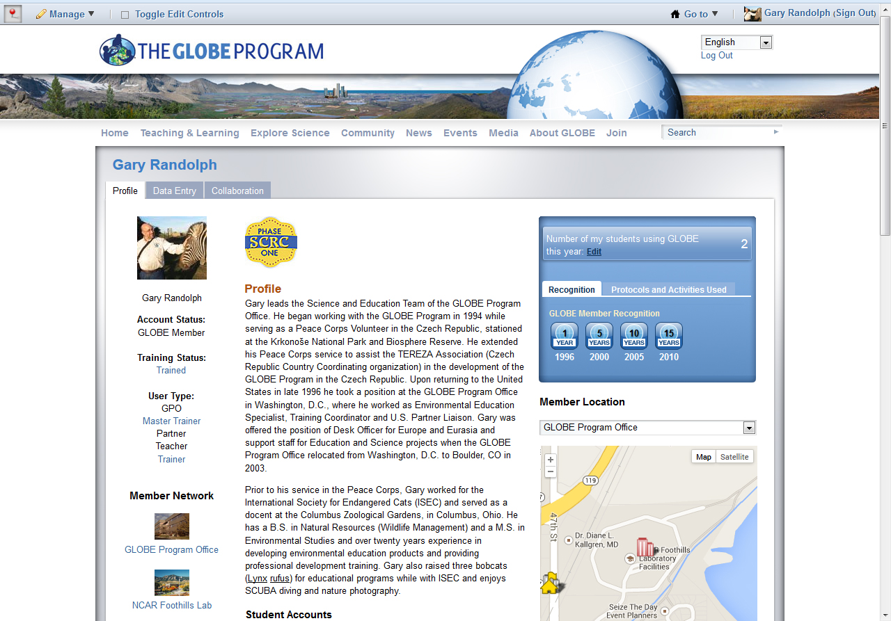
Click on the Data Entry tab next to your profile tab.

Slide 7
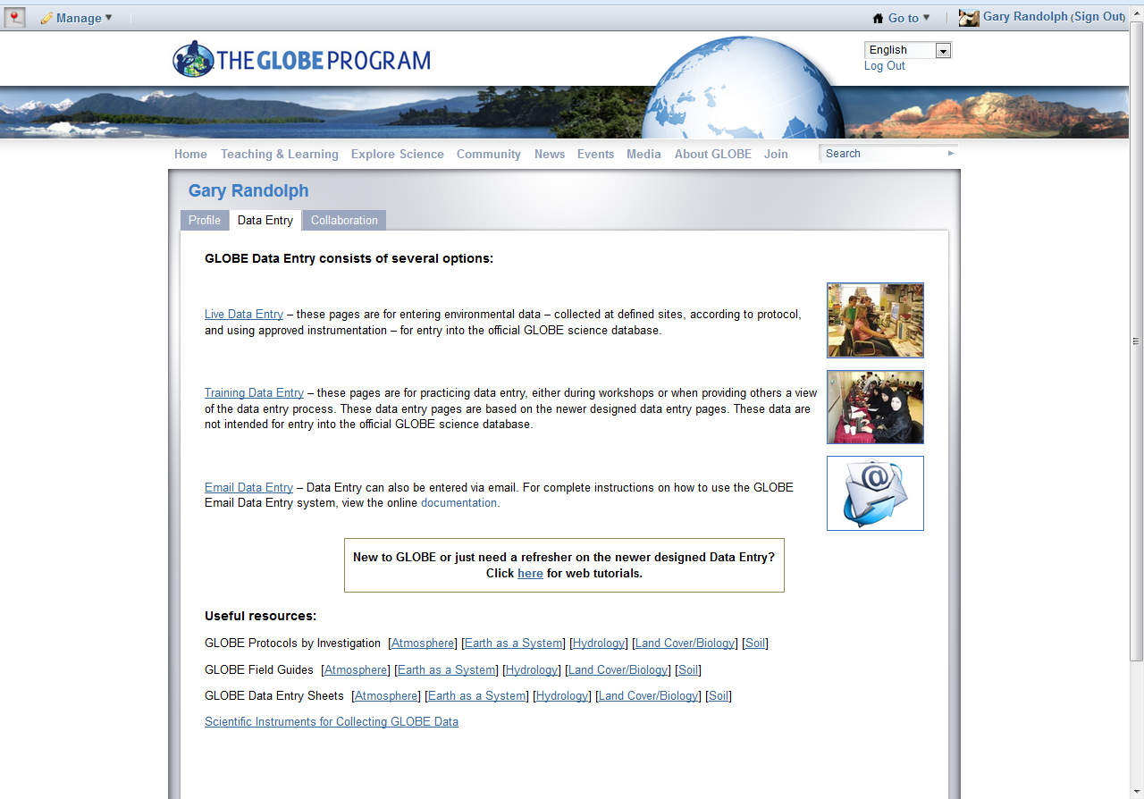
Three options exist for Data Entry: entering data into the live science database, “Live Data Entry”; entering data as a component of training, “Training Data Entry”; and entering data through E-mail. E-mail Data Entry is especially useful for submitting bulk data as well as data being submitted by automatic weather stations.

Slide 8
The GLOBE website also offers a tutorial on the newly designed data entry tools as well as direct links to useful resources, such as protocols, field guides and data entry sheets.

Slide 9
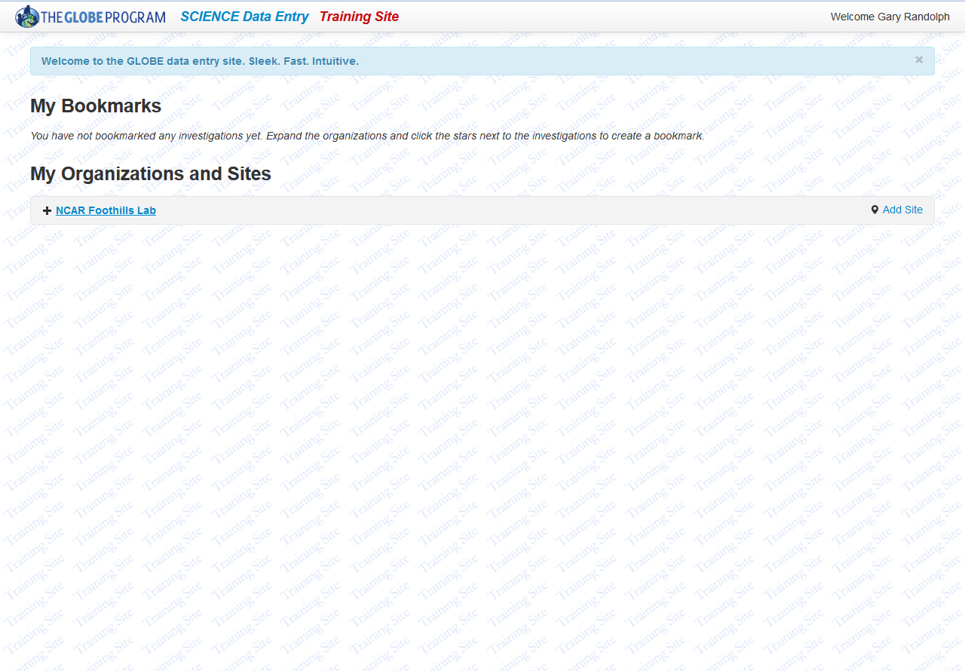
This tutorial will utilize the Training Data Entry tools. These tools and their functionality exactly mimic the Live Data Entry tools. Notice, however, that Training Site is in red and along the top and the background of the page displays a Training Site watermark.

Slide 10
The Data Entry tools will open in a new browser window or tab. There are two sections:
1) My Bookmarks and 2) My Organizations and Sites.

Slide 11
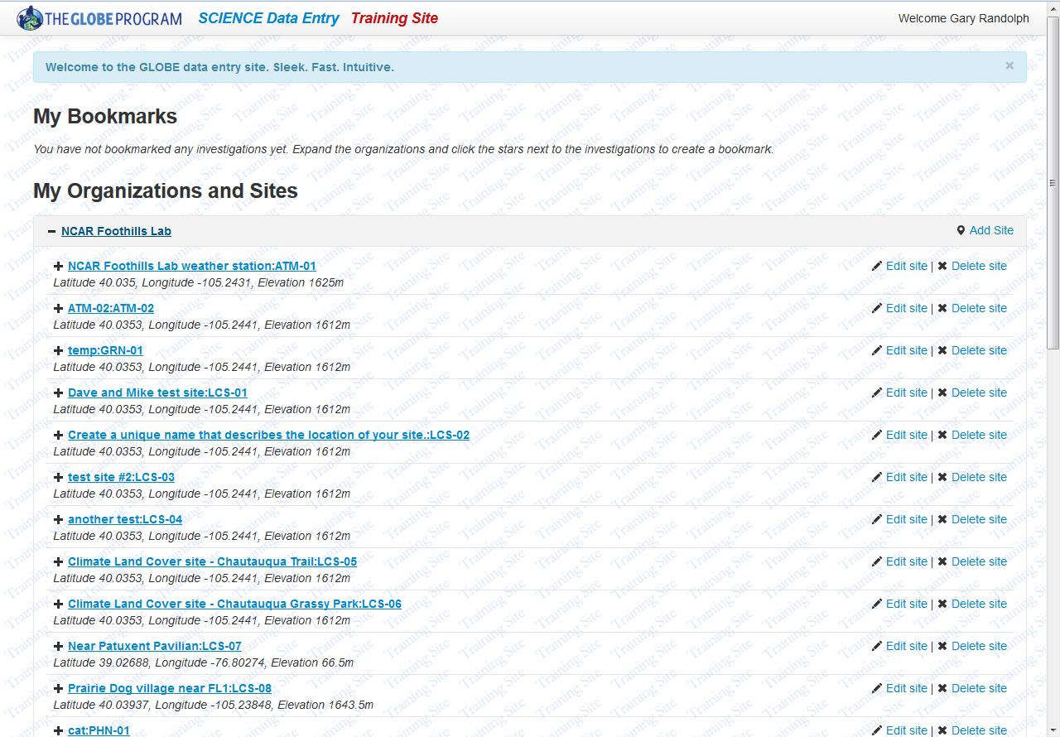
Clicking on your Organization name will list any sites that have been defined. Clicking on it again will close the list of sites.

Slide 12
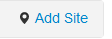
Defining a New Site:
To add a study site, click on the link for your organization.

Slide 13
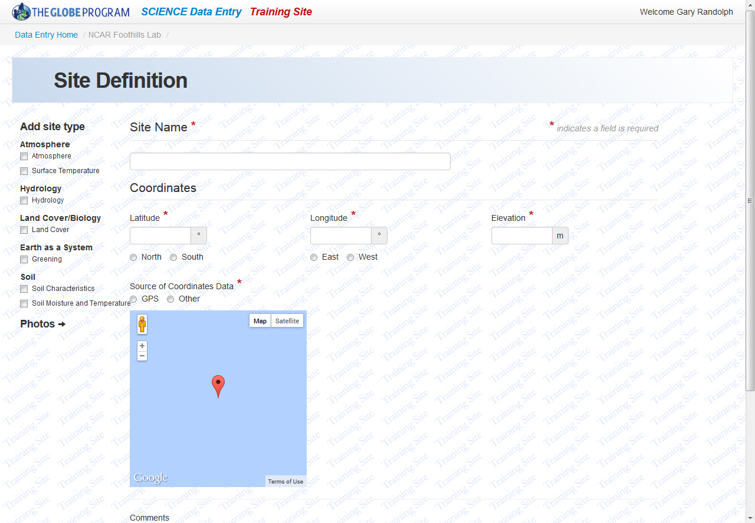
First you’ll need to define your site. Note, that fields that are required are identified by a red asterisk .
Before doing anything else, enter the Site Name and Coordinates (latitude, longitude and elevation). Be sure to use decimal degrees for latitude and longitude.

Slide 14

When creating a Site Name please be specific if your organization will have more than one site of this type. An example of a specific site name is “Grassy area - Front of school”. Identifying the location in the name will help differentiate between similar sites.

Slide 15
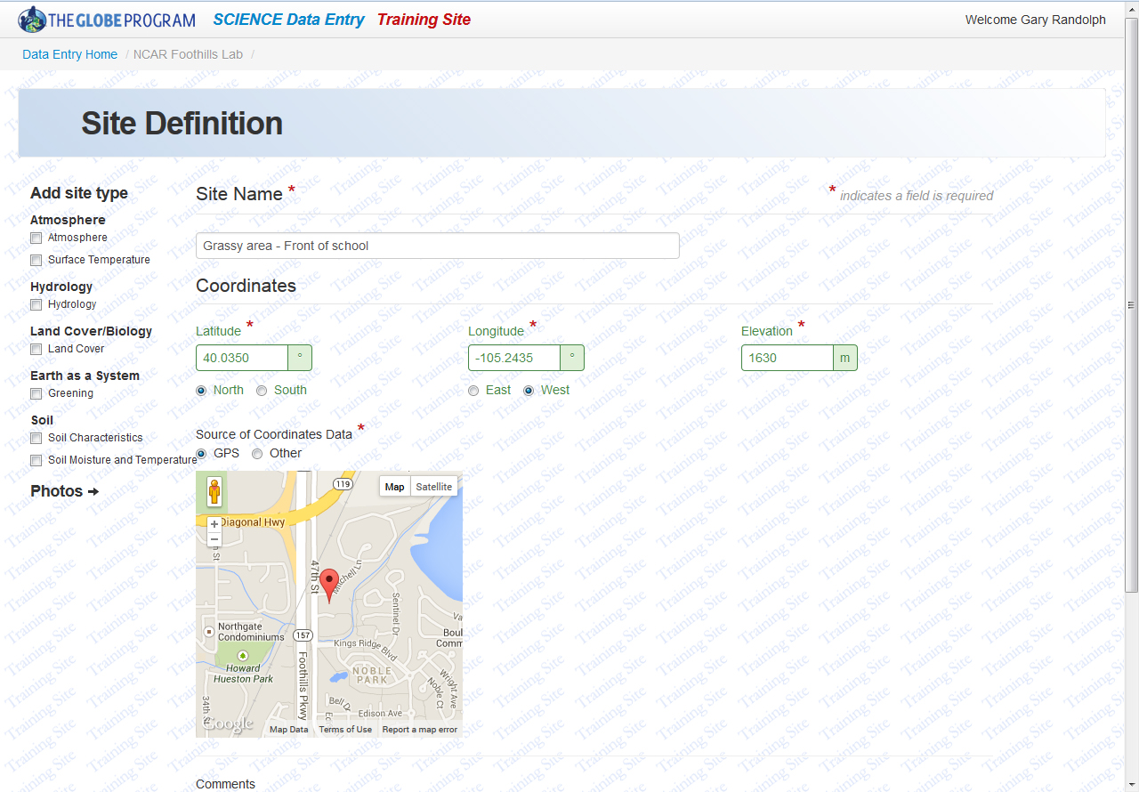
Entering latitude and longitude values will cause the image in the map to change. After the coordinates are entered, the map should display a familiar area. If not, please check the coordinates and the radio buttons below the coordinates to ensure that the appropriate side of the Equator and the Prime Meridian have been selected. Also choose the source of data.

Slide 16
Now that the basic site information is completed, select the site type(s). Click on the box next to the appropriate investigation(s); Atmosphere will be selected for this tutorial.

Slide 17
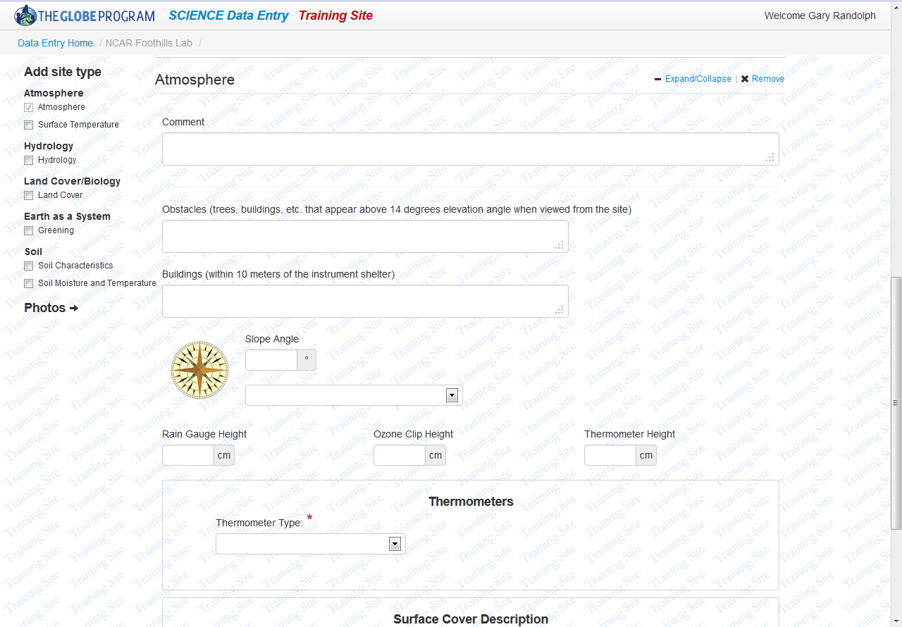
Clicking on the box next to Atmosphere brings up this view. Complete the necessary fields, identified by red asterisks , as well as any data or information for additional fields that you have collected.

Slide 18
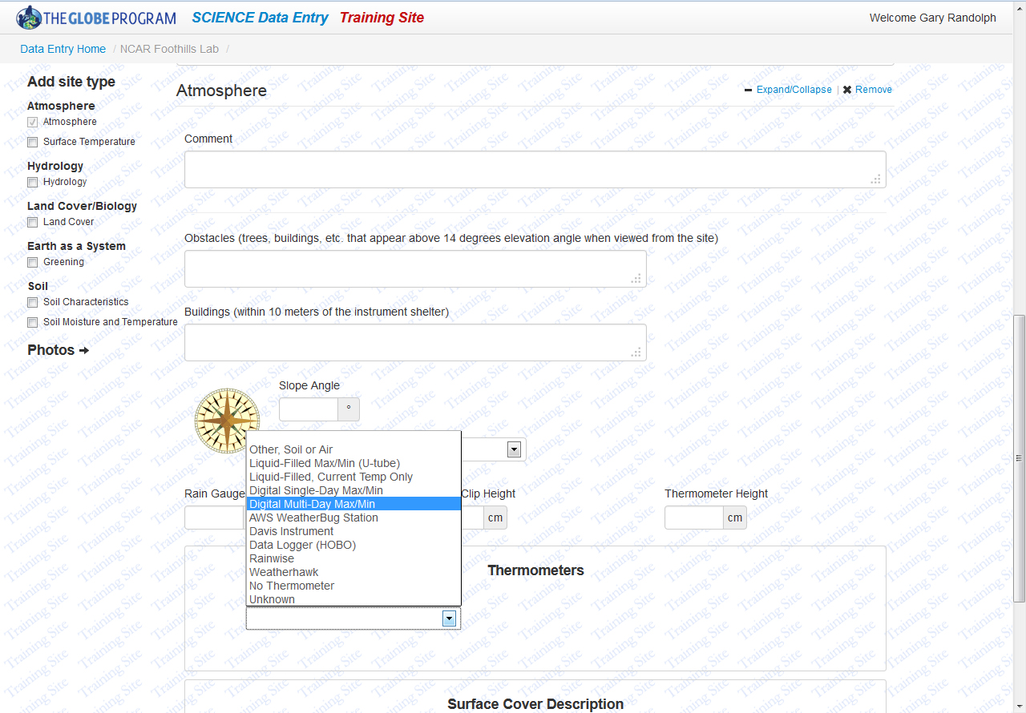
For an Atmosphere site, selecting the thermometer type, including No Thermometer, is the only requirement. It will be left blank in order to display the data entry tool’s response when a required field is not completed.

Slide 19

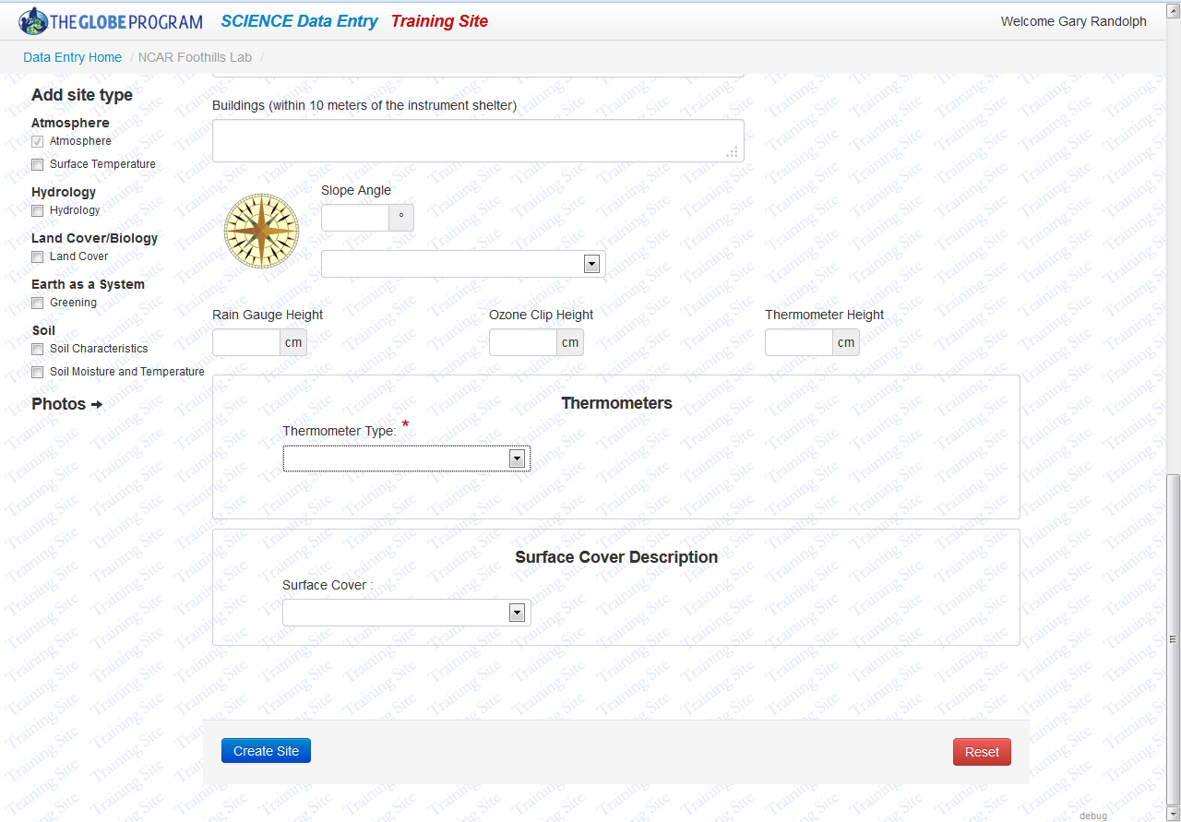
When you’ve completed entering the information, scroll to the bottom of the page and click on the Create Site button.

Slide 20
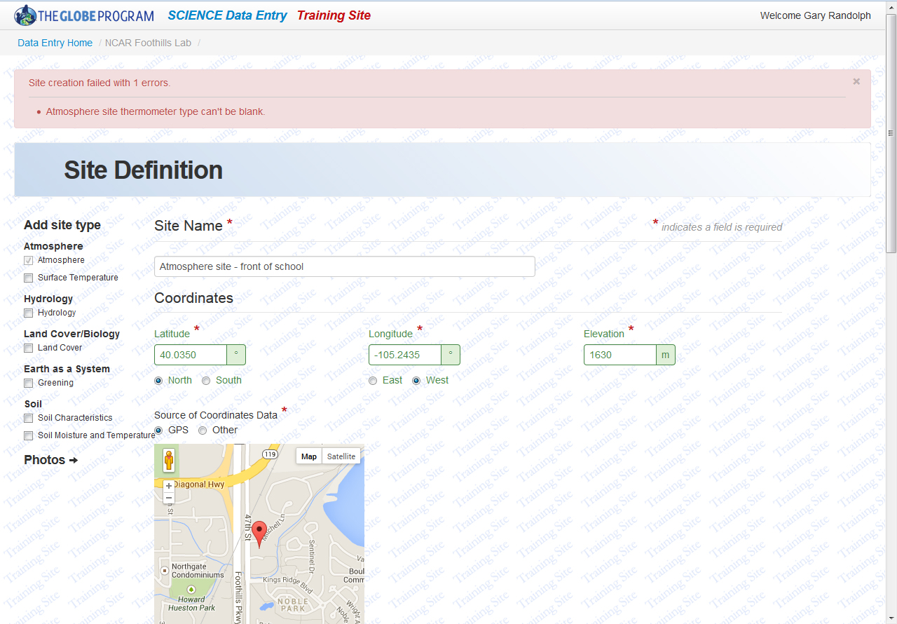
If errors were identified in the data submitted, a message will be displayed at the top of the page stating Site creation failed with the number of errors identified . Below this message, the specific errors will be listed. Notice that the required thermometer type field is identified as the source of the error.

Slide 21
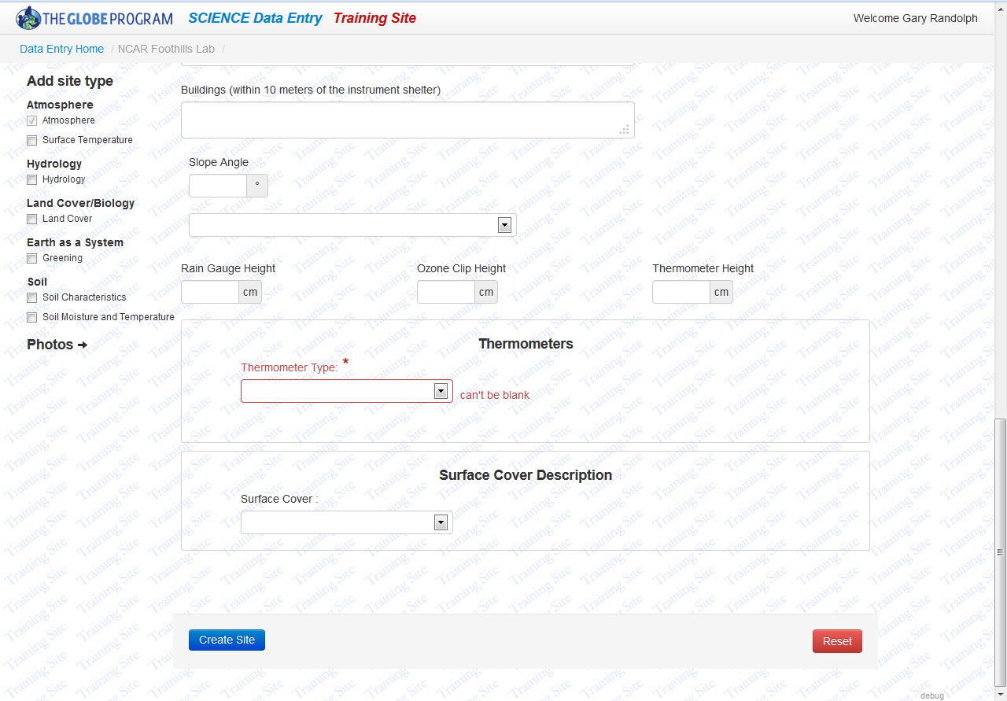
Scrolling down the page to the Thermometer Type pull down will also provide details on the error. Select the appropriate thermometer, including the option of selecting “No Thermometer”, from the list and again click on Create Site.

Slide 22
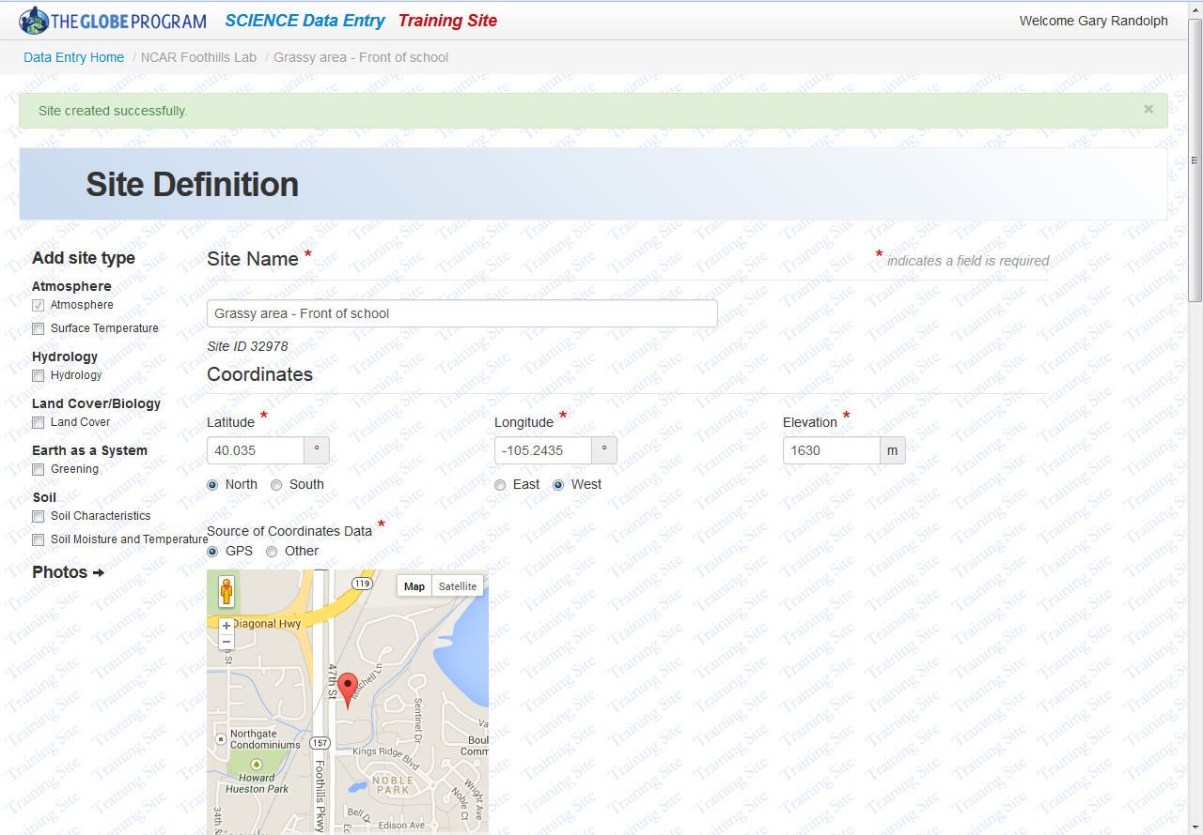
If information was entered correctly, a green bar will appear along the top of the page noting Site created successfully .
To begin entering data, click on the Data Entry Home link.

Slide 23
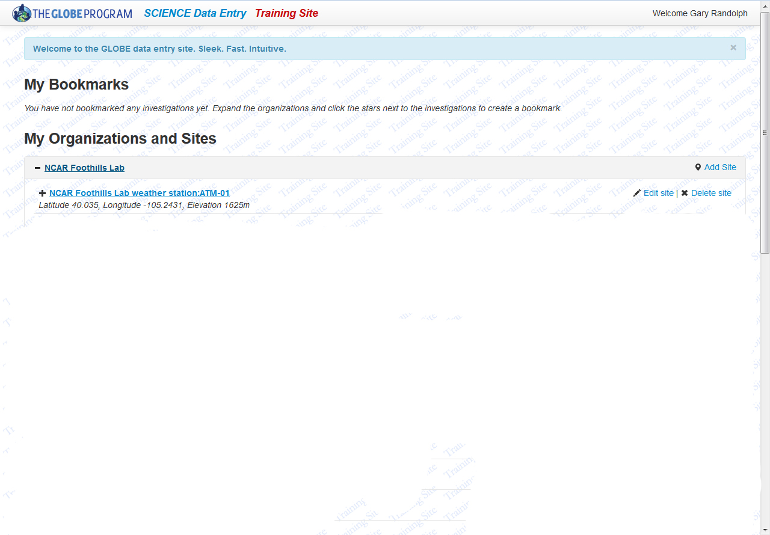

Return to the Data Entry Home page and click on the organization; the site just successfully defined should be listed at the bottom of the list.

Slide 24
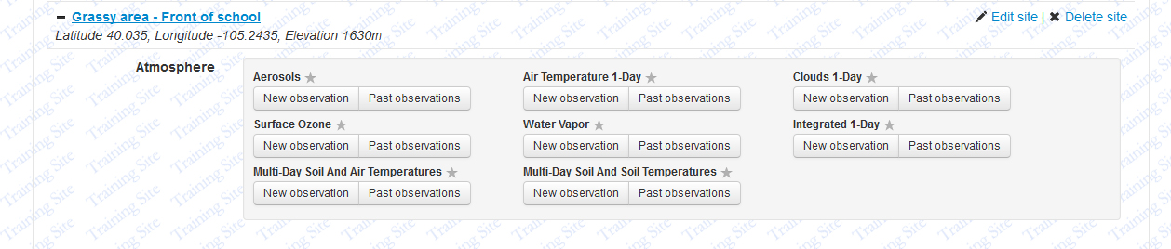
Clicking on the site name will expose the various data entry options available at this site. Click on the New Observations button under Integrated 1-Day. (Note: clicking the site name again will close these options from view)

Slide 25
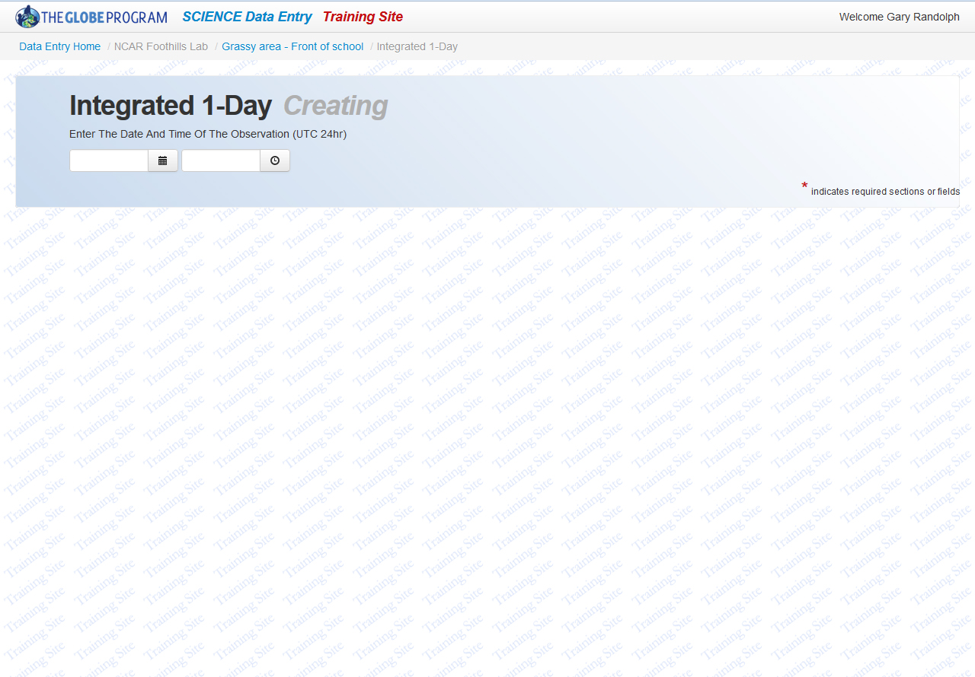
Once on the Data Entry page, two things to take note of: 1) Below the GLOBE Program Science Data Entry Training Site is the “breadcrumbs” of your current page, and 2) after Integrated 1-Day the word “Creating” is visible, as a data submission is being created.

Slide 26
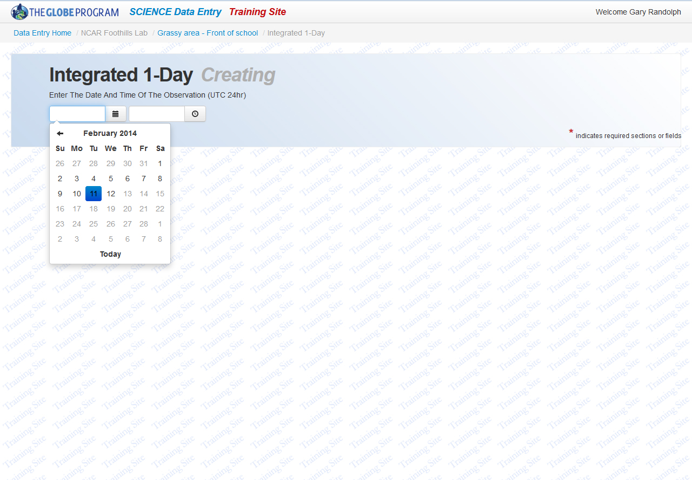
To enter data begin with the date and time of the observations. Click on the calendar icon to select the month, day and year of the observation.

Slide 27
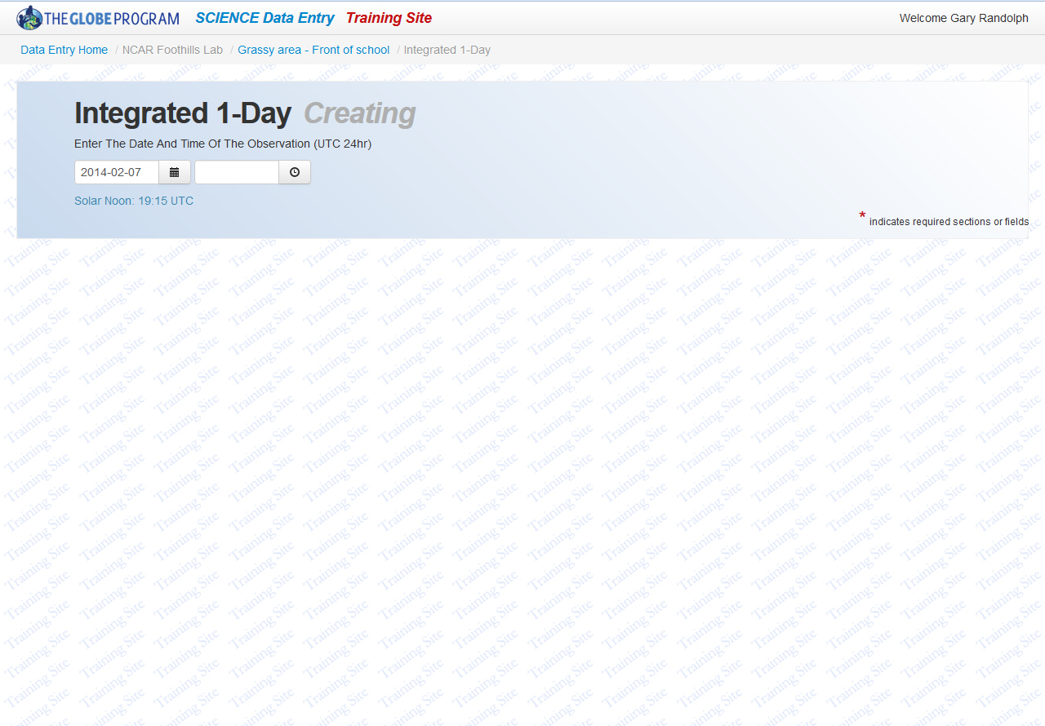
After selecting the date, time of Solar Noon for the site on this date is displayed. Click on the Clock icon to enter the time of the observation.

Slide 28
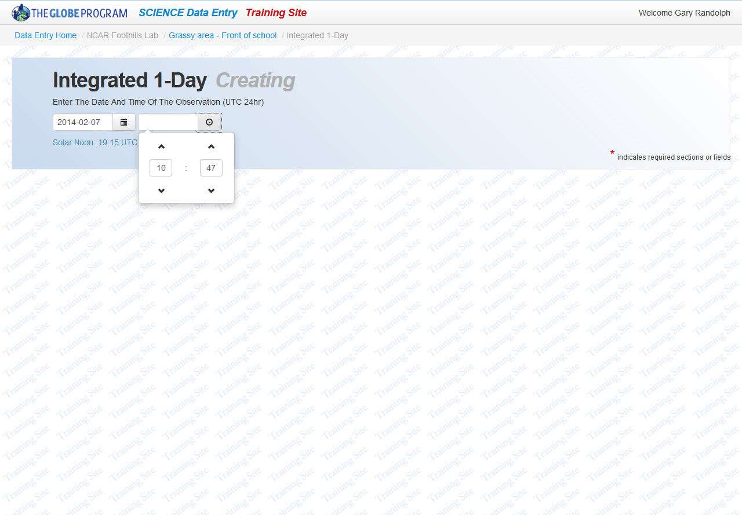
Click the arrows for both hours and minutes to choose the correct time that the observations were made. Remember, this is the time of data collection in Universal Time (UTC). For assistance with local Universal Time, see the FAQ on the GLOBE website at: http://www.globe.gov/about-globe/faq/overview/program-overview/data-entry/convert-ut

Slide 29
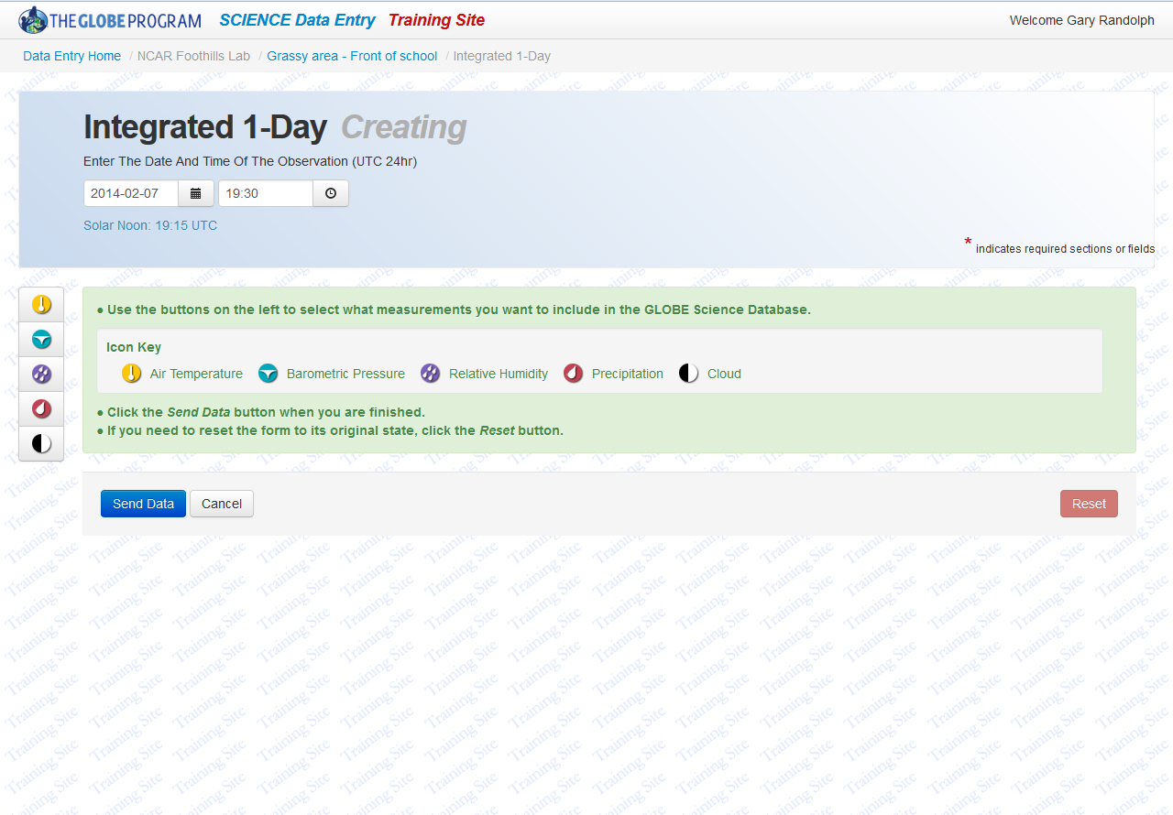
Clicking off of the time tool will provide you with the data entry options for the data entry page selected (e.g., Integrated 1-Day). Below the date and time tools are the data entry options (along the left) and a key to the icons in the center.

Slide 30
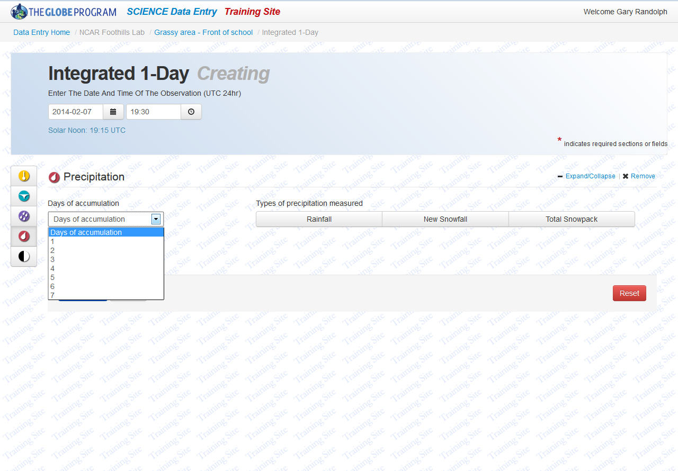
Select a protocol from the icons along the left by clicking on it, for example Precipitation. The data entry tool begins by asking for the days of accumulation and the data for which type or types of precipitation you will enter.

Slide 31
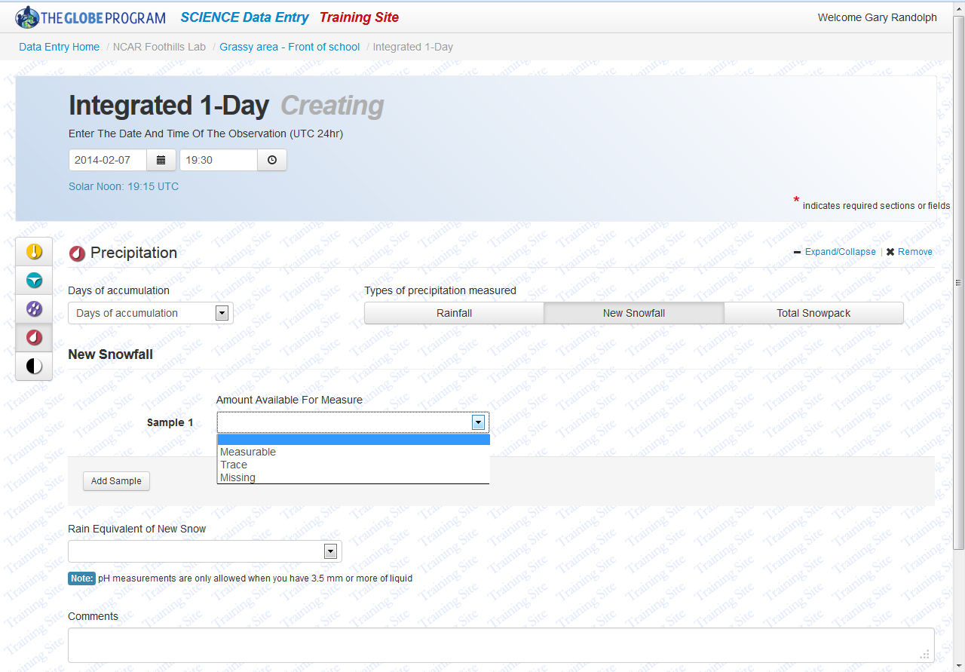
By selecting 1 day of accumulation and “New Snowfall”, the data entry tool provides a drop down selection for Sample 1. Select “Measurable” for data submission, “Trace” if the depth was too small to be measured, or “Missing” if the data were lost. To add additional samples click on the Add Sample button.

Slide 32
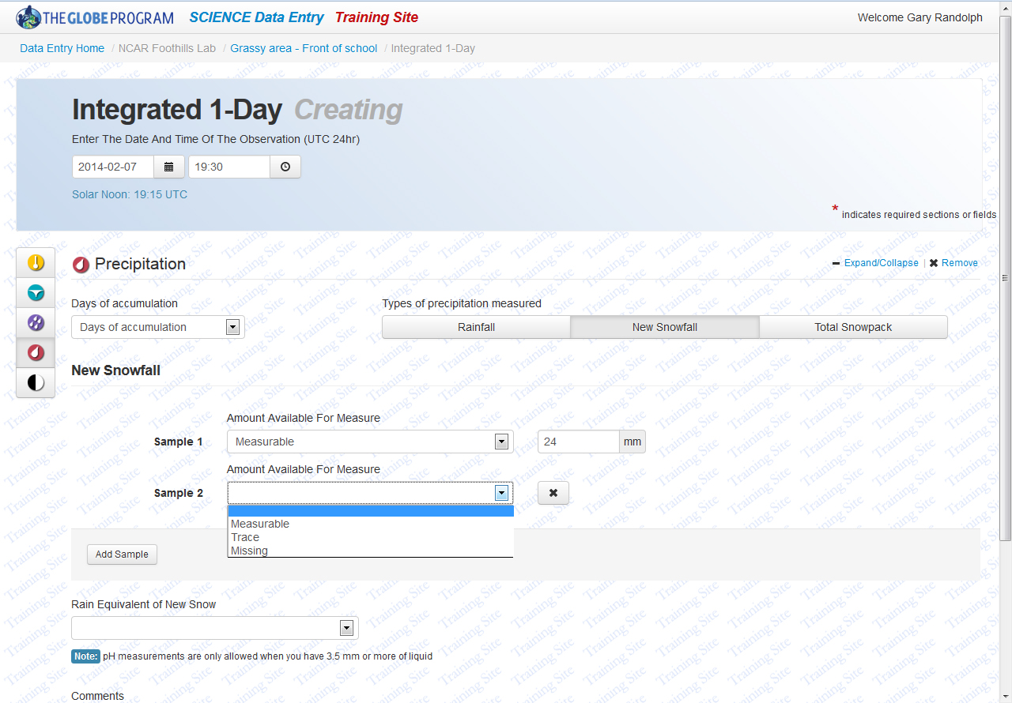
For this example, Measurable has been selected and 24 mm was entered. Up to three samples can be submitted by clicking on “Add Sample”.

Slide 33
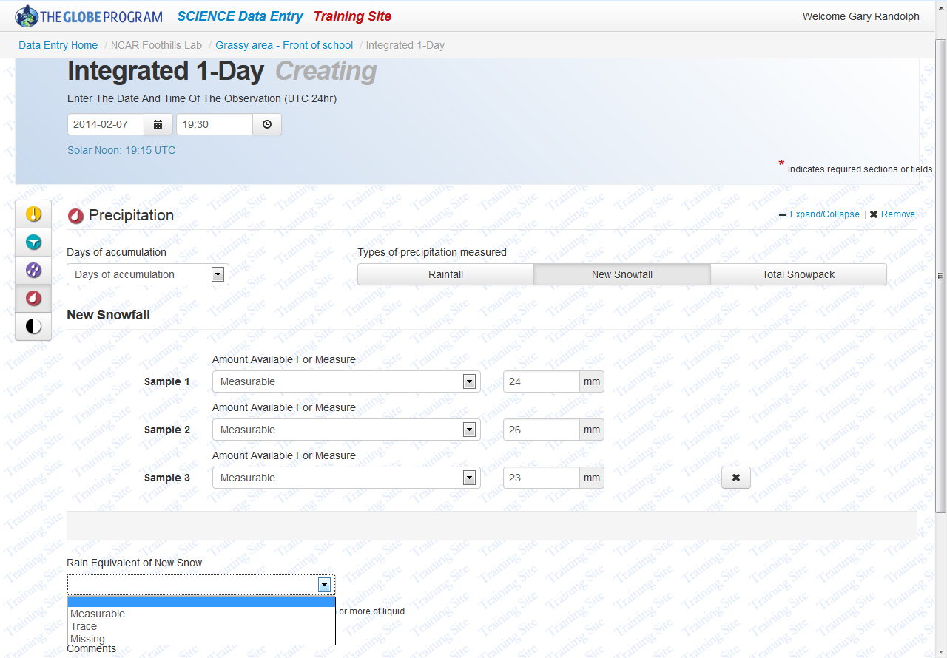
Rain Equivalent of Snowpack can also be submitted, along with the pH of the liquid if greater than 3.5 mm. If these data are available, select Measurable, Trace or Missing.

Slide 34
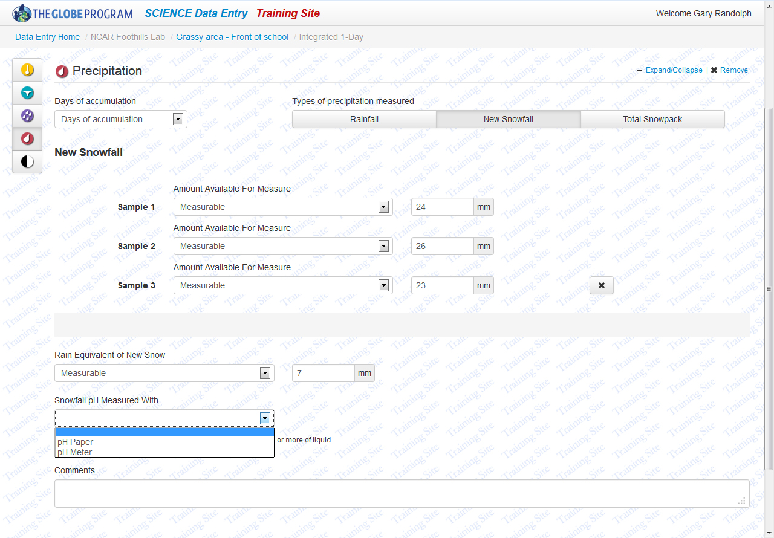
Allowing a sample of the snowfall to melt will provide a Rain Equivalent of Snowfall. The pH of this liquid can also be submitted if greater than 3.5 mm. Enter the mm of liquid and then select the instrument used to measure the pH.

Slide 35
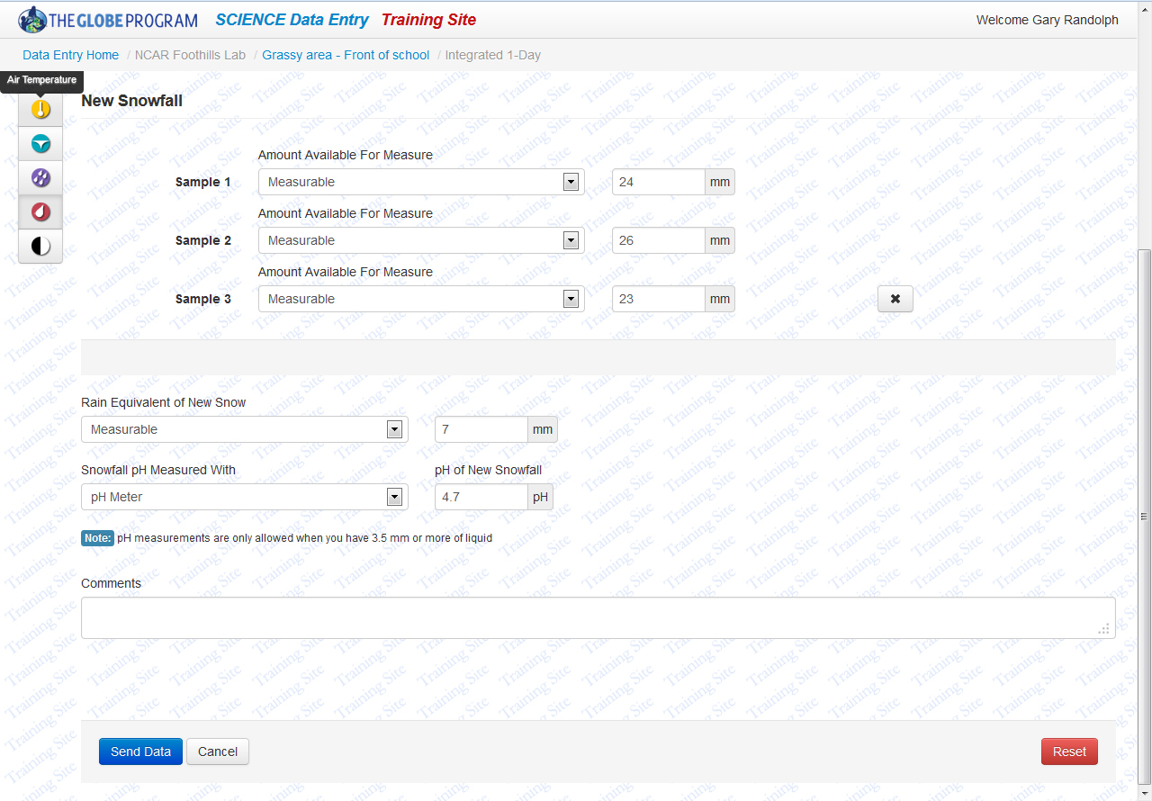
When data have been completely entered, scroll to the bottom of the page and click on Send Data or, if additional data have been collected, click on the appropriate icon along the top left. Holding the mouse cursor over an icon will remind the user of the various protocols available.

Slide 36
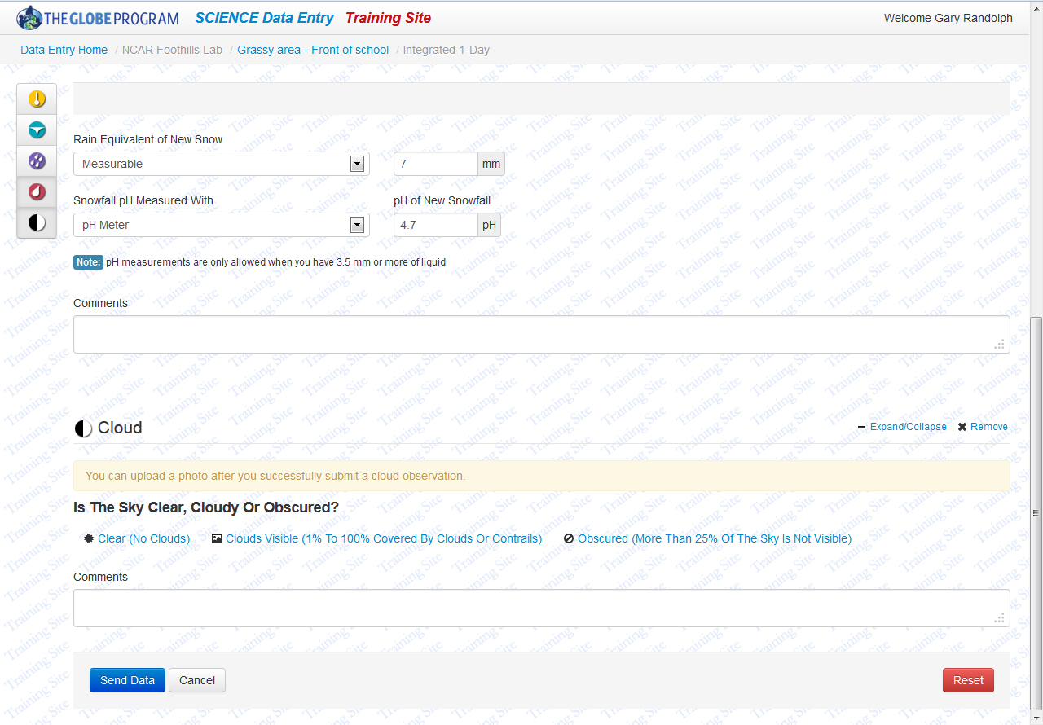
Adding another protocol, for example, Clouds, builds on the data entry page. The Clouds data entry tool begins with a simple question: Is the sky clear, cloudy or obscured?

Slide 37
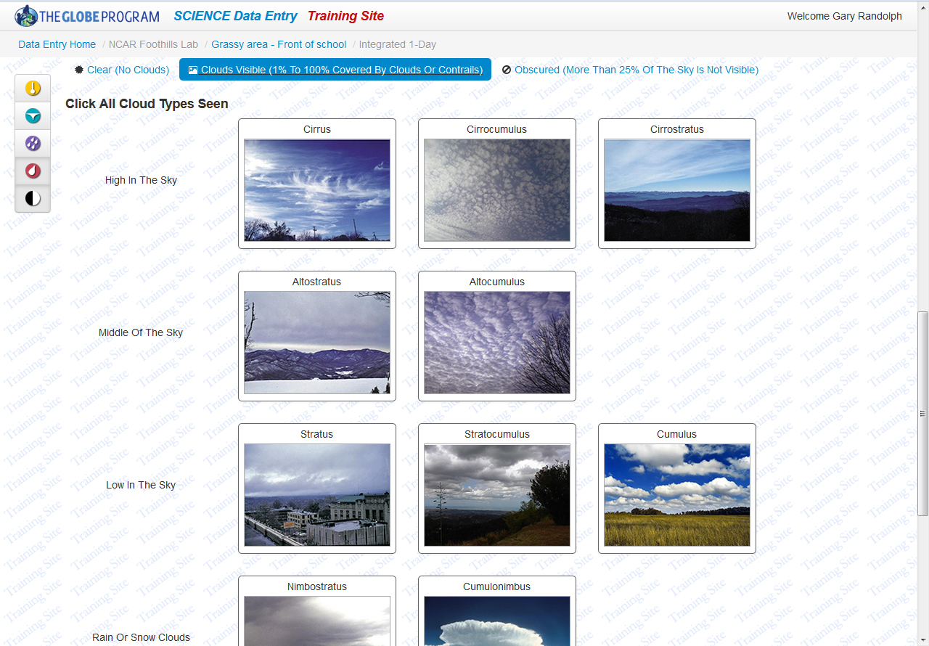
Selecting “Clouds Visible” provides the user with images of the 10 cloud types from the GLOBE Cloud Chart.

Slide 38
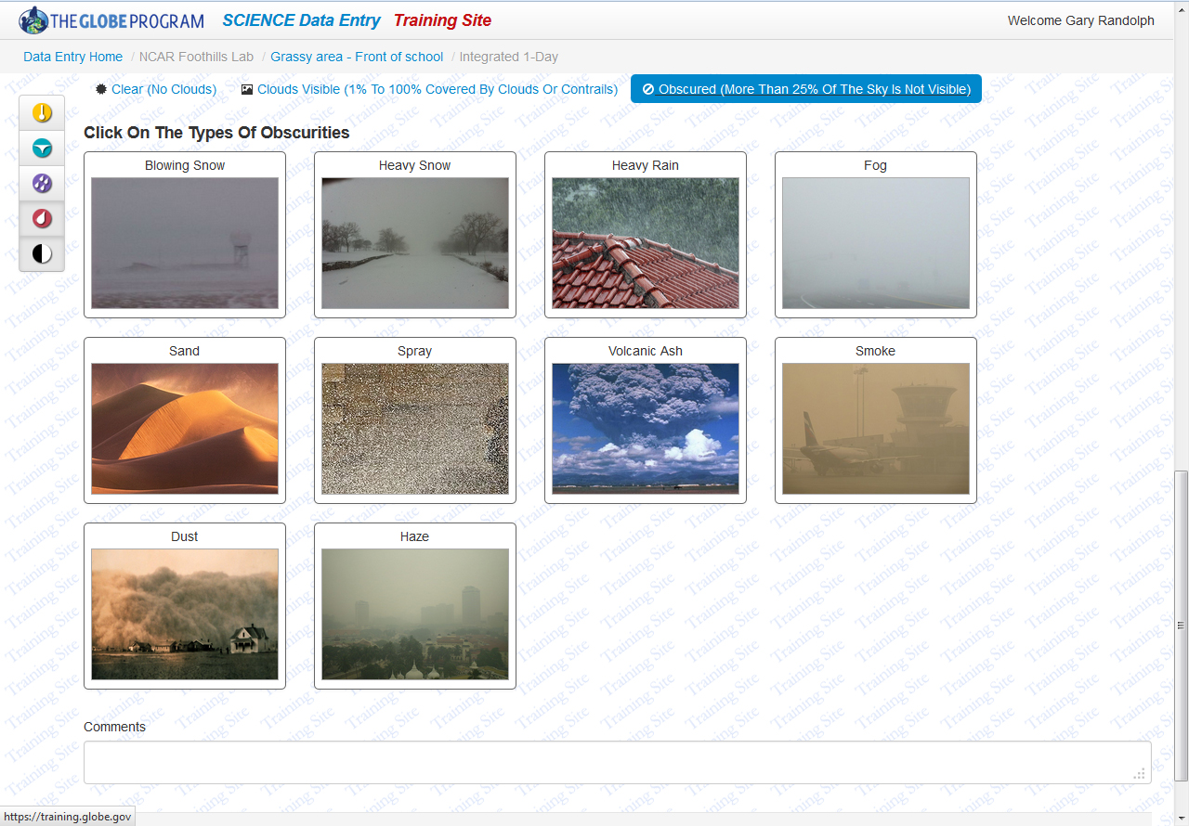
If more than 25% of the sky was obscured from view, preventing the observation of cloud types, select the type or types of obscurities by clicking on the appropriate images.
Note: Obscurities and clouds can not both be selected.

Slide 39
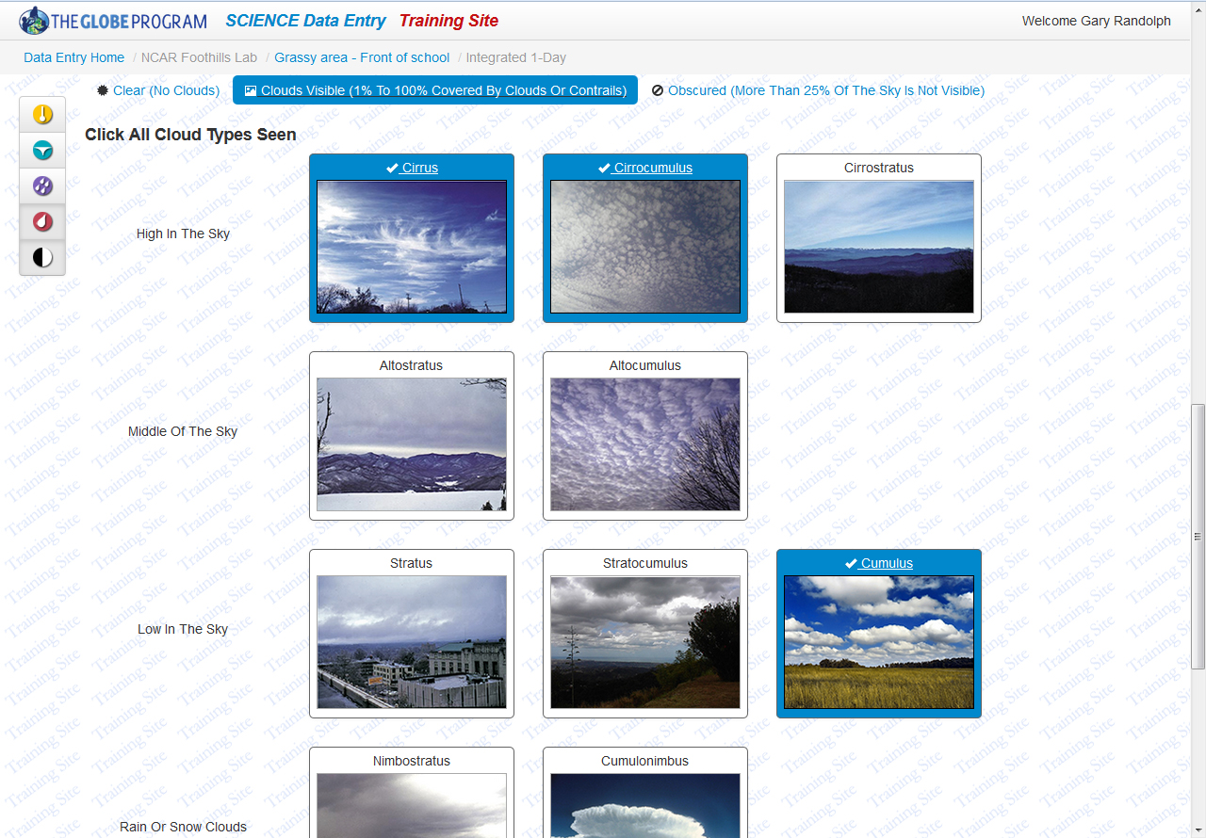
Clicking on any of the could images selects those clouds as being observed in the sky. Clicking on a cloud image again will un-select that cloud.

Slide 40
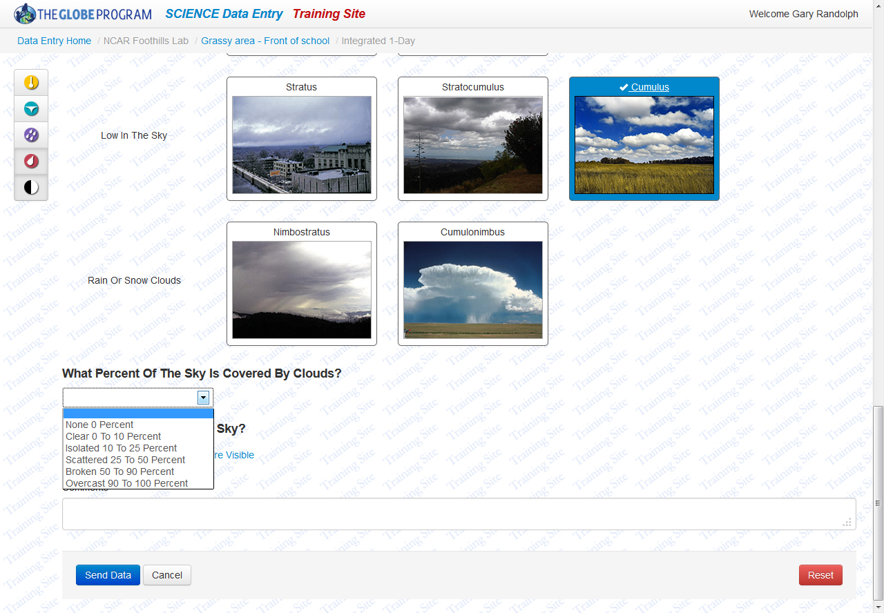
Scrolling down the page will provide the Cloud Cover drop down option.

Slide 41
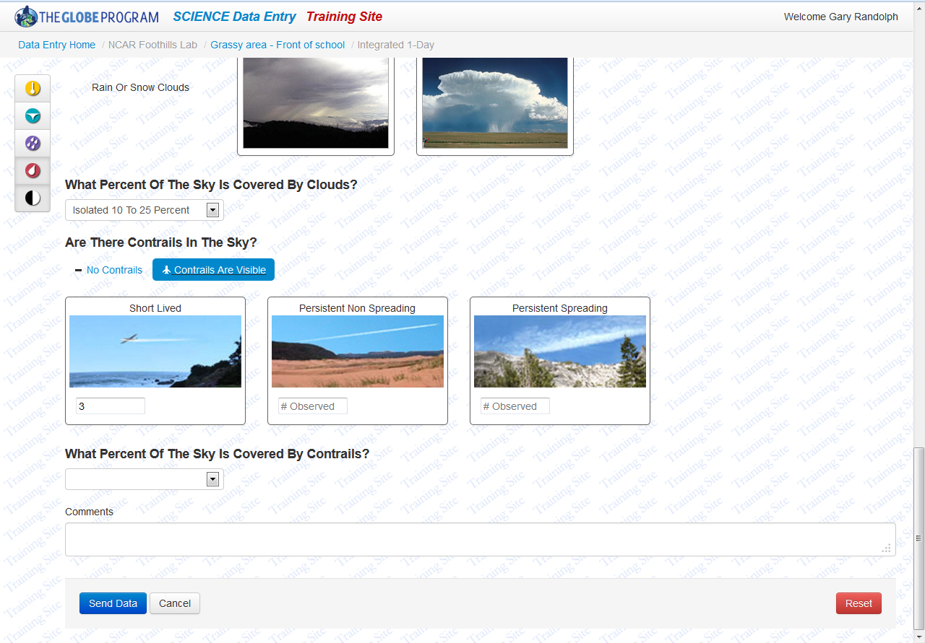
Under Cloud Cover, select whether contrails were visible in the sky and the number of each contrail type observed.

Slide 42

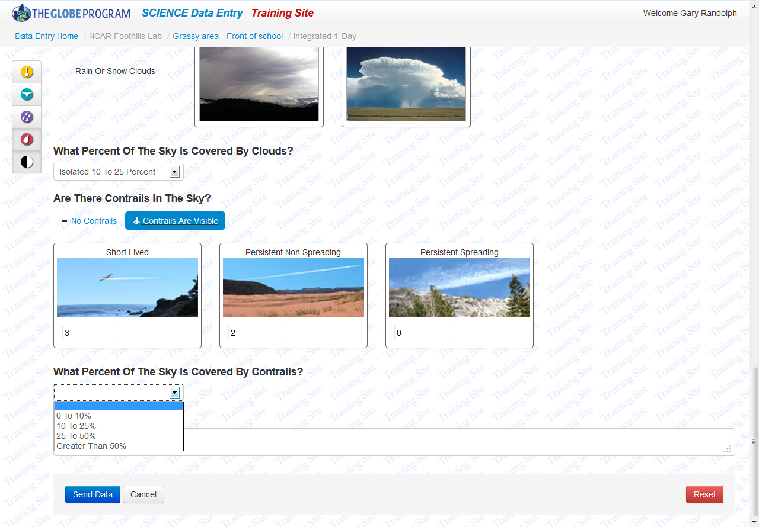
Select the appropriate contrail cover estimate and then either click on Send Data or select another protocol.

Slide 43

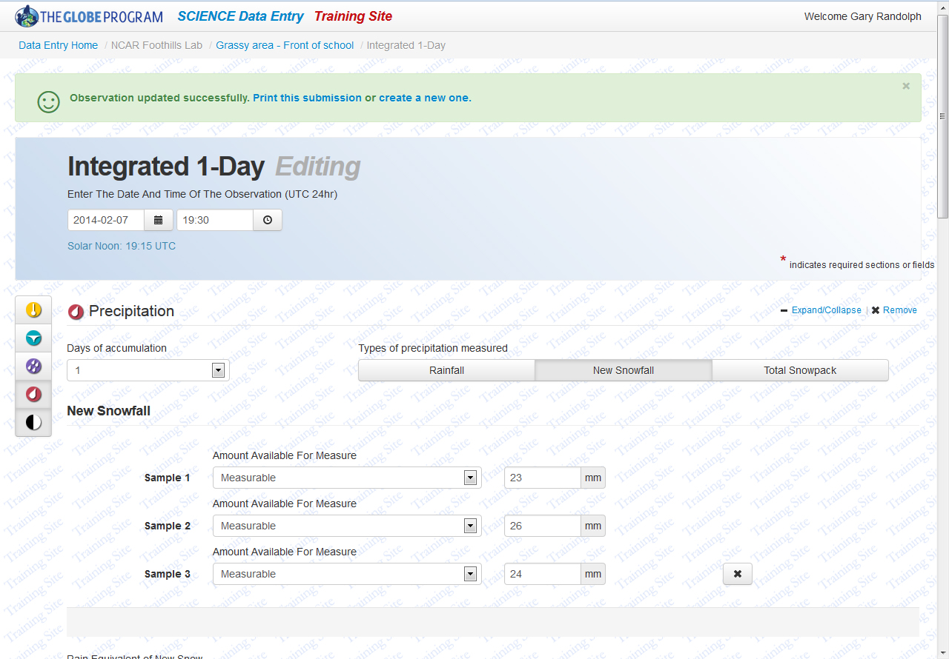
If data were entered correctly, the user will receive a message stating Observation created successfully .

Slide 44
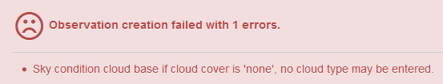
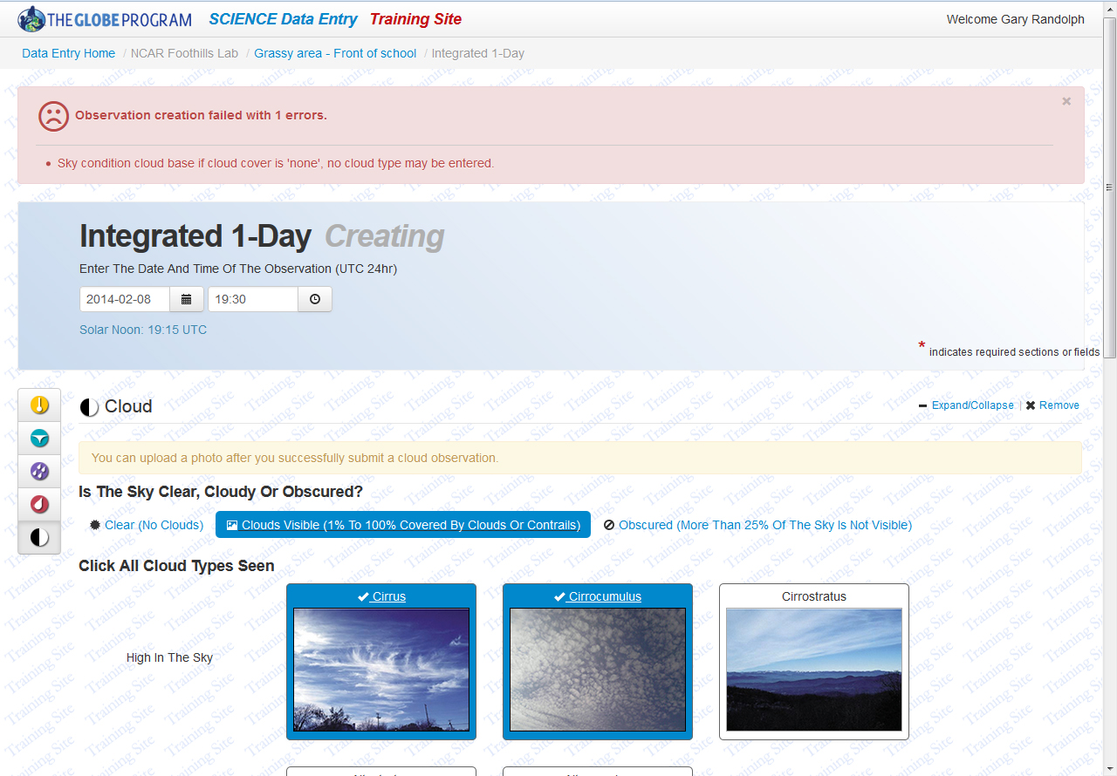
However, if related data are entered that negate each other, for example if clouds are selected but Cloud Cover is set to 0% (no clouds), the user will receive a message stating that an error occurred .

Slide 45
Bookmarking Data Entry Pages:
Click on Data Entry Home. Click on the organization and a site to open up data entry options.
Data entry pages that will be used often can be bookmarked. Click on the small empty star next to a data entry page name (for example “Integrated 1-Day”).

Slide 46
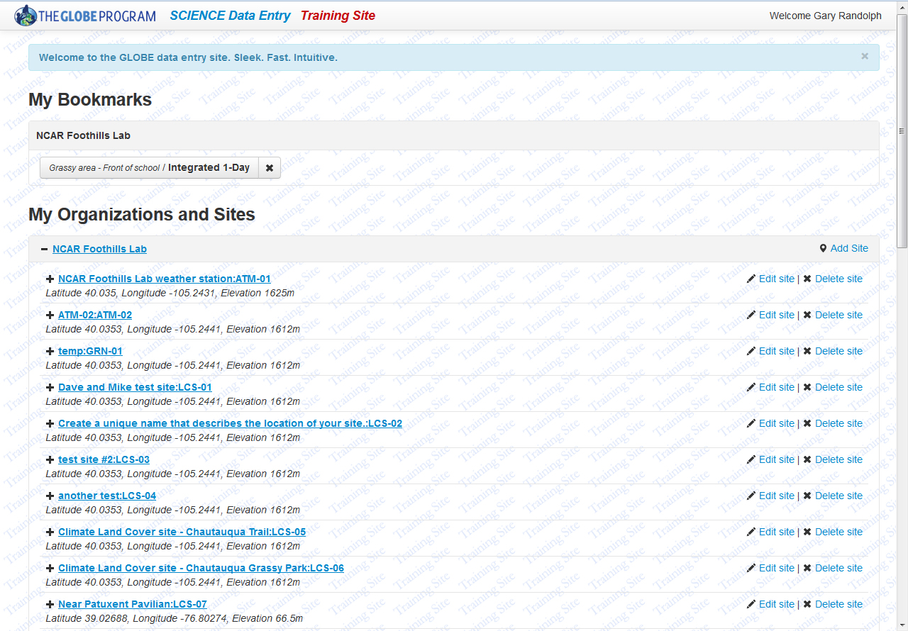
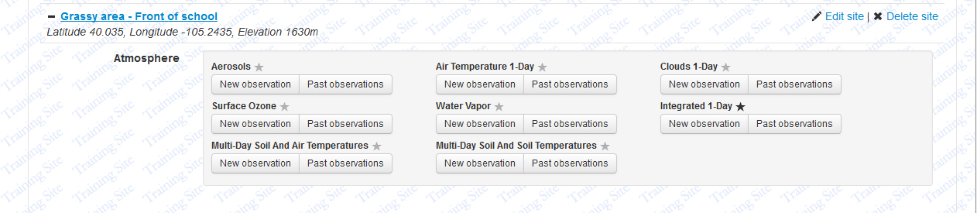
The empty star will become filled and it will be listed under “My Bookmarks” at the top of the page. This will allow for quickly access this data entry page.
To remove the bookmark, simply click on the small x.

