Slide 1
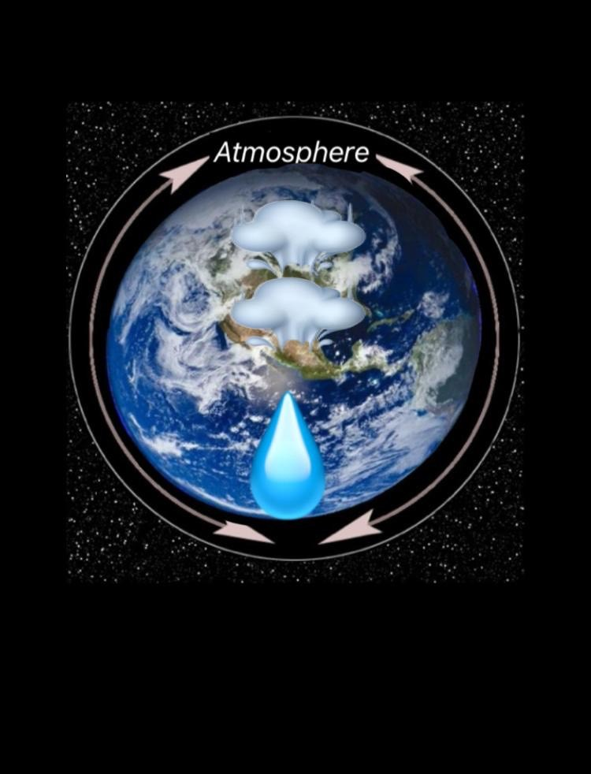

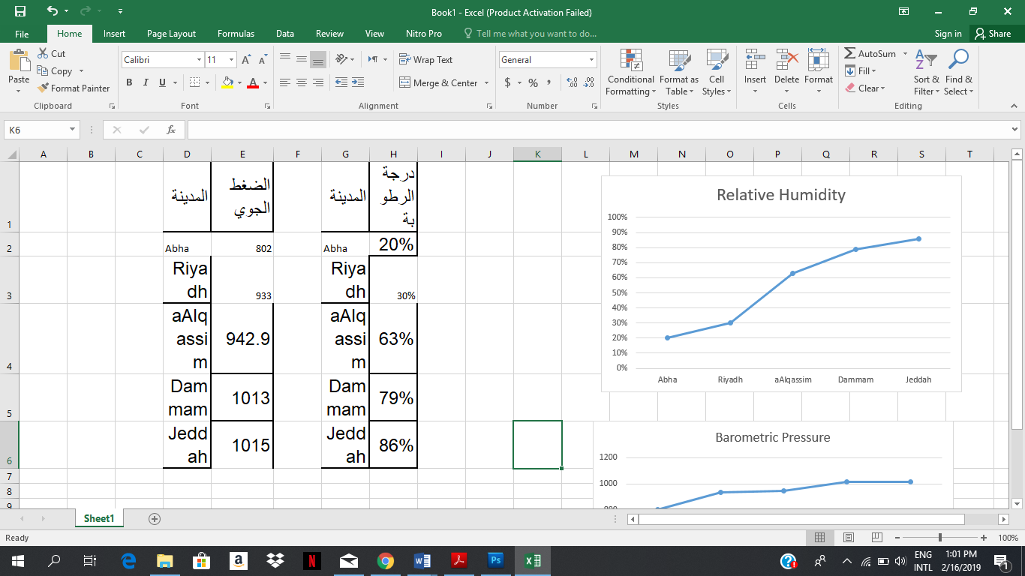
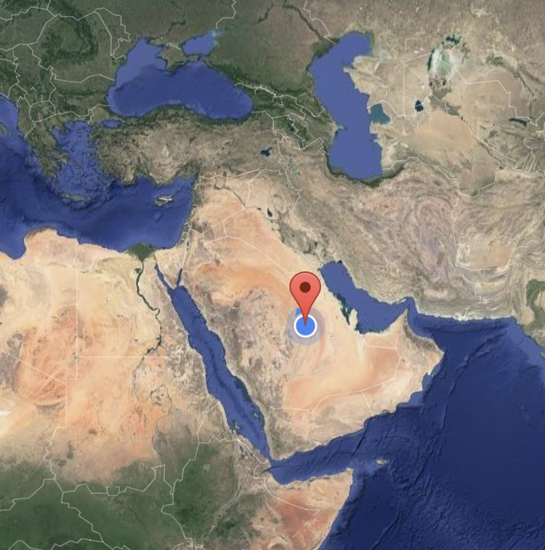
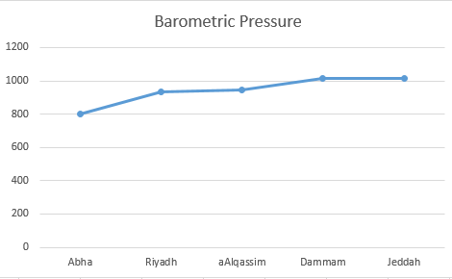
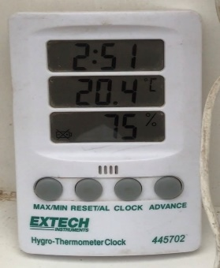
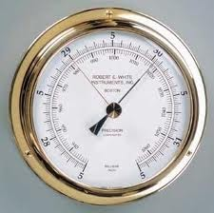
In the beginning, we looked for relationships between atmospheric variables. We took the measurements in 199 secondary school, in Riyadh, Saudi Arabia during the period from January to December 2016. Then we noticed that there is a relationship between temperature and relative humidity. In order to take measurement, we used
The hygrometer which is the globe equipment for measuring humidity (humidity protocol) (Figure 1).
The relationship between relative humidity and air pressure
Reema abdullatif al-ajlan, Reef saeed al-qahtani and Jumanah mohammed al-amri
Arqa First High School, Riyadh, Saudi Arabia
Abstract
Research Methods
Results
Discussion
The study aims to find the relationship between air pressure and humidity in Arga First High School in Riyadh Saudi Arabia.
In this study we used the experimental method in which the relative humidity and air pressure protocol was measured within three months in several regions in Saudi Arabia. During this period the relationship between them and their effect on each other was observed
From this study we find that the relationship between humidity and air pressure is a positive relationship, whenever the humidity increased, air pressure increased and vice versa.
At the end we recommended
1 - Experiment should take place in high relative humidity or none relative humidity areas.
2 – the need to monitor daily readings of humidity and air pressure.
3 – The study of the effect of atmospheric pressure on humans and plants.
This study contributes significantly in developing and monitoring the geographical and climate database in our region.
In the beginning, we looked for the relationship between relative humidity and air pressure. Measurements were taken at the Arqa high school in Riyadh and in different regions of Saudi Arabia during the period from (August 2019 - March 2020).
Then we noticed that there is a relationship between relative humidity and air pressure.
In order to take measurements, we used a hygrometer (a device used to measure moisture) (moisture protocol) (Figure 1)
Figure 1: hygrometer
The barometer (a device used to measure atmospheric pressure) (atmospheric pressure protocol) (Figure 2).
Figure 2: Barometer
Global measurements of relative humidity
(Figure 3: according to Relative Humidity Protocol)
Globe measurements of air pressure
(Figure 4: by air pressure protocol)
From the graphs, we conclude that the relationship between relative humidity and air pressure is a direct relationship. The higher the humidity, the higher the atmospheric pressure and vice versa. The reason for that is when the humidity increases, the water vapour increases in the air and the air pressure is the weight of the air column on the unit Spaces.
As we all know, that there is a relationship between relative humidity and air pressure. we noticed the difference in the values of air pressure from one region to another in Saudi Arabia because of the difference in humidity in the region we noticed the difference in pressure in a certain area, Riyadh, because of the difference in moisture from day to day.
We observed atmospheric pressure and relative humidity for different regions of Saudi Arabia and observed that there was a relationship between them, especially when it changed.
Atmospheric pressure increases humidity. Then we drew the graph and concluded that the relationship between them is a direct relationship. We also observed that relative humidity in an area where its altitude, low the atmospheric pressure has its own characteristics as we discussed earlier.
These results correspond to our hypothesis.
Latitude and longitude | City | relative humidity
46.43'0.01" N, 24.24'0" E | Abha | 20%
46.43'0.01" N, 24.24'0" E | Riyadh | %30
26.11'15.9" N, 44.14'56.4" E | Alqassim | 63%
50.6'0" N, 26.25'48" E | Dammam | 79%
39.10'0" N, 21.32'0" E | Jeddah | 86%
Research Questions
From our study to the relative humidity protocol and our observations of their effect on air pressure in several regions we began to suggest our hypothesis:
1. Is there a relationship between relative humidity and air pressure.
2. What is the effect of water vapor on air pressure.
Relative humidity is a measure of the amount of water vapor saturation in the air (Moussa, 1986, p. 255).
The air pressure is (based on the weight of the air column on the unit spaces).
Based on previous studies, we hypothesized:
There is a direct relationship between relative humidity and atmospheric pressure in Riyadh, Saudi Arabia.
Latitude and longitude | City | air pressure
46.43'0.01" N, 24.24'0" E | Abha | 802
46.43'0.01" N, 24.24'0" E | Riyadh | 933
26.11'15.9" N, 44.14'56.4" E | Alqassim | 942.9
50.6'0" N, 26.25'48" E | Dammam | 1013
39.10'0" N, 21.32'0" E | Jeddah | 1015
Conclusions
Introduction
In this research, we found the relationship between relative humidity and air pressure. We conclude that the relationship is a direct relationship between them. This study contributes significantly to the development and monitoring of a geographic and climate database for our region.
In conclusion, we recommend:
1 - Experiment should take place in high relative humidity or none relative humidity areas.
2 – the need to monitor daily readings of humidity and air pressure.
3 – The study of the effect of atmospheric pressure on humans and plants.
Acknowledgement: We wish to acknowledge, Globe coordination T.Noora Al-Subaie for selecting this topic, Computer teacher Najlia for helping us in logo design and T.Nada and the professor\ Alolyan for their contribution on writing a research paper.
The study aims to find the relationship between air pressure and humidity in Arga First High School in Riyadh Saudi Arabia.
In this study we used the experimental method in which the relative humidity and air pressure protocol was measured within three months in several regions in Saudi Arabia. During this period the relationship between them and their effect on each other was observed
From this study we find that the relationship between humidity and air pressure is a positive relationship, whenever the humidity increased, air pressure increased and vice versa.
At the end we recommended
1 - Experiment should take place in high relative humidity or none relative humidity areas.
2 – the need to monitor daily readings of humidity and air pressure.
3 – The study of the effect of atmospheric pressure on humans and plants.
This study contributes significantly in developing and monitoring the geographical and climate database in our region.
Bibliography
The hygrometer which is the globe equipment for measuring humidity (humidity protocol).
The barometer (a device used to measure atmospheric pressure) (atmospheric pressure protocol).

