Slide 1




LOST SANDBAR
-PRELIMINARY EXPLORATION OF SOIL CHARACTERISTICS IN KEELUNG
Keelung Municipal Anle Senior High School
Huang Sih Chi, Lu Yu Chia

Slide 2
1.Abstract
This study is to explore the relationship between soil and rain and change in pH. we discover:
a. The soil is alkaline: Keelung rainwater is indeed acidic. The average pH in 2020 is about 4.3, but the pH value of the soil we observed is alkaline, which is different from the state we imagined.
b.The soil pH value will recover: Although the rainwater is acidic, the pH value will increase after the rain.
c.Differences in vegetation cover: The part with vegetation is more alkaline than the one without vegetation.
d. Humidity and soil acid-base: When the humidity rises, the pH value of the soil will change, including the increase in the pH value of the vegetation but the decline without the vegetation.
We speculate that it may be the microorganisms in the soil or that the rainwater reacts with the soil, and further research is needed in the future.

Slide 3
2.RESEARCH MOTIVATION
Almost every region in Taiwan has its own famous crops. For example, Yilan has Sanshing scallions; Taitung has sugar apples, but Keelung does not have its own crops. We happened to participate in school's GLOBE observation project which includes observations on soil. We want to use the observation agenda to explore if it is true as the report indicated that Keelung's soil is not suitable for growing crops because of the pH value of rainwater due to rainfall. Because Keelung rains almost every day in winter, according to the journal literature, the pH value of Keelung precipitation is small. According to the definition of acid rain, the pH value of Keelung precipitation is indeed acid rain. Will its weak acidity affect the soil? Combining the pH value of rainwater with the characteristics of the hilly terrain, the falling rainwater enters the ground to become groundwater and flows through the soil layer on the entire slope, resulting in soil acidification.

Slide 4
3.RESEARCH QUESTIONS
a. What happens to the soil pH when it rains in Keelung?
b. After the rain, will the pH of the vegetation and the soil covered by the vegetation be different? If so, what are the reasons?

Slide 5
4.Research Methods

Slide 6
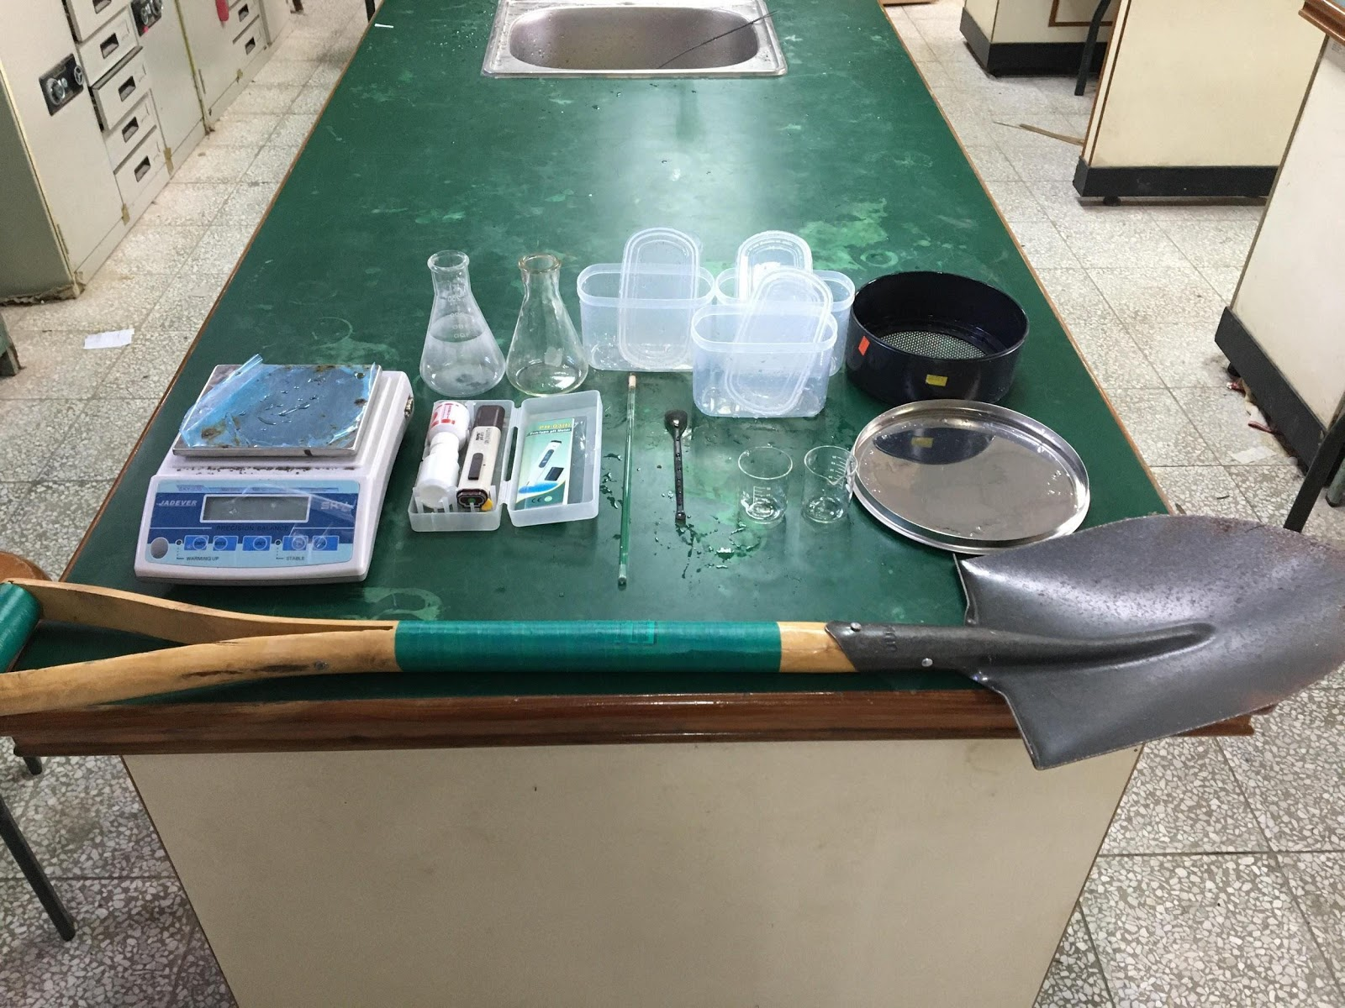
a.EXPERIMENTAL EQUIPMENT
shovel, conical flask (250ml), distilled water, fresh-keeping box * 3 (filling soil, distillation Water, rain), glass rod, spoon, small beaker, scale, pH meter, as shown in figure (1)
figure(1) Research tools

Slide 7
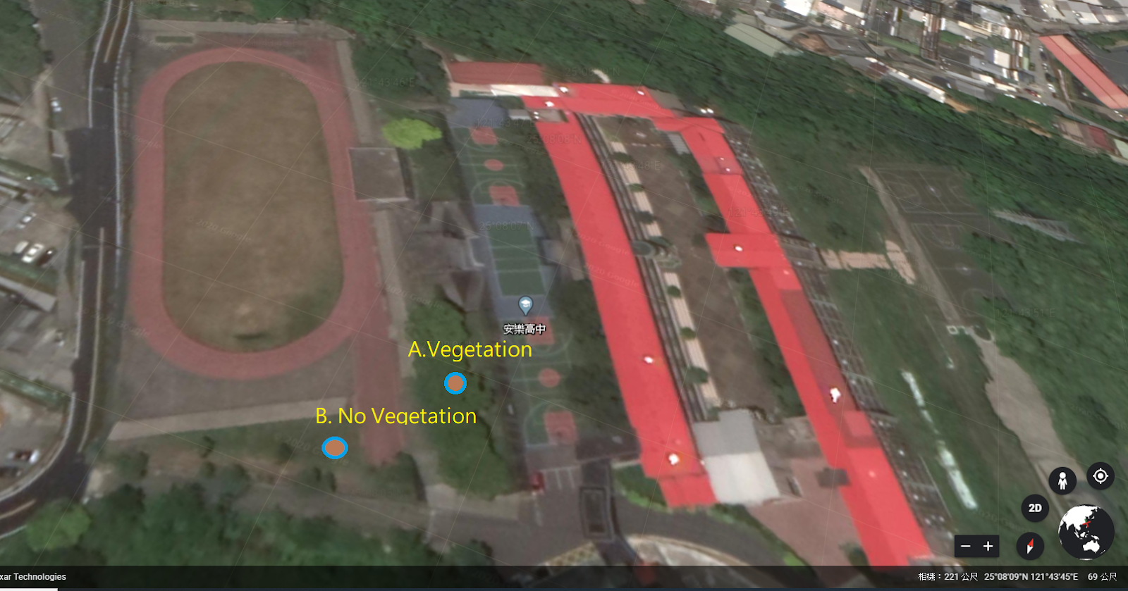
b. SAMPLING LOCATION
back campus fields A. There is vegetation B. No vegetation, as shown in Figure (2)
Figure (2) Sampling location

Slide 8
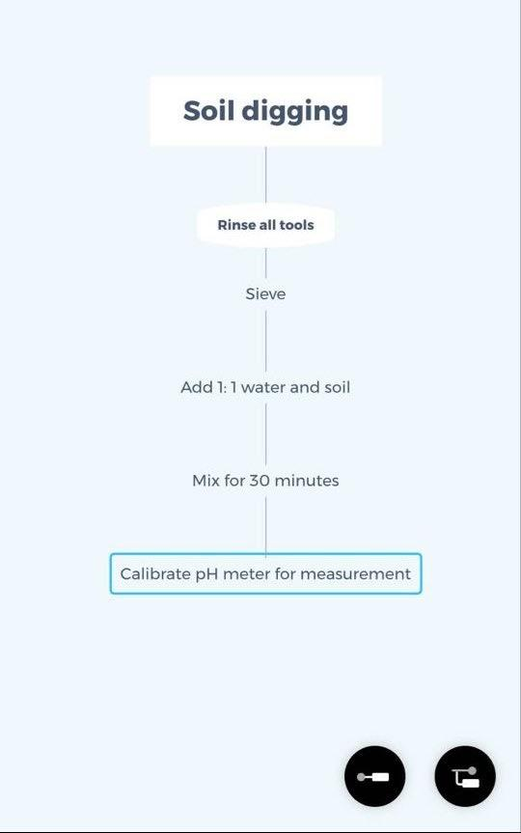
c.RESEARCH PROCESS

Slide 9
4.RESEARCH RESULTS

Slide 10
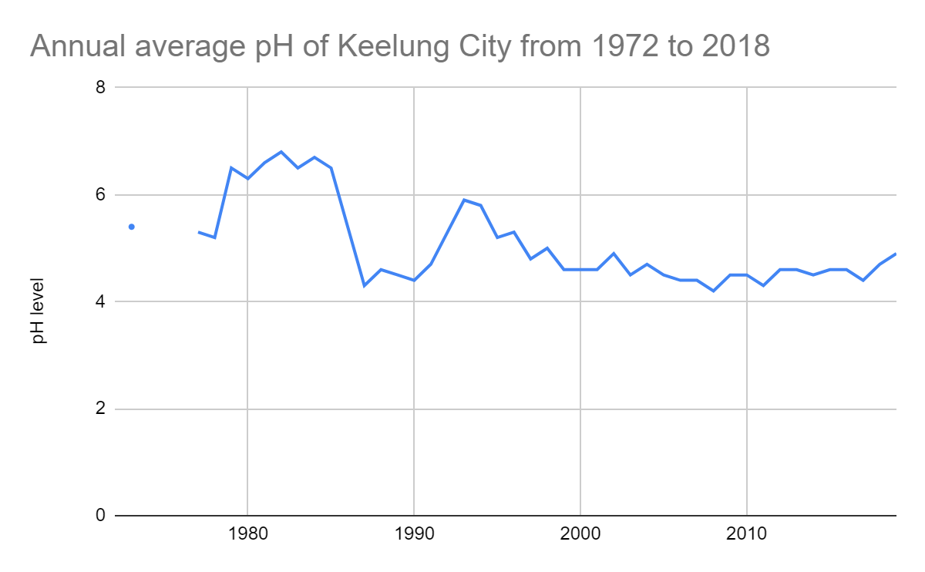
a. What happens to the soil pH when it rains in Keelung?
The dates of precipitation are 2/7, 2/17, 2/27, and 3/1, and according to the Central Weather bureau, the average annual pH value in Keelung is about 4.6 (Source: Central Meteorological Bureau https: //www.cwb. gov.tw/V8/C/D/phRain_All.html?Tab=Year), as shown in Figure (4), but the pH value of the soil we observed is slightly alkaline. As shown in table (1)
Figure (4) Annual average pH of Keelung City from 1972 to 2018

Slide 11
Table (1) Record of sampled soil
date | 2/7 | 2/17 |  | 2/25 |  | 2/26
site | A | A | B | A | B | A | B
Soil surface temperature(°c) | 17.6 | 23.6 |  | 40 |  | 32
Rainwater pH | 5.24 | 5.4
Soil pH | 7.03 | 7.3 | 7.2 | 7.3 | 7.2 | 7.5 | 7.2
Current temperature(°c) | 15 | 10.4 |  | 24.5 |  | 24.2
Max/Min temperature (°c) | 15.7/15.1 | 11.9/9.4 |  | 24.5/21.7 |  | 24.3/17.1
Max/Min Soil temperature (°c) | 16.1/16.3 | 14.5/14.3 |  | 17/16.4 |  | 20.1/17.5
weather0 | rain | rain |  | sun |  | sun
rainfall(mm) | 26 | 100 |  | 0 |  | 0
humidity(%) | 78 | 54 |  | 72 |  | 76

Slide 12
date | 2/27 |  | 2/29 |  |  | 3/1 |  | 3/2
site | A | B | A | B | C | A | B | A | B
Soil surface temperature(°c) | 20.5 |  | 32.6 |  |  | 20.4 |  | 14.5
Rainwater pH | 5.1 |  |  |  |  | 3.7
Soil pH | 7.77 | 6.95 | 7.86 | 7.46 | 7.58 | 7.76 | 7.51 | 8.25 | 7.3
Current temperature(°c) | 20.5 |  | 25.3 |  |  | 18.6 |  | 14.6
Max/Min temperature (°c) | 20.5/ 20.3 |  | 25.8/ 16.4 |  |  | 20.2/ 17.4 |  | 14.4/ 14.8
Max/Min Soil temperature (°c) | 25.1/16.6 |  | 20.3/18.5 |  |  | 18.3/18.2 |  | 19.1/15.4
weather0 | rain |  | sun |  |  | cloudy |  | cloudy
rainfall(mm) | 58 |  | 0 |  |  | 1 |  | 0
humidity(%) | 80 |  | 32 |  |  | 85 |  | 70

Slide 13
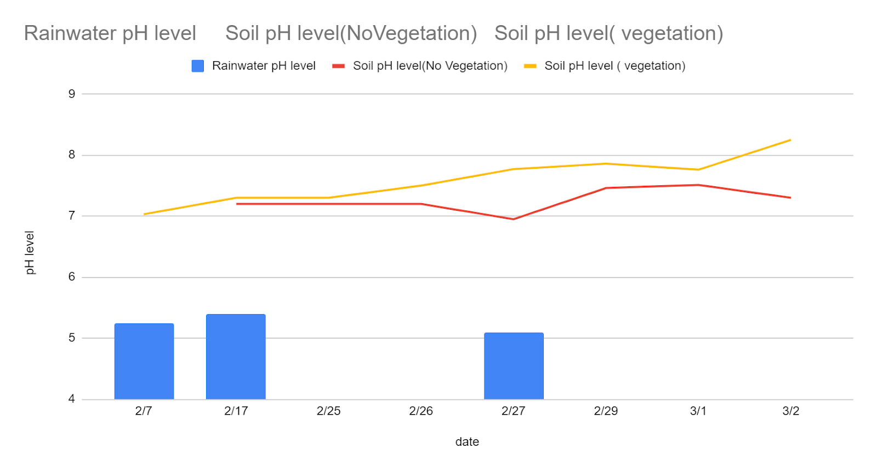
b. After the rain, will the soil pH be different between the vegetation and the uncovered soil? If so, what are the reasons?
(a) The pH value of the site with vegetation is higher than that without vegetation, as shown in Figure (5)
Figure (5)

Slide 14
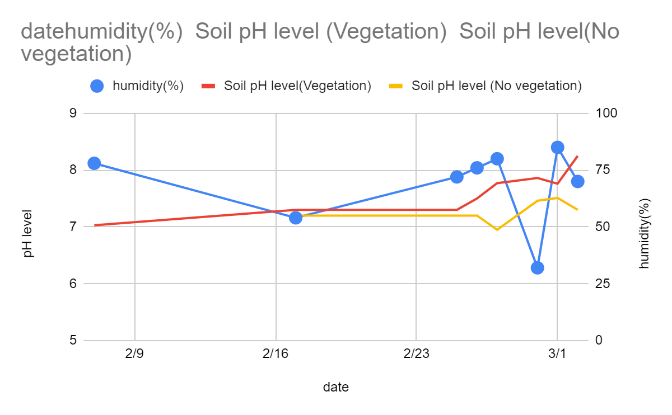
(b). When the humidity increases, the pH value of the vegetation increases but the vegetation decreases, as shown in Figure (6).
Figure (6)

Slide 15
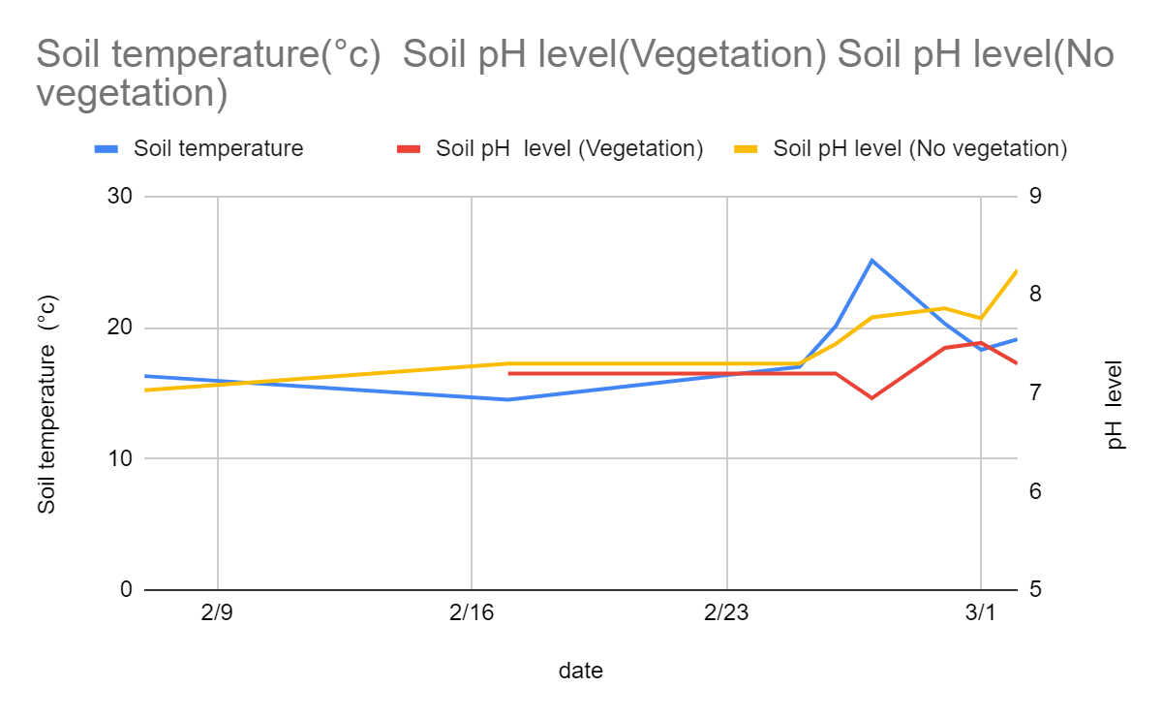
(c). When the temperature rises
The pH value of no vegetation decreases and the pH value of vegetation increases, as shown in Figure (7)
Figure (7)

Slide 16
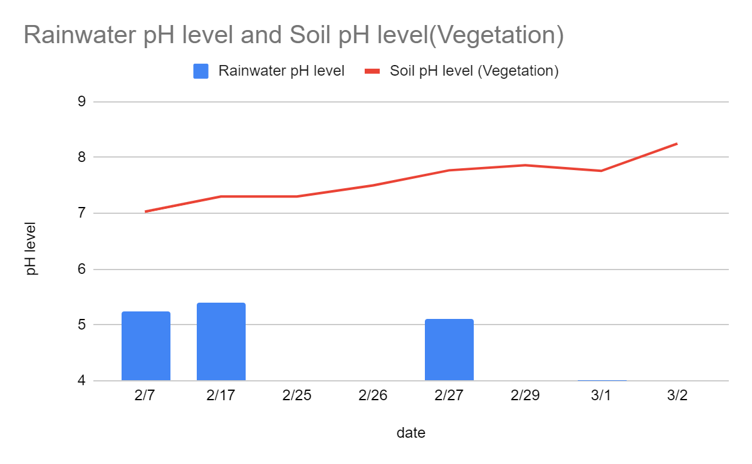
(d). Although the water is acidic, the pH value of the soil after rain has been slightly increased, as shown in Figure (8).
Figure (8)

Slide 17
5.Conclusion
The place with vegetation does show a more alkaline response. According to the literature, we speculate that the soil may have a microbial reaction, or it may be like the concept of a "buffer solution" in our high school textbook. According to the literature, the soil contains a buffer. Substances are compounds such as clay particles, organics, carbonates, and phosphates in the soil. They can be replaced with hydrogen ions in the soil solution, so that the pH of the soil will not change significantly. It may also be due to the type of soil, particle size, and humidity degree of influence. These experiments will be included in observations in the future. Next, we will also use telemetry to compare the differences in image shooting caused by different soil concession layers, and study why the soil may return to alkaline.

Slide 18
6.Bibliography / Citation
a、基隆地區年平均pH值。中央氣象局https://www.cwb.gov.tw/V8/C/
b、黃至亨等(2003)當植物遇到酸雨。中華民國第四十屆中小學科學展覽參展做品專輯，pp26
三、林欣靜 、林格立（民 98年 11月）。天堂來的眼淚──無所不在的酸雨危機台灣光華雜誌https://www.taiwanpanorama.com.tw/Articles/Details?Guid=99e94d41-ad06-4200-b31e-0bbefa37f962&CatId=4
c、洪正峰等(2002)科展行動研究--酸雨對土壤酸鹼性的影響
https://www.greenschool.moe.edu.tw/gs2/partner/item.aspx?k=B8F1BED6FEFEAF4DE5D3A68FFCAEEEEA
d、GLOBE(2014),Soil pH Protocal, https://www.globe.gov/documents/352961/8de1fc2a-dc4e-41c5-a5d9-985865b0d67f, pp9.
e、孫岩章(2004)環境污染病害之診斷與因果之鑑識pp64
f、土壤緩衝物質。國家教育研究院辭書http://163.28.84.216/Entry/Detail/?title=%E5%9C%9F%E5%A3%A4%E7%B7%A9%E8%A1%9D%E7%89%A9%E8%B3%AA&fbclid=IwAR2W-xPMCoHo1n8nTYhqcDnrS0rS-xuRrt0Ma3HOacZIJ8Rfm8HnMnrYIEY
g、林耀東(2015.7) 土壤淨化和緩衝功能p16-17

Slide 19
Thank you!

