Slide 1
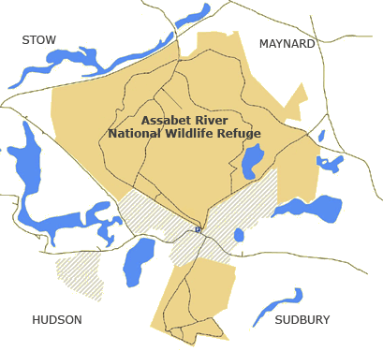
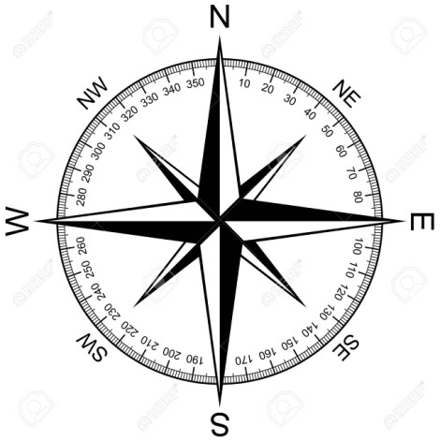
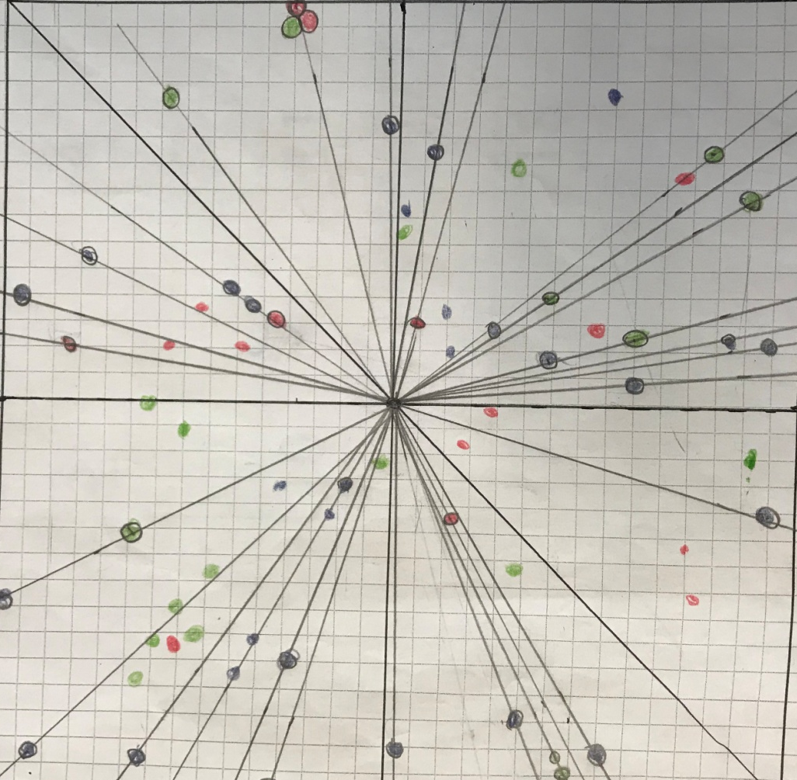
Evaluation of the Carbon Cycle in our school
Grace Charron, Matthew Cloutier, Virginia Crossland, Elizabeth Freeman,
Alyssa Ray, Talal Siddiqui and Lily Weber.
Maynard High School
Abstract
Research Methods
Results
Discussion
Consumption of electricity, pollution due to transportation and industrial manufacturing, and deforestation are major contributors to the human carbon footprint. To understand more about the Carbon Cycle in our area, we posed this question: how does the uptake of carbon by schoolyard vegetation compare to the emissions of carbon by the school? We set-up a site right outside of our school to estimate carbon content of the forest around us and investigate the electricity consumption of our school. We found that despite a large forest area near our school, it may not be enough to compensate the large amount of CO₂ produced by our school system. We want to pursue our study to advocate for the protection of our wildlife.
Our Maynard Research club performed experiments in the woods outside of Maynard High school. In Maynard Massachusetts, our climate consists of hot summers and cold winters but we did our experiments over the course of April and May of 2019 during which it was warm and rainy out.
To properly conduct our experiment, we marked off and measured an square area with a 30M side by first measuring a specific distance in the classroom and then finding the average amount of steps it took us each to travel that distance. We then used this information to calculate how many steps we would need to take to mark off the area of our experiment and the middle point in the square area. After finding the plot of land we would be using, we used a compass on an iPhone to record the azimuth and the coordinates of all of the trees in the marked off area. Finally, we created a system of measurements. The system we used allowed us to easily measure the distance of a tree from the center of our plot. All of our measurements were taken after school around 2:30.
In order to know if the uptake of carbon by our schoolyard vegetation was enough to compensate for the emissions of carbon by the school, we started by evaluating the type of vegetation present in our standard site. We determined that we had over 90% of coverage by trees and shrubs that saplings. The herbaceous component was minimal.
The shrubs biomass was first assessed by calculating the percent cover by both evergreen and deciduous shrubs/saplings following the globe protocol. We then calculated the average height in M for both deciduous and evergreen shrubs/saplings
In order to understand the movement of carbon and how it is stored we have started to explore the potential source of carbon absorption around our school. Maynard High school is located in a special area on the border of the Assabet River national wildlife Refuge. There are over 470 acres of diverse wetland habitat including an Atlantic white cedar swamp.
To date, biological surveys have identified over 650 plant species, 135 bird species, 25 mammals, 17 reptile species and 19 species of fish. In addition to this fortunate location, our building is less than 10 year old and considered a green building. But when we started to investigate the carbon emission of our brand new building we were shocked by the data. The table shows the data we collected from our electricity meter. Using a green house gas equivalency calculator from the environmental Protection agency (EPA), we estimated that our school was producing 8.2 metric tons of CO2 per hour (https://www.epa.gov/energy/greenhouse-gas-equivalencies-calculator).
This alerted us!
Shrub Biomass
Research Question
The Global Carbon Cycle is how carbon is moved through the atmosphere, land, and oceans. Carbon is one of the most common elements on the planet; it can be found in living things, the atmosphere, soil, oceans, and the Earth. The Carbon Cycle is important for the survival of ecosystems along with the climate system of the Earth. By understanding the movement of carbon and where it is stored, we can further understand how the element is impacting climate change. Places where carbon is stored, like fossil fuels and plants, are called Carbon Pools. Carbon Fluxes are the movements of carbon between pools, such as photosynthesis and deforestation. To understand more about the Carbon Cycle in our area, we posed this question:
how does the uptake of carbon by schoolyard vegetation compare to the emissions of carbon by the school?
To acquire our information about the trees, we used a string that had a knot every meter and a tape measure. We used the string by having one person hold one end at the center, and then having another person hold it at the tree, we then counted the knots, and used a ruler after the last knot. To record the trees we started at North, and then rotated to the right, we repeated this process until the entirety of the trees were documented. The Trees were found as far as 19.4 meters and as close to the center as 0.8m. Next, we measured 137 cm up from the ground on the trees. With this measurement, we used a tape measure and wrapped it around a tree to obtain a tree’s circumference that ranged from 254 cm to 26 cm. Examining the shrubs, however, was an entirely different process. To measure the shrubs, we took two steps and then measured the heights of the shrubs that were stepped over. For this process, we used a meter stick, to measure the shrubs. The average height of the shrubs was 0.62m.
Percent cover of shrubs and saplings are plotted on this graph. Data was collected by moving from the center of our site to the 4 corners and recording miss or hits by evergreen or deciduous shrubs or saplings
Average sizes of shrubs and saplings are plotted on this graph. Data was collected by moving measuring each hits with a meter stick
The high school is the most efficient building of our school system; the middle school and the elementary school are on the same site and are much older buildings. Based on this observation we started to investigate the potential of carbon absorption by the Assabet River national wildlife Refuge which line all three school buildings as shown by the picture of Maynard public school taken from Google map. Biomass is a measure of biological matter, customarily expressed in weight. The biomass of a forest is a complex topic that includes all organisms, trees, fungi, insects, and so forth, and is beyond the scope of this study (Chapter 11, Biomass and utilization of trees). We started to focus on biomass of trees. Since trees have substantial moisture content, we first estimated the dry weight of the tree present on our site. From this data following the globe protocol we evaluated the carbon content of two species of tree, the white oak trees and the Eastern white pine. Our site also had a significant number of Downy Hawthorn trees and shrubs, but we were not yet able to evaluate their dry masses. The pine trees around our school store 4413.007g of Carbon per M2. The oak trees store 5348g of carbon per M2. In addition to the tree the evergreen shrubs cover 31% of our site and have an average height of 0.68M, the deciduous shrubs cover 36% and have an average height of 0.56M.
The data for the tree biomass was collected using the globe protocol and the dry biomass was estimated using the website https://apps-scf-cfs.rncan.gc.ca/calc/en/biomass-calculator . The biomass value was then reported for the Carbon content per M² for both the white oak and the Eastern white pine.
Carbon content in tree
Introduction
Everyone leaves a carbon footprint. Even everyday natural processes such as breathing and digestion emit carbon into the atmosphere. This in itself is not a bad thing, as trees and other plants absorb carbon and use it in the process of photosynthesis along with water and sunlight (NOAA). The carbon footprint becomes a problem when there are dense populations of people emitting more carbon than the flora can absorb. Consumption of electricity, pollution due to transportation and industrial manufacturing, and deforestation are major contributors to the human carbon footprint (Buildings and climate change). It’s important to recognize these issues and make a conscious effort to reduce their effect on the planet.
This increase in CO₂ levels directly contributes to climate change. Carbon dioxide is a greenhouse gas, one of the gases that absorbs heat from the sun and traps it within Earth’s atmosphere. Instead of escaping back into space, this heat is radiated back toward Earth causing the planet’s temperature to rise, in what is known as the greenhouse effect. This contributes to other problems, such as rising sea levels due to glacial melting. This could mean major coastal cities all over the world will eventually be underwater, and millions of people will be displaced from their homes. As Earth’s population increases, the emission of greenhouse gases increases as well. More energy is consumed; more cars, planes, and boats are in use; and more trees are cut down to make room for buildings. For every specific building or school, it’s important to understand how much carbon is being emitted compared to how much is being absorbed by the flora in the area. If much more is being emitted than absorbed, steps can be taken to plant more trees and reduce pollution. Our research question attempts to address this problem and become aware of the environment near our school.
Our school is located on the edge of the Assabet River Refuge which comprises over 2,333 acres of varied woodland, wetland, fields, ponds and streams. The terrain is primarily flat. Seventy percent of the refuge is forested with pine and oak. (data from the friends of the Assabet River National Wildlife Refuge: https://www.farnwr.org/index.html)
Carbon content was calculated by taking 50% of the dry mass of each tree estimated with our online calculator. It was then divided by the size of our plot (900M²)
High School CO₂ emission
Electricity consumption ( KW/hour) | CO₂ emission/ (tons/hour) | Reactive energy consumption (KVARh) | Student +personnel number
11596 | 8.2 | 4087 | 421
Conclusions
Despite a favorable location, Maynard public school may still produce more CO2 that its environment can absorb, and our school may be contributing to the increase in greenhouse gas. Our club wants to pursue this preliminary study to establish a full comparison between our carbon emission and the uptake of carbon by the vegetation around us. In the emission side we need to collect data for the two other schools and consider an increase in the consumption during the winter months. We will also estimate the emission due to the personnel and student using car to commute. On the uptake side we need to continue our study to evaluate the carbon content of the Downy Hawthorn trees. We will monitor the changes in our site as far as shrubs growth, sapling turning into tree and changes in tree sizes.
The table show two values from our school electricity meter (the consumption in KW per hours in the first column and the Reactive energy consumption in kilovolt ampere reactive hour in the third column. The CO₂ emission was calculated in tons/hour using an online calculator based on the energy consumption in the second column. The last column show the amount of person in the school every day (students and personnel)
White Oak
Eastern White Pine
Downy Hawthorn
Maynard Public School
Arial view of Maynard Public school from Google map. On this view the high school, the middle school and elementary school are all present. They are all three located on the edge of the Assabet River National Wildlife Refugre
Bibliography
David George Briggs, Forest products measurements and conversion factors. 1994. Chapter 11.
What is the carbon cycle? National Ocean Service-NOAA. 2019 https://oceanservice.noaa.gov
Buildings and climate change, U.S. green building council. 2016
Standard site Carbon cycle protocols- Globe program
We have established a standard site on the border of the refuge right out of the high school at the latitude of 42° 25’15”N degree and the longitude of 71° 27’ 13”W. The elevation is 78.7m. Our site is mainly filled with white oak trees and Eastern white pine. It also had a significant number of Downy Hawthorn trees and shrubs.
We want to thank Larisa Schelkin to introduce us to the globe program and help us start our project. Thanks to the AP BIO students for helping us collect data.

