Slide 1

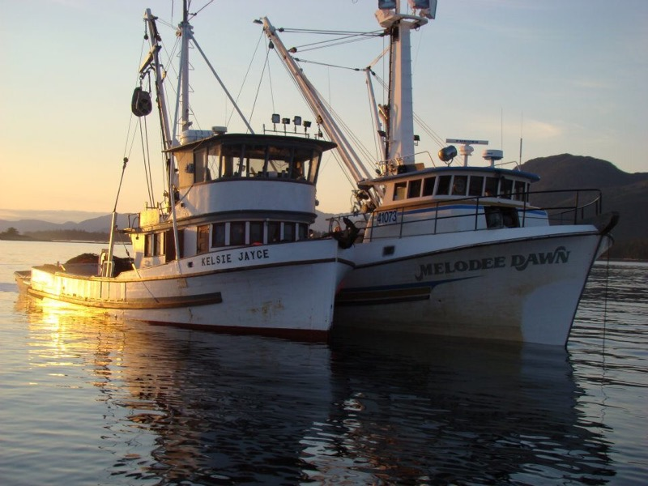
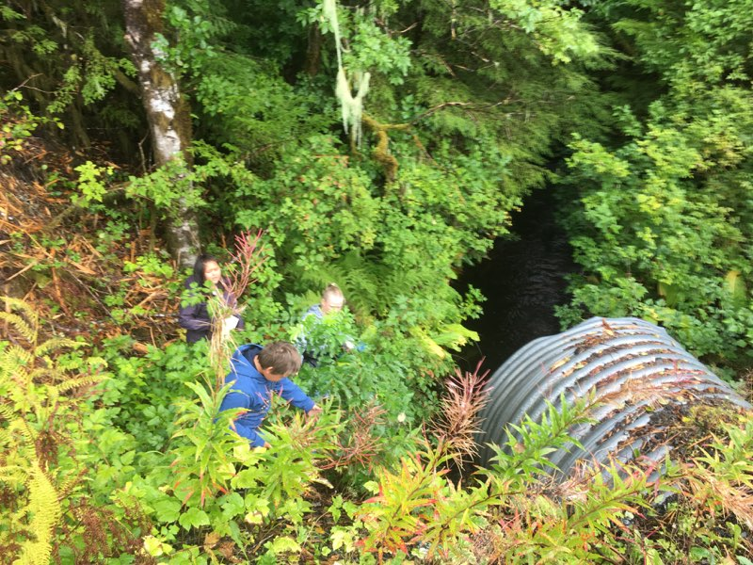
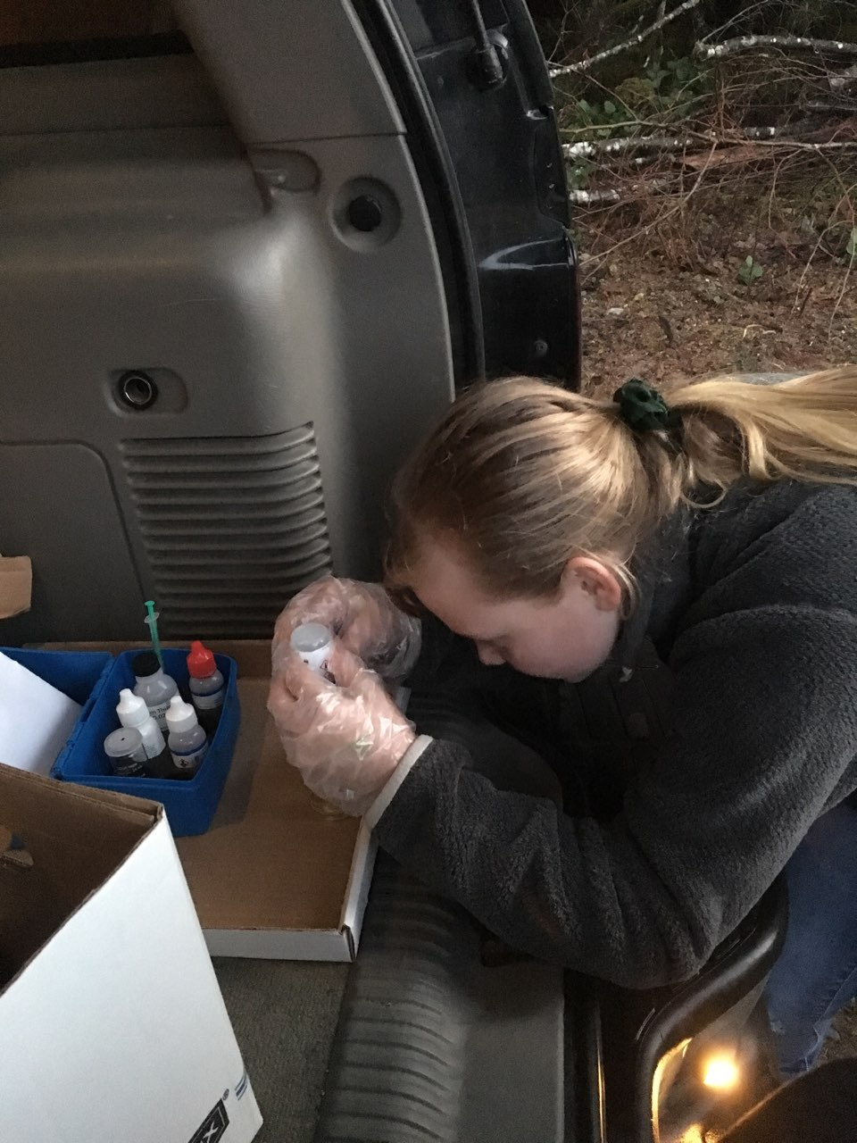
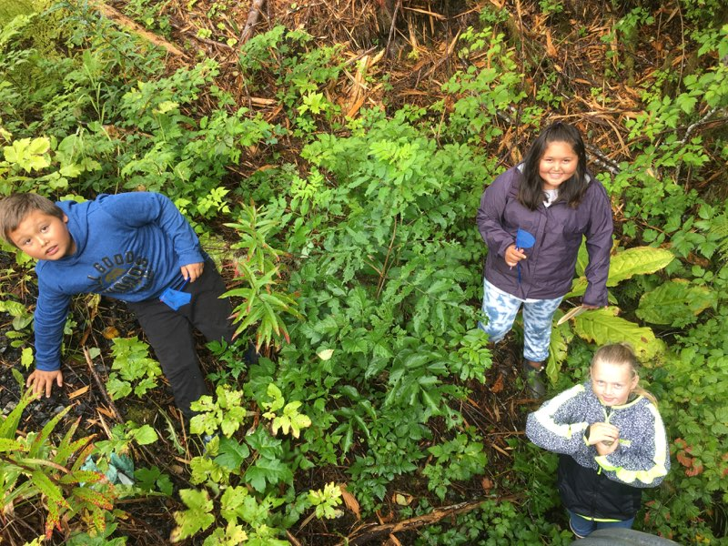
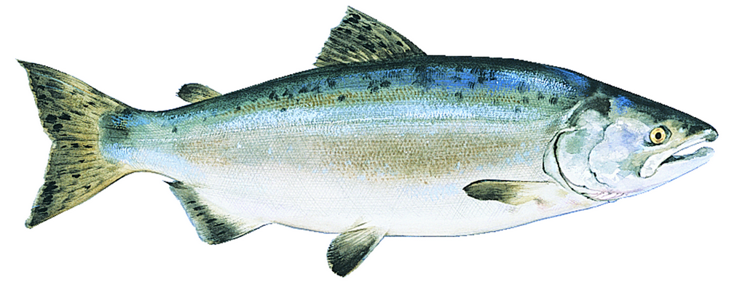
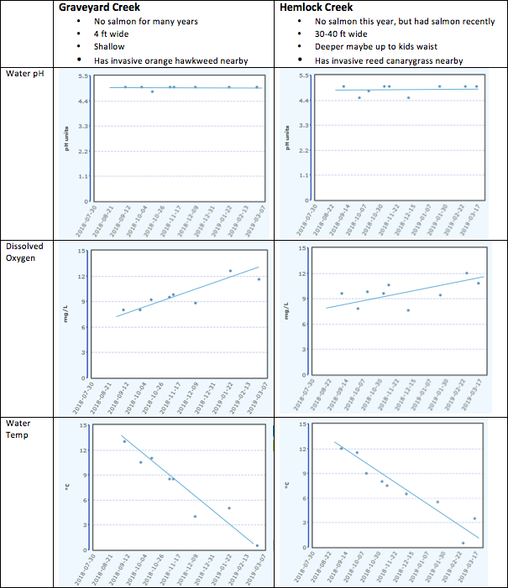
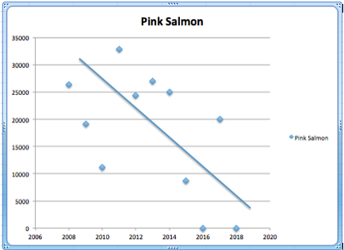
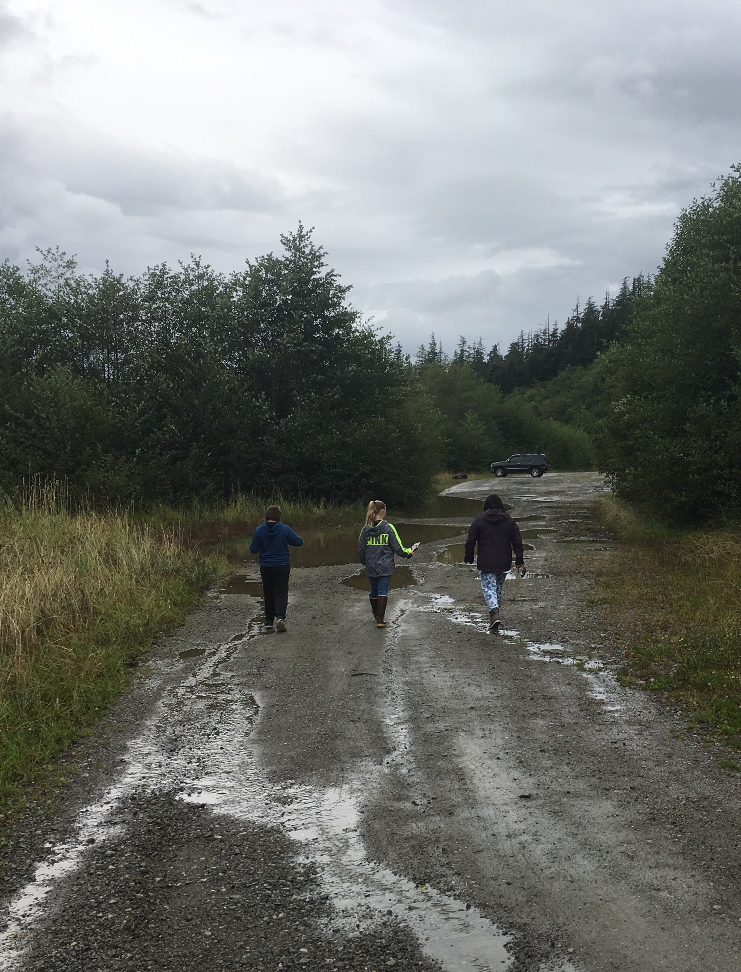
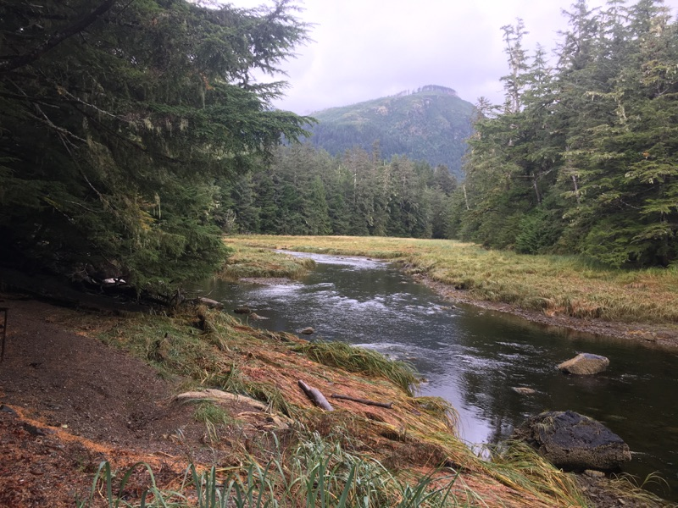
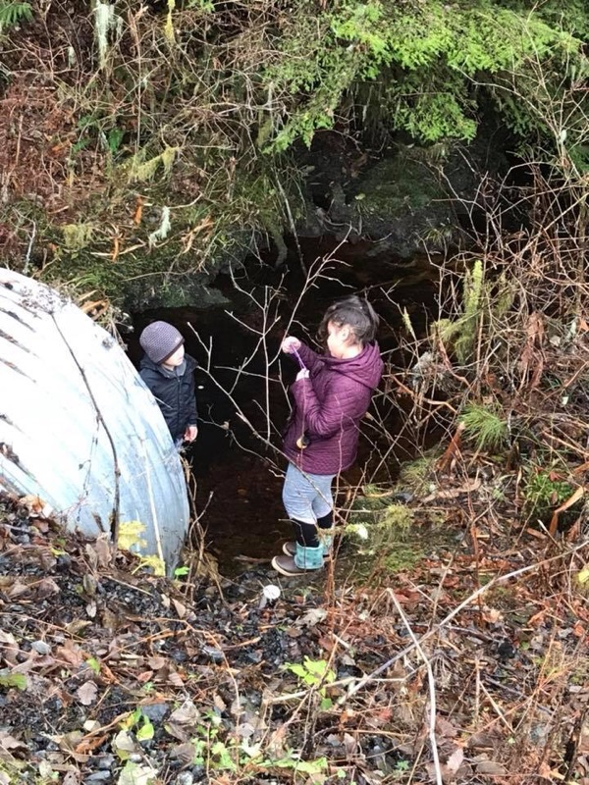
Water Quality and Salmon Return: Water Temperature and Dissolved Oxygen
Michael Duran, Ma’karii Martinez, Mia Winter
Boys and Girls Club of Metlakatla, Metlakatla, Alaska
Introduction
Methods
Discussion and Conclusions
Our fish have been missing. People on our island eat fish. So many people in our families and community are fisherpeople for their jobs. Even people who aren’t commercial or subsistence fishermen eat fish as a part of their diet. We depend on fish! We wanted to know how the water was on different parts of the island, and if it has affected our salmon. In the past Hemlock creek had salmon, but it has decreased a lot. Graveyard Creek had salmon in the past, but not for a very long time. We wonder if the water chemistry and temperature affects the fish.
We sampled water every week at Graveyard Creek and Hemlock Creek on Annette Island, Metlakatla, Alaska from August 2018 to March 2019
We analyzed water samples for Temperature, Dissolved Oxygen, and pH using the GLOBE protocols.
We received salmon return data for Hemlock Creek for the years 2008 to 2018 from the Metlakatla Indian Community Fisheries program.
We looked at our GLOBE data to see if there were any differences in water pH, dissolved oxygen, or temperature between Graveyard Creek and Hemlock Creek. We are waiting for the fish counts for Graveyard Creek and water temperature records of both creeks from the Metlakatla Indian Community Fisheries Program
There was not much difference in pH, dissolved oxygen, or temperature between Graveyard and Hemlock creeks. This is not what we expected to happen in our hypothesis. We thought they would be different because Hemlock has fish returning and Graveyard Creek does not.
When the water temperature decreased through the summer, fall and winter, the dissolved oxygen increased. This is because cooler water can hold more oxygen. Maybe there is something happening other than pH, dissolved oxygen, and temperature that is affecting whether our salmon return to their streams. Maybe there are changes in the habitat like invasive species, or changes out in the ocean, such as pollution, predator increase, ocean temperature changes, or habitat destruction.
In Hemlock Creek, the salmon return bounced up and down. We think this is because of temperature fluctuations in both oceans and creeks.
Questions
Is there a difference in water quality between Hemlock Creek (a creek that has had salmon return) and Graveyard Creek (a runoff creek that hasn’t had salmon for a very long time)?
Was creek temperature related to the salmon returns over the past decade?
Results
Hypothesis
We think that a stream with cooler temperatures and higher dissolved oxygen would be better for fish. We think that Hemlock Creek would have better water for fish than Graveyard Creek because it still had at least some fish coming back.
We think that maybe the water has changed through time in Hemlock Creek and is affecting how many fish come back.
Next Steps
We still wonder if the fish return will improve by the time we are adults.
We could improve the project by collecting more data to compare, participating in fish counts, cleaning more around the creeks, and removing invasive plant species.
Our next steps will be to remove invasive species and learn to seed salmon eggs in the creeks to improve fish return.
Hemlock Creek Fish Count from the
Metlakatla Indian Community Fisheries Program
Acknowledgements
Hemlock Creek (above)
Graveyard Creek (right)
We used the GLOBE hydrology protocols and got our GLOBE data graphs for our sites from the GLOBE website (globe.gov). We thank the Metlakatla Indian Community Fisheries program for giving us the fish count data for Hemlock Creek. We thank Brandi Patterson and Crystal Barajas who came out to monitor the sites with us.
We thank Ms. Sesilynn Schleusner, our club manager, for helping us do this project at our Boys and Girls Club of Metlakatla. We thank Dr. Katie Spellman and Dr. Elena Sparrow at the University of Alaska Fairbanks for talking with us about our data and helping us practice our presentation. Funding for our work and travel is from NASA Arctic and Earth SIGNs project at the University of Alaska Fairbanks and NSF INCLUDES program at University Corporation for Atmospheric Research and our Boys and Girls Club fundraisers and GLOBE Regional Student Research Symposium.

