Slide 1


Investigating The Effect Of Trees On Indoor Environment Conditions: A Case Study Of The University Basic School, Legon

Slide 2
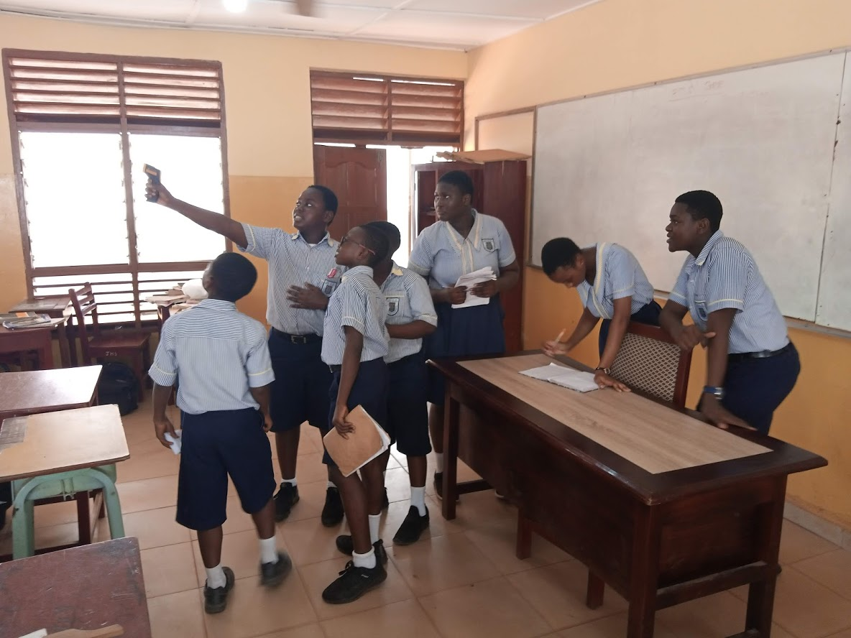
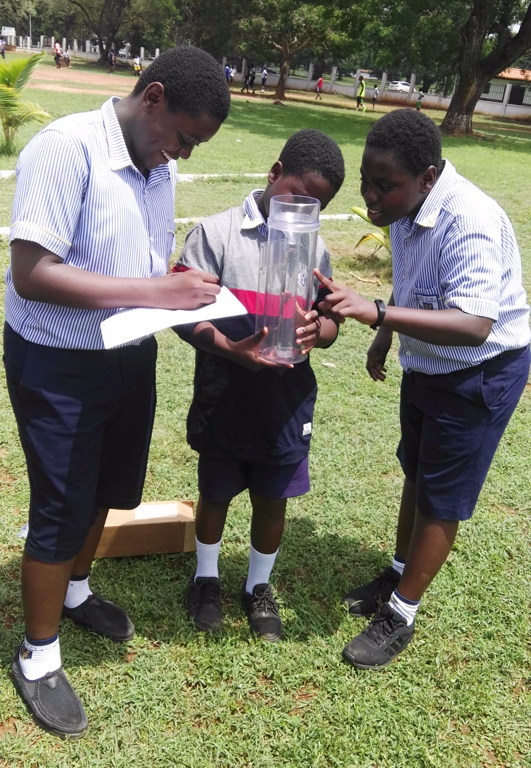
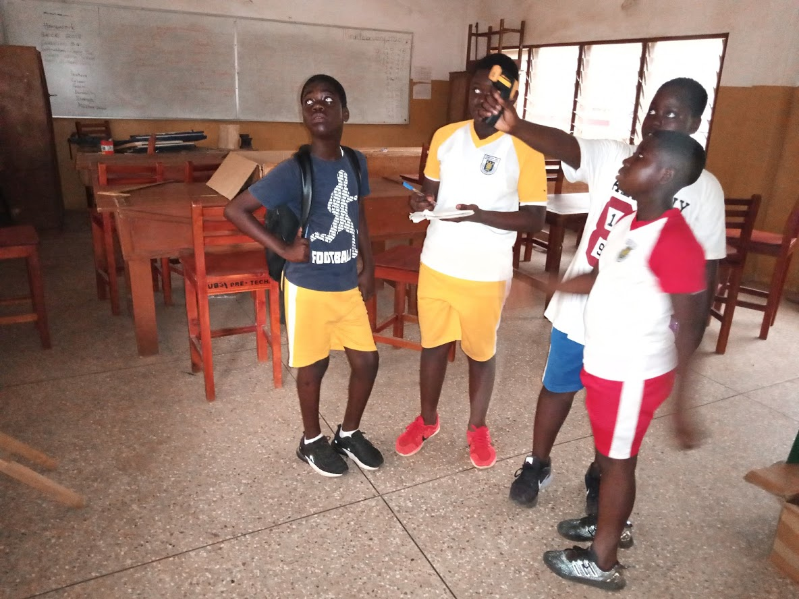
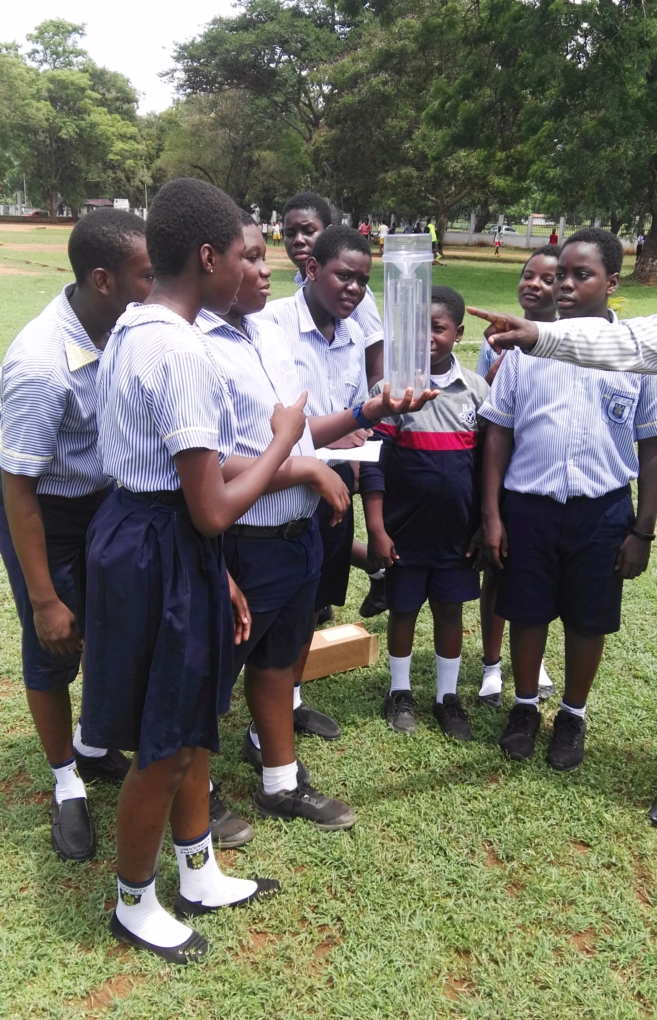
Research questions
Have trees any effect on the on the Indoor environment conditions in a building?
To what extent would the atmospheric conditions of the outdoor environment impact on the comfort of the inhabitants.
Have trees any effect on the on the Indoor environment conditions in a building?
To what extent would the atmospheric conditions of the outdoor environment impact on the comfort of the inhabitants.

Slide 3
A Comparison of surface temperatures

Slide 4
A Comparison of Ambient temperatures

Slide 5
Discussion
The above graphs, indicate that, atmospheric conditions in the two classrooms i.e. A and B differ. Classroom A recorded a slightly lower temperature that classroom B during all the days under observation. the surrounding outdoor environment recorded relatively lower surface and ambient temperatures than classrooms A and B.

Slide 6
Conclusion
From the forgone, it can be concluded that; the outdoor environment has some effect on the indoor environmental conditions in a building. Thus, it could be said that the fact that the trees surrounding classroom a contributes significantly to the indoor environmental condition and comfort of its occupants hence a strong case can be made here for afforestation.

Slide 7
Thank
You
someone@example.com

