Slide 1
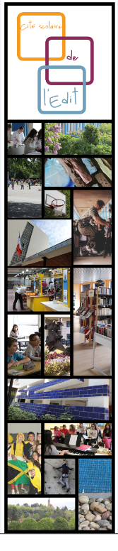


Air quality in chemical valley
LGT de l’Édit – ROUSSILLON

Slide 2
SUMMARY
Introduction : local context
II. Theory
III. Why we did it
Scientific plans
V. Our results
VI. Understanding our results
Conclusion
And after

Slide 3
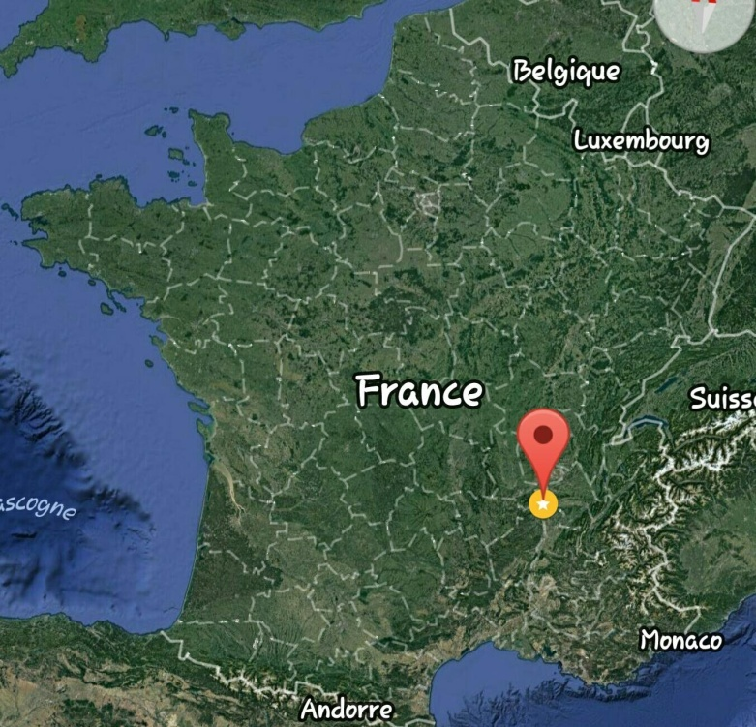
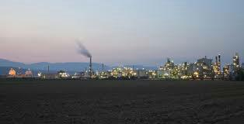
I. Introduction : local context
CHEMICAL VALLEY
HIGHWAYA7
L’ÉDIT’S POSITION

Slide 4
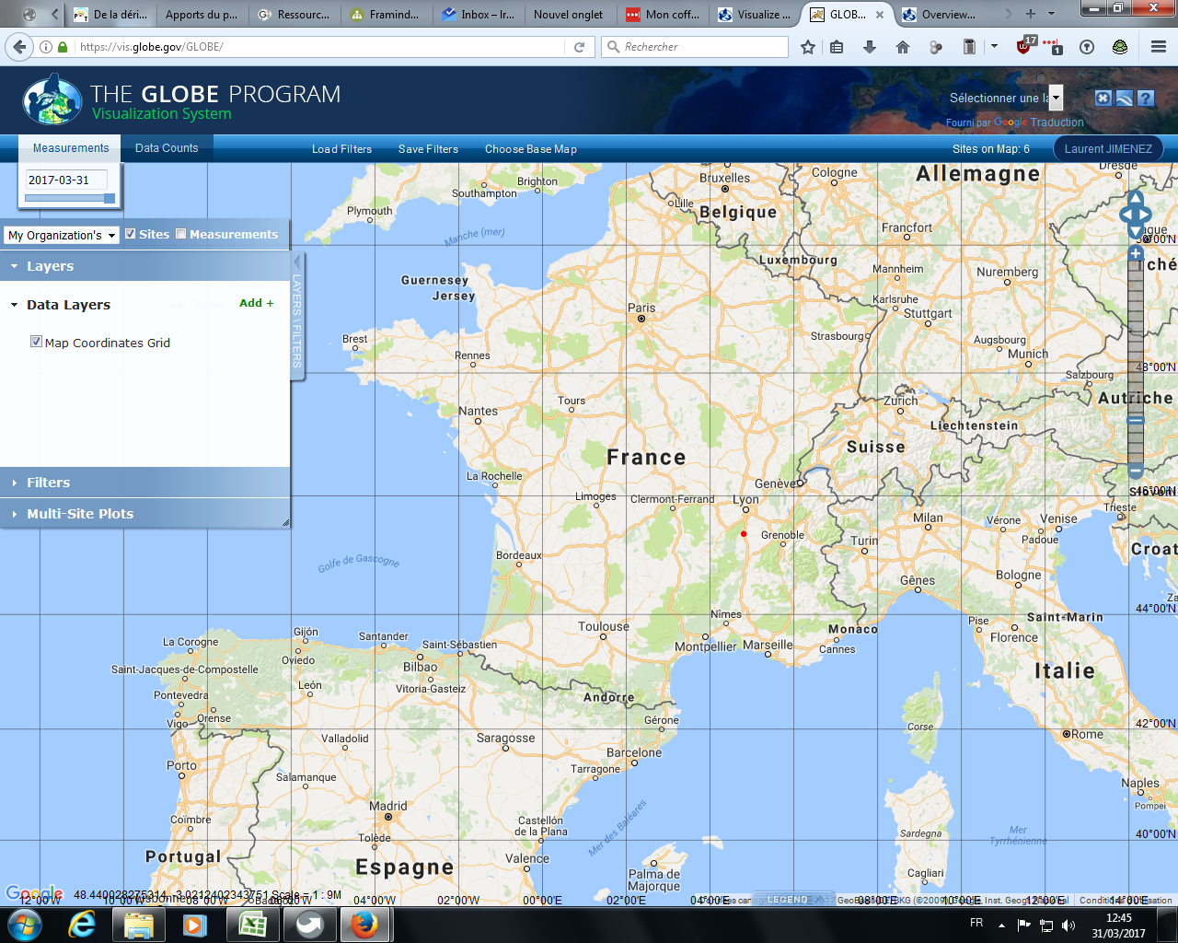
Technical characteristics
Technical characteristics
vcv

Slide 5
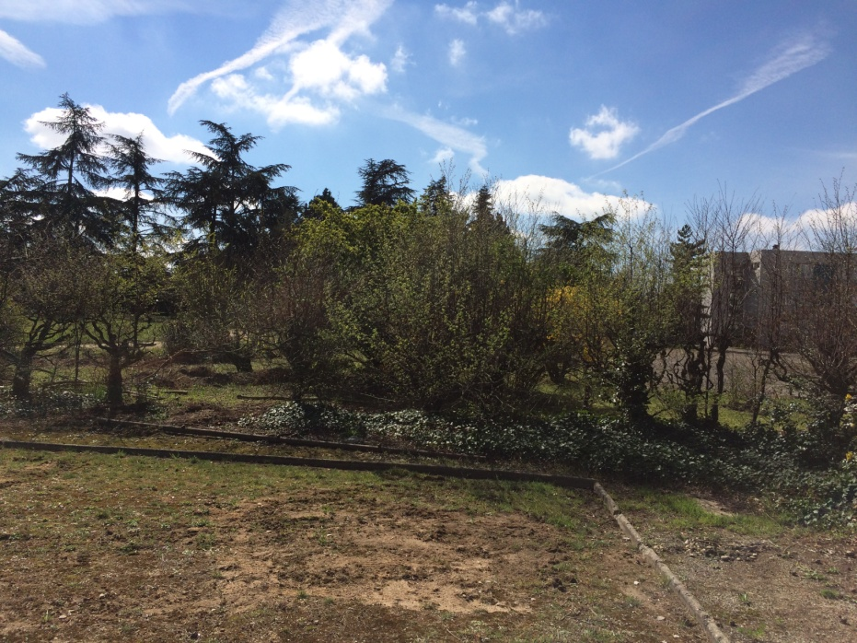
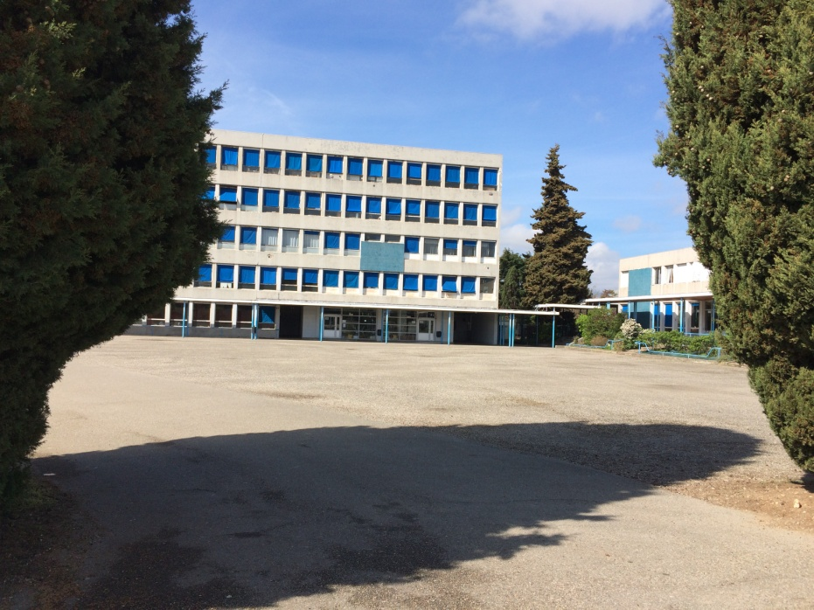
I. Introduction : local context
SCHOOLYARD OF L’ÉDIT

Slide 6
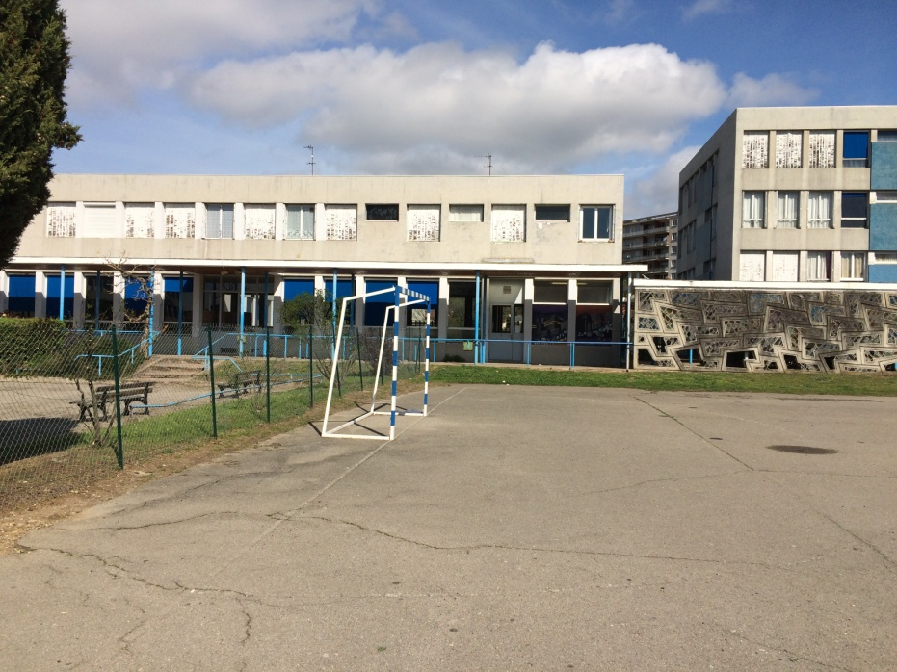
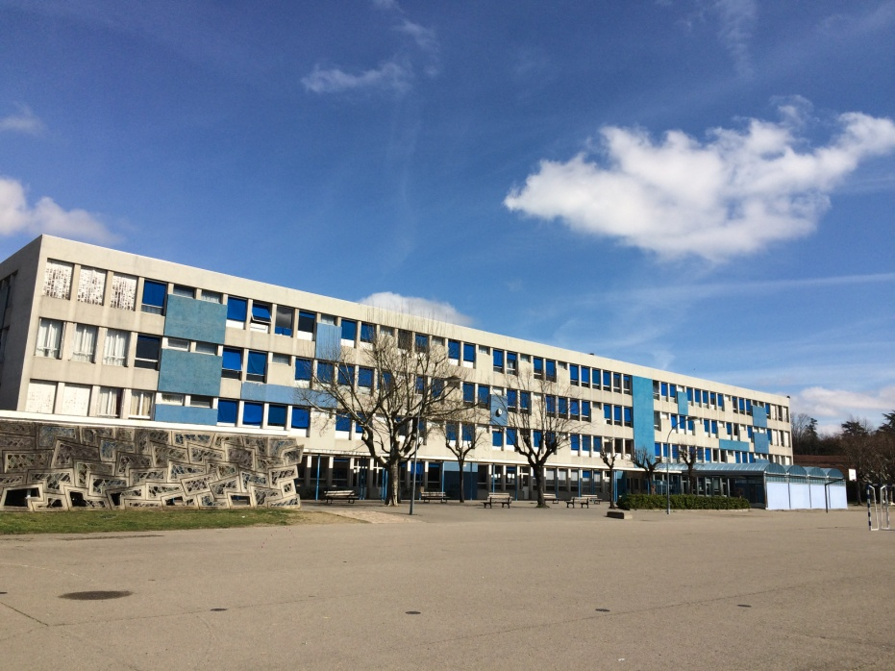
I. Introduction : local context
SCHOOLYARD OF L’ÉDIT

Slide 7
II. Theory
HOW CAN WE EXPLAIN THE PRESENCE OF FINE PARTICULE IN ROUSSILLION ?
We will ask ourselves if it can be caused by the presence of FACTORIES .

Slide 8

III. Why we did it
we did it because we were looking for a reason to understand when there is pollution

Slide 9
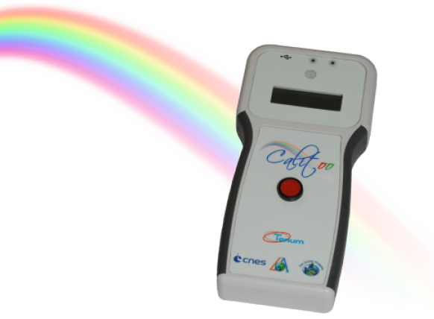
IV. Scientific plans
We measure the optical thickness and it gives us the type of particles (Fine, thick).
We use a device which was lent to us by the CNES, its name is the calitoo.
Notes:
9

Slide 10
IV. HOW IT WORKS
Calitoo is a photometer used to determine the level of aerosols present in the atmosphere and to characterize their size distribution (smoke, polluting gas, ice crystals, dust).
To do this, it measures the optical thickness of the atmosphere at different wavelengths: blue (465nm), green (540nm) and red (615nm).

Slide 11
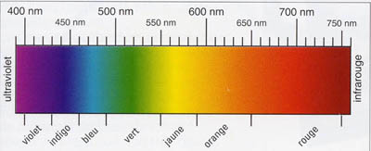
IV. Solar spectrum

Slide 12
IV. Technical characteristics
- Measuring channels: 465, 540 and 619 nm
- 999 possible measurements in memory
- Immediate optical thickness calculation
- USB data transfer
- PC software included
- Power supply: 4 x 1.5V AA batteries
Dimensions: 210 x 100 x 35 mm - Weight: 400 g (With batteries)
- Operating Temperature: -20 ° C to + 55 ° C

Slide 13
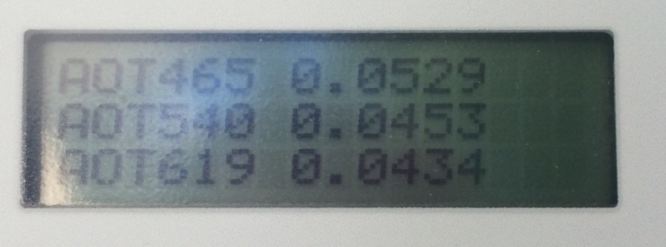
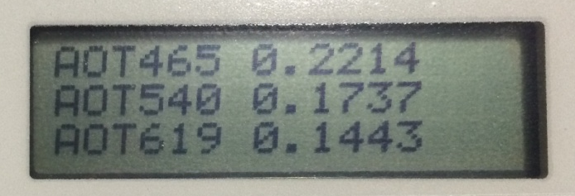
V. Our results
-Not easy to make readings, many clouds around noon (sky more clear in the morning) - Our results are between 0.2 and 0.005

Slide 14
V. Our results
WE HAVE often a "veil" cloudy when one is in high school
Sometimes we find ourselves as in the big polluted cities ...

Slide 15

V. Our
Results
we file our results on globe.gov - We use an application

Slide 16
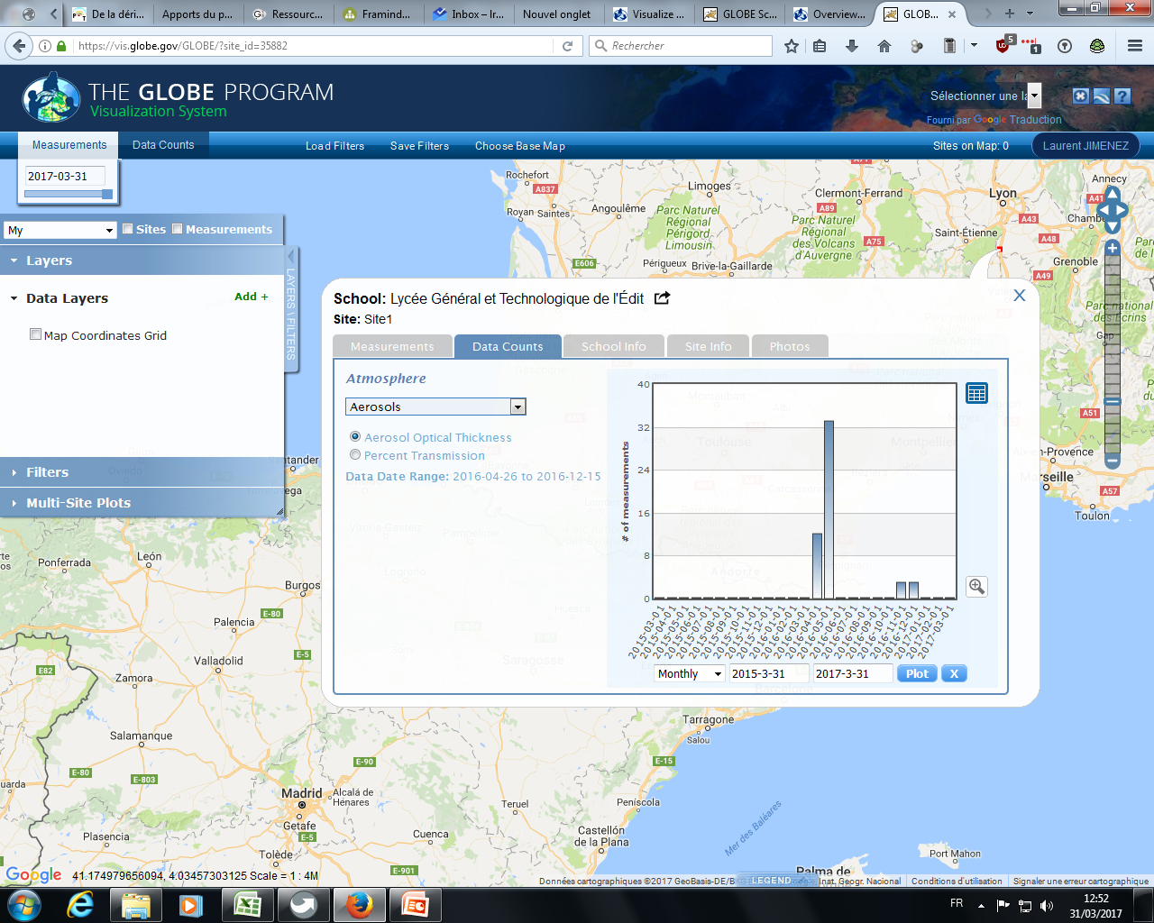

Slide 17
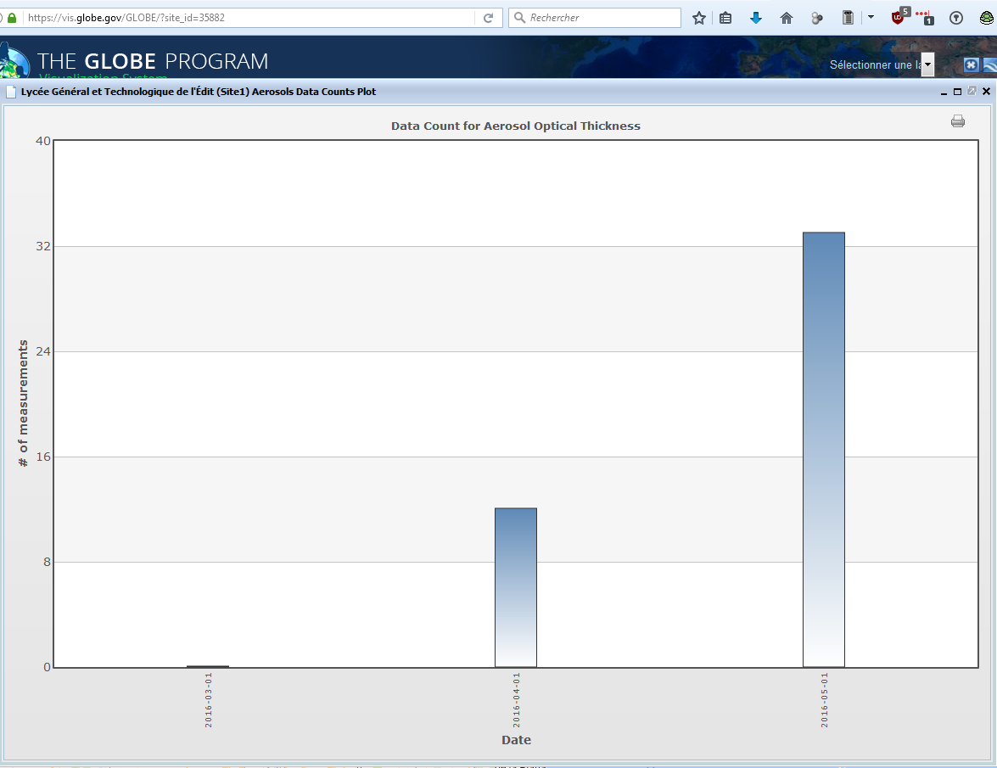

Slide 18
VI. Understanding our results
we did it to simulate the presence of fine particules in the airPlace more particles or fine months (flour, starch paste) in front of the calitoo to check that the coefficient of Ångström changes.
Becher
light

Slide 19
Since 1958, the « Pollution atmosphérique, climat, santé, société » journal has been active in the circulation of scientific knowledge concerning air quality, its consequences on climate change, its impacts on health and a growing social awareness. Digitized since 1992, more than 1.000 articles are available on-line…
The journal, ranked A by the AERES (Agence d’évaluation de la recherche et de l’enseignement supérieur), has an editorial board and a scientific committee.
Articles are published in English or French. Summaries, key words and illustrations captions are available in both languages.

Slide 20
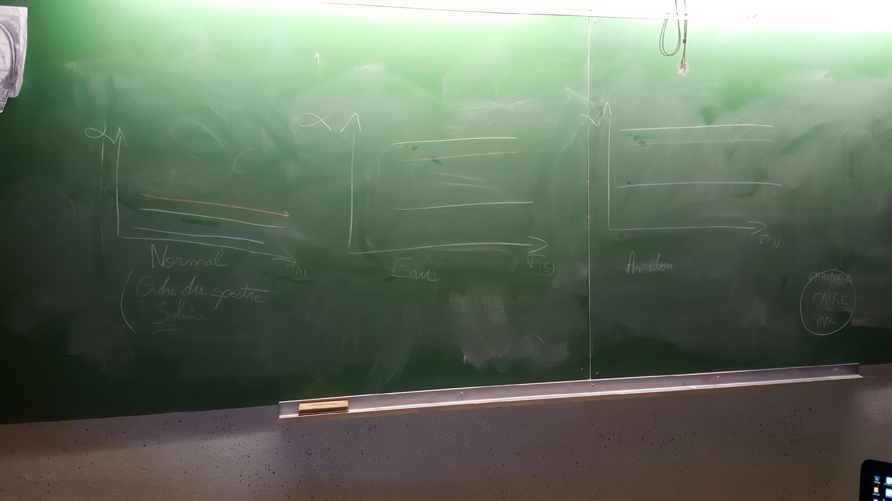
VI. Understanding our results ... not very conclusive, manipulation to resume
INITIAL STATE

Slide 21
VI. Understanding our results ... not very conclusive, manipulation to resume
FINAL STATE
WITH WATER

Slide 22
VI. Understanding our results ... not very conclusive, manipulation to resume
FINAL STATE
WITH STARCH

Slide 23
Conclusion
We made several surveys and found that in Roussillon we were most often polluted with fine particles Moreover, we are located in the Rhone Valley, which intensifies the parking phenomenon and therefore concentration of fine particles produced by local factories and the motorway that is behind the school city.

Slide 24
And after…
Continue the measures Resume our
manipulations Compare our
results with satellite data

Slide 25
LOUIS MOTRET
CAROLINE SOTTY
SOLENNE RIVELLINI

