Slide 1
Does global warming affect the temperature of the Drava River?
STUDENTS: Maja Hozjak, Katarina Hozjan, Nika Sraka
MENTORS: Valentina Pirc Mezga and Maja Labaš Horvat
High school Prelog, Prelog

Slide 2
INTRODUCTION
14th national competition
big problem: global warming
project goal: find out whether air temperature affects water temperature

Slide 3
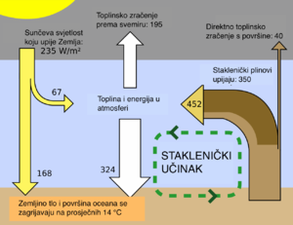
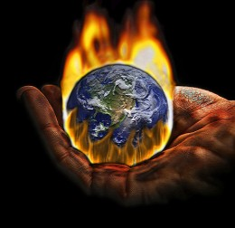
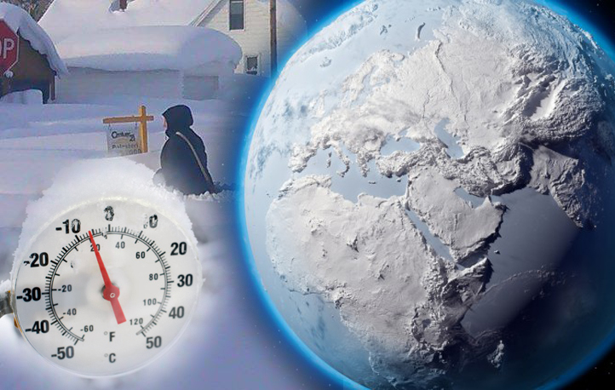
GLOBAL WARMING
the gradual warming of the Earth's surface and the lowest layers of the atmosphere caused by the greenhouse effect

Slide 4
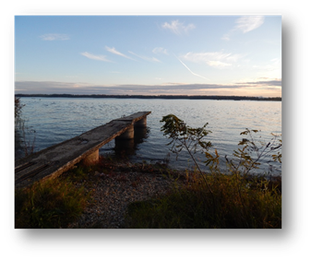
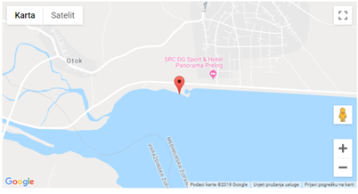
PRELOG MARINA
our measuring station along the Drava River
coordinates: latitude 46.3234 N, longitude 16.6044 E

Slide 5
RESEARCH QUESTIONS
1. Has the water temperature at our station increased at the same rate with the air temperature and what has been the average increase in water temperature in the last 7 years?
2. Did the changes in the water level of the Drava affect the change in water temperature?

Slide 6
HYPOTHESIS
the water temperature will change more slowly, but will still follow the rise in air temperature
the lower the water level, the higher the water temperature will be
each year the average water temperature will be higher

Slide 7
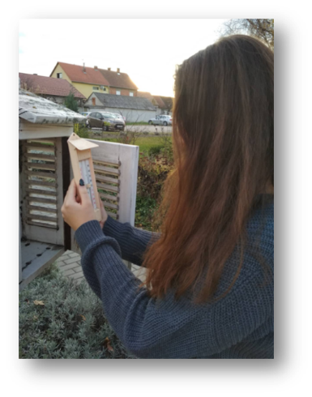
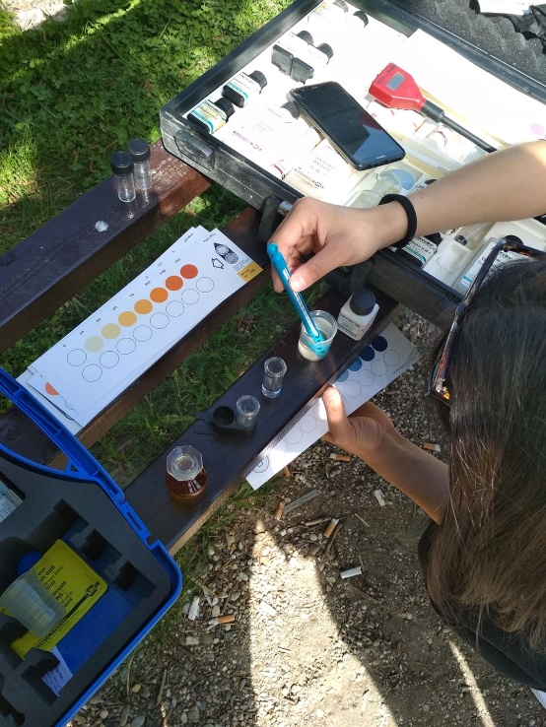
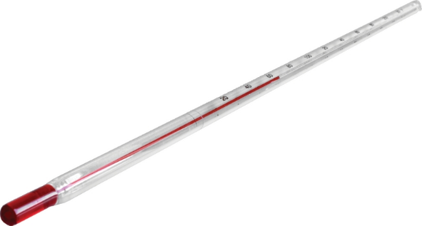
RESEARCH METHODS
GLOBE water protocols
DHMZ
comparison of air, water and water temperature data for the last 7 years

Slide 8
DATA SHOWING AND ANALYSIS
YEAR | 2012. | 2013. | 2014. | 2015. | 2016. | 2017. | 2018.
AVERAGE WATER TEMPERATURE (°C) | 11,6 | 9,63 | 9 | 9,16 | 9,35 | 9,29 | 9,37
TOTAL(°C) | 9,63
Average water temperature in the last 7 years

Slide 9
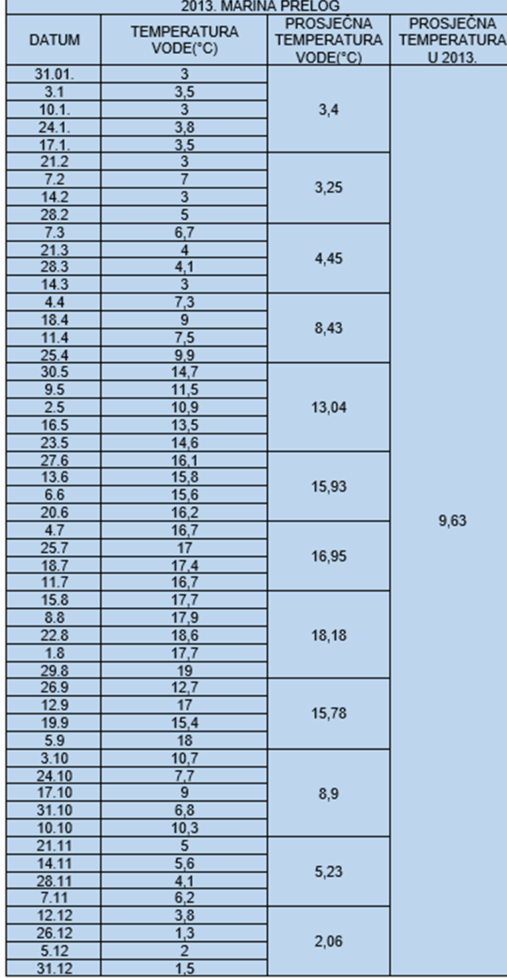
Average water temperature in 2013

Slide 10
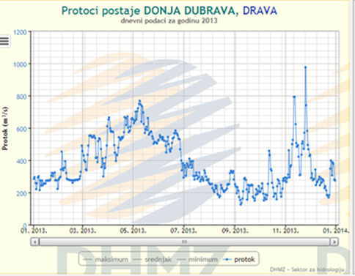
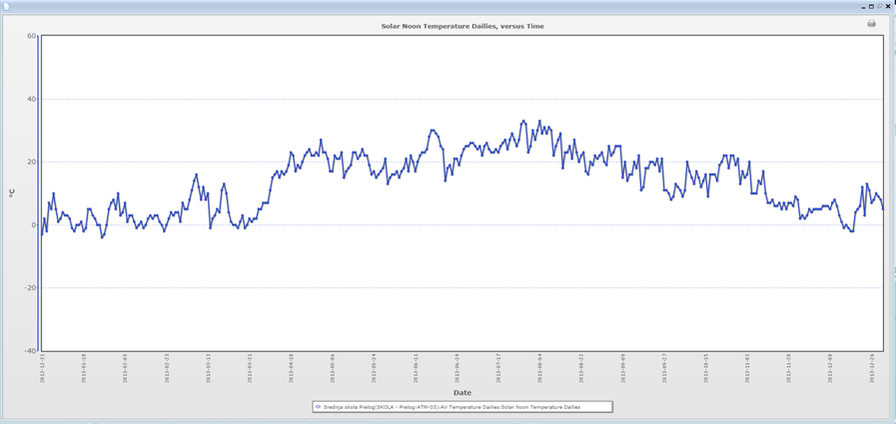
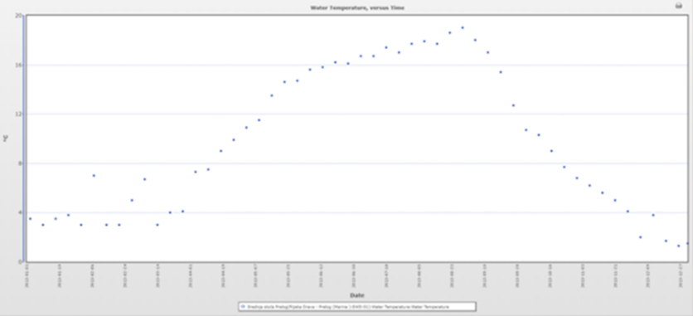
Drava River water level in 2013
Air temperature in 2013
Water temperature in 2013

Slide 11
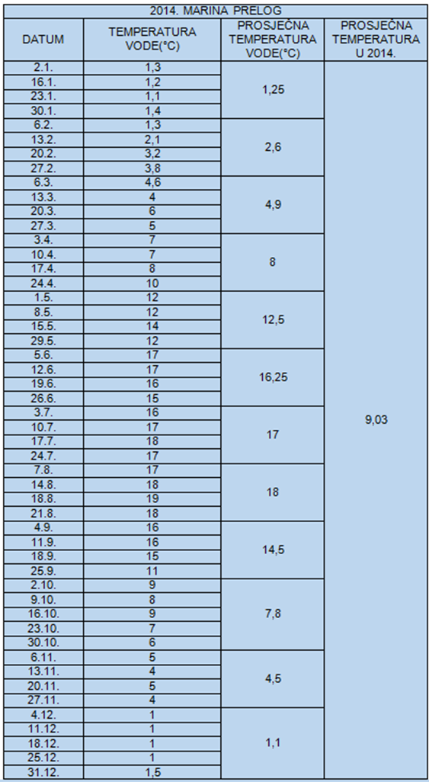

Average water temperature in 2014

Slide 12
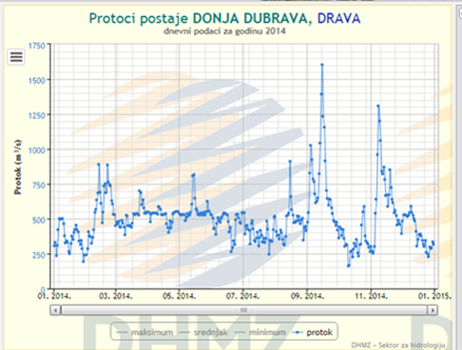
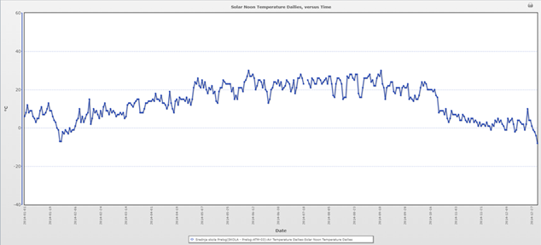
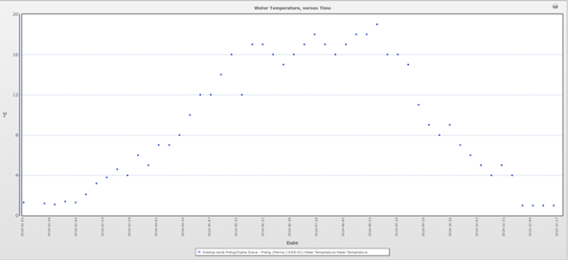
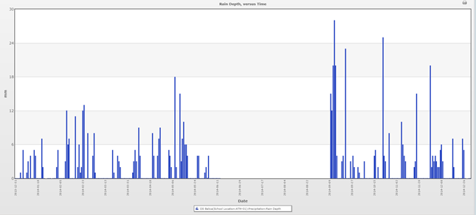
Drava River water level in 2014
Air temperature in 2014
Water temperature in 2014
Rainfall in 2014

Slide 13
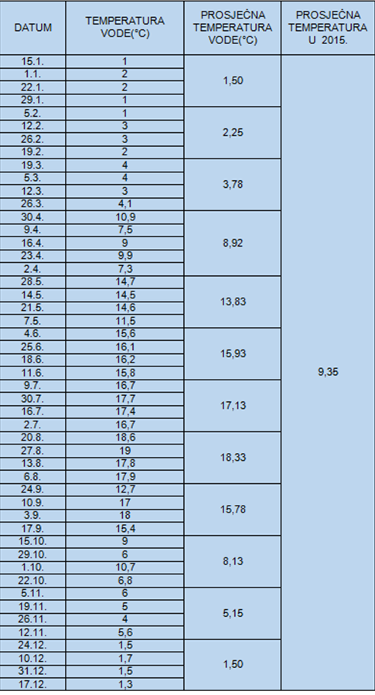
Average water temperature in 2015

Slide 14
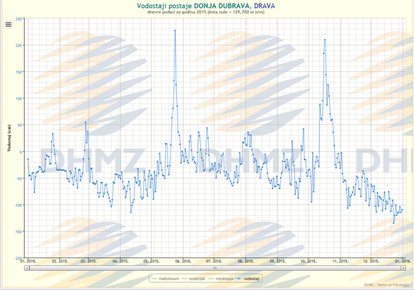
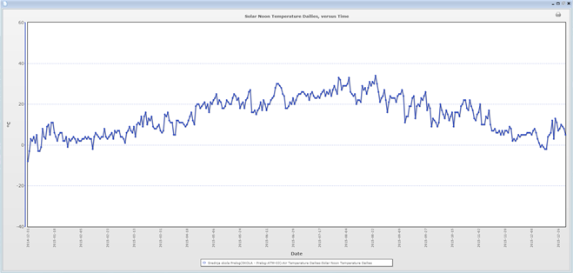
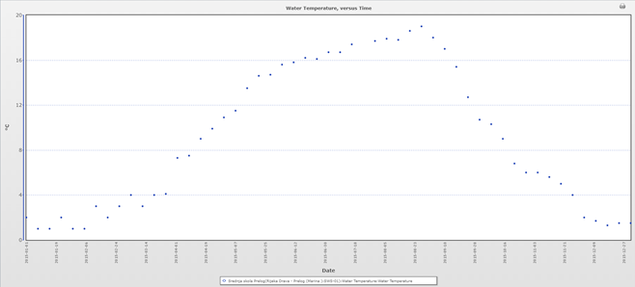
Water level of Drava River in 2015
Air temperature in 2015
Water temperature in 2015

Slide 15
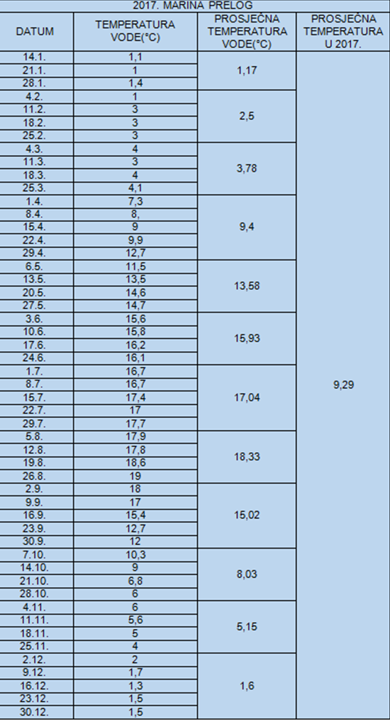
Average water temperature in 2017

Slide 16
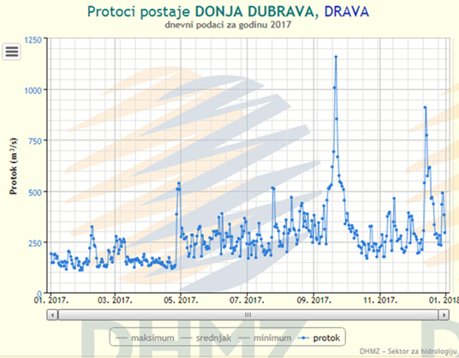
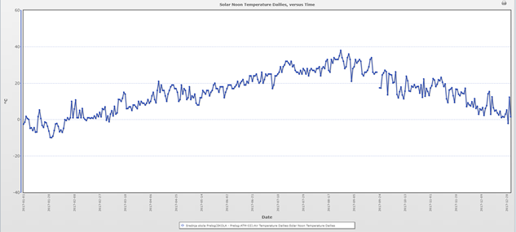
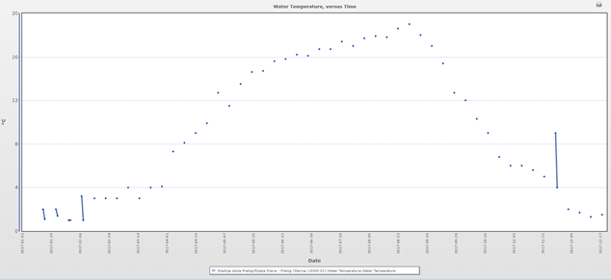
Drava River water level in 2017
Air temperature in 2017
Water temperature in 2017

Slide 17
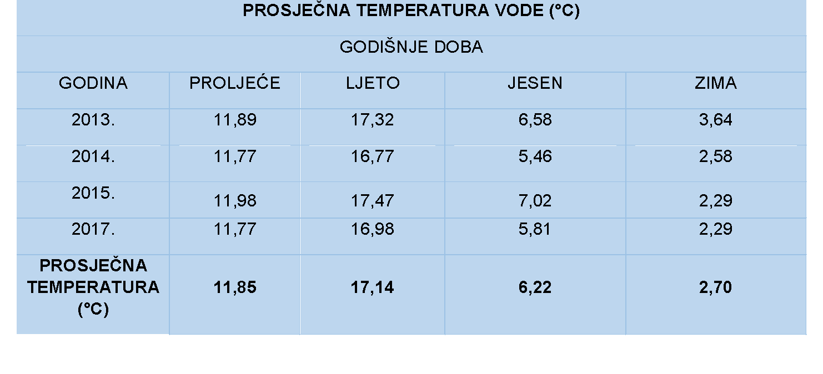
Average water temperature by seasons

Slide 18


COOPERATION
Faculty of Natural Sciences and Mathematics
GIS Institute

Slide 19
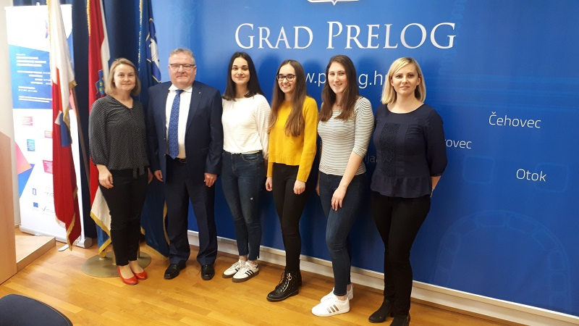
we presented our project to the Mayor of Prelog, Ljubomir Kolarek

Slide 20
CONCLUSIONS
the water temperature will change more slowly, but will still follow the rise in air temperature
the water level will be higher when the water temperature is lower
due to insufficient data and too few measurements, we were unable to prove the last hypothesis and rejected it

Slide 21
the average water temperature in the past 7 years has been around 9 ° C
2015 was the hottest year and 2014 was the coldest

Slide 22
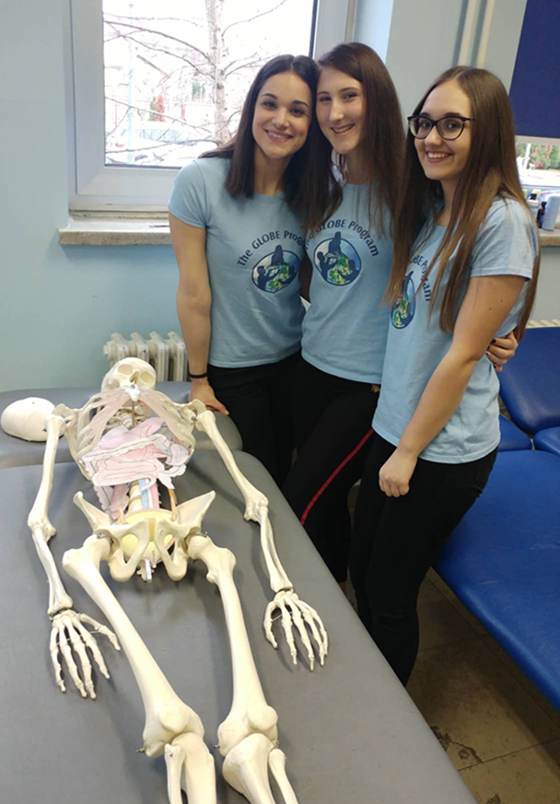
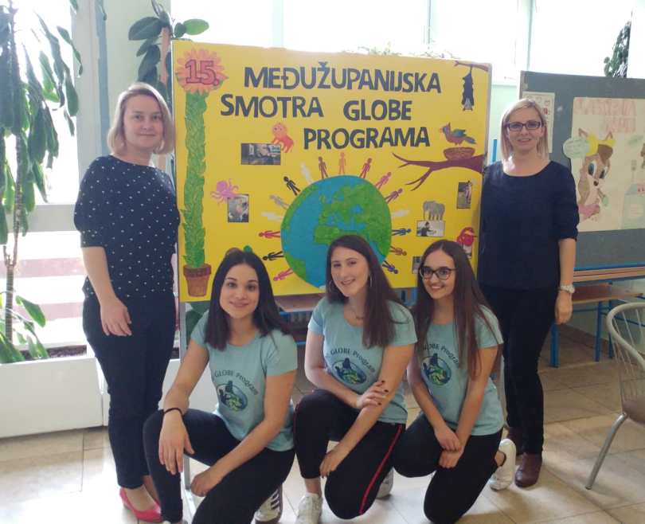
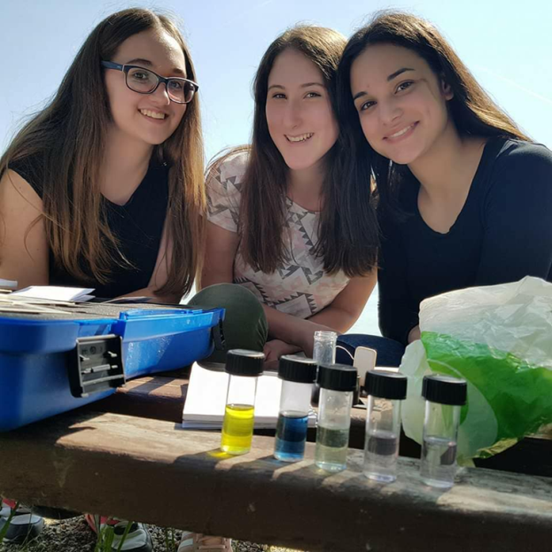
THANK YOU FOR YOUR ATTENTION!

