Slide 1

Factors Beitou Weather's Change

Slide 2
Research Motivation
What days are better to do outdoor activities?

Slide 3
Purpose
To figure out what days are better for outdoor activities.
In terms of that, we should first consider what days are clear days.

Slide 4
Research process
1. Download observation data
2. Chart the observation data
3. Set up the selected condition
4. Gain a conclusion through charts and analyses

Slide 5
Selected Conditions
The day's of rainfall is zero
The current relative humidity should be between 45％ and 60％
The current temperature should be between 18℃ and 25℃

Slide 6
We choose data
from Zhong
Zheng High
School Globe
station、
Shilin Station、
Shipai Station
and Tianmu
Station

Slide 7
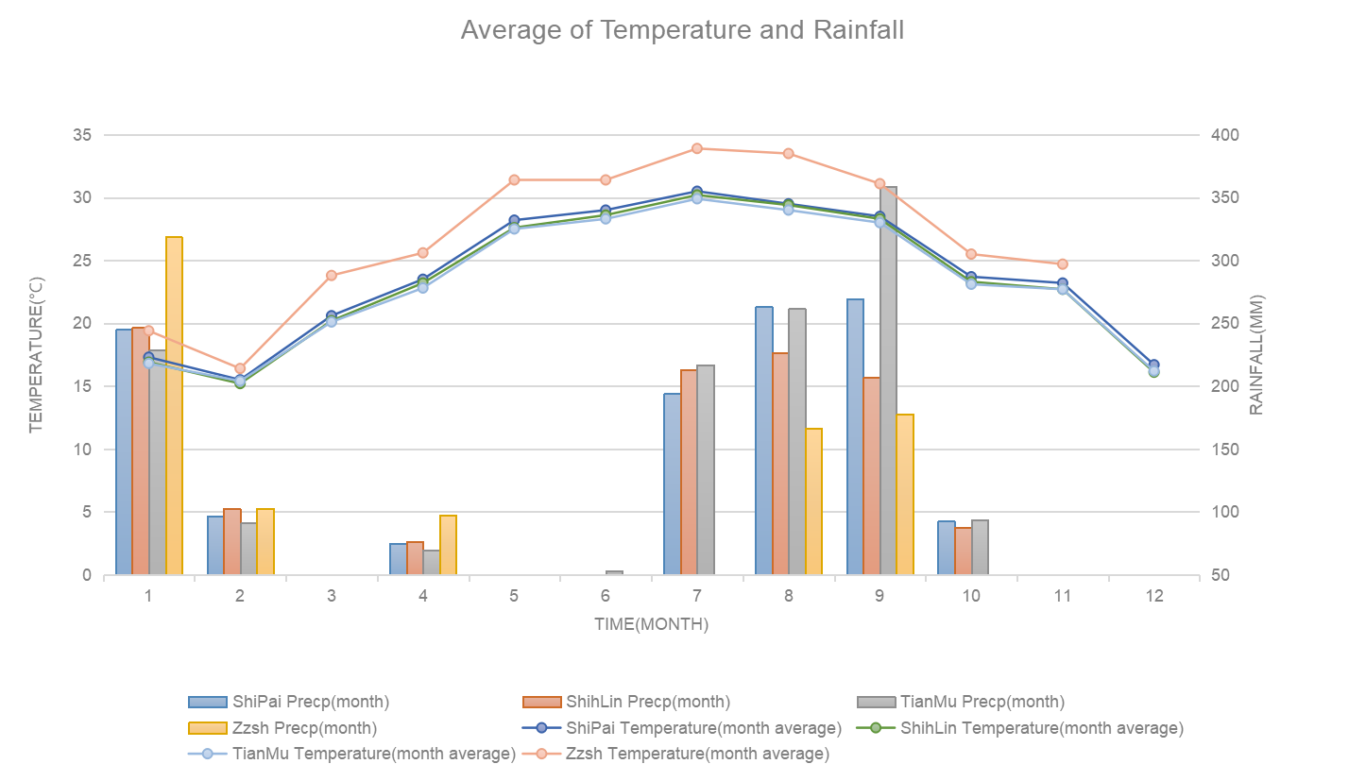


Slide 8
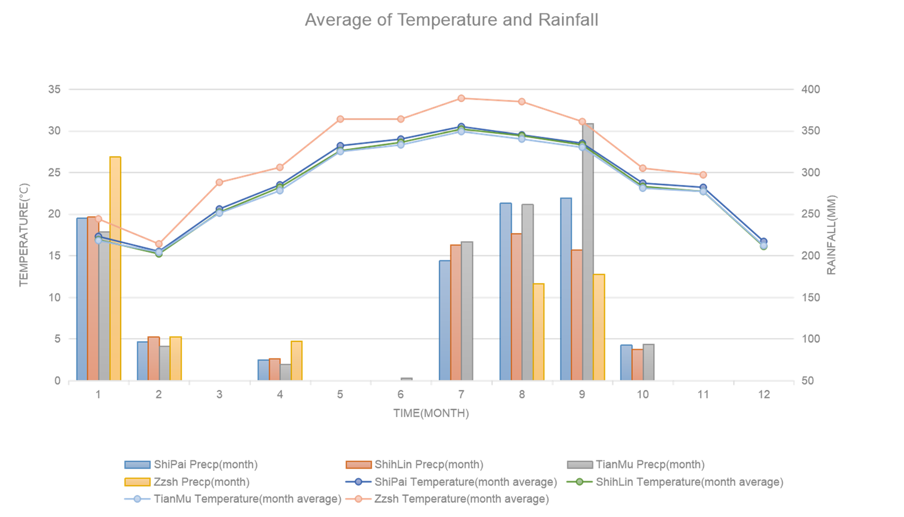


Slide 9
Summary
We chose those three months because their rainfalls were zero and temperature varied between 18℃~25℃
Check the data of the past four year to ensure our choice is correct or not?

Slide 10
Is there any different between the data collected in 2018 and those collected over the past four years?

Slide 11
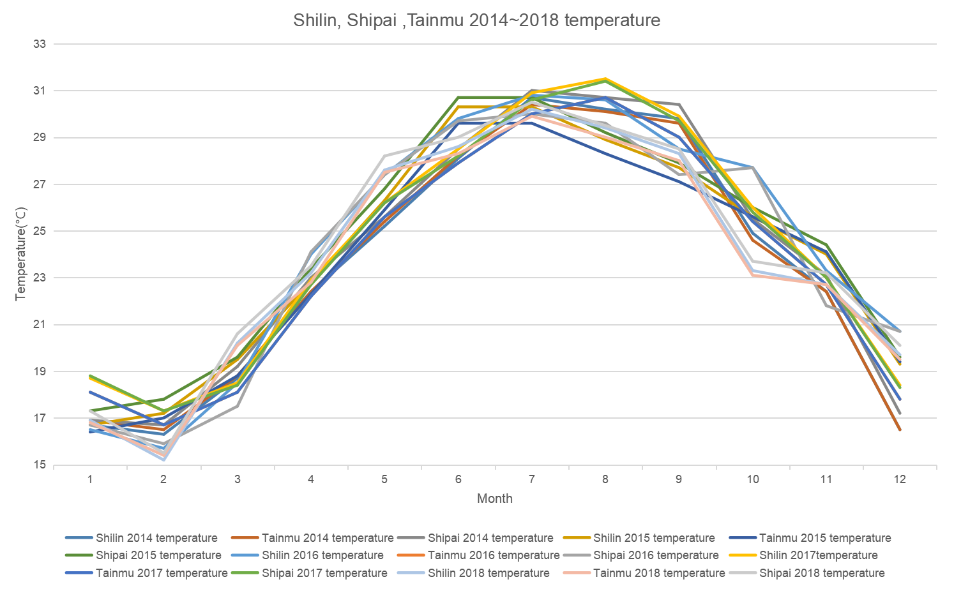


Slide 13
Why we excluded March?

Slide 15
Why we chose November and December?

Slide 16
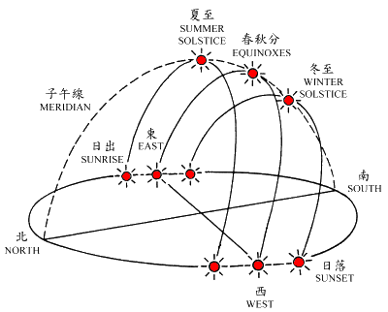
1.

Slide 17
2. On the lee side of the mountain
chart 1
chart 2

Slide 30
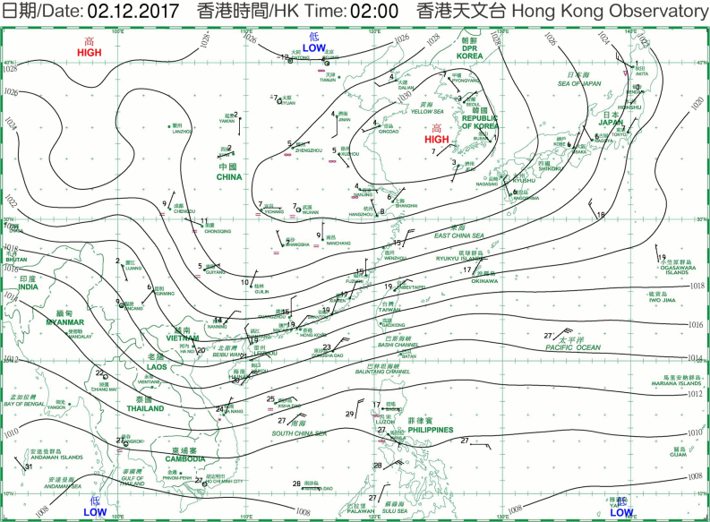
We choose 11/10~11/15 and 12/1~12/6.

Slide 31
Conclusion
We invite you come to Taiwan during the date between 11/10~11/15 and 12/1~12/6 in the year, because it will have fair weather to visite Taiwan.

Slide 32
Collaboration
Fang-Tzu, OU: PPT、Record、Charts、Research report(Chinese)、Collect observation data from Globe Website
Wei-Jen, Hsiao:Record、Charts、Research report(English)、Collect observation data from Central Weather Bureau Website

Slide 33
Thank You For Your Listen

