Slide 1
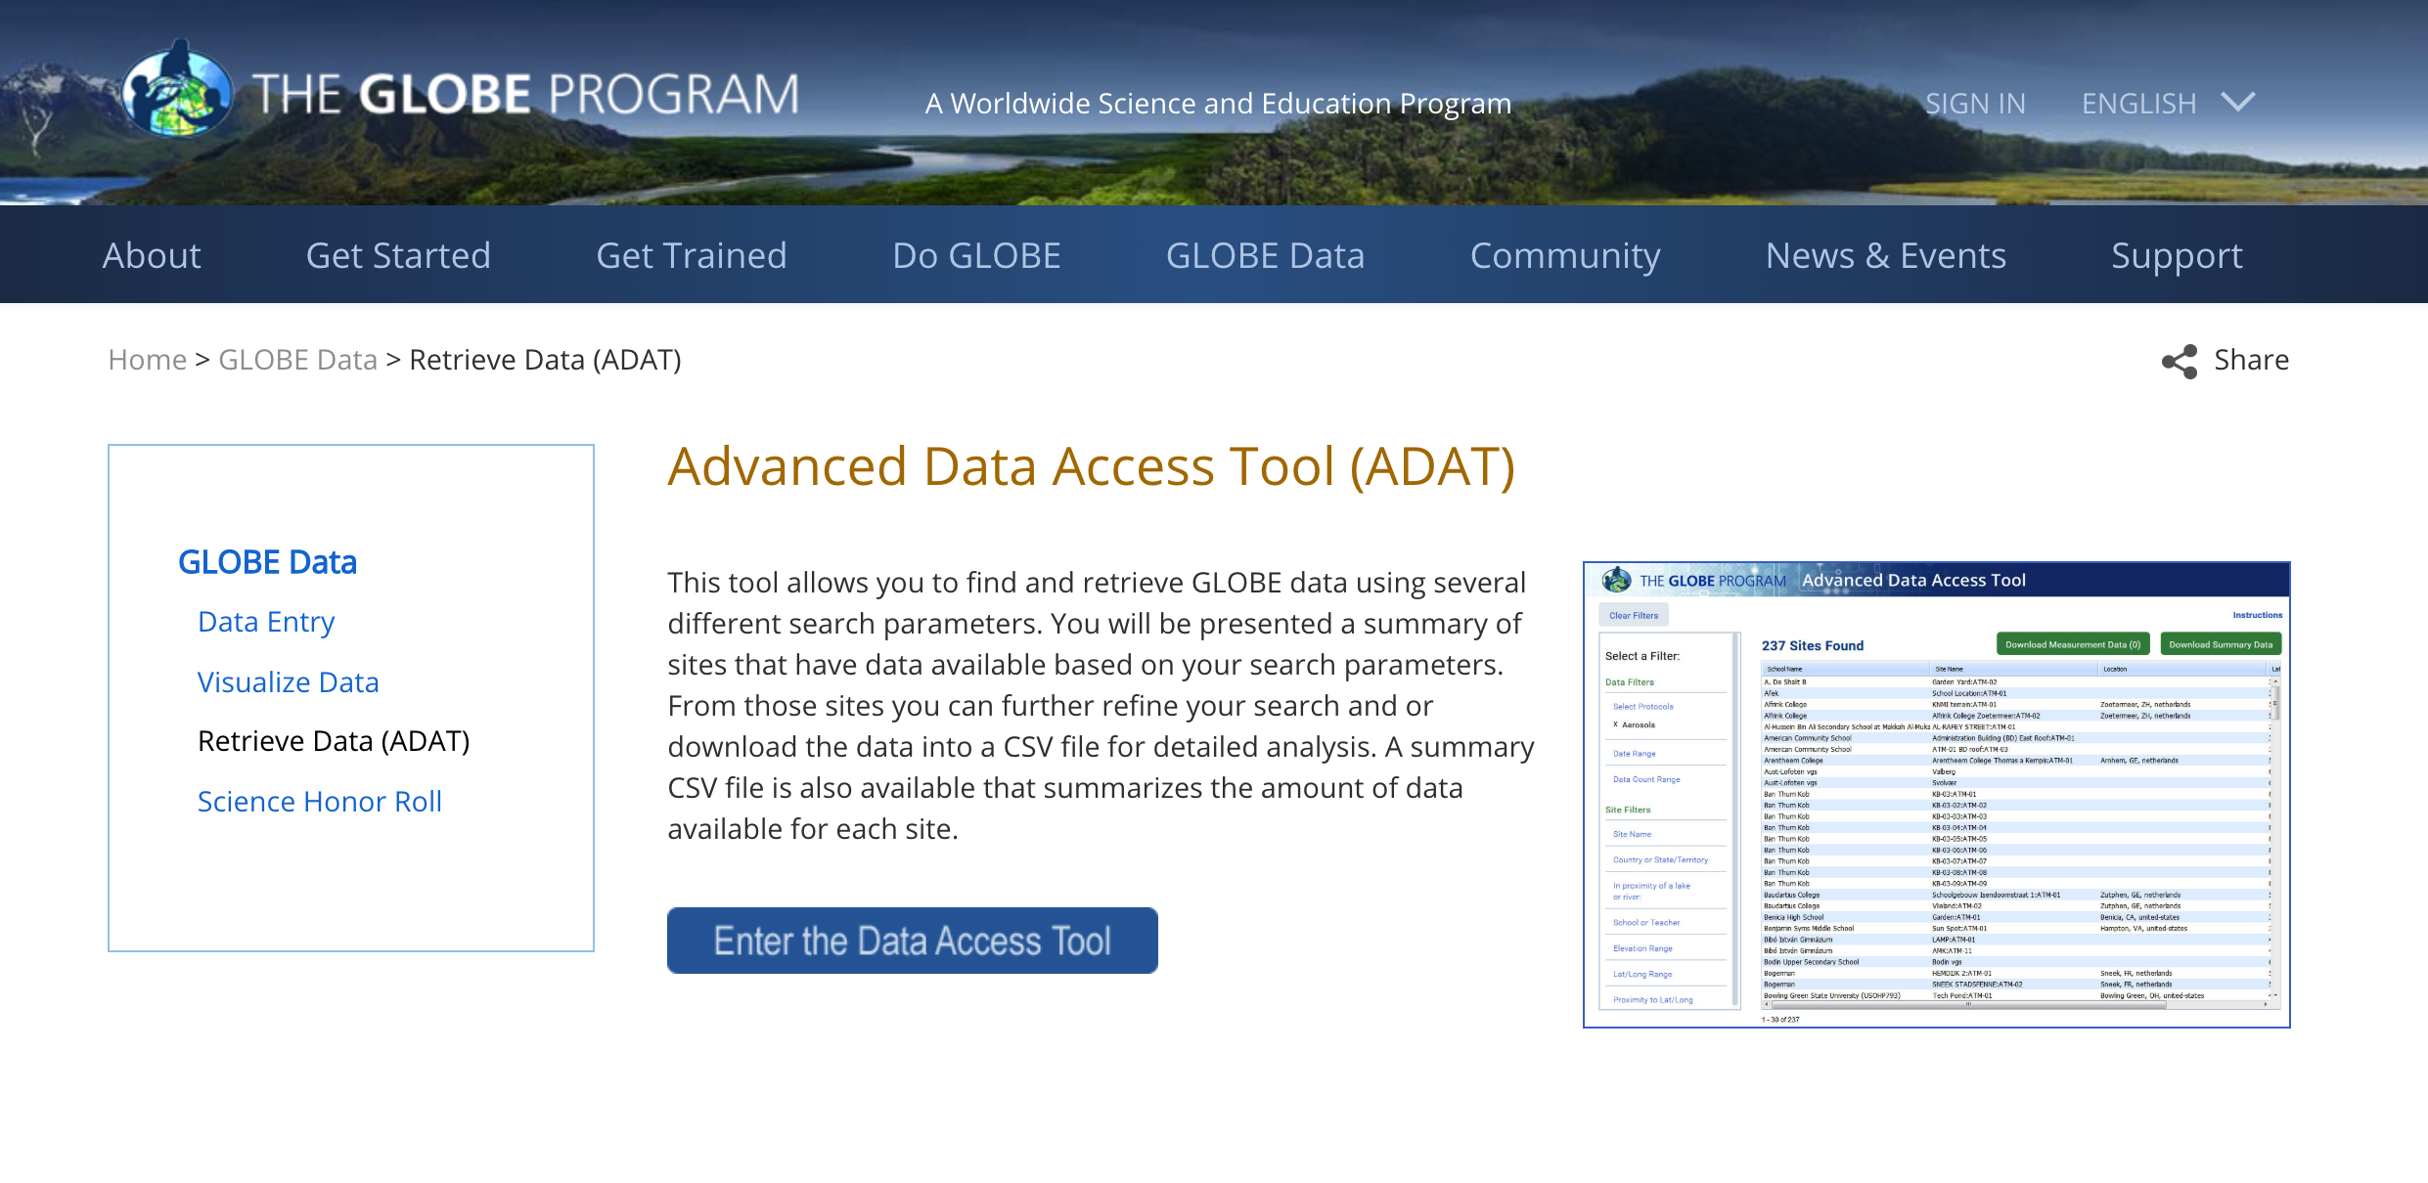
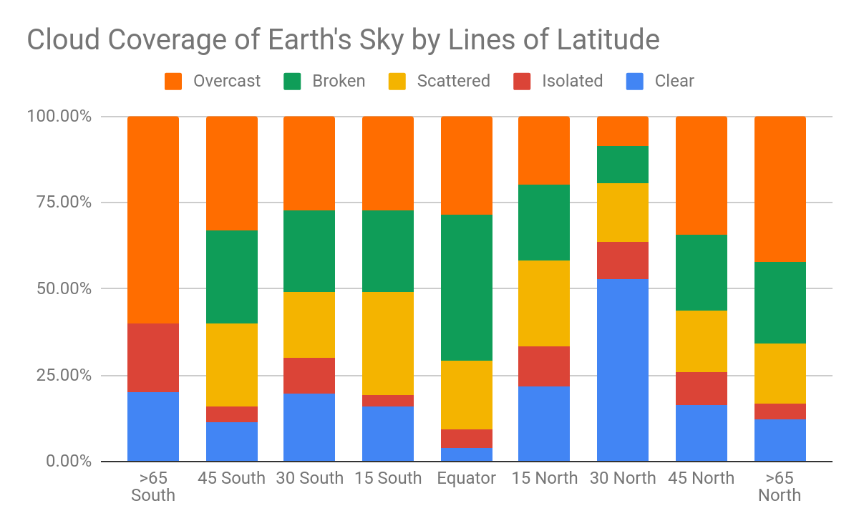
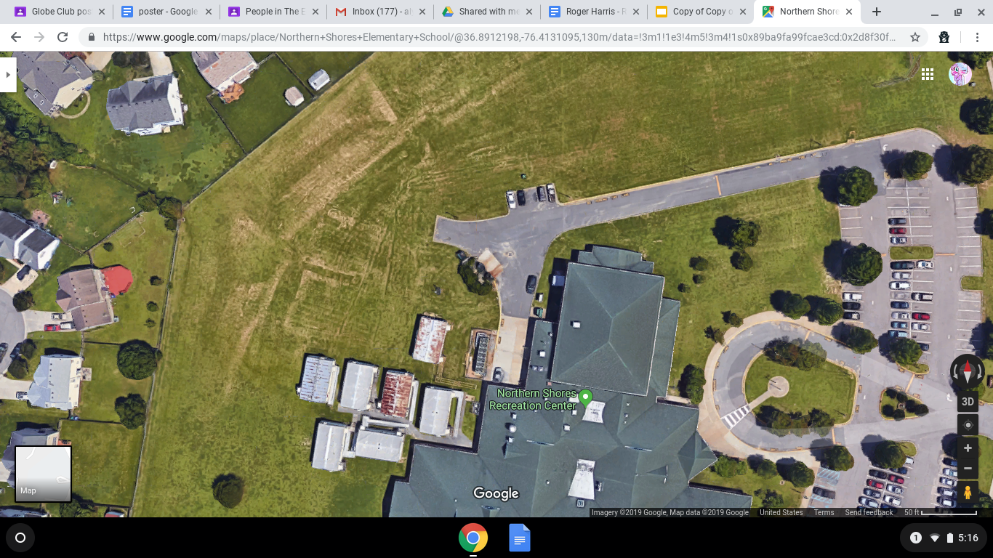
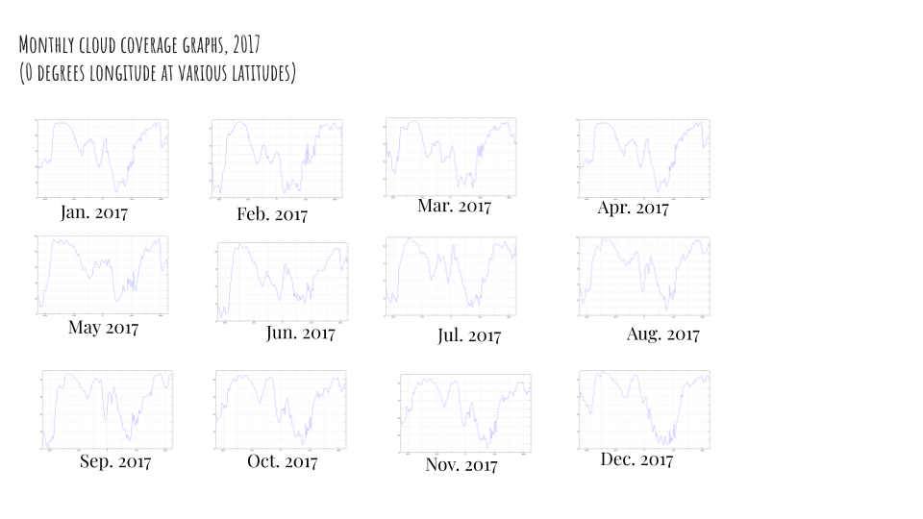
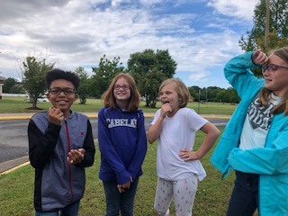
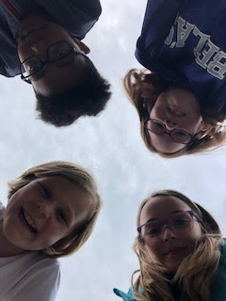
Cloud Cover Around the Globe
Addy Fleming, Will Hampton, Ava Joyner, and Alyssa Pack
Northern Shores Elementary School, Suffolk, VA
Abstract
Research Methods
Results
Discussion
The objectives of this research is to research cloud cover percentages across the globe and how they differ based on location. Our research topic is cloud cover. We are interested in researching this topic because it could lead to a new path of technological advancement in ways to predict weather. It can also help us learn about global warming and climate change. We are investigating the atmosphere with this research because it could help us predict more dangerous weather and help save lives in the path of that weather. Additionally, investigating the cloud cover in different areas can help predict if global warming is potentially happening in that location.
Planning Investigations
Our study site is located in Suffolk, VA and around the world (other GLOBE schools at the 0, 15, 30, 45, and 66 degrees north and 15, 30, 45, and 66 degrees south latitudes).
Our study site is pictured below and is a grassy field at our school. The temperature has changed at the site during the investigation, varying between 50 and 80 degrees.
The GLOBE Cloud protocol was used, along with the Sky viewer and Cloud Identification Chart and the NASA Earth System Data Explorer program to collect cloud cover data.
To collect the data at school, we met on Monday, Wednesday, and Friday at 1:15 pm at the same location each day. We also downloaded the GLOBE cloud data from schools across the world. We picked latitudes near the equator, temperate, and polar regions.
Analyzing Data
GLOBE School Data Collection
Visit www.globe.gov and go to Globe Data then to “Retrieve Data (ADAT)
Filter ADAT byt/long range -10- +10 -180 +180 apply filters
Date (Jan. 2017 to current) & Elevation to +/10 meters
Sorted by latitude, then obtain measurement data, and downloaded data into Microsoft Excel and imported into Google Sheet.
With help from from Mrs. Joyner, we created pivot tables to summarize the data. Using these data, we created the Stacked Column Chart, See Figure 4.
My NASA Data Collection
We first went to the Earth System Data Explorer at My NASA Data (https://mynasadata.larc.nasa.gov/EarthSystemLAS/UI.vm) and searched for Atmosphere/All Data/Clouds/Total Cloud Cover
We downloaded the line graphs to visualize my data where I went to find my data along the following lines of latitude: northern: 0,15,30,45,66+ southern: 15,30,45,66+ for the year of 2017.
Then we made a line graph of the increases and decreases of the cloud cover over the different lines of latitude..
I put them into a Google Slideshow for my other teammates to look over to see the changes over time in cloud cover near the equator and moving to the North and South.
Interpreting Data
The results do not support our hypothesis because the most cloud cover percentage is not at the Equator but in the Northern and Southern Hemispheres. We observe that near the equator there is less cloud cover than near the other schools. So you can predict that there is more dangerous weather near the northern and southern hemispheres than near the equator.
The data is important to science and our community because: we can predict weather and possibly harmful weather
Problems that we had when collecting and analyzing data include the following:
When using My NASA Earth System Data Explorer it was difficult when I had to keep retyping longitude/latitude in the navigation box.
Working with data is tricky. You may highlight the wrong data when working with pivot tables.
Figure 2. ADAT
Research Question
It is important to research this topic because clouds have a major impact on the earth’s climate, weather, and energy. This topic is important to the GLOBE community because it will help determine weather patterns and destructive weather, such as major hurricanes, thunderstorms and tornadoes.
Our research question is “How does the cloud cover differ based on the lines of latitude between the earth’s poles, mid latitudes, and equator regions?”. Our hypothesis to this question is, if the equator gets the most direct sunlight, then the schools collecting cloud cover data near it will have more cloud coverage.
Conclusions
Introduction
Figure 3. GLOBE School’s Total Cloud Cover, 2017 to present
Drawing Conclusions & Next Steps
Our conclusion is supported by the research question because our hypothesis was: “ If the equator has the most direct sunlight , then the schools near it will have more cloud coverge
We appreciate doing this research for GLOBE and NASA because it has taught us how to work in a group and how to scientifically collect data. Also, this project shows us how we can be citizen scientist and help our community.
If we were to do this again, we would pick different regions to collect data differently because we
If we were to continue this research on cloud cover, we would pick different spots on the globe
We would like to thank Mrs. Valdivieso and Mrs. Joyner for starting the globe club at Northern Shores.
Clouds are a natural, self-making phenomenon within the water cycle that is caused by condensation.
We know that clouds affect the temperature of the earth and air and also can help protect us from solar radiation and heat waves. Clouds are a big part of our environment and life on Earth. Clouds can form when the temperature is hot, warm and cold. The amount of water present also affects how clouds are form. When it is cold outside, their will usually not be many clouds, because the water vapor will freeze and then becomes ice crystals. Clouds can form everywhere, but mostly over warm water. Clouds physically form in the atmosphere. Different types of clouds form in at different levels in the atmosphere. We expect to see most change in cloud cover between warmer and colder areas on the planet. This is because of the air temperature.
For our research, we used the following GLOBE and NASA resources:
The GLOBE Cloud protocol
Sky viewer
Cloud Identification Chart
NASA Earth System Data Explorer program to collect cloud cover data.
Figure 1. The area of the location for our research.
Carrying Out Investigations
We used the GLOBE protocol used and the main NASA asset used, as well as My NASA Data’s Earth System Data Explorer.
We collected three kinds of cloud data: 1.) We collected cloud data from Northern Shores; 2.) We analyzed cloud data from other GLOBE schools collected between the present and 01/2017 at the 0, 15, 30, 45, and 66 degrees north and 15, 30, 45, and 66 degrees south latitudes; and 3.) analyzed line graphs of global cloud cover data from My NASA Data at the same latitudes.
We divided our team into four roles: Will Hampton helped with the GLOBE Data Analyst; Addison Fleming was the Science Investigator and helped pull the background information together; Ava Joyner was the Technical Communicator and the NASA Data Scientist and worked with My NASA Data Earth System Data Explorer, and finally, Alyssa Pack was the Media Specialist and designed the presentation.
Bibliography
References
Why are clouds important? https://www.writeabout.com/2016/01/why-are-clouds-important/
What Are Clouds? https://www.nasa.gov/audience/forstudents/k-4/stories/nasa-knows/what-are-clouds-k4.html
In a Warming World, Cloudy Days Are a Boon http://content.time.com/time/health/article/0,8599,1912448,00.html
Determining cloud cover http://www-das.uwyo.edu/~geerts/cwx/notes/chap08/cloud_cover.html
Globe Cloud Protocol: https://www.globe.gov/documents/348614/348678/Clouds+Protocol/7b79ee82-ebd6-4382-9283-181a412f063f
My NASA Data (https://mynasadata.larc.nasa.gov/EarthSystemLAS/UI.vm
Figure 4. Monthly Total Cloud Coverage (percent coverage)

