Slide 1
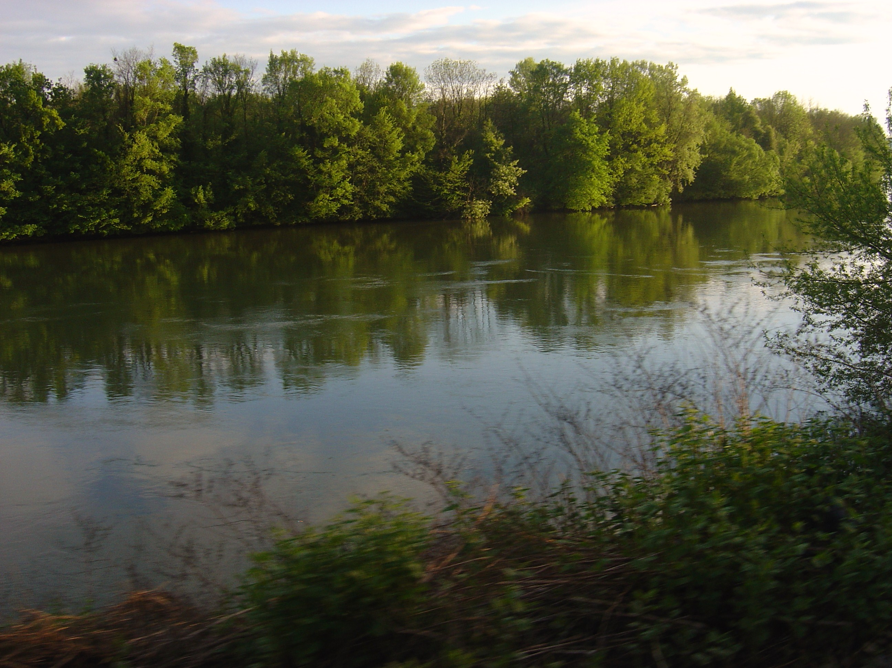
The Drava River through miles and seasons
III. Primary School Varaždin i
Primary School I. Kukuljevića, Belišće

Slide 2
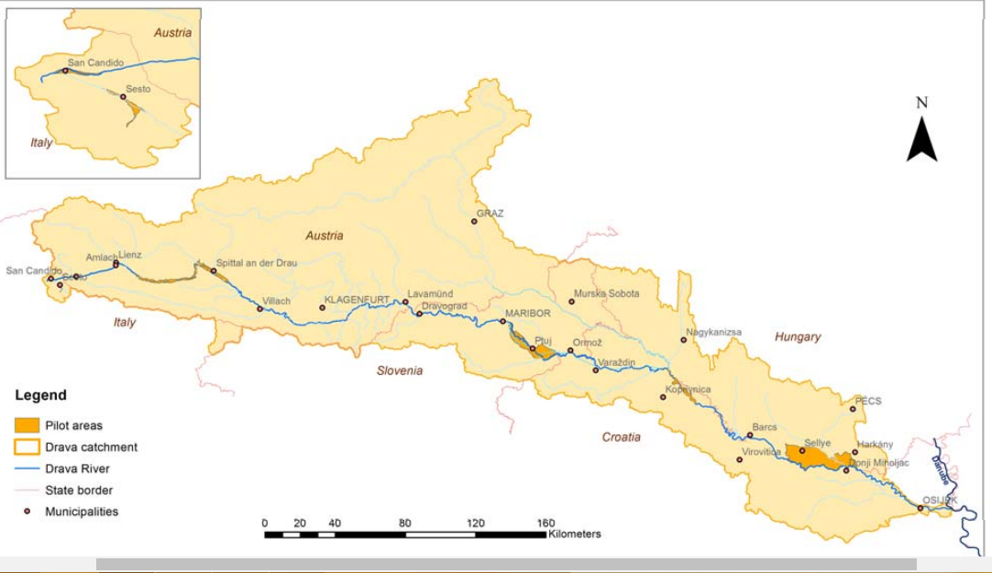
River Drava

Slide 3
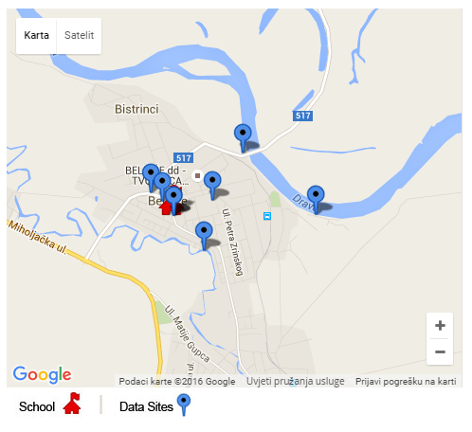
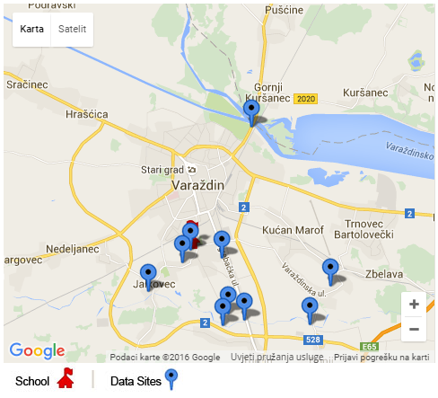
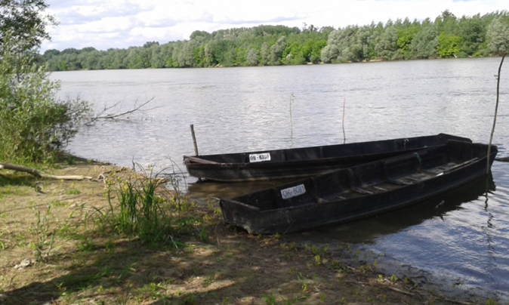
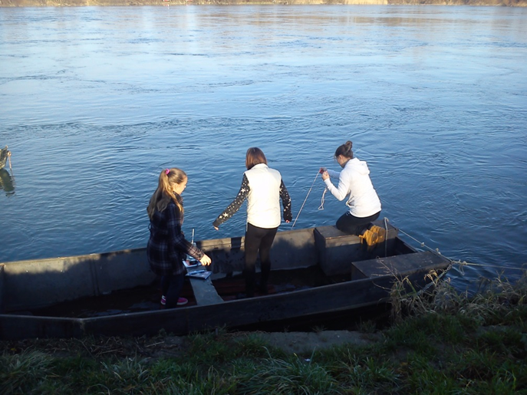
Belišće 45.6903° 18.4169° 93m
Varaždin 46.320679° 16.358726° 173 m

Slide 4

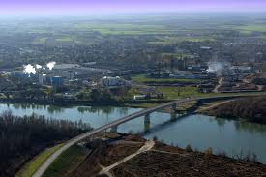
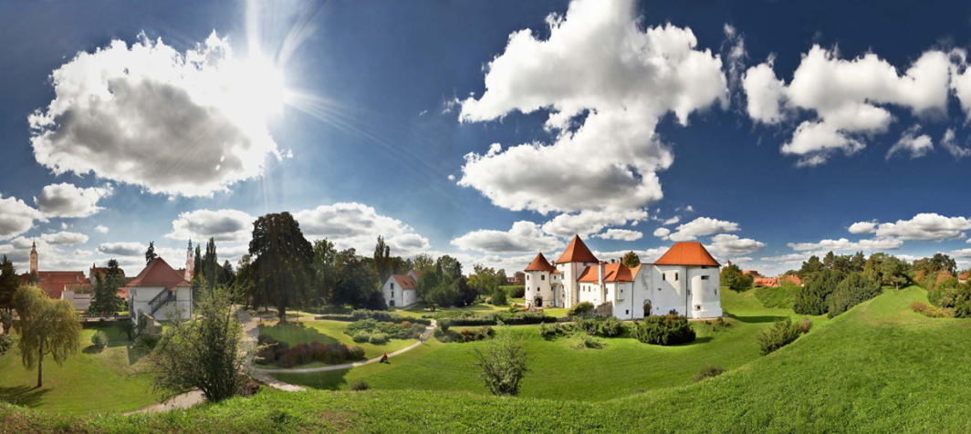
Research questions / hypotheses
1. What is the annual mean temperature of the river Drava in Varazdin and Belisce?
1. What are the most differ properties of Drava on the two stations during the year?
2. How water level affects the temperature and water clarity at these stations?

Slide 5

Hypothese:
1. Annual mean temperature of the water will be balanced without major deviations on both the station with minimum temperatures in winter and peaking during the summer months.
2. Small differences are expected in water temperature, the greater the difference on the two stations is expected in the transparency of the water.
3. Water level affects the properties of the Drava river. A higher water level of the water causes less transparency and a lower temperature at both stations.

Slide 6
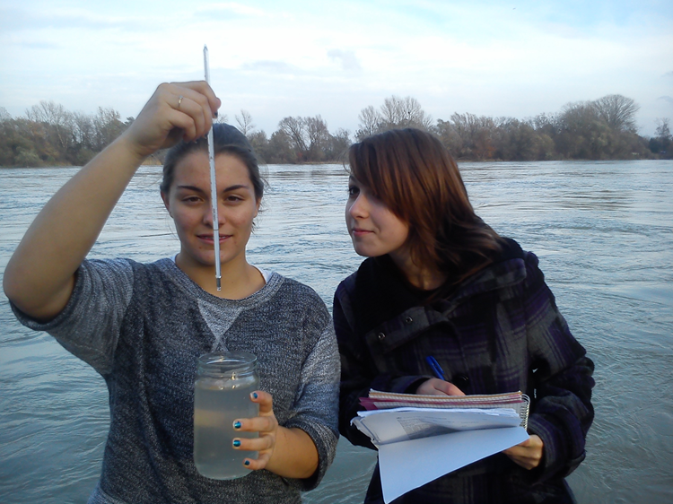
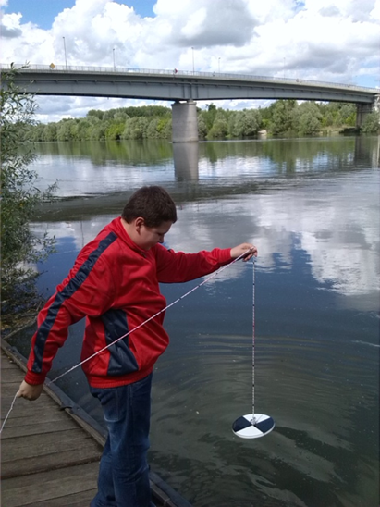

Research methods
water and air temperature -alcohol thermometers
transparency - Secchi disk
Water level - National Meteorological and Hydrological Service (DHMZ)

Slide 7
Data
The research lasted one year (from 4th October 2014 to 4th October 2015).
The research lasted one year (from 4th October 2014 to 4th October 2015).
The collected data we presented graphically.

Slide 11
Graphic view of impact of water levels (Blue line) on transparency (Red line) at the station Varazdin

Slide 12
Graphic view of impact of water levels (Blue line) on transparency (Red line) at the station Belisce

Slide 13
The dynamics of the water level (red line) and water temperature (blue line) at the station Varazdin

Slide 14
The dynamics of the water level (red line) and water temperature (blue line) at the station Belisce

Slide 15
Conclusion
1. Annual temperature is uniform without any major deviations at both stations
2.Bigger transparency of water at station Varazdin
3. Greater amounts of water causes lower temperature and lower water clarity
Higher water level at station Belisce
Uniform water level at station Varazdin

